Slide 1
U.S. Health Care in Comparative Perspective
Donald W. Light
Fellow, Edmond J. Safra Center for Ethics, Harvard University
Professor, University of Medicine & Dentistry of New Jersey
Senior Fellow, Center for Bioethics, University of Pennsylvania
WWW.PHARMAMYTHS.NET
PNHP Conference San Francisco 27 Oct 2012
(May contain inaccuracies. Subject to revision)
Notes:
10/26/2012

Slide 4
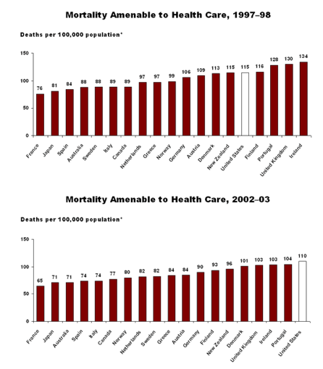

Slide 5
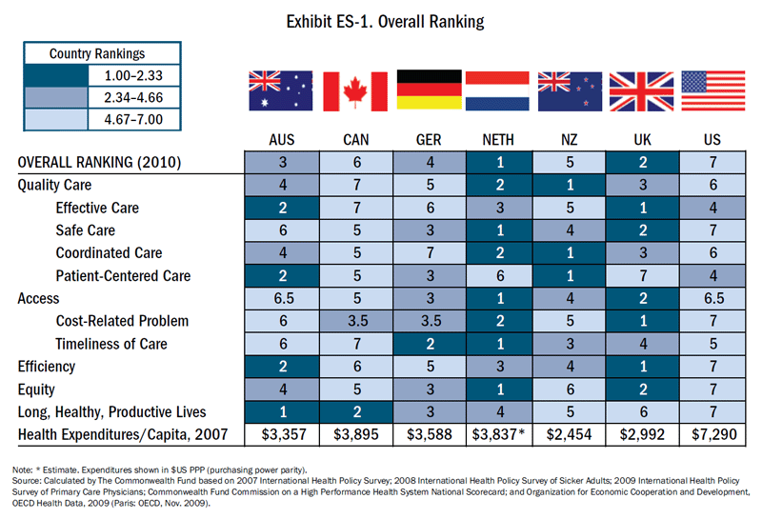

Slide 6
Source: Organisation for Economic Co-operation and Development (2010), "OECD Health Data", OECD Health Statistics (database). doi: 10.1787/data-00350-en (Accessed on 14 February 2011).
Notes: Data from Australia and Japan are 2007 data. Figures for Belgium, Canada, Netherlands, Norway and Switzerland, are OECD estimates.
Notes:
EXHBIT 2

Slide 7
Notes:
EXHBIT 4A

Slide 8
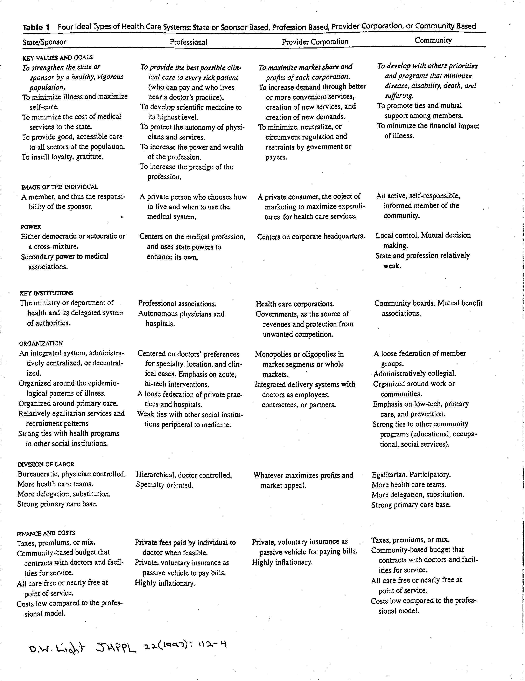

Slide 9
Notes:
EXHBIT 11

Slide 10
Notes:
EXHBIT 8

Slide 11
Source: Organisation for Economic Co-operation and Development (2010), "OECD Health Data", OECD Health Statistics (database). doi: 10.1787/data-00350-en (Accessed on 14 February 2011).
Notes: Data from Australia and Japan are 2007 data. Figures for Canada, Norway and Switzerland, are OECD estimates. Numbers are PPP adjusted.
Notes:
EXHBIT 10

Slide 12
Health systems entail 4 functions:
Stewardship
Financing (collection, pooling, distribution)
Service provision
Resource generation (train, build, innovate)
…

Slide 13
Revenue collection
Compulsory insurance? …or taxes?
Community rated premiums? Risk rated?
Risk blind? Guaranteed renewal?
Flat tax, flat % or progressive % tax?
User fees? Co-payments? (dis-insurance)
Goals? -restrain use, or collect revenue?
Voluntary insurance as supplement? Or substitute?
Or both?
Usually risk rated (but not VHI in Ire), tight coverage limits
What should be the philosophy of risk sharing?

Slide 14
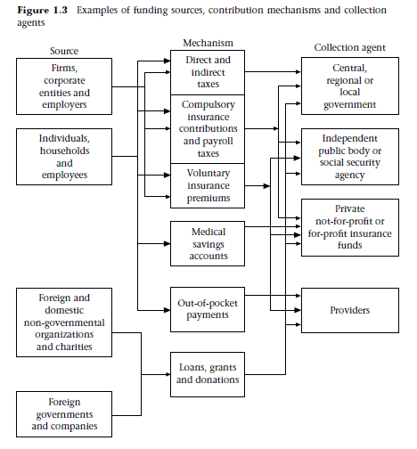

Slide 15
Measures of performance (Murray & Frenk)
Fair financial contribution (input measure)
Both average and equity of distribution
ALL payments from households (risk protection) (like?...)
(“…and the sick get poorer.”)
“Responsiveness” (process measure)
Respect for persons (Dignity, confidentiality, autonomy)
Client orientation (prompt attention, quality)
Health Improvement throughout life-course (outcome measure)
Average and equity of distribution

Slide 16
Overall system performance (2000)
1 France
10 Japan
18 UK
25 Germany
30 Canada
37 USA (with very hi score in responsiveness)
(Costa Rica, Cuba 36 & 39) (Italy 2, Spain 7)
Hue and cry.
Health level (DALE) relative to capacity: USA 72nd

Slide 17
Thank you

