Slide 1
Social Networking for Single Payer
how to make your social media presence more effective for advancing healthcare-for-all
Stanton Shek, MS4
Geisel School of Medicine at Dartmouth

Slide 2
Outline of Today’s Session
Learn the different types of social media sites
Further details of the most popular websites
Applying Midwest Academy Organizational principles to social networking
How to take full advantage of Facebook
Strategy for Twitter

Slide 3
There are a lot of websites out there

Slide 4
Making Sense of It All
Social Networking | Facebook, Twitter, LinkedIn, Google+
Social Bookmarking | Reddit, StumbleUpon, Digg
Curation Sites | Pinterest, Tumblr, Paper.li
Meetups/Events | Meetup.com, Facebook Events
Photo Sharing | Instagram, Flickr
Video Sharing | Youtube, Vimeo
Geolocation | Foursquare
Blogs | WordPress, Blogger, LiveJournal
Wikis | Wikipedia

Slide 5
Social Networking
Facebook, Twitter, LinkedIn, Google+
Allows users to add friends, send messages, and share content
Emphasizes the connection between people
Other types of social media allow for networking, but usually focus more on content sharing

Slide 6
Social Bookmarking
Reddit, StumbleUpon, Digg, Delicious
Users share their online content (articles, photos, videos, music) with other users
Other users who encounter the links may vote in approval or disapproval of the link
This will in turn give higher or lower visibility to that content in the community
In addition, users can comment on submitted links and have discussions (ideally)

Slide 7
Curation Sites
Pinterest, Tumblr, Paper.li
You add content to your individual page which will be presented to others
Most comparable to an online scrapbook or gallery as it has a greater emphasis on pictures
One of the fastest growing types of social media websites

Slide 8
Meetups/Events
Meetup.com, Facebook Events
Can connect users with similar interests and direct them to groups that meet in real life
Plan and organize events
Send Invitations and keep track of RSVPs

Slide 9
Photo or Video Sharing
Instagram, Flickr // Youtube, Vimeo
Users upload their photos and videos to the website where they can share with their friends or select audiences

Slide 10
Geolocation
Foursquare
Users “check-in” at landmarks and notable places to share with friends
Community competition of who goes to certain locations more frequently

Slide 11
Blogs
WordPress, Blogger, LiveJournal
Online journal
Long form written content

Slide 12
Wikis
Wikipedia
Content is created and edited by crowdsourcing
Usually develop encyclopedias for specific topics

Slide 13
Take A Closer Look

Slide 14
TITLEEEEEEEEE
#2 most popular website in US
The most popular social network
Has functions similar to other social media sites
Social bookmarking – Sharing links
Curating – With Timeline, the profile can be a gallery
Meetup – Facebook Events
Photo and Video Sharing
Geolocation – Facebook Places
Blog – Facebook Notes (less popular)
Notes:
They take popular features from other sites and put it on FB. People are familiar with this site. Most accessible for us as an organization. PNHP has an older demographic.

Slide 15
TITLEEEEEEEEE
#8 most popular website in US
Facebook status updates – but more frequent
140 characters or less
Trending Topics – able to see most popular topics overall and in specific regions
#singlepayer
Direct contact to media figures, celebrities, and politicians
Can tweet “@” them
Potentially they can retweet (RT) your message to their followers

Slide 16
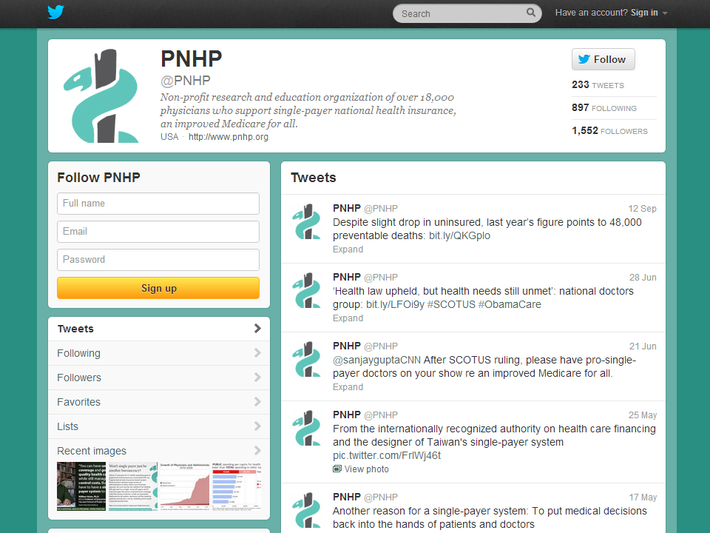
TITLEEEEEEEEE
INSERT TWITTER SCREEN SHOT HERE

Slide 17
TITLEEEEEEEEE
#63 most popular website in US
Self proclaimed “Front Page of the Internet”
Social bookmarking
Users post links that are “upvoted” or “downvoted”
Individual “subreddits” for a wide range of specific topics (e.g. r/politics, r/progressive, r/aww)
Has been the launch pad for major news stories
A major source of content that goes viral

Slide 18
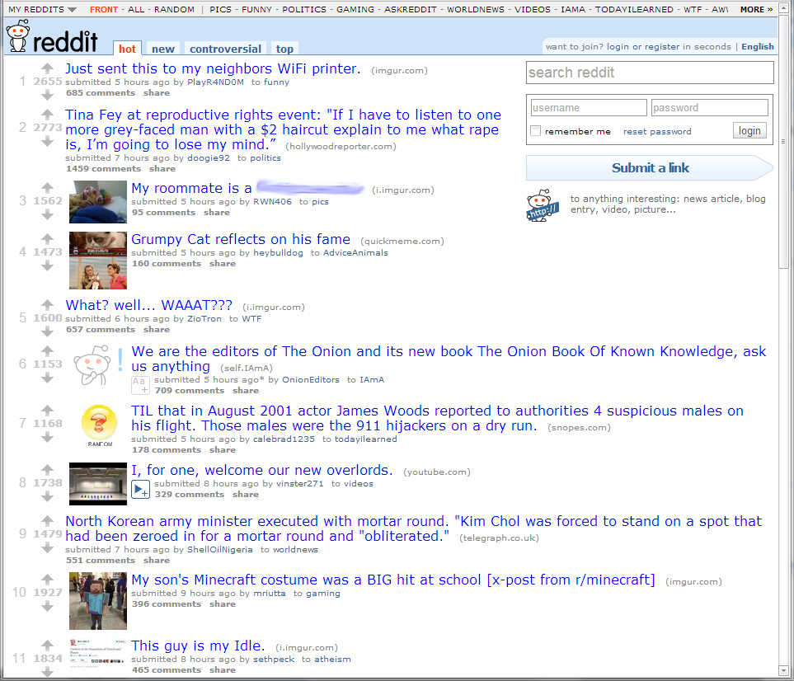
TITLEEEEEEEEE
INSERT TWITTER SCREEN SHOT HERE

Slide 19
Social networking site
Similar to Facebook, but better control of who sees your posts with “Circles”

Slide 20
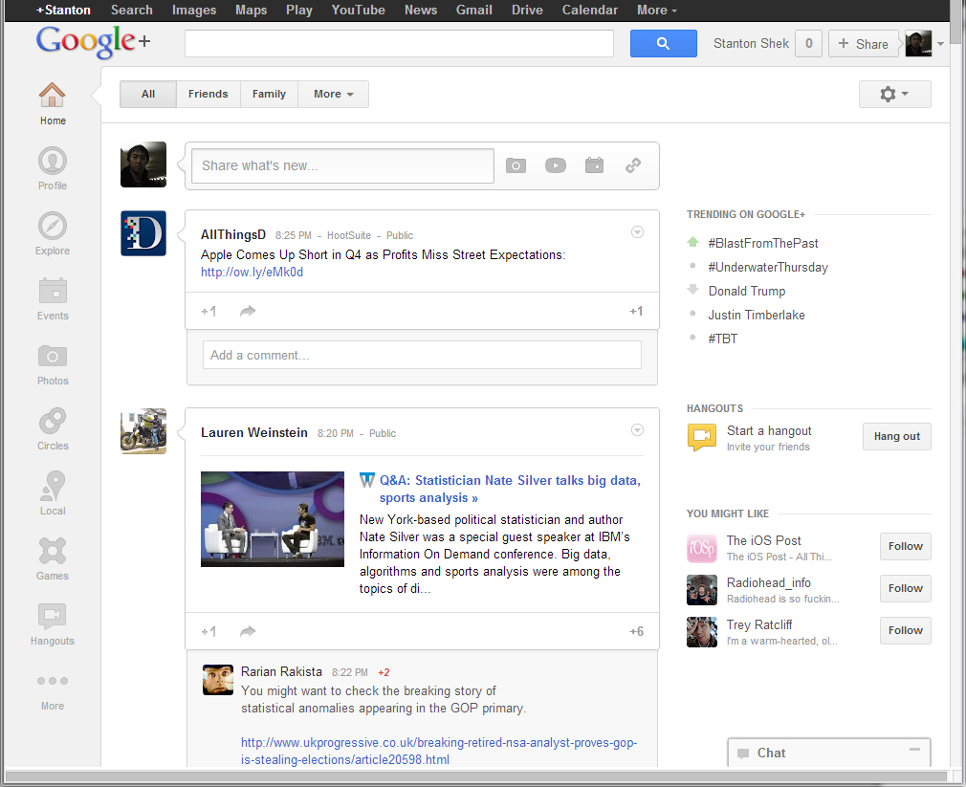
INSERT Google+ logo

Slide 21
#54 most popular website in US
Take and share pictures – apply vintage filters
Reportedly fastest growing photo sharing platform
Can only access through Facebook or Smartphone app (iPhone and Android)

Slide 23
TITLEEEEEEEEE
#15 most popular website in US
Curating site – Scrapbooking, Purchase Wishlist
Fastest growing website over past year
A lot of linking to small online retailers and boutiques – Etsy.com

Slide 24
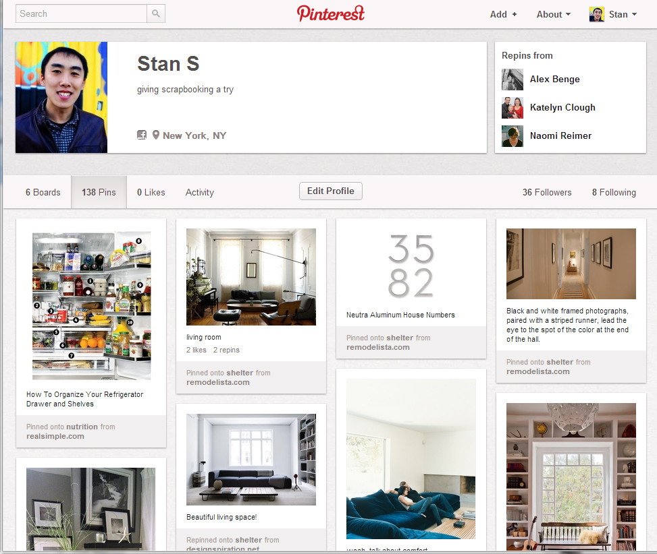
TITLEEEEEEEEE

Slide 25
How Does The Single Payer Movement Increase Its Social Media Presence?
For us, we focus on Facebook
Most users are passive participants of Facebook – let’s begin to be active
Dive-in!
Many of us are “Friends” with our colleagues who are also in the medical field
We can take advantage of our clout with our friends and family
Recognize that our social media presence is small and we have to strategize accordingly
Notes:
Customize your profile – make it nice, add friends! It’s like activism in person, and it somewhat requires some additional extroversion.

Slide 26
How Does The Single Payer Movement Increase Its Social Media Presence?
Our Goals
Motivate supporters to become members
Raise awareness of single payer
Create more supporters
Try to make our content go “viral”

Slide 27
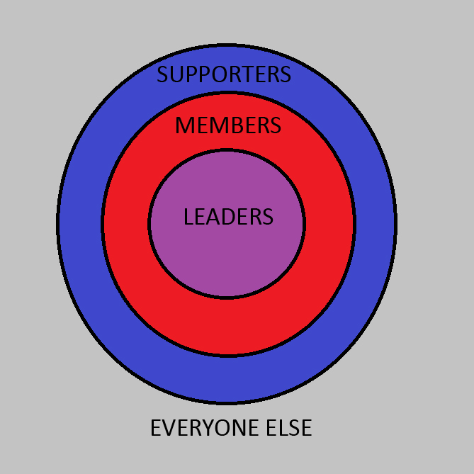
Applying Midwest Academy Organizing Principles to Social Networking
Notes:
Midwest Academy is an organizational workshop for prospective leaders – AMSA is a big proponent of it and is their model for organizational building

Slide 28
Applying Midwest Academy Organizing Principles to Social Networking
Recruitment is essential for any organizational building -- both in person and online
Always try to motivate people to do more

Slide 29
Applying Midwest Academy Organizing Principles to Social Networking
“People joined organizations or took more responsibility, not just because it was the right thing to do, not just because they were concerned about the issue, but because they also got something out of it. Learning a new skill, making new friends, or the feeling of satisfaction that comes from fighting the good fight. We also saw that when people joined or moved up in an organization, there was another person helping it to happen. Someone was actively trying to get each of these people more involved.”
- Midwest Academy Organization 101
Notes:
Self Interest

Slide 30
Applying Midwest Academy Organizing Principles to Social Networking
Recruitment is essential for any organization building both in person and online
Always try to motivate people to do more
If someone “Likes,” comments, “Shares” your post, you should follow up
This is social networking after all

Slide 31
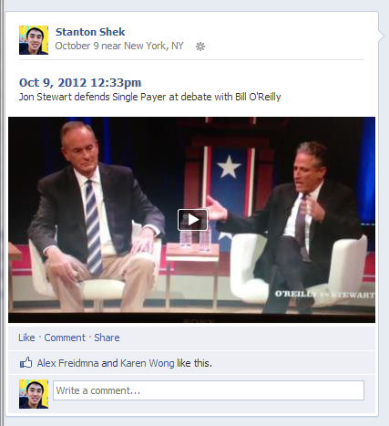

Slide 32
Single Payer Goes Viral
Unfortunately, content posted directly to Facebook rarely becomes viral
However, we can play a part and continue the chain reaction by sharing popular or already “viral” content with our Friends
Facebook has 2 major features for sharing content: “Like” and “Share”

Slide 33
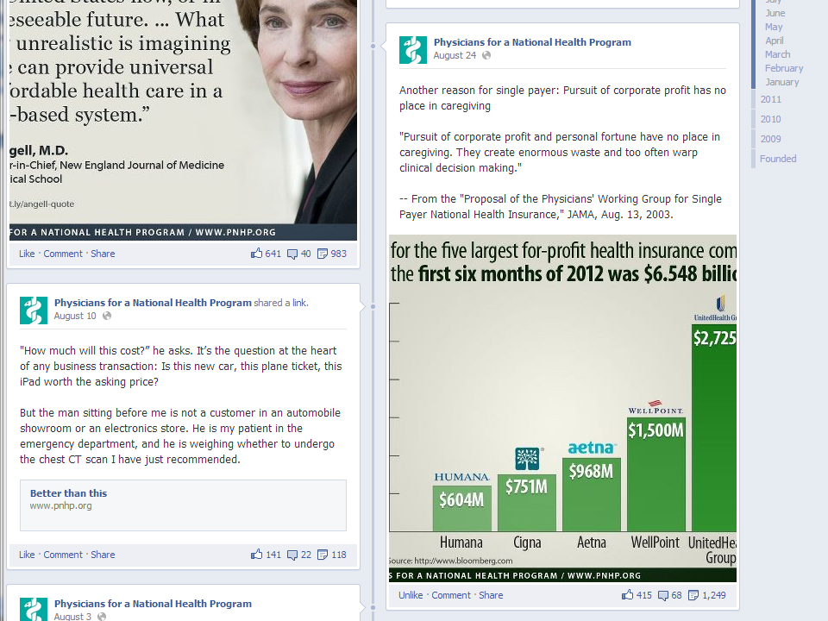

Slide 34
What your Friends see when you “Like” a link

Slide 35
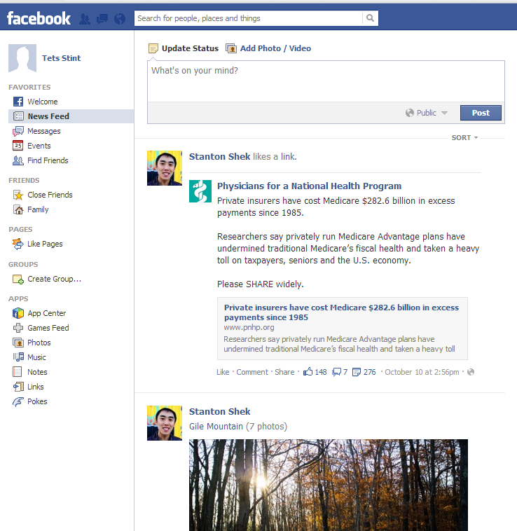

Slide 36
What happens when you click “Share”

Slide 37
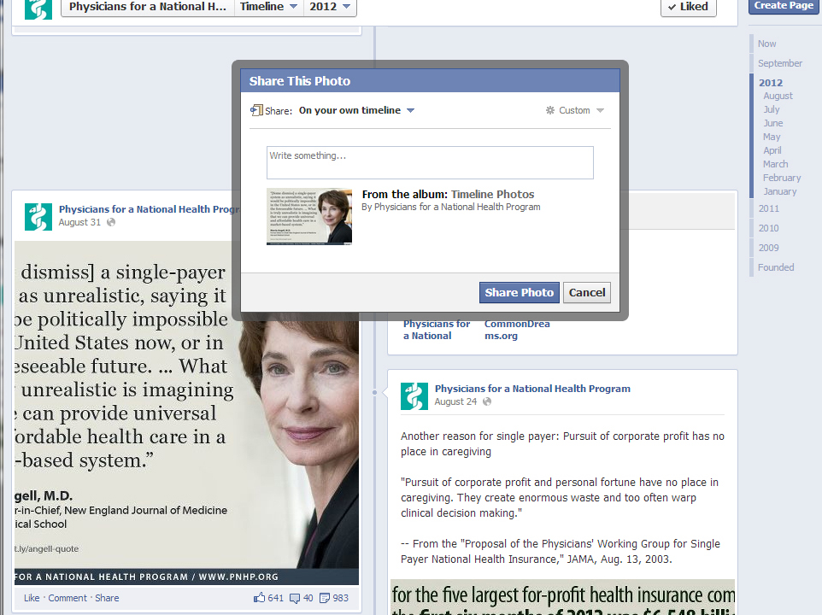

Slide 38
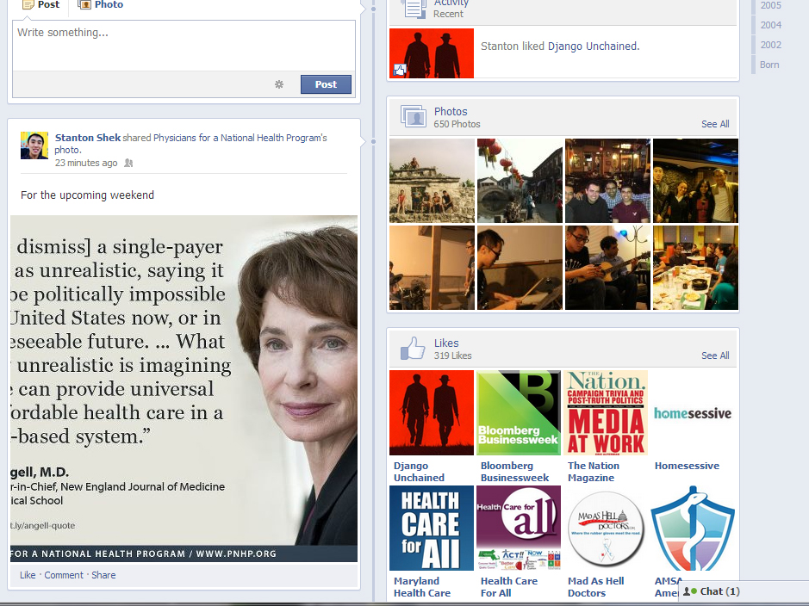

Slide 39
Single Payer Goes Viral
Unfortunately, content posted directly to Facebook rarely becomes viral
However, we can play a part and continue the chain reaction by sharing popular or already “viral” content with our Friends
Facebook has 2 major features for sharing content: “Like” and “Share”
“Liking” things on Facebook is more subtle than “Sharing”
“Like” often! Especially on PNHP content
“Share” if you want to add content to your Timeline or Profile

Slide 40
Tips for Posting Content on Facebook

Slide 41
TLDR
Too Long Didn’t Read
We have 5 seconds to get the message across
Easy to digest facts in pictures
Think “meme”
Notes:
We know this very well – That’s why they have abstracts at the beginning of articles

Slide 42
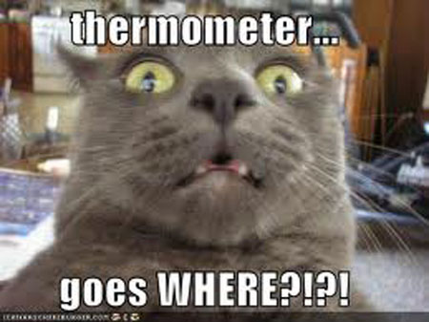
Lolcats

Slide 43
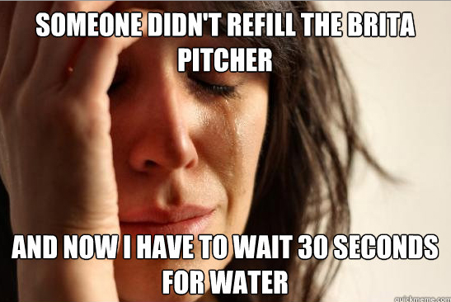
First World Problems

Slide 44
TLDR
Too Long Didn’t Read
We have 5 seconds to get the message across
Easy to digest facts in pictures
Think “meme”
Have an attractive title that will get people to click
Time your submission to when you think your Friends are most active on the site

Slide 46
“Better Than This” Article
By Dave Dvorak, M.D. Minnesota Medicine, July 25, 2012
"How much will this cost?” he asks. It’s the question at the heart of any business transaction: Is this new car, this plane ticket, this iPad worth the asking price?
But the man sitting before me is not a customer in an automobile showroom or an electronics store. He is my patient in the emergency department, and he is weighing whether to undergo the chest CT scan I have just recommended.
“I’m uninsured,” he says. “I lost my health coverage when I got laid off from my job three years ago. This is all coming out of my pocket.”
An ex-smoker in his late 40s, he has been coughing up increasing amounts of bloody sputum over the past month. What began as occasional, tiny red flecks has progressed to thick crimson streaks he can no longer ignore.
“I can only give you an estimate,” I say, “but I’m guessing a chest CT scan plus the radiologist’s fee will run in the neighborhood of $2,000.”
Like most emergency physicians, I have catalogued in my brain an endless litany of precise numbers—physiologic parameters, normal lab values, weight-based drug doses. But when it comes to knowing the costs of the myriad tests, medications and treatments that I routinely order for patients, I can offer little more than a rough estimate.
“I was afraid you’d say something like that,” he says. “I figured CT scans don’t come cheap.” He sighs quietly. “I’m raising my 8-year-old daughter on a pretty lean budget.” He looks thin in his hospital gown and a shade pale, a few days of graying stubble on his chin.
“But I’ve been worried about this for too long,” he says. “I know I need to have it.”
An hour later, I am seated at my computer scrolling through digital CT images while the radiologist on the phone describes the findings.
“In the hilum of the left lung there is a 4.5 centimeter lesion very likely to represent malignancy,” she says. My gaze falls on the irregularly shaped white mass, its tiny tentacles invading the delicate latticework of the surrounding lung tissue.
“Unfortunately, it gets worse,” the radiologist says. “There are also multiple scattered smaller lesions throughout both lungs, highly suspicious for metastases.”
There was a time during medical school and residency when I regarded abnormal clinical and radiographic findings with intrigue. I remember the excitement of hearing my first heart murmur. Of palpating a thyroid nodule. Of visualizing an ovarian mass on pelvic ultrasound.
But after years of clinical practice and countless patient encounters, I now find it difficult to view abnormal findings separately from the human lives they affect. I see an elderly woman’s hip X-ray, knowing that the fracture line coursing through the femoral neck likely spells the end of her days of independent living. A peculiar bright patch lighting up in the brain’s left hemisphere on an MRI scan signifies that a man will no longer be able to grasp a pen or a coffee mug in his right hand, will never again be able to speak a meaningful word to his family.
I hang up the phone, my eyes lingering on the CT images, the sinister white lung mass and its small-but-ominous satellites. And I am aware of their significance—that a middle-aged man will not live to see his daughter’s wedding.
I return to the patient’s room and sit down on the bedside stool. Before I speak, I feel his gaze upon me, anxiously searching my face for any subtle indication of the words to come.
“I’m sorry to have to give you this news,” I say, “but your CT scan shows findings concerning for lung cancer. It’s possibly spread to both lungs.”
He stares ahead, unblinking, his facial pallor seemingly more apparent. After a few moments, he speaks.
“On some level, I was expecting something really bad like this,” he says. “But, of course, you always hope that everything will turn out fine.”
My mouth, having grown dry, lacks the appropriate words to console him in this moment of utter sorrow. So I put a hand on his arm.
“I’ll talk to our on-call oncologist,” I tell him. “We’ll figure out a plan for you.”
He waits patiently until I return to his room once more, armed with an action plan.
“The oncologist is going to admit you to the hospital and start the workup,” I explain. “He’ll order a PET scan to see if there’s been spread to other parts of the body. Then they’ll do a biopsy of that main lesion in your lung to determine the best treatment options—whether it be radiation, chemotherapy or some combination of the two.”
A long period of silence follows, time for my patient to process the information I have conveyed. I anticipate forthcoming questions.
“I suspected that you’d want to do all those things,” he says, finally. “But I’ve already been thinking this through, and I’ve decided that I’m going to have to pass on your recommendations.”
It is not a reply I was expecting. “Why is that?” I ask.
“As I said before, I’ve got no health insurance,” he says. “But there’s one thing I do have—my house. And it’s fully paid for. I guess I’m not willing to mortgage it—and ultimately lose it—to pay off endless medical bills. My house is the only thing…” His voice trails off.
After a pause, he continues. “My house is the only thing I’ll have to leave my daughter when I’m gone.”
Tears have gathered in the corners of his eyes. I offer him a box of tissues, and he takes one.
We sit together in a room in a modern emergency department in a rich country, a land where highly trained specialists confidently wield the newest technologies and expensive pharmaceuticals. But these treasures are not accessible to all, for ours is also a land where private health insurance is bought and sold as a commodity. Ours is a system known to shake down sick people for money they don’t have. Ours is the only wealthy democracy that fails to guarantee health coverage to all of its citizens.
Just as it is failing now.
He looks down at his watch. “Thanks for all you’ve done. I really appreciate it. But I’ve gotta leave now,” he says. “I have to go pick her up from school.”
As I watch him reach behind his neck to untie his hospital gown, I can’t help but feel that we owe him so much more. I can’t help but feel that we—health care providers, hospital administrators, insurance company executives, politicians, all those who strenuously fight the changes that our system desperately needs—we all have failed him.
I can’t help but feel that we are better than this.
PNHP note: Dave Dvorak, M.D., M.P.H., practices emergency medicine in Edina, Minn. This article led to his being declared "physician winner" in Minnesota Medicine's ninth annual writing contest. Dvorak is a member of Minnesota Physicians for a National Health Program.
2012, Minnesota Medical Association
Likes: 141
Comments: 22
Shares: 188

Slide 47
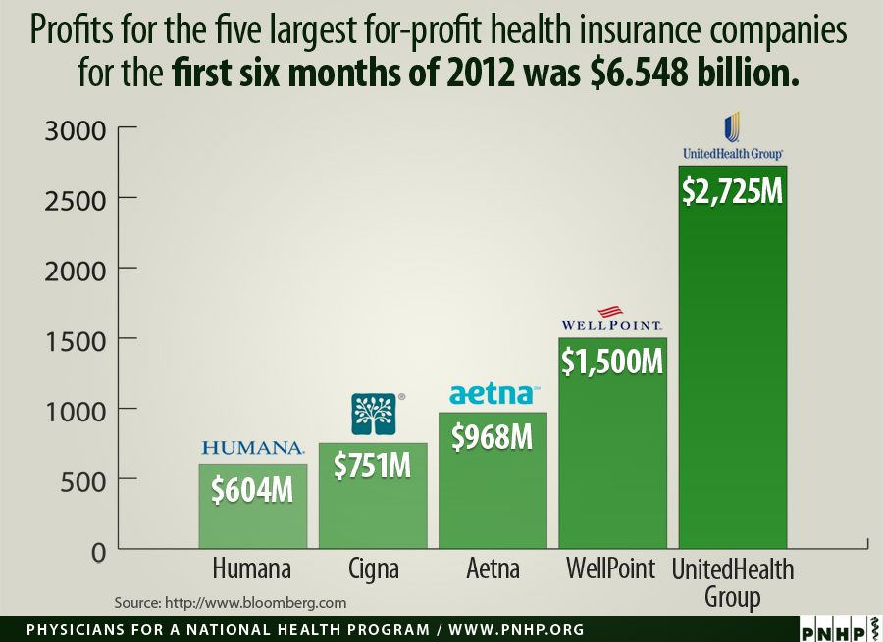
Likes: 415
Comments: 68
Shares: 1,249
Notes:
The way social media is heading towards 140 character posts – it unfortunately gets less thoughtful, but we have to recognize that.

Slide 48
Facebook Pages with Good Content
PNHP
PNHP California
Healthcare-NOW!
Occupy Healthcare
Single Payer Healthcare PDX
PUSH PA (Penn United for Single Payer Healthcare)
Vermont for Single Payer
Health Care For All (MA based)
Maryland Health Care for All
Oregon Single Payer Campaign
Doctors for the 99%
Notes:
I’m sure there are other great resources. But hopefully you will remember, TLDR when you pick which ones you post as you want to make them count

Slide 49
Using Facebook To Stay Informed
Many of your favorite websites have Facebook Pages that you can “Like” (aka Subscribe) and see updates in your Newsfeed
NYTimes, Huffington Post, Daily Kos, Mother Jones
Like an RSS Reader or Google Reader
Compiles articles into one spot
Can devote an individual “Friend List” to subscribed content

Slide 50
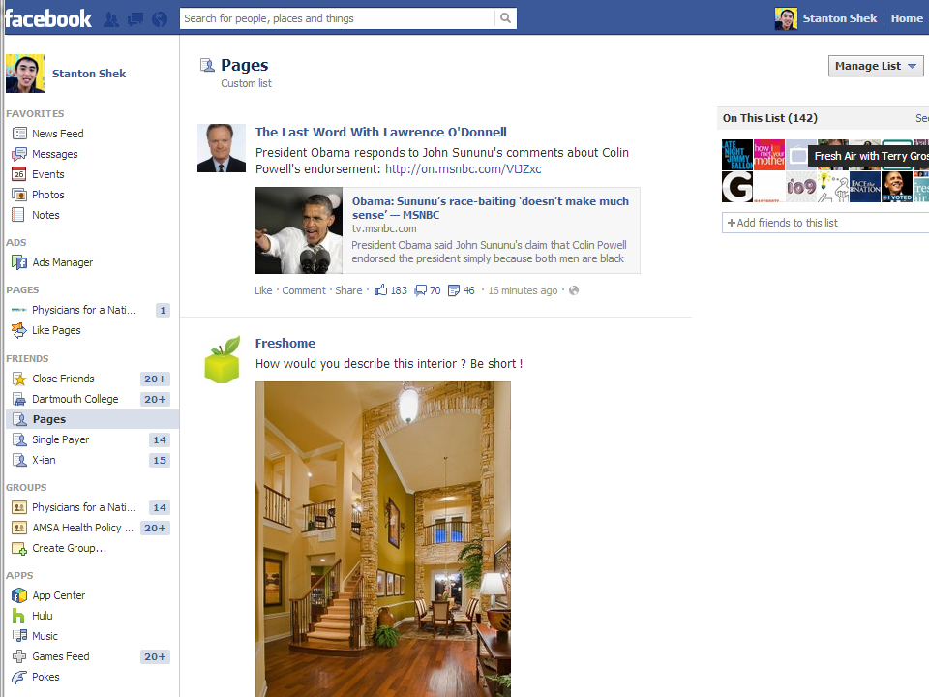

Slide 51
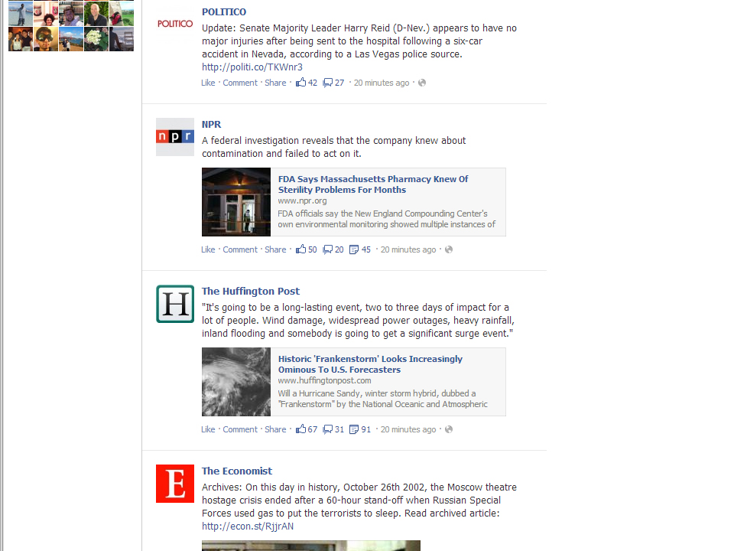

Slide 52
Creating a Friend List Dedicated to Pages

Slide 53
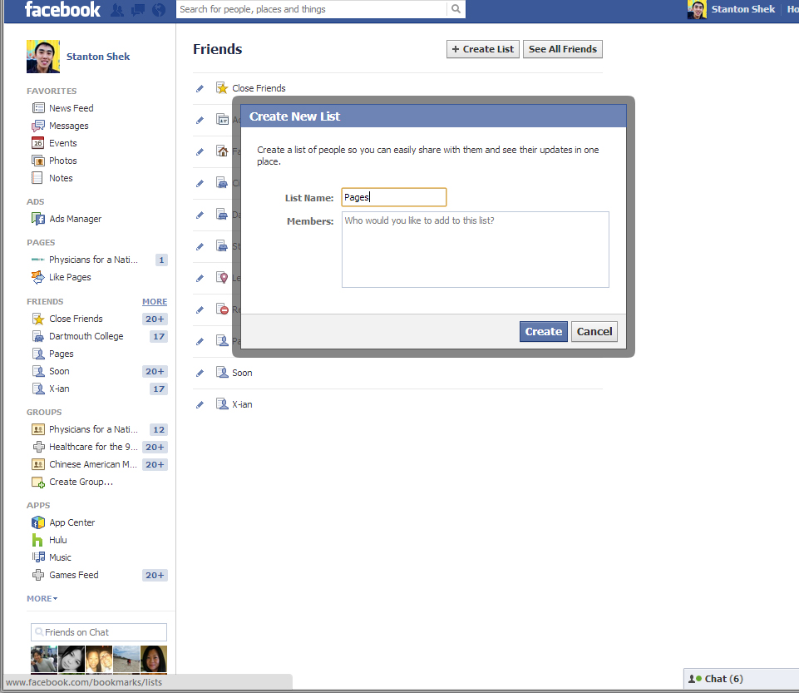
Using Facebook To Stay Informed
Many of your favorite websites have Facebook Pages that you can “Like” (aka Subscribe) and see updates in your Newsfeed
NYTimes, HuffingtonPost, DailyKos,
RSS Reader or Google Reader

Slide 54
Using Facebook To Stay Informed
Many of your favorite websites have Facebook Pages that you can “Like” (aka Subscribe) and see updates in your Newsfeed
NYTimes, HuffingtonPost, DailyKos,
RSS Reader or Google Reader

Slide 55
TITLEEEEEEEEE
#8 most popular website in US
Facebook status updates – but more frequent
140 characters or less
Trending Topics – able to see most popular topics overall and in specific regions
#singlepayer
Direct contact to media figures and celebrities
Can tweet “@” them
Potentially they can retweet (RT) your message to their followers
Notes:
Sign up – Dive in

Slide 56
TITLEEEEEEEEE
Major Goals
Have #singlepayer be a Trending Topic
Directly contact to media figures, celebrities, and politicians
Can tweet “@” them
Potentially they can retweet (RT) your message to their followers

Slide 57
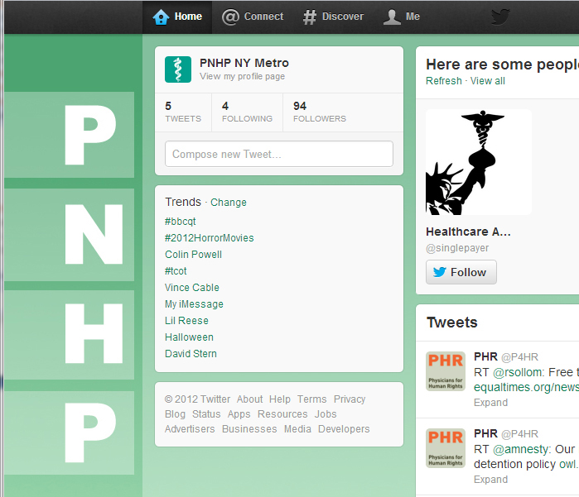

Slide 58
TITLEEEEEEEEE
Major Goals
Have #singlepayer be a Trending Topic
Extremely difficult with our minimal numbers
A single tweet is a drop in an ocean of tweets
Even a few dozen tweets at once would go largely unnoticed
Directly contact to media figures, celebrities, and politicians
Can tweet “@” them
Potentially they can retweet (RT) your message to their followers

Slide 59
TITLEEEEEEEEE
Major Goal
Directly contact to media figures and celebrities
Think of it like a “Letter to the Editor” – just a lot shorter
Hopefully they RT you
Provide Instant Feedback to these “Influencers” and content generators
Another way to contact your representatives in government

Slide 60
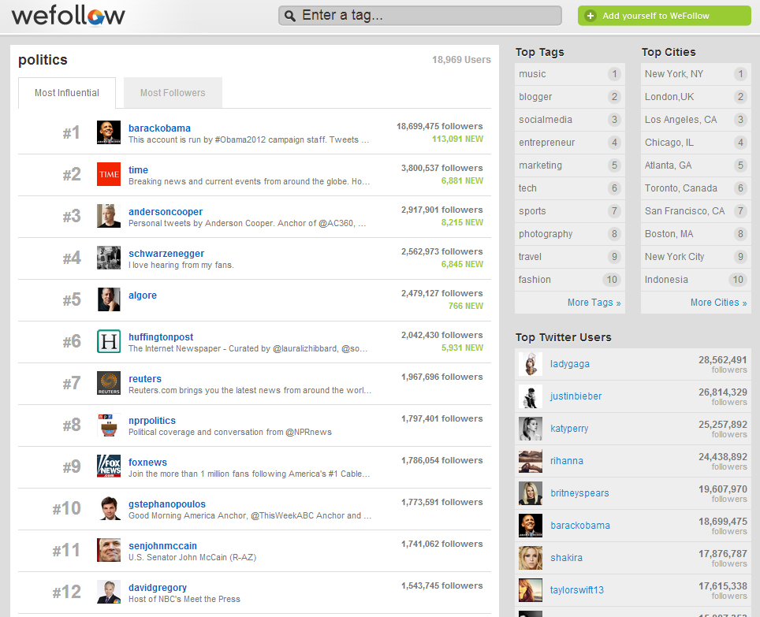

Slide 61
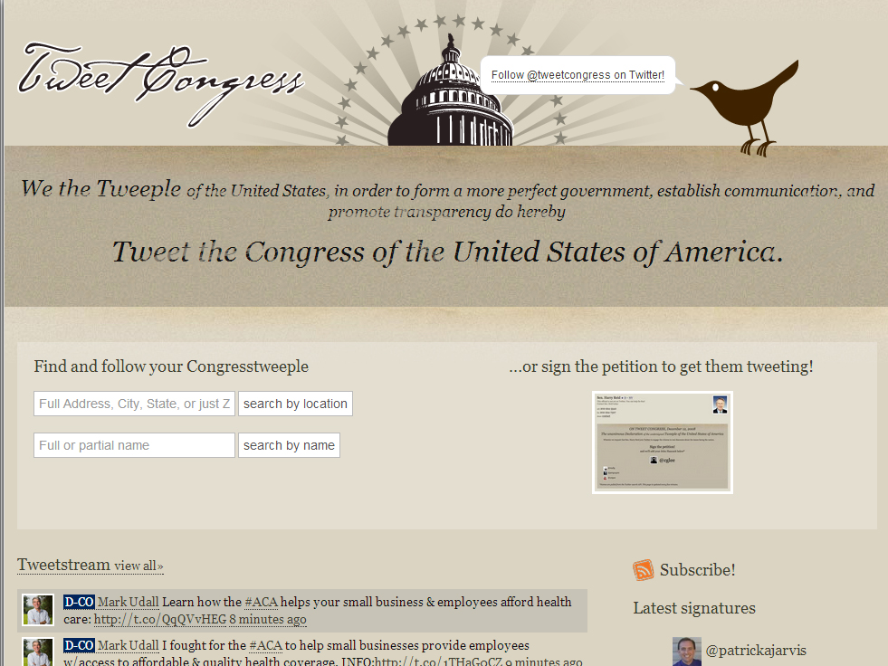

Slide 62
TITLEEEEEEEEE
Not All Twitter Accounts Are Equal
Some have a lot of Followers
Some are better and will RT tweets
Some only post links to their own content
Some are run by staff & interns

Slide 63
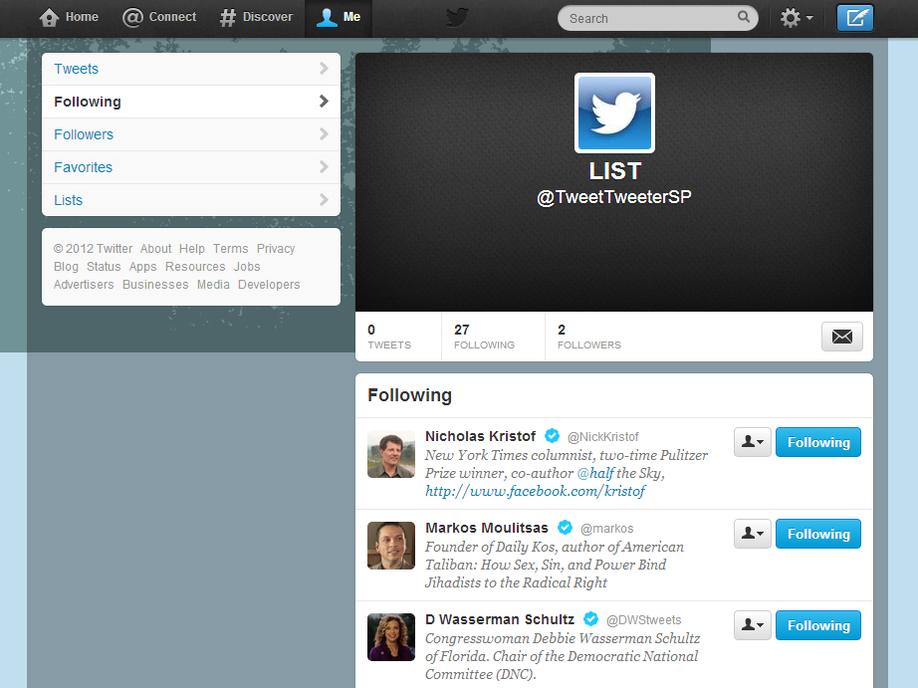

Slide 64
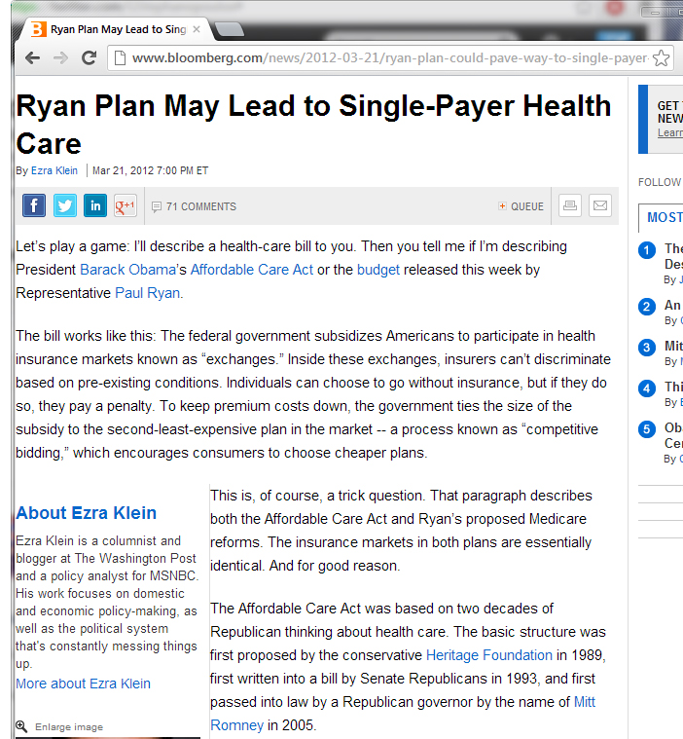

Slide 65
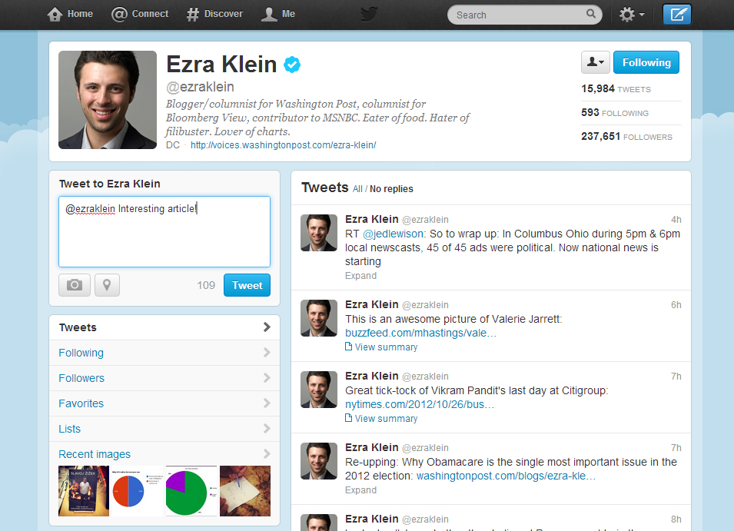

Slide 66
Lastly…

Slide 67
Summary
“Like” content often on Facebook
Remember TLDR
Follow up with Friends who express interest in your posts
Tweet @ media figures, celebrities, politicians
Don’t feed the trolls (or become a troll)
“Friend” & network with people you meet here
PNHP Facebook Page Event
Find people in attendance
Be a part of PNHP’s “Social Media Task Force”

Slide 68
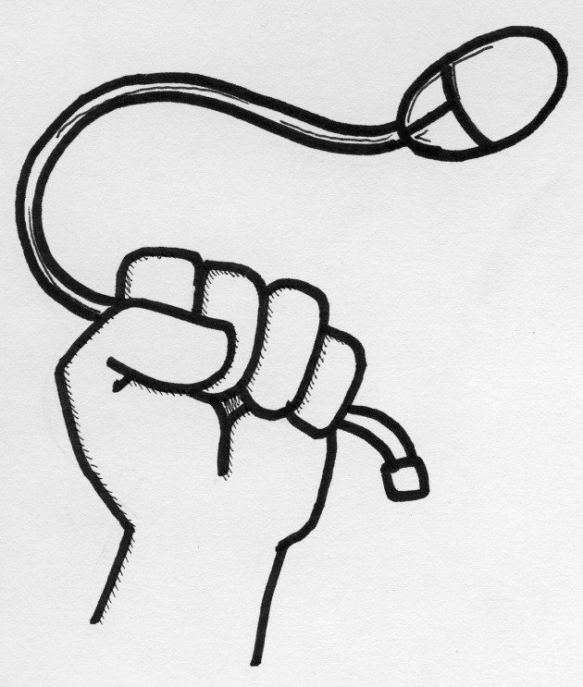
Questions?
Thank you!

