Slide 1
Physicians for a
National Health Program
We are a non-profit research and education organization of 18,000 physicians, medical students and health professionals who support
single-payer national health insurance.

Slide 2
Costs are
Rising

Slide 3
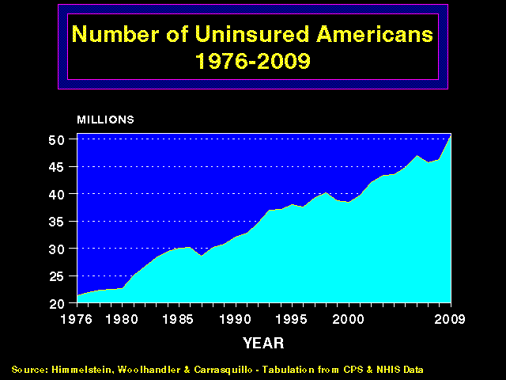
Health Care Costs Far Outpace Incomes
Average Per Capita Health Spending as % of Median Income
35%
30%
25%
20%
15%
10%
5%
1974 | 1980 | 1985 | 1990 | 1995 | 2000 | 2005 | 2011
Source: Himmelstein & Woolhandler calculation
based on data from NCHS and Bureau of the Census

Slide 4
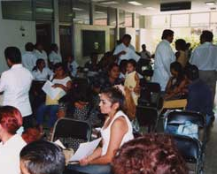
The Uninsured

Slide 5
More and More
Uninsured Americans
50
45
40
35
30
25
20
Millions of Uninsured American
1976 | 1980 | 1985 | 1990 | 1995 | 2000 | 2005 | 2012
Source: Himmelstein, Woolhandler & Carrasquilo.
Tabulation from CPS & NHIS data

Slide 6
Uninsured Veterans
Percent of non-elderly Veterans with neither health insurance nor VA care
Source: Woolhandler & Himmelstein.
Analysis of Current Population Survey data.

Slide 7
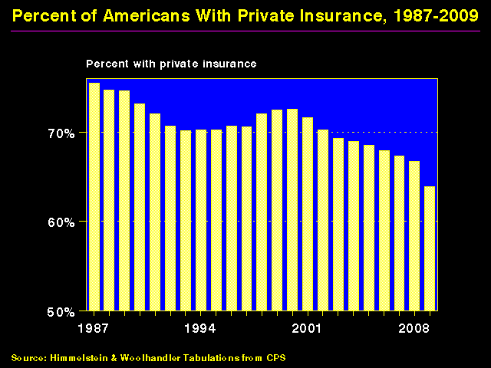
Shrinking Private Insurance
Percent with private coverage
80%
70%
60%
50%
1960
1970
1980
1990
2000
2012
Source: Himmelstein and Woolhandler – Tabluations from CPS and HIAA data
Note: Data are not adjusted for minor changes in survey methodology

Slide 8
Mentally Ill Pushed Out of Private Coverage
Percent of people with severe mental illness with private coverage
Source: Health Affairs 2013;32:1723
Note: Severe mental illness = psychological distress causing functional limitations

Slide 9
Shrinking Retiree Coverage
Share of large firms offering retiree health benefits
70%
60%
50%
40%
30%
20%
10%
0%
1988
1995
2000
2005
2011
Source: Kaiser/HRET Employer Survey, 2011

Slide 10
Chronically Ill and Uninsured
Condition | % Uninsured | # of Uninsured
Diabetes | 16.6% | 1.4 million
Elevated cholesterol | 11.9% | 4.0 million
Hypertension | 15.5% | 5.9 million
Asthma / COPD | 19.3% | 3.5 million
Previous cancer | 15.4% | 1.1 million
Cardiovascular disease | 16.1% | 1.3 million
Any of the above | 15.6% | 11.4 million
Source: Wilper et al. Annals of Internal Medicine.
2008;149:170

Slide 11
44,798 Adult Deaths Annually
Due to Uninsurance
State | Percent Uninsured | Excess Deaths
California | 23.9% | 5,302
Texas | 29.7% | 4,675
Florida | 26.0% | 3,925
New York | 17.5% | 2,254
Georgia | 23.6% | 1,841
USA | 15.3% | 44,798
Source: Wilper et al. Am J Public Health 2009.
State tabulations by author

Slide 12

Uninsured Children:
Higher Inpatient Mortality
Adjusted* mortality rate
Source: Abdulah, et al. J Public Health, Oct. 29, 2009.
*Adjusted for gender, race, age, location,
hospital type, admission source

Slide 13
Medicaid:
Poor Access, but
Better Than Nothing

Slide 14
Medicaid Enrollment
50%
40%
30%
20%
10%
1987 | 1992 | 1997 | 2002 | 2007 | 2012
Source: Bureau of the Census

Slide 15
Many Specialists Won’t See
Kids With Medicaid
% of Clinics Scheduling
Appointments for Children
Bisgaier J, Rhodes KV.
N Engl J Med 2011;364:2324-2333
Notes:
15
Figure 2 Clinics Scheduling Specialty Care Appointments for Children, According to Type of Insurance. Public insurance was reported by callers as the Illinois Medicaid–Children's Health Insurance Program (CHIP) umbrella program; private insurance was reported by callers as Blue Cross Blue Shield. Each of the 273 clinics was called twice (for a total of 546 calls) by the same caller, with only insurance coverage varying between the two calls: once reporting Medicaid–CHIP coverage and once reporting private coverage. Calls were made 1 month apart, and the order of the reported insurance status was randomly assigned. Asthma clinics included 38 allergy–immunology clinics and 6 pulmonary disease clinics.

Slide 16
Medicaid Helps
A randomized controlled trial in Oregon
Source: NEJM May 2 2013
Note: Catastrophic medical costs = out-of-pocket spending >30% of income
Depression = screened positive for depression on PHQ8
Notes:
16
Figure 2 Clinics Scheduling Specialty Care Appointments for Children, According to Type of Insurance. Public insurance was reported by callers as the Illinois Medicaid–Children's Health Insurance Program (CHIP) umbrella program; private insurance was reported by callers as Blue Cross Blue Shield. Each of the 273 clinics was called twice (for a total of 546 calls) by the same caller, with only insurance coverage varying between the two calls: once reporting Medicaid–CHIP coverage and once reporting private coverage. Calls were made 1 month apart, and the order of the reported insurance status was randomly assigned. Asthma clinics included 38 allergy–immunology clinics and 6 pulmonary disease clinics.

Slide 17
High Deductible Insurance
Impedes Access
Worsens Health
Threatens Financial Ruin

Slide 18
Deductibles Are Rapidly Increasing
Percent of workers with deductibles
>$1,000
Kaiser/HRET Survey of Employer-Sponsored Benefits, 2013

Slide 19
Americans Lack Assets to
Pay High Deductibles
Median Net Financial Assets
Note: FPL = Federal Poverty Level
Source: Jacobs & Claxton. Health Affairs 2008;W:214

Slide 20
Underinsurance =
Poor Access + Financial Stress
Source: Commonwealth Fund, Sept, 2011.
*Skipped Rx, test, treatment, follow-up, or visit because of cost

Slide 21
Increasing Un- and Under- Insurance
Insured
Under-Insured
Uninsured
Commonwealth Fund, Sept. 8, 2011
2012 Biennial Health Insurance Survey

Slide 22
Uninsured and Under-Insured
Delay Seeking Care for Heart Attacks
Odds ratio for delayed care*
Source: JAMA April 15, 2010. 303:1392
*Adjusted for age, sex, race, clin. charact., hlth status,
social/psych fx, urban/rural. Under-insured=had coverage
but patient concerned about cost

Slide 23
Insurance for Eye Care:
More Visits, Better Outcomes
Odds ratio: insured:
uninsured for eye care
Source: JAMA Ophthalmology 2013; 131:499

Slide 24
Financial Barriers Worsen
Diabetes Care and Outcomes
JGIM On-Line, 9/27/2013.
Note: Financial barrier = needed to see a doctor
in last 12 months but couldn’t
Notes:
24
Figure 2 Clinics Scheduling Specialty Care Appointments for Children, According to Type of Insurance. Public insurance was reported by callers as the Illinois Medicaid–Children's Health Insurance Program (CHIP) umbrella program; private insurance was reported by callers as Blue Cross Blue Shield. Each of the 273 clinics was called twice (for a total of 546 calls) by the same caller, with only insurance coverage varying between the two calls: once reporting Medicaid–CHIP coverage and once reporting private coverage. Calls were made 1 month apart, and the order of the reported insurance status was randomly assigned. Asthma clinics included 38 allergy–immunology clinics and 6 pulmonary disease clinics.

Slide 25
Higher Medication Co-Pays =
Worse Pediatric Asthma Outcomes
Children age 5-18
Source: JAMA 2012;307:1284

Slide 26
Breast Cancer Patients with Higher Copayments Less Likely to Take Aromatase Inhibitors
Odds ratio for continuing Aromatase Inhibitor
90-Day Medication Copayment
Source: J Clin Oncol 2011;29:2534

Slide 27
Medicare HMO Copayments Drive
Less Office Visits, More Hospitalizations
Difference between plans that did and didn’t raise copays
Outpatient Visits | Hospital Admissions | Hospital Days
Source: NEJM 2010;362:320
All figures are per 100 enrollees

Slide 28
Higher Copayments =
Kids Without Care
Percentage with no physician visits in year
Source: Rand Experiment. Pediatrics 1985;75:942

Slide 29
Who Pays for Long Term Care?
Source: JAMA 2013;310:786

Slide 30
Most of the Medically Bankrupt Had Coverage
Insurance at Illness Onset
Source: Himmelstein et al. Am J Med: August, 2009

Slide 31

Planning for Retirement?
Don’t Forget Health Care Costs
“Medicare covers only 51% of health care services….
For a 65 year old couple retiring this year, the cost of health care in retirement will be $240,000.”
New York Times. Wealth Matters

Slide 32
More Under-Insurance,
Less Medical Care
Commonwealth Fund Biennial Health Insurance Surveys
20023, 2005, 2010, 2012

Slide 33
Increasing Medical Bill and
Debt Problems
Percentage of adults aged 19-64
Source: Commonwealth Fund Biennial Health Insurance Surveys
2005, 2010, 2012

Slide 34
Medical Bills’ Side Effects
32
million
Problems due to medical bills past two years.
Adults age 19 - 64
19
million
5 million
4 million
Source: Commonwealth Fund
Biennial Health Insurance Survey, 2012

Slide 35
High Deductible Health Plans:
A $1,000 Pay Cut for Women
Median Health Expenditure (2006)
Source: Woolhandler and Himmelstein – JGIM 6/07

Slide 36
Rising
Economic Inequality

Slide 37
Change in Real Family Income
1979 - 2012
Source: Bureau of the Census

Slide 38
Income of the Wealthiest 0.01%
As multiple of average income, 1920 - 2012
700
600
500
400
300
200
100
1920 | 1930 | 1940 | 1950 | 1960 | 1970 | 1980 | 1990 | 2000 | 2010
Includes capital gains
Source: Piketty & Saez, http://elsa.berkeley.edu/~saez/tabfig2005prel.xls

Slide 39
Top Tax Rate and GDP Growth
Low taxes on wealthy don’t mean more growth
100%
80%
60%
40%
20%
Average
per capita
GDP growth
during decade
Top tax rate
1913 | 1925 | 1935 | 1945 | 1955 | 1965 | 1975 | 1985 | 1995 | 2005 | 2013
Sources: Tax Policy Center and Left Business Observer, 2013

Slide 40
Widening Gap in Life Expectancy Between High and Low Earners
Remaining Life Expectancy for Men Turning 60
Waldron. ORES, Social Security Admin, #108, 2007

Slide 41
Labor’s Share
Of National Income Is Shrinking
65%
60%
55%
50%
45%
40%
Wages and salaries as percent of national income
1929
1970
2011
Source: US Commerce Department – “National Income by Type of Income”

Slide 42
Number of People in Poverty
50
40
30
20
10
Millions
1960 | 1970 | 1980 | 1990 | 2000 | 2012
Source: Census Bureau

Slide 43
Child Poverty Rates
Denmark
Sweden
France
Germany
Netherlands
UK
Canada
US
0% | 5% | 10% | 15% | 20% | 25%
Source: OECD 2011
Note: Figures are for 2009 or most recent available

Slide 44
Welfare Time Limit Increases Deaths
1
.99
.98
.97
.96
.95
No time limit
Time limit
Survival
16% higher mortality =
9 months of
life expectancy
0 | 5 | 10 | 15 | 20
Years
Source: Health Affairs 2012;32:1072. Randomized Controlled Trial in Florida.
Note: Time limit group received job training and placement assistance

Slide 45
Incarceration Rates
Prisoners per 100,000 population
Source: Walmsley – World Prison Population List, 9th Ed.

Slide 46
US Prison and Jail Population
2,500
2,000
1,500
1,000
500
13% of black men cannot vote
because of criminal record:
More than one in four in
AL, FL, MS, IA, NM, WA, WY
Thousands
1925
1945
1965
1985
2005
2012
Federal and state prisons
Jails
Source: Historical Statistics and Stat Abstracts of the US.
Bureau of Justice Stats. NY Times 10/23/98

Slide 47

Persistent Racial Inequalities

Slide 48
Employment Discrimination
White felons get more job offers than Blacks with clean records
30%
20%
10%
0
Percentage called back for interview
White Applicants | Black Applicants
Clean record | Felony conviction
Researcher sent well-groomed Black and White college students to apply for jobs
All had identical resumes, except half listed a cocaine conviction
Source: New York Times 3/20/2004

Slide 49
Wealth and Income:
The White / Minority gap
Source: Census Bureau and Pew Center, 2011

Slide 50
Excess Deaths Among African Americans
83,369 fewer would have died in 2000 if racial gap were eliminated
Excess African American deaths
Source: Satcher et al. Health Affairs 2005;24:459

Slide 51
Causes of Black/White Disparity
In Life Expectancy
Source: MMWR 2001;50:780

Slide 52
Blacks Less Likely to Get
Voice Preservation Therapy
Odds ratio for receiving radiation therapy as initial treatment among laryngeal cancer patients
*Adjusted for age, year, sex, and tumor characteristics
Source: Arch Otolaryng-Head and Neck Surg 2012;138:644

Slide 53
Black Enrollment in US Medical Schools
20%
15%
10%
5%
AAMC Goal
%Blacks in 1st Year Class
1976 | 1982 | 1988 | 1994 | 2000 | 2006 | 2012
Source: RWJ Fdn. 1987, AAMC, and
JAMA Annual Medical Education Special Issue

Slide 54
Physicians/Population by Race/Ethnicity
Physicians per 1000 population
Data are for 2008
Source: AMA and Census Bureau

Slide 55
Immigrants Get Little Care
Health Care
$ per capita
*Adjusted for ethnicity, poverty, age, insurance status, patient/parent-reported health status
Source: Mohanty et al. Am J Public Health 2005;95:1431

Slide 56
Immigrants Keep Medicare Afloat
$10.1 Billion
Net contribution to Medicare Trust Fund, 2009
$3.7 Billion
-$30.9 Billion
*Adjusted for ethnicity, poverty, age, insurance status, patient/parent-reported health status
Source: Mohanty et al. Am J Public Health 2005;95:1431

Slide 57
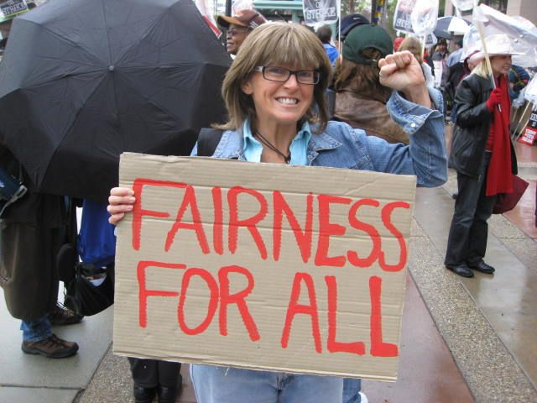
Rationing Amidst a Surplus of Care

Slide 58
Unnecessary Procedures
Percent of Procedures
Source: Commonwealth Fund.
Quality of Healthcare in the U.S. Chartbook 2002

Slide 59
22.5% of 111,707 Defibrillator Implants
Were Not Evidence-Based
Sometimes Lethal
Death rates 3.17 times higher (0.57% vs. 0.18%)
No improvement in rates over time
Note: In-hospital death rate for non-evidence-based ICD implantation was 0.6%. Cost of ICD implant ~$25,000
Source: JAMA 2011;305:43

Slide 60
More Unnecessary Heart Caths
In New York than Ontario
Number of
stenotic
vessels
0
1
2
3
71%
56%
Source: JAMA 2013;310:163
30-day mortality higher in NY than Ont despite less severe disease
Triple vessel or left main disease: 13.0% in Ontario, 7% in NY

Slide 61
Outcomes of New vs. Old
Hip/Knee Prosthetic Joints
30% of newly-introduced prostheses worsened outcomes
0% improved outcomes
Note: Comparison is to prostheses that had been available for >5 years
Source: J Bone Joint Surg 2011;suppl3(e):51-4.
Data from Australian Orthopedic Assoc.

Slide 62
Administrative Overhead Rising

Slide 63
Growth of Physicians and Administrators
3000%
2500%
2000%
1500%
1000%
500%
0
Growth Since 1970
1970 | 1980 | 1990 | 2000 | 2010
Physicians
Administrators
Data updated through 2013
Source: Bureau of Labor Statistics; NCHS; Himmelstein/Woolhandler analysis of CPS

Slide 64
Doctor’s Paperwork Increasing
Hours per week spent on paperwork and administration
Source: Medscape – Physician Compensation Report

Slide 65
Investor-Owned Care:
Inflated Costs,
Inferior Quality

Slide 66
Extent of For-Profit Ownership
For-Profit Firms’ Share of Total Revenue
*Data are for share of establishments
Source: Commerce Department, Service Annual Survey, 2013 or more recent available data
Health Af 2012;31:1286

Slide 67
Health Insurance Industry Profits, 2012
Pharmaceuticals | $55.2 Billion
Insurers | $13.5 Billion
Equipment/Supplies* | $5.1 Billion
Distributors/Wholesalers | $3.7 Billion
Hospitals/Nursing Homes | $3.2 Billion
Source: Fortune. May 2013
*Note: Reflects one-time write-down of $4.1 billion by Boston Scientific

Slide 68
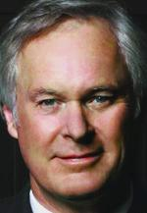

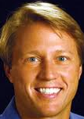
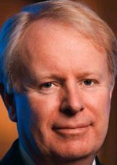
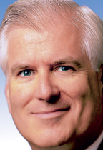
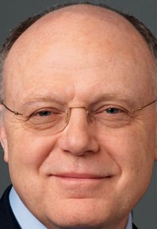
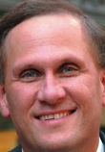
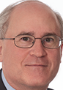
Health Care CEOs’ Pay, 2012
Richard Bracken
HCA
Leonard Schleifer
Regeneron
Kent Thiry
DaVita
David Pyott
Allergan
Total Pay: $34.6M
Holdings: $84.5M
Total Pay: $30.0M
Holdings: $666M
Total Pay: $26.8M
Holdings: $66.3M
Total Pay: $19.4M
Holdings: $108M
Miles White
Abbott
Ian Reed
Pfizer
Robert Parkinson
Baxter
Leonard Bell
Alexion
Total Pay: $19.0M
Holdings: $143M
Total Pay: $18.5M
Holdings: $48.1M
Total Pay: $16.0M
Holdings: $89.2M
Total Pay: $13.6M
Holdings: $311M
Source: NY Times. 6/30/2013

Slide 69
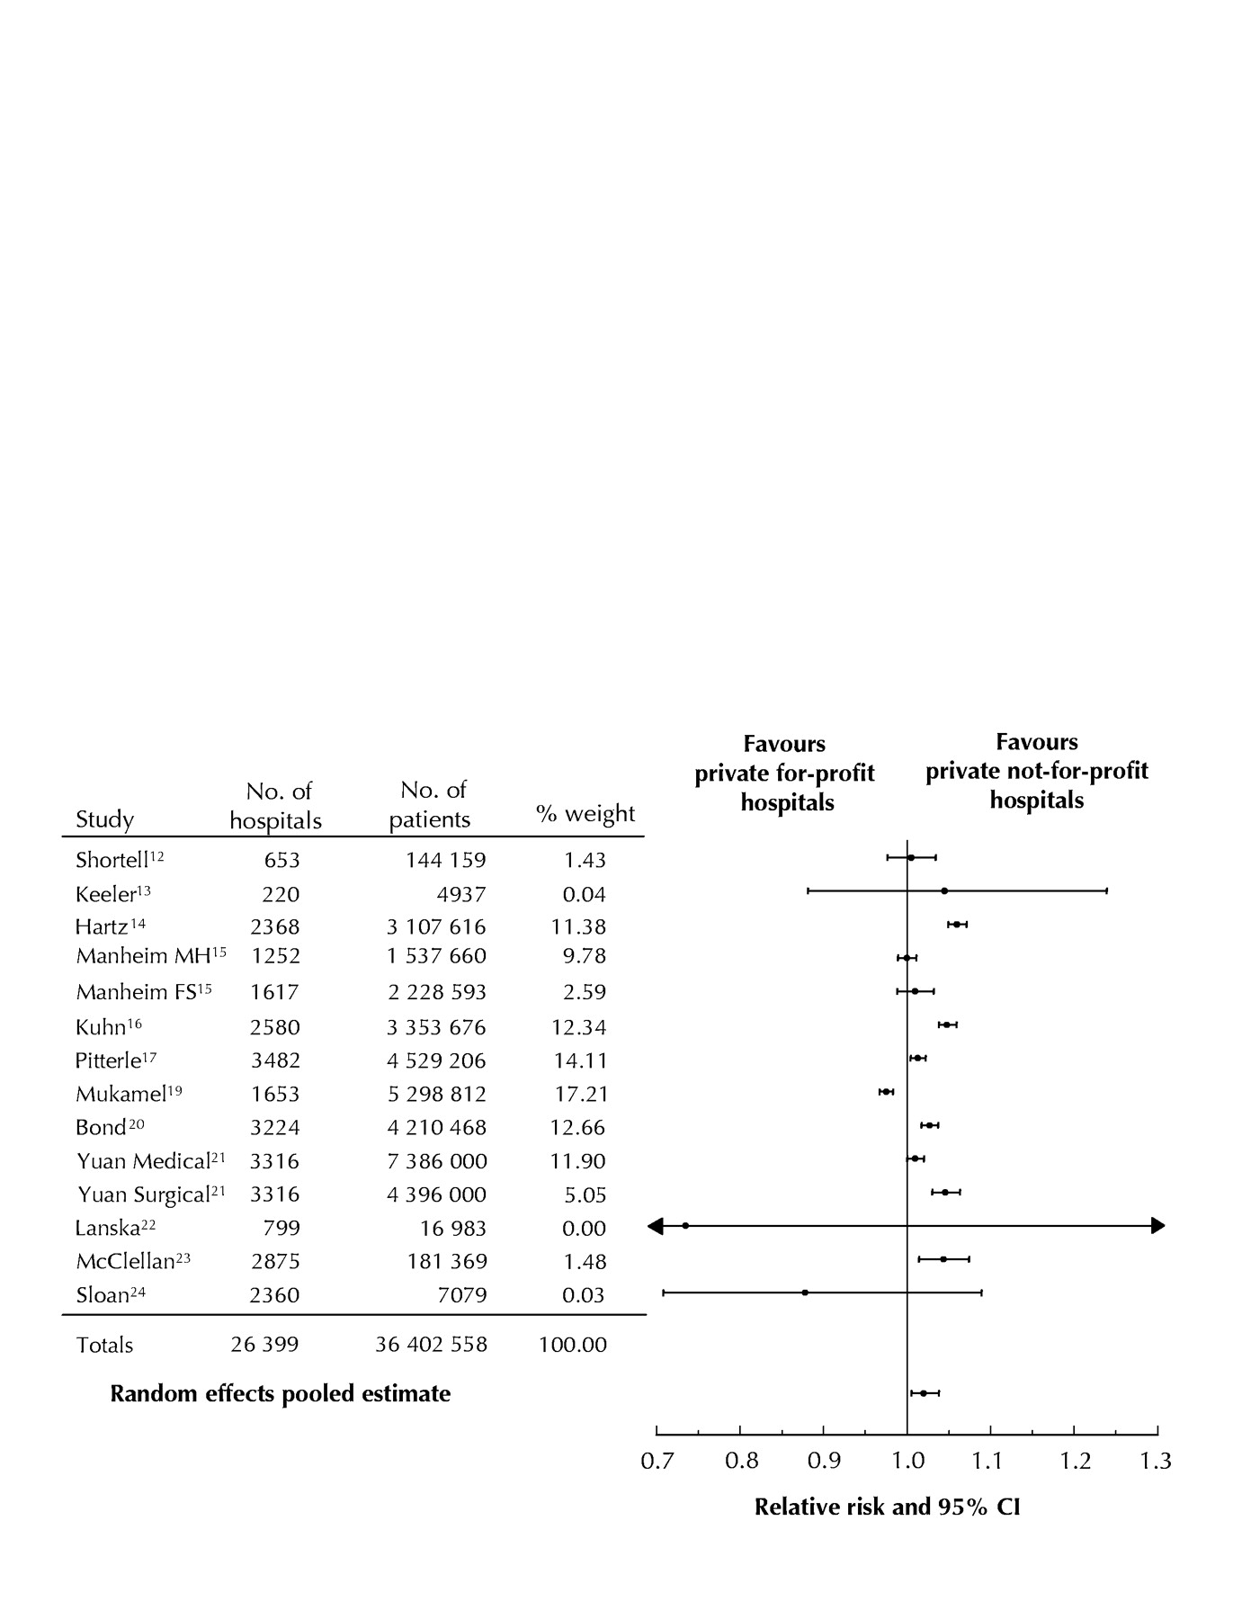
For-Profit Hospitals’
Death Rates Are 2% Higher
Favors
for-profit hospitals
Favors
not-for-profit hospitals
Relative risk and 95% CI
Relative risk of hospital mortality for adult patients in private for-profit hospitals relative to private not-for-profit hospitals
Source: CMAJ Devereaux et al. 166 (11): 1399.

Slide 70
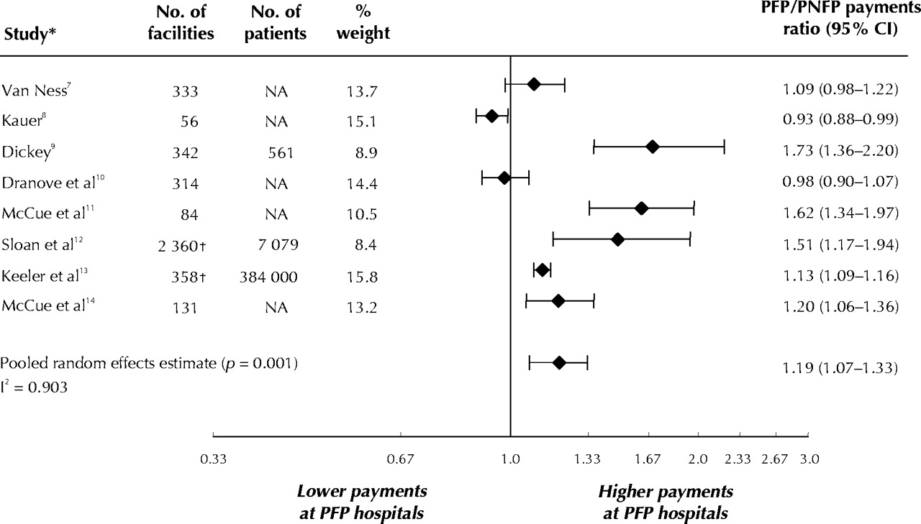
For-Profit Hospitals Cost 19% More
Lower payments at PFP Hospitals
Higher payments at PFP Hospitals
PFP/PNFP Payments Ratio (95% CI)
Relative payments for care at private for-profit (PFP)
and private not-for-profit (PNFP) hospitals
Source: CMAJ Devereaux et al. 170 (12): 1817.

Slide 71
Quality Measures for MI, CHF, Pneumonia:
For Profit Hospitals Are Worst; VA is Best
Odds ratio
of meeting composite quality measures (Higher = Better)
Source: Arch Int Med 2006;166:2511

Slide 72
Low Quality Hospitals
More Likely to be For-Profit
For-Profit
Non-Profit / Government
Source: Health Affairs 2011;30:1904.
Quality rating based on Medicare’s Hospital Compare data

Slide 73
For-Profit Hospitals’ Quality Lowest
More Nurses = Higher Quality Rating
Percent of patients giving hospital highest quality rating
Source: NEJM 10/31/2008

Slide 74
Tenet (AKA “NME”)
1985-1993: Recurrent criminal activity. Bribing state officials, kickbacks for referrals, and kidnapping psychiatric patients
1994-1995: Pays $379M Federal fine for insurance fraud/kickbacks. Pays more than $200M in private settlements.
CEO Richard Esmer retires with annual pension of $822,670 plus lump sum payment of $2.6M
1995: New CEO J. Barbakow appointed
2002-2003: FBI raids Tenet hospital re: unnecessary heart surgery + Medicare fraud
2003: Barbakow forced out (total compensation = $400M)
2003-2004: Pays $449M for unneeded heart surgery settlement
2006: Pays $215M + $900M for Medicare outlier fraud + $80M for improperly deducting previous fines from taxes
Mod Hlthcr 3/29/85,4/26/85, 9/6/93, 7/4/94, 11/4/02, 1/16/06, 11/27/06; NYT 10/22/91, 7/31/94, 11/1/02, 6/30/06; USA Today 8/26/02

Slide 75
Two For-Profit Giants Dominate Dialysis
Medicare pays, shareholders profit
Share of Dialysis Patients
Source: Modern Healthcare 9/16/2013

Slide 76
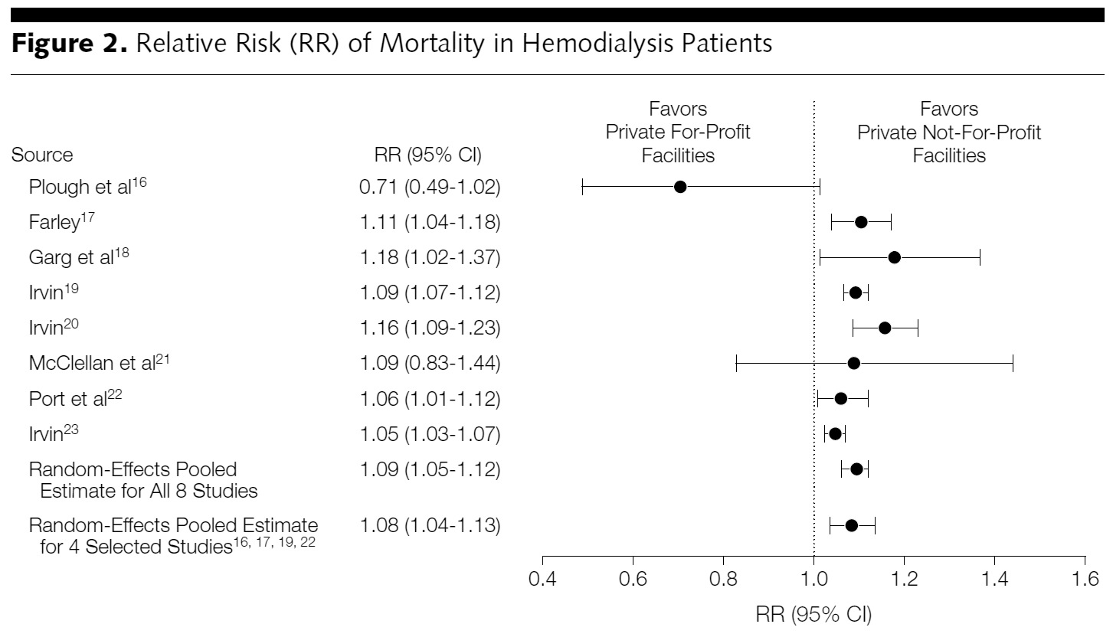
For-Profit Dialysis Clinics’
Death Rates Are 9% Higher
Relative Risk (RR) of mortality in hemodialysis patients
Source: Devereaux P. JAMA. 2002;288(19):2449-2457.

Slide 77
During era when more EPO = more profit
For-Profit Dialysis Facilities
Overdosed Patients with EPO
50,000
40,000
30,000
20,000
10,000
0
Weekly EPO units for patients with HCT <33%
Non-Profit | For-Profit | Hospital-Based
Note: Higher EPO dose associated with higher CV death rate
Similar pattern was observed among patients with HCT.33%
Source: JAMA 2007;297:1667

Slide 78
Quality Better at
Non-Profit Nursing Homes
1
4
0
1
A meta-analysis including every published study
0
0
0
0
Results favor for-profits
Results favor non-profits
Most studies with non-significant results also favored non-profits
Parenthetic numbers = N
Source: BMJ 2009;33:B2732

Slide 79
For-Profit Nursing Homes:
More Inappropriate Feeding Tubes
Rate of feeding tubes in patients with advanced cognitive impairment
Note: Adjusted odds ratio for for-profits = 1.09
Source: JAMA 2003;290:73

Slide 80
Hospice Care Goes For-Profit
2011: 60%
Percent of hospices under for-profit ownership
1993: 6%
Source: National Home Care and Hospice Surve & MEDPAC

Slide 81
For-Profit Hospices Avoid Unprofitable Patients
Likelihood of accepting all patients, regardless of care needs
(and profitability)
Source: Health Affairs 2012;31:2690
Note: Based upon accepting patients on chemo, TPN, transfusions, tube feeds, intrathecal cath, palliative radiation, or living alone

Slide 82
For-Profit Hospice Scams
Growing role of Venture Capital
Reincorporation
Cherry picking
Reward your friends
VC firms (e.g., KKR, owned RJ Reynolds) buying up hospices
Hospices overbill Medicare and then close/reincorporate to avoid repayment – all 430 that overbilled in 2009 were for-profit
Enroll non-terminal patients who generate profits up to 20% (LOS rose 60% 2000-2009; 110,000 pts. had LOS >240 days in 2009)
Bonuses/kickbacks for referrals
Source: P. Waldman, Bloomberg 12/6/11 and 2/3/12

Slide 83
Urologists who buy IMRT facilities
Dramatically Increase Usage
Profit motive bends prostate cancer treatment decisions
IMRT costs $14,000 more than brachytherapy,
$11,000 more than external beam radiation,
but has not been show to do better.
% of patients referred for IMRT
Note: IMRT = Intensity Modulated Radiotherapy
Source: NEJM 2013;369:1629

Slide 84
When Orthopedists Own Device Distributor,
Spinal Fusions Increase
Procedures per 1,000 surgical discharges
Hospitals with:
Physician owner
No physician owner
Source: HHS Office of the Inspector General,
October 2013

Slide 85
US Prescription Drug Spending
Prescription drug spending,
Billions of dollars
Source: CMS, Office of the Actuary
Note: 2012-2014 estimated

Slide 86
Drug Companies’ Cost Structure
Marketing and Admin
35%
Manufacturing
27%
Profits
(After Taxes)
18%
R&D
13%
Source: Health Affairs 2001;20(5):136

Slide 87
2012 Fraud/Civil Fines
Against Drug Firms
Glaxo – $3 Billion
Illegal promotion (Paxil & Wellbutrin)
Hiding safety problems (Avandia)
Johnson & Johnson - ~$2 Billion
Illegal marketing. Risperidal (multiple cases)
Abbott -- $1.5 Billion
Illegal marketing, Depakote
Amgen – $762 Million
Illegal marketing, Aranesp
Merck – $322 Million
Illegal marketing, Vioxx
Sanofi – $109 Million
Physician kickbacks for Hyalgan
Sources: NYT 7/3/2012; Fiscal Times 8/31/2012;
Modern Healthcare 2/25/13

Slide 88

Drug Firms’ Fraud:
Pay the Ticket, Keep on Speeding
“In April [2010], AstraZeneca became the fourth major drug company in three years to settle a government investigation with a hefty payment…
“$520 million for what federal officials described as an array of illegal promotions of antipsychotics for children, the elderly, veterans and prisoners.
“Still, the payment amounted to just 2.4 percent of the $21.6 billion AstraZeneca made on Seroquel sales from 1997 to 2009.”
New York Times – 10/3/10

Slide 89
Investor-Owned HMOs
Provide Lower Quality of Care
Source: Himmelstein, Woolhandler & Wolfe.
JAMA 1999; 282:159

Slide 90
For-Profit Medicare HMOs:
Worse Quality Rheumatoid Arthritis Care
Percent of RA patients who received a DMARD
DMARD = Disease Modifying Agent
Receipt of DMARD is a HEDIS measure
Source: JAMA 2011;305:480

Slide 91
Investor-Owned Medicaid HMOs:
Higher Administrative Costs, Lower Quality
Note: Publicly Traded = Publicly traded Medicaid-only plans
Source: McCue. Commonwealth Fund, June, 2011

Slide 92
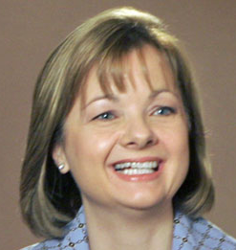

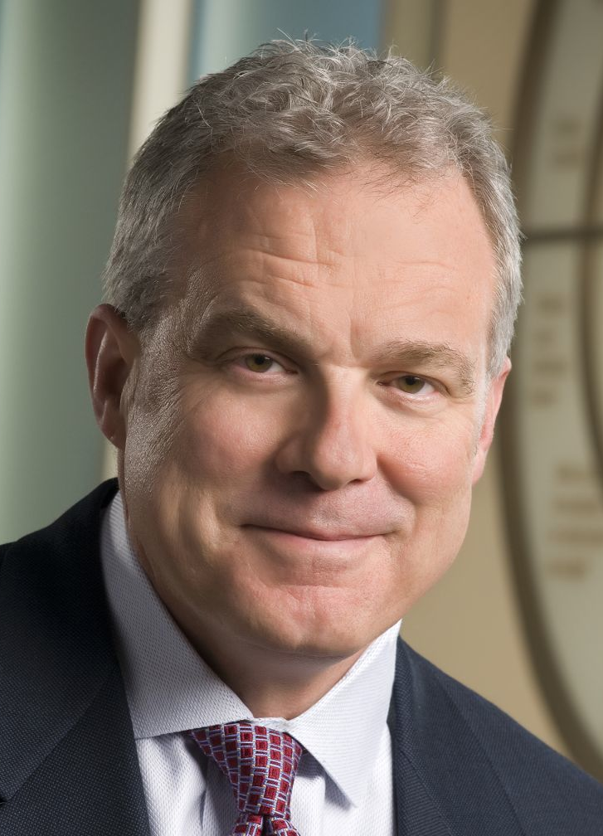
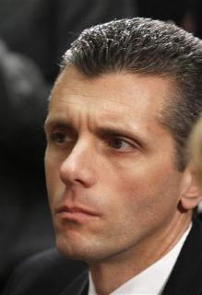
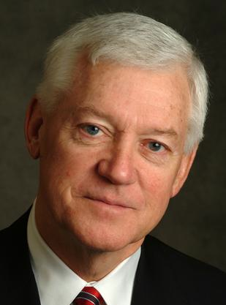
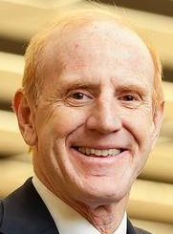
HMO CEOs’ 2012 Pay
Angela Braly
Steve Hemsley
Mark Bertolini
Wellpoint
$20.6 Million
United HC
$13.9 Million
Aetna
$113.3 Million
David Cordani
Allen Wise
Jay Gellert
Cigna
$12.9 Million
Coventry
$12.0
Million
HealthNet
$10.2 Million
Sources: Modern Healthcare 5/13/2013
and AFL-CIO CEO Database

Slide 93
HMO Overhead, 2013
SEC Filings/Reports to Shareholders. Data for Q1 or Q2
Calculated as 100% – Medical Loss Ratio
Note Medicare/Medicaid enrollees included in some figures

Slide 94
Medicare
Remains Solvent and Relatively Efficient

Slide 95
Number of Years Before Medicare Trust Fund Projected to be Exhausted
Year of estimate
Estimated number of years until Trust Fund exhausted
Medicare Trust Funds Annual Reports

Slide 96
Risk Adjustment Increased
Medicare HMO Overpayment
25%
20%
15%
10%
5%
Annual Increase
4181%
2441%
1970
2011
Medicare
Private Insurance
National Health Accounts – Historical Series, Table 16

Slide 97
Most Physicians Accept Medicare
100%
90%
80%
70%
60%
50%
Percent of physicians
Accepts new Medicare patients
Accepts new private insurance patients
2005 | 2006 | 2007 | 2008 | 2009 | 2010 | 2011 | 2012
DHHS, Office of ASPE, August, 2013
(based on analysis of NAMCS)

Slide 98
Medicare Threatened by
Private Medicare Advantage Plans

Slide 99
Can Seniors Make Informed HMO Choices?
Proportion with knowledge of how HMOs work
Note: Reading level needed to understand insurance policy descriptions = college
Source: AARP Survey – Health Affairs 1998;17(6):181
EBRI Notes 10/2006
Notes:
99

Slide 100
Medicare Enrollees
Choose Poorly Among Drug Plans
<16% enrolled in economically optimal Part D plan*
Note: Economically Optimal = Plan that minimized costs.
Analysis based upon 2008 data
Source: NBER 18166 – June, 2012
Notes:
100

Slide 101
Private Medicare Advantage Plans’
High Overhead
Overhead
per enrollee
2008
Source: US House Committee on Energy and Commerce. December, 2009

Slide 102
Despite Medicare’s lower overhead, enrollment of Medicare patients in private plans has grown because of cherry picking.

Slide 103
Medicare HMO Enrollment
14
12
10
8
6
4
2
0
Medicare HMO enrollment (Millions)
1985 | 1990 | 1995 | 2000 | 2005 | 2013
Source: CMS

Slide 104
A Few Sick People
Account for Most Health Dollars
Percent of total health spending accounted for by decile
Top 2 deciles account for 78.3%
Decile of Privately Insured
Source: MEPS Data, from Thorpe and Reinhart

Slide 105
Medicare HMOs:
The Healthy Go In, The Sick Go Out
Inpatient costs as percentage of FFS Medicare
High medical needs when they leave
Healthier patients join
Source: NEJM 1997;337:169

Slide 106
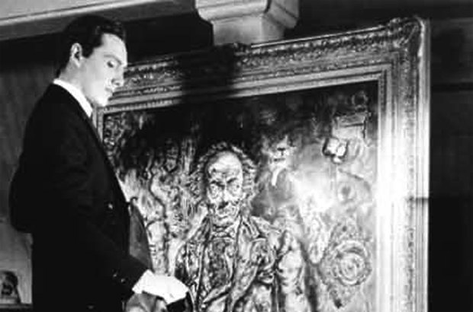
Profit-Driven Up-coding Makes
Accurate Risk Adjustment Impossible
High cost providers inflate both reimbursement and quality scores by making patients look sicker on paper

Slide 107
The Science of Making Patients Look Sicker on Paper
Up-Coding
No Extra Severity Payment |  | Equivalent but Extra Credit
Acute Kidney Insufficiency |  | Acute Renal Failure
Mg = 1.6 |  | Hypomagnesemia
Delirium |  | Encephalopathy
Anemia 2⁰ to GI Bleed |  | Anemia 2⁰ to Acute Blood Loss
Malnourished |  | Moderately Malnourished
COPD Exacerbation |  | Acute Respiratory Decompensation
Polysubstance Abuse |  | Continuing Polysubstance Abuse

Slide 108
Hospitals That Got Federal HIT Bonuses Raised ED Billings: EMRs Facilitate Upcoding
50%
40%
30%
20%
10%
+47%
Annual increase in claims coded at the highest levels
Hospitals receiving incentives for electronic recordkeeping
+32%
Other hospitals
2006 | 2007 | 2008 | 2009 | 2010
Source: NY Times 9/21/12

Slide 109

UpCoding at United HealthCare
Chart audits at its PacifiCare unit found that 45% of risk scores “were invalid because the diagnoses were not supported”
OIG estimated that PacifiCare was overpaid $424 million in 2007 alone, 18% of Medicare capitation payments - $2,244 per enrollee
Source: Office of the Inspector General, DHHS – November, 2012

Slide 110
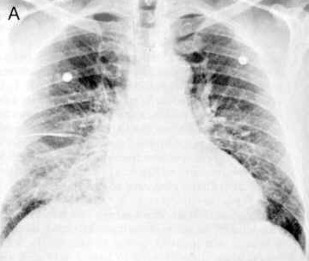
How Could a Medicare HMO
Profit on CHF Patients?
A CHF diagnosis increases the HMO’s capitation rate by 41%
Among Fee-for-Service Medicare enrollees with CHF:
    The costliest 5% averaged > $37,000/year
    The least costly 5% averaged $115/year
Universal echocardiogram screening would label many asymptomatic seniors as having CHF
Source: MedPAC data for 2008

Slide 111
VA Subsidizes Medicare HMOs
Medicare pays the plan, VA delivers the care, nobody pays the VA
$3 billion
$2 billion
$1 billion
Annual uncompensated cost to VA of care for Medicare HMO enrollees
2004 | 2005 | 2006 | 2007 | 2008 | 2009
Note: VA cost for Medicare HMO patients’ care = 10% of VA budget in 2009
Source: Trivedi et al. JAMA 2012;308:67

Slide 112
Medicare Overpays HMOs
Overpayments Total $283 Billion Since 1985
$40
$30
$20
$10
Medicare HMO overpayments as compared to FFS costs for similar patients ($Billion)
1985 | 1990 | 1995 | 2000 | 2005 | 2012
VA
Cherry Picking
Legislated
PNHP Report 10/2012 based on data from MedPAC, Commonwealth Fund, Trivedi et al.
VA = Cost of VA uncompensated care provided to Medicare HMO enrollees
Legislated = Congressionally-mandated excess payments to Medicare HMOs

Slide 113
Bundled payment under ACOs:
A Rerun of the
HMO Experience?

Slide 114
Explosive Growth of ACOs
Number
of ACOs
Source: Health Affairs Blog 10/31/13

Slide 115
HMO and ACO Similarities
Diagnosis: FFS and “fragmentation”
Rx: Invert FFS incentives
  Shift insurance risk to providers
  “Protect” patients with “Pay for Performance (P4P)”
  Consolidate providers into entities large enough to be “held accountable” for cost (via capitation)

Slide 116
HMO and ACO Differences
More ACOs are provider-based (so far)
Patients mostly not aware they’re in an ACO

Slide 117
Why the ACO/HMO
Concept Resonates
Lots of redundant high tech facilities and useless, even harmful interventions
Neglect of primary care, public health, prevention, mental health
Lack of teamwork
Quality problems that need system solutions
Inadequate public accountability

Slide 118
HMO-ACO Logic
FFS is the problem;
But . . . small clinics and hospitals can’t bear risk,
Shifting risk creates incentive to deny care, so
Capitation (shifting insurance risk) is the solution.
Report cards and risk adjustment are necessary.
So consolidation is necessary.

Slide 119
High Risk HMO Patients
Fared Poorly in the RAND Experiment
HMO
Free Fee-For-Service
Source: RAND Health Insurance Experiment, Lancet 1988;1:1017
Note: High Risk = 20% of population with lowest income
+ highest medical risk

Slide 120
Depressed Patients:
Fee-For-Service vs. Managed Care
Primary Care Patients
Patients Seeing Psychiatrist
# of Functional Limitations
Fee-For-Service
Managed Care
Source: Medical Outcomes Study. JAMA 1989; 262:3298
Arch Gen Psych 1993; 50:517

Slide 121
Failure of Medicare HMO Risk Adjustment
Implications
For ACOs
Resources transferred from sick to healthy
Biggest cheaters are biggest winners, undermines ethical behavior
ACOs that embrace problem patients driven from the market
No net savings, probable increased costs
More risk adjustment leads to MORE, not less cherry picking – i.e. selecting healthier patients within each risk stratum
Intensive coding makes patients appear sicker on paper, ups risk-adjusted capitation fee and factitiously raises quality scores
ACOs that fail to cherry pick or intensify coding will get low payments, and factitiously poor quality scores
Risk Adjustment
Intensive Coding
Impact on ACOs

Slide 122
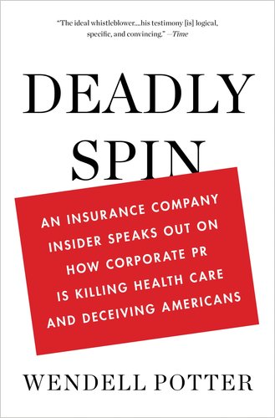
Spinning the Research Findings
On ACO Costs

Slide 123
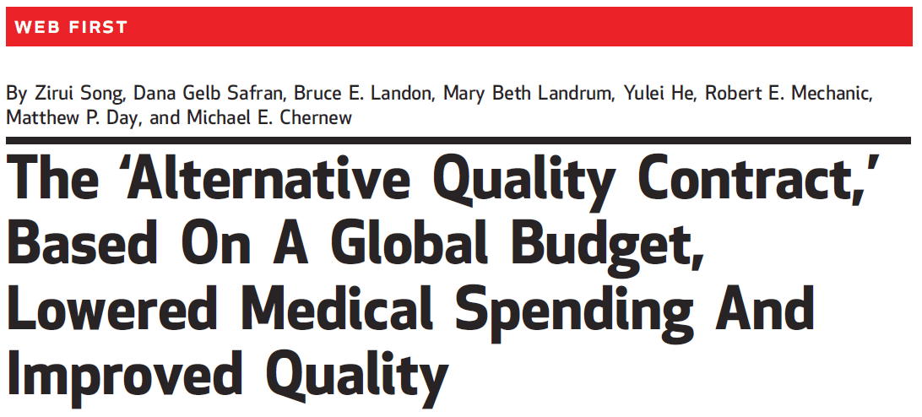
The Headline
On Massachusetts ACO Results
“Overall, participation in the contract over two years led to savings of 2.8% (1.9% in year 1 and 3.3% in year 2).
Source: Song et al. Health Affairs 2012;31:1885

Slide 124
But Buried in the Text
“Our findings do not imply that overall spending fell. . . . [because] ten of the eleven organizations [earned] a budget surplus payment. . . .
“All organizations earned a 2010 quality bonus, and most received infrastructure support.
“This result makes it likely that total Blue Cross Blue Shield payments to groups in 2010 exceeded medical savings.”
Source: Song et al. Health Affairs 2012;31:1885

Slide 125
Medicare’s PGP/ACO Demo. Project:
Gaming, But No Savings
“The model for the ACO program… has been tested in the PGP Demonstration Project…
“Diagnosis coding changes the PGP sites initiated… produced apparent savings that resulted in shared savings payments to some of the demonstration sites, but not actually fewer dollars spent”
Berenson RA. Am J. Managed Care, 2010; 16:721-726.

Slide 126
JAMA Analysis of ACO Demonstration
Omitted the Bonuses Paid to ACOs
Average annual increase in Medicare payment/beneficiary
$1,296
$1,230
$1,206
$1,230
FFS Payments
Bonuses
*LVCs=incident stroke, MI, hip fracture, colon cancer
Source: Colla et al. JAMA 2012;308:1015

Slide 127
ACOs = Medical Practices owned by
Corporate Oligopolies

Slide 128
Insurers Morphing into ACOs:
Purchases of Clinics and Practices, 2011
UnitedHealth bought Monarch Healthcare – a Pioneer Medicare ACO with 2,300 physicians
Wellpoint paid $800 million for CareMore – a chain of 28 clinics with employed physicians
Humana purchased SeniorBridge – an in-home care manager with 1500 providers - and Concentra for $790 million – an urgent care and occupational health clinic firm
Source: Business Insurance, 1/15/12

Slide 129
For-Profit HMOs Increasingly Dominant
75%
50%
25%
0
% of HMO Enrollment as For-Profit
1980
1985 | 1990 | 1995 | 2000
2003
Source: Interstudy

Slide 130

Modern Healthcare. Vol 42/No 52. Dec. 24/31, 2012

Slide 131
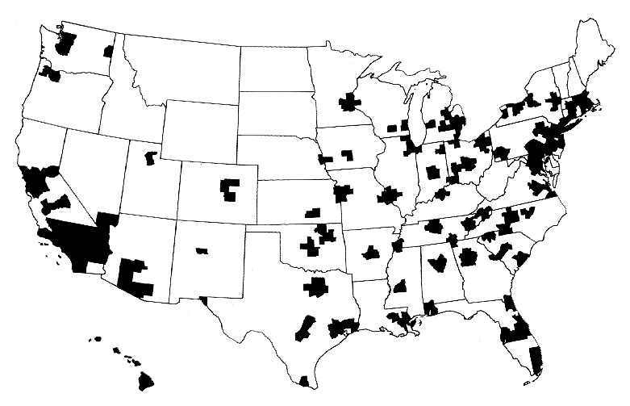
Half of Americans Live Where
Population Is Too Low for Competition
A town’s only hospital will not compete with itself
Highlighted areas are health markets with populations greater than 360,000
Source: Kronick R et al. N Engl J Med 1993;328:148-152.

Slide 132
More Doctors Are
Hospital Employees
Percent of newly hired physicians employed by hospitals
Source: Medscape July 9, 2012

Slide 133
Hospital Mergers Rising
105
93
Hospital mergers and acquisitions
76
60
60
50
54
50
46*
*2013 data through date of publication
Each deal may involve multiple hospitals
NY Times Aug 12 2013

Slide 134
Poll: Patients Reject ACOs
“Here are two different ways Medicare could pay doctors.
Which of these do you think would be better for you?”
NEJM 2013;369:1066. Kaiser/RWJ/Harvard Survey, 201

Slide 135
Medical Homes and Enhanced Primary Care
Do Not Require ACOs
Medical Homes” that integrate more nurses, social workers etc. into primary care and cut physicians’ panel size may improve care and reduce ED and inpatient utilization, possibly enough to offset the additional personnel costs.
This intervention does not require
recycling the HMO experiment.

Slide 136
The Toxicity of
Pay for Performance (P4P)

Slide 137
Assumptions Implicit in
“Pay for Performance” (“P4P”)
1. Performance can be accurately ascertained
2. Individual variation is caused by variation in motivation
3. Financial incentives will add to intrinsic motivation
4. Current payment system is too simple
5. Hospitals/MDs delivering poor quality care should get fewer resources

Slide 138
Quality Scores Tell More About Patients than Physicians
Harvard physicians with poorer/minority patients score low
Patient characteristics in panels of
high- and low-scoring physicians
Source: Hong C et al. JAMA 9/8/2010. 304:10;1107.

Slide 139
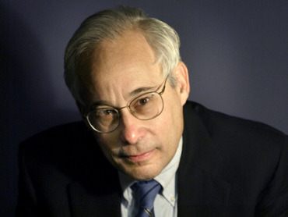
Don Berwick: P4P Can Dissociate
People From Their Work
“I do not think it’s true that the way to get better doctoring and better nursing is to put money on the table in front of doctors and nurses. I think that's a fundamental misunderstanding of human motivation.
Don Berwick, M.D. Health Affairs. 1/12/2005

Slide 140
Don Berwick: P4P Can Dissociate
People From Their Work
“I do not think it’s true that the way to get better doctoring and better nursing is to put money on the table in front of doctors and nurses. I think that's a fundamental misunderstanding of human motivation.
“I think people respond to joy and work and love and achievement and learning and appreciation and gratitude - and a sense of a job well done. I think that it feels good to be a doctor and better to be a better doctor.
“When we begin to attach dollar amounts to throughputs and to individual pay we are playing with fire. The first and most important effect of that may be to begin to dissociate people from their work.”
Don Berwick, M.D. Health Affairs. 1/12/2005

Slide 141
95% of Plans Cheat on
HEDIS Quality Measures
Medicare Advantage plans failing to cheat fall in rankings
Percent of elderly patients prescribed drugs that should be avoided
Annals of Internal Medicine 2013;159:456
Researchers compared reported HEDIS scores for high risk prescribing to actual Medicare Part D payment records for all enrollees and for enrollees sampled for HEDIS scoring

Slide 142
Medicare’s Premier Demonstration:
A P4P Failure at 252 Hospitals
Worse
5-year outcomes show no effect on mortality
Change from baseline in 30-day mortality
Better
Note: P4P failed even among poor performers at baseline
Source: NEJM March 28, 2012

Slide 143

Cochrane Review of
“Paying for Performance”
“We found no evidence
that financial incentives
can improve patient outcomes.”
July 6, 2011
Flodgren et al. “An overview of reviews evaluating the effectiveness of financial incentives in changing healthcare professional behaviors and patient outcomes.

Slide 144
ACOs and P4P
Implementation Without Evidence
P4P is official Medicare policy, widely adopted by private payers
    No RCTs showing improved outcomes.
    No improvement in largest demonstration project.
    Concern about negative side effects.
ACOs are the newest health policy panacea
    No RCTs
    No savings in largest demonstration project.
    Disturbing HMO experience.
Implementing everywhere interventions
– which have been proven nowhere –
risks failure on a colossal scale

Slide 145

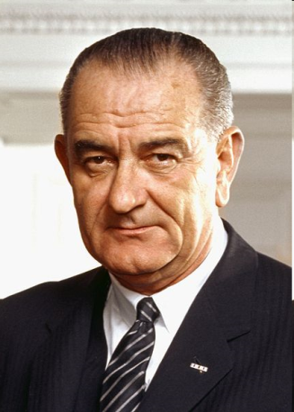
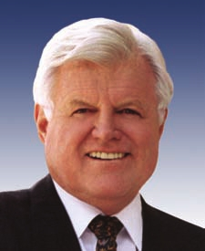
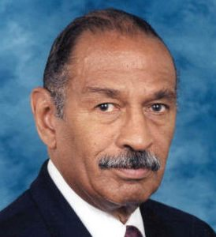
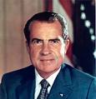

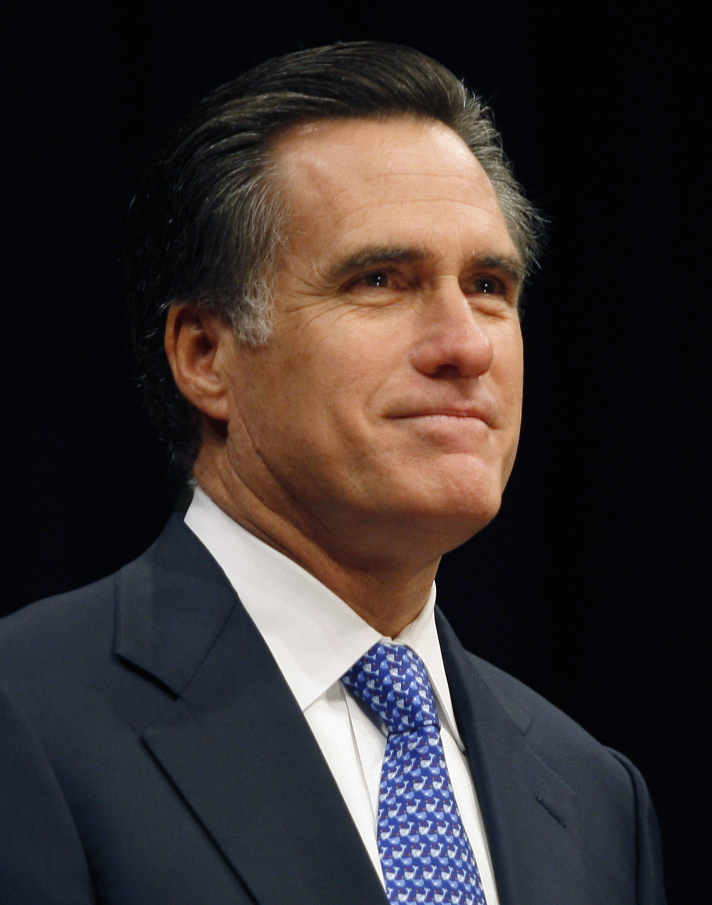

Progress(?) of US Health Reform
National Health Insurance
Medicare
Single Payer
HR 676
Employer mandate
Individual mandate
Individual mandate
Affordable Care Act
Notes:
145

Slide 146
Mandate Model Reform:
Keeping Private Insurers In Charge

Slide 147
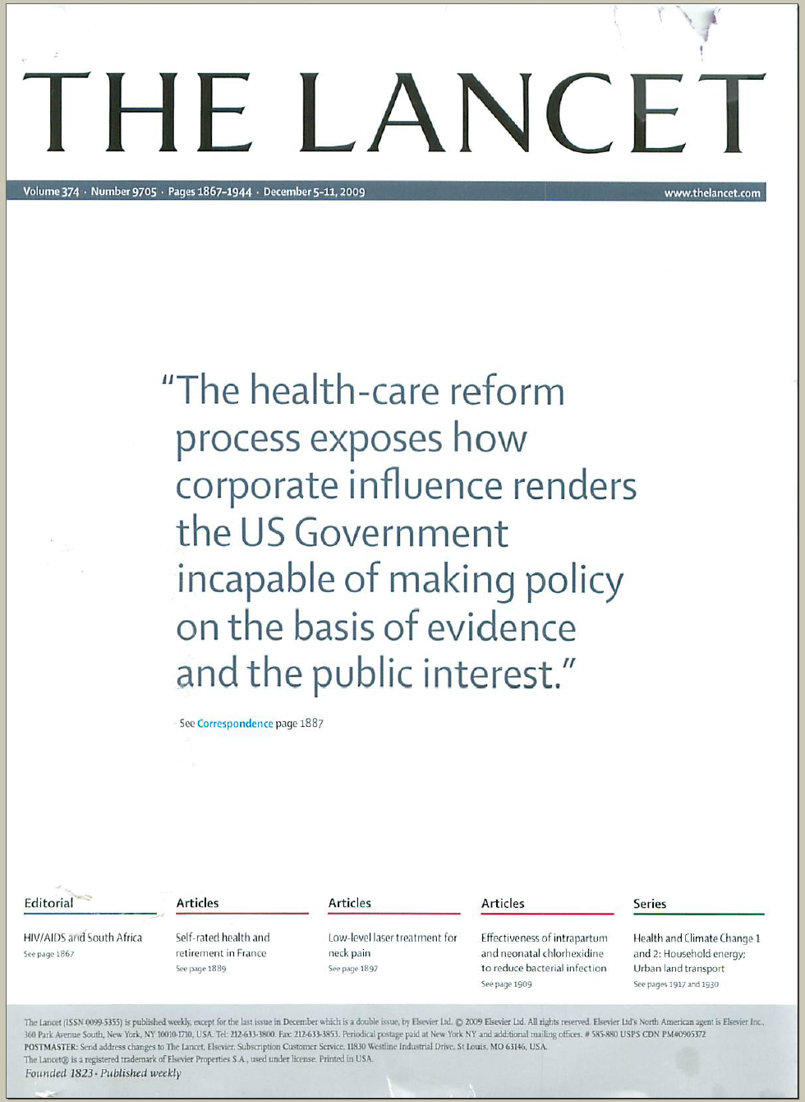
The Lancet Put It On Their Cover
“The health-care reform process exposes how corporate influence renders the US Government incapable of making policy on the basis of evidence and the public interest.”
Source: Lancet Dec 5, 2009. Cover of vol. 374.

Slide 148
Mandate Model of Reform
Expanded Medicaid-like program
  Free for poor
  Subsidies for low income
  Buy-in without subsidy for others
Employer mandate +/- individuals
Managed Care / Care Management
Employer mandate
Individual mandate
Individual mandate
Affordable Care Act
Notes:
148

Slide 149
The Structure of the
Affordable Care Act (Partial)
Insurance Reforms
Delivery Reforms
More
People
Better
Coverage
Medicaid expansion
Exchanges
Guaranteed Issue
Kids <26
Cost: MLR, Rate Review
Prescription Drugs
Prevention Benefits
Medicare Advantage
Integrated Care
ACOs, Bundles…
Dual Eligibles
Care Transitions
Quality Focus
Value-Based Payment
Transparency, Data Sharing
Fraud & Abuse
Innovation
CMMI
Prevention
Funds
Pricing Reforms
FQHCs

Slide 150
Uninsured in Massachusetts
40%
30%
20%
10%
Percent Uninsured
Medicaid Expansion
Dukakis Bill
Reform
1987
1990 | 1995 | 2000 | 2005
2012
Source: Census Bureau
Figures prior to 1999 adjusted for changes in CPS survey methods

Slide 151
Adults Who Needed Care but
Cost Was an Obstacle
Percent of MA residents aged 18-64
Insured and uninsured adult residents who needed care
but for whom cost was an obstacle.
Massachusetts Division of Healthcare Finance and Policy, 2011

Slide 152
Massachusetts Health Reform:
Little Impact on Medical Bankruptcy
Source: Himmelstein, Thorne, Woolhandler.
Am J Med 2011;124:224

Slide 153
Massachusetts’ Reform:
More Bureaucrats, No More Caregivers
Change in health employment, 2005/06 to 2008/09
Source: Staiger DO et al. NEJM 2011:e24(1)

Slide 154
Health Costs Have Risen Faster in Massachusetts Since 2006 Reform
$20,000
$15,000
$10,000
$5,000
Average Premium for Employer-Based Family Coverage
Massachusetts
Reform
United States
1996 | 1998 | 2000 | 2002 | 2004 | 2006 | 2008 | 2010
Mechanic R E et al. Health Aff 2012;31:2334-2342
Notes:
Average Annual Employer-Based Family Health Insurance Premiums, Massachusetts And The United States, 1996–2011

Slide 155
Premiums Rising, Benefits Falling
In Massachusetts
Change in MA average private insurance premiums and benefits since 2009
MA Ctr for Health Info and Analysis, August 2013

Slide 156
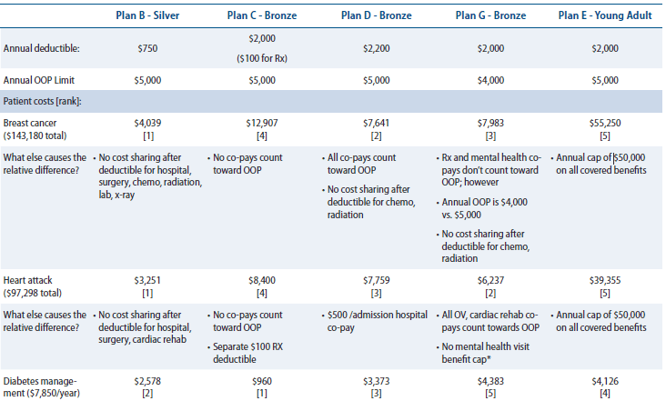
Massachusetts Plans Leave Many With High Out-of-Pocket Costs
Source: Center for American Progress

Slide 157
Massachusetts Plans Leave Many With High Out-of-Pocket Costs
Source: Center for American Progress
 | Plan C – Bronze | Plan G - Bronze
Breast Cancer | $12,907 | $7,983
Diabetes Management | $960 | $4,383

Slide 158
Federal Taxpayers Paid for MA’s Reform
Source: Boston Globe 6/26/2011:A9
(From Executive Office of Administration and Finance)

Slide 159
Number of Uninsured Americans
50
40
30
20
10
0
Millions of Uninsured American
1976
1985
1995
2005
2014
2021
With state opt-outs
As enacted
Himmelstein, Woolhandler, & Carrasquillo
Tabulations from CPS & NHIS data + CBO projections

Slide 160
Most Aren’t Directly Affected by ACA
Medicare
16%
Medicare
16%
Uninsured
10%
Medicaid
10%
Uninsured
18%
Medicaid
14%
Exchanges 7%
Current private
56%
Current private
53%
CBO Estimate, May 2013

Slide 161
Health Insurance Reform
Under the ACA
10 essential benefits, but no standard benefit package
Eliminates co-pays and deductibles, but only on preventive services
Limits insurers’ overhead to 15-20%, but lobbying has weakened enforcement
No regulation of premiums, deductibles and co-pays
Out-of-pocket caps, but uncovered services (and in some cases) drug costs don’t count

Slide 162
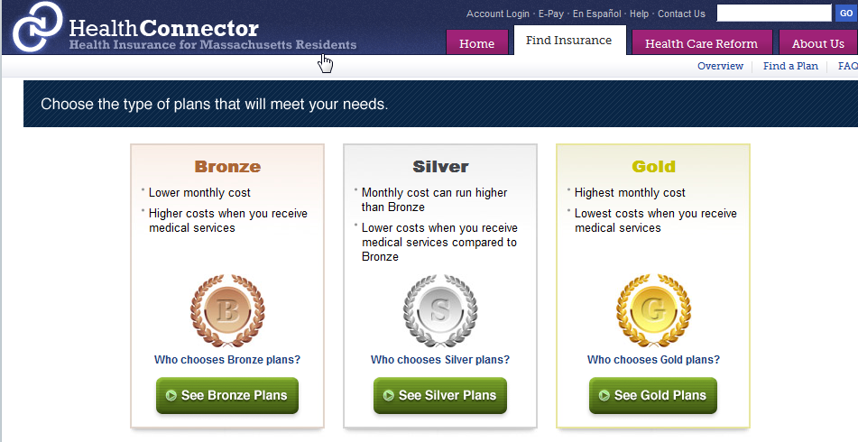
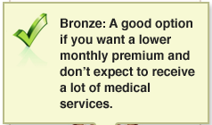
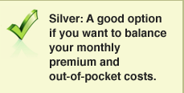

Underinsurance Becomes the Norm
(Average Employer Plan: 87% coverage)
60%
Actuarial value
70%
Actuarial value
80%
Actuarial value

Slide 163
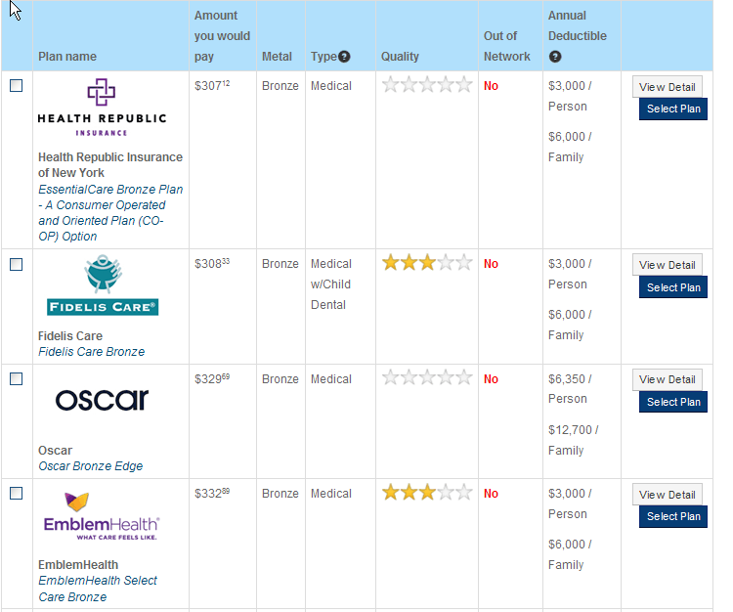
Cheapest Coverage Options
50 year old; New York City

Slide 164
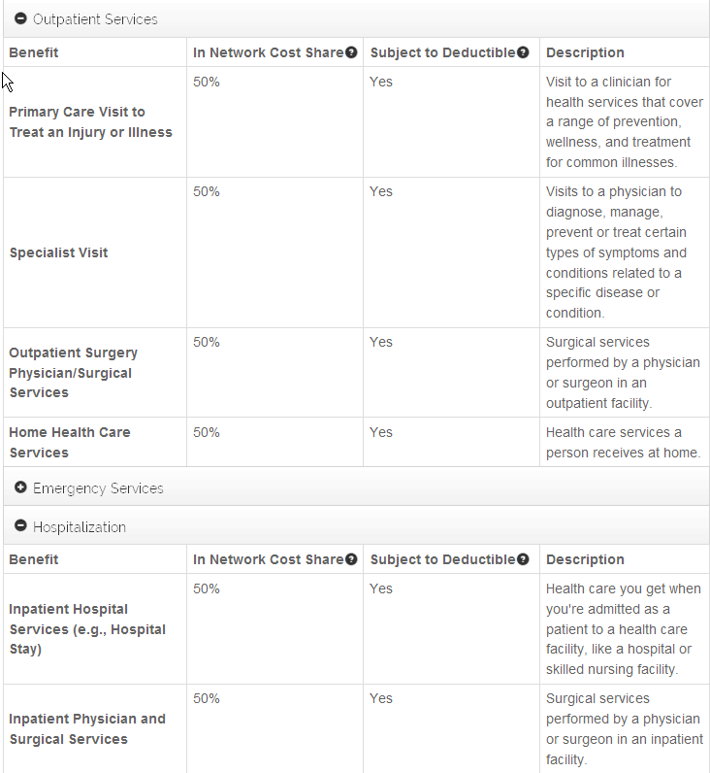

What’s Covered

Slide 165
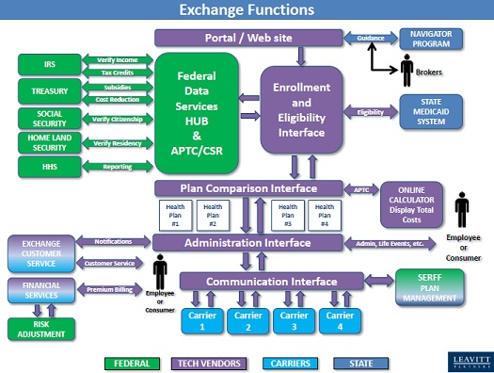

Slide 166
Vermont’s Exchange Costs
100,000 Exchange users expected
28,000 of pre-ACA’s 42,000 uninsured
72,000 pre-ACA insured
$170 million initial cost of Exchange
$1,700 per user
$6,071 per newly insured person
$92 million
Exchange cost 2015 – 2018
$218 million
Additional costs (over 5 years) for integrated eligibility system, staffing, operations, etc.
Source: Independent Review of Health Benefits Exchange (HBE)
And Integrated Eligibility (IE) Solutions, July 2013

Slide 167
ACA’s Unproven Cost Containment Tools
Health Information Technology (HIT)
Chronic Disease Management
Payment reforms (e.g., ACOs, bundled payments, value-based purchasing)

Slide 168
Public Money,
Private Control

Slide 169
US Public Spending per Capita for Health
Exceeds Total Spending in Other Nations
$8,950
2011 healthcare spending per capita
Data are for 2011
Sources: OECD 2013; Health Affairs 2002 21(4)88

Slide 170
The U.S. Trails Other Nations

Slide 171
Americans Work Longer Hours
2300
2100
1900
1700
1500
1300
Japan
Average hours worked per year
USA
Norway
UK
France
1970 | 1980 | 1990 | 2000 | 2010
NY Times 9/19/2013: Business Page 1.
Based on US Census and OECD data

Slide 172
Cost and Access Problems Among Sicker Adults
U.S. Access Is Worse
50%
40%
30%
20%
10%
0
Percent Reporting Problems (Among Sicker Adults)
UK | France | Canada | Austral. | N. Zeal. | USA
Hard to Pay Med Bills
Cost Was Access Problem
Source: Health Affairs 2011;30:2437

Slide 173
Life Expectancy
Years
Note: Data are for 2011 or most recent year available
Source: OECD, 2013

Slide 174
Potential Years of Life Lost
Per 100 People for All Causes
Years
Note: Data are for 2011 or most recent year available
Source: OECD, 2013

Slide 175
Infant Mortality
Deaths in First Year of Life Per 1,000 Live Births
Note: Data are for 2011 or most recent year available
Source: OECD, 2013

Slide 176
Maternal Mortality
Deaths per 100,000 Live Births
Note: Data are for 2011 or most recent year available
Source: OECD, 2013

Slide 177
High U.S. costs don’t result from
Bad Health Habits,
Aging, or
Overuse of Care

Slide 178
Smoking Prevalence
Percent of population over age 15 who smoke daily
Note: Data are for 2011 or most recent year available
Source: OECD, 2013

Slide 179
Percent Elderly
Percent of population over age 64
Note: Data are for 2012 or most recent year available
Source: OECD, 2013

Slide 180
Hospital Inpatient Days per Capita
Note: Data are for 2011 or most recent year available
Source: OECD, 2013

Slide 181
Physician Visits per Capita
Note: Data are for 2011 or most recent year available
Source: OECD, 2013

Slide 182
Nurses per 1,000 Population
Note: Data are for “professionally active nurses”
for 2011 or most recent year available.
Source: OECD, 2013

Slide 183
Hip Replacements per 100,000 Population
Note: Data are for 2011 or most recent year available
Source: OECD, 2013

Slide 184
Stem Cell Marrow Transplants
Transplants per million population
Note: Data are for 2012 or most recent year available
Source: OECD, 2013

Slide 185
US Renal Failure Patients Are
Less Likely to Get Transplants
Percent
of ESRD Patients with Functioning Transplant
Note: Data are for 2011 or most recent year available
Source: OECD, 2013

Slide 186
Use of Electronic Medical Records
USA is middle of the pack
100%
75%
50%
25%
Percent
of primary care doctors using EMR
SWI | CAN | FRA | USA | GER | AUSL | NZEA | UK
Commonwealth Fund Survey of Primary Care Physicians, 2012

Slide 187
Acute MI Outcomes
In-Hospital 30-Day Case-Fatality Rate
Deaths per 100 patients
Note: Short LOS may cause understatement of US in-hospital fatality rate
Source: OECD, 2012

Slide 188
Hemorrhagic Stroke Mortality
In-Hospital 30-Day Case-Fatality Rate
Deaths per 100 patients
Note: Short LOS may cause understatement of US in-hospital fatality rate
Data is age/sex standardized
Source: OECD, 2012

Slide 189
Out-of-Pocket Payments
Dollars per Capita
Note: Data are for 2011 or most recent year available
Figures adjusted for Purchasing Power Parity
Source: OECD, 2013

Slide 190
Clinical Medicine Journal Articles
1992-2002 per Thousand Population
Source: Lancet 2004;363:250

Slide 191
Insurance Overhead
Dollars per Capita
Note: Data are for 2011 or most recent available
Figures adjusted for Purchasing Power Parity
Source: OECD, 2013

Slide 192
US Doctors Face Biggest Rx Hassles
Percent of primary care doctors saying MD or staff time getting needed Rx approvals is a major problem
Commonwealth Fund Survey of Primary Care Physicians. November 2012
Note: Rx indicates prescribed drug or treatment

Slide 193
US Doctors’ Satisfaction Is Low
Percent of primary care doctors saying they are satisfied or very satisfied
Commonwealth Fund Survey of Primary Care Physicians. November 2012

Slide 194

Canada’s National Health Insurance Program

Slide 195
Minimum Standards for
Canada’s Provincial Programs
Universal coverage that does not impeded, either directly or indirectly, whether by charges or otherwise, reasonable access.
Portability of benefits from province to province
Coverage for all medically necessary services
Publicly administered, non-profit program

Slide 196
Canadian National Health Program Improved Access to Care
80%
70%
60%
50%
Percent of people with serious symptoms seeing a physician, before and after passage of NHP in Quebec
Before NHP
1 year after NHP
NEJM 1973;289:1174

Slide 197
% of People with an Unmet Health Need
Canadians and US Insured Are Similar
Source: Joint Canada/US Survey of Health, 2002-03.
CDC and Statistics Canada

Slide 198
Waiting Times for Doctor Appointments
Boston and Canada
Mean wait time in weeks for non-urgent visit
*US Ortho figure represents semi-urgent request for visit
Sources: Canadian Medical Association 2007 National Physician Survey.
Merritt Hawkins 2009 Survey

Slide 199
Mental Health Treatment, US & Canada
Severely Ill in Canada Get More Care
Percent receiving treatment
Source: Health Affairs May/June, 2003:128

Slide 200
Quality of Care Slightly Better
In Canada Than USA
Meta-analysis of patients treated for same illnesses.
(US studies included mostly insured patients.)
Source: Guyatt et al, Open Medicine, April 19, 2007

Slide 201
Infant Mortality
30
20
10
Deaths per 1,000 Live Births
First province implements NHP
USA
Canada
1955 | 1965 | 1975 | 1985 | 1995 | 2009
Sources: Statistics Canada, Canadian Institute for Health Information, National Center for Health Statistics

Slide 202
Canadians’ Life Expectancy
Growing Faster than Americans’
80
75
70
65
Life expectancy at birth
1950 | 1960 | 1970 | 1980 | 1990 | 2000 | 2005
Canada
USA
Sources: StatCan & NCHS

Slide 203
Health Costs as % of GDP
19%
17%
15%
13%
11%
9%
7%
5%
Canada’s NHP Enacted
USA
Health costs % of GDP
“Uniquely American”
NHP Fully Implemented
Canada
1960 | 1970 | 1980 | 1990 | 2000
2014
Source: Statistics Canada, Canadian Institute for Health Info, and NCHS/Commerce Dept.

Slide 204
US Medicare Coverage
Much Worse than Canada’s
Percent of seniors’ total medical expenses covered
Note: Not comparable to figures for employer coverage because of high LTC needs in elderly
Source: EBRI and Himmelstein/Woolhandler analysis of Health Canada data

Slide 205
Cost Control in a Parallel Universe
Growth in Medicare Spending Per Senior
Source: Himmelstein & Woolhandler
Arch Intern Med, December, 2012

Slide 206
How Has Canada Controlled Costs?
Lower administrative costs via single payer - 16.7% of total health spending vs. 31.0% in the U.S.
Lump-sum, global budgets for hospitals
Stringent controls on capital spending for new buildings and expensive new equipment
Single buyer purchasing reins in drug/device prices
Low litigation and malpractice costs
Emphasis on primary care
Exclusion of private insurers - private plans overcharged U.S. Medicare by $34 billion in 2012
Source: Himmelstein & Woolhandler
Arch Intern Med, December, 2012

Slide 207
Hospital Billing and Administration
Dollars per capita, 2014
Source: Woolhandler/Himmelstein/Campbell
NEJM 2003;349:769 (updated 2013)

Slide 208
Physicians’ Billing and Office Expenses
Dollars per capita, 2014
Source: Woolhandler/Himmelstein/Campbell
NEJM 2003;349:769 (updated 2013)

Slide 209
Overall Administrative Costs
Dollars per capita, 2014
Source: Woolhandler/Himmelstein/Campbell
NEJM 2003;349:769 (updated 2013)

Slide 210
Difference in Health Spending, 2014
Per capita data.
Sources: Woolhandler/Himmelstein/Campbell NEJM 2003;349:769 (updated 2013). NCHS and CIHI

Slide 211
Few Canadians Seek Care in the US
40% of US ambulatory facilities near border treated no Canadians last year; another 40% <1/month
Michigan + New York + Washington hospitals treated a total of 909 Canadians/year (only 17% of them elective).
Of “America’s Best Hospitals”, only one reported treating more than 60 Canadians/year.
In a survey of 18,000 Canadians, 90 had received any medical care in the US last year – only 20 had gone to the US seeking care.
Surveys of US ambulatory providers near the border,
hospital discharges, and Canadian citizens
Source: Health Affairs 2002;21(3):19

Slide 212
Few Canadian Physicians Emigrate
Net loss (number moving abroad – number returning)
A negative number indicates that more physicians returned from abroad then moved abroad
Source: Canadian Institute for Health Information

Slide 213
Canadian Physicians’ Incomes
2010 – 2011
Specialty | Income
Family Medicine | $265,881
Internal Med | $361,551
Pediatrics | $270,073
Psychiatry | $214,702
Dermatology | $398,410
Specialty | Income
OB-GYN | $449,121
General Surgery | $411,995
Thoracic Surgery | $529,728
Ophthalmology | $573,258
All Canadian physicians: $307,482
Source: Canadian Institute for Health Information

Slide 214
Trends in Canadian Physician Incomes
4.5
4
3.5
3
2.5
2
Mean physician income as multiple of all Canadian
full time employees
1950 | 1960 | 1970 | 1980 | 1990 | 2000 | 2010
Source: Grant and Hurley, U Calgary School of Public Pol. Research Papers. July 2013, Vol 6, Iss 22.

Slide 215
Canadian Malpractice Insurance Costs
2013 Data. Canadian Dollars
Specialty | Ontario* | Quebec | Other Provinces
FP/GP/Psych | $2,268 | $1,386 | $1,344
Cardiology | $4,080 | $3,217 | $1,608
Anesthesia | $7,812 | $6,199 | $4,296
Neurosurgery | $42,216 | $28,240 | $19,836
OB-GYN | $49,416 | $43,295 | $17,904
*Ontario reimburses physicians for premiums about 1986 level
Source: Canadian Medical Protective Association
www.cmpa-acpm.ca

Slide 216

Applicants per Medical School Place
Source: AAMC and
Association of Faculties of Medicine of Canada

Slide 217
What’s OK in Canada?
Compared to the USA…
Life expectancy 2 years longer
Infant deaths 25% lower
Universal comprehensive coverage
More physician visits, hospital care; less bureaucracy
Quality of care equivalent to insured Americans’
Free choice of doctor and hospital
Health spending half of USA level

Slide 218
What’s the Matter in Canada?
The wealthy lobby for private funding and tax cuts; they resent subsidizing care for others.
Result: government funding cuts (e.g., 30% of hospital beds closed during the 1990s) causing dissatisfaction and waits for care.
USA and Canadian firms seek profit opportunities in health care privatization
Conservative foes of public services own many Canadian newspapers
Misleading waiting list surveys by right wing Fraser Institute

Slide 219
Americans Want NHI
“Would you prefer the current health insurance system… or a universal coverage program like Medicare that is government run and financed by taxpayers?”
Source: ABC News Poll; USA Today; Kaiser Survey 9/06

Slide 220
The Rising Popularity
Of National Health Insurance
“Who should provide coverage?”
1979
2009
Government
40%
Private
Enterprise
48%
Government
59%
Private
Enterprise
32%
Don’t
Know
12%
Don’t
Know
9%
Source: CBS News / New York Times Poll, Feb. 1, 2009

Slide 221
Growing Physician Support for NHI
Strongly supportive
Generally supportive
Neutral
Against
Surveys of random samples of US physicians, 2002 & 2007
Source: CBS News / New York Times Poll, Feb. 1, 2009

Slide 222
Massachusetts Doctors
Support Single Payer
Source: Massachusetts Medical Society Survey. Oct. 2012

Slide 223
More Health Economists
Favor Single Payer
50%
40%
30%
20%
10%
0
Percent agreeing the US should adopt…
Canada-Style Reform | Employer Mandate | Refundable Tax Credit
Source: J Hlth Policy Politics & Law 2008;33:707

Slide 224
Many Who Oppose ObamaCare
Prefer Single Payer
Source: NY Times based on CNN/ORC Poll May 17-18 2013
Figures don’t add to 100% because some had “no opinion”

Slide 225

A National Health Program for the
USA

Slide 226
National Health Insurance
Universal – covers everyone
Comprehensive – all needed care, no co-pays
Single, public payer – simplified reimbursement
No investor-owned HMOs, hospitals, etc.
Improved health planning
Public accountability for quality and cost, but minimal bureaucracy
Proposal of the Physicians Working Group for Single Payer NHI
JAMA 2003;290:798

Slide 227
Funding for the NHP
Revenue Sources
NHP
Fund
Recipients of Money
Medicare and Medicaid
Hospital Operating Costs
Hospital Capital Costs
State /Local Governments
HMOs
Employers
Fee-for-Service Physicians
Private Insurance Revenues
Home Care Agencies
New Taxes
Long-Term Care
Source: NEJM 1989;320:102

Slide 228
Hospital Payment Under an NHP
Hospitals remain privately owned.
Capital purchases/expansion budgeted separately based on health planning goals.
Negotiated global budget for operating costs. Operating funds cannot be diverted to capital.
Himmelstein and Woolhandler. NEJM 1989;320:102

Slide 229
Three Options for Physician and Ambulatory Care Payment Under the NHP
Fee for
Service
Mandatory assignment
Simplified negotiated fee schedule
Capitation for Institutions
With Salaried Docs
Free disenrollment
Capitation for operating costs, not capital purchases, profits or doc incentives
No selective enrollment period
Inpatient care under hospital’s global budgets
Globally Budgeted Institutions
Hospitals
Clinics
Home care agencies
Institutions with salaried physicians
Source: Himmelstein and Woolhandler.
NEJM 1989;320:102

Slide 230
America Can Do This.
Excellent hospitals, empty beds
Enough well-trained professionals
Superb
research
Current spending
is sufficient
We already have what it takes

