Slide 1
U.S. Nursing Homes and Single Payer
PNHP Annual Meeting November 2, 2013 Boston, MA
Christopher Cherney
Nursing Home Administrator
Berkeley, California
ccherney@earthlink.net

Slide 2
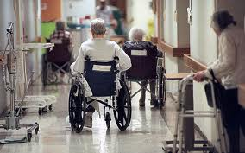
U.S. Nursing Homes
15,500 skilled nursing facilities (SNFs)
Compare: 13,000 McDonald’s restaurants
1.4 million “residents” in 1.6 million available beds
88% occupancy
3.2 million admissions per year
Source: CMS, 2009

Slide 3
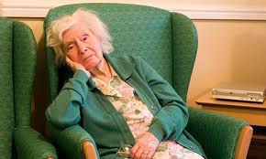
U.S. Nursing Homes
Resident characteristics
Average age, 79 years
71% of residents are female
60% cannot perform at least three activities of daily living
40% have a cognitive impairment
Source: CMS, 2009

Slide 4
U.S. Nursing Home Revenues
$144 billion in gross revenue
About 6% of total U.S. health care expenditures
About 15 times greater than Hollywood gross revenue
67% of U.S. nursing homes are for-profit
27% non-profit
OK, TX, CA
85% of SNFs are for-profit
Source: CMS, 2009

Slide 5
Nursing Home Revenue Sources
Public Sources $92 billion 64%
Medicare $30 billion 21%
Medicaid $62 billion 43%
Private Sources $52 billion 36%
Private insurance $10 billion 7%
Out-of-pocket* $42 billion 29%
*Includes Social Security income
Source: CMS. (2009). National Health Expenditures.

Slide 6
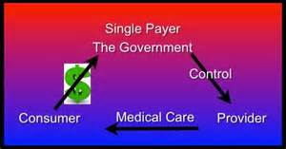
Nursing Homes: Almost Single Payer
About 70% of all dollars paid to U.S. nursing homes ALREADY comes from public sources.
For thousands of U.S. nursing homes, the government is the sole payer.

Slide 7
Ten Biggest U.S. Nursing Home Companies
City, Total Total Total Ownership
Company State Beds SNFs Revenue Type
HCR Manor Care Toledo, OH 28,092 277 n/a for-profit
Golden Living Plano, TX 31,143 305 n/a for-profit
Life Care Centers Cleveland, OH 29,272 221 n/a for-profit
Kindred Louisville, KY 27,905 226 $4.35B for-profit
Sun Healthcare Irvine, CA 22,243 200 $1.9B for-profit
SavaSeniorCare Atlanta, GA 21,279 186 n/a for-profit
Extendicare Milwaukee, WI 16,889 167 $1.3B for-profit
Evang. Lutheran Sioux Falls, SD 12,419 177 $915M non-profit
Skilled H Group Foothill Ranch, CA 10,456 74 n/a for-profit
TOTALS 199,698 1,833
Source: Provider magazine, June 2011.

Slide 8
Nursing Home Finance 101
Maximize Revenue
Minimize Expense
Every nursing home’s greatest expense is labor.
Labor expense ranges between 60-80% of every nursing home’s budget.

Slide 9
Managing SNF Expenses
Expense Estimates
Low-quality High-quality
For-profit Non-profit
Wages/Benefits 63% 80%
Administration 13% 9%
Management fee 9% 0%
Rent 7% 2%
Profit 4% 3%
Maintenance 3% 5%
Bad debt 1% 1%
Administrators of for-profit nursing homes quickly learn: pay rent and management fees first!!

Slide 10
SNFs Generate Profits on Multiple Fronts
Real estate
company
Rehab, pharmacy, and DME companies frequently are closely-held affiliates of the management company principals
Management
Company
Rent = 7-12% of monthly gross
Rehab company
Monthly fee ranges from 5-9%
Nursing Home
Pharmacy
company
RENT AND MANAGEMENT FEES EQUAL 10 to 20-plus PERCENT OF GROSS REVENUES
DME company
“PROFIT”

Slide 11
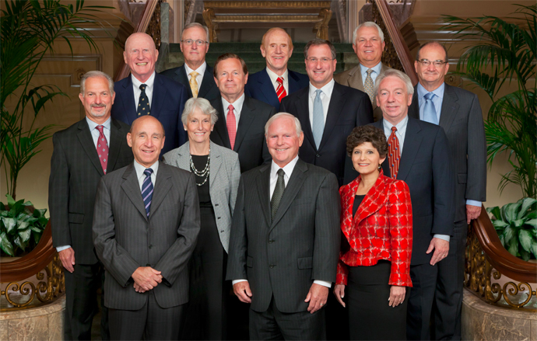
The R(eal)E(state)AL Money
Stock Market Nursing Homes
REIT Symbol Cap. in Portfolio
Health Care Property Investors HCP $19.4 B 333
Ventas, Inc. VTR $19.2 B 381
Health Care REIT, Inc. HCN $18.6 B 250
Omega Healthcare Investors, Inc. OHI $3.9 B 150
Sources:Market capitalization, Wikinvest, 2013; Nursing homes in portfolio: annual reports
Ventas Board of Directors includes
Jay Gellert, CEO, HealthNet
Robert Reed, CFO, Sutter Health
Ventas, Inc. Board of Directors

Slide 12
SNF Direct Care Staffing
Federal requirement: “sufficient staff”
No numeric minimum
Some estimate that 90% of SNFs fail to provide sufficient staff to meet resident needs
Some state staffing standards
TN 2.0 hours per patient per day (PPD)
PA 2.7 hours PPD
CA 3.2 hours PPD
DE 3.6 hours PPD
Expert-recommended standard
No less than 4.13 hours PPD

Slide 13
Nursing Home Staffing
70% of direct care provided by Certified Nursing Assistants (C.N.A.s)
C.N.A.s receive 75 hours of training (~2 weeks)
16 hours of which must be hands-on
$24,000 per year average wage
$11.54 per hour
One in three C.N.A.s receives public assistance
Registered Nurses provide about 25% of licensed nursing hours.

Slide 14
Maximizing SNF Profit
The easiest way to optimize SNF profit is to limit direct care staffing
Primarily by “not replacing” staff who call off sick.
An effective way to limit this widespread practice is to link SNF reimbursement to actual staffing levels, based on electronic payroll records
Section 6106 of the Affordable Care Act, entitled “Ensuring Staffing Accountability,” requires SNFs to “submit staffing information based on payroll data in a uniform format.”

Slide 15
The U.S. Nursing Home Paradigm
About $100 billion per year in public monies flows to mostly for-profit corporations, to care for elderly, mostly-impoverished, dependent adults, at substandard staffing levels, in facilities largely owned by profit-seeking real estate investors.

Slide 16
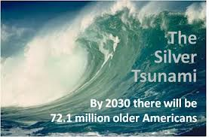
Lack of U.S. Geriatricians
In 2012, there were 7,356 board-certified U.S. geriatricians.
A high-quality long-term care system will require more physicians who specialize in geriatrics.

Slide 17
Nursing Homes and Single Payer
Key political issues
Emphasize that the current system, although privatized and profitized, is financed by an almost-single payer.
Eliminate profit-making, especially real estate profit-making.
Provide living wages and benefits for frontline staff, especially C.N.A.s.
Key operational issues
Enforce minimum staffing standards of 4.1 hours per resident per day, based on payroll records.
Ensure greater physical presence in nursing homes of Geriatricians and Registered Nurses.

Slide 18
Call to Action
Stay committed to PNHP at your local level.
Let us know if you are willing to serve on a PNHP Long-Term Care Program Workgroup.

Slide 19
Call to Action
Promote discussion among your peers about geriatrics.
Always mention long-term care in your discussions on single-payer national health care!

Slide 20
Additional Slides

Slide 21
The Need for Long-Term Care
Long-Term Care Services and Supports (LTCSS)
Defined as assistance with activities of daily living to people who cannot perform them on their own
12 million Americans rely on LTCSS (4% of population)
56% are age 65 or older
$211 billion spent on LTCS in 2011
More than half spent on nursing homes
Currently, 62% of LTCSS are paid by Medicaid
Source: U.S. Senate Commission on Long-Term Care Report to Congress, September 18, 2013

Slide 22
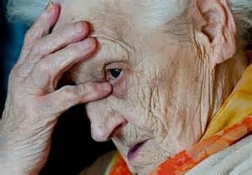
The Unaffordability of LTCSS
Only 1 in 3 older U.S. adults has non-housing financial assets equivalent to one year of SNF care ($70,000).
46% of elderly households have less than $10,000 in non-housing assets.
Source: U.S. Senate Commission on Long-Term Care Report to Congress, September 18, 2013

Slide 23
How to Finance LTCSS
Expand Medicare or create Part L (for consolidated Long-Term Care services)
Social insurance model
Mandatory participation
Public financing
Spreads risk broadly
Everyone is at risk for needing LTCSS

