Slide 1
From “war on poverty” to “war on poor”: social policy, health, and austerity
Jacob Bor & Adam Gaffney
PNHP Annual Meeting – Boston
November 2, 2013

Slide 2
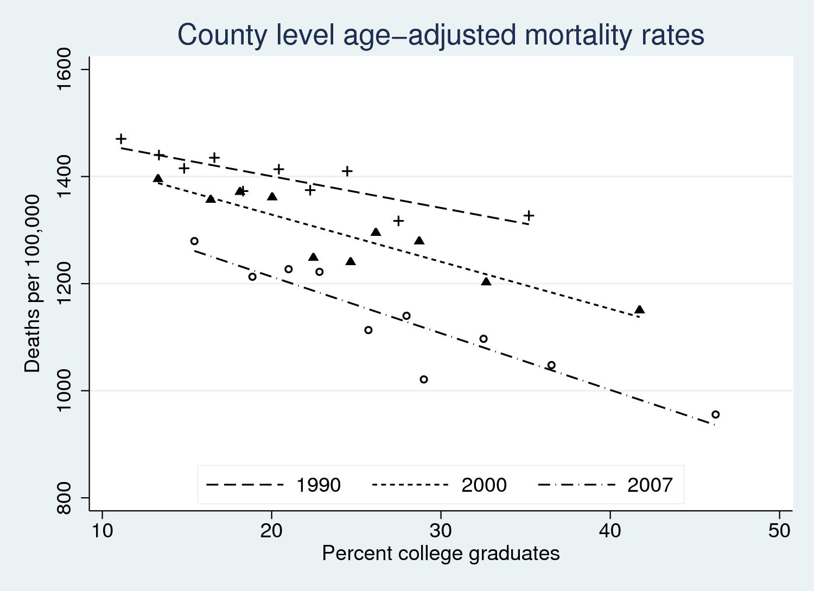
Rising socioeconomic disparities in health
RR = 0.90
RR = 0.75
Bor, Cutler, Glaeser 2013

Slide 3
But: not always the case!
From 1968-1980, mortality improvements were equally shared.
Bor, Cutler, Glaeser 2013; see also: Krieger et al 2009, Ezzati et al. 2009

Slide 4
But: not always the case!
From 1968-1980, mortality improvements were equally shared.
After 1980, divergence, with mortality stagnating in low-education counties.
Reason for divergence unknown.
Bor, Cutler, Glaeser 2013; see also: Krieger et al 2009, Ezzati et al. 2009

Slide 5
Socioeconomic disparities in health
Why do we care?
  Social injustice: resources should not matter for health
  Opportunity for intervention: resources do matter for health, at indiv. and societal level (fundamental cause)
  Policy environment is likely an important determinant of geographic disparities

Slide 6
Socioeconomic disparities in health
Why do we care?
  Social injustice: resources should not matter for health
  Opportunity for intervention: resources do matter for health, at indiv. and societal level (fundamental cause)
  Policy environment is likely an important determinant of geographic disparities
Public policy to reduce socioeconomic disparities in health
  Redistribute resources
  Solve market failures
  Not just health insurance: importance of non-health sector interventions
  Austerity / cut-backs to social programs, regulation, will have health consequences

Slide 7
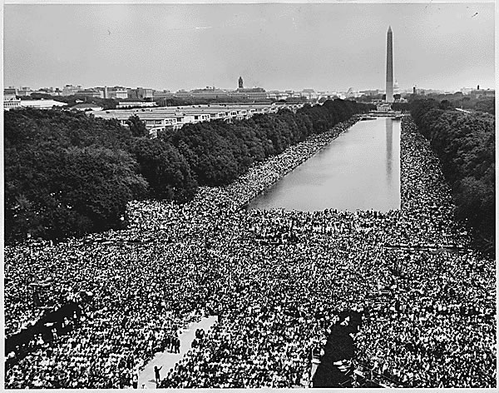
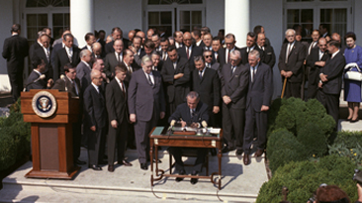
“War on Poverty” and related programs
Food Stamps (1964)
Head Start (1965)
Medicaid/Medicare (1965)
Community health centers
Housing assistance (1964)
Clean Air Act (1963, 1970)
School Breakfast Program (1966)
Federal education asst. (1965)
1963 March for Jobs and Freedom (“March on Washington”)
President Johnson signing 1964 Economic Opportunity Act

Slide 8
Evidence on “War on Poverty” and health
Food Stamps (1964)
  Improves food security (Nord & Prell 2011), a determinant of physical & cognitive development
  Improves pregnancy outcomes (Almond et al. 2011)
Head Start (1965)
  Significant reduction in child mortality (Ludwig & Miller 2007)
  Reductions in adolescent depression and obesity (Carneiro & Ginja 2008, Frisvold and Lumeng 2009)
Medicaid (1965)
  Large causal impact on self-reported health, mental health, financial security (Finkelstein et al. 2011, 2012)
  Improvements in birth outcomes (Currie & Gruber 1996)

Slide 9
Evidence on “War on Poverty” and health
Medicare (1965)
  Reduces mortality, activity limitations (Chay et al. 2010)
  Financial risk protection (Finkelstein & McKnight 2007)
Clean Air Act (1963, 1970, 1990)
  1,300 fewer infant deaths in 1972 (Chay & Greenstone, 2003)
  130,000 deaths averted per year (EPA 2011)
Community health centers (1965)
  Large reduction in mortality with introduction of CHCs (Bailey & Goodman-Bacon 2012)

Slide 10
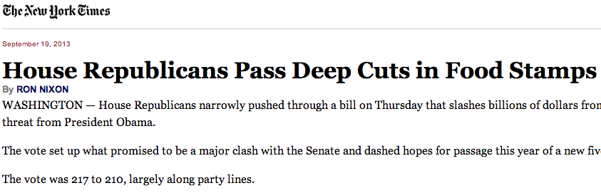
From “War on Poverty”…
… to “war on poor”: Food Stamps
ARRA’s 6% stimulus ends Nov 1.
In addition, Republican version of Farm Bill would
  cut $40B over 10 years.
Subject of upcoming budget negotiations.
New York Times, September 19, 2013

Slide 11
From “War on Poverty”…
… to “war on poor”: Head Start
“Slots for 51,000 preschoolers were eliminated along with child care slots for 6,000 babies. Children will lose 1.3 million days of service at Head Start centers and more than 18,000 employees will be laid off or see their pay reduced.” – USA Today, August 13, 2013

Slide 12
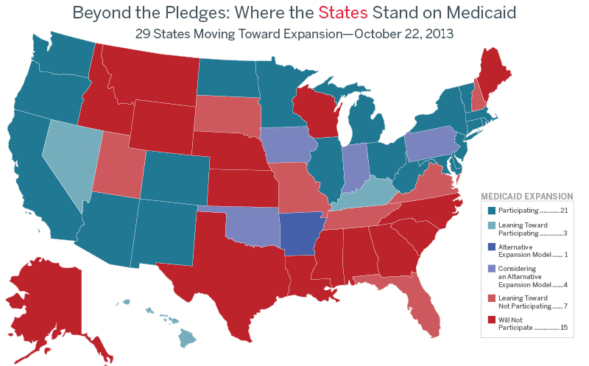
From “War on Poverty”…
… to “war on poor”: Medicaid
Excluded:
2/3 of poor blacks and single mothers without insurance;
over half of low-wage workers without insurance
http://www.advisory.com/

Slide 13
Unconditional cash transfers…
…an overlooked policy option?
To reduce socioeconomic disparities in health, reduce socioeconomic disparities.
Popular in developing countries
Easy to implement, non-paternalistic, efficient
Evidence on health impacts from developing countries:
  Child nutrition / development (Duflo 2003)
  Elder health (Case 2006)
  Improved mental health, lower cortisol, lower domestic violence (Haushofer & Shapiro 2013)

Slide 14
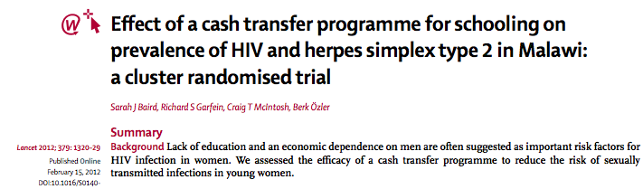
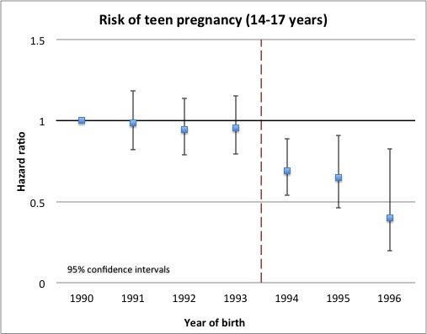
Cash transfers: sexual and reproductive health impacts
Bor (2013). Cash transfers and teen pregnancy in rural South Africa.
“HIV prevalence at 18 months was 1·2% in the intervention group versus 3·0% in the control group (adjusted odds ratio [OR] 0·36, 95% CI 0·14–0·91).”
-Baird et al. 2012, The Lancet
“30% lower hazard of pregnancy among girls eligible for cash grant.”

Slide 15
Conclusions
Large and growing socioeconomic disparities in health
Possible (and necessary) to address disparities through social, environmental, and other public policies that:
  Redistribute resources
  Solve market failures (regulate pollution, fund research, provide health insurance, etc.)
Austerity harms the government’s ability to do these things, and thus harms population health

Slide 16
Synergies with single payer movement?
Single payer → frees resources for social programs
  Bulk purchasing, lower administrative costs, and rationing
Health professionals → advocates for social policy as population health intervention
  Partner with natural constituencies for, e.g., housing, food stamps, early childhood education, living wage, etc.
Efforts to expand “health care” to include wrap around social services for patients
  Financial model is difficult
  What about people who never walk through clinic door?
Your stories, ideas…

