Slide 1
STATE-BASED REFORM: Policy dilemmas
Obstacles to Extrication

Slide 2
TYPES OF OBSTACLES
Familiarity
Political
Policy
The above categories never separate themselves into sharp, distinct categories

Slide 3
BREAKDOWN OF FINANCIAL SAVINGS WITH SINGLE PAYER REFORM
Reduce administrative spending – by providers, insurers, government & individuals
Economies of bulk purchasing
Aligning infrastructure with public health needs
Improving preventive care and population health
Single payer structure greatly facilitates provider payment reform

Slide 4
Funding a state-based single payer system: “The biggest tax increase in the history of Vermont”
Minimizing the magnitude of this “biggest tax increase”:
1 Efficiencies and savings built into single payer systems
2 Assuring the continued inflow of funds from existing funding sources

Slide 5
FUNDING STATE-BASED REFORM
Relative contributions of taxes targeted to business vs individual taxpayers
Type of business tax could lead to disagreements within the business sector
Specific issues of multistate companies—creative accounting, moving employees
All businesses can threaten to lay off employees, or even relocate to other states…. multi-state companies can threaten most persuasively
Relative contributions of various types of taxes: Sales/VAT, passive vs active income, payroll, other
Lessons from 30-hr/wk rule of PPACA

Slide 6
Funding a state-based single payer system: “The biggest tax increase in the history of Vermont”
Minimizing the magnitude of this “biggest tax increase”:
1 Efficiencies and savings built into single payer systems
2 Assuring the continued inflow of funds from existing funding sources
We can reconfigure in-state sources of funds (e.g. employee payroll deduction for private insurance policy can convert to payroll tax)
How to preserve out-of-state funding sources

Slide 7
Out of state sources of funds
FEDERAL GOVERNMENT
Medicare
Active military
Veterans
Federal employees
Fed contribution to Medicaid
Community health centers
Indian Health Service
PRIVATE SECTOR
Retiree coverage from out-of-state
Workers Comp carriers
Auto insurers
Out-of-staters seeking care in Vermont
Out-of-state employers who employ Vermonters
Multi-state companies who employ Vermonters

Slide 8
Creating a State insurance fund
States would create a State Insurance Fund (SIF) which will house funds and pay providers
Sources of Funds:
Revenue collected from taxes levied within the state
Funds collected from multi-state and out-of state businesses, federal government, retiree health funds, workers comp providers, etc
Expenditures: The SIF will pay practitioners and facilities for all care. Could use a variety of payment models: fee-for-service, capitation, “pay-for-quality”, global budgeting…

Slide 9
POLICY OBSTACLES: Medicaid
States will require a waiver to blend in Medicaid monies
States will need to prove that all mandated services are being provided to this population--Separate tracking of this population will need to occur
Eligibility determination at the individual level may need to be maintained

Slide 10
Medicare
A waiver for the entire Medicare population would ease administrative burden on providers and State Insurance Fund
Funding—Could capitate the entire population. Precedent exists with Medicare Advantage programs—State-based capitation is less complex than that which exists for Medicare Advantage
If state-based capitation is not done, then a la carte CPT coding would need to be done at level of practice, then they could bill
Alternatively, billing could be centralized and performed by the State Insurance Fund for the entire state. In turn, providers would be reimbursed by the SIF

Slide 11
Medicare supplemental policies
Some are funded by out-of-state sources
Should those funded by in-state sources be relieved of their promises to fund retiree coverage?
How to handle those who fare worse under state-based coverage

Slide 12
Medicare advantage and medicare Pharmacy benefit coverage
Both could/should be prohibited
Some individuals may fare worse under state-based coverage
Practice efficiency would be maximized with single pharmacy formulary for all populations, entire state

Slide 13
The military…
Active military and their families
Military retirees and veterans’ benefits
Many veterans may choose to shift their care from VA to state-based system—Savings to VA (= extra costs to the state)
If capitation is selected for either group, will be administratively complex, with care outside of the state, war injuries and their consequences all factors

Slide 14
OTHER FEDERAL EMPLOYEES…
Many are unionized
Anxiety over comprehensiveness and stability of state-based coverage and quality of coverage (copays, deductibles)

Slide 15
Care provided to out-of-staters
18% of Vermont hospital revenue derives from care provided to non-Vermonters. An important boon to Vermont’s economy
Billing for these patients could be centralized at State Insurance Fund
INCLUDES:
Episodic care to vacationers/visitors
Snowbirds who reside in other states majority of the year spend the summer in VT
Some individuals across Vermont’s borders receive their regular primary care and/or specialty care in Vermont

Slide 16
Care provided for “medical immigrants”
Medical Immigrants: Poorly insured individuals from other states who develop major, expensive illnesses may relocate to Vermont to take advantage of UHC
Incentives for under- and uninsured middle class individuals is far greater than for poor individuals: Protect assets, investments, credit rating, avoid bankruptcy
Solutions: Delay in coverage for 1 – 2 years
Preexisting condition clause
Initial one time supplemental fee to recent arrivals who enroll in GMC

Slide 17
Worker’s comp & auto insurance
Several insurers provide this coverage
Components include temporary and permanent disability payments, and payments for injury-related medical/surgical care. Dissecting out the relative cost of these components would be the first step toward removing the medical components from these insurance systems
These insurers may be reluctant to relinquish control of the medical component—heavily abused (?). So insurers turn to intense case management to control utilization
Billing could be done by State Insurance Fund

Slide 18
Vermonters who work in other states
Vermont’s State Insurance Fund may hold little leverage over out-of-state employers to make a contribution to our insurance fund, when the employer knows that the employee will have health insurance based on residence in Vermont. Vermont could appeal to these employers to make a contribution, but it would be voluntary
If the employers offer a financial incentive to refuse insurance, Vermonters would likely wish to take advantage of this incentive (can Vermont law prohibit this?)

Slide 19
Out-of-staters who work in vermont
Vermont employers must be taxed based on number of employees, and NOT the number of Vermont employees (or we would be creating an incentive to hire out-of-state workers)

Slide 20
POTENTIAL NON-PARTICIPANTS IN gmc
Workers Comp carriers
Auto insurers
Out-of-state and multi-state employers providing traditional insurance (who will not be paying taxes to the SIF)
Insurers covering federal employees
Medicare beneficiaries
Medigap/retiree plans
Medicare Advantage
Medicare D Drug Plans
Active military
Indian Health Service
Vacationers, tourists, and all other non-Vermont residents who receive medical services in Vermont

Slide 21
Three methods to collect payment from out-of-state insuring entities
Fees for services billed by providers
SIF collects coded billing reports from all providers and centralizes the billing function. Then SIF pays all practitioners and health care facilities for the care they provide
Insuring entity and Vermont SIF negotiate a capitated payment for the entire population that insurer covers

Slide 22
The provider based fee-for-service model
Familiar, no policy/procedural change is needed
Provider has incentive to maximize coding/ensure its accuracy
Heavy administrative burden on practices
Makes payment reform far more administratively complex, problematic
Eliminates possibility of single pharmacy formulary for the entire state

Slide 23
If the state insurance fund did the billing…
Less incentive for practice- and hospital-based billing to perform accurately, maximize billing
Eases administrative burden on practices, but overall administrative effort is not changed, part of it has simply been relocated to the State Insurance Fund
Creates possibility of a single pharmacy formulary for the entire state (could lead to savings from bulk purchasing, and would be far simpler for prescribers)
Greatly facilitates provider payment reform

Slide 24
Capitated payments from non-participating insurers to State insurance fund
Could ease overall administrative burden
Negotiation simplest for defined, stable, larger populations (IBM employees, Vermont’s Medicare population).
A la carte negotiation isn’t practical for the myriad of insurers involved, many of whom might be insuring one or just a few individuals in the entire state

Slide 25
BREAKDOWN OF FINANCIAL SAVINGS WITH SINGLE PAYER REFORM
Reduce administrative spending – by providers, insurers, government & individuals
Economies of bulk purchasing
Aligning infrastructure with public health needs
Improving preventive care and population health
Single payer structure greatly facilitates provider payment reform

Slide 26
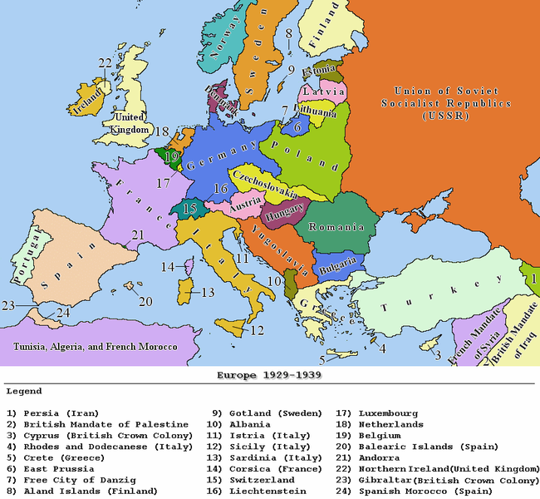

Slide 27
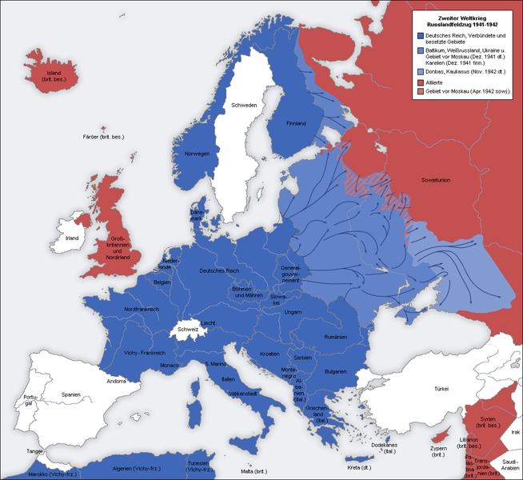

Slide 28
Which is easier: successfully implementing state-based single payer reform or defeating fascism?

