Slide 1
International Health Systems: Models for the U.S.
Canadian Health Care System
in 3 minutes flat!
Karen Palmer
PNHP Board Advisor
Simon Fraser University, Adjunct Professor

Slide 2
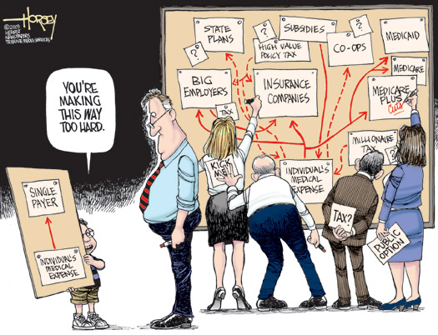

Slide 3
How to describe Canada’s health care system in one sentence?
Interlocking set of 10 provincial and 3 territorial health insurance plans
Publicly administered
Publicly funded
Privately delivered
Universal
Accessible
Comprehensive coverage
Portable wherever you go
Choice of provider

Slide 4
What services are covered?
All medically necessary hospital and physician services

Slide 5
Who decides what’s medically necessary?
Medical experts, including physicians, not insurance companies

Slide 6
Can you choose your own doctor?
Yes
You choose FP and they refer to appropriate specialists (that you can choose)

Slide 7
Where do doctors work?
Most in “private” practice just like in the US
Some in other practice settings, such as clinics, community health centres, and group practices

Slide 8
How are doctors paid?
Private practice = FFS
Group practice = alternative payment schemes (salary, blended payment)
Fee schedules negotiated between each provincial/territorial government and medical associations
Notes:
Doctors in private practice are generally paid through fee-for-service schedules negotiated between each provincial and territorial government and the medical associations in their respective jurisdictions. Doctors in group practices are more likely paid through alternative payment schemes, such as salaries or a blended payment (e.g., fee-for-services plus incentives).

Slide 9
How are hospitals paid?
Mostly through global budgets, though some are experimenting with activity-based funding (ABF), the Canadian version of PPS/DRGs

Slide 10
Aren’t there waits in Canada?
Sometimes
Some waits, in some provinces, for some physicians, for some elective procedures
Canada, waiting based on medical need
US, waiting based on ability to pay

Slide 11
Do Canadian’s like Medicare?
almost universally loved
2012 online survey, 2,207 respondents
94% say important source of collective pride
74% say “very important.”
Source: http://www.thestar.com/news/canada/2012/11/25/poll_finds_canadians_lagging_in_support_for_monarchy_proud_of_medicare.html

Slide 12
Are there threats to Medicare in Canada?
Yes
Constitutional challenge from Cambie Surgical Centre and Dr. Brian Day (former head of CMA)
Neo-liberal agenda
Conservative PM – keep federal health care funding at current level until 2017. Then, instead of 6% increase in funding/year, health transfer to provinces and territories tied to economic growth, with 3% minimum.

Slide 13
Canadian Doctors for Medicare

