Slide 1
From Medicaid Expansion to Single Payer:
Organizing in the
Red States
Ed Weisbart, MD
Sam Dickman
Rob Stone, MD

Slide 2
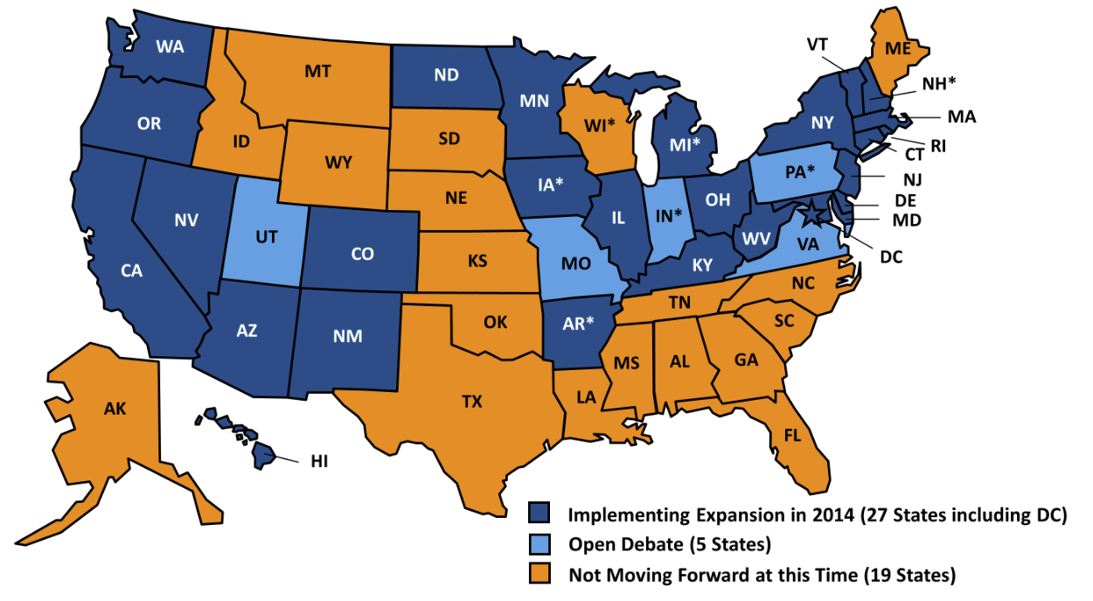
24 States Have
Not Expanded Medicaid
http://kaiserfamilyfoundation.files.wordpress.com/2014/04/8505-figure-1.png
Accessed Nov 4, 2014

Slide 3

The ACA Expands Medicaid
MO House Interim Task Force on Medicaid Expansion
Independence, Springfield, Columbia, Kennett, Cameron, St. Louis
“The parade of parasites.”
– MO state rep

Slide 4
Avoid the Common Traps
Avoid false equivalents
Single payer is not “Medicaid for All”.
Medicaid expansion is not the hidden road to single payer.
Know
the data
Medicaid improves health. Period.
Most states come out ahead economically.
Respect your opposition
Every side thinks they hold the moral high ground.
Dignity begets dignity.
“Oregon showed Medicaid doesn’t save lives”
Misleading but true
  Prospective randomized controlled trial of expanding Medicaid
  No change in mortality, average HgbA1c, blood pressure, etc.
The rest of the story
  6,000 in each arm x 17 months
  95% were non-diabetic
  Big drops in uncontrolled DM, HTN, lipids, depression, costs…
Luebberring, L. Director, MO Budget Office
Medicaid Impact on Budget. Jan 31, 2014

Slide 5
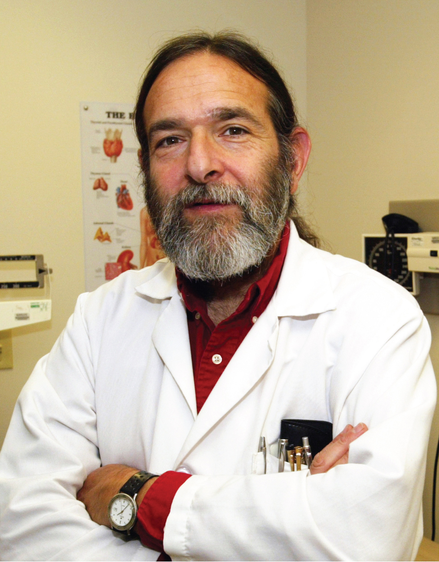
Two Segues to Single Payer
Strategy #1: Quote David Himmelstsein
“Medicaid is far from perfect.
In many parts of the country, Medicaid pays so little that patients have trouble finding a doctor who will accept it.
A single-payer program like Canada’s that covers all Americans is a far better solution for both the poor and the middle class.
But until we get to single payer, Medicaid is the only safety net for many low-income Americans.”
Dr. David Himmelstein
Co-founder of Physicians for a National Health Program

Slide 6
Two Segues to Single Payer
Strategy #2: “Everybody in, nobody out”
The “Kid Glitch”:
The ACA was designed for adults.
CHIP is in
jeopardy
Funding ends Sept. 1 2015
Non-Medicaid kids could migrate to the “marketplace”
Marketplace has higher cost-share
“Affordable” definition for subsidies based on individual, not family, rates.
Higher copays and deductibles
Inadequate benefits
Limited habilitative/physical therapies
No routine dental
Other limitations
Correction requires an act of Congress
Illustrates the problem of fragmented solutions

Slide 7
Opting out of Medicaid Expansion:
Health and Financial Impacts
Sam Dickman
Harvard Medical School and Cambridge Health Alliance
PNHP Annual Meeting
November 15, 2014
Notes:
I’m Sam Dickman – I’m a medical student at Harvard, and this project is about the effects of states opting out of Medicaid expansion

Slide 8
Why should medical students care about
Medicaid expansion?
Notes:
Ask students in the room.
Possible responses:
Students working in academic centers see a high proportion of un- and under-insured
A way to engage with local politics in a city/state that may not be where they grew up
General sense of social justice, which seems strongest when students are applying to and just entering med school
Overall, med students should care because everybody should care

Slide 9
How Many People
Would Benefit in Opt-Out States?
Dickman et al, Health Affairs Blog, 2014
Notes:
Walk through results, briefly

Slide 10
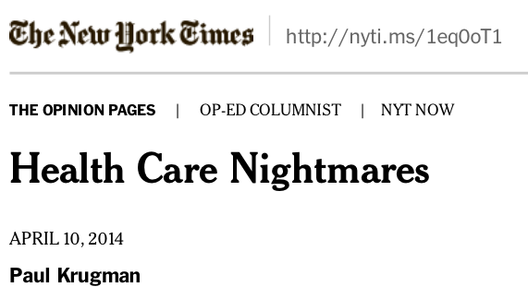

“…it’s already quite easy to find examples of people who died because their states refused to expand Medicaid.
According to one recent study, the death toll from Medicaid rejection is likely to run between 7,000 and 17,000 Americans each year.”
Notes:
Pro-Obama(care) response

Slide 11
How Many People
Would Benefit in Louisiana?
Dickman et al, Health Affairs Blog, 2014
Notes:
Walk through results, briefly

Slide 12
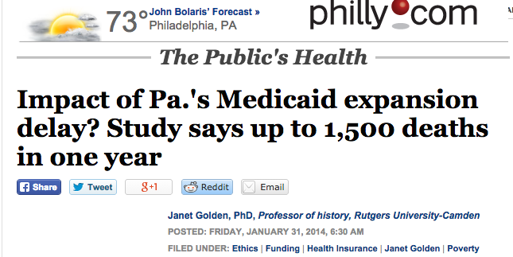
Notes:
State-level news response – highlight importance of state-level analysis

Slide 13
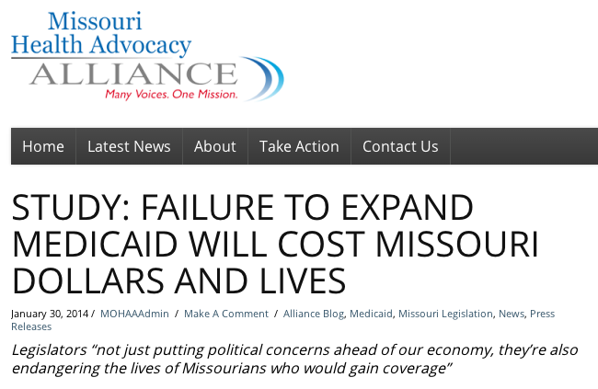
Notes:
Activist response

Slide 14


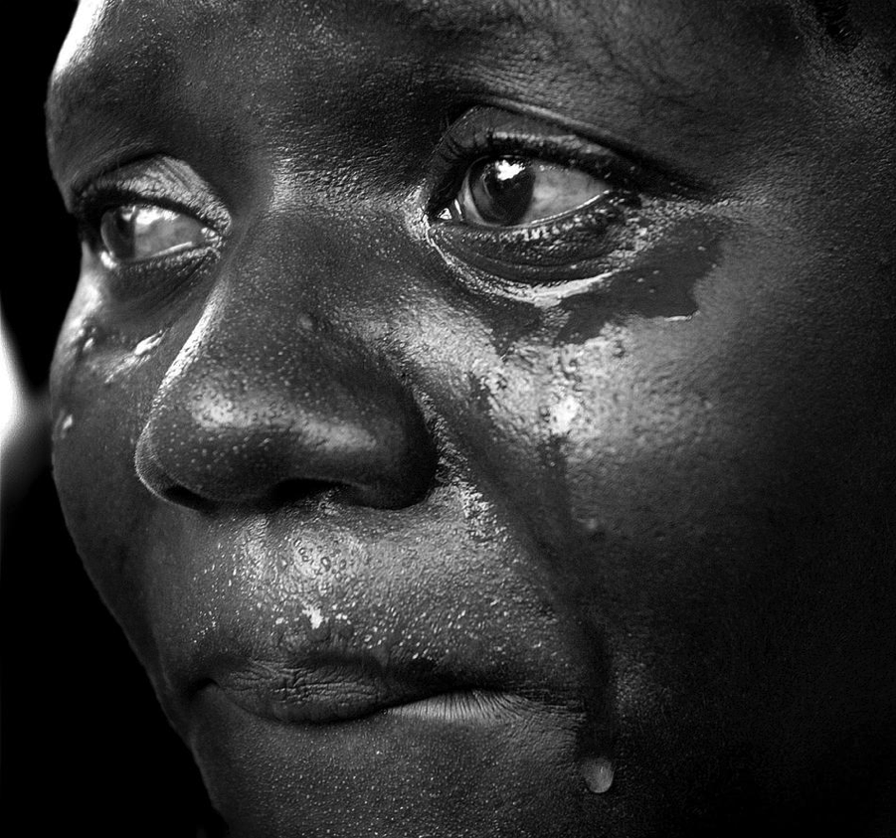
Lessons for Future Research
Local/state-level data are important for organizing.
One death is more compelling than a thousand missed pap smears.
Notes:
State-level political response

Slide 15

Indiana Case Study:
Hoosiers Fight for Medicaid Expansion
Rob Stone, MD

Slide 16
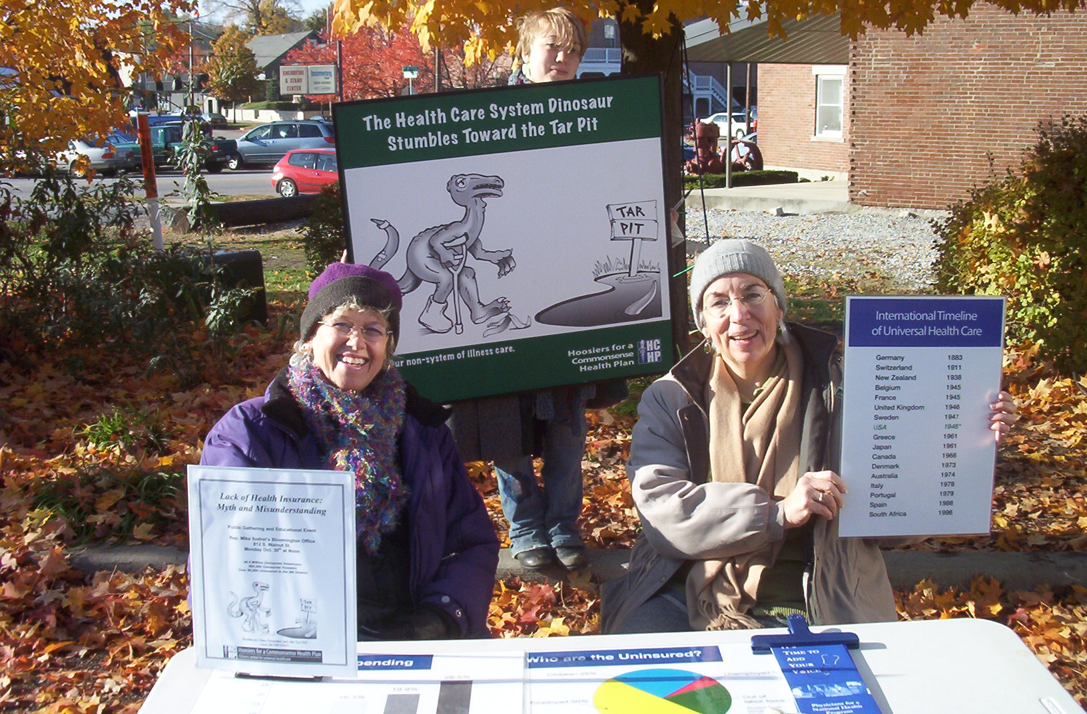

Slide 17
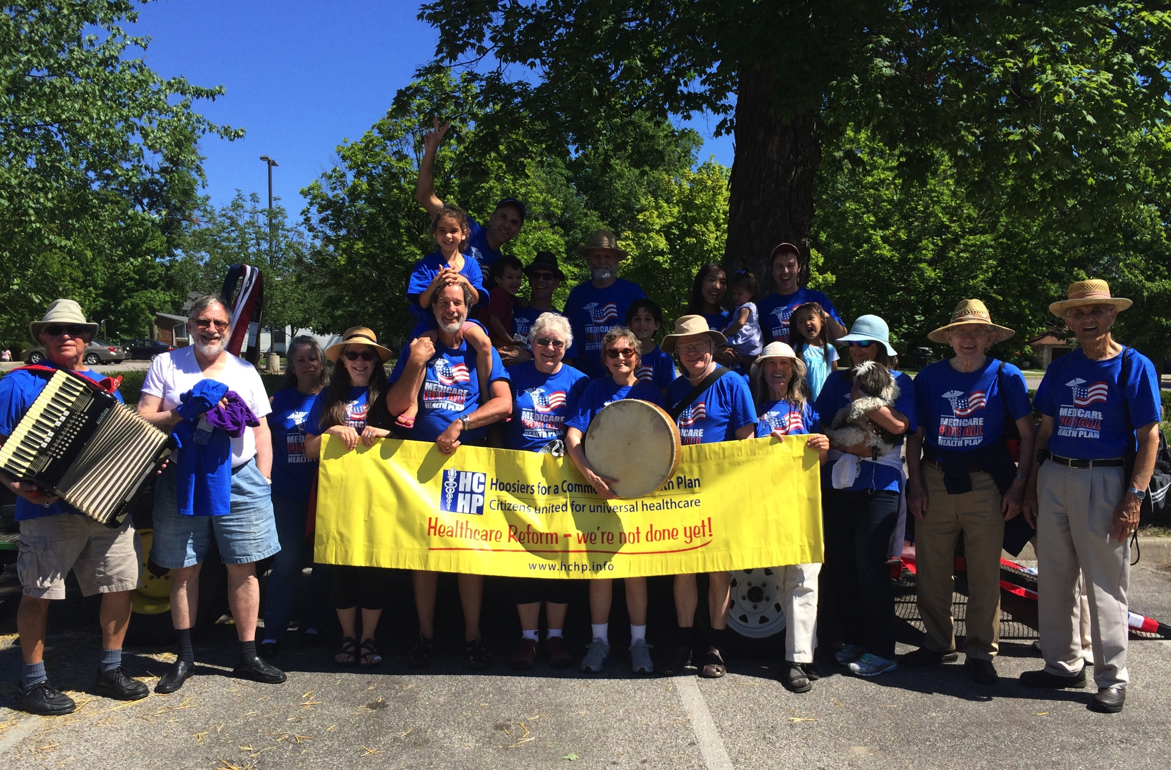

Slide 18


Slide 19
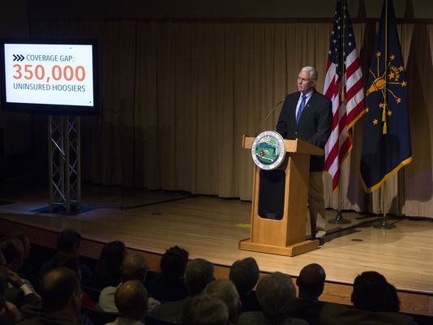
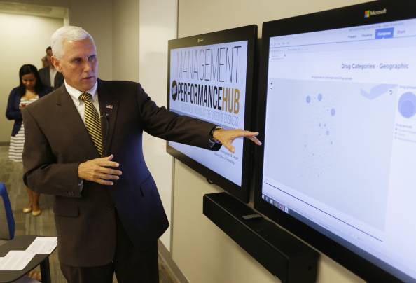
“Indiana is reforming,
not expanding, Medicaid.”
“Does Pence want out of Medicaid expansion?”

Slide 20

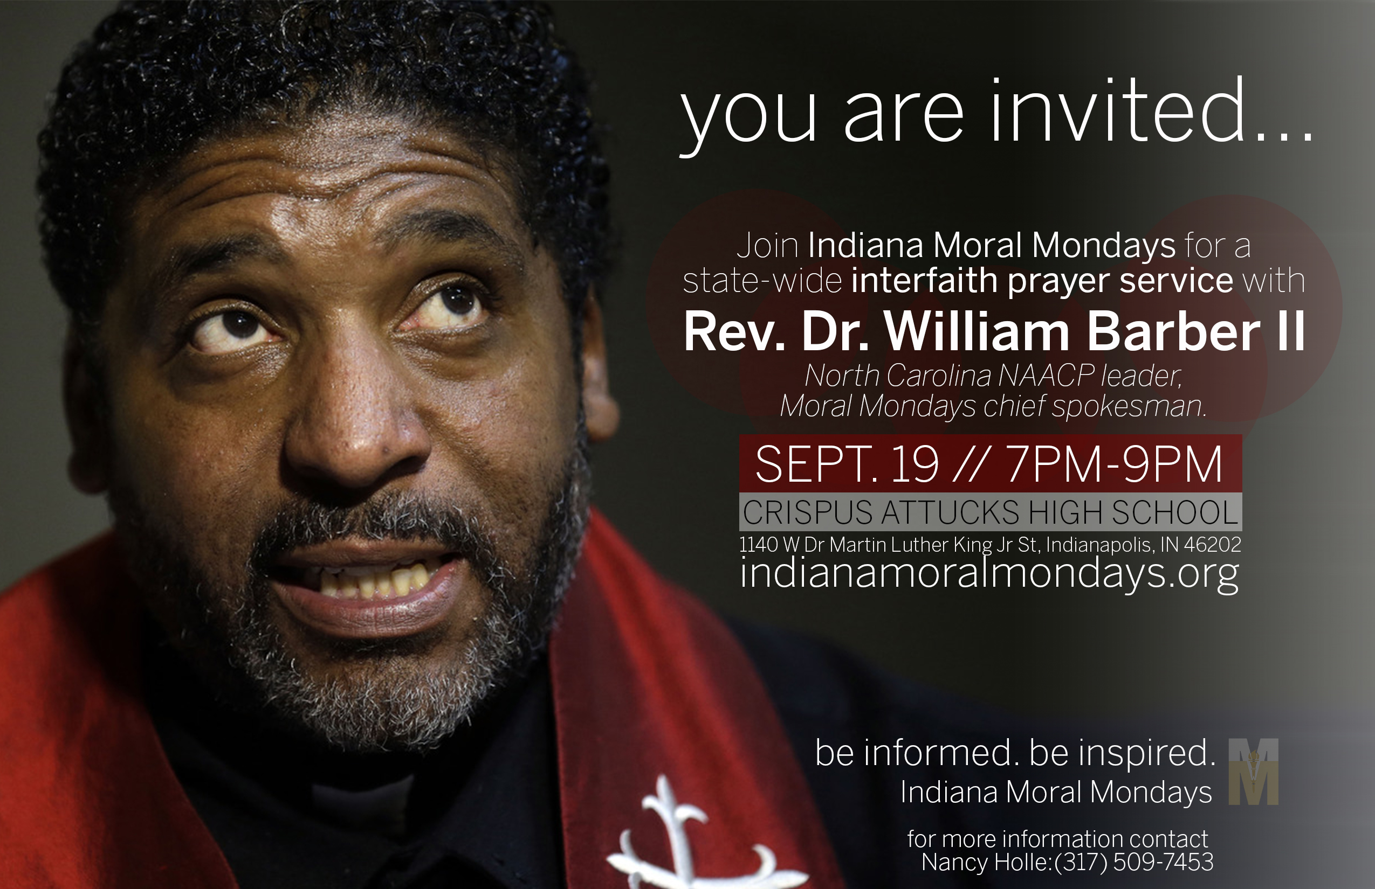
Indiana Moral Mondays

Slide 21
