Slide 1
Organizing an Advocacy Day
SNaHP Summit
February 14, 2015
Madeline Haas, Ajay Major, Xin Guan, and Phyllis Ying,
all MS-3 at Albany Medical College
Special thanks to Ashley Cobb, Jessica Reid,
Tori Chee, and Arielle Gerard for their input

Slide 2
Overview & Objectives
Introduction to advocacy
Key decisions in planning a legislative advocacy day
Next steps
Q&A

Slide 3
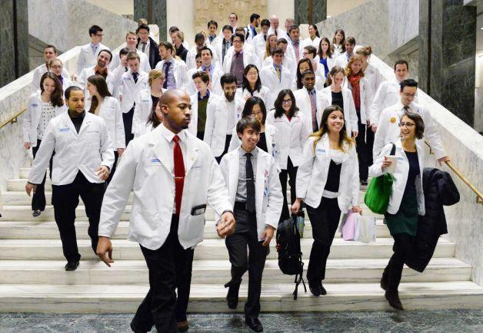
First Annual Medical Student Advocacy Day January 28, 2014, New York State Capitol
Photo courtesy of the Albany Times Union.
Notes:
70 students from New York State
25 legislators
5 issues
2 bills passed
Several legislators changed their votes

Slide 4
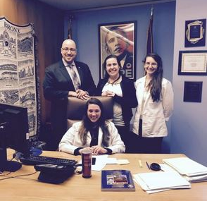
Second Annual Medical Student Advocacy Day February 3, 2015, New York State Capitol
Syringe access team with bill sponsor Senator Rivera (back left).
Medical student Faraz Khan (AMC ’17) speaking on medical professional participation in torture at the noon press conference.
Podium banner.
Photos courtesy of Arielle Gerard.
Notes:
What happens when a scandal happens just before advocacy day?
Same topics or new topics?
Passing the torch – what worked and didn’t work?

Slide 5
Advocacy: what is it?
Per Wikipedia….
Advocacy is a political process by an individual or group which aims to influence decisions within political, economic, and social systems and institutions.
Another example…
Advocacy is any action that speaks in favor of, recommends, argues for a cause, supports or defends, or pleads on behalf of others.

Slide 6
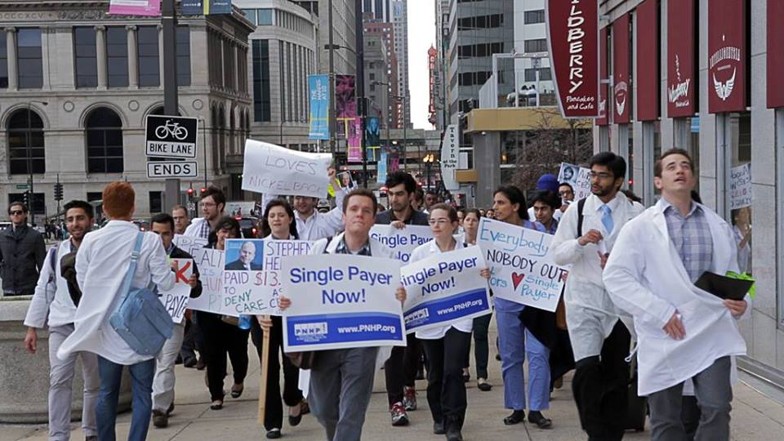
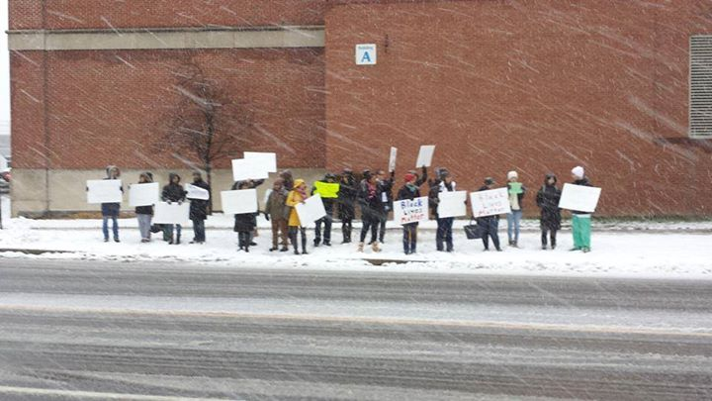
Examples of advocacy
Staging a demonstration
Writing editorials for your local newspaper
Organizing letter-writing campaigns
Meeting with policy makers
Participating in legislative writing

Slide 7
Why organize an advocacy day?
Gain legislators’ support for your cause
Raise awareness in the community of your cause
Mobilize students to act
Give students first-hand experience in advocacy

Slide 8
Teaching our peers to advocate
“I enjoyed the opportunity to learn about legislation and to actually feel like I was making a difference by speaking with legislators about a bill in which I believe strongly.”
“I learned that our elected officials and their staff take us seriously because we're medical students. I was amazed at how earnestly we were listened to, largely because we had the privilege of wearing those white coats.”
“I learned that there is so much more to being a physician than just clinical care. We have the power and responsibility to make a stand for the things we believe to be right.”

Slide 9
Organizing a legislative advocacy day: key decisions
How will you organize?
How will you involve and train students?
What will you advocate for?
Who will you talk to?
How will you budget and fundraise?

Slide 10
How will you organize?
Key decision #1
Notes:
Each Advocacy Day coordinator selected an issue based on personal interest and experience. Coordinators handled logistics, helped to arrange meetings with legislators, and recruited students to serve as group leaders and participate in legislator meetings on Advocacy Day. Decide in advance who will sechedule legislative meetings

Slide 11
How will you involve and train students?
Key decision #2
Recruit from whole student body vs. selected clubs
Several workshops vs. one training day
Tiered level of involvement for leaders vs. day-of participants
Notes:
Voiceover what we did at AMC:
Email to student body seeking group leaders and day-of participants
Three workshops for group leaders: legislative process, strategies for researching issues and legislators
Small team meetings for participants: led by group leaders, goal to formulate a plan for the legislator meetings

Slide 12
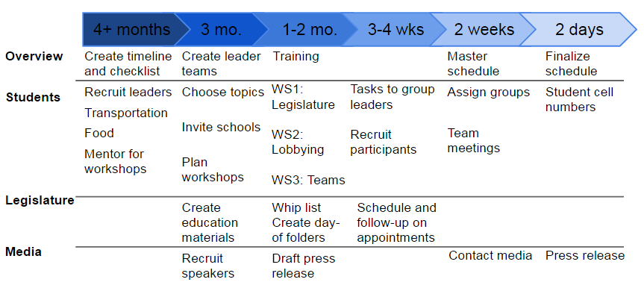
Create a timeline

Slide 13
Training workshops
What is advocacy?
Ice breaker: “Why did you come to medical school?” Gets people talking, reminds them of their passions, forces them to articulate interests
How does the legislative process work?
How do you research a bill?
Demonstrate
How do you craft an argument?
Have people practice
Image from Schoolhouse Rock, https://www.youtube.com/watch?v=Otbml6WIQPo

Slide 14
Tips for a training day
Your training day should include:
Educational handouts
Speakers to give background on your issue
Speakers to give tips for lobbying
Organized time to plan with legislative teams
Inspirational keynote
Slide courtesy of Dr. Jessica Reid.

Slide 15
Topics to cover to prepare for advocacy day
Organizing the encounter
Team roles
Answering tough questions
Tips for a successful visit
Slide courtesy of Dr. Jessica Reid.
Notes:
We held these trainings in the weeks leading up to Advocacy Day, and covered these topics (elaborated on following slides)
FYI slides taken from Jessica Reid of CAPSA

Slide 16
Four easy steps for a successful legislative visit
1. Introduce
2. Inquire
3. Inform
4. Request
Slide courtesy of Dr. Jessica Reid.
Notes:
There are many models people have used in organizing a visit. Here is a simple one.
1. Introduce - team members introduce themselves (name, school, future profession) quickly!
*Team leader introduces your organization (SNaHP, etc.) and the topic (why are you there)
- Also mention if you live in their district/voted for them
2. Inquire - Ask the legislator if he/she has heard of your issue (ex: HR 676) and if they plan to support it this year
- This is where your homework comes in of knowing their prior voting record, authorship history, etc.
- Their answer will guide which argument you choose to make the case for your issue
3. Inform (this is the meat of your visit)
- Each group member prepares argument from various themes (ie. social justice, financial savings, etc)
- The group should split up potential questions/areas of expertise (this helps spread how much you need to know and doesn’t leave your team looking around at eachother wondering who will answer)
- Personal stories can be very powerful (remember to frame the story about how single-payer would fix the problem)
(You may not get through them all)
4. Request: The action step (THIS IS WHY YOU ARE THERE)
- You may have a couple of asks prepared depending on their support
*Supporter - Ask them to co-author, encourage colleagues to do the same
*Undecided - Ask what information they need to be supportive. FInd and provide that information after the visit. Ask them to attend a movie screeing/read the packet/learn more. Continue the conversation.
*Opponents - Find out why they oppose (what might changed their mind). Offer to find and provide additional information.

Slide 17
Team roles
Leader/time-keeper
Split up your arguments
Assign one person to the “Ask”
Record keeper
Follow-up person
Slide courtesy of Dr. Jessica Reid.
Notes:
Choose a team leader to be in charge of introducing your group and the reason for the meeting (1 sentence)
- Also makes sure everyone stays on subject/doesn’t ramble/everyone gets a chance to speak
- One technique is for the leader to give a nod at the next group member when it is time to move on to the next point
Each person should pick and prepare 1 point or argument they can make or a brief personal story
Choose 1 person to make the ask
Choose a note-taker/record keeper (record the legislators position, comments, requests for more information
Choose a follow up person - this person will give the legislator/staffer the information packet. Should exchange business cards. Shoudl give thank you card (can do immediately after the visit).

Slide 18
Answering tough questions
Provide your advocates with a handout of expected/common questions and answers.
The bridge method
Acknowledge the question
Connect with a bridge phrase (“and that’s why,” “even more important,” “in spite of that”)
Deliver a positive message
Notes:
Have the team split the topics so everything is covered.
If you don’t know an answer, say so. “I’m not sure about that, but I’d be happy to look that up and provide your office with that information after our meeting”

Slide 19
Tips for a successful visit
1. Do your homework
2. Meet with team/develop your game plan
3. Arrive early
4. Be concise, stay on message
5. Be ready to trouble shoot
6. Follow up after your visit
Slide courtesy of Dr. Jessica Reid.
Notes:
Homework -
- Research your representative, look at their website, votesmart.org
- Look for party affiliation, biographical information, committee assignments, key issues of concern for the legislator
- Are they are previous supporter or co-author?
- Review their voting record and any publicly stated views/opinions on the issue
Meet with Team
- see team role side
Arrive 10 minutes early, enter the office as a team
Stay on message, be concise, don’t disagree with each other, prepare arguments for anticipated questions
- Your homework should guide which arguements will be most effective
- Make your case, allow the legislator to speak, ask questions, give their opinion/concerns
- Request 30 minute meeting, may be 20 minutes or less depending on how busy they are
Follow up
- Even though the meeting is over, this is just the start to developing a relationship with the representative
- Thank you card
- Give records to one of your organizers (database for future)
- Check in periodically/provide additional information requested
- Send new information/articles as appropriate

Slide 20
What will you advocate for?
Key decision #3
Single payer bill
Medicaid expansion
Another issue in healthcare justice
Will you form a coalition with students who have other interests?
Notes:
This goes back to your goals for the day – educating students / building a coalition / passing a specific bill

Slide 21
Who will you talk to?
Key decision #4
How is your legislature organized?
Assembly and senate, etc.
Selection criteria:
Constituency
Members of committees currently considering the bill
Bill sponsors
Known opponents of the bill
Notes:
This goes back to your goals

Slide 22
To find the right legislators
On the legislature website, search for your bill by number or keyword
After you’ve selected your bill
Page with Summary, Actions, Votes, Memo, Text
Short history of the bill
Where the bill is (which committee, etc.)
Any votes taken
Full text of the bill
Find committee chair and members
Notes:
Other resources such as the advocacy organization you’re a part of – may have a whip list

Slide 23
Scheduling appointments
Create a wish-list of 10 legislators you’d like to meet with, number of total meetings you’d like to have, and when (morning/afternoon)
Google each legislator to find their official Senate/Assembly website, then select the contact page
Call the legislator’s office and request the email address of the legislative scheduler
Title the subject of your emails, “For the Scheduler”
You may have to call and email several times
Keep a written record of all appointments and confirm appointments one week prior to advocacy day
Notes:
Job for co-organizers or team leaders

Slide 24
How will you budget and fundraise?
Key decision #5
Costs include transportation, snacks, advertising
Identify funding sources within your medical school
Dean supported lunch, transportation
National umbrella organizations
PNHP paid for transportation for other SNaHP chapters
Notes:
This goes back to your goals

Slide 25
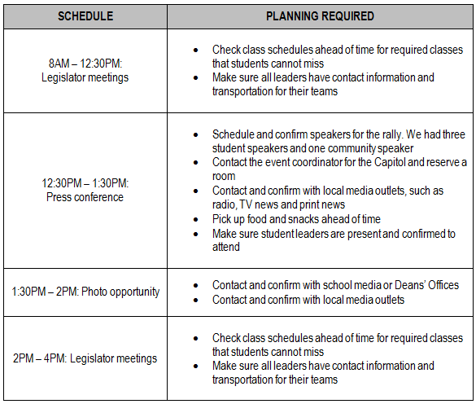
Advocacy Day

Slide 26
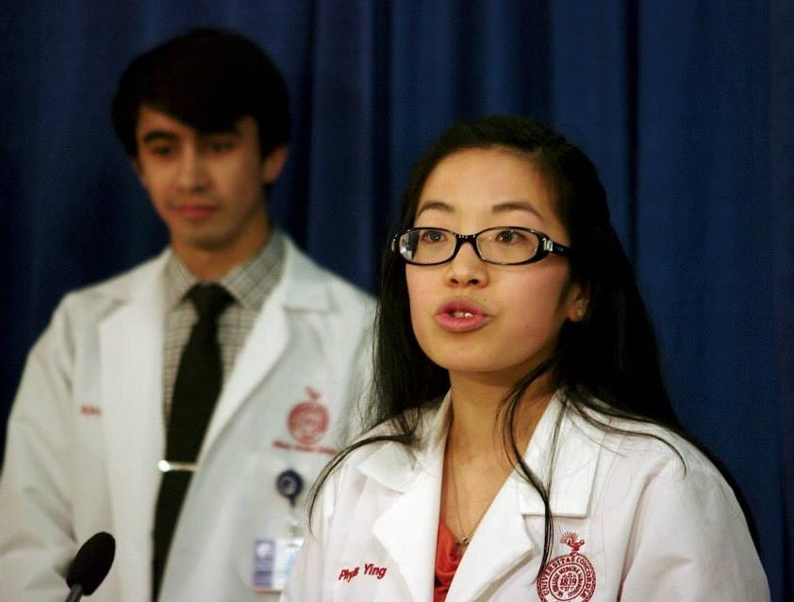
Other factors to consider
What are you including in your lobby day packet?
For participants: map of office locations, appointment schedule, etc.
Leave-behind for elected officials: educational information on your issue(s)
Who will spread the word?
Press conference with speakers
Media coverage (newspapers, tv, radio, internet)

Slide 27
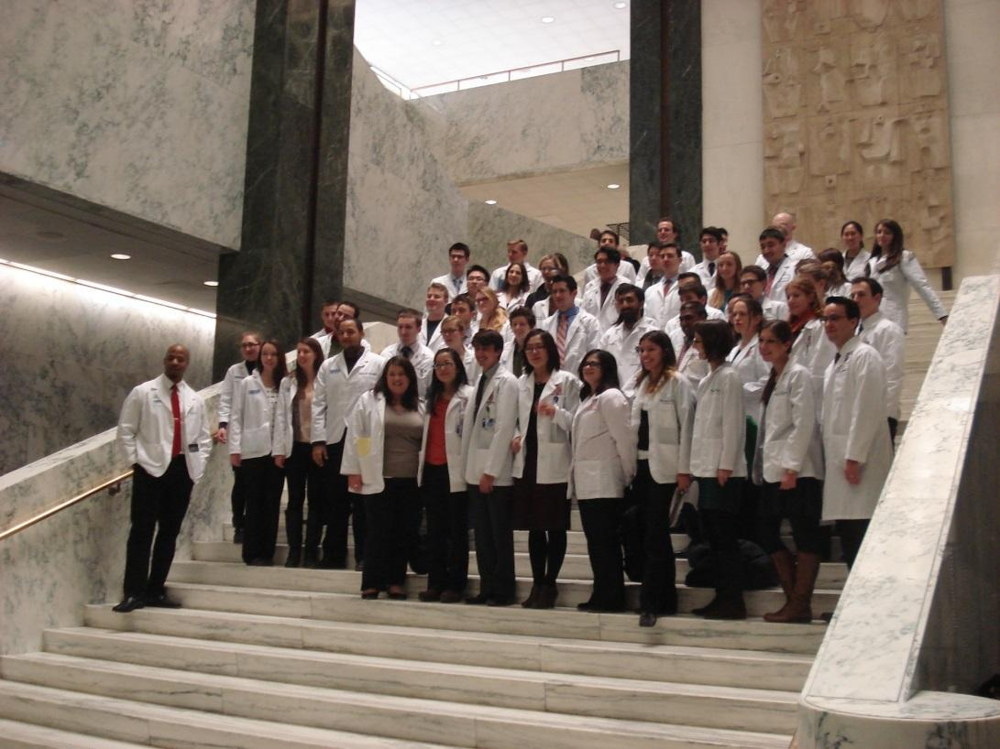
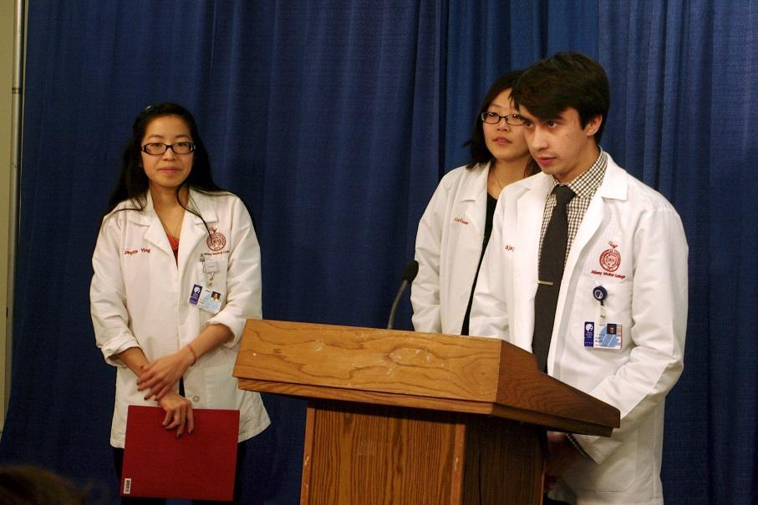
Be professional and have fun!

Slide 28
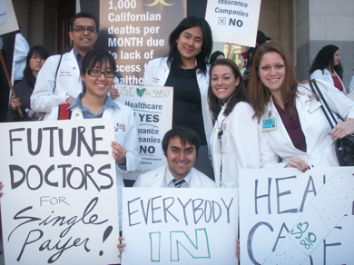
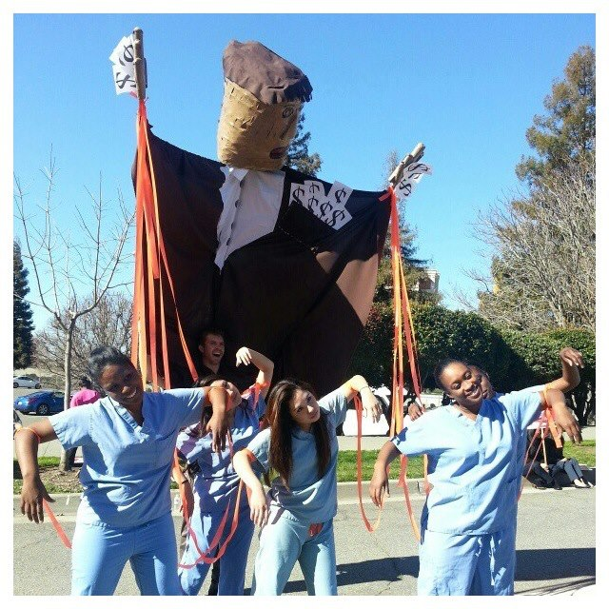
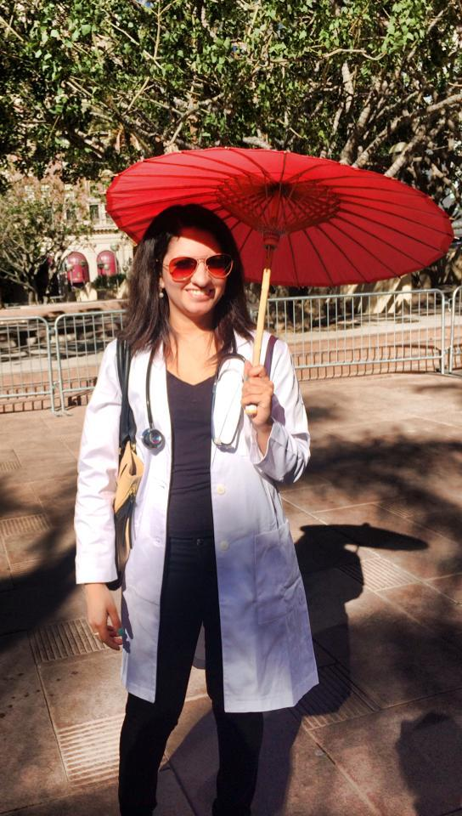
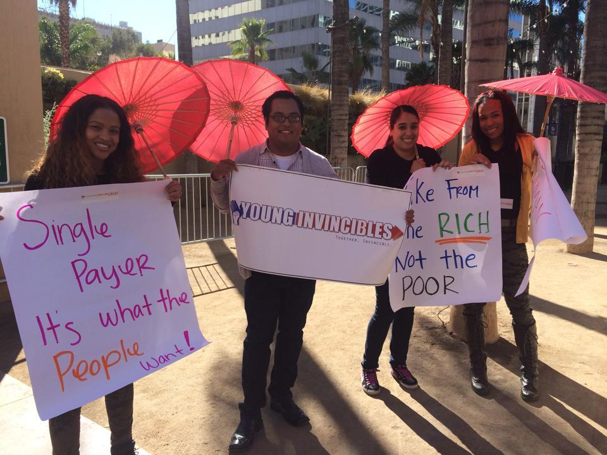
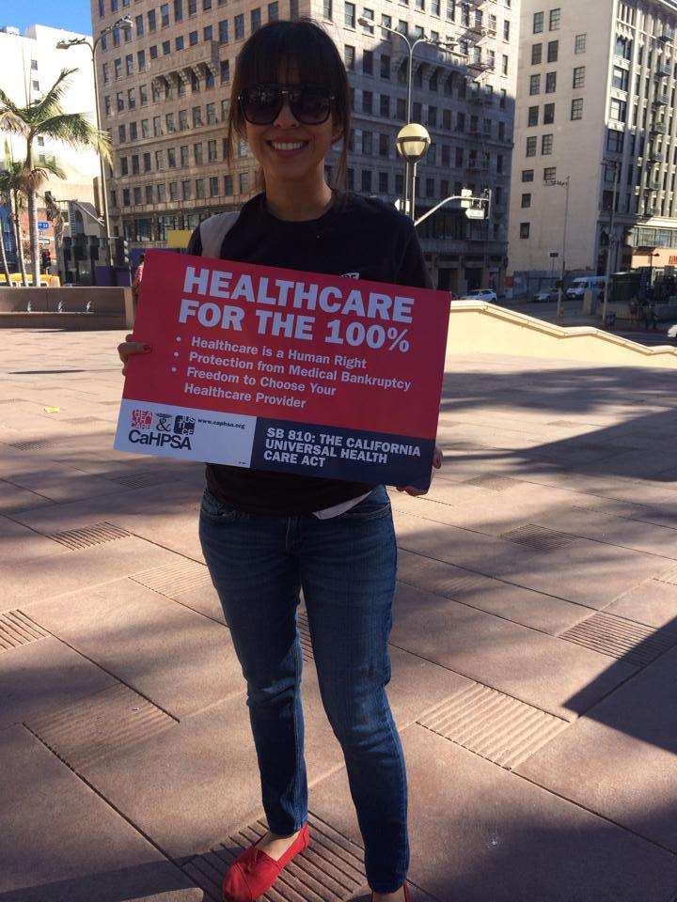
CaHPSA lobby day
Slide courtesy of Dr. Jessica Reid.
Notes:
2013 - No Strings Attached
2014 - Completely Covered California
Creative themes
Have changed our focus with the political landscape

Slide 29
After advocacy day
Thank you notes
Follow-up with press
Participant survey
Elect next-year’s leadership
Join other lobby days
Notes:
Trying to speak with Tori and Arielle before Wednesday so I can add more about leadership transition

Slide 30
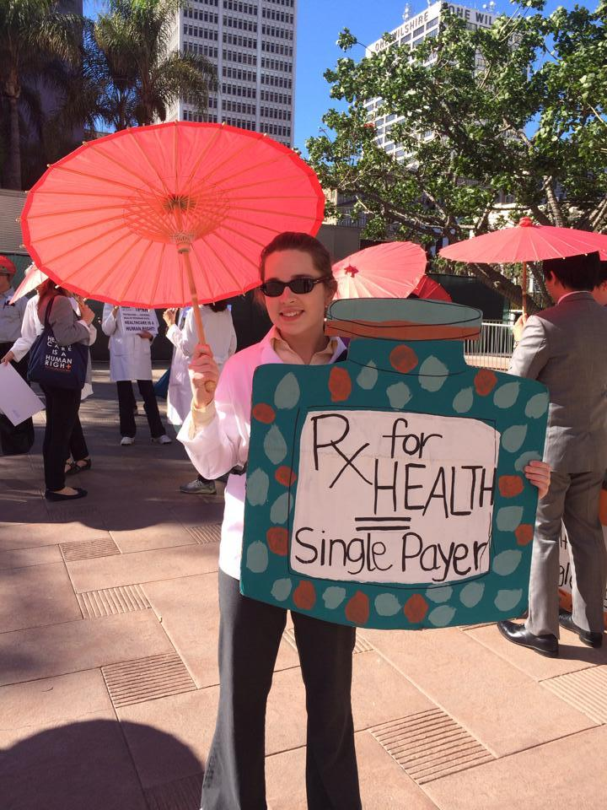
Next steps
1. Join PNHP (free student membership)
http://www.pnhp.org/
*Also connect with your statewide/local chapter: http://www.pnhp.org/stateactions
2. Stay connected online
SNaHP Facebook Group: https://www.facebook.com/groups/SNaHP
PNHP Facebook Group: https://www.facebook.com/doctorsforsinglepayer
Twitter: Follow us @PNHP; #PNHP #SinglePayer
3. Start a SNaHP chapter at your school
http://www.pnhp.org/action/how-to-start-a-pnhp-student-chapter
http://www.cahpsa.org/CaHPSA/Chapters.html
Slide courtesy of Dr. Jessica Reid.

Slide 31
Next steps
4. Request a PNHP speaker to speak at your school
http://www.pnhp.org/resources-for-students
5. Plan a Legislative Advocacy Day
http://www.pnhp.org/resources-for-students
6. Write/call your elected officials
*To look up elected officials → http://votesmart.org/
*To look up bills in Congress and list of sponsors → http://thomas.loc.gov/home/thomas.php
- National Single Payer Bill: HR 676
Slide courtesy of Dr. Jessica Reid.

Slide 32
Next steps
7. Engage your community
*Write an op-ed
*Give a talk/host an event/plan a movie screening
http://www.pnhp.org/action/activism
8. Join the national SNaHP Political Advocacy or Education & Base-Building Leadership Teams
Monthly calls to connect and collaborate
Questions?
Contact Emily Henkels, our national organizer, if you need
help or want to discuss other ideas.
e.henkels@pnhp.org
madeline.haas@gmail.com
ajay@majorajay.com
Slide courtesy of Dr. Jessica Reid.

Slide 33
As health professional students, we are the voice of our health care system’s future!
Slide courtesy of Dr. Jessica Reid.

