Slide 1
Single Payer 101
A Beginner’s Guide to the Rationale for Single Payer

Slide 2
A Year in Headlines…

Slide 3
What Single-Payer Is NOT:
NOT a reimbursement strategy
  Can coexist with fee-for-service, capitation, DRGs, etc.
NOT a health-care delivery scheme
NOT government employment of/control over doctors (socialized medicine)
NOT socialism
  Webster’s Dictionary: any of various economic and political theories advocating collective or governmental ownership and administration of the means of production and distribution of goods
NOT a magic bullet, but still very important

Slide 4


Financing via Private Insurance:
Premiums
Reimbursement

Slide 5
Problems: For-Profit Interests
What does “competition” look like?
Adverse Selection
The Medical Loss Ratio
Policy Recission
Pre-Existing Conditions
Experience Rating & Regressive Financing
High Deductible Plans

Slide 6
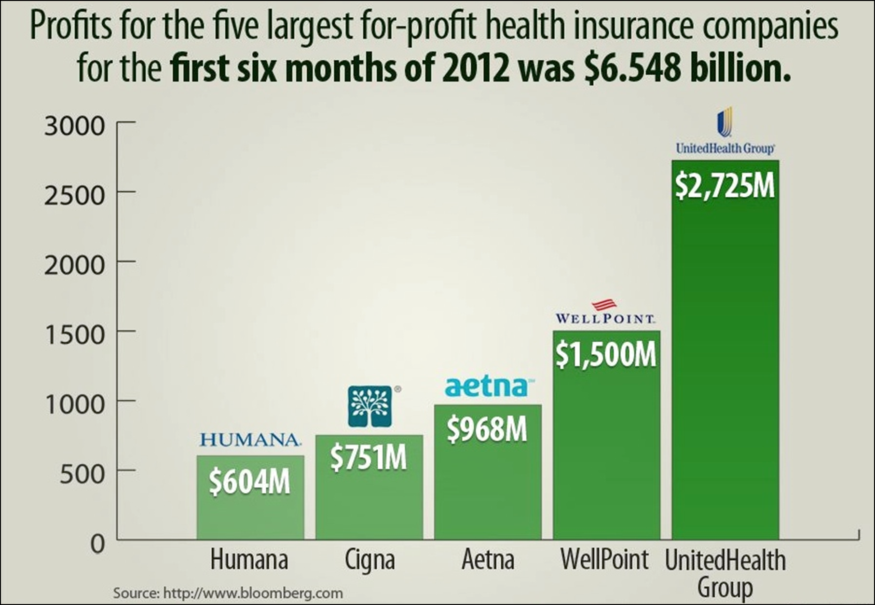

Slide 7
Problems: The Uninsured & Underinsured
Insurance & Employers
  2011: >21% of people in working households uninsured¹
Lack of Portability
Fragmented Access & Lack of Choice
Incomplete Coverage
  2010: 33% of Americans forwent seeing a doctor or filling a prescription due to costs²
Financial Hardship
  Medical bills contribute to half of all bankruptcies³
Health Consequences
  45,000 deaths annually are attributed to a lack of health insurance⁴
1. US Census Bureau, 2012.
2. Schoen et al., 2010.
3. Himmelstein et al., 2009.
4. Wilper et al., 2009

Slide 8
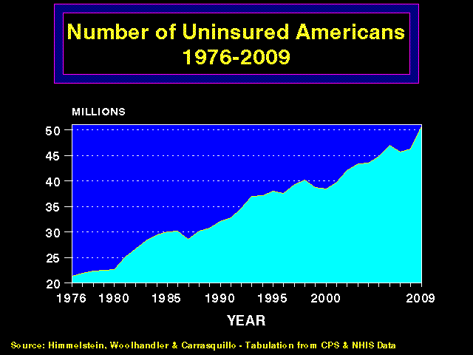
More and More
Uninsured Americans
50
45
40
35
30
25
20
Millions of Uninsured American
1976 | 1980 | 1985 | 1990 | 1995 | 2000 | 2005 | 2012
Source: Himmelstein, Woolhandler & Carrasquilo.
Tabulation from CPS & NHIS data

Slide 9
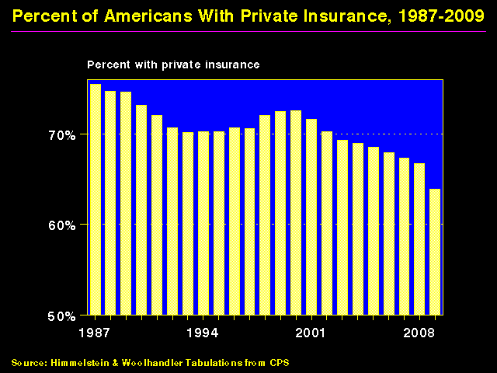
Shrinking Private Insurance
Percent with private coverage
80%
70%
60%
50%
1960
1970
1980
1990
2000
2012
Source: Himmelstein and Woolhandler – Tabluations from CPS and HIAA data
Note: Data are not adjusted for minor changes in survey methodology

Slide 10
Chronically Ill and Uninsured
Condition | % Uninsured | # of Uninsured
Diabetes | 16.6% | 1.4 million
Elevated cholesterol | 11.9% | 4.0 million
Hypertension | 15.5% | 5.9 million
Asthma / COPD | 19.3% | 3.5 million
Previous cancer | 15.4% | 1.1 million
Cardiovascular disease | 16.1% | 1.3 million
Any of the above | 15.6% | 11.4 million
Source: Wilper et al. Annals of Internal Medicine.
2008;149:170

Slide 11
44,798 Adult Deaths Annually
Due to Uninsurance
State | Percent Uninsured | Excess Deaths
California | 23.9% | 5,302
Texas | 29.7% | 4,675
Florida | 26.0% | 3,925
New York | 17.5% | 2,254
Georgia | 23.6% | 1,841
USA | 15.3% | 44,798
Source: Wilper et al. Am J Public Health 2009.
State tabulations by author

Slide 12
Problems: Waste
Contract Negotiation & Bargaining Power
Administrative Costs
  25 to 31% of health care expenditures in the US – twice those in Canada¹
Insurer Waste
  Eligibility Screening
  Underwriting
  Dividends and Salaries
  Managed Care
Provider Waste
  Billing and Coding
  Approval and Appeals in Managed Care
  Lack of check on for-profit providers
  1. Woolhander, Campbell, & Himmelstein DU, 2003; Himmelstein et al, 2014

Slide 13
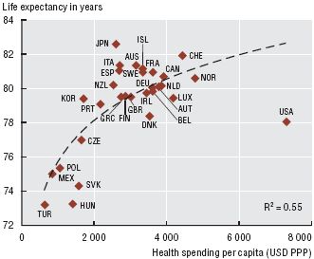
OECD Health Data (2009)

Slide 14
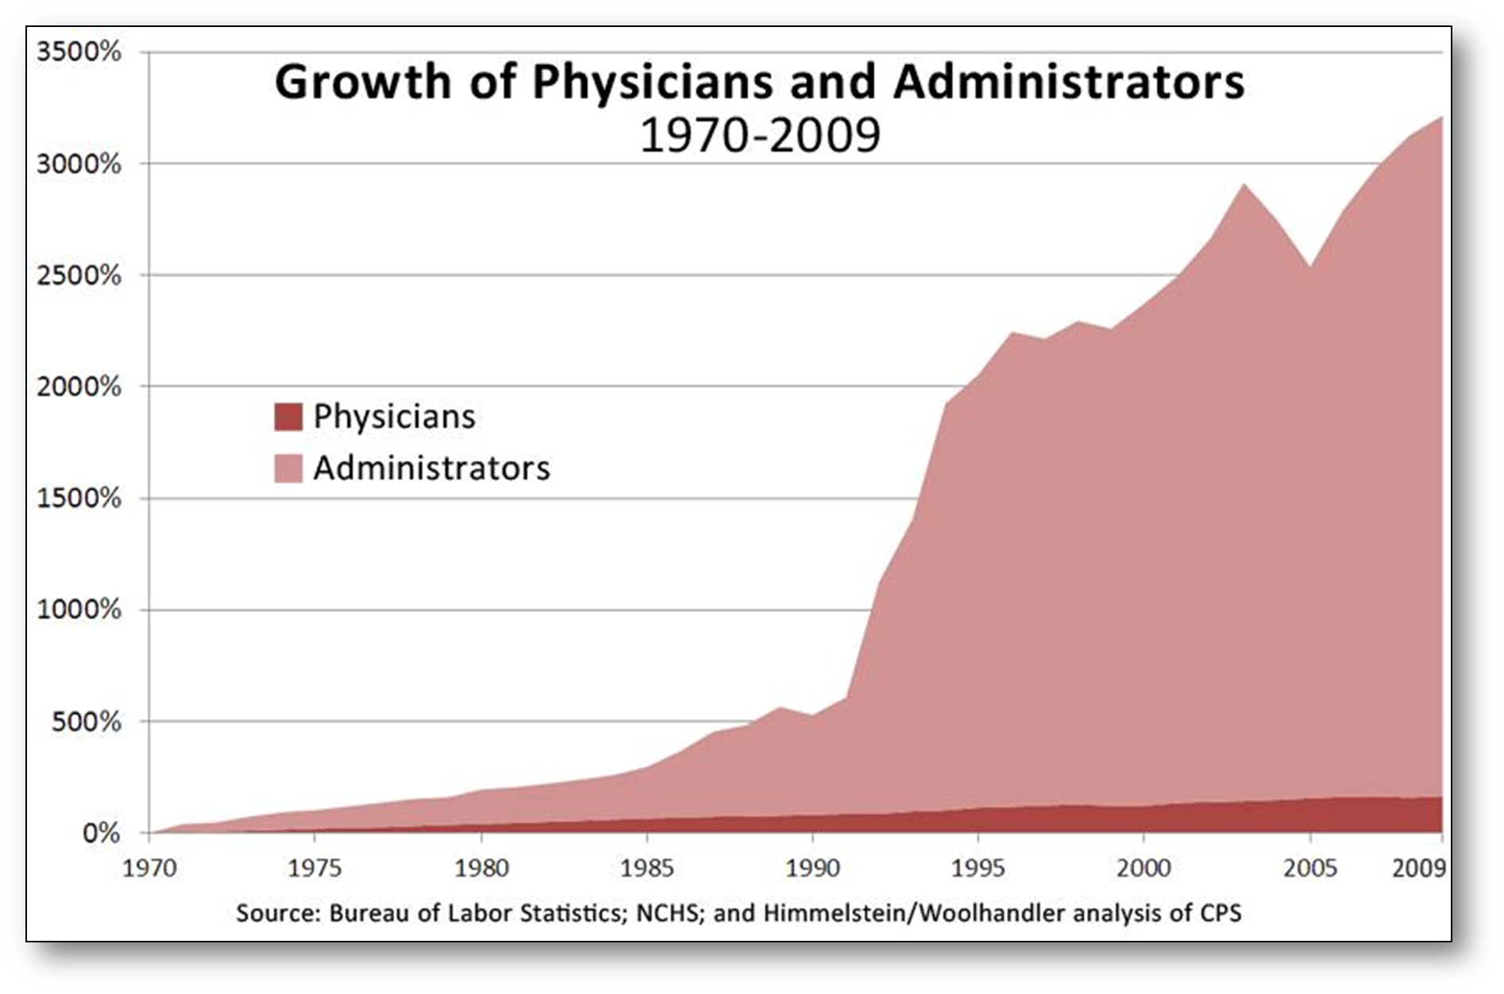
Where is spending growth coming from?

Slide 15
Overall Administrative Costs
Dollars per capita, 2014
Source: Woolhandler/Himmelstein/Campbell
NEJM 2003;349:769 (updated 2013)

Slide 16
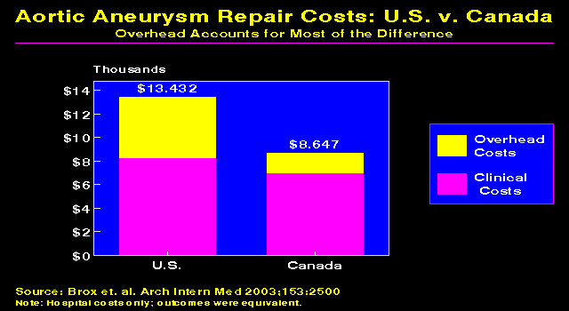

Slide 17
Insurance Overhead
Dollars per Capita
Note: Data are for 2011 or most recent available
Figures adjusted for Purchasing Power Parity
Source: OECD, 2013

Slide 18
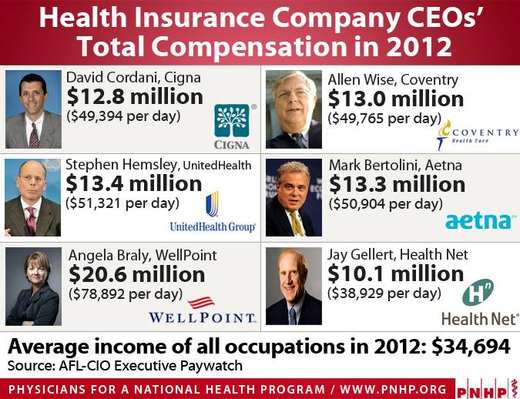

Slide 19
Financing via Single Payer
Reimbursement
Taxes

Slide 20
Key Features of Single Payer
Covers everyone, from birth to death
Comprehensive coverage, including payments to medical, dental, vision, and long-term care
Administered pricing and bulk purchasing by the non-profit governmental payer
Progressive financing and subsidized access for the poor

Slide 21
Benefits of Single-Payer
Non-Profit
  Patients getting care as the bottom line
  No need to exclude the sick
Universal coverage
  True spreading of risk
  Community rating and progressive contributions
  Fully portable coverage
Streamlined Administration
  More efficient billing and reimbursement
  Compatible with any reimbursement strategy
  Cost savings in healthcare, boosting other economic sectors

Slide 22
More Benefits of Single Payer
More effective payer-provider negotiations
  More even distribution of power
  Balances delivery of care and cost savings
Government accountability
  Democratic process decides amount of coverage/expenditures
  Transparency
  Patients as the stakeholders
Facilitates further reforms
  Encourages change in reimbursement strategies
  Allows directing of dollars where they’re needed most
  A coordinated way to pay for improvements in quality

Slide 23
What about the ACA/Obamacare?
Subsidizes expansion of private insurance coverage
Minimum essential benefits, but many exceptions/grandfathered plans
About 30 million people will remain uninsured
Medicaid expansion now optional
Limits on MLRs
Virtually no measures that will reduce costs
Public option lost to political wrangling

Slide 24

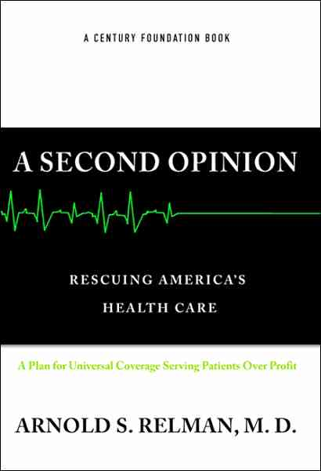

Recommended Reading

Slide 25
What next…?
YOU can give this talk!
Solidify a chapter at your school – expose each new class to the fundamental arguments for single payer
Reach out to your community - educate seniors, union members, congregations, and business groups.
Interface with the public and your legislators – write letters to the editor and op-eds, and lobby your representatives in person at your state capitol.
Pass the torch to your friends, colleagues, and protégés – help us grow our movement into an exponentially larges grassroots force!

Slide 26
Contacts
Josh.Faucher@gmail.com
www.PNHP.org
PNHP’s Annual Meeting – Every Fall
SNaHP’s Student Summit – Every Spring
Travel Scholarships Available

Slide 27
Waiting Times for Doctor Appointments
Boston and Canada
Mean wait time in weeks for non-urgent visit
*US Ortho figure represents semi-urgent request for visit
Sources: Canadian Medical Association 2007 National Physician Survey.
Merritt Hawkins 2009 Survey

