Slide 1
Legislative Power Mapping
Swathi and Shruthi Bhuma
California Health Professional Student Alliance

Slide 2
Note: Case studies from the 3/5/16 presentation were removed to maintain confidentiality of specific plans and strategies used. If you’d like to see the original slides, please email ShruthiBhuma@gmail.com SwathiBhuma@gmail.com

Slide 3
Basic Principles
"When you have a big problem to solve, break it down to smaller ones first.”
Sid Kattragada

Slide 4
Agenda
Introduction and Overview
Step by Step Process
Coalition Building
Citizen Lobbying
Helpful Tips
Recap & Conclusion

Slide 5
Introduction and Overview

Slide 6
Notes:
http://www.npr.org/sections/health-shots/2016/01/26/464300484/a-judges-guidance-makes-jurors-suspicious-of-any-eyewitness

Slide 7
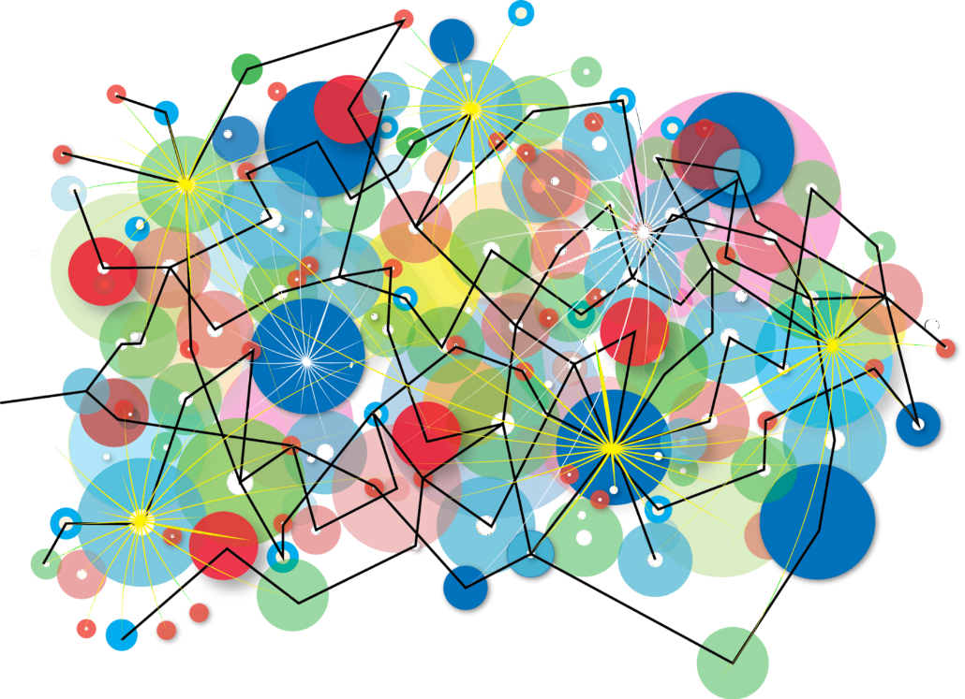
Power Mapping (Overview)
A powerful tool to analyze power relationships and help develop a strategy for creating change
Notes:
https://www.linkedin.com/pulse/wait-what-todd-hannula?articleId=6059240913866153984#comments-6059240913866153984&trk=prof-post
http://www.aauw.org/files/2013/06/Powermapping-Description-and-How-Tos-Handout.pdf

Slide 8
Informs Strategy Pertaining to…..
Coalition Building
Citizen Lobbying
“with whom should we develop a relationship with”
“who can we use to influence this legislator”

Slide 9
Step by Step Process
Use Case #1

Slide 10
Informs Strategy Pertaining to…..
Coalition Building
Citizen Lobbying
“with whom should we develop a relationship with”
“who can we use to influence this legislator”

Slide 11
Power Mapping: Coalition Building
Determine policy focus
Determine target(s)
Identify and map out influencers of target(s)
Determine relational power lines
Target priority relationships
Make a plan

Slide 12
Power Mapping: Step 1
Determine policy focus
Determine target(s)
Identify and map out influencers of target(s)
Determine relational power lines
Target priority relationships
Make a plan

Slide 13
Power Mapping: Determine Policy Focus
Choose issue and/or legislation
Determine level of government (National/State/Local)
Determine location in legislative cycle
Determine what success looks like

Slide 14
Power Mapping: Step 2
Determine policy focus
Determine target(s)
Identify and map out influencers of target(s)
Determine relational power lines
Target priority relationships
Make a plan

Slide 15
Power Mapping: Determine Target(s)
Analysis will help you both choose the best targets and better understand how they can be reached and influenced
Target Prioritization Matrix
Notes:
Worksheet Source: http://www.ctbh.org/documents/Power_Mapping_Worksheet.pdf

Slide 16
Power Mapping: Determine Target(s)
Sample Questions
Knowledge of the issue (high, med, low)
Do they support your objective? (yes, maybe, no)
Accessibility
Are they vulnerable?
Open to changing opinion?
Are they dead set in their position?
Could you neutralize their opposition?
What issues do they care about?
Do they know your organization?
Do you have organizational allies/constituents that live in their district?
Do beneficiaries of the policy you’re advocating for live in their district?
Do they belong to the party in power or hold high rank?
Do they hold rank in the committee in which the legislation currently lies?
Is their office term limit coming up?

Slide 17
Sample Target Prioritization Matrix
Checklist Criteria | Target A | Target B | Target C | Target D | Target E
Knowledge of the issue (high, med, low) | Med | Med | Med | High | High
Do they support your objective? (yes, maybe, no) | No | Maybe | Maybe | Maybe | Maybe
Accessibility Are they vulnerable? Open to changing opinion? Are they dead set in their position? Could you neutralize their opposition? | Dead-Set Against | Open to changing opinion | Open to changing opinion | Open to changing opinion | Open to changing opinion
What issues do they care about? | Housing Land-use, Environment, and Transportation; Public Safety and Justice | Education, Veterans, Parks & Recreation, Transportation | Small Business, Environment, Transportation, Housing, Education | Health, LGBT Rights, Higher Education, Transportation | Health, Land-use and Transportation, Public Safety and Justice, Public Health
Do they know your organization? | No | Yes | Yes | No | No
Do you have organizational allies/constituents that live in their district (many, few, none)? | None | Few | Many | Few | Few
Do beneficiaries of the policy you’re advocating for live in their district (many, few, none)? | Many | Many | Many | Few | Few
Do they belong to the party in power or hold high rank? | No | Yes | Yes | Yes | Yes
Do they hold rank in the committee in which the legislation currently lies? | No | ? | ? | Yes | Yes
Is their office term limit coming up? | Yes (2010) | No | No | No | Yes (2012)

Slide 18
Power Mapping: Step 3
Determine policy focus
Determine target(s)
Identify and map out influencers of target(s)
Determine relational power lines
Target priority relationships
Make a plan

Slide 19
Power Mapping: Identify Influencers
Public Influences
Ex: Media, Voters, Organizational Affiliations
VIP Influences
Ex: Elected Officials, Special Interest Groups, Government Agencies, Non-Elected Community Leaders, Campaign Contributors
Personal Influences
Ex: Family, Friends, Social Affiliations
Relevant Staff
Ex: Chief of Staff, Policy Aide

Slide 20
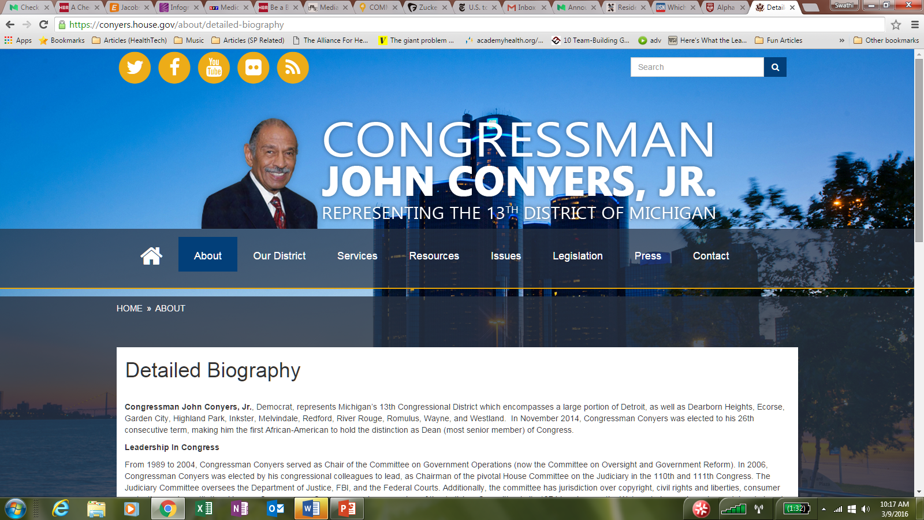
Power Mapping: Identify Influencers

Slide 21
Power Mapping: Map Influencers
Public Influence #5
Public Influence #6
Personal Influence #1
Personal Influence #2
Relevant Staff #1
VIP Influence #2
Elected Official
(Target C)
Relevant Staff #2
Public Influence #4
VIP Influence #1
Public Influence #1
Public Influence #2
Personal Influence #3
Public Influence #3
Public Influence #3

Slide 22
Power Mapping: Step 4
Determine policy focus
Determine target(s)
Identify and map out influencers of target
Determine relational power lines
Target priority relationships
Make a plan

Slide 23
Power Mapping: Relational Power Lines
Public Influence #5
Public Influence #6
Personal Influence #1
Personal Influence #2
Relevant Staff #1
VIP Influence #2
Elected Official
(Target C)
Relevant Staff #2
Public Influence #4
VIP Influence #1
Public Influence #1
Public Influence #2
Personal Influence #3
Public Influence #3
Public Influence #3

Slide 24
Power Mapping: Step 5
Determine policy focus
Determine target(s)
Identify and map out influencers of target(s)
Determine relational power lines
Target priority relationships
Make a plan

Slide 25
Power Mapping: Target Priority Relationships
Identify the following:
(1) Nodes of Power
(2) Most Important Influencers regarding your policy (Ex. VIP Influence #1)
Public Influence #5
Public Influence #6
Personal Influence #1
Personal Influence #2
Relevant Staff #1
VIP Influence #2
Elected Official
(Target C)
Relevant Staff #2
Public Influence #4
VIP Influence #1
Personal Influence #3
Public Influence #1
Public Influence #2
Public Influence #3
Public Influence #3
Notes:
When you see an person or institution with several lines going to it – a connector, that’s called a node of power

Slide 26
Power Mapping: Target Priority Relationships
Identify the following:
(1) Nodes of Power
(2) Most Important Influencers regarding your policy (Ex. VIP Influence #1)
Public Influence #5 (Major Newspaper)
Public Influence #6
Personal Influence #1
Personal Influence #2
Relevant Staff #1
VIP Influence #2
Elected Official
(Target C)
Relevant Staff #2
Public Influence #4
VIP Influence #1
Public Influence #1
Public Influence #2
Personal Influence #3
Public Influence #3
Public Influence #3

Slide 27
Power Mapping: Target Priority Relationships
Identify the following:
(1) Nodes of Power
(2) Most Important Influencers regarding your policy (Ex. VIP Influence #1)
Public Influence #5 (Major Newspaper)
Public Influence #6
Personal Influence #1
Personal Influence #2
Relevant Staff #1
VIP Influence #2
Elected Official
(Target C)
Relevant Staff #2
Public Influence #4
VIP Influence #1
Public Influence #1
Public Influence #2
Personal Influence #3
Public Influence #3
Public Influence #3

Slide 28
Power Mapping: Step 6
Determine policy focus
Determine target(s)
Identify and map out influencers of target(s)
Determine relational power lines
Target priority relationships
Make a plan

Slide 29
Power Mapping: Review Target Priority Relationships
Public Influence #5 (Major Newspaper)
Public Influence #6
Personal Influence #1
Personal Influence #2
Relevant Staff #1
VIP Influence #2
Elected Official
(Target C)
Relevant Staff #2
Public Influence #4
VIP Influence #1
Public Influence #1
Public Influence #2
Personal Influence #3
Public Influence #3
Public Influence #3

Slide 30
Power Mapping: Identify Internal Allies
Public Influence #5 (Major Newspaper)
Public Influence #6
Personal Influence #1
Personal Influence #2
Relevant Staff #1
Relevant Organizational Ally #1
VIP Influence #2
Elected Official
(Target C)
Relevant Staff #2
Public Influence #4
Relevant Organizational Ally #2
VIP Influence #1
Personal Influence #3
Public Influence #1
Public Influence #2
Public Influence #3
Public Influence #3
Relevant Organizational Ally #3

Slide 31
Power Mapping: Identify Internal Allies
Public Influence #5
Public Influence #6
Personal Influence #1
Personal Influence #2
Relevant Staff #1
VIP Influence #2
Elected Official
(Target C)
Relevant Organizational Ally #1
Relevant Staff #2
Public Influence #4
Relevant Organizational Ally #2
VIP Influence #1
Personal Influence #3
Public Influence #1
Public Influence #3
Public Influence #2
Public Influence #3
Relevant Organizational Ally #3

Slide 32
Power Mapping: Identify Internal Allies
Public Influence #5
Public Influence #6
Personal Influence #1
Personal Influence #2
Relevant Staff #1
Relevant Organizational Ally #1
VIP Influence #2
Elected Official
(Target C)
Relevant Staff #2
Public Influence #4
VIP Influence #1
Personal Influence #3
Public Influence #1
Public Influence #2
Public Influence #3
Public Influence #3

Slide 33
Power Mapping: Identify Internal Allies
Public Influence #5
Public Influence #6
Personal Influence #1
Personal Influence #2
Relevant Staff #1
None
VIP Influence #2
Elected Official
(Target C)
Relevant Staff #2
Public Influence #4
VIP Influence #1
Personal Influence #3
Public Influence #1
Public Influence #2
Public Influence #3
Public Influence #3

Slide 34
Power Mapping: Design & Execute Plan(s)
General Tips
Meet people where they are
Strive for mutual understanding and respect
“Green light, Yellow light, Red light” (know your limits)
Notes:
http://www.imi.ie/dont-forget-strategy

Slide 35
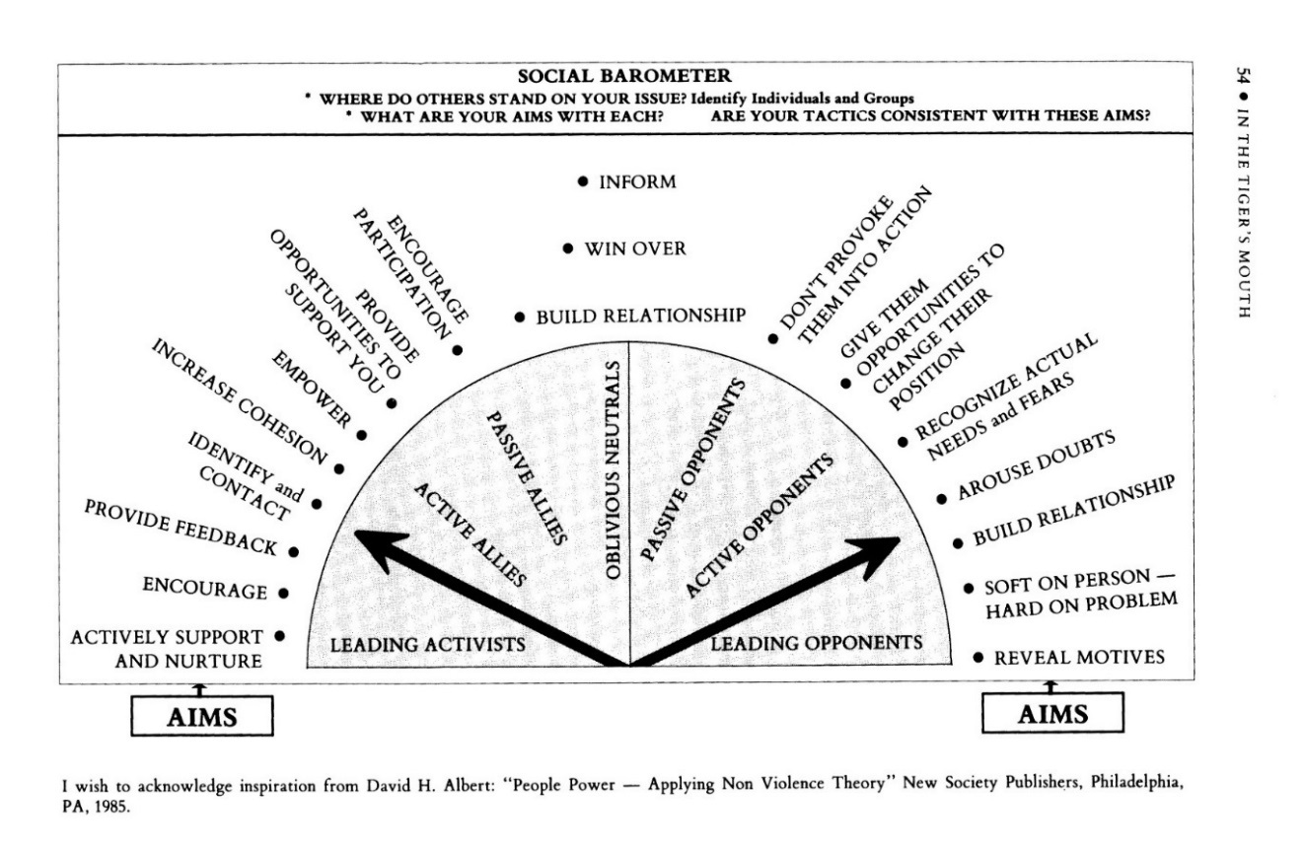
Power Mapping: Design & Execute Plan(s)
Helpful guide for forging relationships and/or sustaining engagement
Notes:
Worksheet Source: http://www.ctbh.org/documents/Power_Mapping_Worksheet.pdf

Slide 36
Power Mapping: Design & Execute Plan(s)
Examples
Health Fair + Community Teach-In
Talk with and/or present to organization’s leadership
Fiscal Study delineating savings to County/State/Country
Educational Town-Health
Notes:
Unlock Your Creativity

Slide 37
Power Mapping: Design & Execute Plan(s)
Health Fair + Community Teach-In
Talk with and/or present to organization’s leadership
Fiscal Study delineating savings to County/State/Country
Educational Town-Health
Notes:
Unlock Your Creativity
http://www.highlandhosp.com/2015/09/19th-annual-kanawha-city-health-fair-set-for-september-16th/
http://www.issaquahhighlands.com/event/townhall-re-new-polygon-development-near-swedish/
http://www.graphicsfactory.com/search/meeting-p1.html

Slide 38
Power Mapping: Summary
Determine policy focus
Determine target(s)
Identify and map out influencers of target(s)
Determine relational power lines
Target priority relationships
Make a plan

Slide 39
Step by Step Process
Use Case #2

Slide 40
Informs Strategy Pertaining to…..
Coalition Building
Citizen Lobbying
“with whom should we develop a relationship with”
“who can we use to influence this legislator”

Slide 41
Power Mapping: Citizen Lobbying
Determine policy focus
Determine target(s)
Identify and map out top organization influence(s) of target(s)
Determine messenger/ally from top organizational influence(s)
Make legislative visit(s)

Slide 42
Power Mapping: Step 1
Determine policy focus
Determine target(s)
Identify and map out top organization influence(s) of target(s)
Determine messenger/ally from top organizational influence(s)
Make legislative visit(s)

Slide 43
Power Mapping: Determine Policy Focus
Choose issue and/or legislation
Determine level of government (National/State/Local)
Determine location in legislative cycle
Determine what success looks like

Slide 44
Power Mapping: Step 2
Determine policy focus
Determine target(s)
Identify and map out top organization influence(s) of target(s)
Determine messenger/ally from top organizational influence(s)
Make legislative visit(s)

Slide 45
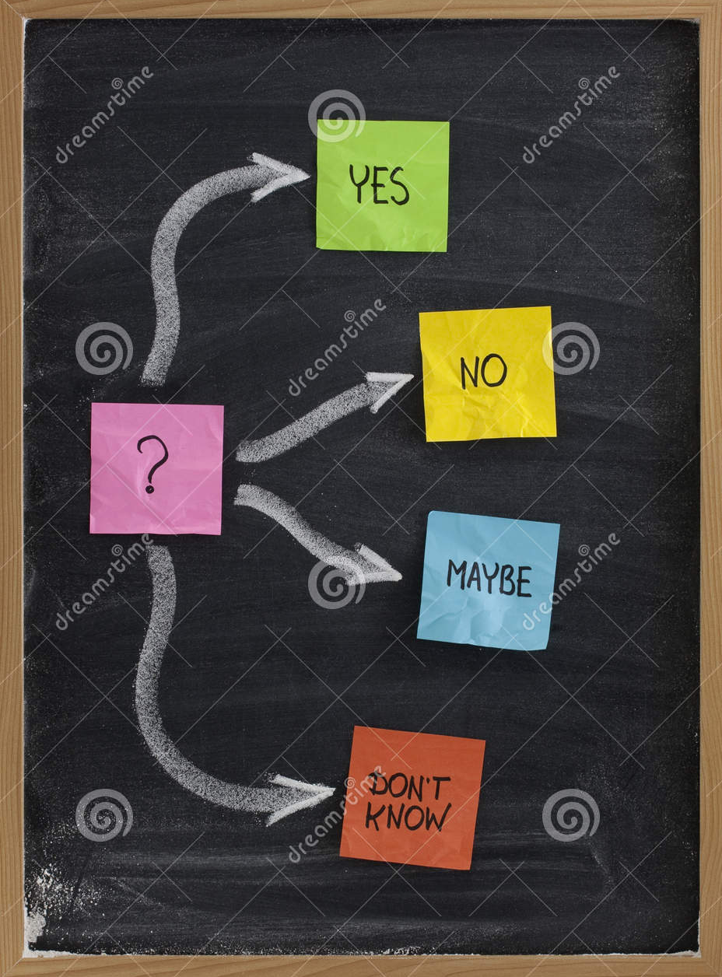
Power Mapping: Determine Target(s)
Determine position of each elected official on committee of interest in the legislature
Notes:
http://thumbs.dreamstime.com/z/decision-making-undecided-concept-11064369.jpg
http://googglet.com/images/5sos%20logo%20tally

Slide 46
District 3
District 2
District 4
Pertinent Committee
District 1
District 5

Slide 47
District 3
District 2
District 4
Pertinent Committee
District 1
District 5

Slide 48
Power Mapping: Step 3 & 4
Determine policy focus
Determine target(s)
Identify and map out top organization influence(s) of target(s)
Determine messenger/ally from top organizational influence(s)
Make a plan

Slide 49
Top Organization Influencer
District 3
District 2
Top Organization Influencer
#2
Top Organization Influencer
#1
Top Organization Influencer
Pertinent Committee
Top Organization Influencer
#3
District 5

Slide 50
Messenger/Ally from Top Organization Influencer
Messenger/Ally from Top Organization Influencer
Top Organization Influencer
District 3
District 2
Top Organization Influencer
#2
Top Organization Influencer
#1
Top Organization Influencer
Pertinent Committee
Top Organization Influencer
#3
District 5
Messenger/Ally from Top Organization Influencer

Slide 51
Power Mapping: Step 5
Determine policy focus
Determine target(s)
Identify and map out top organization influence(s) of target(s)
Determine messenger/ally from top organizational influence(s)
Make legislative visit(s)

Slide 52
Legislative Visits
Notes:
http://www.clipartbest.com/us-capitol-clip-art
http://www.picgifs.com/clip-art/meeting/
http://www.clipartbest.com/handshake-clip-art

Slide 53
Power Mapping: Summary
Determine policy focus
Determine target(s)
Identify and map out top organization influence(s) of target(s)
Determine messenger/ally from top organizational influence(s)
Make legislative visit(s)

Slide 54
Helpful Tips

Slide 55
Facilitation
Clearly delineate agenda and process for each step in the workshop
Strategically schedule breaks
Determine who to invite to the workshop and if applicable, assign pre-work
Use Post-It notes + colored tape/marker + whiteboard/chalkboard/butcher-paper before digitizing anything
Revisit and tweak as needed
Notes:
http://www.workshopexercises.com/Engagement.htm

Slide 56
Recap & Conclusion

Slide 57
Power Mapping (Recap)
Power mapping allows you to
build shared understanding of how power works around your advocacy issue
Understand key actors, their power and influence on the advocacy objectives before defining or refining strategies
Trigger personal and organizational reflection, leading to better relationships within and between partner organizations
Notes:
http://www.wateraid.org/~/media/Publications/GTF-Power-Analysis-Briefing.ashx.

