Slide 1
Mental Health Disparities among MARGINALIZED populations
Shruti Revankar and Jerome Jeevarajan

Slide 2
Test your knowledge

Slide 3
What percentage of U.S. adults with a mental health condition received treatment?
41%
Among adults with a severe mental health condition, 62.9%
Notes:
http://www.samhsa.gov/data/sites/default/files/NSDUH-FRR1-2014/NSDUH-FRR1-2014.pdf

Slide 4
What is the average loss in life expectancy for bipolar disorder, schizophrenia, alcohol/drug abuse and depression?
Bipolar disorder - 9 to 20 year reduction
Schizophrenia - 10 to 20 year reduction
Alcohol and/or drug abuse - 9 to 24 year reduction
Recurring depression - 7 to 11 year reduction
To put this into perspective…heavy smokers see a 8-10 year loss.
Some of these conditions lead to an average loss of life that is equivalent to someone who smokes 20+ cigarettes a day.
Notes:
http://www.ox.ac.uk/news/2014-05-23-many-mental-illnesses-reduce-life-expectancy-more-heavy-smoking

Slide 5
How many Americans die each year from suicide?
~42,000 to 43,000 die every year
Approximately 117 suicides a day
For each suicide, there are 25 attempts (may vary because data is hard to gather)
Notes:
http://afsp.org/about-suicide/suicide-statistics/

Slide 6
Mr. John Oliver the Wise
https://youtu.be/NGY6DqB1HX8?t=275

Slide 7
Homeless population

Slide 8
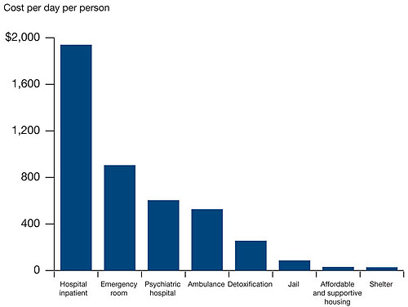
Mental Health Burden within the Homeless Population
20-25% of the homeless population suffers from some form of severe mental illness
More than 124,000 of the 610,000 homeless people in the U.S.
A study in California determined that 15% of all people suffering from serious mental illnesses were homeless at least once in a one-year period
Mental health problems are a significant independent risk factor for homelessness
Source: Federal Strategic Plan to Prevent and End Homelessness
Notes:
http://www.nationalhomeless.org/factsheets/Mental_Illness.pdf
http://www.usatoday.com/story/news/nation/2014/08/27/mental-health-homeless-series/14255283/
http://ps.psychiatryonline.org/doi/abs/10.1176/ps.2009.60.4.465

Slide 9
Progress Being Made

Slide 10
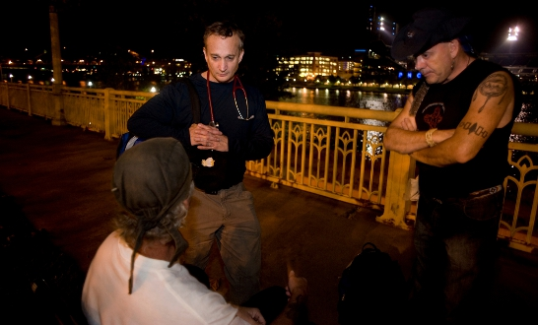
Operation Safety Net
Street Medicine in Pittsburgh
First program of its kind
Another program: Houston outreach program started in 2011 to identify homeless individuals and assess vulnerability and signs of mental illness
Relocates individuals into public housing
Average wait time until move-in: 56 days
Notes:
https://www.pmhs.org/operation-safety-net/
http://www.usatoday.com/story/news/nation/2014/08/27/mental-health-homeless-series/14255283/

Slide 11
Incarcerated population
(and their families)

Slide 12
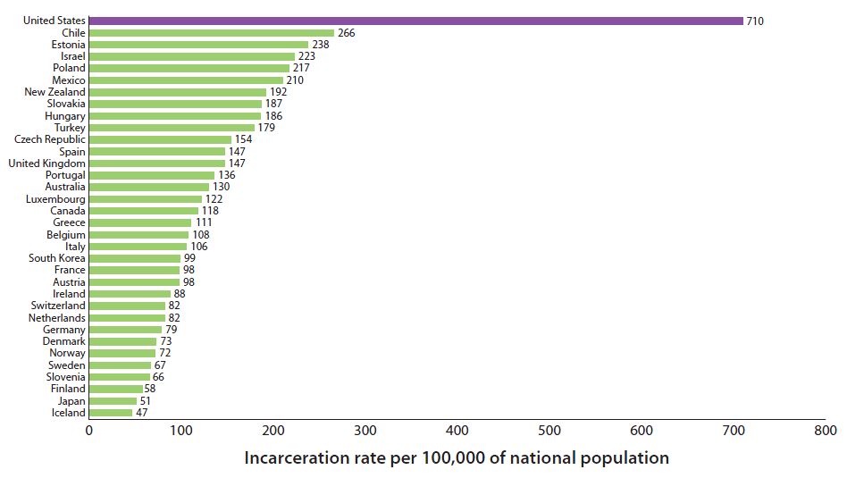
Mental Health Burden within the Incarcerated Population
2.2 million in U.S. jails and prisons, and another 4.5 million on probation or parole
1 of every 35 adults
1 in 3 black men can expect to go to prison – intersectionality
Notes:
DOJ and Bureau of Justice Statistics
http://www.brookings.edu/~/media/multimedia/interactives/2014/10_facts_crime/crimeFig6.png

Slide 13
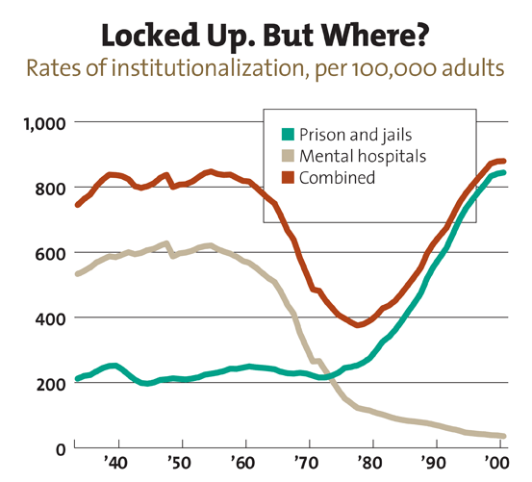
Mental Health Burden within the Incarcerated Population
72% of people in prison with a serious mental health condition also have a substance dependence issue
Rikers Island in New York – over 11,000 prisoners, ~40% have a diagnosed mental health condition
More than all the adult patients in New York state psychiatric hospitals combined
PTSD, Depression, Anxiety
Notes:
http://www.safetyandjusticechallenge.org/wp-content/uploads/2015/01/incarcerations-front-door-report.pdf
http://www.nytimes.com/2015/04/12/nyregion/for-mentally-ill-inmates-at-rikers-a-cycle-of-jail-and-hospitals.html?_r=1

Slide 14
Progress Being Made

Slide 15
Improving Mental Health for the Incarcerated Population
Reintegration Programs
Students teaching GED classes to incarcerated population
Amachi

Slide 16
LGBTQ Youth

Slide 17
Mental Health Burden within the LGBTQ Youth Population
~9 million LGBTQ youth
LGBTQ teenagers are ~6 times more likely to experience a mental health condition such as depression or generalized anxiety disorder
LGBTQ youth (age 10-24) are 4 times more likely to experience suicidal ideation, attempt suicide, or engage in self-harm
38-65% of transgender individuals experience suicidal ideation
Notes:
https://www.nami.org/Find-Support/LGBTQ
CDC. (2011). Sexual Identity, Sex of Sexual Contacts, and Health-Risk Behaviors Among Students in Grades 9-12: Youth Risk Behavior Surveillance. Atlanta, GA: U.S. Department of Health and Human Services.
Grossman, A.H. & D'Augelli, A.R. (2007). Transgender Youth and Life-Threatening Behaviors. Suicide and Life-Threatening Behaviors.37(5), 527-37.

Slide 18
Progress Being Made

Slide 19
New Mental Health Resources for LGBTQ Youth
LGB students have fewer suicidal thoughts and attempts when schools have gay-straight alliances and policies that prohibit expressions of homophobia for 3+ years
The Gay and Lesbian Medical Association’s Provider Directory lists inclusive providers
The Trevor Project is a support network for LGBTQ youth that provides crisis intervention and suicide prevention
The Rainbow Access Initiative educates health care providers on LGBTQ specific issues
Notes:
https://www.nami.org/Find-Support/LGBTQ
Saewcy EM, Konishi C, Rose HA, Homma Y. School-based strategies to reduce suicidal ideation, suicide attempts, and discrimination among sexual minority and heterosexual adolescents in Western Canada. International Journal of Child, Youth and Family Studies 2014;1:89‒112.

Slide 20
veterans

Slide 21
Mental Health Burden within the Veteran Population
23.4 million veterans in the U.S.
Quarter million Vietnam veterans with PTSD
30% of active duty and reserve personnel in Iraq/Afghanistan have a mental health condition requiring treatment
Less than 50% of returning veterans receive any mental health care
Recent studies show veterans with mental health diagnoses experience increased stigma and barriers to care
Approximately 22 veterans die each day because of suicide
Veterans with PTSD or subthreshold-PTSD endorse anger, violence, and aggression significantly more than their colleagues without PTSD
Notes:
http://www.thenationalcouncil.org/topics/veterans/
http://ps.psychiatryonline.org/doi/full/10.1176/ps.2009.60.8.1118
http://www.medicalnewstoday.com/articles/297149.php?trendmd-shared=1
Jakupcak M, Conybeare D, Phelps L, Hunt S, Holmes HA, Felker B, Klevens M, McFallME: Anger, hostility, and aggression among Iraq and Afghanistan war veterans reporting PTSD and subthreshold PTSD. J Trauma Stress 2007; 20:945–954

Slide 22
Progress Being Made

Slide 23
Improving Mental Health for the Veteran Population
117.6% increase in treatment intensity for veterans with PTSD at the VHA since 1997 due to recent increases in PTSD treatment funding
Veterans Court – alternative to incarceration that focuses on mental health and drug treatment
Notes:
http://ps.psychiatryonline.org/doi/10.1176/appi.ps.201100432?trendmd-shared=0

Slide 24
Minorities

Slide 25
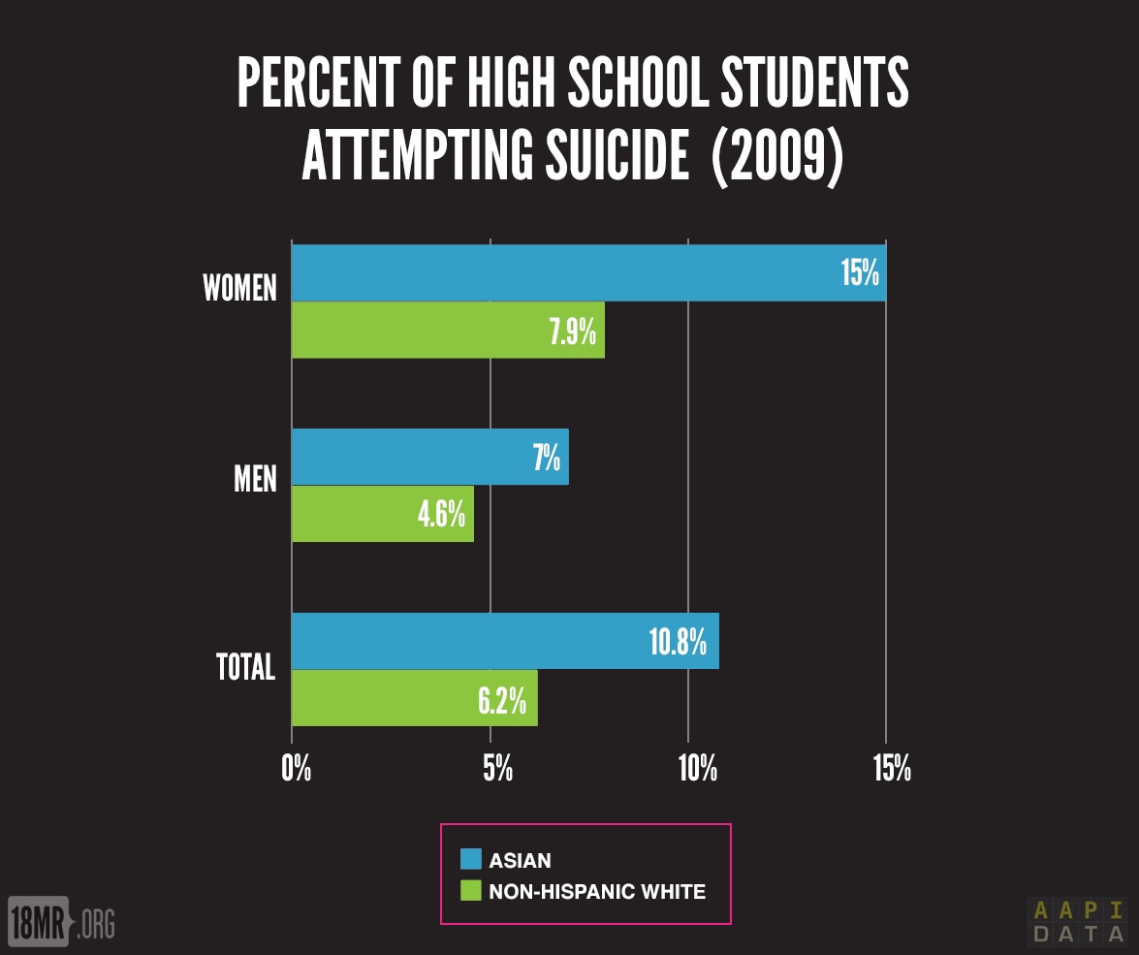
Mental Health Burden Among Asian Americans
Asian American women have a higher lifetime rate of suicidal thoughts
Asian American college students are more likely to have suicidal thoughts and to attempt suicide
Notes:
CDC, 2012. High School Youth Risk Behavior Survey Data. http://apps.nccd.cdc.gov/youthonline
Duldulao, A.A., Takeuchi, D.T., & Hong, S. (2009). Correlates of suicidal behaviors among Asian Americans. Archives of Suicide Research, 13, 277-290.

Slide 26
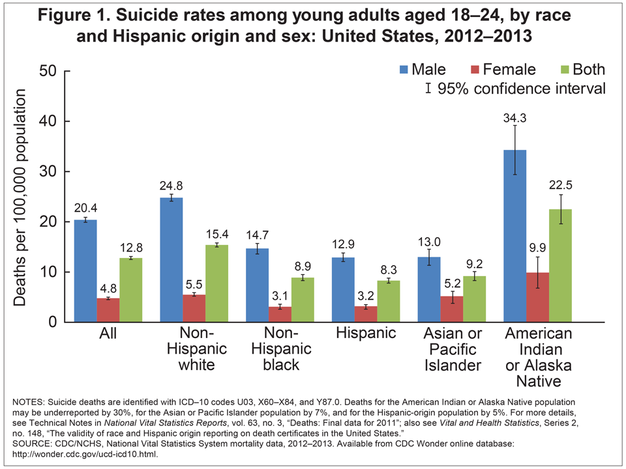
Mental Health Burden Among Native Americans
Young native women in Alaska are 19 times more likely to die because of suicide
Not many studies
Notes:
http://america.aljazeera.com/watch/shows/america-tonight/america-tonight-blog/2013/8/28/5-huge-native-americanhealthissuesyoudontknowabout.html

Slide 27
Mental Health Burden Among Black Americans
Racial and ethnic minorities are expected to become the majority in America by 2050
African Americans living below the poverty level are 3 times more likely to report psychological distress
Higher rates of PTSD because of higher crime rates
Costs and lack of insurance – most common reason to not use mental health services across all racial/ethnic groups
Belief that mental health services will help – least common reason
Notes:
CDC and HHS
http://minorityhealth.hhs.gov/omh/browse.aspx?lvl=4&lvlid=24
http://www.nimh.nih.gov/news/science-news/2015/a-new-look-at-racial-ethnic-differences-in-mental-health-service-use-among-adults.shtml

Slide 28
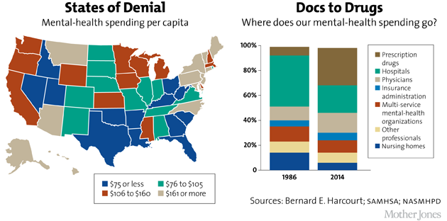
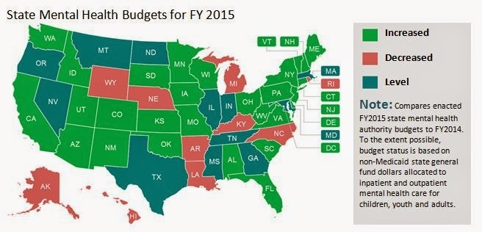
Inadequate State Mental Health Budgets
Source: National Alliance on Mental Illness
Notes:
http://www.governing.com/topics/health-human-services/gov-mental-health-report-national-alliance.html

Slide 29
Discussion QUESTIONS

Slide 30
Discussion Questions
What facts did you learn that you were surprised by?
How do you think single payer health care would improve mental health care for these marginalized populations?
What can be done on a campus level that targets one or more of these problems?
In medical school, are you given enough tools to handle mental health issues in your patients?
What are some flaws in our mental health system as it pertains to marginalized populations that we missed?

