Slide 1
The Intersections of Universal Coverage and Public Health
Ashley Cobb, MS4, MPH
Swathi Damodaran, MS4, MPH

Slide 2
Overview
Universal Health Coverage
History, Definition, Goals
Public Health
Definition, Goals
Complementary Systems
Public Health in Practice

Slide 3
Definitions

Slide 4
Universal Coverage
The goal of universal coverage is to ensure that all people obtain the health services they need without suffering financial hardship when paying for them - WHO¹
Access
Affordable
Quality
Capacity
Notes:
Question: what do we need to achieve universal coverage?
Everyone in a population having access to appropriate, promotive, preventive, curative, and rehabilitative health care when they need it and at an affordable cost.
For a community or country to achieve universal health coverage, several factors must be in place, including:
A strong, efficient, well-run health system that meets priority health needs through people-centred integrated care (including services for HIV, tuberculosis, malaria, noncommunicable diseases, maternal and child health) by:
informing and encouraging people to stay healthy and prevent illness;
detecting health conditions early;
having the capacity to treat disease; and
helping patients with rehabilitation.
Affordability – a system for financing health services so people do not suffer financial hardship when using them. This can be achieved in a variety of ways.
Access to essential medicines and technologies to diagnose and treat medical problems.
A sufficient capacity of well-trained, motivated health workers to provide the services to meet patients’ needs based on the best available evidence.

Slide 5
Why Universal Coverage?
Notes:
Is health a human right?--> does this mean all services?
How do you define health? How do you define universal coverage?
Anything missing from the definition as defined as WHO?
Does single-payer achieve universal coverage?

Slide 6
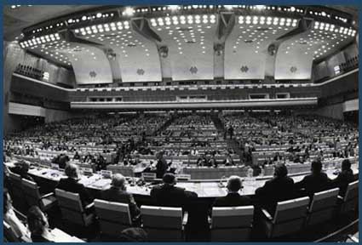
History
1883: The Bismarck Model
1945: End of WWII
1948: WHO Constitution
1978: Declaration of Alma Ata
1980s: HIV/AIDs outbreak
2005: World Health Assembly
http://www.rockefellerfoundation.org/uploads/files/23e4426f-cc44-4d98-ae81-ffa71c38e073-jesse.pdf
Notes:
1880s: Named for the Prussian Chancellor Otto von Bismarck invented the welfare state as part of the unification of Germany in the 19th century. insurers are called "sickness funds" - everyone had to be covered, not for profit. Cumpulsory sickness insurance.
The primary reason for the emergence of these programs in Europe was income stabilization and protection against the wage loss of sickness rather than payment for medical expenses, which came later.
1945: NHS established - a time when Britain saw health care as crucial to one of the "five giants" that were declared should be slain during post-war reconstruction. (want, disease, squalor, ignorance, idleness) The cataclysm of war provided an opportunity that might not have been taken in quieter times.
1948: WHO Universal Declaration of Human Rights: “the right of everyone to the enjoyment of the highest attainable standard of physical and mental health”— now a cornerstone to global health governance.
1978: The International Conference on Primary Health Care (PHC) convened by WHO and United Nations Children's Fund (UNICEF) in Alma Ata (Kazakhstan) in 1978 and attended for the first time by representatives from all countries in the world, generated a solemn Declaration that strongly
emphasized: a) health as a basic human right; b) the role of the state in the universal provision of health care; c) community participation as a fundamental prerequisite for effective health care.
1980s: HIV/AIDs created a renewed interest in justice and the perception of health as a human right. scared a lot of people.
2005: Noting that health-financing systems in many countries need to be further developed in order to guarantee access to necessary services while providing protection against financial risk, the Assembly adopted a resolution on sustainable health financing and universal coverage and social health insurance and urged the Director-General to provide support to Member States to evaluate the impact of changes in health-financing systems on health services as they move towards universal coverage.

Slide 7
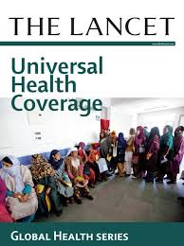
Recent History
2010: WHO Report
2012:
Lancet Series
WHA
2013:
Framework Convention on Global Health
World Bank UHC Study Series
2014: Toward Universal Coverage by 2030
Notes:
2010: WHO Report: “Health Systems Financing: The Path to Universal Coverage”. In this report, the World Health Organization maps out what countries can do to modify their financing systems so they can move more quickly towards this goal - universal coverage - and sustain the gains that have been achieved The report builds on new research and lessons learnt from country experience. It provides an action agenda for countries at all stages of development and proposes ways that the international community can better support efforts in low income countries to achieve universal coverage and improve health outcomes.
2012: A special Lancet series on progress toward universal health coverage, This first of its kind series addresses and expands upon three critical elements in the global movement towards UHC: the effects of universal health coverage on population health; government involvement in universal health coverage, and how low-income and lower middle-income countries in Africa and Asia are progressing towards universal health coverage. WHA: UHC “is the single most powerful concept that public health has to offer”- Margaret Chan.
2013: BASED IN JUSTICE. Framework Convention on Global Health (FCGH)–grounded in the right to health, with the central goal of reducing immense domestic and global health inequities–could serve as a robust global governance instrument to underpin the United Nations post-2015 Millennium Development Goals (MDGs). It would ensure for all people the three essential conditions for a healthy life–public health, health care, and the positive social determinants of health–while advancing good governance, responding to drivers of health disadvantages for marginalized populations, elevating health in other legal regimes, and enhancing people's ability to claim their rights.Framework monitors three different indicators: health service coverage; financial risk protection; and equity or coverage for the entire population.
WB UHC series: looked at 22 countries + MASS with UHC. The Bank’s universal health coverage study series offers knowledge and operational tools to help countries tackle challenges in ways that are fiscally sustainable and that enhance equity and efficiency. The team will also test the UNICAT, a new universal coverage assessment tool, which they developed based on lessons from the studies. The tool will help countries assess their strengths and weaknesses in implementing universal health coverage.
2014: UHC high priority in the post-MDGs era: SDGs. Has moved to the top of the Global Health Agenda. Co-sponsored by the World Bank Group and the World Health Organization (WHO), this half-day high-level event will identify ways in which countries can accelerate achievement of the Millennium Development Goals (MDGs) and emerging post-2015 targets with aligned support from the global development community around universal health coverage.

Slide 8
Margaret Chan on Universal Coverage-
“The single most powerful concept that public health has to offer…..Universal coverage is the best way to cement health gains made during the previous decade. It is a powerful social equalizer and the ultimate expression of fairness”
Notes:
Every year 100 million people are pushed into poverty because they have to pay for health services directly.
Universal health coverage has a direct impact on a population’s health. Access to health services enables people to be more productive and active contributors to their families and communities. It also ensures that children can go to school and learn. At the same time, financial risk protection prevents people from being pushed into poverty when they have to pay for health services out of their own pockets. Universal health coverage is thus a critical component of sustainable development and poverty reduction, and a key element of any effort to reduce social inequities. Universal coverage is the hallmark of a government’s commitment to improve the wellbeing of all its citizens.

Slide 9
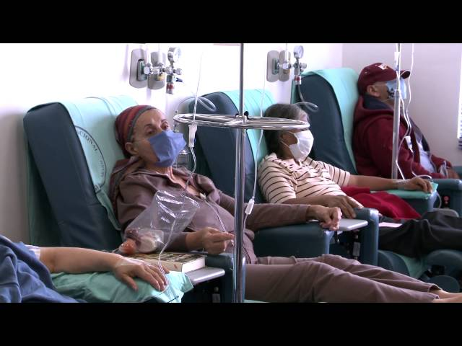
Achieving Universal Coverage²
Notes:
Question: how can we achieve universal coverage?
-national health reform → single-payer
-single payer is an insurance reform → what else do we need? (think about the three parts of universal coverage)
-Access: better health systems, delivery of care
-Affordable: physician payments, what services are we valuing
-Quality: primary care services, prevention services,
Video: by WHO looking at how different countries are implementing policies and programs to achieve universal coverage

Slide 10
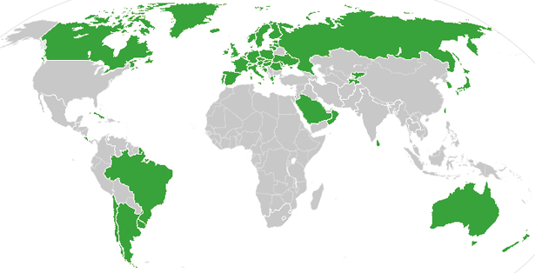
Current Status
Source: The Atlantic, 2012
Notes:
Thirty-two of the thirty-three developed nations have universal health care, with the United States being the lone exception (as of 2013).

Slide 11
Universal Coverage in the US: A Brief Look
1880s-Medicare
1901-1909
1930s
1960s
1883-1912
1915: AALL Bill
1940s
2012: ACA
PNHP website: http://www.pnhp.org/facts/a-brief-history-universal-health-care-efforts-in-the-us
Notes:
WHAT CAN WE LEARN FROM HISTORY?
Political feasibility in the US
1880s: The campaign for some form of universal government-funded health care has stretched for nearly a century in the US On several occasions, advocates believed they were on the verge of success; yet each time they faced defeat.
1883-1912: essentially the federal government left matters to the states and states left them to private and voluntary programs. The US did have some voluntary funds that provided for their members in the case of sickness or death, but there were no legislative or public programs during the late 19th or early 20th century. In the Progressive Era, which occurred in the early 20th century, reformers were working to improve social conditions for the working class. However unlike European countries, there was not powerful working class support for broad social insurance in the US The labor and socialist parties’ support for health insurance or sickness funds and benefits programs was much more fragmented than in Europe.
1901-1909: President Theodore Roosevelt was in power and although he supported health insurance because he believed that no country could be strong whose people were sick and poor, most of the initiative for reform took place outside of government. Roosevelt’s successors were mostly conservative leaders, who postponed for about twenty years the kind of presidential leadership that might have involved the national government more extensively in the management of social welfare.
AALL Bill: 1906, the American Association of Labor Legislation (AALL) finally led the campaign for health insurance. In a nutshell, the bill limited coverage to the working class and all others that earned less than $1200 a year, including dependents. The services of physicians, nurses, and hospitals were included, as was sick pay, maternity benefits, and a death benefit of fifty dollars to pay for funeral expenses. This death benefit becomes significant later on. Costs were to be shared between workers, employers, and the state.
Supported by AMA initially but later oppoed, opposed by AFL and commercial insurance companies.
1917: Anti-German fever → denounced “German socialist insurance” and opponents of health insurance assailed it as a “Prussian menace” inconsistent with American values. End of the compulsory insurance debate until the 1930s.
1930s: focus shifted from stabilizing income to financing and expanding access to medical care. By now, medical costs for workers were regarded as a more serious problem than wage loss from sickness. ⇒ CCMC 1926-1932 (Committee on the Cost of Medical Care) recommended that more national resources go to medical care and saw voluntary, not compulsory, health insurance as a means to covering these costs.
-------FDR 1st Attempt: Franklin D. Roosevelt (FDR), whose tenure (1933-1945) can be characterized by WWI, the Great Depression, and the New Deal, including the Social Security Bill. We might have thought the Great Depression would create the perfect conditions for passing compulsory health insurance in the US, but with millions out of work, unemployment insurance took priority followed by old age benefits. FDR’s Committee on Economic Security, the CES, feared that inclusion of health insurance in its bill, which was opposed by the AMA,would threaten the passage of the entire Social Security legislation. It was therefore excluded.
-------FDR’s second attempt — Wagner Bill, National Health Act of 1939. which gave general support for a national health program to be funded by federal grants to states and administered by states and localities. However, the 1938 election brought a conservative resurgence and any further innovations in social policy were extremely difficult.
1940s: Henry Sigerist (medical Historian, JHU). He passionately believed in a national health program and compulsory health insurance.
1943: Wagner-Murray- Dingell Bill. The bill called for compulsory national health insurance and a payroll tax. Although the Wagner-Murray-Dingell Bill generated extensive national debates, with the intensified opposition, the bill never passed by Congress despite its reintroduction every session for 14 years! Had it passed, the Act would have established compulsory national health insurance funded by payroll taxes.
TRUMAN: 1945-1953: Cold War/Communism- The health care issue (national health insurance) finally moved into the center arena of national politics and received the unreserved support of an American president. ompulsory health insurance became entangled in the Cold War and its opponents were able to make “socialized medicine” a symbolic issue in the growing crusade against Communist influence in America. Truman was strongly committed to a single universal comprehensive health insurance plan. Whereas FDR’s 1938 program had a separate proposal for medical care of the needy, it was Truman who proposed a single egalitarian system that included all classes of society, not just the working class.
1960s: Union-negotiated health care benefits also served to cushion workers from the impact of health care costs and undermined the movement for a government program. Aime Forand introduced a new proposal in 1958 to cover hospital costs for the aged on social security. Predictably, the AMA undertook a massive campaign to portray a government insurance plan as a threat to the patient-doctor relationship. In response, the government expanded its proposed legislation to cover physician services, and what came of it were Medicare and Medicaid. Finally, in 1965, Johnson signed it into law as part of his Great Society Legislation, capping 20 years of congressional debate.
2012 ACA: individual mandate

Slide 12
What is Public Health?

Slide 13
Public Health is...²

Slide 14
Tools of Public Health
The science of protecting and improving the health of families and communities through promotion of healthy lifestyles, research for disease and injury prevention, and detection and control of infectious diseases - CDC³
Research
Policy
Education
Services
Notes:
Question: How does public health achieve this goal?
Question: How can we engage the public health community to forward the mission of single payer and universal coverage?

Slide 15
Universal Coverage
Public Health
What are the core values?
Notes:
Social justice
Equity
Humanitarianism, health as a human right
Equality
Prevention
Population-focus
Mutual Responsibility
Cost-effectiveness/affordability
Primary care
Access
Social Determinants of Health

Slide 16
EQUITY
Notes:
Question: What is equity? What is equality? How do the two differ?
How does this definition relate to our earlier discussion of health as a human right?

Slide 17
Margaret Chan...again:
"Universal health coverage is one of the most powerful social equalizers among all policy options. It is the ultimate expression of fairness,"
- Margaret Chan, WHO Director-General
Quoted on Tuesday at a two-day conference on universal health coverage, Singapore.
Notes:
Providing universal health coverage is a key way to address increasing global inequality
Achieving such coverage demands "deliberate policy decisions," she said, adding, "At a time when policies in so many sectors are actually increasing social inequalities, I would be delighted to see health lead the world towards greater fairness in ways that matter to each and every person on the planet."

Slide 18
Single-Payer and Equity
Increased access for primary care services, but not specialty care^{5, 6}
Socioeconomic differences in access
Education-based inequities⁷
Geographic differences in access to resources remain⁸
Notes:
5,6: Canadian research
7: Taiwan - Northern Taiwan has more resources allocated, rural areas still suffer

Slide 19
How Can Public Health Fill the Equity Gap?

Slide 20
Public Health in Practice

Slide 21
Public Health in Practice
Imagine that you are the Canadian minister of health in Ontario.
Everyone in your province has health insurance coverage under the national system.
You still find socioeconomic based inequities for specialty care services.

Slide 22
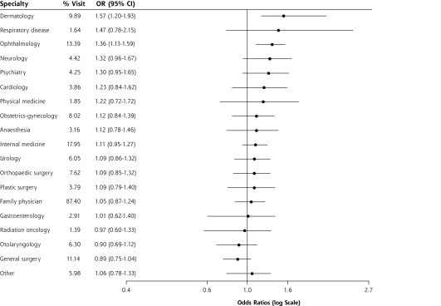
In particular, you find an education-based inequity where those with low levels of education see less ophthalmologists than those with high levels of education⁷
Notes:
More specifically concerned with eye health

Slide 23
Improving Eye Health
How would you address the inequity?
Policies?
Programs?
Services?

Slide 24
Question: What do you see as the biggest barriers to Universal Coverage in the US? What are the next steps? Future of public health/UHC?
Notes:
Thinking about NCDs….outbreak control (Ebola)......

Slide 25
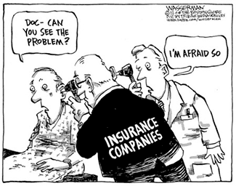
Thank you! Any questions?

Slide 26
References
World Health Organization. (2014). What is universal Coverage? Retrieved on 2/11/15 from http://www.who.int/features/qa/universal_health_coverage/en/.
World Health Organization. (2013). WHO: The many paths towards universal health coverage. Retrieved on 2/11/15 from https://www.youtube.com/watch?v=VQ3sHfYzcv8.
American Public Health Association. (2014). What is public health? Retrieved on 2/11/15 from https://www.apha.org/what-is-public-health.
Centers for Disease Control. (2015). What is Public health? Retrieved on 2/11/15 from http://www.cdcfoundation.org/content/what-public-health.
Veugelers PJ and Yip AM. (2003). Socioeconomic disparities in health care use: Does universal coverage reduce inequalities in health? J Epidemiol Community Health 57:424-428.
Gusmano MK, et al. (2009). Achieving horizontal equity: must we have a single-payer health system? Journal of Health Politics, Policy and Law 34(4):617-33.
Glazier RH, et al. (2009). Universal health insurance and equity in primary care and specialist office visits: a population-based study. Ann Fam Med 7(5):396-405.
Kreng VB and Yang C. (2011). The equality of resource allocation in health care under the National Health Insurance System in Taiwan. Health Policy 100(2-3):203-210.

