Slide 1
Organizing in your Specialty and Medical Society
Andrea DeSantis, DO
Richard Bruno, MD
Michael Kaplan, MD

Slide 2
Goals of this Workshop
Identifying existing forums for organizing around the topic of Single Payer within your medical specialty
Writing resolutions
Put a strategy in place and tips for success
Group networking activity

Slide 3
Join existing Committees or Communities
Join an existing committee or group
      Already tasked to oversee content and programing around similar topics like patient care, practice improvement, health of the public
Start an interest group within your organization e.g., The American Academy of Family Physicians’ Member Interest Groups (“MIGs”)
  AAFP MIGs were started by a few doctors at the the annual Student and Resident conference

Slide 4
Find the Like Minded…
  Attend meetings and forums and ask the tough questions…. then watch and see who responds favorably!
    Medical bankruptcy
    Logistical challenges of underinsurance (churn)
    Increasing administrative costs
    Physician burnout
    Start networking from there

Slide 5
Find the Like Minded…
Identify influential SP supporters or sympathizers who are currently active or have a history within the Society.
Reach out with emails, phone calls and conversations asking for advice and direction
  Past present presidents and board members
  Staff and chapter directors
    Medical School Faculty
    Single Payer activists in your community

Slide 6
Local and National
Meetings and Conferences
Attend chapter and national meetings get the “lay of the land”.
Offer to give or organize a PNHP national speaker to give evidence based lectures to attendees, students and residents.
Consider submitting a formal resolution for Single Payer or a topic relevant to Single Payer.
Invite and help staff a PNHP booths at local or national meetings.

Slide 7
Tips for keeping organized as you organize…
Set Goals and Objectives
Create positions to help divide up the work:
      Chair, Co-chair, Secretary, Treasurer, Meeting Coordinator..
Hold regularly scheduled group call-in or on-line meetings (same time and day of the month)
Keep meeting notes and working documents in a central on-line and interactive location
Be creative and have fun!

Slide 8
Other Societies taking action…
California Medical Association (CMA)
  Drs. Art Chen and Corinne Frugoni
  Technical advisory committee was appointed to study:
      1332 Waiver to Implementation of a public Option
      1332 Waiver similar to Vermont’s Green Mountain Care
      Consideration of pilot studies of either program

Slide 9
Other Societies taking action…
California Medical Association’s tips for success
    Be persistent – submitted yearly for 4 years in a row
    Find allies – within the staff and fellow delegates
    Wording changes (physician run, evidence based and innovation waver instead of SP)
    Focus on the quadruple aim (includes physician burn out)
    The power of the few…. with good data and a positive message

Slide 10
Organizing Within Your State Chapter Or Your Local Medical Society
Get elected or selected for their governing body. These positions are often open to any who express interest. Attend the meetings.
Mass Medical Society HOD passed a resolution to study SP support, which was included in annual survey. Votes to support Single Payer generally failed 2 to 1.
Provide education. PNHP speakers are available.
Submit resolution to State Chapter or Medical Society supporting SP. Keep resubmitting.

Slide 11
Other Societies Taking Action
The American College of Physicians (ACP)
The American Academy of Pediatrics (AAP)
  Dr Rober Zarr has helped organize resolutions.
  Outright support was voted down last year but is in the works for 2017.
The American Society of Clinical Oncology (ASCO)
  “Why Oncologists should support single payer” (Dr. Ray Drasga)

Slide 12
Other Societies Taking Action
The American Psychiatric Association
  Dr. Leslie Gise organizes a panel discussion on payment reform at every meeting
The Michigan State Medical Society (MSMS)
  Dr. James Mitchiner headed up efforts to study SP
  Allocated $50,000 for the study of single payer
The American Medical Association (AMA)
  Dr. Peter Orris and medical student James Curry
  An “updated study of health care payment models”

Slide 13
Crafting and submitting resolutions
Investigate the protocol for submission
Find samples of prior resolutions; fill in single payer topics
    Outright support of Single Payer
    Medicare negotiating drug prices
    “The study of”… finance reform, SP, etc.
    Focus on popular topics…barriers to care like HDHC, medication costs, physician shortages in rural and urban America
Collaborate with chapters and special groups to co-sponsor or submit their own version.

Slide 14
Reach out to PNHP for Support
Advice!
Resources!!
Expertise!!!

Slide 15
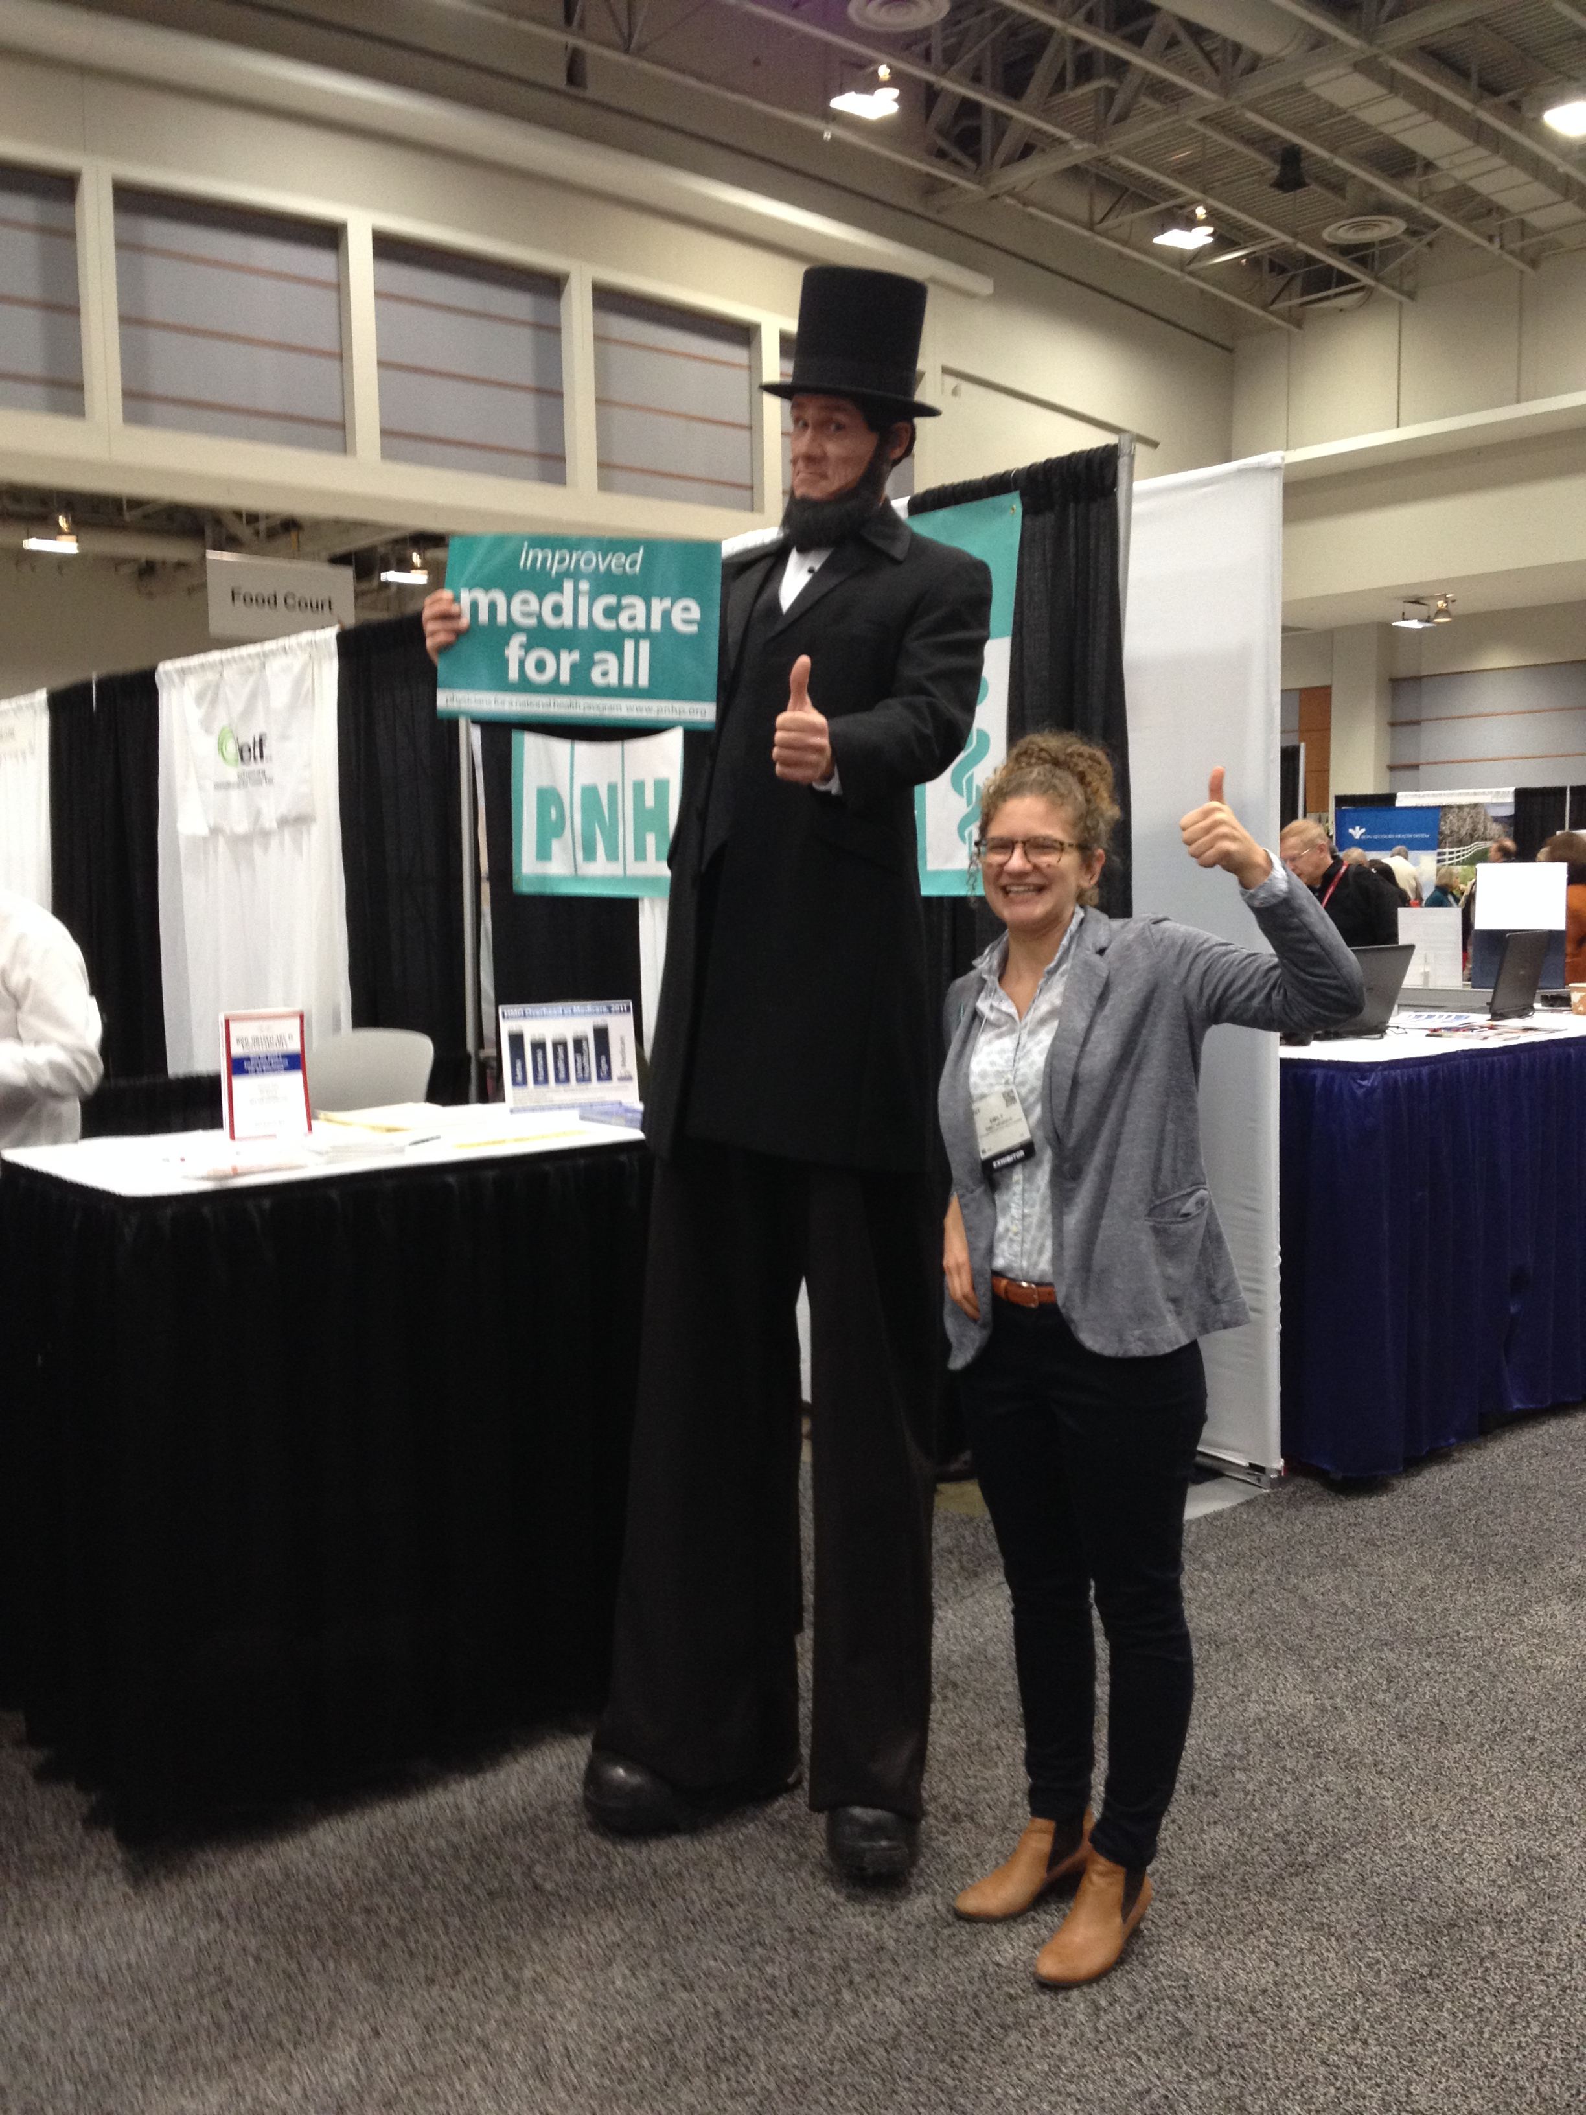
Sponsorship of a booth in the exhibit areas

Slide 16
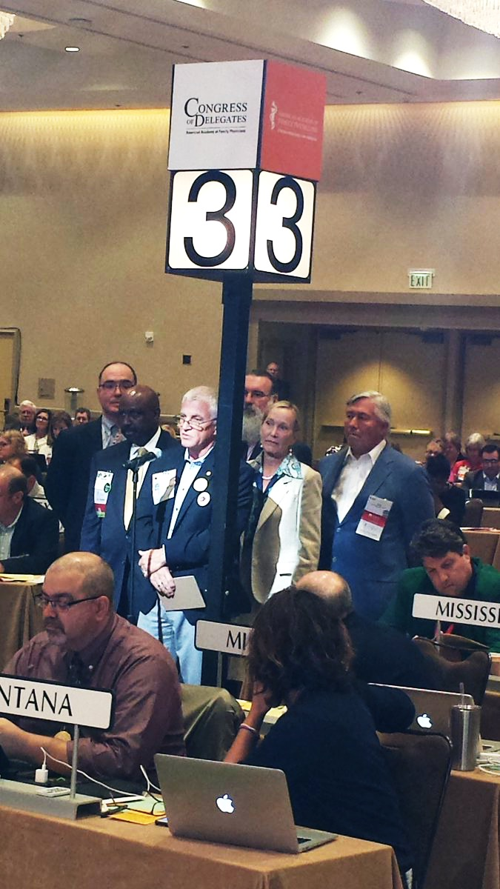
AAFP
Congress of Delegates
Orlando Florida 2016
Six past presidents
organized an unprecedented show of support for
Single Payer.

Slide 17
Single Payer Resolutions at the AAFP COD
Approved: The resolution for support of legislation allowing Medicare to negotiate drug prices. (Oregon, Illinois, and New York)
Three were tabled for further Board review:
  Two resolutions supporting Single Payer
    Physician Protection under SP (New York chapter)
    The AAFP advocate for a SP system (New York chapter)
  Study of a National Publicly finances privately delivered. (Illinois)
  The Commission for government affairs will be handling the task of studying this issue as it pertains to the quadruple aim (cost, access, quality and physician burn out)

Slide 18
Break out activity
Gather into medical specialties and…
  Identify where our current finance system impacts the quadruple aim in a negative manner specific to your specialty.
  Identify where SP would help correct that problem
  Come up with one or two things you can do to start influencing, networking, and organizing for single payer in your medical society or local medical association.
  Open discussion

