Slide 1
Single Payer in the Era of Defending the ACA
Ebiere Okah, MS IV and Lily Ostrer MS III

Slide 2
Overview
Popularity of single payer
Barriers to single payer implementation and the feasibility of enacting single payer healthcare system during Trump Administration
Value of collaborating with allied groups to prevent ACA repeal
Importance of continuously fighting for single payer

Slide 3
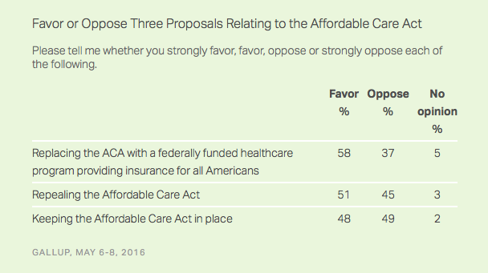
Popularity of the ACA and Single Payer
Notes:
http://www.gallup.com/poll/191504/majority-support-idea-fed-funded-healthcare-system.aspx
Only 22% of Americans say they want the ACA repealed and do not favor replacing it with a federally funded system

Slide 4
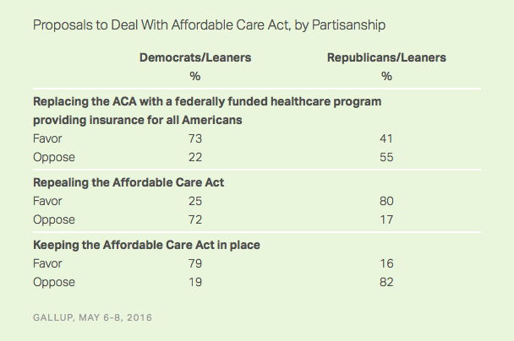
Popularity of the ACA and Single Payer
Notes:
http://www.gallup.com/poll/191504/majority-support-idea-fed-funded-healthcare-system.aspx

Slide 5
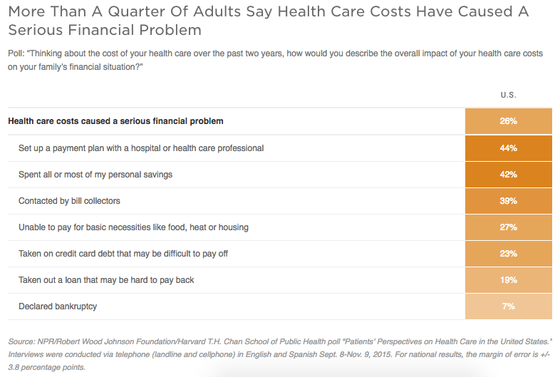

Slide 6
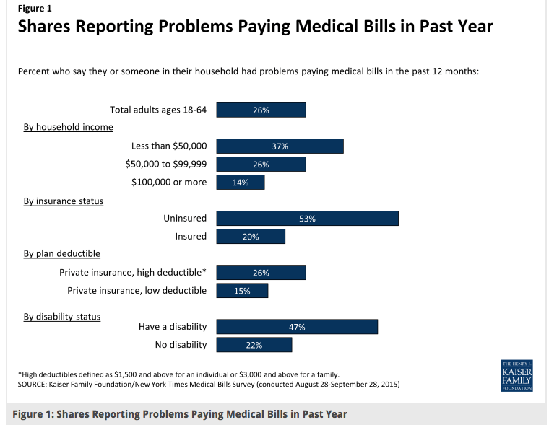

Slide 7
Popularity of ACA and Single Payer
Single payer is more popular than the ACA
There is some Republican support for single payer
Notes:
When forced to choose between single payer or the ACA, those who were OK with at least one of those options chose single payer (64% to 32%).

Slide 8
If single payer is so popular, why aren’t we closer to a single payer system?

Slide 9
Why aren’t we closer to a single payer system?
Americans are personally happy with their health insurance
Strength of insurance industries and medical industry
Political opposition
Lack of organized movement for health care access

Slide 10
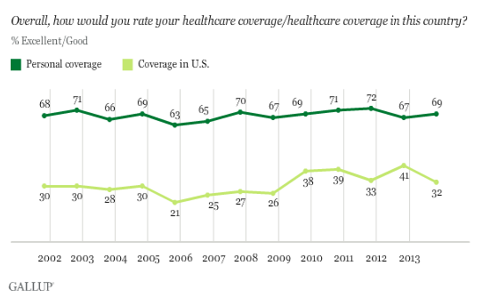

Slide 11
Industry Opposition to single payer
Current narrative based on insurance overhead, insurance profits, and health provider resources spent on billing
Hospitals and pharmaceutical companies bill excessively and with wild variability (“Bitter Pill..”)
AMA opposed creation of government-sponsored insurance plan in 2008
Notes:
http://www.gallup.com/poll/191504/majority-support-idea-fed-funded-healthcare-system.aspx

Slide 12
Political opposition to single payer
Republicans’ low-tax, anti-entitlement philosophy
Republican public fight against the ACA

Slide 13
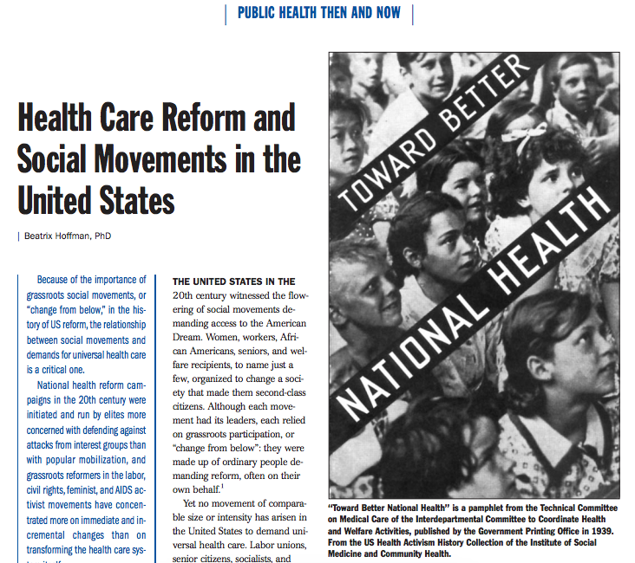
Lack of organized health care movement
Notes:
Beatrix Hoffman, PhD - Journal of American Journal of Public Health

Slide 14
Lack of organized health care movement
“National health reform campaigns in the 20th century were initiated and run by elites more concerned with defending against attacks from interest groups than with popular mobilization, and grassroots reformers in the labor, civil rights, feminist, and AIDS activist movements have concentrated more on immediate and incremental changes than on transforming the health care system itself.”
Notes:
There has been much less grassroots organizing in healthcare than in other popular movements (Medicare march w/ elderly)
Professional organizations cannot lead this movement. The uninsured should be the face of this movement.
Comprehensive reform is a long-term goal.

Slide 15
ACA

Slide 16
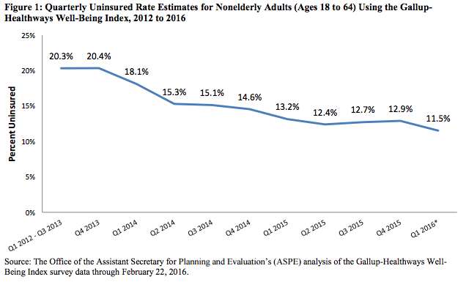
What did the ACA achieve?

Slide 17
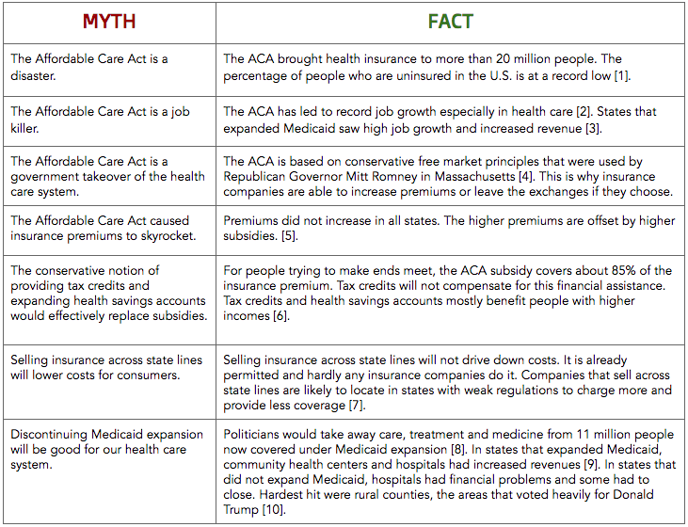
From Public Health Awakened:

Slide 18
Single Payer, beloved by all?
Single payer is popular in the general public but perceived impractical
Major opposition to single payer primarily from healthcare industry
Organized medicine
Hospitals
Pharmaceutical companies
Health insurance
Political opposition to single payer
Republican political philosophy: low taxes and small government (entitlement programs)
Politicians beholden to healthcare industry

Slide 19
Where are we right now with health care? American Health Care Act?

Slide 20
American Health Care Act
House Republicans drafted a new healthcare bill that would:
Reduce the number of Medicaid recipients
Reduce the tax burden on the rich
Eliminate the individual mandate to purchase insurance
Eliminate employer mandate to provide insurance
Reduce individual premium subsidies
Eliminate subsidies for out-of-pocket expenses
Keep dependent coverage until age 26, pre-existing conditions policy, and essential health benefits

Slide 21
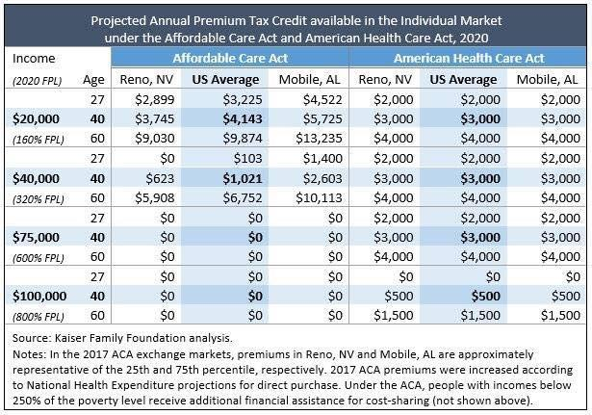

Slide 22
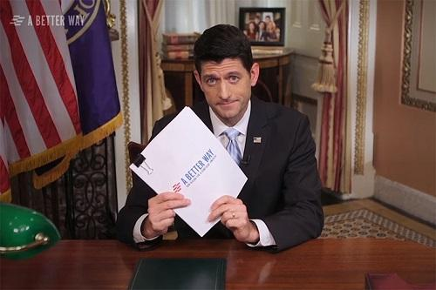
ACA Repeal?

Slide 23
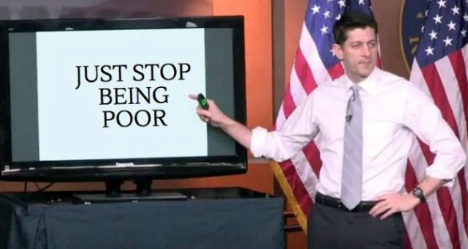
ACA Repeal?

Slide 24
Summary
Republicans in Congress will not create a healthcare plan that results in better and more comprehensive coverage.
Health care is expensive and costs continue to rise.
Americans are generally happy with their healthcare costs while being generally dissatisfied with our country’s expenditures on health care.
Americans support single payer.

Slide 25
Will repealing the ACA bring us closer to single payer? What would the impact of repealing the ACA be?

Slide 26
Two Paths
Ignore efforts to fight ACA repeal and continue to push for single payer
Join the fight against ACA repeal while also pushing for single payer

Slide 27
Path 1: Ignore ACA, push for single payer
If ACA repealed, 20 million people will lose health insurance coverage
Can single payer be a substitute?
Will we reach a “crisis” that might bring about single payer?

Slide 28
Path 2: Fight for ACA and single payer
Can the ACA be a stepping stone to single payer?
It doesn’t change the use of private insurance but it changes people’s understanding of healthcare as a right ensured by the government.
Can the ACA be improved to include single payer? Is there a path towards single payer using the framework of the ACA?

Slide 29
Ignore the ACA, push for single payer | Protect the ACA and fight for single payer
Responses from participants: ACA has already failed, leaves 10s of millions of people out, insurance is inadequate under ACA (bronze plans) Idea that we should keep ACA to prevent crisis is a non-argument -- we are in a crisis We tried the conservative way and it has kept us in crisis ACA failing in terms of cost control Focus on progressive movement Other groups are protecting the ACA ACA leaves out undocumented people, HR 676 does not | Responses from participants: Instead of losing so many people that are currently insured, work off of where we are now -- have a healthier body of people to mobilize We are in a crisis either way -- with whatever basic improvements we have had with the ACA, we have more people with access to insurance Single payer is about putting people and coverage under one plan, 20 million people would lose coverage The pool of underinsured/uninsured constantly highlighted in discussions about the ACA HR 676 is more about putting forth an idea than a pragmatic system; would be naive to think that ACA could be repealed and replaced with single-payer in adequate timeframe The way we defend the ACA is different than the way democrats defend it -- we can address parts in a different way

Slide 30
Keep single payer on the table
There is never a “right” time for pushing for a progressive cause.
Tea party
The ACA is insufficient in its coverage and with many people having insurance in name only.
It’s important to press for something you believe in rather than playing defense.
We know that single payer is popular, so there is no reason we can’t harness that energy for more, even now.

Slide 31
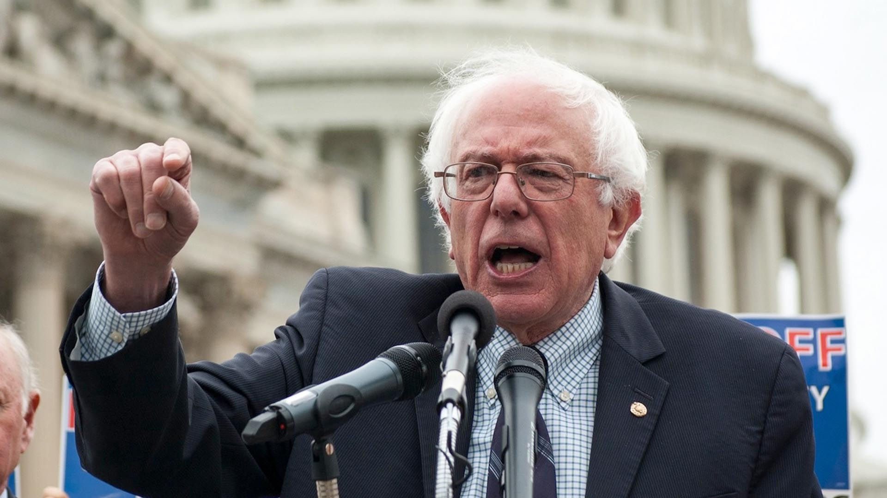
What else?
Narrative on single payer needs to change
Focus on the problem, not the solution
Healthcare is too expensive
ACA does not address rising healthcare costs and skyrocketing deductibles
Any plan that covers fewer people than the ACA is not acceptable
Healthcare is a human right
Change the narrative of the responsibilities of the government
Bernie Sanders

Slide 32
Conclusions
-Always important to be pushing for single-payer
-important to align ourselves with others defending access to health care in the face of extreme threats; building alliances in these moments can lead to a stronger coalition for single-payer in the future
-Is this a political opportunity moment? What strides can be made toward single-payer during Trump’s presidency? (discussion)
http://annals.org/aim/article/2605414/single-payer-reform-only-way-fulfill-president-s-pledge-more

