Slide 1
Intersections between the Movement for a National Health Program and the Fight for Racial Justice
Ebiere Okah (M4) and Lily Ostrer (M3)
Icahn School of Medicine at Mount Sinai

Slide 2
Outline
How racism affects our healthcare system
How insurance access facilitates racial discrimination in health care access
Segregated care
Discussion: How do we incorporate racial justice into the fight for single payer?

Slide 3
White Supremacy
“White supremacy is an historically based, institutionally perpetuated system of exploitation and oppression of continents, nations and peoples of color by white peoples and nations of the European continent; for the purpose of maintaining and defending a system of wealth, power and privilege. “
--Definition by the Challenging White Supremacy Workshop, San Francisco, CA

Slide 4
Racism and Policy
Racism → Media Representation → Public Perception→ Policy

Slide 5
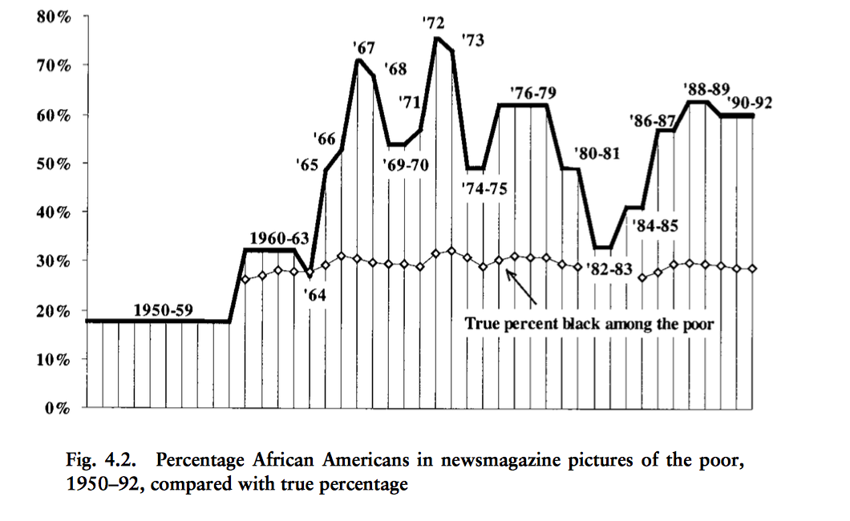
Changing Face of Poverty
“welfare mess”
War on poverty begins
Recessions
Source: Gilens, M. How the poor became black. Race and the Politics of Welfare Reform.

Slide 6
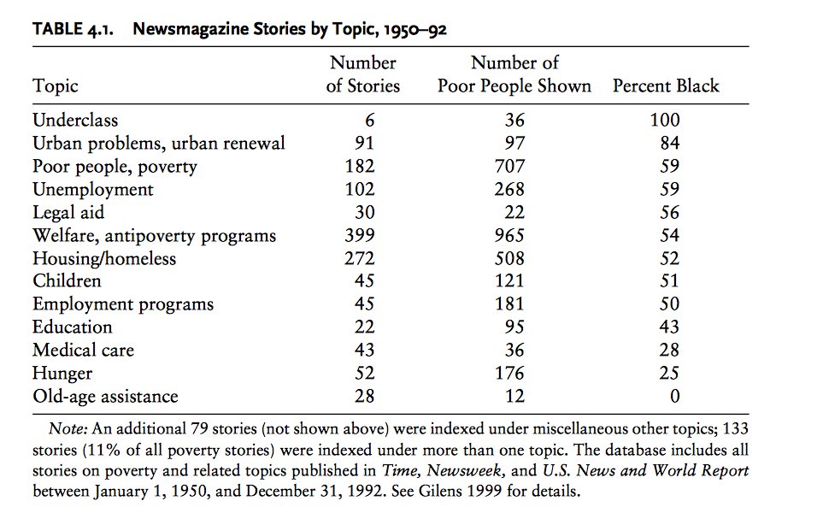
Poverty, Sympathy and Race
Source: Gilens, M. How the poor became black. Race and the Politics of Welfare Reform.

Slide 7
Racism and Policy
Racism → Media Representation → Public Perception→ Policy

Slide 8
Public Perception (YouGov)
Do you think that most welfare recipients are white, black or Hispanic?
Notes:
https://d25d2506sfb94s.cloudfront.net/cumulus_uploads/document/t5xd6b47t8/tabs_OP_Race_and_Class_20160125.pdf

Slide 9
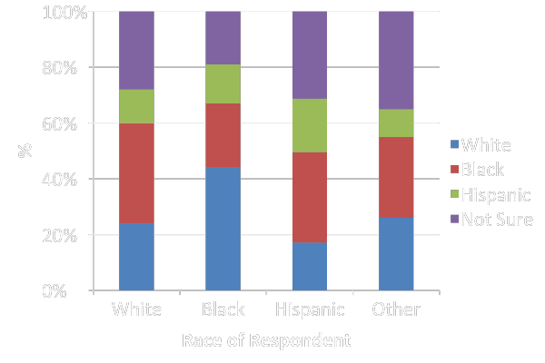
Welfare Use by Race (perceptions)

Slide 10
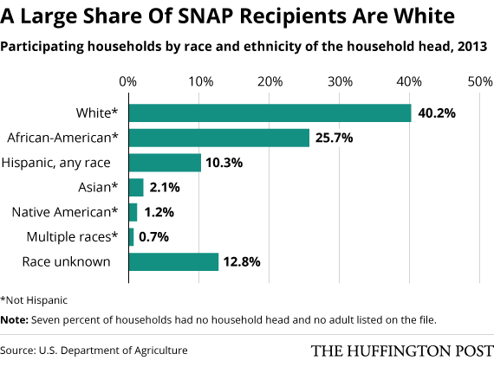
Welfare Use by Race in Reality

Slide 11
Racism and Policy
Racism → Media Representation → Public Perception→ Policy

Slide 12
ACA, 2010
Composed of two laws:
Patient protection and Affordable Care Act
Health Care and Education Reconciliation Act of 2010
Increase both private and public insurance, reducing the number of uninsured

Slide 13
Rush Limbaugh on ACA
“This is a civil rights bill, this is reparations, whatever you want to call it.”
Notes:
https://www.washingtonpost.com/blogs/plum-line/wp/2014/05/23/yes-opposition-to-obamacare-is-tied-up-with-race/
http://www.sciencedirect.com/science/article/pii/S0022103109002649
http://america.aljazeera.com/opinions/2016/2/racism-undermines-support-for-government-spending.html
http://www.thenation.com/article/how-populists-like-bernie-sanders-should-talk-about-racism/

Slide 14
Medicaid Expansion
Original law required expansion to anyone making less than 138% of federal poverty level
Federal government covers all costs of expansion until 2016, then 90% of costs after that
Supreme court struck down the “required” expansion allowing states to decide

Slide 15
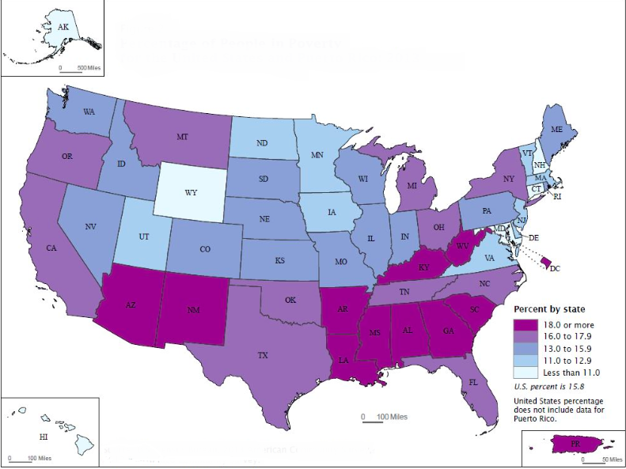
Poverty Rate, 2013
￼
￼

Slide 16
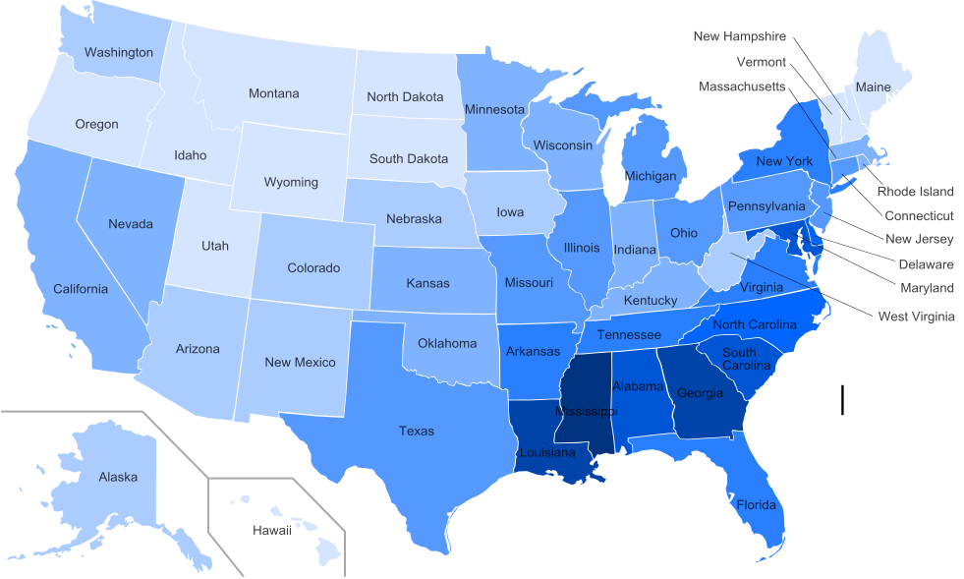

Slide 17
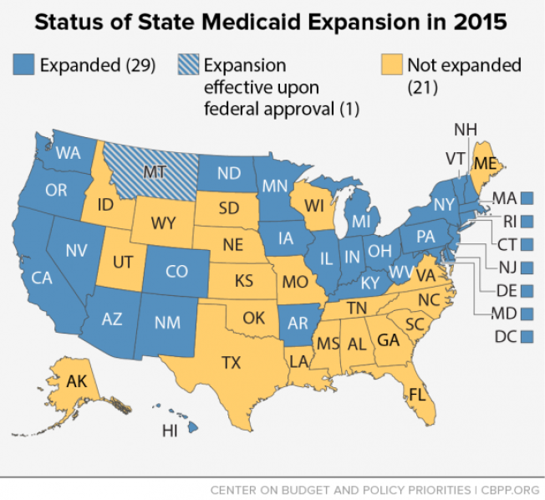

Slide 18
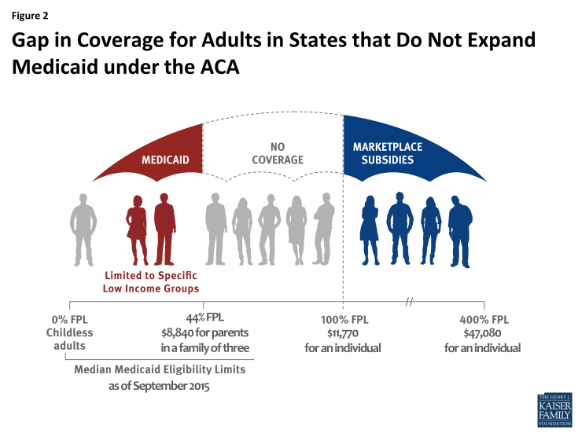
The Coverage Gap
Source: Kaiser Family Foundation

Slide 19
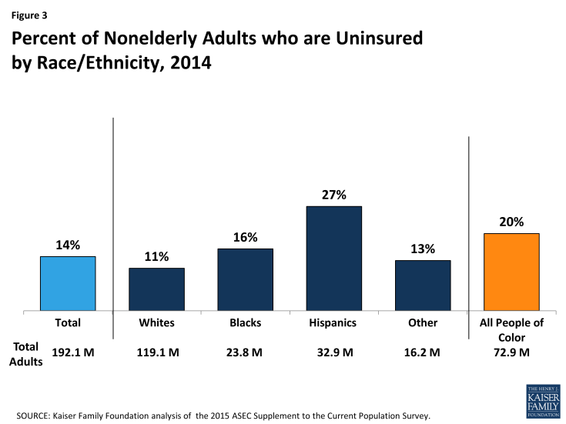
Racial Disparities in Coverage
Source: Kaiser Family Foundation

Slide 20
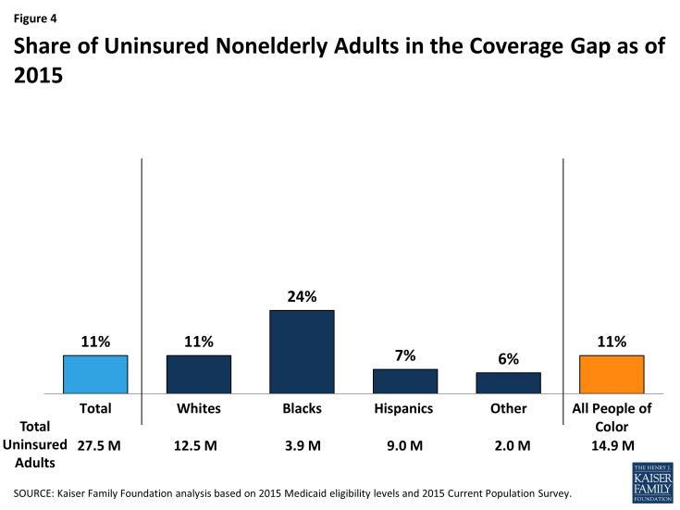
Race and Coverage Gap
Source: Kaiser Family Foundation
Notes:
Blacks are disproportionately in states that did not expand medicaid

Slide 21
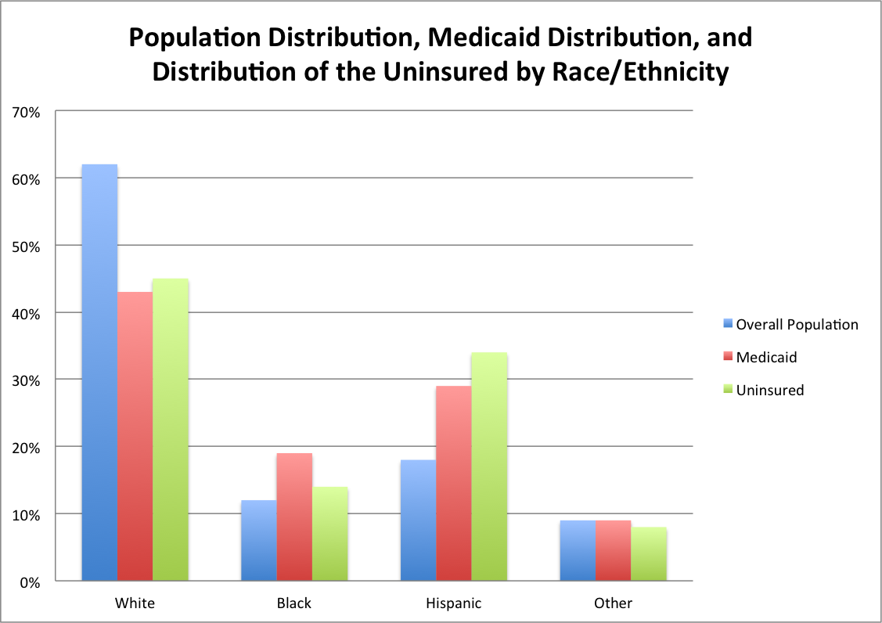
source: Kaiser Family Foundation http://kff.org/statedata/

Slide 22
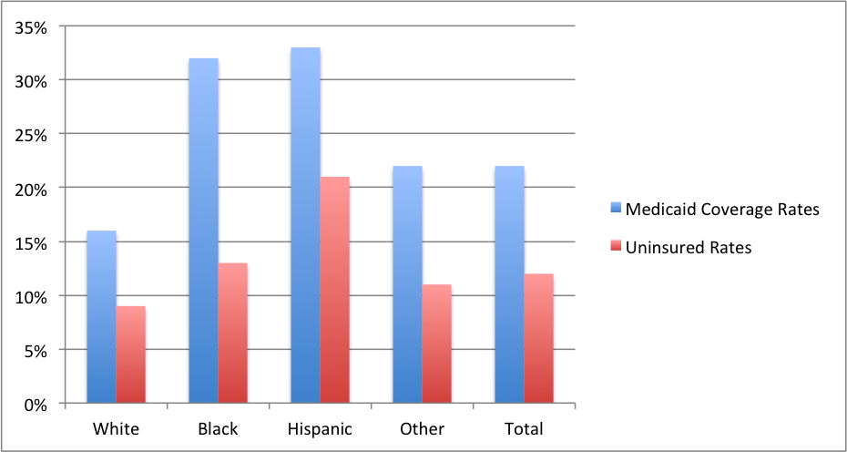
Medicaid / Uninsured Rates by Race

Slide 23
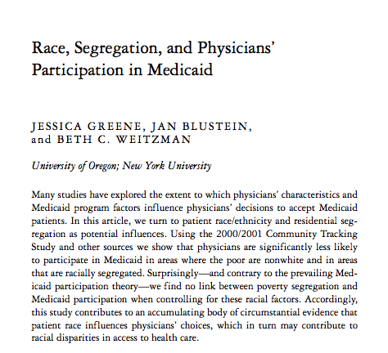
Notes:
2006

Slide 24
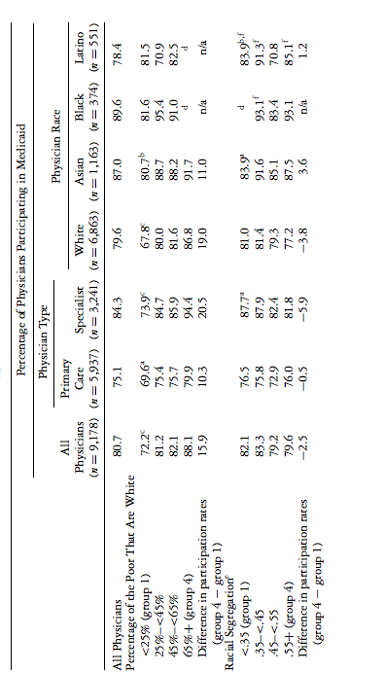

Slide 25
We participate in this every day:
Segregated Care at Mount Sinai
Insurance status is a major mechanism to perpetuate racism in health care -- to provide worse care to people of color
Private Insurance
Table 1. Appointment wait times in days
 |  | FPA |  | IMA
 |  | Mean |  | Mean
Primary Care |  | 3.3 |  | 20.8
Dermatology |  | 2.8 |  | 50.5
Endocrinology |  | 29.3 |  | 54.0
GI |  | 24.0 |  | 69.0
Orthopedics |  | 7.8 |  | 77.3
Total |  | 13.4 |  | 54.3
Medicaid
Internal
Medicine
Associates
Faculty
Practice
Associates
Data collected by Caitlyn Braschi and Lily Ostrer
Notes:
Charlotte just talked about how white physicians are more likely to accept Medicaid if a greater percentage of the poor are white. This is not a theoretical issue or something that we can change about ourselves even if we think of ourselves as anti-racist future physicians. We participate in this every day.

Slide 26
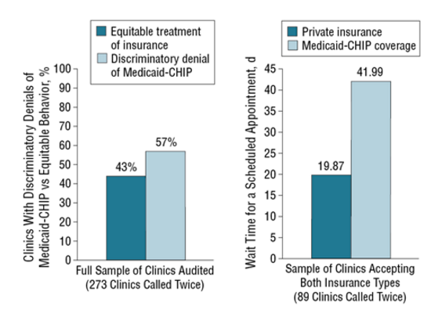
Segregated care at Academic Medical Centers
Academic medical centers and equity in specialty care access for children.
Bisgaier J1, Polsky D, Rhodes KV.
Notes:
And this isn’t just at Mount Sinai. A similar study was done in Chicago where researchers posed as mothers attempting to get medical care for their children. They called 273 different clinics in the Chicago area and attempted to make appointments for a child with Medicaid-CHIP vs private insurance. 57% of clinics accepted children with private insurance but not children with Medicaid. For clinics that accepted children with both types of insurance, wait times for children with Medicaid were nearly twice as long.
http://archpedi.jamanetwork.com/article.aspx?articleid=1148401
RESULTS:
Of the 273 paired calls to clinics, 155 (57%) resulted in discriminatory denials of Medicaid-CHIP. The odds of a discriminatory denial were 45% lower if a clinic was AMC affiliated (odds ratio, 0.55; 95% CI, 0.31-0.99). On average, academic clinics scheduled Medicaid-CHIP appointments with wait times 40 days longer than private insurance (β, 40.73; 95% CI, 5.06-76.41).
CONCLUSIONS:
Affiliation with an AMC was associated with fewer discriminatory denials of children with Medicaid-CHIP. However, children with Medicaid-CHIP had significantly longer wait times at AMC-affiliated clinics compared with privately insured children. Academic medical centers' propensity toward serving publicly insured patients makes them candidates for targeted resource allocation, perhaps with incentives contingent on equitable appointment acceptance and wait times.

Slide 27
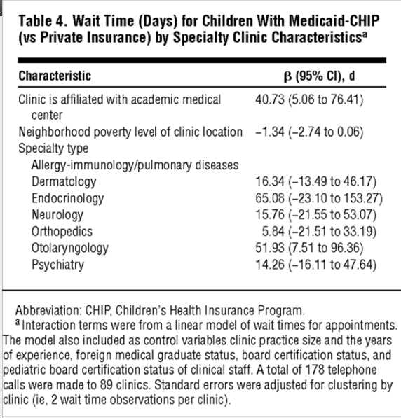
Notes:
Wait times on average were 40 days longer for patients with Medicaid-CHIP if the clinic was associated with an academic medical center. In Endocrinology, wait times were 65 days longer.

Slide 28
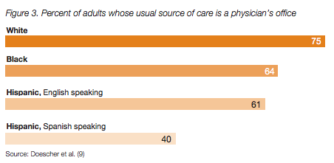
Segregation in health care is rampant and intentional
Notes:
Segregation in health care leads to massive disparities in access to care between racial/ethnic groups. White people are much more likely than black and Hispanic people to rely on a physician’s office, rather than the emergency room or no care at all, as their usual source of care.
Outpatient care—which is more closely tied to residential patterns and insurance status and which has never been subjected to Medicare Title VI compliance reviews—is more segregated than hospital care. For example, compared with whites, blacks have 1.67 times the number of emergency department visits per year, 2.20 times the number of outpatient department visits, but only .87 times the number of physician office visits.29 As documented by a recent assessment that linked the race of Medicare beneficiaries to information obtained from a telephone survey of physicians, primary care for blacks tends to be separate and unequal.30 Eighty percent of the visits of black Medicare beneficiaries were accounted for by 22 percent of physicians. The physicians providing such care to blacks were less likely to be board-certified and more likely to report difficulty in obtaining access for their patients to high-quality specialist and diagnostic services.
If you are a good doctor and want
this is how our system is set up
as students, we participate in care of one group
no matter how much we want this system to be different, our practice is conditioned by the system

Slide 29
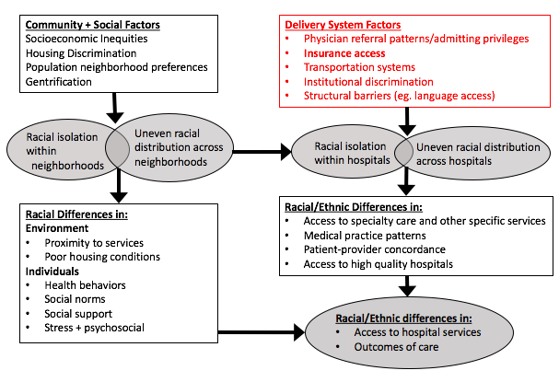
Adapted from: Vaughan Sarrazin, Mary S et al. “Racial Segregation and Disparities in Health Care Delivery: Conceptual Model and Empirical Assessment.” Health Services Research 44.4 (2009): 1424–1444. PMC. Web. 2 Mar. 2016.
Notes:
When we think of health disparities we usually think about things like neighborhood segregation, food desserts, gentrification and housing discrimination. But we participate in a system that causes racial health disparities.
we participate in racial health disparities

Slide 30
Is single payer the solution?

Slide 36
Discussion
To what extent should racial justice be part of the fight for single payer?
How do we as student advocates link the movement for single payer with the fight for racial justice?
Notes:
Healthcare system is borne out of racism and also perpetuates it

Slide 37
Vision for the Future
We cannot fight for single payer without concurrently fighting against racism.
We should better articulate how the current health care system is a powerful mechanism in our society to devalue the lives of people of color.
We must centralize discourse regarding racism in the current medical system in our efforts to explain why single payer is necessary.
Without these efforts, we may be repeating history.
Notes:
We have shown that racism exists in the current medical system and that in order to have an anti-racist medical system we need single payer, but we cannot achieve that simply by arguing for single payer without recognizing that racism exists in our current medical system and that is a major barrier to achieving a single-payer system.

