Slide 1
A Better Plan: Single Payer 101 (aka “what is this conference and how did I get here”)
Andy Hyatt
Boston University School of Medicine (MD 2018)
ashyatt@bu.edu
Slide deck based off work by Anand Saha

Slide 2
What is the point of a healthcare system?
What do we want out of it?

Slide 3
“Triple Aim” of Good Healthcare Systems
QUALITY of patient care
Better POPULATION HEALTH outcomes
Minimize COST
Notes:
Based on work by Don Berwick

Slide 4
Another way to put this
Healthcare should be
Universal
Affordable
Accessible
High Quality
Notes:
Everyone gets it!
No one forgoes necessary care because of costs
Accessible- it should be in your community
Speaks for itself

Slide 5
So how does our system fare?
Well…

Slide 6
The Most Expensive Health Care System In the World
USA: $8,713
Annual per capita dollars spent on health care
Average: $3,453
Data are for 2013 or nearest year
US$ Purchasing Power Parity
OECD data accessed Nov 30 2015
Notes:
Our country spends a lot
This compares us to our “peer nations” in the developed world

Slide 7
Health Insurance Is Increasingly Unaffordable
Average Family Premium as a Percentage of Median Family Income
http://www.commonwealthfund.org/interactives-and-data/chart-cart/presidents-column/costs-of-failure/average-family-premium-as-a-percentage-of-median-family-income
Accessed Feb. 25, 2016
Notes:
And our families spend a lot

Slide 8
31% of Our Healthcare Dollars are not spent on healthcare
Medical care
69%
Canada
Medical overhead, administration, and insurance profits
31%
84%
16%
United States
$1,300 monthly premium → $200 monthly waste
Woolhandler, et al “Costs of Health Administration in the U.S. and Canada,” NEJM 349(8) Sept. 21, 2003
Notes:
This goes to profits, adminstrators

Slide 9
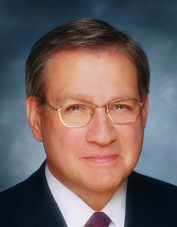
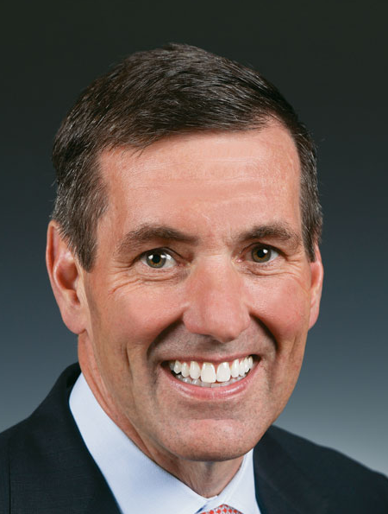
Health Insurance CEO 2014 Pay
Mark Bertolini | Joseph Swedish | Michael Neidorff
David Cordani | Steve Hemsley | Bruce Broussard
Aetna
Annual Comp:
$15.0 M
Pay/Weekday:
$57,745
Wellpoint
Annual Comp:
$8.1 M
Pay/Weekday:
$31,016
Centene
Annual Comp:
$ 28.1 M
Pay/Weekday:
$107,962
Cigna
Annual Comp:
$27.2 M
Pay/Weekday:
$104,479
United
Annual Comp:
$66.1 M
Pay/Weekday:
$254,328
Humana
Annual Comp:
$13.1 M
Pay/Weekday:
$50,319
Source: SEC filings
Notes:
Nice collection of white men getting rich off our medical bills

Slide 10
Drug Company Profits
Return on Revenue (%)
Fortune 500 rankings for 1995-2015
Total drug company profits, 2010 = $44.6 billion
Notes:
But they cry poor- we need high drug prices to fuel drug discovery!
That’s a load of BS, but that’s another lecture

Slide 11
Ok but if we spend a lot we must get a lot right?
Well…

Slide 12
Infant Mortality Deaths in First Year of Life Per 1,000 Live Births
Note: Data are for 2013 or most recent year available
Source: OECD, 2015

Slide 13
We’re Number 25 in Life Expectancy
Life Expectancy at birth
2013 data from OECD accessed Nov 19 2015
https://data.oecd.org/healthstat/life-expectancy-at-birth.htm
Notes:
Womp

Slide 14
Ultimate cost: 45,000 Annual Deaths
State | Percent Uninsured | Excess Deaths
California | 23.9% | 5,302
Texas | 29.7% | 4,675
Florida | 26.0% | 3,925
New York | 17.5% | 2,254
Georgia | 23.6% | 1,841
USA | 15.3% | 44,798
Source: Wilper et al. Am J Public Health 2009.
State tabulations by author
Notes:
This is comparing pre-ACA baseline to the present
Present figures estimate around 30K excess deaths/year

Slide 15
Ultimate Cost: Personal Bankruptcy
62%
of all bankruptcies in 2007 were medical
92%
had medical debts over $5,000
or 10% of pretax family income
75%
had health insurance
Himmelstein, et.al. Am J Med, August, 2009
Notes:
Most of these people had insurance!

Slide 17
Ok but what about Obamacare?? Didn’t that fix it?
Well…

Slide 18
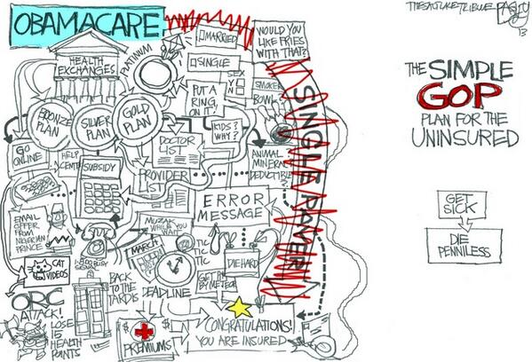

Slide 19
Notes:
The standard liberal response to this is derision
But this is a real downside to the ACA, and makes it politically vulnerable
Medicare, Medicaid, Social Security don’t have this problem

Slide 20
No but seriously WTF is the ACA
Three main pillars
Regulate
Insurance companies, please be a little less evil!
Mandate
Everyone go buy insurance
Subsidize
Either through Medicaid or Subsidies
Plus some other stuff
ACOs, staying on your parents’ insurance, etc
Notes:
Things like banning yearly and lifetime caps, exclusion based on pre-existing conditions
And a bunch of other stuff too like staying on your parents’ insurance until you’re 26, ACOs, limits on insurers overhead

Slide 21
Gains in Access to Care Under the ACA
Percent of adults 19-64 who needed but did not get:
Source: Commonwealth Fund Biennial Health Insurance Surveys 2005, 2010, 2012, 2014

Slide 22
30 Million Will Remain Uninsured
Uninsured (Millions)
Graphic by the New Republic
CBO May 2013 Update on ACA
CBO Feb 2014 Update on Budget and Economic Outlook
Notes:
So above gains in access will likely plateau

Slide 23
Deductibles Are Increasing Rapidly
Percent of Workers
With Deductibles >$999 (Single Coverage)
Source: Kaiser/HRET Survey of Employer-Sponsored Benefits, 2015
Notes:
The ACA didn’t cause this, but it didn’t help either

Slide 24
Source: Pear, R. NYTimes Nov 14, 2015

Slide 25
Uninsured and Under-Insured Delay Seeking Care for Heart Attacks
Odds ratio for delayed care*
Source: JAMA April 15, 2010. 303:1392
*Adjusted for age, sex, race, clin. charact., hlth status, social/psych fx, urban/rural.
Under-insured=had coverage but patient concerned about cost
Notes:
Why is this bad?

Slide 26
Insurers Risk Select Via Formulary Design Insurance corporations skirting ACA regulations
Drugs of Choice | Illness | Plan 1 | Plan 2 | Plan 3
Anti-Retrovirals | HIV | No | No | No
Triptans | Migraines | No | No | No
Anti-Psychotics | Schizophrenia | No | No | No
Macrolides | Pneumonia | Yes | No | No
L-Dopa | Parkinson’s | Yes | No | No
Anti-Convulsants | Seizures | Yes | No | No
ACE Inhibitors | Hypertension | Yes | Yes | No
Metformin | Diabetes | Yes | Yes | No
Oster & Fendrick, Am J Managed Care 2014;9:693-4
Plan 3 = Harvard Pilgrim
“No” = No drug of choice available on Tier 1 (lowest co-pay)
Notes:
This is a way around the ACA reg forbidding discrimination based on pre-existing conditions

Slide 27
What about this guy?

Slide 28
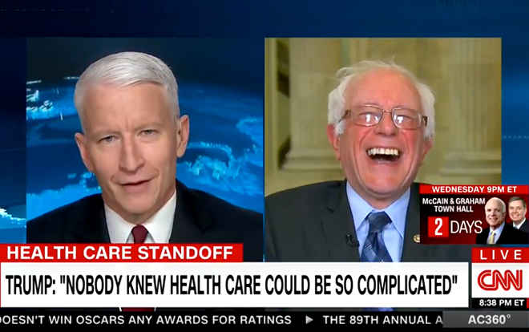

Slide 29
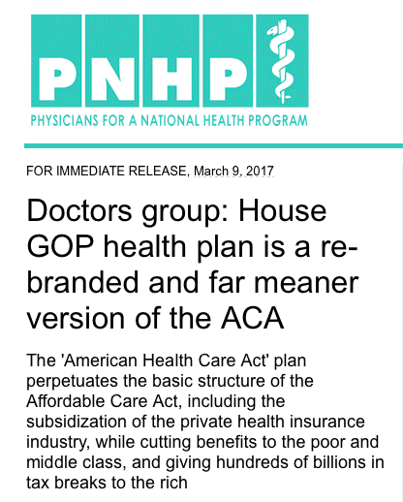
The American Health Security Act

Slide 30
Trumpcare tl;dr
Cut subsidies for private insurance
Cuts Medicaid, looks to end expansion in 3 years
Decreased support for out of pocket costs
Switches individual mandate for “continuous coverage” penalty
Tax cuts for the rich and corporations
The cure for everything that ails this great nation
Notes:
Change subsidies from income based to age based (but mostly flat)
Medicaid- not a block grant yet, but moving in that direction

Slide 31
If only there was a better way…

Slide 32
Single Payer: Healthcare as a human right
EVERYONE gets health insurance from birth to death
All necessary services paid for
Paid for by progressive taxation
Instead of sick people paying more, rich people do
No co-payments, deductibles, cost sharing
Notes:
There aren’t a lot of slides here
But that’s because single payer is simple

Slide 33
PNHP Proposal: HR 676 “Improved Medicare for All”
Who?
How?
Cuts administrative costs by $476B annually
Cuts pharmaceutical costs to ‘European levels’ by $116B annually
Total savings: $592B
What?
Sponsored by Rep John Conyers (D-MI); 63 co-sponsors.
Saves $592B annually while covering all 30M+ uninsured Americans, and improving benefits.
Improves quality, reduces cost, expands access
Notes:
Administrative costs cut because it is less complicated. And pharmaceutical costs cut because of collective bargaining.
FYI look out for Bernie to introduce a bill in the Senate
Savings more than enough to cover all uninsured people, retrain those who lose jobs

Slide 34
PNHP Proposal: HR 676 “Improved Medicare for All”
Streamline payment
Stop administrative waste, save ~$400B annually
Create a single risk pool
Stop profit of suffering
Offer only
one plan
Stop marketing waste
Collective bargaining
Stop pharmaceutical profits
Increase prevention
Stop expensive diseases from starting
Free choice
of providers
Stop rationing of health care professional choice
Credit: PNHP California chapter
Notes:
Administrative costs cut because it is less complicated. And pharmaceutical costs cut because of collective bargaining.

Slide 35
Can We Afford Single Payer?
Under HR 676, 95% of Americans will pay less than they currently do
Notes:
We are paying for single-payer without getting the benefits of it. A public program is only as good as the amount of money you put into it, and we are putting in more than anyone else in the world.

Slide 36
Overall Administrative Costs per Capita United States and Canada, 2016
Source: Woolhandler et al. NEJM 2003;349:768 (updated); Himmelstein et al. Health Aff 9/2014

Slide 37
A Summary Snapshot
The US has by far and away the most expensive healthcare system in the world for no extra quality
In the US:
30 Million remain uninsured WITH the ACA
116 Million forgo medical care due to cost annually
1.7 Million declare bankruptcy each year due to inability to pay medical bills
Estimated 45,000 die per year due to lack of coverage
US Census Bureau, 2012
Credit: Drs. Himmelstein and Woolhandler

Slide 38
A Fork in the Road
19%
17%
15%
13%
11%
9%
7%
5%
USA 1971:
HMO Act
USA
Health costs % of GDP
Canadian Single Payer Fully Implemented
Canada
1960 | 1970 | 1980 | 1990 | 2000
2014
Source: Statistics Canada, Canadian Institute for Health Info, and NCHS/Commerce Dept.

Slide 39
Most Want Medicare-for-All Do you favor “expanded, universal Medicare-for-All”?
All Adults
Democrats
Source: Kaiser Health Tracking Poll, 12/17/2015

Slide 40
“Expanded, Universal Medicare for All” Favored by Most Independents and Even Many Republicans
Independents
Republicans
Source: Kaiser Health Tracking Poll, 12/17/2015

Slide 41
Most Physicians Support a National Health Program.
Psychiatry
Peds Specialties
Emergency Med
General Peds
General Int. Med
Med Specialties
Family Med
OB-Gyn
General Surgery
Surg Specialties
Radiology
59%
of physicians support single payer
0 | 25% | 50% | 75% | 100%
Percent supporting National Health Insurance
2007 detail of surveys of random samples of US physicians.
Carroll and Ackerman. Ann Int Med 2008;148:566

Slide 42
Canadian Physicians’ Incomes
Specialty | Income |  | Specialty | Income
Family Medicine | $275,296 |  | OB-GYN | $485,407
Internal Med | $381,776 |  | General Surgery | $443,188
Pediatrics | $299,399 |  | Thoracic Surgery | $563,263
Psychiatry | $255,794 |  | Ophthalmology | $584,150
Dermatology | $434,163 |  | Average | $328,640
Canadian Institute for Health Information
Figures are gross income, Canadian $, 2013-2014

Slide 43
We Can Win the Trifecta
“You can have
universal coverage and
good quality healthcare
while still managing to
control costs…
but you need
Single-Payer to do it.”
Dr. William Hsiao
Harvard Health Economist

Slide 44
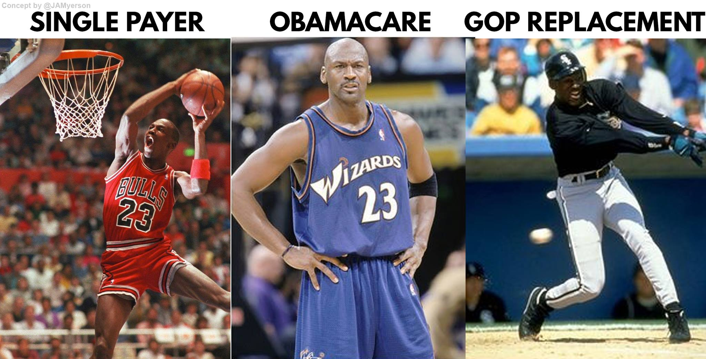
In summary

Slide 45
For more information…
Andrew.s.hyatt@gmail.com
Health policy websites:
The Commonwealth Fund: www.commonwealthfund.org
Kaiser Family Foundation: www.kff.org
Health Affairs Blog: http://healthaffairs.org/blog/
Physicians for a National Health Program: www.PNHP.org

