Slide 1
The Shortcomings of Healthcare Reform Prove It’s Time For…
Single Payer, Improved
Medicare For All
Anand Saha & Bryant Shuey

Slide 2
Students for a National Health Program (SNaHP)
1,000+ medical students, public health students, nursing students, and other future healthcare professionals
We believe access to high-quality health care is a human right
We support Single-payer “Improved Medicare for All”
Medical care should be privately delivered but publicly funded
Health care should be provided equitably as a public service
Health care should not be bought and sold as a commodity

Slide 3
Triple Aim
Cost Minimize costs
QUALITY Improve health outcomes
Access Universal healthcare?

Slide 4
The Most Expensive Health Care System In the World
USA: $8,713 per person in 2013
Annual dollars spent on health care per person
Modern world average: $3,453 per person
Data are for 2013 or nearest year
US$ Purchasing Power Parity
OECD data accessed Nov 30 2015

Slide 5
US Spending per Capita
USA’s public spending exceeds everyone’s total spending!
2010 healthcare spending per capita
Data are for 2010
Sources: OECD 2012; Health Affairs 2002 21(4)88
Notes:
We are paying for single-payer without getting the benefits of it. A public program is only as good as the amount of money you put into it, and we are putting in more than anyone else in the world.

Slide 6
Health Insurance Is Increasingly Unaffordable
Average Family Premium as a Percentage of Median Family Income
http://www.commonwealthfund.org/interactives-and-data/chart-cart/presidents-column/costs-of-failure/average-family-premium-as-a-percentage-of-median-family-income
Accessed Feb. 25, 2016

Slide 7
30 Million Remain Uninsured
Uninsured (Millions)
Graphic by the New Republic
CBO May 2013 Update on ACA
CBO Feb 2014 Update on Budget and Economic Outlook

Slide 8
Why Are So Many Uninsured?
KCMU Analysis of 2013 NHIS
Notes:
Countries with UHC

Slide 9
Infant Mortality Deaths in First Year of Life Per 1,000 Live Births
Note: Data are for 2013 or most recent year available
Source: OECD, 2015

Slide 10
We’re Number 25 in Life Expectancy
Life Expectancy at birth
2013 data from OECD accessed Nov 19 2015
https://data.oecd.org/healthstat/life-expectancy-at-birth.htm

Slide 11
Ultimate cost: 45,000 Annual Deaths
State | Percent Uninsured | Excess Deaths
California | 23.9% | 5,302
Texas | 29.7% | 4,675
Florida | 26.0% | 3,925
New York | 17.5% | 2,254
Georgia | 23.6% | 1,841
USA | 15.3% | 44,798
Source: Wilper et al. Am J Public Health 2009.
State tabulations by author
Notes:
Just based on the states not expanding, not expanding Medicaid will cost about 7,000-17,000 lives.
Senator Bill Burr from North Carolina asked “how many die on the waiting list each year?” Canadian doctor replied “I don’t know but 45,000 die each year from inadequate health insurance.

Slide 12
We Can Win the Trifecta
“You can have
universal coverage and
good quality healthcare
while still managing to
control costs…
but you need
Single-Payer to do it.”
Dr. William Hsiao
Harvard Health Economist
engineer of Taiwan’s healthcare system

Slide 13
1,000+ students in 50+ chapters

Slide 14
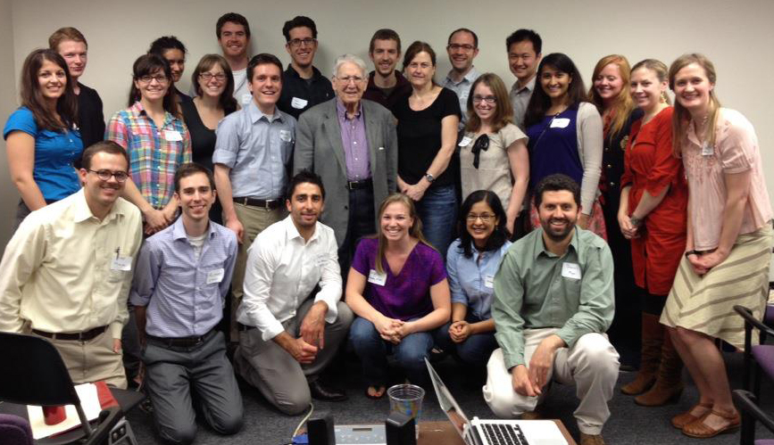
2012

Slide 15
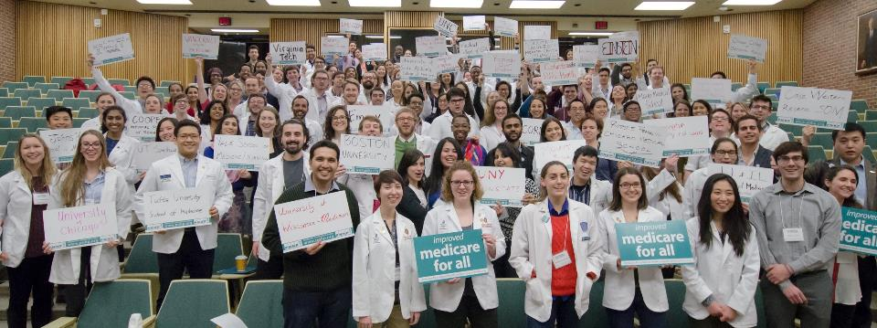
2016

Slide 16
“Everybody in…
___________ _____!”

Slide 17
What do we want?! _____
When do we want it?! ___

Slide 18
Where are we with single payer?
How do other countries health systems operate?

Slide 19
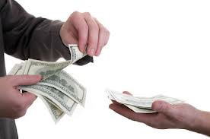
Two components of a healthcare system
Healthcare
Delivery
(Healthcare providers)
Financing
(Health Insurance)

Slide 20
TR Reid’s 4 models of healthcare
 | Beveridge Model | Bismarck Model | National Health Insurance | Out-of-pocket
Insurance | Public | Private | Public | None
Healthcare | Public | Private | Private | Private
Examples of countries | Britain, Italy, Scandinavia | Germany, Japan, France | Canada, Taiwan | African countries, India, S America
(Britain’s NHS)
single-payer!
T.R. Reid's book The Healing of America: A Global Quest for Better, Cheaper, and Fairer Health Care
Notes:
Beveridge and NHS are single-payer but PNHP’s proposals maintain private doctors/hospitals

Slide 21
TR Reid’s 4 models of healthcare
Beveridge Model
Insurance: Public, provided and financed by government through tax.
Healthcare: Public, doctors are employees of government.
Bismarck Model
Insurance: Private, non- profit companies provide insurance.
Healthcare: Private, doctors run private businesses.
National Health Insurance
Insurance: Public, provided and financed by government through tax.
Healthcare: Private, doctors run private businesses.
Out-of-pocket
No formal system for…anything.
Rich get healthcare

Slide 22
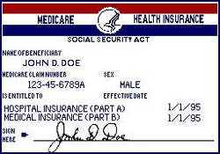
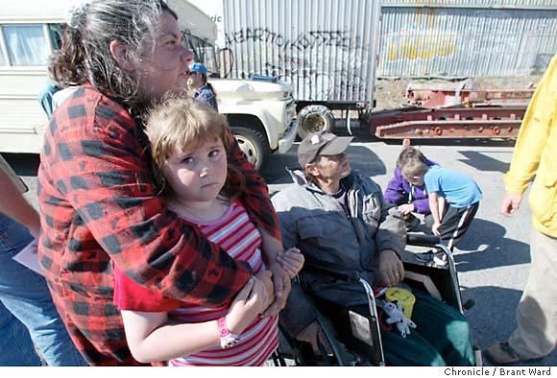
USA = patchwork of models
Beveridge Model
Insurance: Public, provided and financed by government through tax.
Healthcare: Public, doctors are employees of government.
Bismarck Model
Insurance: Private, non- profit companies provide insurance.
Healthcare: Private, doctors run private businesses.
National Health Insurance
Insurance: Public, provided and financed by government through tax.
Healthcare: Private, doctors run private businesses.
Out-of-pocket
No formal system for…anything.
Rich get healthcare
Credit: PNHP California
Notes:
This is a completely socialized health system. The doctors and nurses were trained in government institutions, they’re government employees practicing in government owned hospitals and all bills are paid by the government
The second type is called the Bismarck model after the first chancellor of Germany. This type of system is found in Germany, France Japan and a number of other countries. In this system, people purchase insurance OR pay into “Sickness Funds”, usually jointly funded by their employer, which then pays the bills. Hospitals and Doctor’s offices are largely private. The government regulates these sickness funds and they must give insurance to anyone and are non profit
The third type of system could be labeled “National Health Insurance” and is found in Canada, Australia and New Zealand among others. In this type of system the financing mechanism is socialized, but the delivery of care remains largely private. Everyone pays taxes into this fund, which then pays the bills to private providers.
The forth system could be described only as “Out-of-Pocket” and is what is found in Cambodia, Bangladesh and most African countries. In this system, those who can pay have access to healthcare. Those who cannot stay sick or die.
The US is unique in that we don’t have any one type of system, we’re the only country with aspects of all four of these. For Veterans and their families we’re Britain. For those who receive health insurance through their employer we’re Germany or France. For people over 65 we’re Canada. And for the rest, we’re countries in Africa that let people die if they can’t afford to buy health insurance.

Slide 23
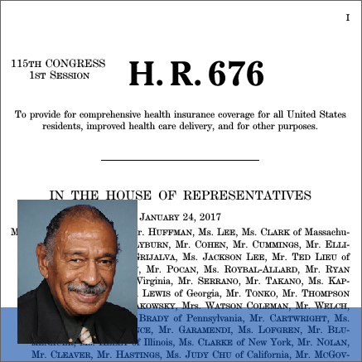
HR 676: The Expanded and Improved Medicare for All Act
“…establishing a non-profit universal single-payer health care system would be the best way to effectively contain health care costs and provide quality care for all Americans.”
-Representative John Conyers, Jr. (D-Mich)

Slide 24
HR 676: The Expanded and Improved Medicare for All Act
Establishes Medicare for All Program to provide all individuals residing in the United States and U.S. territories with health care from birth until death including:
all medically necessary care
primary care and prevention
dietary and nutritional therapies
prescription drugs
emergency care
long-term care
mental health services
dental services
and vision care

Slide 25
Institutional Participation
Only public or nonprofit institution participation
Nonprofit health maintenance organizations (HMOs) that deliver care in their own facilities may participate
No sales of duplicated benefits, may sell benefits that are not medically necessary
The bill sets forth methods to pay institutional providers and health professionals for services. Financial incentives between HMOs and physicians based on utilization are prohibited

Slide 26
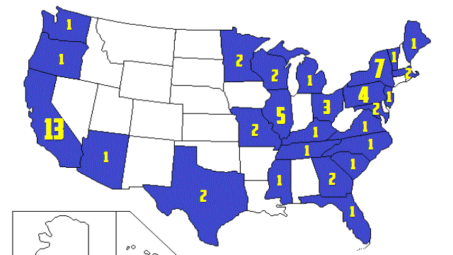
Representative Cosponsors: 61

Slide 27
American Healthcare Act
Individual Mandate
BOO!
Repealed
BOOO!
Employer Mandate
BOO!
Repealed
BOO!
Copayment Subsidies
Repealed
Premium Subsidies
BOO!
Income -> Age Based
Medicaid expansion
BOO!
Reduction starting 2020
BOO!
Health Savings Accounts
Increased caps
BOO!
Charging more for the Elderly
From 3:1 to 5:1
STEP TOWARDS UHC
STEP BACKWARDS
Credit to NY Times for style

Slide 28
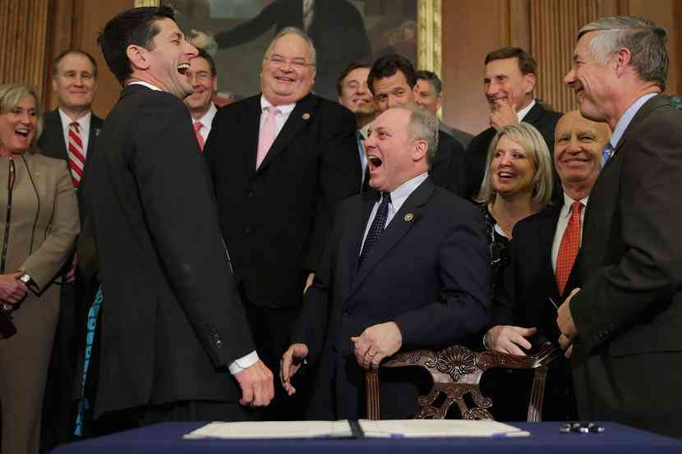
MEME
AND THEN WE TOLD THEM HEALTH SAVINGS ACCOUNTS WILL IMPROVE ACCESS TO HEALTHCARE!

Slide 29
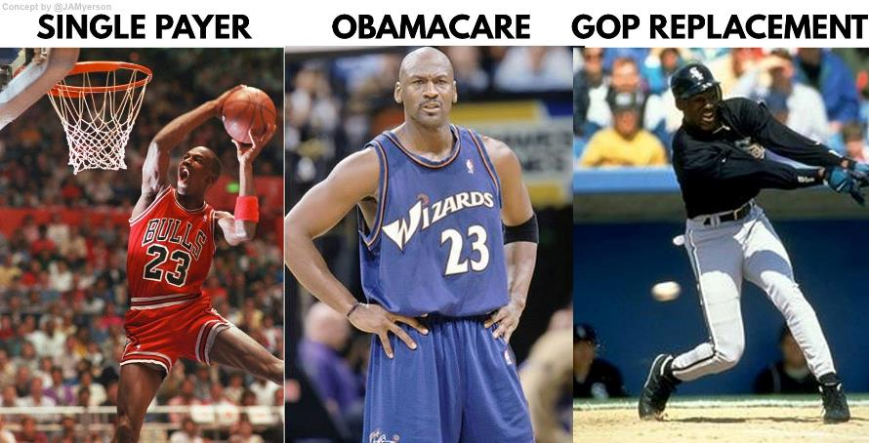

Slide 30
From the Streets to the Hill
Local Organizing
Expanding Knowledge Base
Creating and Strengthening Relationships
-Student, community, legislator
Learning the Legislative Process
Building the Movement for Medicare for All

Slide 31
SOCIAL MEDIA
HASHTAGS
SOCIAL MEDIA EVENT

