Slide 1
Turning Activism into Art
Shirlene Obuobi
3/3/2018

Slide 2
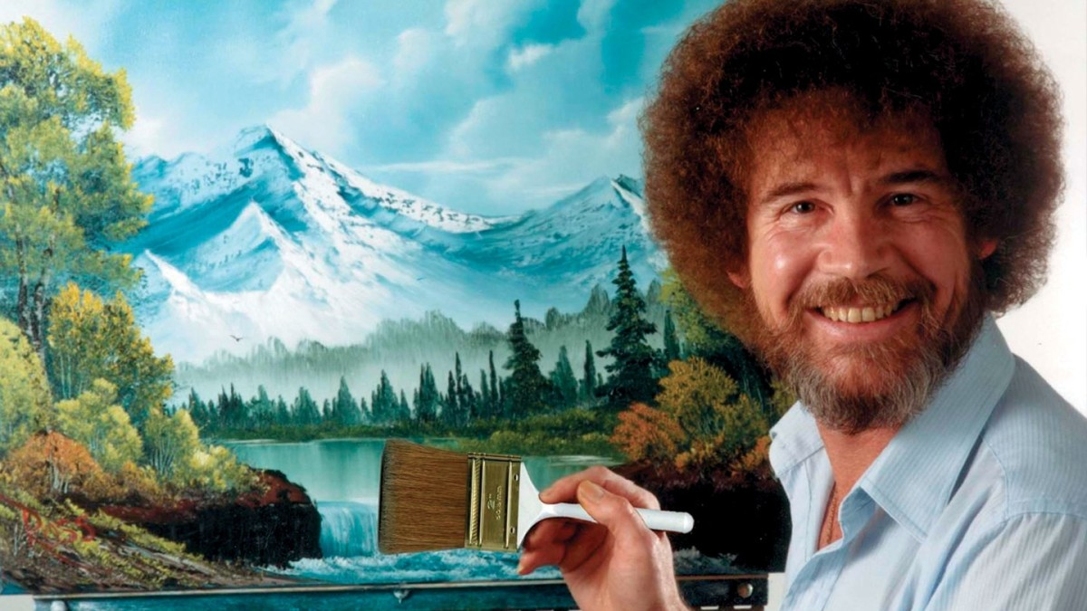

Slide 3
GOALS
Discuss political cartoons as a medium
Assuage your fears of putting pen to paper
Make some pro-single payer cartoons for the internetz!

Slide 4
We’re already used to Art being Political!

Slide 5
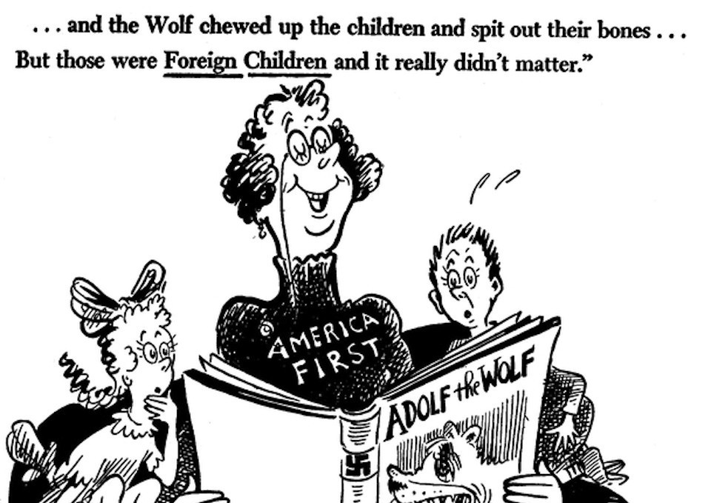

Slide 6
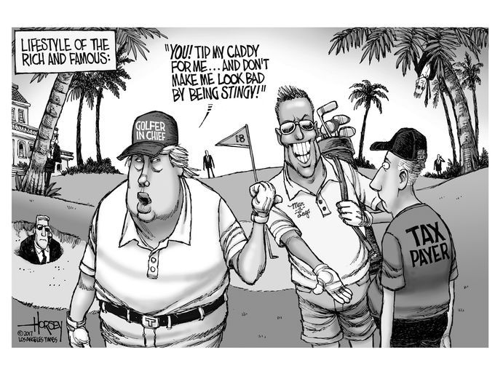

Slide 7
Why are Political Cartoons So Effective?
“A picture is worth a thousand words”
Images have EMOTIONAL CONTENT
Can reference current events without introduction
Don’t need explanation – you can watch people derive their own meanings!

Slide 8
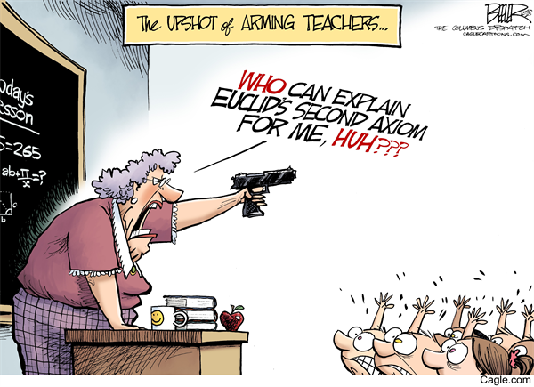

Slide 9
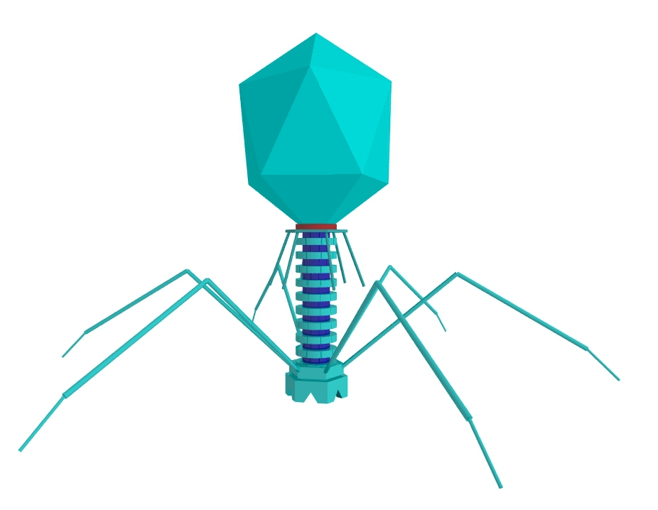

Slide 10
But Shirlene… I can’t draw!
That’s okay! You don’t have to be an artist to make impactful cartoons!
Credit: xkcd (https://xkcd.com/1954/)

Slide 11
STEPS TO MAKING A POLITICAL CARTOON
Think about what made you interested in single payer!
A Patient Experience?
A Personal Experience?
An Injustice You’ve Witnessed?
An Absurdity within the Current System?
CONDENSE that thought into 1-2 sentences
Start off with scratch paper- write down your ideas!
DRAW !

Slide 12
SHARE YOUR WORK!
All of your completed comics will be posted online on the SNaHP FB page and my comic page
Share them with your friends! Start conversations!
@ShirlywhirlMD on Facebook and Instagram!

Slide 13
THANK YOU! Questions?
2:15pm – Break/ meet in MEB A for Second Line and Demonstration

