Slide 1
Bird-Dogging as a Political Tactic: The 2016 Election
Students for a National Health Program
Political Advocacy Team
⬥
Keanan McGonigle & Matt Moy

Slide 2
Workshop Overview
What is Bird-Dogging?
Why Bird-Dog?
Bird-Dogging 101
Our Strategy for the 2016 Election
Discussion

Slide 3
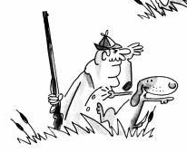
I. What is Bird-Dogging?
From the OED:
Bird-dog: n. a gun dog trained to retrieve birds
Eg. In Amer. Speech (1960) Bird-dog, a dog which accompanies a bird-hunter for the purpose of scenting the game and picking it up after it falls
Target.
You.
Issue or demand.
Notes:
You are the dog
The bird is the issue or the demand
The politician is the hunter

Slide 4
I. What is Bird-Dogging?
From PublicCitizen.org:
Bird-dog (bûrd'-dôg), v. To follow, monitor and/or seek out a subject of interest, such as a public official, with persistent attention to get answers to questions or influence the subject.

Slide 5
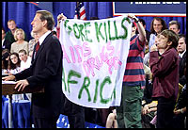
Examples

Slide 6
II. Why Bird-Dog?
Politicians love to avoid difficult issues
i.e. Healthcare reform and single payer
If we want a single payer system, we need to bring it up in conversation
Bird-dogging is an effective way to organize our tactics in order to reach this goal

Slide 7
III. Bird-Dogging 101: The Nine Steps
Find an event
Gather a posse
Make a plan
Arrive early
Get a chance to ask
Ask your question (and get an answer!)
Get media attention
Get a report out
Repeat!
Adapted from 2012 Stop AIDS and 2014 Single Payer in MA Birddogging 101 Trainings

Slide 8
1. Find an Event
Gather information about where to find presidential candidates:
Like on Facebook
Follow on Twitter
Subscribe to e-mails
Visit websites
Listen for radio announcements
Call offices
Ask for more information in person
Be ready to act quickly and on short notice
Notes:
- Don’t expect others to know about an event; if you discover it, tell people!
Calling– call campaign offices and say, “Hi! I have a few friends who were wondering what the next couple of opportunities are to meet Candidate X.”
Asking questions– what’s the format, when do doors open, will there be a Q&A?
Smaller events are easier

Slide 9
2. Gather a Posse
Connect with other single payer advocates and go to campaign appearances together
Bring other friends
Give everyone a job:
Question asker
Recorder
Photographer
Press person
Reporter
Notes:
Every person who comes can play a role; four or five polite people armed with effective questions can change the vibe of a Q&A session, and win commitments!
Teach your friends, or bring them along for moral support
Be ready to swap roles in case logistics change!

Slide 10
3. Make a Plan
Everyone should know the plan, including his or her role
Consider where best to position yourself for:
The handshake line
Photos
Talking to staffers
Talking to press
Recording the conversation
Think about bringing a poster

Slide 11
3. Make a Plan Ctd.
Prepare statements about your issue in advance in case you speak to press
Develop your questions ahead:
Use the template on the next slide to write questions you can ask in 10-20 seconds
Try to have them memorized
Write them down on note cards
Have follow-up questions on hand for when candidates give incomplete answers

Slide 12
3. Make a Plan Ctd.
How to write a good question:
1. Thank or praise the candidate
2. Explain the issue
3. Describe your personal interest in the problem
4. Propose a solution
5. Make your demand with a specific, closed-ended, yes or no question
(and point out any influential supporters of your plan)
Notes:
If you need help, ask an experienced bird-dogger!
Keep in mind, a good question is only 10-20s in length!!

Slide 13
4. Arrive Early
Get good seats and assess the situation!
Aim to be in or near the front row
Stay close to the microphones
Disperse your crew as needed to increase chances of the target calling on multiple group members
Make eye contact with the target or staffers
Look excited!
Find out what others are asking about
Notes:
Keep in mind, during election time:
Smaller events earlier in campaign season are more like meet and greets
Larger events may have arranged seats and a microphone, with the candidate behind a podium
More tips on looking excited:
Nod your head in emphatic agreement with the candidate’s statements
Be excited when they first walk in the room! This will make them want to talk to you!
A staffer may ask you if you’re a supporter of the campaign. It’s ok to say you are still trying to determine which candidate to support. You are there because you’re enthusiastic about learning more about the candidate’s policies. They’ll be flattered and excited for you.

Slide 14
5. Get a Chance to Ask
Smooth Approach:
If you can anticipate where the target is going in a crowd, position yourself strategically
First, Fast, and Highest Hand Raise:
Raise your hand before the questions are called for, even before the target finishes inviting questions
Raise your hand even if there is no planned Q&A
You’re on a mission – don’t be shy!

Slide 15
5. Get a Chance to Ask Ctd.
Use the handshake line as an opportunity to ask questions
Shake the target’s and don’t let go until you have an answer (within reason)
If you have trouble, grab the candidate’s hand and say “Mr./Mrs./Senator/Secretary______, I have a question for you!”
The recorder should be ready to capture the the answer via video, voice, or pen and paper
Notes:
Don’t hold on for too long if the target isn’t going anywhere
*The person asking the question should not be the person recording!

Slide 16
5. Get a Chance to Ask Ctd.
Talk to a staffer if you see one; he or she will be tasked with looking into the issue after we bring it up
Have your friends crowd around you and the target so they can’t easily avoid your question
Use stall tactics
Ask for autographs
Have the photographer ask for photographs (politicians are suckers for posed photos!)
Notes:
Everyone in the posse should be ready with the question or a follow-up

Slide 17
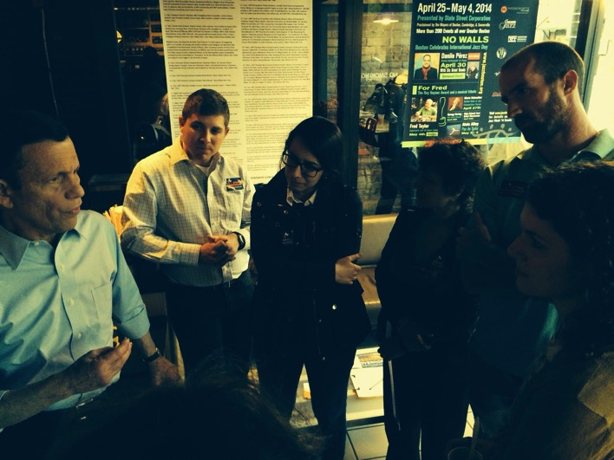
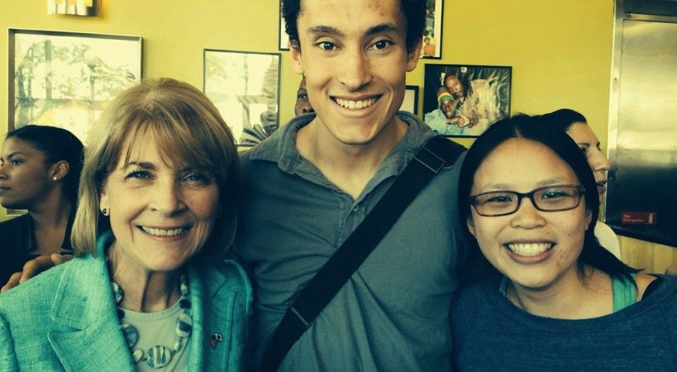
Don’t forget the camera!
Bird-dogging Martha Coakley
MA Gubernatorial Race, 2014
Bird-dogging Steve Grossman
MA Gubernatorial Race, 2014

Slide 18
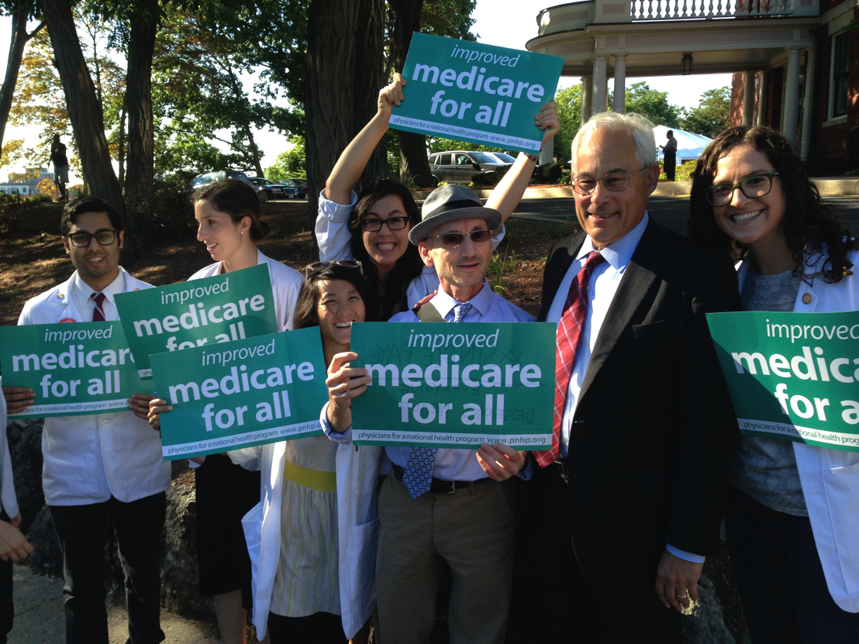
Don’t forget the camera!

Slide 19
6. Ask Your Question
Introduce yourself
Act naturally, and ask your question from memory or using notes
Anticipate that the candidate may…
… start talking before you are done
… respond to your question with a talking point
→ Redirect him or her politely
Repeat your question or have a friend ask a follow-up in order to focus the conversation
Notes:
- When you get called on…

Slide 20
7. Get Media Attention
Get the press to cover your question and the politician’s answer
The press person should scope out the scene for media
Approach press members
Don’t be afraid to ask if someone is press
Carry a sign: “Media, talk to me!”
Whatever the press asks you, respond with your prepared statement
Notes:
This is the MOST important step!
Press duty person should be ready!
*Note on talking to reporters:
If they say, “How do you like the Senator’s new hairpiece?”, it is perfectly appropriate to dodge the question completely and respond with your quote instead:
“The important thing here today was that the candidate made a clear commitment to instating a single payer healthcare system in Massachusetts if elected governor.”

Slide 21
7. Get Media Attention Ctd.
Plan ahead!
Prepare a press release
Discover which members of the press are writing about the issue by searching Google News
Find out who is likely to be interested in the issue
Write letters to the editor and op-eds
Talk to Mark Almberg (mark@pnhp.org), Communications Director for PNHP
Notes:
Contact the writers you find ahead of time and send them your press release

Slide 22
8. Get a Report Out
The reporter should update the rest of the group on efforts and progress within 24 hours
Google form
Listservs
Social media
This helps others piggyback on your accomplishments AND inspires the group!
Show off your picture!
Notes:
This will be a huge part of our campaign, considering how spread out we are!

Slide 23
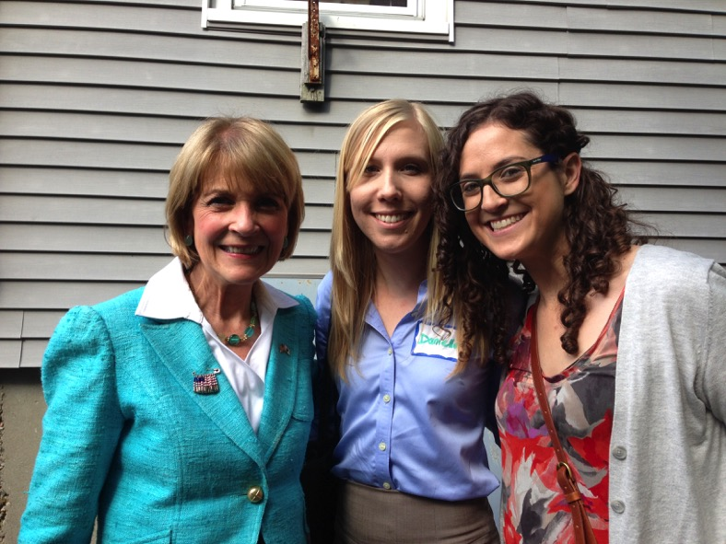
9. Repeat!
Questions?
Bird-dogging Martha Coakley
MA Gubernatorial Race, 2014
Notes:
*Our experiences bird-dogging in MA

Slide 24
IV. Our Strategy for 2016
As a national group:
Develop questions
Stay current on events & other chapters’ updates
Join Google group
Central support: Janine & Andy (jrpetito13@gmail.com, ashyatt@bu.edu)

Slide 25
IV. Our Strategy for 2016 Ctd.
SNaHP chapters:
Assign point people to keep your chapter on target
Find local events
Advertise to and recruit other nearby chapters
Report back to the national group using the Google form

Slide 26
IV. Our Strategy for 2016 Ctd.
Targets:
Presidential candidates
Candidates for Congress and state legislature
Example:
A a voter in this election, I am concerned about healthcare as a human right for all Americans. I believe that a single payer plan is the best solution to this problem. Bernie Sanders has expressed his support for this type of reform, would you endorse a single payer system?

Slide 27
V. Discussion
Your questions
Other ideas
Planning:
Who, when, where?
Question brainstorming

Slide 28
Thank you!
And many thanks to Katrina Ciraldo of BUSM for her advice and expertise.

