Slide 1
Making the Most of Media: How to Amplify Your Voice, Spark Conversation, and Build Momentum

Slide 2
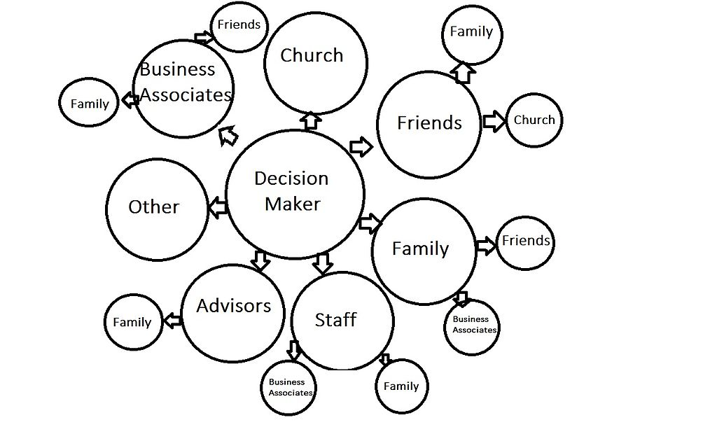
What is Power?
What does power mean to you?
How do you know that someone has power?
Who has power over you?
Who do you have power over?
How do you get power?
What different kinds of power are there?
Notes:
Preceding a discussion of media advocacy with a discussion of power is important because:
It is important to stay focused and to not let advocacy or activism become the game in and of itself. Have to keep in mind what it would feel like to WIN and strive for that.
Asking these kinds of questions of your unique situation will help you target your efforts.
Power is like pornography -- you know it when you see it

Slide 3
“Improvements in health status are believed to come about primarily from gaining more power over the policy environment rather than simply gaining more knowledge about health behaviors.”
What is your policy environment? What’s your city council doing right now? Who’s your mayor?
Notes:
Ref: https://www.ncbi.nlm.nih.gov/pubmed/7883943
All politics is local!
In other words, when you empower the community, you improve their health. Comparable to self-efficacy + psychological health, but also a testament to the fact that the community knows what they need best.

Slide 4
Media ‘Wins’
Different from legislative or electoral wins -- and thus different goals/strategies
Shifting the ‘Overton window’
Changing a reader’s mind
Increasing public awareness of an issue and urgency
Amplifying someone’s voice
“Hearts and minds”
Notes:
What are some others?
Inform (educate, facts, stats, what is the current status of the issue)
Recast (get out ahead of arguments: this is especially valuable with single payer, where there’s so many misconceptions)
Encourage (call to action)
Overton: to many, single payer health care would be such an incredible relief that it is literally unimaginable
Changing minds: “Huh, I’d never thought of that,” or “ Actually, read the other day. People love to be right, and they love to be sad, and they love to be outraged!”
What are some articles/op-eds/or just things you’ve seen on the internet that have stuck in your head?
REF: https://ctb.ku.edu/en/table-of-contents/advocacy/media-advocacy/working-with-media/main

Slide 5
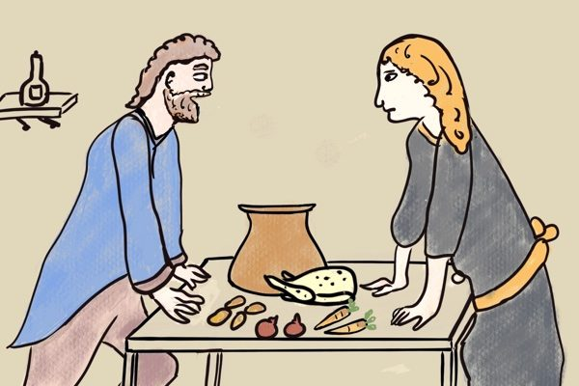
The Power of Narrative
Stories matter
Center the voices of those most affected by policy
Don’t wonk yourself
But be well versed in and confident in your facts
Stories are truth and truth is power
Politicians know this
Patients know this

Slide 6
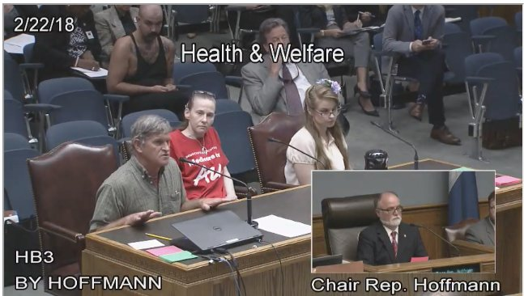
Notes:
Two people who had personal, specific stories about why Medicaid Work Requirements would be damaging for people like them. Got legislators to say that MWR weren’t about kicking people off Medicaid. Another legislator then added an amendment that said that no one could get kicked off Medicaid because of the WRs. Everyone had to vote for it! Power of stories, power of the personal, power of looking locally. Everyone was like, oh it’s so crazy that MWRs are hard to pass in a deep red state. Well….here’s proof that politics is personal, not just red/blue

Slide 7
Social Media Tips and Tricks
Stories, pictures, memes, jokes, videos -- people love ‘em
Pay attention to what works and constantly re-evaluate your strategy
Be conscious and proactive about who you signal boost or amplify
Get to know your local media outlets and reporters
Follow Us!! @SNaHP_National and @PNHP on Twitter
Notes:
Pay attn: what time of day do you get the most engagement? What kind of tweets/posts tend to be the most popular?
Actively seek out the voices of those who are marginalized and/or who would be most affected by single payer. The fight for single payer will not be won by doctors or medical students. It will be won by listening to patients and by building coalitions: labor, patient advocacy groups. Imagine if we could get the AARP -- the largest membership based org in the world -- to support single payer.
Get to know: follow them on SM, read their articles. What is the lay of the land in your area? What issues are people worried about? What do people care about?
Follow: follow orgs and people that are fighting for the same thing you are. This seems obvious but it’s not something that just happens naturally.

Slide 8
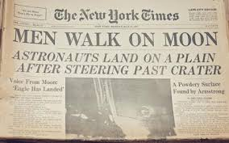
Writing a Press Release
Don’t forget your journalism basics -- who/what/when/where/why/how
Send it out two weeks before your event + reminder email, if possible
Keep it short and sweet
Focus your energy on one compelling, final sentence that clearly articulates why a reporter should be there
What kind of events get press releases? [[see above]]

Slide 9
Building a List of Contacts
PNHP can help with this
The local media landscape is bigger than you think
Try to identify someone in your chapter who would be good at this -- someone who is local or someone who reads widely or someone who has worked in journalism
Notes:
PNHP has access to an online media database and can provide contacts to members. Contact clare Fauke at clare@pnhp.org for more details.

Slide 10
*What are some problems in your community that would be solved by a single payer system?*
Notes:
Activity: Think/Pair/Share. Maybe do different levels: neighborhood, city, state. When you make stuff concrete for people -- that builds power. ASK: use this as the basis for a piece when you get home.

Slide 11
So. Many. Opportunities!
SNaHP blog
Medical school blogs
Campus newspapers
Local media outlets (alternative)
Local media outlets (daily, LTE, op-ed)
National medical websites (in Training, Kevin MD, STAT, etc.)
Social media groups (SNaHP national, SNaHP regional, medical schools)
Social media pages (personal)
Notes:
We’re gonna go through these in the next few slides

Slide 12
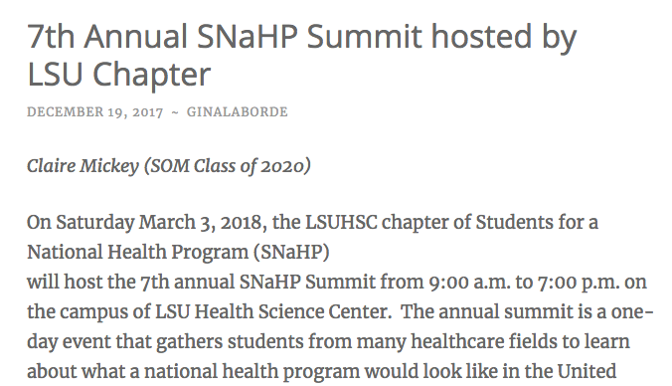
Notes:
Med School Blog
Who: people who are already gung-ho, so give them a new tool/argument.
How:

Slide 13
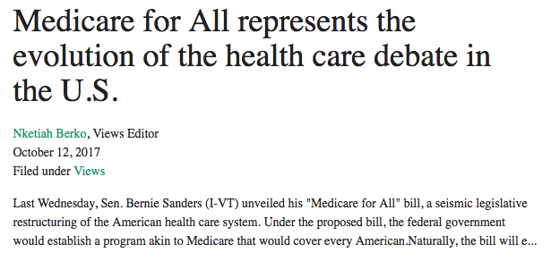
Notes:
College Paper: Tulane Hullaballoo
Who: college students who might have a lot of passion but not all the arguments or not know how to get involved

Slide 14
Notes:
Local papers: Alt
Who: similar to above...people who are likely to already agree with you, but need a nudge to get involved or an argument to drop on their more conservative friends
How:

Slide 15
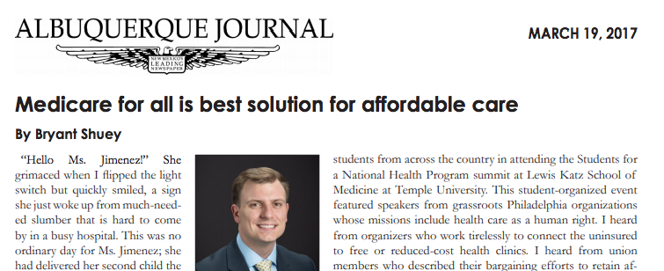
Notes:
Post PNHP op-ed -- PNHP will help you do this!!!
Who: Politicians!!!! They look at their local newspapers to get a sense of what their constituents are looking at. Email the op-ed editor of your local paper, often there is a little online form you can fill out to do an LTE, email multiple times if you don’t hear back
LTE:
Be timely: submit the afternoon that something happens. Be topical and be fast.
Be succinct: there will be a word limit, but you should be clear and succinct on a sentence level, too. Keep your argument pointed -- can you summarize it in one sentence? You should be able to, and that should be your opening and closing sentences.
Identify yourself: this is obvious but don’t forget to say that you’re a medical student and why whatever bill/candidate/issue is of particular concern to you as a future medical professional
Op-Ed:

Slide 16
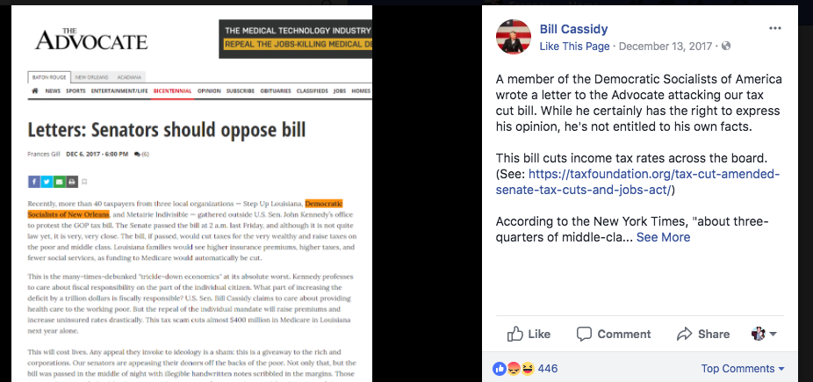
Notes:
They are listening! Well, not listening, so much as looking for opportunities to position themselves in opposition to something they think that their voters will perceive as ‘bad’ or ‘radical’
In this sense -- single payer is the BEST issue to advocate for, and the best ‘home’ for your health justice advocacy. Because people. Freaking. Love it.

Slide 17
Your Go-To Single Payer Arguments
Ask yourself first: why is this important to me and my community?
How health care works in other countries
The money we’ll save
The paperwork we won’t have to do
The high quality care we’ll be able to provide
Anticipate arguments, but don’t live there
Notes:
Ask yourself: why is this important to me as a medical student, a person, an American? In this context? In this community? Right now? Feel it out.
Again, I think it’s so crucial to understand that winning single payer is literally unimaginable to the vast majority of Americans. Including (really, esp) Democrats!! Part of every single payer media piece needs to do some of that ‘world building.’ give people permission to believe that things can be better, and watch how quickly they’ll fight for it. One tiny step forward in this is reminding folks that other countries already have this and it works pretty damn great
money/paperwork: this stuff makes SENSE to people! And everyone -- conservatives esp -- hate paperwork and bureaucracy.
Care: Here’s where your voice as a medical professional really makes a difference. You can speak to specific thigns you’ve witnessed and been frustrated by and how, precisely, single payer will alleviate that
Anticipating: it’s important to anticipate possible arguments, but don’t build your argument in a negative space. We will win if we can articulate a vision for a future that people can strive for

Slide 18
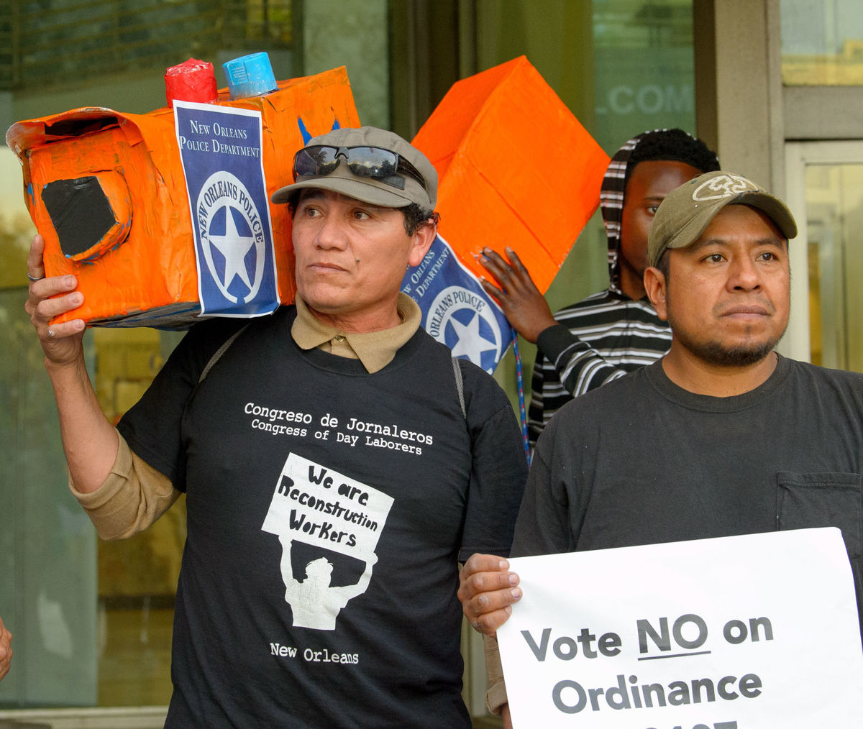
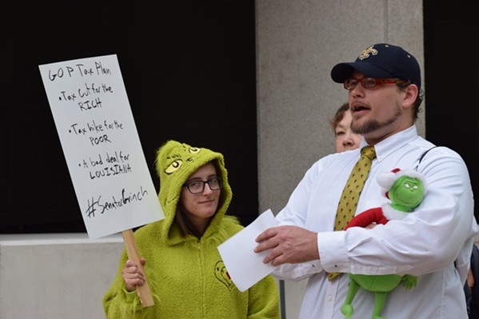
Be Bold + Be Creative + Build Coalitions
Notes:
Obviously, the tax bill passed. And it would’ve been ideal if it hadn’t. But we had multiple great conversations with people on the street, and everyone who participated felt empowered. SEveral people took on roles and responsibilities they’d never done before, including myself!
Build political clarity within yourself!!!

Slide 19
Next Steps!
Write an op-ed or an LTE when you get home
Join the Media Team -- talk to me after
Today:
11:45 am - Break/Go Grab Your Lunch in the Cafeteria
Vegetarian/Vegan/Gluten Free get separate box lunches
12:00 pm - SNaHP Chat Mentoring Sessions in the Cafeteria
Notes:
Reach out to PNHP staff for support!!

Slide 20
@awgaffney
@nataliesurely
@dsamfa
@swoolhandler
@LaborforSpayer
@NationalNurses
@AugieLindmark
Thank you to DSA New Orleans and their Gimme a Brake (Light)! Event planning guide for the press release tips!
frances.loretta@gmail.com
@francesloretta

