Slide 1
Organizing on a Time Crunch: #Right to Health Action Walkthrough
Paige-Ashley Campbell, Maria Mihailescu, Cyrus Alavi, Hans Strobl

Slide 2
Why we do what we do
What is advocacy?

Slide 4
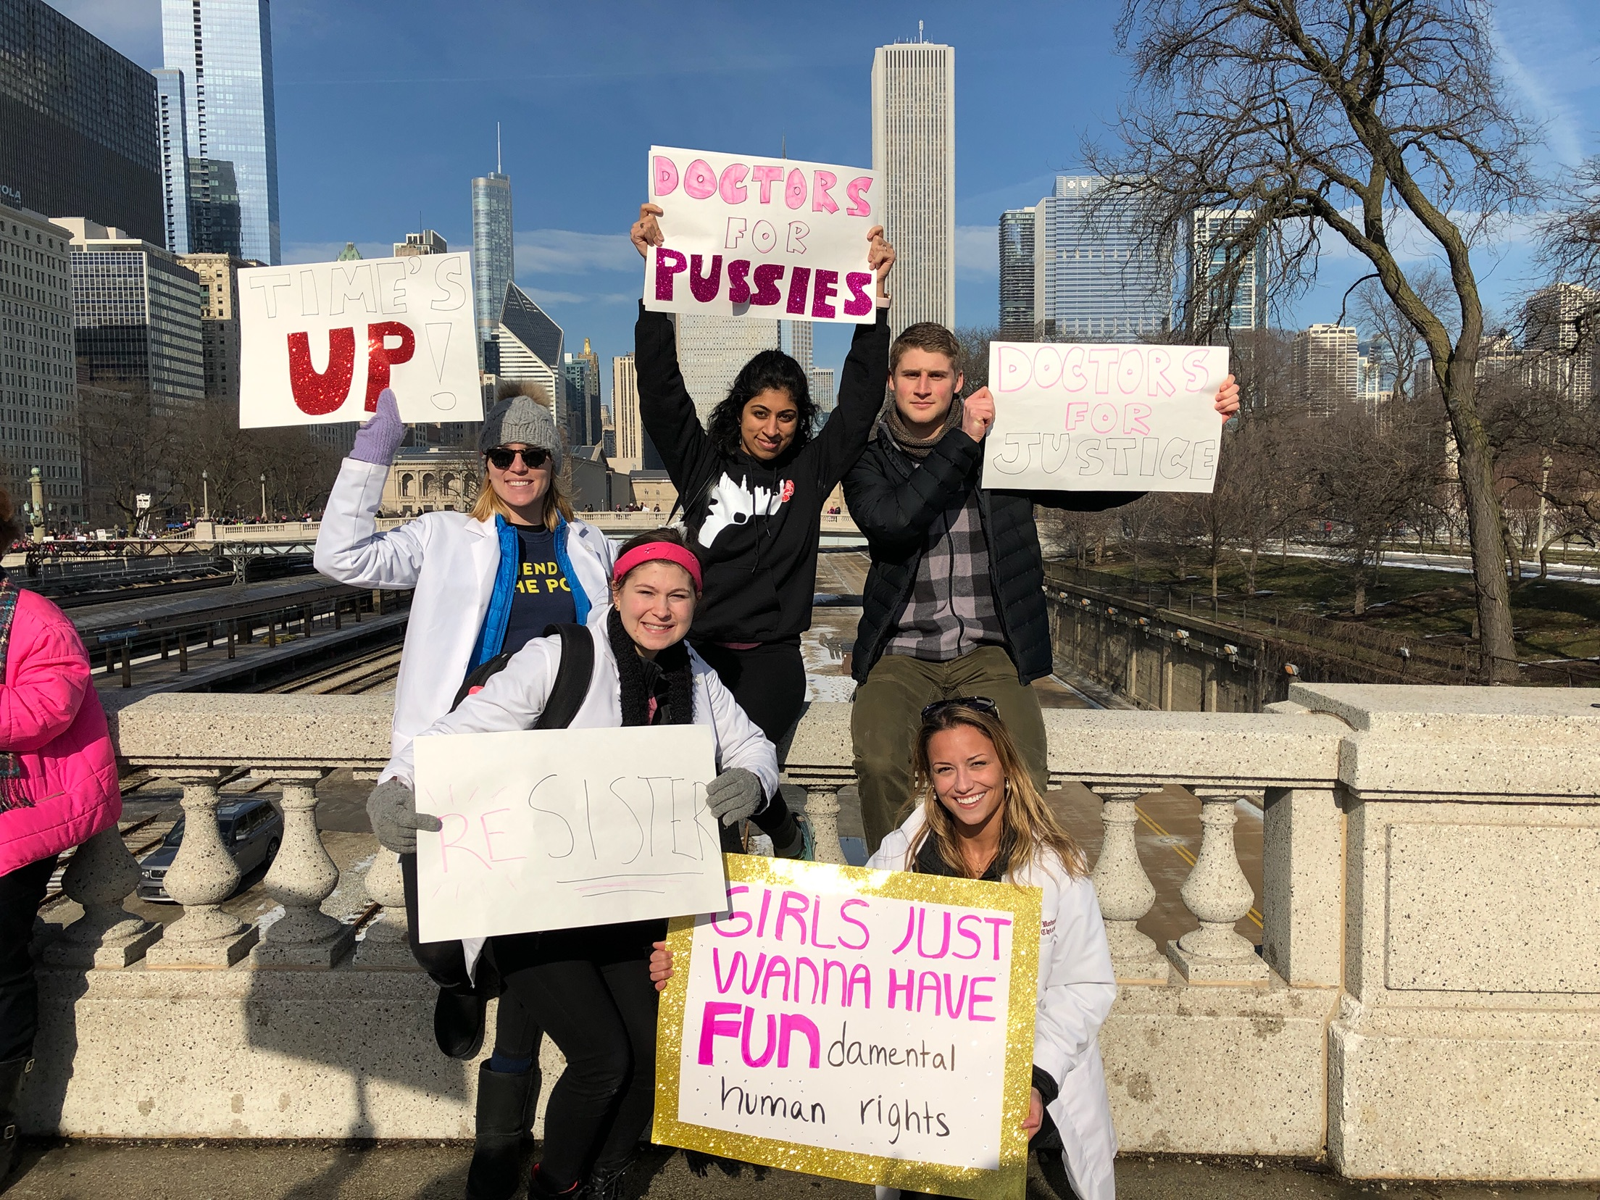
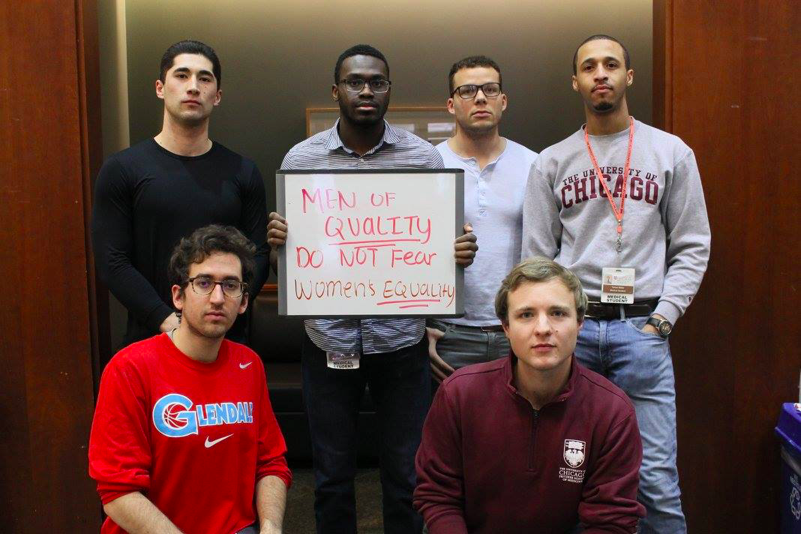
Why we do what we do
What is advocacy?
Grassroots vs. Lobbying

Slide 5
Why we do what we do
What is advocacy?
Grassroots vs. Lobbying
What you can do as part of SNaHP

Slide 7
Impact
Tailor your activities to the goal at hand
Petition signing* and social media engagement are great ways to recruit volunteer advocates
Call your legislator’s district office
Plan a visit!
*signatures make a great deliverable during your lobby visit!

Slide 8
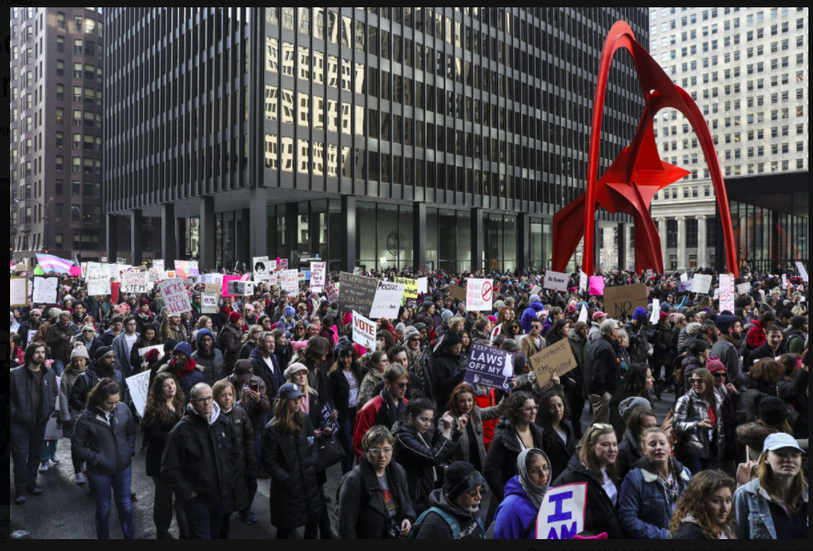
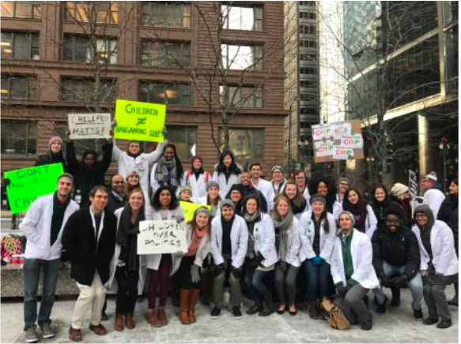
Organizing a Rally
Exemplified by the successful Pritzker rally for CHIP December 2017 - Federal Plaza

Slide 9
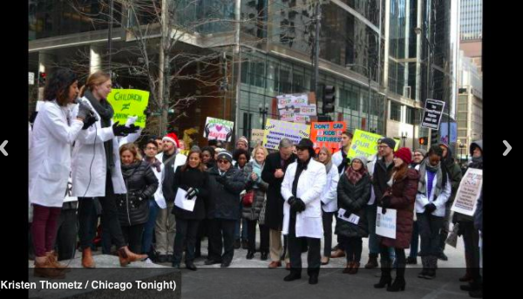
The Holy Template
Logistics Speakers
Attracting attendees & the dreaded press

Slide 10
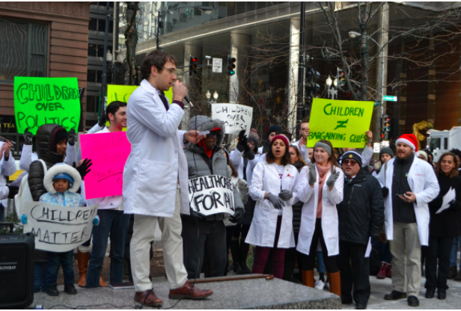
Logistics
Pick a specific cause “Women’s rights” vs “gender equality in workplace”
Pick a meaningful location Want a bill passed? Rally in front of state legislature building
Avoid getting arrested Ensure with law enforcement and location’s admins about possible permits or local laws
“Federal plaza admins tried to tell us we couldn’t use the public space. We fought back. You will get resistance, know your rights and persist”

Slide 11
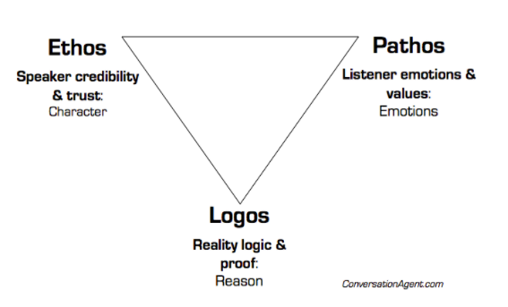
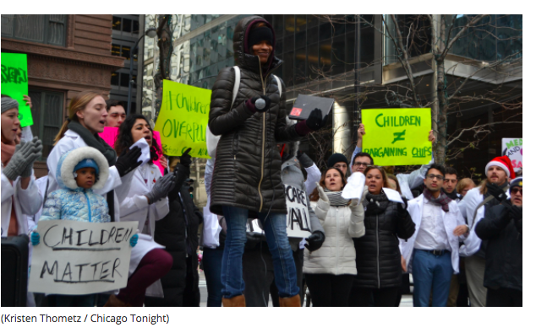
Speakers: who

Slide 12
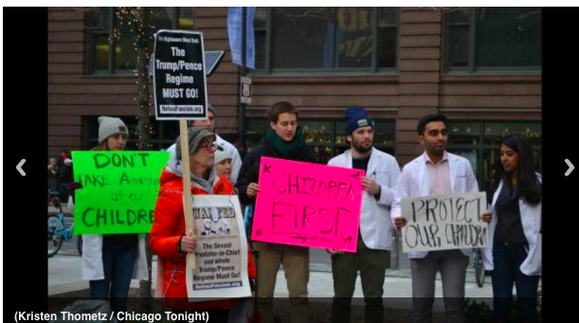
Find speakers
government officials, issue advocacy groups, local political action committees, democratic caucuses, student groups, and local progressive blogs etc…
Email them Why is this important? Why will their participation make a difference?
Harass them until they respond Don’t be shy
“If you’re lucky 1 or 2 might respond on the first request. They are busy people. Persist, the second ask will be more successful. And a third won’t hurt. Persistence demonstrates value”
Katie Ellis, Pritzker DFA

Slide 13
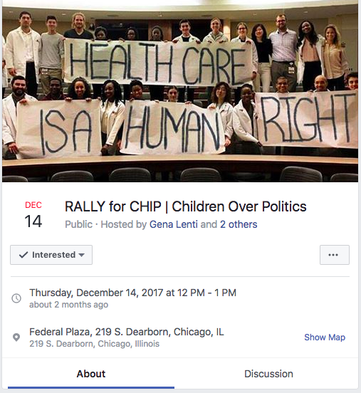
Make it BIG
Social media Facebook, twitter, group photos
Advertise write a letter to editors for local newspaper: why rally will be huge
Other groups Invite other advocacy/social justice groups

Slide 14
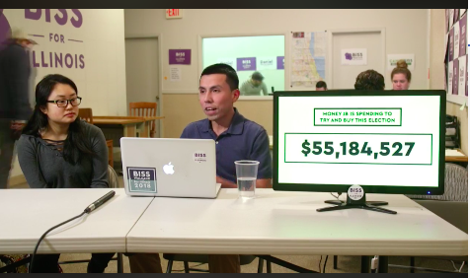
Contact the press
Find a mentor “It was actually Clare Fauke of PNHP, not DFA, who gave us a complete comphensive list of press contact and was super helpful with advice on how to write a press release”

Slide 15
Contact the press
Find a mentor “It was actually Clare Fauke of PNHP, not DFA, who gave us a complete comphensive list of press contact and was super helpful with advice on how to write a press release”
Compose a press release Again, find a mentor to help you. There’s template online. There are many resources, don’t over-exhaust yourself

Slide 16
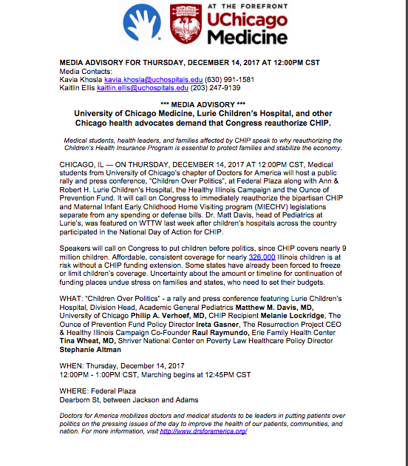

Slide 17
Contact the press
Compose a Press Letter 1. The release type, date, and contact information is clearly at the top

Slide 18
Contact the press
Compose a Press Letter 1. The release type, date, and contact information is clearly at the top
2. A header about the event with a sub-header description about the organizer

Slide 19
Contact the press
Compose a Press Letter 1. The release type, date, and contact information is clearly at the top
2. header about the event with a sub-header description about the organizer
3. summary paragraph about what the rally is, when and where it will be

Slide 20
Contact the press
Compose a Press Letter 1. The release type, date, and contact information is clearly at the top
2. header about the event with a sub-header description about the organizer
3. summary paragraph about what the rally is, when and where it will be
4. Clearly state who the speakers are and importantly, their role in the cause (sell this!)

Slide 21
Contact the press
Compose a Press Letter 1. The release type, date, and contact information is clearly at the top
2. header about the event with a sub-header description about the organizer
3. summary paragraph about what the rally is, when and where it will be
4. Clearly state who the speakers are and importantly, their role in the cause (sell this!)
5. Restate who, when, and where (not in paraphaph form) and at the bottom, list the rally coordinator’s information

Slide 22
Get the Facts
4 Basic Steps of Health Advocacy Change
4. Communicate a clear and compelling story
2. Organize Support
3.Define the problem and make your plan
Define the problem and make your plan
Communicate a clear and compelling story of what is wrong and what should be done.

Slide 23
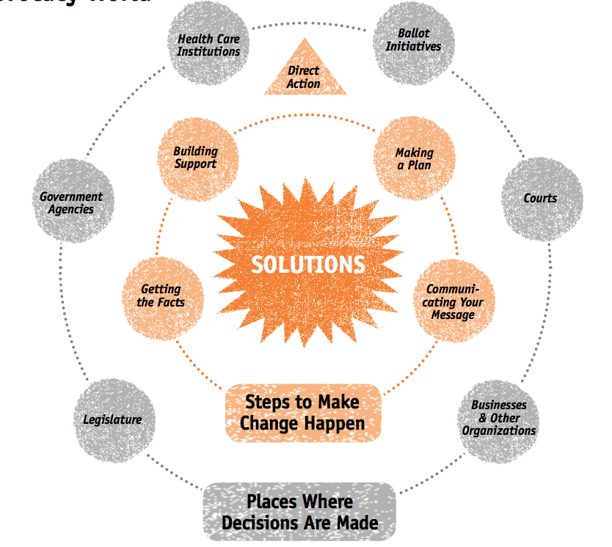
http://www.racialequitytools.org/resourcefiles/AFC_Manual_01.pdf

Slide 24
Identification & Outreach to Key Stakeholders:
Phonebanking
Homebase
Petition
Institution Photo
Identify Key Stakeholders
Who are your local lawmakers?
Government Agencies
What are their stances on Medicare for all?
Explore any intersection of advocacy and electoral objectives

Slide 25
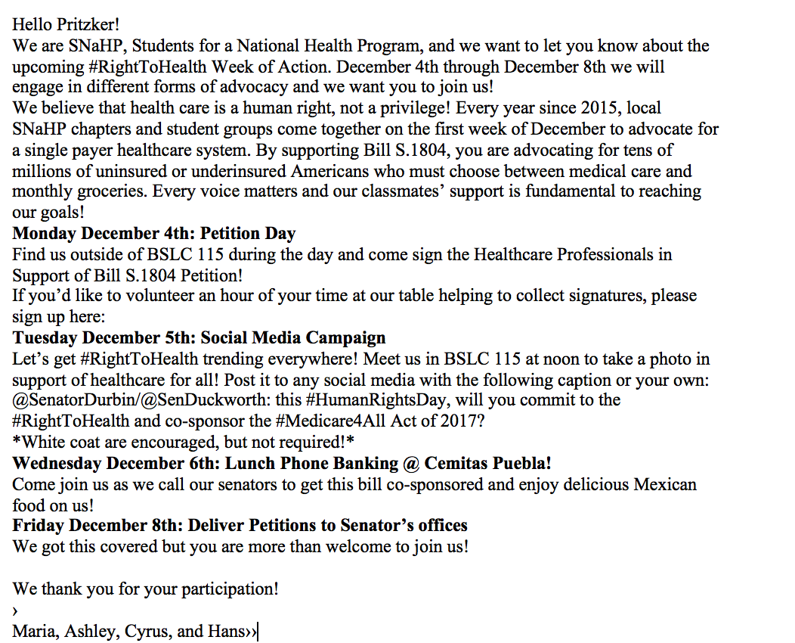
The Email Out to Key Stakeholders: Homebase
Introduction
Schedule

Slide 26
The Email Out to Key Stakeholders: Lawmakers
Introduction
To whom it may concern,
My name is Paige-Ashley Campbell and I am co-chair of the University of Chicago Pritzker School of Medicine chapter of the student branch of Physicians for a National Health Program (SNaHP). The week of December 4th marks the third annual SNaHP week of action. We believe that healthcare is a human right, not a privilege! Every year since 2015, local SNaHP chapters and student groups come together on the first week of December to advocate for a single payer healthcare system. By supporting Bill S.1804, we are advocating for tens of millions of uninsured or underinsured Americans who must choose between medical care and monthly groceries. I would like to schedule a meeting for the week of December 4th with Senator Duckworth or her health legislative assistant in her Chicago office (230 S Dearborn St) to discuss the Senator’s position on S 1804, the Medicare for All Act of 2017. The representatives of SNaHP would appreciate the opportunity to express our support of the bill. Thank you for your time. I look forward to your response.
Purpose
Set a meeting date

Slide 27
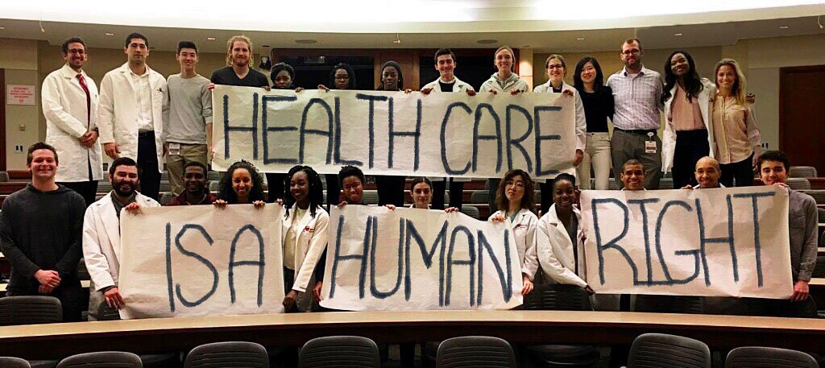
Pritzker students gather for photo opp in BSLC

Slide 28
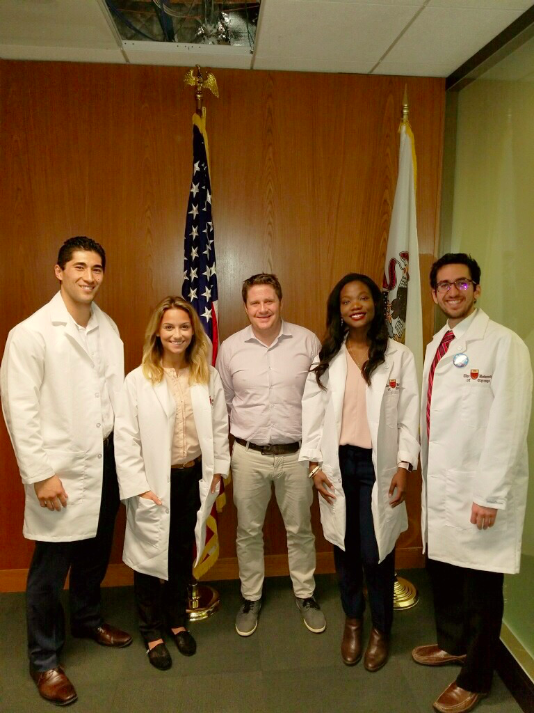
Pritzker SNaHP leaders meet with Senator Duckworth’s Special Projects Manager David Applegate

Slide 29
Information Preparation for Petition Signing: What We Did
What is the Medicare for All Act
The position of targeted state senators
Arguments for the hesitant

Slide 30
Preparation for Petition Signing: What We Wish We Did
Recruitment at door.
Single payer 101 flyer & Medicare For All 101 Flyer
Delegate a person to the task of talking to those who are hesitant
Google form petition
SNaHP listserv recruitment

Slide 31
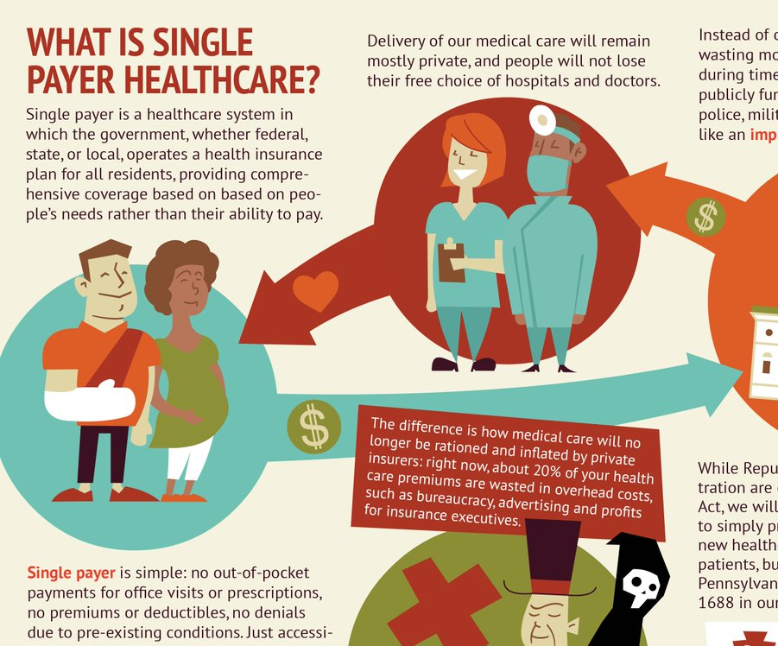
Preparation for Petition Signing: What We Wish We Did cont.
Organize petitions for different lawmakers:
Signatures should match constituency
The more impactful signatures the better
In Single payer 101 flyer & Medicare For All 101:
Philosophical argument (Medicare for all, Human Right)
Economic argument
How can single payer reduce costs?

Slide 32
Preparation for Lobbying Visits:
Acquire background information on the individual who you are meeting
Prepare personal stories and make patients the focus of stories.
Do you know anyone who has suffered because they could not afford or did not have access to healthcare?

Slide 33
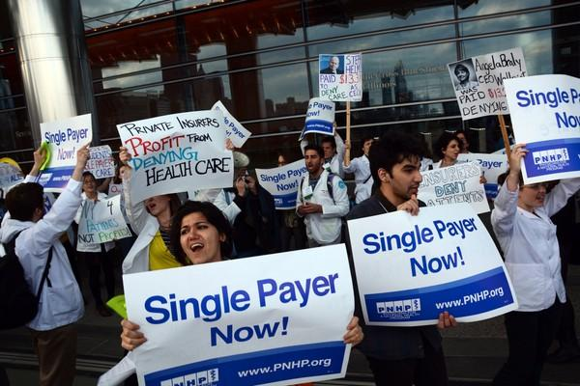
The Lobby Visit
Introduce yourselves and explain your status and role
Thank them for taking the time to meet with you.
Give them a brief overview of single payer
Why it is important for the communities that they represent?
Thank them for any health care efforts they have supported.

Slide 34
The Lobby Visit
Bring up the prepared personal stories (patient focused)
Ask about any roadblocks regarding health care related legislation
Discuss the economics of single payer
Listen to their point of view and anticipate counterarguments.
“Wouldn’t this just increase taxes and force people to pay more?” How do you respond?

Slide 36
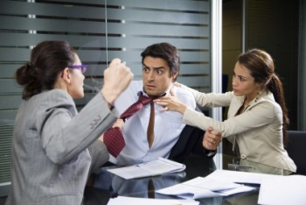
The Lobby Visit
Take care not to get too emotional and accidentally show irritability, impatience or aggression. Be careful because this will immediately reflect poorly on your group.
Bring visual aids and other accurate informational material. 1 or 2 pages, not 10 pages.
Make yourself available as a resource so they can come to you for information.
Vote for them if they support the cause!

Slide 37
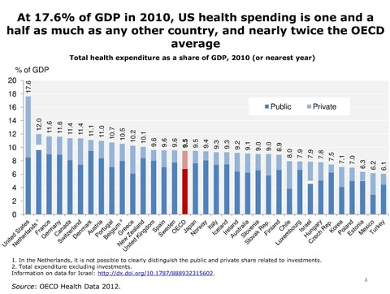
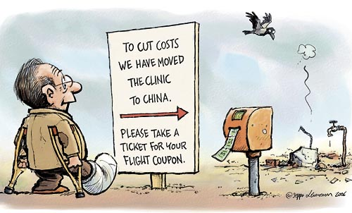
DON’T BE CONFRONTATIONAL, BRING DATA, and TELL GOOD STORIES

