Slide 1
Medicare for All What does it mean for dentistry?
Ed Weisbart, MD, CPE, FAAFP
Physicians for a National Health Program
Chair, MO Chapter

Slide 2
America Really Wants Dentists
Non-partisan.
Non-political.
Non-policy.
Just clinical work.

Slide 4
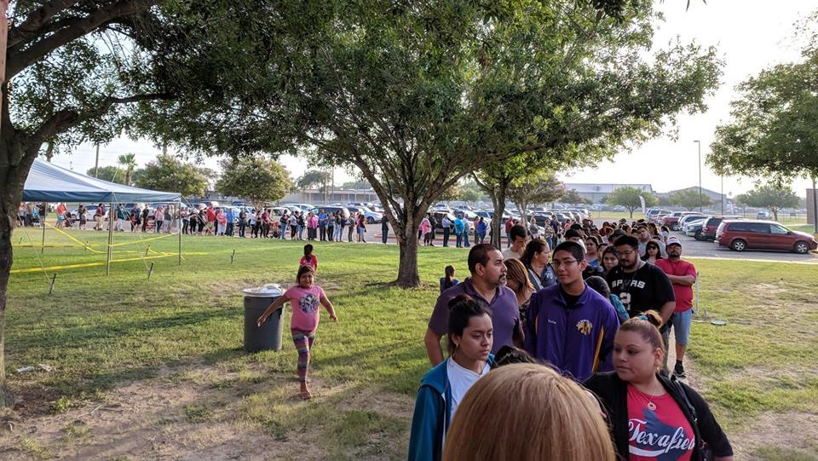

Slide 6
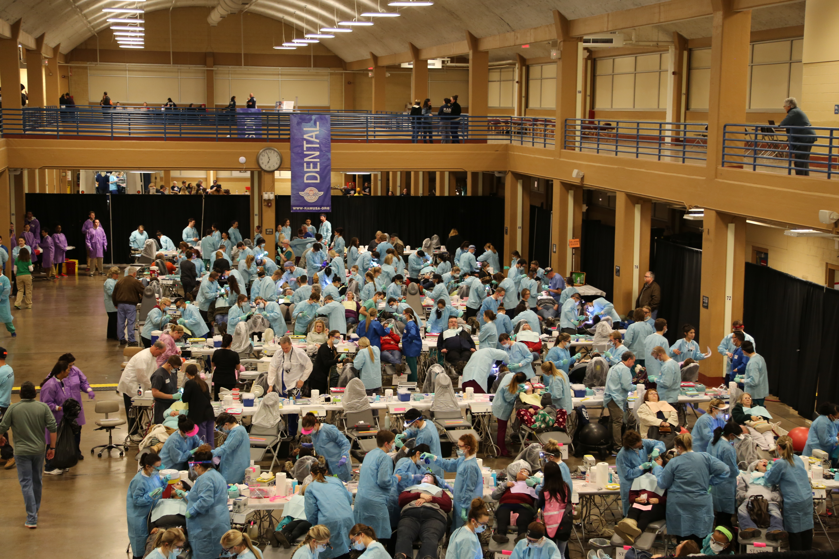

Slide 7
Medicare for All Needs Dentistry
Examples of problems potentially exacerbated by poor dentition
Coronary Artery Disease
Diabetes
End Stage Renal Disease
Preterm Labor
Pneumonia
Alzheimer’s Disease
Depression
Falls
Isolation
Emergency Department use
Skilled Nursing Facility use
Greater dependence on family caregivers
https://ubcmj.med.ubc.ca/ubcmj-volume-7-issue-1/dental-care-in-canada-the-need-for-incorporation-into-publicly-funded-health-care/dental-care-in-canada-the-need-for-incorporation-into-publicly-funded-health-care/
https://www.commonwealthfund.org/publications/issue-briefs/2018/jan/how-medicare-could-provide-dental-vision-and-hearing-care

Slide 8
Lack of Dental Access Is Tragic and Expensive
Commonwealth Fund
ADA
CDC
70% of Medicare beneficiaries who had trouble eating because of their teeth did not go to a dentist in the past year.
At $749 per visit, Emergency Department dental visits cost the USA $1.6 Billion in 2012.
Oral health problems cost the USA $6 Billion in productivity
A health system that under-treats dental problems will have
worse outcomes and higher costs
https://www.commonwealthfund.org/publications/issue-briefs/2018/jan/how-medicare-could-provide-dental-vision-and-hearing-care
https://www.cdc.gov/oralhealth/basics/index.html
https://www.statnews.com/2017/07/17/dentistry-medicine-division/
http://www.ada.org/~/media/ADA/Science%20and%20Research/HPI/Files/HPIBrief_0415_2.ashx

Slide 9
Both Bills Include “Oral Health”
HR 676
Unchanged since 2003
SB 1804
Introduced 2017
“The full scope of dental services, services, including periodontics, oral surgery, and endodontics, but not including
cosmetic
dentistry.”
102(a)11
“Oral health, audiology, and vision services.”
201(a)(9)
Now is the time for dentists to
weigh in on the benefit design

Slide 10
Both Bills Include “Oral Health”
Many open issues. Take a stand!
Exclude Dental
Insurance Design
Practice Impact
Wrong side of history
For many, dental is more popular than medical coverage
Model after Part A? B? C? D? Which?
Benefit design of prevention, extraction, and…?
Annual $ max? Why?
Less admin load
Less bad debt
More patients = more upsells beyond basic covered benefits

