Slide 1
Building a feminist, anti-racist, pro-immigrant, pro-disabled people’s SP movement: Why & how?
Roona Ray, MD MPH
Physicians for a National Health Plan
Annual Conference
Philadelphia, 2 November 2019

Slide 2
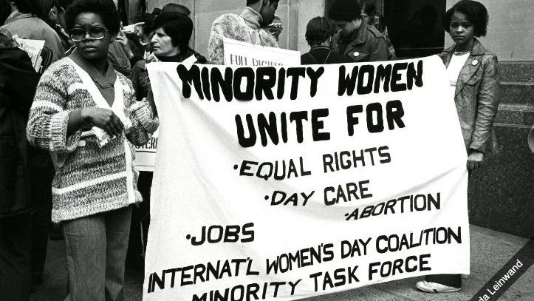
[Why is single payer a feminist, anti-racist, pro-immigrant, pro-disablity rights issue?? //]

Slide 3
Outline & objectives//
Why is single payer a feminist, anti-racist, pro-immigrant, pro-disabled people’s issue?
How do we organize with this perspective in our communities?
Some approaches
Exploring potential allies
Some readings
Single payer will expand access to care for women, people of color, immigrants, & disabled people.
Single payer will eliminate the incentives that create a two-tiered, separate & unequal health system.

Slide 4
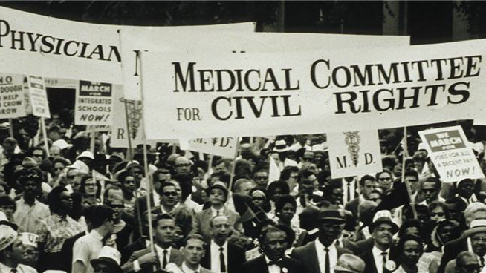
We build power by involving people who are most affected by the healthcare crisis &/or working in solidarity with them.

Slide 5
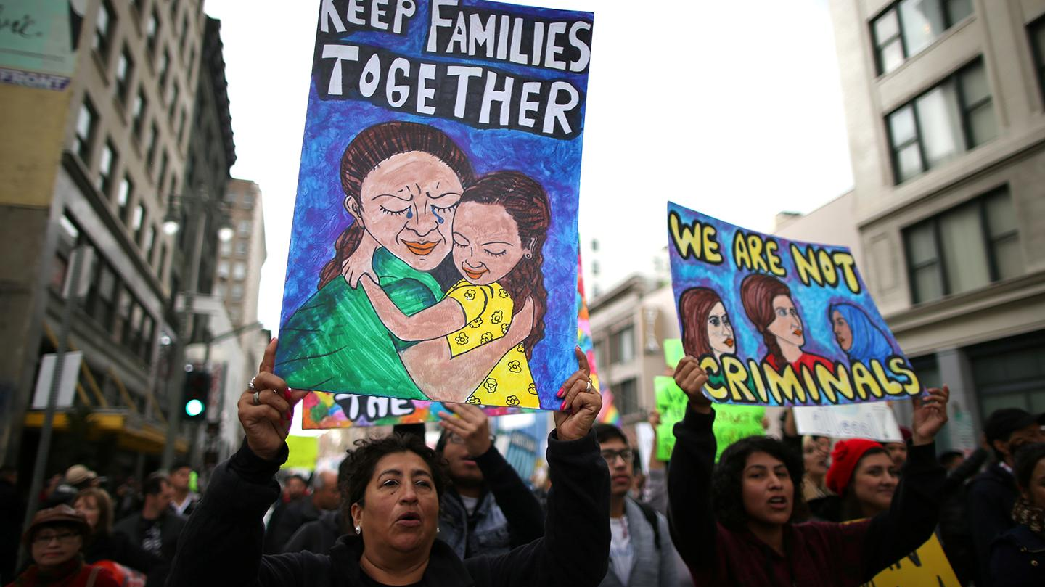
How do we organize for single payer as feminists, anti-racists, pro-immigrant, & pro-disability rights organizers?//

Slide 6
How do we unlearn sexism, racism, xenophobia, & ableism?

Slide 7
Single payer is one part of a larger landscape of demands & movements for justice demands that we must engage with.

Slide 8
Who in your community cares about feminism, racial justice, immigrants, & disabled people?

Slide 9
How would you approach potential allies as a single payer activist?

Slide 11
[listening]

Slide 12
How would you & your community’s life change if you had guaranteed healthcare?

Slide 14
[more listening]

Slide 15
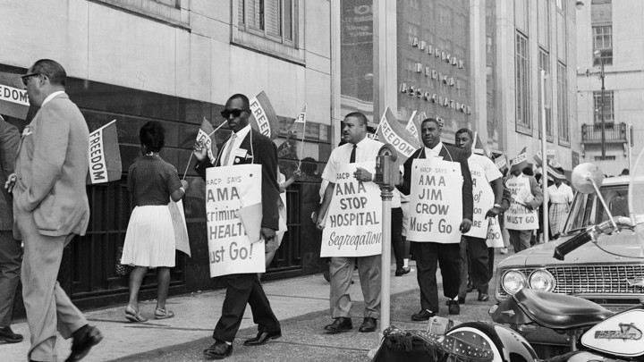
Demands for healthcare for all in current movements for women, people of color, & immigrants: //
Black Mamas Matter Alliance
Poor People’s Campaign
NY Immigration Coalition
Democratic Socialists of America NYC Socialist Feminist Working Group
The Movement for Black Lives
National Women’s Liberation
National Domestic Workers’ Alliance
National medical association?

Slide 16
Some reads: //
“Best Practices for White-Led Organizations to Promote Health Equity and Racial Justice in Health Advocacy”
“The Fight for Healthcare Has Always Been About Civil Rights”
“Undocumented, Uninsured, Unafraid”
”The Feminist Case for Single Payer”

Slide 17
Thanks! //

Slide 18
Approaches in New York
Anti-racism training
Online and in collaboration with a community group
Healthcare Rights and Access Survey
With focused outreach to immigrants & communities of color, including translation on-demand
Jointly organized events
Power to Heal, a film about how Medicare desegregated US hospitals
People of color & immigrants caucus
New flyer on racial & immigrant justice & SP
Solidarity actions
E.g. against the proposed public charge rule

Slide 19
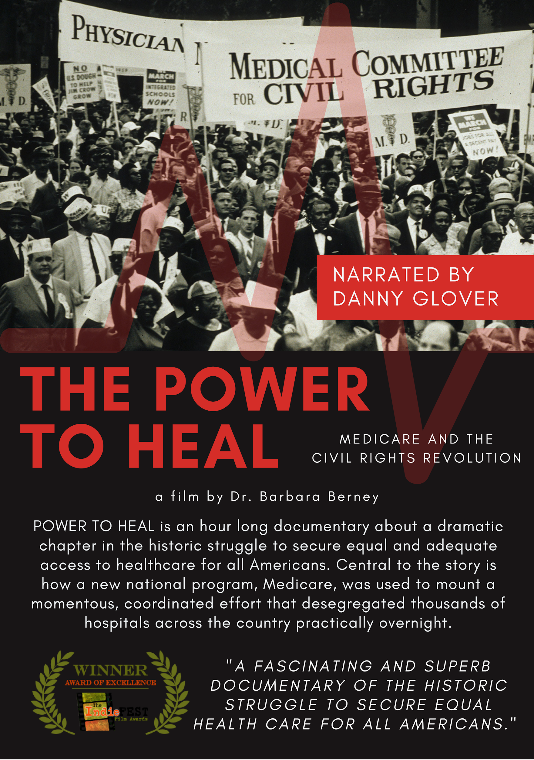










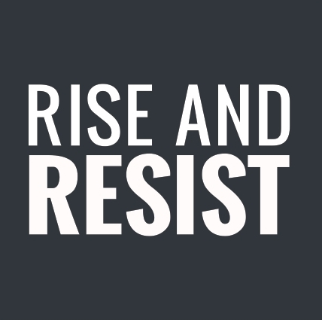

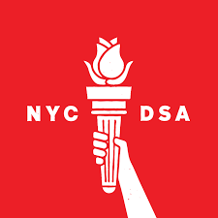

Notes:
https://vimeo.com/wetanational/review/274987698/42255f2254

