Slide 1
Building a diverse movement for single-payer: why and how
Workshop agenda:
Information foundation
Reforming our communication for connection
How to organize a teach-in
Group activity with social media

Slide 2
All Means ALL
Racial Equity and Health Justice
Sanjeev K. Sriram, MD, MPH
@DrAmericaShow
@DrSriram
@dramerica_allmeansall
Notes:
Sanjeev K. Sriram, MD, MPH
“Dr America” for We Act Radio, physician, and health justice activist

Slide 3
Progress made by the ACA
Notes:
https://www.kff.org/disparities-policy/issue-brief/changes-in-health-coverage-by-race-and-ethnicity-since-implementation-of-the-aca-2013-2017/

Slide 4
59% of the 28 million uninsured are people of color

Slide 5
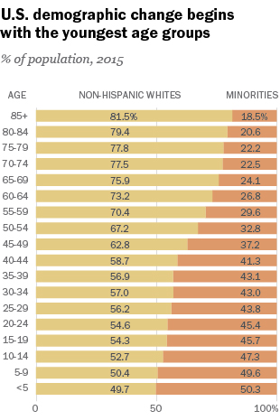
People of Color: Majority in 2040 NOW
2011: 50.4% of US infants (< 1yr) are people of color
2011: under age-10 non-white population is majority in 13 states (HI, CA, NV, AZ, NM, TX, NY, NJ, MD, DC, FL, GA, MS)
2014-15 school year: minority student enrollment in public schools > whites
2018: people of color are majority in HI, CA, NV, NM, TX, DC, PR (MD at 49.5%)
2020: over half of US children < 18yr will be people of color
Notes:
https://www.npr.org/sections/ed/2016/07/01/484325664/babies-of-color-are-now-the-majority-census-says

Slide 6
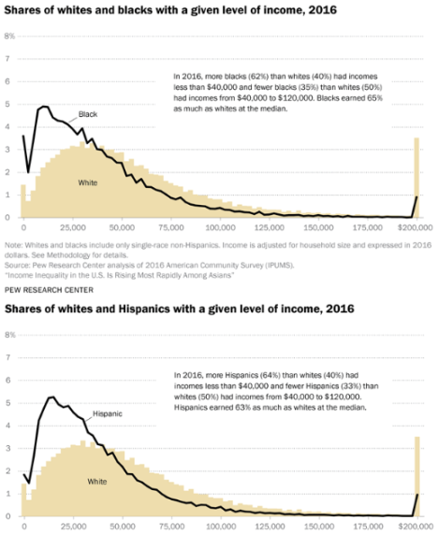
Income Inequality & Racial Inequality
62% of Blacks and 64% of Latinx earn less than $40,000 compared to 40% of Whites
35% of Blacks and 33% of Latinx have incomes from $40,000 to $120,000 compared to 50% of Whites
69% of Americans do not have $1,000 in savings
40% of Americans do not have $400 for an emergency
Notes:
https://www.pewsocialtrends.org/2018/07/12/appendix-a-income-distributions-of-whites-blacks-hispanics-and-asians-in-the-u-s-1970-and-2016/

Slide 7
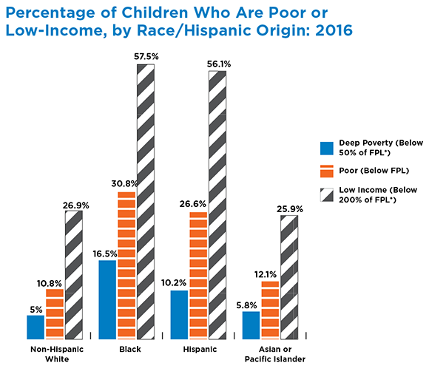
Income Inequality & Racial Inequality
100% FPL in 2016 = $24,300 / yr for a family of 4.
Low Income (200% FPL)
57.5% of Black children
56.1% of Latinx children
26.9% of white children
Below FPL
30.8% of Black children
26.6% of Latinx children
10.8% of white children
Notes:
childtrends.org

Slide 8
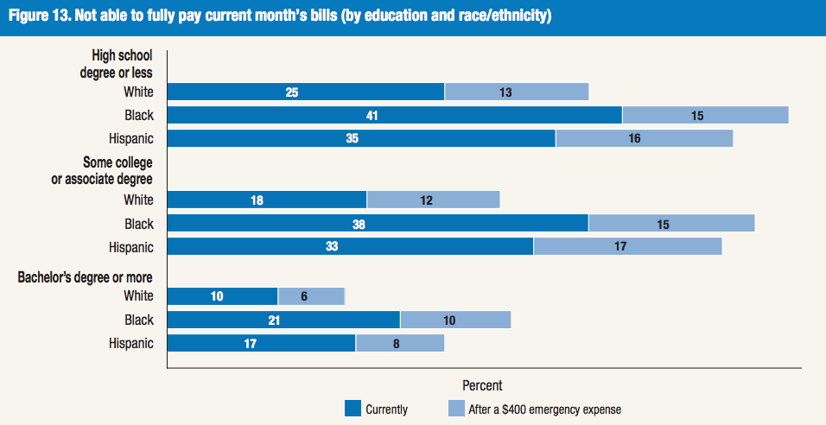
The Pain of a $400 Emergency…
Notes:
https://www.federalreserve.gov/publications/files/2017-report-economic-well-being-us-households-201805.pdf

Slide 9
NOW is the time for Medicare For All
Why the ACA is important but insufficient:
Medicaid can work wonders – depending on where you live
Private insurance is unreliable
The current fragmented system is inefficient, unjust, unsustainable, and unrealistic
2017 Pew Research: 85% of Blacks and 84% of Latinx say the government should ensure health coverage
NOW is the time to make racial equity a cornerstone, not a side project or after-thought, of health policy.
Notes:
http://www.pewresearch.org/fact-tank/2017/01/13/more-americans-say-government-should-ensure-health-care-coverage/

Slide 10
Medicare For ALL?
What’s said about MFA:
How it sounds:

Slide 11
59% of the 28 million uninsured are people of color

Slide 12
Medicare For All will help POC
With MFA, health care is a human right no matter what you earn, where you live, or what you look like.
The coverage moves with you for life: job to job, state to state, graduation, retirement, etc.
Community hospitals and clinics will have more reliable funding to stay open with high quality staff and resources.
More support for health care in under-served and rural communities.
In S 1129 and HR 1384, there will be funding to build and maintain racial equity across hospitals and clinics.
MFA will not end all racism in health care. The policies help but are not a cure-all.

Slide 13
All Means All
As we build Medicare for All, we must engage minority communities who have been overlooked or under-prioritized
Center MFA on racial justice and eliminating health inequities
Multi-lateral approaches:
Engage and energize our communities
Motivate academic medicine & public health
Push members of Congress & 2020 candidates
Educate, organize, & agitate on social media
#Medicare4All #MedicareForAll #AllMeansAll
Learn more at www.socialsecurityworks.org/allmeansall
@DrAmericaShow
@DrSriram
@dramerica_allmeansall

Slide 14
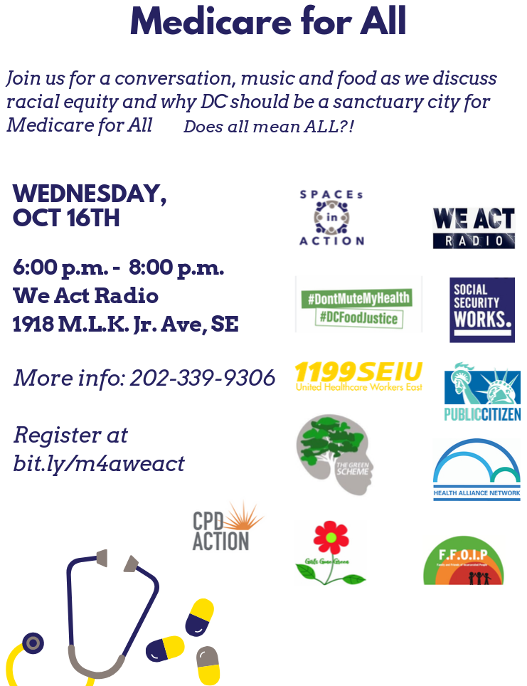
Organizing a teach-in
Teach-ins: relevant info is shared wonks, organizers, & community
Sharing experiences builds solidarity & trust
Action steps are planned
“Awareness” is not enough
Where?: DON’T hold it at hospitals or academic medical centers.
Community clinic?... Maybe
Church, library, community center, local radio station, etc (trusted safe spaces)
When?: Weekday evenings are sometimes more feasible than weekends.

Slide 15
Organizing a teach-in
Who are your coalition partners? What are their must-haves for the agenda?
Can they canvass the area and spread the word? Help with the budget?
How will the agenda be made? What topics will be covered? Budget time for Q&A
How does MFA fit with a local public health issue (hospital closure, pollution, striking workers, etc.)?
What is your budget?
Donated spaces: great, but requires flexibility for the host(s) & coalition partners
AV and sound equipment?
Food and drinks: if the event is in a food desert, feed people.
Sponsorship from local businesses?
Advertising?: social media needs to connect with communities

Slide 16
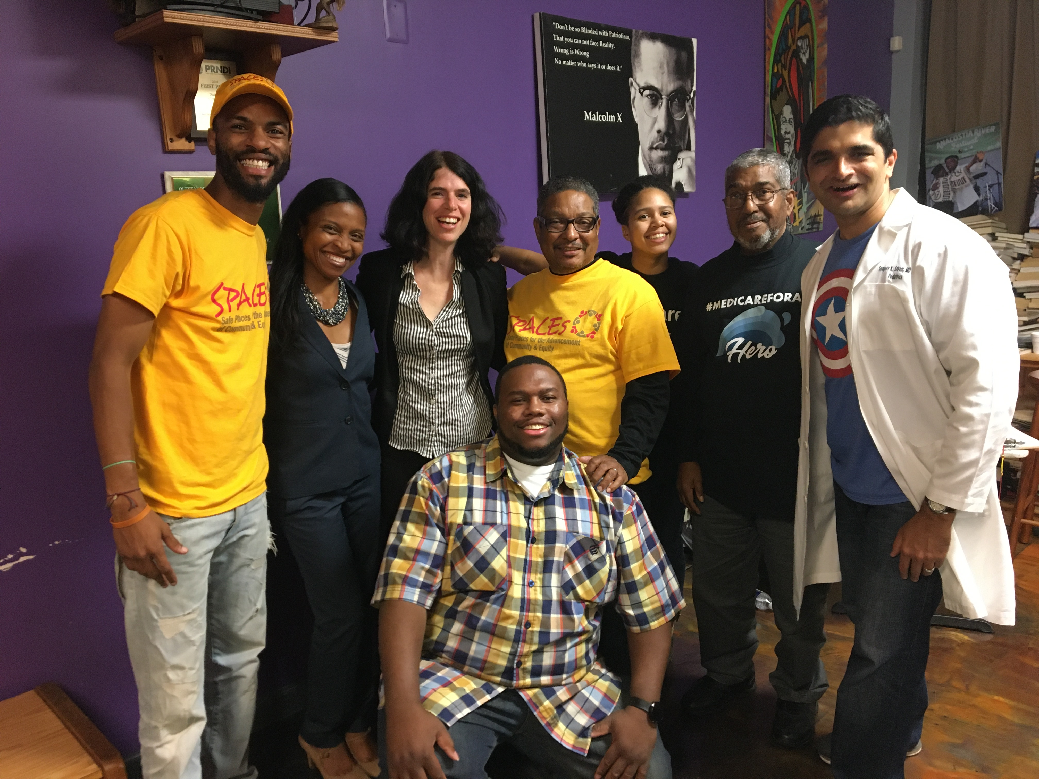
Organizing a teach-in
What action will be taken?
Some action steps may be known beforehand: everyone goes to a hearing, town hall meeting, or protest
Allow for new action items to be developed, especially in the community
Welcome new participation:
Give / share speaking time
Make posters together
Arrange transportation

