Slide 1
AMA Resolutions
Alankrita Siddula
AMA-MSS

Slide 2
MSS Efforts
June 2014 - Asked AMA to advocate for single-payer health insurance, not adopted, “advocate” too strong in light of AMA’s continued opposition to single payer
November 2014 - Asked AMA-MSS to support state-level single payer, adopted as amended to support all ideas for universal coverage including but not limited to single-payer
June 2017 - Asked AMA-MSS to support implementation of national single-payer system, adopted

Slide 3
MSS Continued
November 2017- Asked AMA to neutralize language against single-payer, referred for study until Annual June 2018, delayed to Annual June 2019
June 2019:
Within MSS a resolution was brought forth asking AMA to support single-payer, neutralize language, and leave Partnership for American Health Care Future, not adopted by MSS as they wanted to see the results of the previous resolution’s study
HOD meeting - Report from Council for Medical Services on resolution from 11/2017 did not fully answer the ask of the resolution, cherry-picked data to compare healthcare proposals, and ultimately recommended that the AMA continue support for ACA and work to expand coverage through the ACA
Historic vote by HOD on MSS-proposed amendment asking again for neutralization of language: 47% Yes, 53% No -- >a matter of 20 votes, things are moving in the right direction

Slide 4
MSS Continued
Currently, medical students are working on state level changes by petitioning state medical societies to either neutralize their stance against single-payer if they have policy opposing it or support implementation of a national single-payer system.
Therefore, when the subject is again broached at a HOD meeting, state delegates can vote in favor of neutralization or in favor of support.

Slide 5
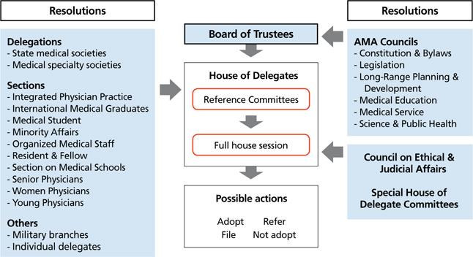
There are many avenues to bring resolutions forward to the AMA

Slide 6
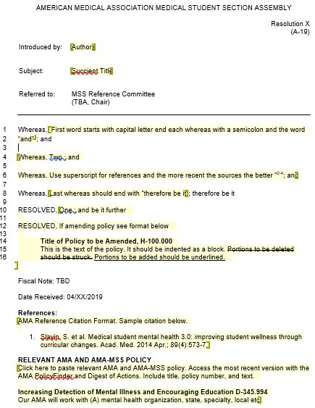
Template

Slide 7
Whereas clauses
Arguments must be relevant → they must support resolved clauses
Make sure to include full scope of argument, every angle that can be taken
Make sure the wording is not very flowery, but clear and concise

Slide 8
Resolved Clauses - Verbs
The verbs used within the resolved clauses are important in shaping your ask
“Support” over “Recognize”
“Promote” to ask for resources to be devoted to raising awareness of an issue
“Advocate” over “Encourage”
“Research/Study” over “Identify” - allows for a more broader approach, “identify” is appropriate if it is a specific topic
In general do no use negative verbs: oppose, condemn, object to

Slide 9
Resolved Clauses - Specific vs broad asks
Specific asks can be difficult to pass, while vagues asks can be more comfortable to address and allow for easy adoption
Yet, as the implementation of an adopted policy is up to the Board of Trustees, if there is room for interpretation then there could be unintentional consequences of a resolution
The wording of resolved clauses is a fine balance between being too explicit yet not too ambiguous to achieve the ultimate goal.

Slide 10
Feedback
Workshop everything!
Get multiple people within and outside the organization to read it before submission.
Take seriously any feedback given, especially from any councils or committees that see resolutions before a final submission and if the feedback concerns language.

Slide 11
Timelines
Be aware of deadlines!
Some organizations have very short timelines and hence require quick turnaround.

