Slide 1
COVID-19: A case for Improved and Expanded Medicare for All
Rachel Madley
Fellow
Physicians for a National Health Program-NY Metro

Slide 2
Disclosures
Rachel Madley is a paid student fellow for PNHP-NY Metro
Rachel Madley has no other financial interests related to this content

Slide 3
Coming Up:
Single Payer/New York Health Act 101
Legislative Updates
Coronavirus: A case for BOLD health reform
How to continue to advocate virtually

Slide 4
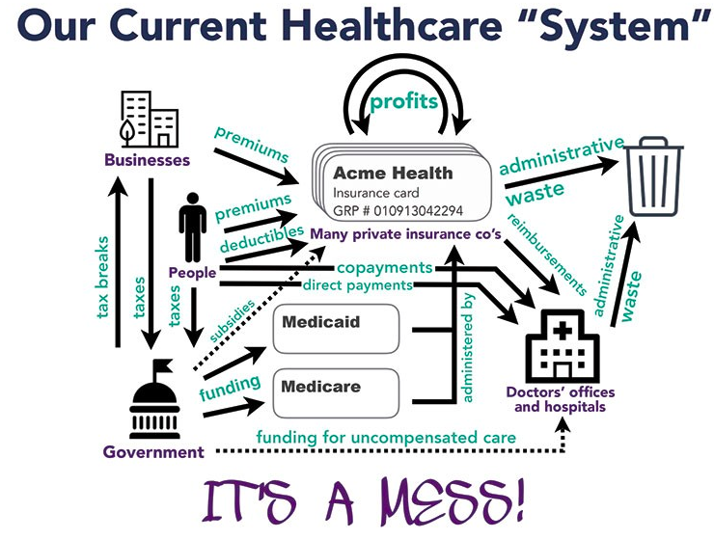
Our broken healthcare system
Source: PNHP-NY Metro and Campaign for NY Health
Notes:
We have a fragmented system with a mixture of public and private insurance with thousands of different plans and networks
This results in extreme administrative waste
Private insurance prioritizes profit over patients
Their bottom line is to make money, not healthcare
It is incredibly expensive with or without insurance
Leads to decreased life expectancy, increased infant and maternal mortality
More expensive than any other country with universal healthcare- mostly administrative waste

Slide 5
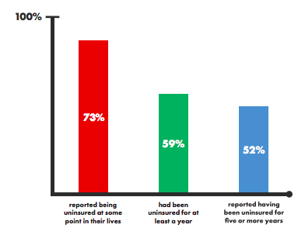
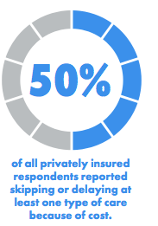
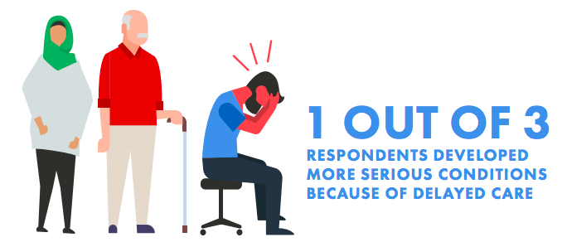
New Yorkers are suffering
https://d3n8a8pro7vhmx.cloudfront.net/pnhpnymetro/pages/7901/attachments/original/1558914810/FromCoveragetoCareNYS_Report.pdf?1558914810

Slide 6
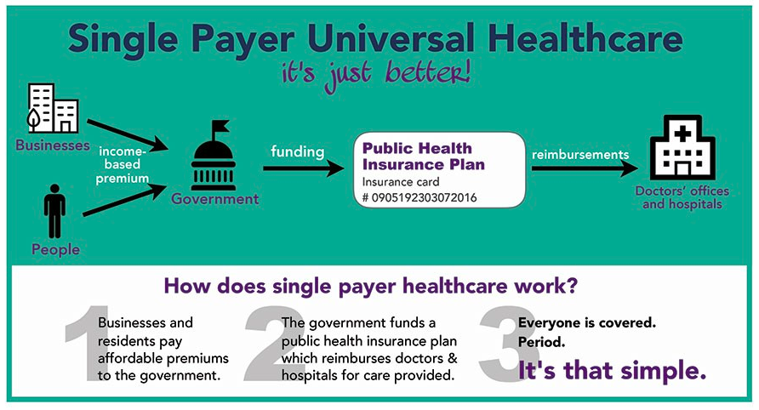
How do we fix it?
Notes:
People pay taxes based on ability to pay, additional taxes on high earners
Patients see any provider theyd like (no networks)
The government pays these hospitals and doctors (single payer)
Bottom line- Doctors remain privately operated but care is publicly funded

Slide 7
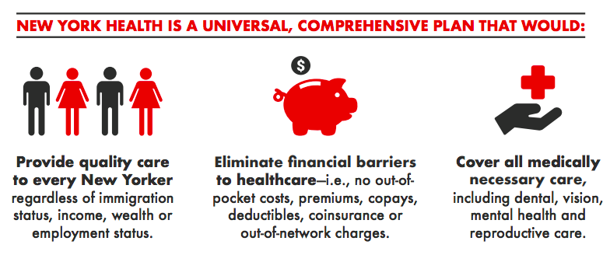
The New York Health Act (NYHA)
Single payer healthcare for NY state (Gottfried A5248/Rivera S3577)
Notes:
NYHA is state-level M4A

Slide 8
Legislative Update
NYHA:
Assembly- 81 co-sponsors (76 = majority)
Passed 2015, 2016, 2017, 2018
Senate- 31 co-sponsors (32 = majority)
1 more needed for a majority
Budget:
Governor Cuomo is proposing cuts to Medicaid in his budget

Slide 9
Coronavirus: A case for single-payer healthcare

Slide 10
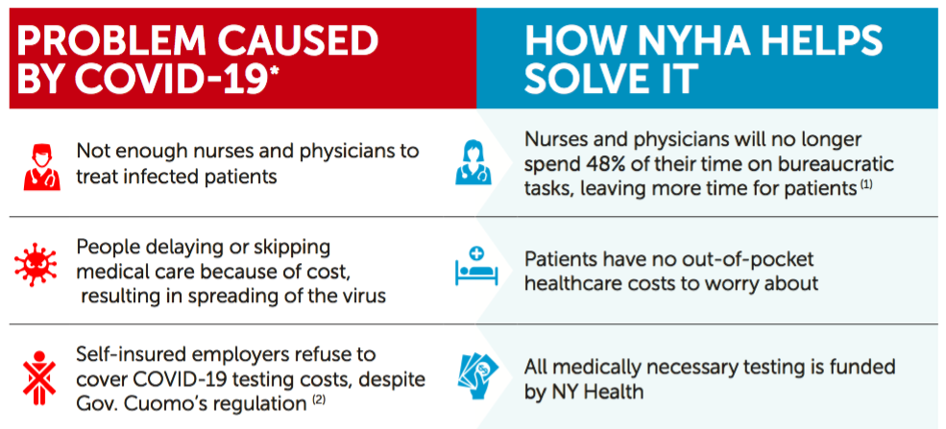
Coronavirus: A case for the New York Health Act

Slide 11
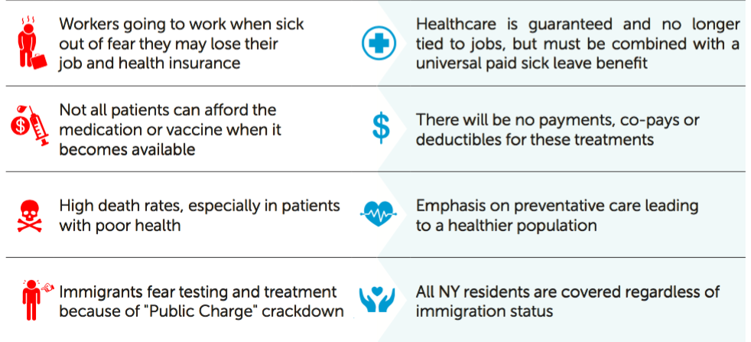
Coronavirus: A case for the New York Health Act

Slide 12
The U.S Response to COVID-19
Inadequate testing of population
Confirmed cases in the US: 51,914
Tests performed: 170,000
Deaths: 673
Estimated actual cases: 50,000-500,000
Dashboard with up-to-date case and death numbers from the WHO: https://experience.arcgis.com/experience/685d0ace521648f8a5beeeee1b9125cd
https://thehill.com/policy/healthcare/487562-johns-hopkins-professor-estimates-at-least-50000-people-have-coronavirus-in
Notes:
America is set up to ration care based on income, race, ethnicity, gender, etc. we are not set up to provide universal healthcare!

Slide 13
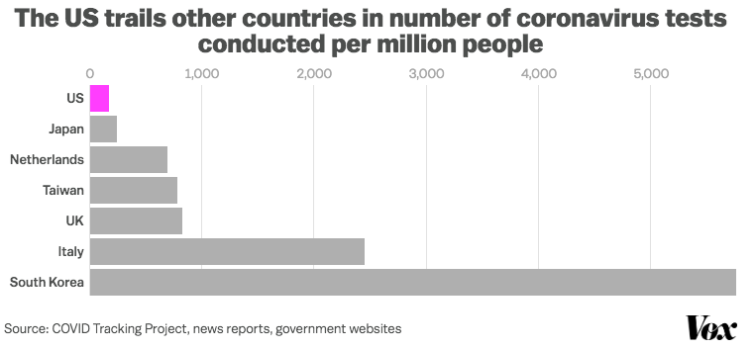
The U.S Response to COVID-19
Inadequate testing of population
https://www.vox.com/policy-and-politics/2020/3/13/21178289/confirmed-coronavirus-cases-us-countries-italy-iran-singapore-hong-kong
Notes:
America is set up to ration care based on income, race, ethnicity, gender, etc. we are not set up to provide universal healthcare!

Slide 14
The U.S Response to COVID-19
Inadequate testing of population
Dr. Anthony Fauci, head of the National Institute for Allergies and Infectious Diseases, said the U.S. health system just isn't designed for universal testing. “The system is not geared to what we need right now – what you’re asking for,” Fauci told a House committee on Thursday. “That is a failing. It’s a failing. Let’s admit it.”He added: “The idea of anybody getting (a test) easily the way people in other countries are doing it, we’re not set up for that. Do I think we should be? Yes. We’re not.”
· https://abcnews.go.com/Politics/trump-responsible-testing-problems-things/story?id=69590286&cid=social_twitter_abcn
Notes:
America is set up to ration care based on income, race, ethnicity, gender, etc. we are not set up to provide universal healthcare!

Slide 15
The U.S Response to COVID-19
Confusion and worry over who will pay for testing and treatment
Governor Cuomo and other states released regulations requiring private insurers to waive the cost sharing for COVID-19 test
Self-insured employers (which cover 60% of employer insured people) can opt-out of this
President Trump states that private health insurers will cover the cost of testing AND treatment
This was incorrect and clarified by insurers that they are only covering testing
https://www.latimes.com/business/story/2020-03-06/insurers-coronavirus-coverage

Slide 16
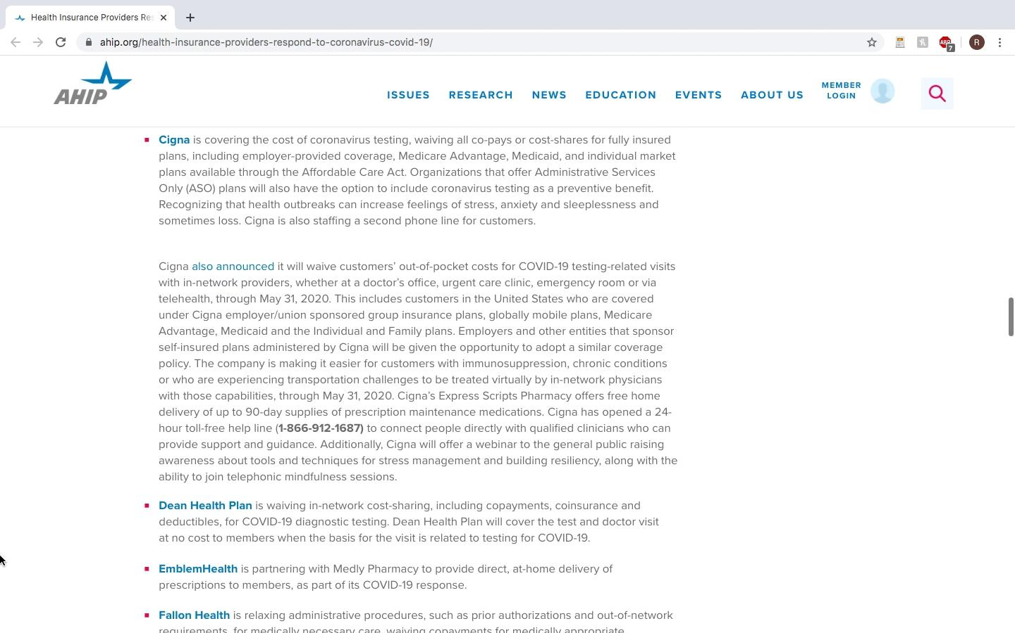
The U.S Response to COVID-19
Private health insurers explanations of what is and is not covered for COVID-19, each company has different stipulations

Slide 17
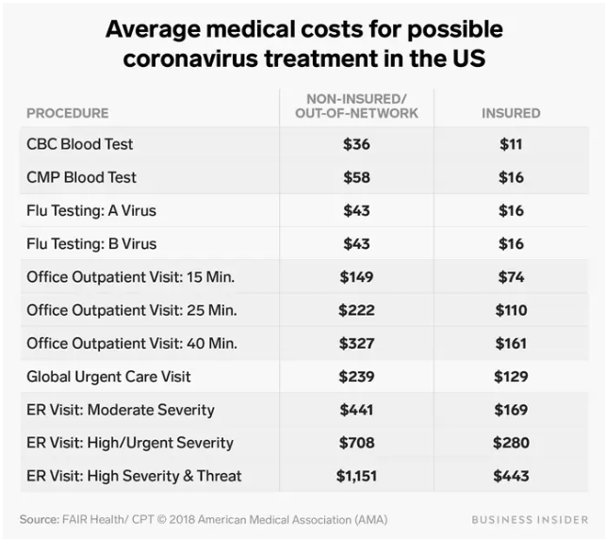
The U.S Response to COVID-19
Prohibitive costs of testing/treatment for suspected COVID-19
Even if testing is free, there are many other costs associated with COVID-19-related care

Slide 18
The U.S Response to COVID-19
Prohibitive costs of testing/treatment for suspected COVID-19

Slide 19
The U.S Response to COVID-19
Lack of resources needed to treat everyone affected by COVID-19
Healthcare workers are concerned about shortages of all resources
Especially intensive care unit beds and medical staff

Slide 20
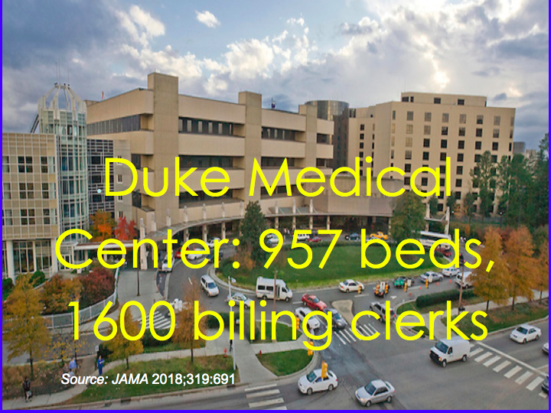
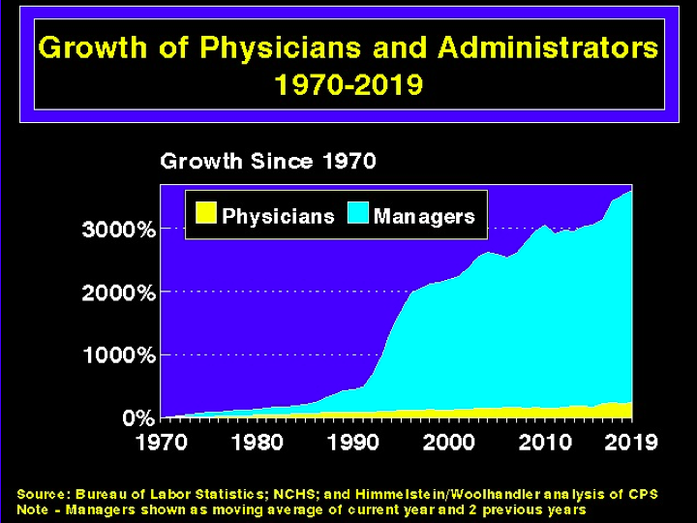
The U.S Response to COVID-19
Lack of resources needed to treat everyone affected by COVID-19
Hospital beds per 1,000 people- 2.8
ICU beds in the US: 100,000
Estimated patients needing intensive care: 200,000-2 million
Notes:
https://data.oecd.org/healtheqt/hospital-beds.htm

Slide 21
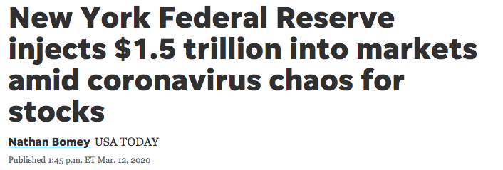
The U.S Response to COVID-19
Government loan of $1.5 trillion to banks

Slide 22
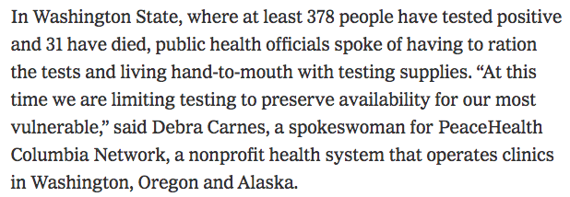
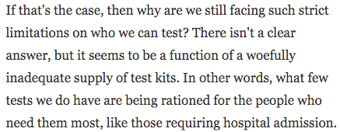
The U.S Response to COVID-19
RATIONING
-NY Times (1)
-The Guardian (4)
-NPR (3)
-The Atlantic (2)
Notes:
https://www.nytimes.com/2020/03/13/opinion/coronavirus-best-response.html
https://www.theatlantic.com/science/archive/2020/03/who-gets-tested-coronavirus/607999/
https://www.npr.org/sections/health-shots/2020/03/14/815727231/opinion-early-coronavirus-testing-failures-will-cost-lives
https://www.theguardian.com/world/2020/mar/14/coronavirus-us-testing-donald-trump

Slide 23
The U.S Response to COVID-19
BAD POLICY: Budget cuts and lack of expansion of health programs such as Medicaid
Governor Cuomo is proposing cuts of $2.5 billion from NY Medicaid budgets
Cuomo’s cuts change Medicaid procedures which disqualifies NYS from receiving $6 billion in relief funding from the federal government
14 states have not expanded Medicaid

Slide 24
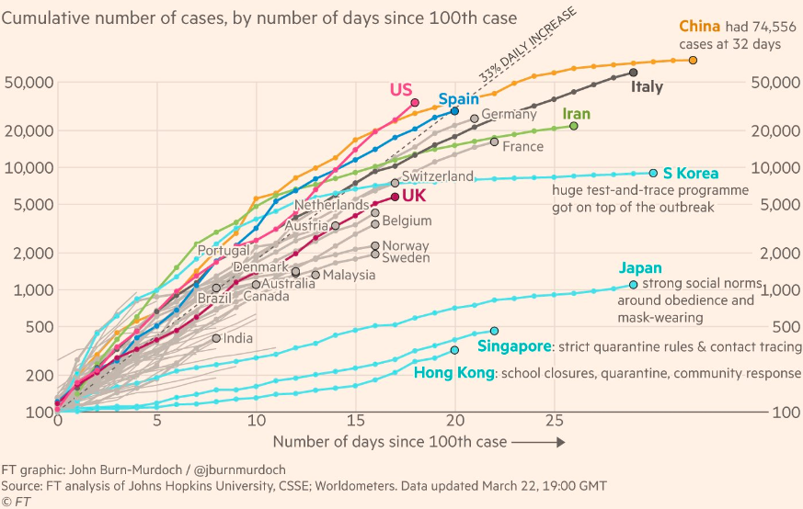
How are other countries responding to COVID-19?

Slide 25
Italy’s COVID-19 Situation
53,578 cases as of 3/22
4,827 deaths as of 3/22
Widespread testing
Single-payer healthcare system

Slide 26
Italy
United States
More widespread testing than US
Allows accurate situational analysis
Payment for all medical care through the single-payer system
# New cases slowing compared to US
Healthcare system set up for universal treatment
3.2 hospital beds per 1,000 (2.8 in US)
Inadequate testing of population
Confusion and worry over who will pay for testing and treatment
Prohibitive costs of testing/treatment for suspected COVID-19
Lack of resources needed to treat everyone affected by COVID-19
Government loan of $1.5 trillion to banks
Budget cuts and lack of expansion of health programs such as Medicaid
Tests per million people
Notes:
Even though Italy’s situation is bad, they have a more accurate estimation of number of cases, no worry about payment for testing or care turning patients away and they STILL struggle to get the outbreak under control. Any system will struggle with a pandemic, italy’s single payer system has allowed for more testing, they have more doctors and hospital beds per capita than the U.S. where they lacked was in public health spending, which is separate from healthy delivery. Further, they are still faring much better than the US in terms of ability to test widely and treat people without financial and administrative barriers. If italy is failing at treating COVID-19, then the US didn’t even show up for the exam

Slide 27
Italy’s Response to COVID-19
“But for all their fears, Italians don’t have to worry that tests won’t be available, or that they’ll have to pay for those tests, or for any of their care. They don’t have to fear that if they seek help now, they’ll get a surprise bill later or that medical costs will bankrupt them.” - Alice Speri Italian expat
https://theintercept.com/2020/03/12/italy-coronavirus-united-states-preparedness/

Slide 28
South Korea’s COVID-19 Situation
8,897 cases
104 deaths
~12,000 tests per day (US ran this many test in two weeks 3/1-3/14 two weeks)
Single-payer healthcare system
Spread is slowing as of 3/12
Reported first case on same day as U.S.

Slide 29
South Korea
United States
Aggressive testing
Payment for all medical care through the single-payer system
Allocation of resources to hard-hit areas
Government reimbursing medical facilities for financial losses from quarantines
12.3 hospital beds per 1,000 people (2.8 in US)
Prior public stockpile of 13 million antiviral doses and new ICU beds nationwide
Inadequate testing of population
Confusion and worry over who will pay for testing and treatment
Prohibitive costs of testing/treatment for suspected COVID-19
Lack of resources needed to treat everyone affected by COVID-19
Government loan of $1.5 trillion to banks
Budget cuts and lack of expansion of health programs such as Medicaid
Tests per million people
https://www.latimes.com/world-nation/story/2020-03-14/south-koreas-rapid-coronavirus-testing-far-ahead-of-the-u-s-could-be-a-matter-of-life-and-death
https://www.voanews.com/science-health/coronavirus-outbreak/south-korea-shows-world-how-slow-spread-coronavirus
https://www.ncbi.nlm.nih.gov/pmc/articles/PMC3845460/

Slide 30
South Korea’s Response to COVID-19
"The gov't is covering the financial costs for related testing and treatment instead of saddling individuals with those expenses. The gov't is also reimbursing medical facilities for losses incurred from imposed quarantines." - South Korean Government Briefing
“By aggressively testing, South Korea’s coronavirus outbreak may have appeared dire at first, but it eventually helped authorities allocate resources to the worst-hit areas and provide early treatment to infected individuals.” - Journalist in South Korea
https://www.latimes.com/world-nation/story/2020-03-14/south-koreas-rapid-coronavirus-testing-far-ahead-of-the-u-s-could-be-a-matter-of-life-and-death
https://www.voanews.com/science-health/coronavirus-outbreak/south-korea-shows-world-how-slow-spread-coronavirus

Slide 31
Cuba’s COVID-19 Situation
16 confirmed cases
1 death
Developed a medication being used to treat COVID-19 complications (Interferon Alpha 2b)
https://www.mintpressnews.com/cuba-leading-world-fight-against-coronavirus/265771/

Slide 32
Cuba
United States
Inadequate testing of population
Confusion and worry over who will pay for testing and treatment
Prohibitive costs of testing/treatment for suspected COVID-19
Lack of resources needed to treat everyone affected by COVID-19
Government loan of $1.5 trillion to banks
Budget cuts and lack of expansion of health programs such as Medicaid
Universal Healthcare System
Emphasis of preventative medicine
Development and testing of antiviral during past epidemics
Medical solidarity (sent doctors abroad to help with COVID-19)
Aggressive public health measures
5.2 hospital beds per 1,000 people (2.8 in US)
Nationalized factories mobilied to produce masks
https://portside.org/2020-03-24/cubas-coronavirus-response-putting-other-countries-shame

Slide 33
Cuba’s Response to COVID-19

Slide 34
Taiwan’s COVID-19 Situation
Close proximity and high travel volume to and from China makes it at high risk for large outbreak
Original models predicted Taiwan would have some of the highest case numbers
Only 153 cases as of March 21st (population of 23 million)
Wang CJ, Ng CY, Brook RH. Response to COVID-19 in Taiwan: Big Data Analytics, New Technology, and Proactive Testing. JAMA. Published online March 03, 2020. doi:10.1001/jama.2020.3151

Slide 35
Taiwan
United States
Aggressive testing immediately
Integration of National Health Insurance database with customs and travel database
Payment for all medical care through the single-payer system
Government invested $6.66 million USD in production of medical equipment
Prior government spending to increase doctors, ICU beds, and public health response
3.2 hospital beds per 1,000 (2.8 in US)
Inadequate testing of population
Confusion and worry over who will pay for testing and treatment
Prohibitive costs of testing/treatment for suspected COVID-19
Lack of resources needed to treat everyone affected by COVID-19
Government loan of $1.5 trillion to banks
Budget cuts and lack of expansion of health programs such as Medicaid
Tests per million people
Wang CJ, Ng CY, Brook RH. Response to COVID-19 in Taiwan: Big Data Analytics, New Technology, and Proactive Testing. JAMA. Published online March 03, 2020. doi:10.1001/jama.2020.3151

Slide 36
Taiwan’s Response to COVID-19
“Taiwan’s health insurance lets everyone not be afraid to go to the hospital. If you suspect you have coronavirus, you won’t have to worry that you can’t afford the hospital visit to get tested,” she said.
“You can get a free test, and if you’re forced to be isolated, during the 14 days, we pay for your food, lodging and medical care,” Kolas said. “So no one would avoid seeing the doctor because they can’t pay for health care.”- Kolas Yotaka Taiwan government spokesperson (1)
“The U.S. has enormous capacity,” says Wang, the Stanford professor. But he notes that it “needs to mount a coordinated effort, like Taiwan, because the infection impacts many aspects of society and really affects people’s lives.” (2)
https://www.nbcnews.com/health/health-news/what-taiwan-can-teach-world-fighting-coronavirus-n1153826
https://time.com/5802293/coronavirus-covid19-singapore-hong-kong-taiwan/

Slide 37
What do nations controlling COVID-19 well have that the US doesn’t?
Universal healthcare
care for everyone in need
infrastructure to support universal need
Government investment in the healthcare system- not healthcare budget cuts
Aggressive early testing
Unified approach
Quick action
Social protections for people affected by COVID-19
Taiwan, South Korea- hard hit by SARS
SARS exposed the cracks in their systems and they learned from them to ensure the same mistakes were not repeated

Slide 38
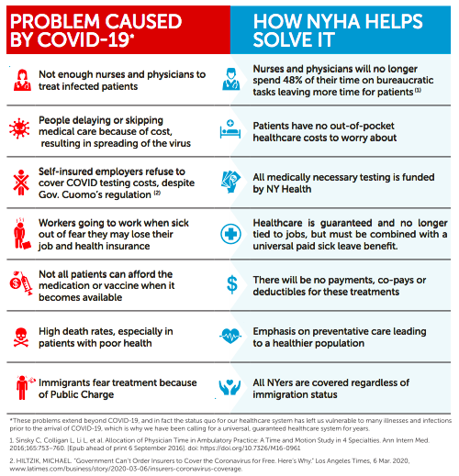
Single-payer healthcare provides nations with a unified health system to quickly and effectively tackle pandemics
Single-payer alone cannot adequately control an outbreak, but an outbreak cannot be controlled without it
Other social protections, such as paid sick leave, are necessary to effectively combat a pandemic
Additional public health measures, such as a Pandemic Response Team are also necessary
Notes:
The US healthcare system is not setup to treat everyone, even in a pandemic

Slide 39
People of all ideologies are embracing Medicare for All
Support for Medicare for All is increasing across multiple demographics
pg. 191 https://morningconsult.com/wp-content/uploads/2020/03/200344_crosstabs_CORONAVIRUS_ADULTS_Adults_v3_JB.pdf

Slide 40
Our message when organizing during COVID-19: How can we learn from this crisis and make change so we are ready when it inevitably happens again?
*It is equally important to ensure we are supporting our community and front-line healthcare workers and those affected in any way possible

Slide 41
Virtual Advocacy Resources
Go Bold On Healthcare in 2020 Policy Priorities.
COVID-19 and the Case for Single Payer Webinar materials here.
Social Media Toolkit: www.bit.ly/GoBoldSocial031720
Letters & Op-Eds Webinar materials here.
Story Sharing & Social Media Webinar materials here.

Slide 42
Resources- How to advocate virtually
Call your representative and tell them that we need these bold healthcare reforms in NY immediately
Use these slides as a reference for bill numbers
Write an Op Ed or Letter to the Editor
Engage on social media (see the social media toolkit)
Tell your story
Post to your elected officials
Post educational materials and engage your family/friends in conversation

