Slide 1
On the Front Line of
Fighting COVID-19
Healthcare Workers
Need Medicare for All

Slide 2
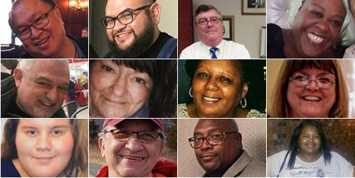
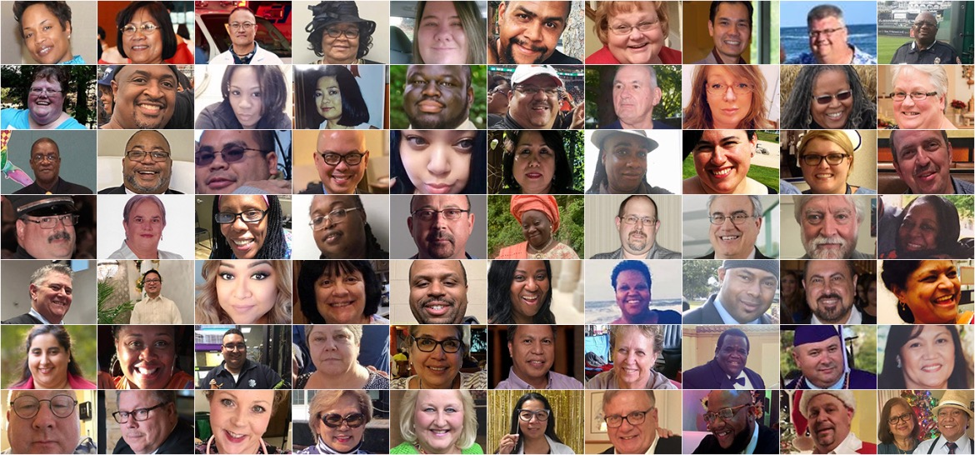
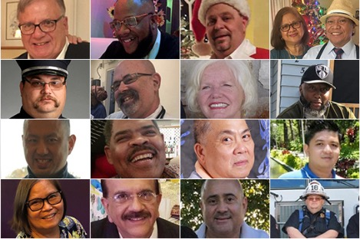
655 Healthcare Workers Have Died of COVID-19 as of June 19, 2020
Nursing Home Workers
Home Health Workers
Nurses' Aides
Medical Assistants
Practical Nurses
Registered Nurses
Emergency Medical Technicians
Hospital Support Staff (Janitors, Foodservice, and others)
Advanced Practice Nurses
Physician Assistants
X-ray Technicians
Physicians
Many, many other workers
https://khn.org/news/exclusive-investigation-nearly-600-and-counting-us-health-workers-have-died-of-covid-19/
https://khn.org/news/lost-on-the-frontline-health-care-worker-death-toll-covid19-coronavirus/
Accessed June 20, 2020

Slide 3
655 Healthcare Workers Have Died of COVID-19 as of June 19, 2020
“Lost on the front line”
after helping patients
during the pandemic
https://khn.org/news/exclusive-investigation-nearly-600-and-counting-us-health-workers-have-died-of-covid-19/
https://khn.org/news/lost-on-the-frontline-health-care-worker-death-toll-covid19-coronavirus/
Accessed June 20, 2020

Slide 4
655 Healthcare Workers Have Died of COVID-19 as of June 19, 2020
More than 80% of nurses
had not even been tested
by late May 2020
https://www.nationalnursesunited.org/press/new-survey-results
Accessed June 20, 2020

Slide 5
655 Healthcare Workers Have Died of COVID-19 as of June 19, 2020
Trump halted regulations
that would have protected healthcare workers
against coronavirus, influenza, or TB
https://www.npr.org/2020/05/26/862018484/trump-team-killed-rule-designed-to-protect-health-workers-from-pandemic-like-cov
Accessed June 20, 2020

Slide 6
Healthcare Workers Were Already at High Risk of Severe Illness or Death
Age
26.6% are at risk because of age or chronic health conditions
No Leave
28.6% of all patient-contact personnel do not have paid sick leave
Poverty
600,000 live in poverty, impairing social distancing outside of work
Insurance
11.4% of workers with diabetes, and 20.8% of workers with chronic lung disease, are uninsured despite working in healthcare
https://www.acpjournals.org/doi/10.7326/M20-1874 Accessed June 21, 2020

Slide 7
COVID-19 Is Particularly Dangerous for Workers in Home Care or Nursing Homes
Percentage Without Health Insurance
https://www.acpjournals.org/doi/10.7326/M20-1874 Accessed June 21, 2020

Slide 8
COVID-19 Is Particularly Dangerous for Workers in Home Care or Nursing Homes
Lower
Wages
More Minorities
More Women
Aged and Aging
58% earn less than $30,000
26% are
Black
82% are
Women
7% are age
65 and older
https://www.kff.org/coronavirus-covid-19/issue-brief/covid-19-and-workers-at-risk-examining-the-long-term-care-workforce/ Accessed June 21, 2020

Slide 9
Americans Are Using Less Healthcare, Including for Life-Threatening Issues
National change
in Emergency Department visits
Before and during COVID-19
Data is comparing pre-Covid (January 5 - March 14 2020) vs during Covid (March 15 - May 23, 2020)
https://www.cdc.gov/mmwr/volumes/69/wr/mm6925e2.htm Accessed June 23 2020

Slide 10
Americans Are Using Less Healthcare, Including for Life-Threatening Issues
National change
in Emergency Department visits
Before and during COVID-19
At least two reasons for avoiding healthcare:
Fear of catching COVID-19 in an ER
Unemployment = More financial barriers
Data is comparing pre-Covid (January 5 - March 14 2020) vs during Covid (March 15 - May 23, 2020)
https://www.cdc.gov/mmwr/volumes/69/wr/mm6925e2.htm Accessed June 23 2020

Slide 11
Family Physician Offices Closing in the Pandemic
 | End of March 2020 | End of June 2020 | Reduction
Family physicians in office-based practices
Jobs in FP offices (including physicians)
138,707
80,682
-58,025
1,872,907
1,088,774
-784,133
HealthLandscape is a division of the American Academy of Family Physicians
End of June data projected on June 22, 2020
https://healthlandscape.org/covid19/ Accessed June 22 2020

Slide 12
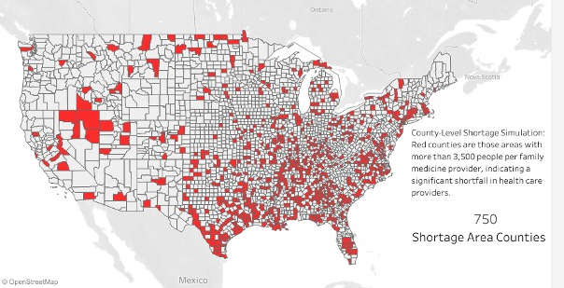
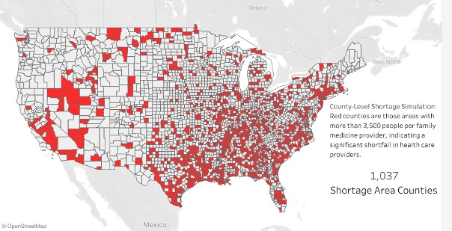
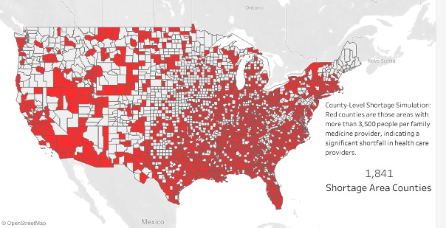
Family Physician Offices Closing in the Pandemic
Counties with more than 3,500 people
per family physician
March 2020: 750
April 2020: 1,037
May 2020: 1,424
June 2020: 1,841
Entire USA has
3,141 counties
HealthLandscape is a division of the American Academy of Family Physicians
End of June data projected on June 22, 2020
https://healthlandscape.org/covid19/ Accessed June 22 2020

Slide 13
Healthcare Workers Fired and Furloughed Much More than Insurance Industry Workers
Change in Workforce
March and April 2020
https://www.bls.gov/news.release/empsit.t17.htm Accessed June 21, 2020

Slide 14
In April and May 2020, 266 US Hospitals Announced Furloughs
Emory Healthcare
BJC Healthcare
UW Medicine
Mayo Clinic
Atlanta GA
1,500 furloughs
St. Louis MO
2,962 furloughs
Seattle WA
5,500 furloughs
Rochester MN
30,000 furloughs or cut hours
In Spain, the government announced
it was hiring 50,000
additional healthcare workers.
https://www.beckershospitalreview.com/finance/49-hospitals-furloughing-workers-in-response-to-covid-19.html
https://www.nytimes.com/2020/03/24/world/europe/coronavirus-europe-covid-19.html
Accessed June 21, 2020

Slide 15
In addition to some patients avoiding healthcare, Why Furlough Employees in a Pandemic?
American hospital economics are driven
by the pursuit of lucrative procedures.
Pandemics reveal what
a bad idea that is.

Slide 16
In addition to some patients avoiding healthcare, Why Furlough Employees in a Pandemic?
Steward Healthcare
“A seismic financial shock”
because “elective surgeries are
the cornerstone of our hospital
system's operating model.”
9 states across the USA
25 Urgent Care Centers
35 community hospitals
107 Skilled Nursing Facilities
7,900 beds
https://www.scpr.org/news/2020/04/02/91635/covid-19-hits-some-health-care-workers-with-pay-cu/
Accessed June 21, 2020

Slide 17
Medicare for All protects hospitals by creating Global Operating Budgets
Hospital Financing Today
Medicare for All Financing
Per-patient payments make hospitals dependent on their most profitable services
Surpluses get invested in more of the most profitable services
Decreases in profitable services create a fiscal emergency requiring furloughs and firings
Global budgets for each hospital
Aligns resources with the health needs of the community
Creates a budget of reserve funds for pandemics and other natural disasters, apart from regular operations

Slide 18
Medicare Makes Rapid Innovation Easier
Medicare pays for telehealth
See and hear your doctor using your phone’s camera at home
Medical practices can remain open despite patients staying home
Medicare led the way on innovation
Many corporate insurers have followed Medicare’s lead
Medicare for All would do this better
Fast and universal implementation of important public health strategies
Get corporations out of the way of healthcare
https://www.modernhealthcare.com/medicare/cms-expands-medicare-telehealth-services-fight-covid-19

Slide 19
Unsung heroes of rapid innovation in a pandemic: The VA Quickly Scaled-Up Telehealth
1000% Increase in Telehealth Visits
Infrastructure Deployed Rapidly
March 2020: 2,500 per day
June 2020: 25,000 per day
Includes virtual mental health care
Five-fold increase in video bandwidth
Distributing iPads to veterans who lack the technology
The VA innovations are leading the nation.
Single payer would make this easier for us all.
https://federalnewsnetwork.com/veterans-affairs/2020/06/how-va-drastically-expanded-telehealth-during-the-pandemic/
Accessed June 29 2020

Slide 20
Healthcare Workers and Hospitals Need Single Payer Medicare for All
Not furloughs; public health!
Global hospital budgets mean equipment and staff could be redirected towards pandemic care
Coordinated purchasing
Purchasing and logistical power to provide adequate PPE directed to “hot spots”
We all need
our healthcare
Everyone would have coverage, regardless of age, income, or job, including healthcare workers

Slide 21
Physicians for National Health Program
Non-profit, non-partisan, member-supported 501(c)3
Membership open to everyone
www.PNHP.org/COVID19
@PNHP
Facebook.com/DoctorsForSinglePayer

