Slide 1
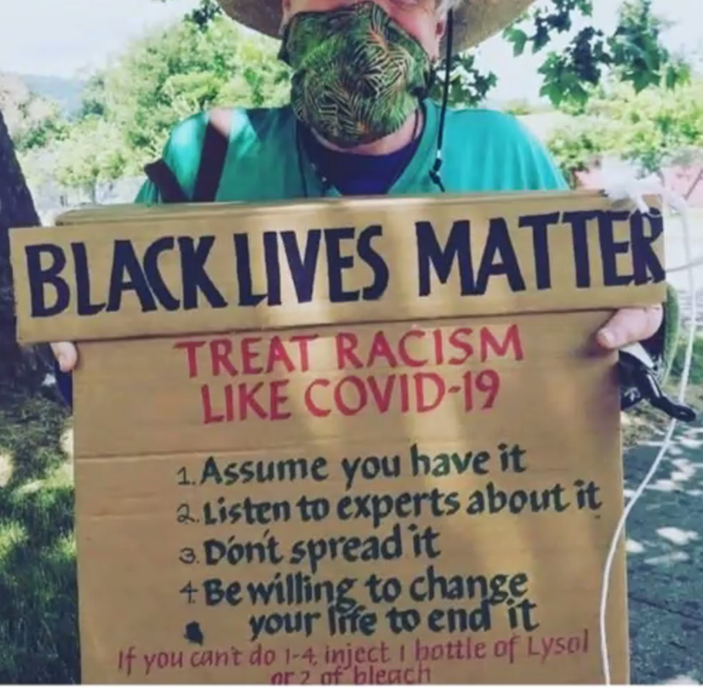
Part 2 of 2: “I Can’t Breathe” Racism and Covid & The Case for Single Payer, Expanded and Improved Medicare for All
Steven B. Auerbach, MD, MPH, FAAP
Physicians for a National Health Program
Campaign for New York Health

Slide 2
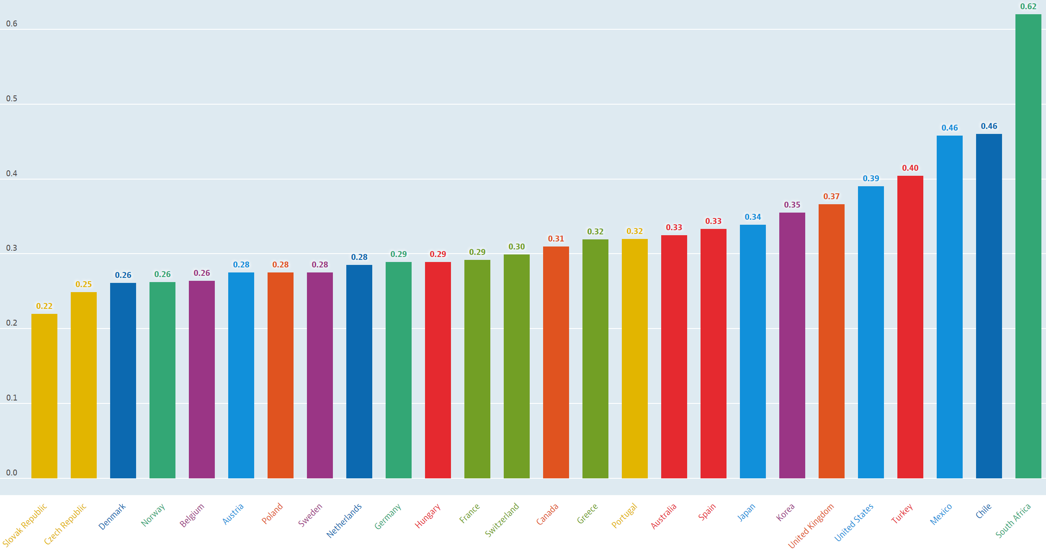
Income Inequality (OECD)
Gini coefficient: 0=complete equality. 1=complete inequality https://data.oecd.org/inequality/income-inequality.htm
USA
= 18.7

Slide 3
Some White:Black Health Inequities
Black life expectancy at Birth is 3.5 years less than whites, and six years less for current 40-year-olds.
Compared to White Americans, Blacks are:
twice as likely to die from diabetes,
seven times more likely to die from HIV/AIDS,
22% more likely to die from heart disease, and
71% more likely to die from cervical cancer, with higher death rates for all cancers combined.
Black mothers are twice as likely as white mothers to lack PNC and 320% higher maternal mortality.
Black babies are more than twice as likely to die than white babies. Most of these deaths are preventable.
People of color account for over half of America’s uninsured. Hispanic and Black Americans have significantly higher uninsured rates (19% and 11%) than whites (8%).
Insured Black families spend nearly 20% of household income on premiums.
Nearly one-third of Black Americans aged 18 to 64 have past-due medical bills.
Majority Black communities are 67% more likely to have a shortage of primary care providers.
Hospitals are more likely to close in communities with high levels of segregation and low-income residents.
How Structural Inequalities in NY’s Health Care System Exacerbate Health Disparities During the Covid-19 Pandemic: A Call for Equitable Reform
https://www.cssny.org/publications/entry/how-structural-inequalities-in-new-yorks-health-care-system-exacerbate-heal

Slide 4
Political/Social/Economic Determinants of Health
It’s Racism (and Classism), not Race
Disparities and Differences by:
Wealth and Income
Workplace conditions, Job type and autonomy
Residence location, type, size
Household size and density
Land Use, Physical environment
Means of transport (private car vs crowded subway) and time of travel home/work
Access to Childcare
Access to Education
Access to Nutrition
…and also Access to Healthcare
See:
Racial Health Disparities and Covid-19: Caution and Context, NEJM 2020;383:201-03 https://www.nejm.org/doi/full/10.1056/NEJMp2012910
Examining Social Determinants of Health, Stigma, and COVID-19 Disparities; Healthcare 2020, 8(2), 168; https://doi.org/10.3390/healthcare8020168
America: equity and equality in health. The Lancet. April 7, 2017 https://www.thelancet.com/series/america-equity-equality-in-health
Where Health Disparities Begin: The Role Of Social And Economic Determinants; Health Affairs https://www.healthaffairs.org/doi/full/10.1377/hlthaff.2011.0685

Slide 5
Evidence That Racial Disparities Would Be Reduced with Single Payer
See also:
https://pnhp.org/racial-health-inequity/
https://socialsecurityworks.org/allmeansall/
https://whitecoats4blacklives.org/

Slide 6
Medical Conditions Shorten Black Lives
86% are amenable to
medical prevention
and treatment
Months of Adult Black Lives Lost as Compared to Whites
Ratios from MMWR May 2, 2017
Years assume a 4-year total difference for adults
Note: “Other” includes conditions (e.g., diabetes) for which Black death rates are higher and some (e.g., COPD, cirrhosis) for which Black death rates are lower.

Slide 7
Access to Care Reduces White vs Black Death Gap AmJMed: United States counties with low black male mortality rates https://www.amjmed.com/article/S0002-9343(12)00556-6/fulltext
1,200
1,000
800
600
400
200
0
Black Men: USA
Deaths per 100,000 people
White Men USA
Black Men: 66 Counties with Black<White mortality
High Military/Veteran status is protective factor
1980 | 1985 | 1990 | 1995 | 2000 | 2005
Of 1307 counties with black mortality rates classified as reliable by the National Center for Health Statistics (at least 20 deaths):
66 recorded lower mortality among black men than corresponding US whites.
Most notable, 97% of the 66 counties were home to or adjacent to a military installation, versus 37% of comparable US counties (P<.001).
Blacks in these counties had less poverty, higher percentages of elderly civilian veterans, and higher per capita income.
Within these counties, national black:white disparities in mortality were eliminated for ischemic heart disease, accidents, diseases of the liver, chronic lower respiratory diseases, and mental disorder from psychoactive substance use.
Application of age-, race-, ethnicity-, gender-, and urbanization-specific mortality rates from counties with relatively low mortality would reduce the black:white mortality rate ratio for black men aged 25 to 64 years from 1.67 to 1.20 nationally and to 1.00 in areas outside large central metropolitan areas.
Notes:
Of 1307 counties with black mortality rates classified as reliable by the National Center for Health Statistics (at least 20 deaths), 66 recorded lower mortality among black men than corresponding US whites. Most notable, 97% of the 66 counties were home to or adjacent a military installation versus 37% of comparable US counties (P<.001). Blacks in these counties had less poverty, higher percentages of elderly civilian veterans, and higher per capita income. Within these counties, national black:white disparities in mortality were eliminated for ischemic heart disease, accidents, diseases of the liver, chronic lower respiratory diseases, and mental disorder from psychoactive substance use. Application of age-, race-, ethnicity-, gender-, and urbanization-specific mortality rates from counties with relatively low mortality would reduce the black:white mortality rate ratio for black men aged 25 to 64 years from 1.67 to 1.20 nationally and to 1.00 in areas outside large central metropolitan areas.

Slide 8
Medicare For All Would Reduces Racial Disparities
Post-MI Mortality
Dialysis (Medicare)
VA System
Age 65+
Post-MI Deaths:
31% greater among all-Americans if under-insured.
3% greater among Blacks after adjusting for insurance;
Blacks survive longer than whites
Blacks survive longer than whites
Mortality rates quickly match across races
Eliminate racial differences in insurance;
Greatly reduce racial differences in survival.
Post MI: Insurance Status, not Race, is Associated with Mortality After an Acute Cardiovascular Event in Maryland ; JGIM 2012: http://dx.doi.org/10.1007/s11606-012-2214-2
Dialysis: Racial Differences in Mortality and End-Stage Renal Disease; Am J Kid Dis 2008: https://dx.doi.org/10.1053%2Fj.ajkd.2008.06.004
VA: Association of Race With Mortality and Cardiovascular Events in a Large Cohort of US Veterans; Circulation 2015: doi/10.1161/CIRCULATIONAHA.114.015124
Age 65+: Sex, Race, and Age Differences in Observed Years of Life, Healthy Life, and Able Life among Older Adults Study; J PersMed 2015; https://doi.org/10.3390/jpm5040440

Slide 9
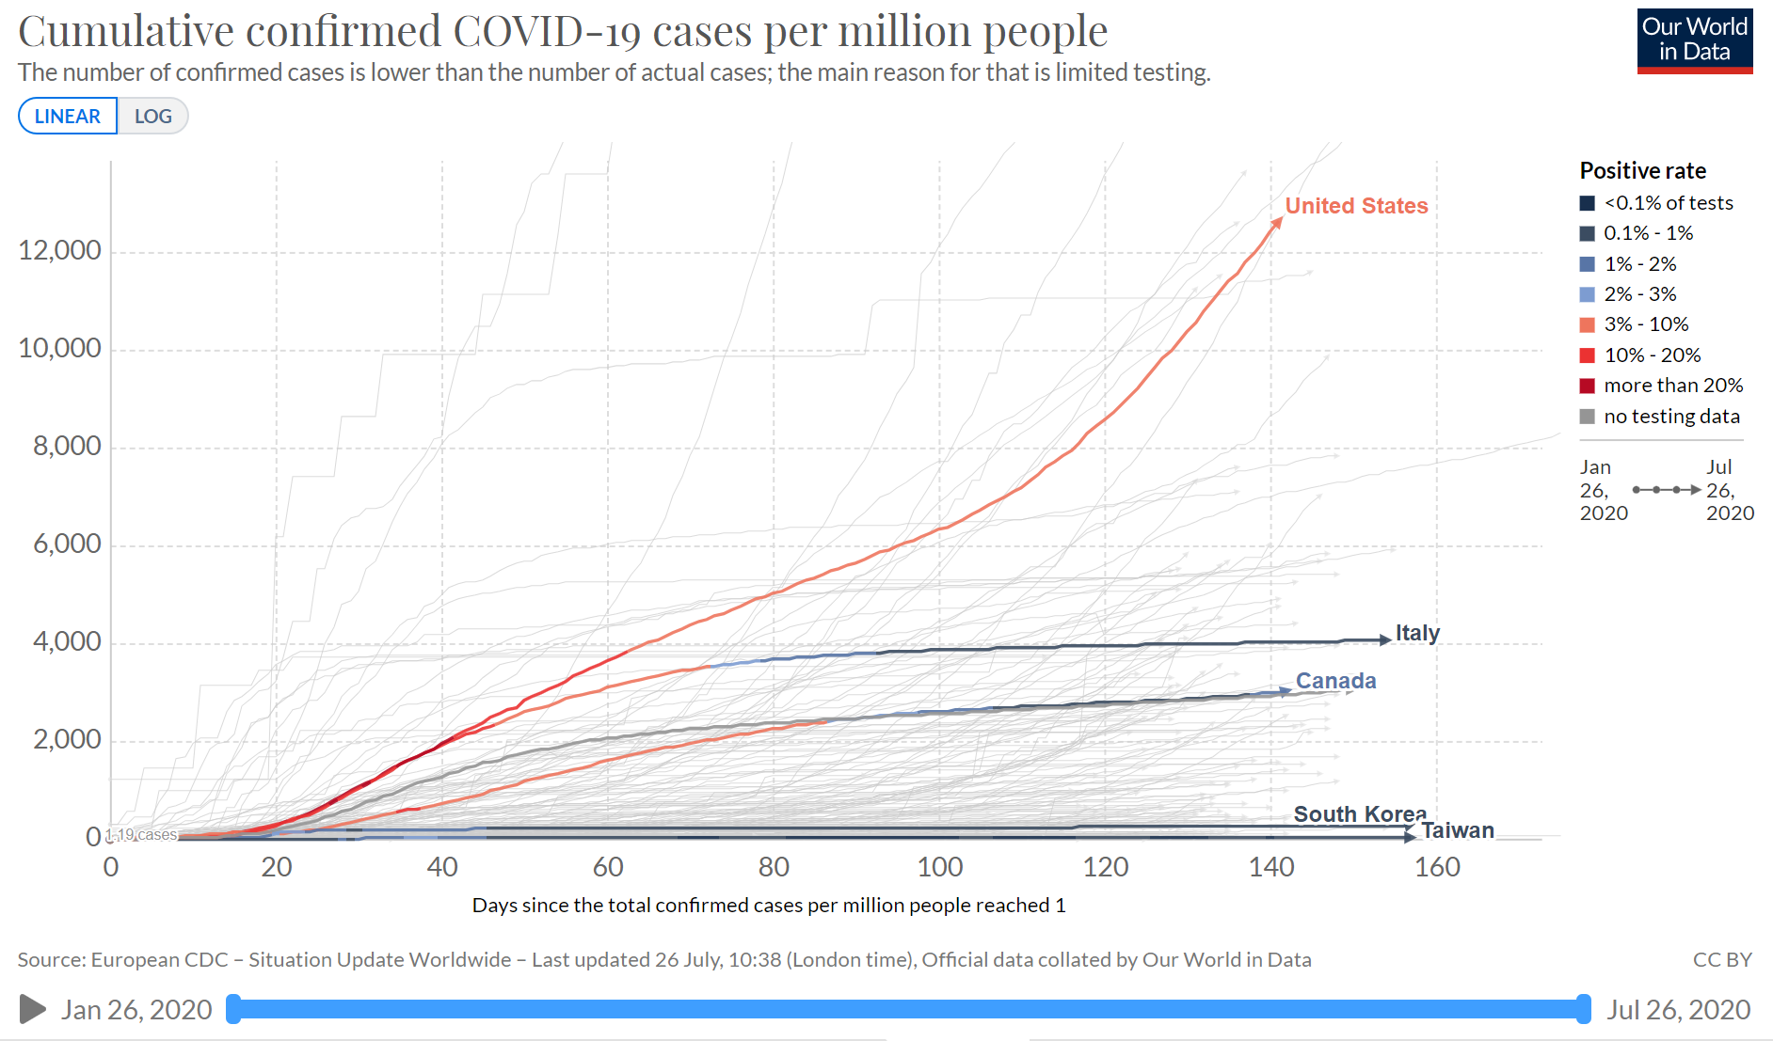
Covid Has Further Exposed the Pre-Existing Conditions of the U.S. Healthcare System See also: https://pnhp.org/covid-19-and-medicare-for-all/
Source: https://ourworldindata.org/coronavirus-data-explorer
European Union

Slide 10
Why was America So Vulnerable to COVID-19?
Already deteriorating health status*
Weakened public health capacity
A crumbling, racist social safety net
Wasteful, structurally-racist health system that prioritizes profitability over needs
*Case and Deaton: https://www.brookings.edu/bpea-articles/mortality-and-morbidity-in-the-21st-century/

Slide 15
How Structural Inequalities in NY’s Health Care System Exacerbate Health Disparities During the Covid-19 Pandemic: A Call for Equitable Reform
https://www.cssny.org/publications/entry/how-structural-inequalities-in-new-yorks-health-care-system-exacerbate-heal

Slide 17
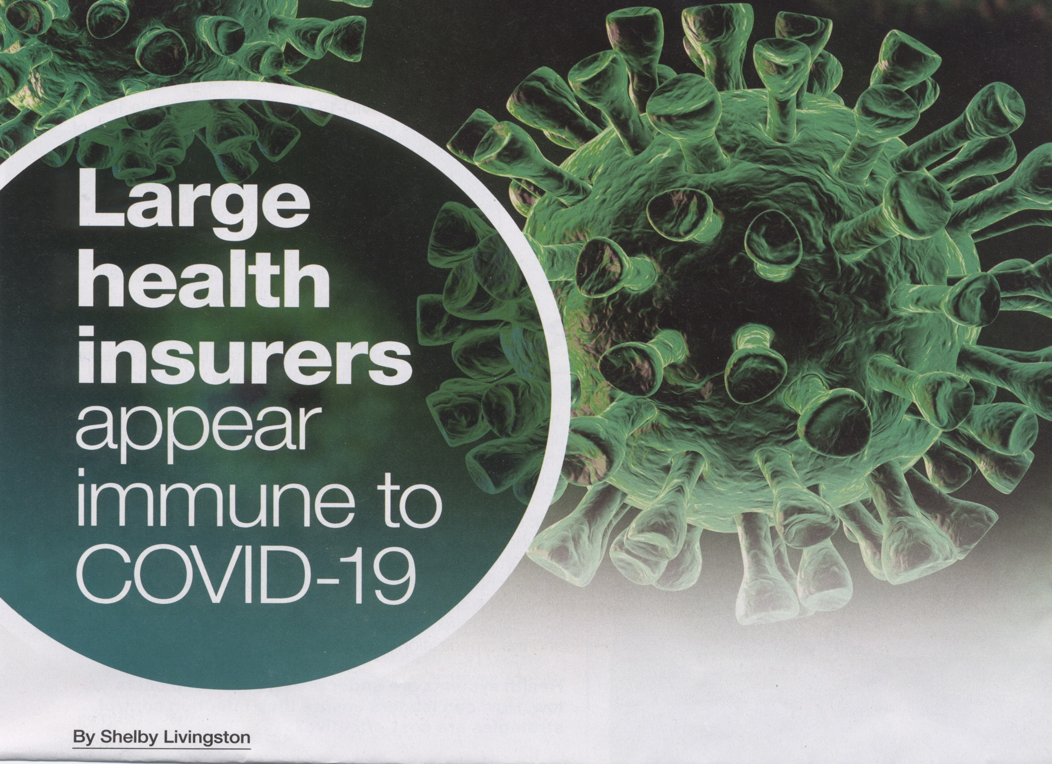
“The industry, according to our estimates, could have a net benefit” Dean Unger, VP, Moody’s, 5/11/2020

Slide 20
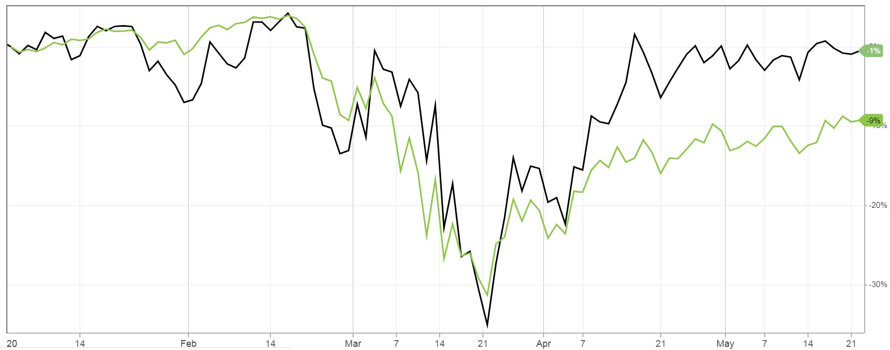
Health Insurers’ Stocks Near All Time Highs Wall Street Thinks Their Future is Rosy
Health Insurers
January 1, 20201
S&P 500

Slide 21
Current Financing Model Does Not Work
“Cash-starved hospitals and doctor groups cut staff amid pandemic
Hospitals across the country have deferred or canceled non-urgent surgeries to free up bed space and equipment for
covid-19 patients. But that triage maneuver cut off a main source of income, causing huge losses that have forced some
hospitals to let go of health-care workers as they struggle to treat infected patients.” –Washington Post, April 9, 2020
During a Pandemic, an Unanticipated Problem: Out-of-Work Health Workers
Across the country, plunging revenues from canceled nonemergency medical appointments have forced hospitals to
furlough or cut the pay of doctors, nurses and other staff. - NY Times, April 3, 2020
“Elective surgeries are the cornerstone of our hospital system’s operating model – and the negative impact due to the
cancellation of these procedures cannot be overstated.”
- Statement released by Steward Healthcare, largest for-profit hospital chain, owned by Cerberus Capital
“Alex Hlumyk, of Hubbard, Ohio, a certified medical assistant, had been helping screen potential coronavirus patients
before his Steward-owned physicians' practice furloughed him.”
- NY Times 4/4/20
“To Stay Afloat in the Pandemic, Doctors' Offices Turn to GoFundMe”
- Medscape - May 10, 2020.
Need to replace “Gig-economy” of Pay for Service & Pay for Performance
with some degree for Global Budgeting and Health Service Planning

Slide 22
What do nations controlling COVID-19 well have that the US doesn’t?
Universal healthcare
Everybody knows there is care for everyone in need
Infrastructure to support universal need, including to respond to surges in need
All medically necessary care for everyone in need
Eliminate financial barriers. People can seek care without fear of point of service cost, bankruptcy
Government investment in the healthcare system- not healthcare budget cuts
Aggressive early testing
Unified national pandemic response program
Quick action
Social protections for people affected by COVID-19
Taiwan, South Korea, Singapore… & Canada - hard hit by SARS
SARS exposed the cracks in their systems, and they learned from them to ensure the same mistakes were not repeated

Slide 23
Healthcare Costs Deter People From Seeking Testing and Treatment
Current System | Medicare for All
30 million Americans have no insurance; 70 million have plans with such high deductibles that they cannot afford to seek care.
As a result, half to one-third of Americans delay medical care because of cost.
Delaying care spreads the virus.
No out-of-pocket expenses means that patients get care when they need it, without worrying about costs.
When treatments and vaccines become available, early and wide use without financial barriers can slow or stop the spread of the virus.

Slide 24
Patients Can’t Afford Prescription Drugs; Authorities Have Limited Influence
Current System | Medicare for All
No out-of-pocket costs for any medically necessary care.
Medicare would powerfully negotiate drug prices on behalf of all Americans.
Creates public drug manufacturing capacity during an emergency.
Increases public funding of drug R&D.
30 million Americans have no prescription coverage, millions more face unaffordable copays.
Pharmaceutical manufacturers control our nation’s drug supply and will not develop new treatments that don’t promise a hefty profit.

Slide 25
Under-Resourced Hospitals Face a Surge of Patients with Costly, Critical Health Needs
Current System | Medicare for All
Facilities must absorb costs of treating many more uninsured patients.
Hospitals are already burdened by administrative waste, spending as much as 25% of revenues on insurance and billing work — starving them of resources during a health emergency.
Not enough Nurses & Physicians to take care of everybody
Instead of a complex fee-for-service model, hospitals would be funded through annual global operating budgets, which would be increased during emergencies.
Public health authorities could move supplies quickly to meet local needs.
Nurses and Physicians wouldn’t be spending 48% of their time on non-care related administration snf bureaucracy

Slide 26
Our Nation Lacks Public Health Resources To Aggressively Respond to an Emergency
Current System | Medicare for All
Hospital closures in rural and low-income areas leave us without enough hospital beds during an emergency.
Health care workers quickly run out of protective equipment and other supplies, endangering themselves, their patients, and the entire nation.
Medicare for All could redirect $600 billion per year of administrative waste to patient care and public health.
Stable, predictable funding for hospitals means that facilities in rural and low-income areas have the resources to serve their communities during a pandemic.

Slide 27
Public Health Authorities Don’t Have Accurate Data for Timely, Informed Decisions
Current System | Medicare for All
Proprietary electronic health records mean American hospitals and clinics often cannot communicate with each other or with local and national health departments.
Authorities must rely on individual facilities to report data, delaying important policy decisions.
A unified national electronic record system would give officials real-time data from every hospital and clinic in the nation.
Data empowers leaders to make quick policy decisions and direct personnel and equipment where needed.

Slide 28
Mass Layoffs Will Force Millions Off Their Workplace Health Insurance
Current System | Medicare for All
178 million Americans with job-based insurance risk losing coverage during a public health crisis, making them less likely to seek care.
Workers go to work even when sick for fear of losing job and health insurance tied to job
Those who need care could face catastrophic medical bills, worsening the effects of the recession.
Seamless, lifelong coverage that is not tied to employment.
Americans will enjoy the freedom and security of comprehensive coverage no matter what happens in the economy.
(still also need universal paid sick leave benefit)

Slide 29
People of all ideologies are embracing Medicare for All
pg. 191 https://morningconsult.com/wp-content/uploads/2020/03/200344_crosstabs_CORONAVIRUS_ADULTS_Adults_v3_JB.pdf
Even among Trump supporters 28% say Covid has made them more likely to support universal health care proposal's where all Americans would get their health insurance from the government, compared to 24% less likely; albeit with 49% don’ know/neutral

Slide 30
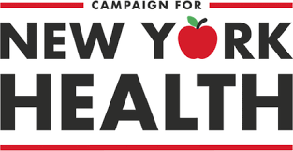
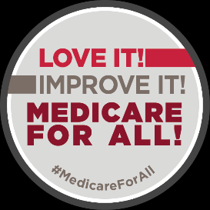
Linky Goodness: Organizations
http://pnhp.org
http://www.pnhpnymetro.org
https://www.nyhcampaign.org
https://www.healthcare-now.org
https://medicare4all.org/
https://www.citizen.org/topic/health-care/medicare-for-all/
https://www.businessformedicareforall.org/
http://www.laborforsinglepayer.org/
Presenter: Dr. Steve Auerbach E: dr.stevea@gmail.com
See also: The Case for Medicare for All (free PDF download from Public Citizen; 69 pages w/fully referenced Q&As):
https://www.citizen.org/sites/default/files/the_case_for_medicare-for-all_-_february.pdf

