Slide 1
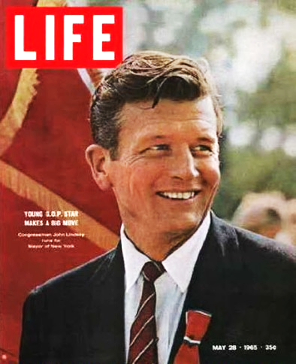
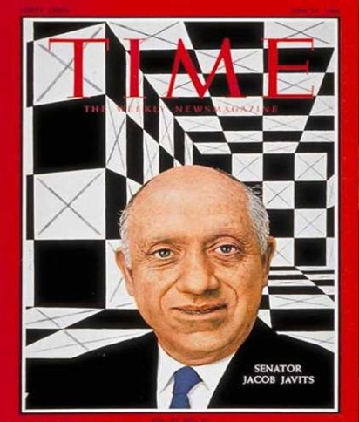
The USA has Medicare today because These Guys Failed
Proposed a
“Public Plan Option”
instead of Medicare
The country said no in 1962.
Medicare enacted in 1965.
Rep John Lindsay
Sen Jacob Javits
1962 bills HR11253 and S2664
https://www.jacobinmag.com/2017/07/trumpcare-obamacare-repeal-public-option-single-payer

Slide 2
The “Public Option” –
The Merits
The “Public Option” – Challenges and Risks
A potential pathway to universal coverage
Adds one additional choice of insurer, not compulsory
Applies the free market
Easier political lift than Medicare for All
Blurred with MFA
Not universal coverage
Misses many of MFA savings
Easily subverted to non-public commercial insurance
Insurers are skilled at undermining a public plan

Slide 3
A Best-Case Public Option
Strongly Tied
to Medicare
Better than Medicare Today
Starts Big
and Grows
Not contracted out
Uses Medicare’s national networks
Providers accept both or neither
Payments based on Medicare’s rates
Cover dentistry, hearing, optometry, pharmacy, full reproductive care
No copays or deductibles
Premium subsidies for lower-income
Allow individuals, employers, and state Medicaid plans to opt in
Auto-enroll uninsured (allow anyone to opt out)
https://pnhp.org/2010/03/09/wheelbarrow-parable-part-2-2/
http://www.sharedprosperity.org/bp180.html
https://www.jacobhacker.com/assets/3_hacker_public_plan_august_2009.pdf
Accessed Sept 5 2020

Slide 4
A Best-Case Public Option
Strongly Tied
to Medicare
Better than Medicare Today
Starts Big
and Grows
If the public option continues to gain political traction,
pay attention to how closely
it matches these ideals
https://pnhp.org/2010/03/09/wheelbarrow-parable-part-2-2/
http://www.sharedprosperity.org/bp180.html
https://www.jacobhacker.com/assets/3_hacker_public_plan_august_2009.pdf
Accessed Sept 5 2020

