Slide 1
THE RURAL
HEALTH CARE
CRISIS
What do communities need to survive and thrive?
"Of all the forms of inequality, injustice in health care is the most shocking and inhuman because it often results in physical death." Rev. Martin Luther King, Jr.

Slide 2
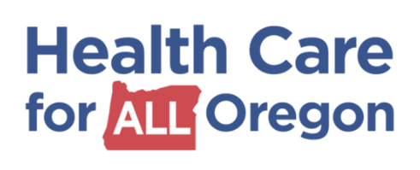
Presented By
Barbara C. Harrison, 2020
Community Activist and Educator
bcharrison0921@gmail.com
607 279 6429
Notes:
PRESENTED BY
Single Payer New York
Finger Lakes for New York Health Chapter

Slide 3
Presentation Outline
Map of Oregon
Definition of rural
Definition of Social Determinants
Graph – Rural Lives Are Cut Short
Issues faced by rural communities graphic organizer
Graph – Rural Americans Have Poor Access to Care
Graph – Median Health Care Expenditures Rural and Urban Pop
Graph – The More Rural Your County The More Likely You Are Uninsured
Graph – It’s More Dangerous to be Pregnant in a Rural Community
Graph – Rural Community – One in Three Rural Seniors Have No Natural Teeth
Photographs of protests “Save Our Hospitals”
Bar graph of rural hospital closures 2005 - 2020
Graph – Health Expenditure per Capita, 2018
What is single payer?
What single payer will cover
Definition of Global Budgeting
Notes:
PRESENTATION OUTLINE I am going to speak about barriers facing rural communities in accessing health care. I will start with a definition of rural and a map of Oregon. Next I will show a graphic organizer of Issues faced by rural communities. I will go into depth on one particular barrier and how a single payer system will begin to reduce inequity in rural areas.
History of Health Care in the United States
www.annenbergclassroom.org/Files/Documents/Timelines/HealthCare.pdf
http://midlevelu.com/blog/timeline-history- us-health-care-system
Different kinds of single payer systems
Federal level single payer bills
New York Health Act (A5260) (S3525)
Resources – Federal and New York State
Next Steps
3

Slide 4
Presentation Outline (cont’d)
Definition of Capital Expenditures
Global Budgeting in the OECD Countries
Maryland Model of All-Payer Rate Setting
What is the relationship between single payer and global budgeting?
How does implementing Single Payer and Global Budgeting change how rural communities’ health needs are met?
Next Steps
National Single Payer Resources
State of Oregon Single Payer Resources
Rural Resources
Supplemental Slides
Single Payer Legislation vs. Affordable Care Act
Global Budgeting in the OECD Countries (table)
France
Finland
Maryland – All-Payer Rate Setting

Slide 5
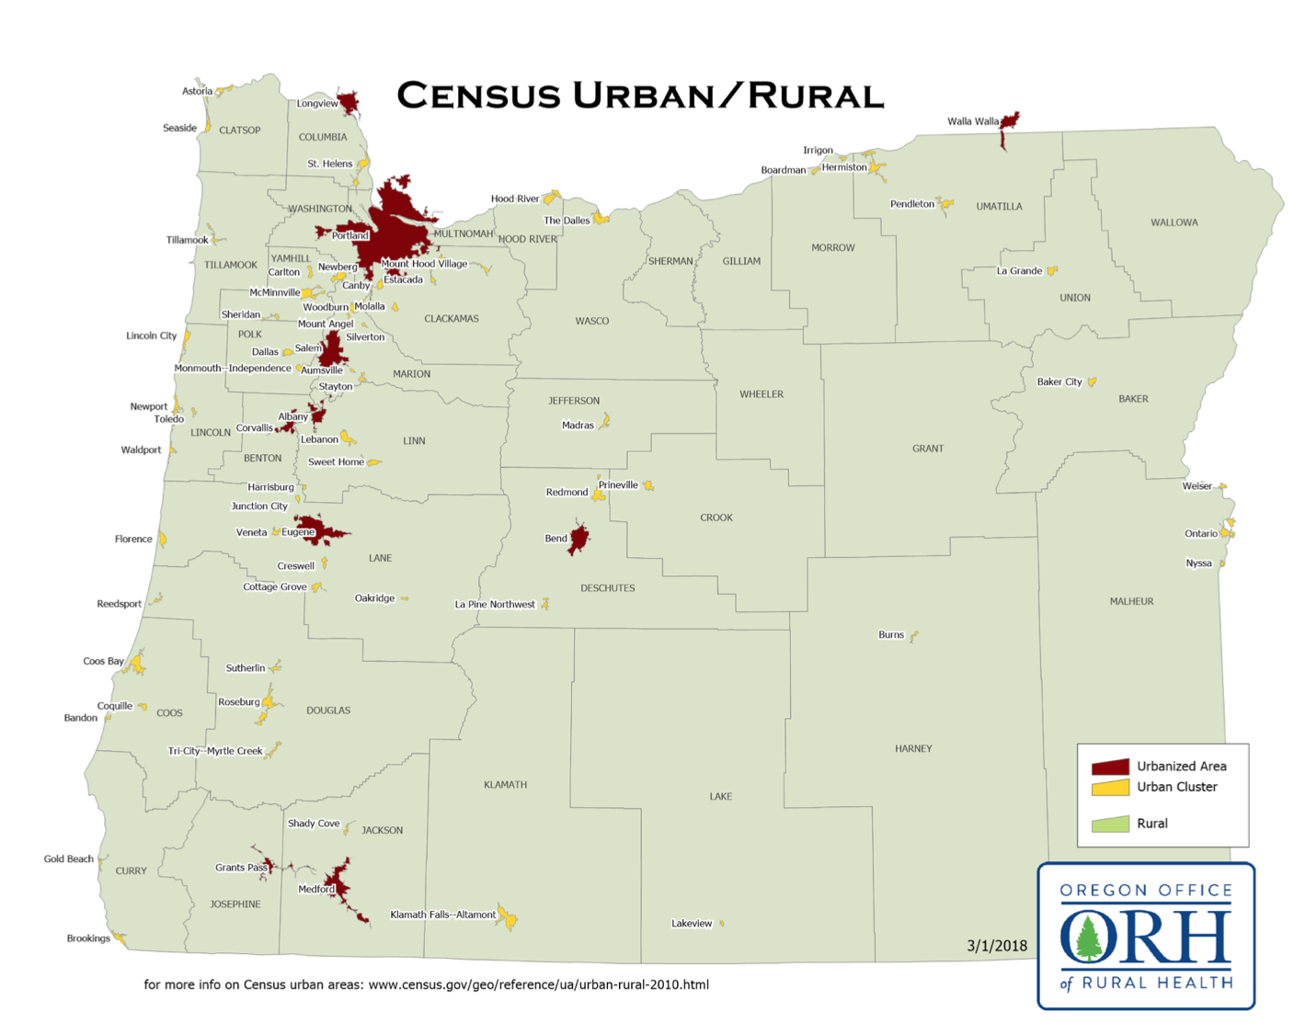
Notes:
Red – urbanized area
Yellow – urban cluster
Green – rural

Slide 6
Definition of rural
There is no one definition that defines rural places and people that serves all policy purposes and goals.
Methods for defining rural are based on geographic units (counties, census blocks, zip code tabulation areas); measures of inter-dependence across geographic boundaries – generally commuting that are sometimes combined with population density or provider characteristics.
These methods impact program eligibility and availability of resources for communities, and the choice in definition can result in significantly different populations.
2010 Census data, the Census Bureau counts 59.5 million people living in rural areas, but Office of Management and Budget (OMB) counts only about 46.2 million people living in rural areas.
Rural Policy Research Institute http://www.rupri.org/Forms/RuralDefinitionsBrief.pdf
https://rupri.public-health.uiowa.edu/publications/policypapers/Considerations%20For%20Defining%20Rural%20Places.pdf
Accessed October 19, 2020
Notes:
Methods for defining rural are based on geographic units (counties, census blocks, zip code tabulation areas); measures of inter-dependence across geographic boundaries – generally commuting that are sometimes combined with population (e.g., minimum population to be classified as urban); population density or provider characteristics. These methods impact program eligibility and availability of resources for communities, and the choice in definition can result in significantly different populations.
Ultimately, the choice of how to define rural should occur in the context of what is desired or intended to be achieved by the policy or program in order to best meet rural health needs. Rural and urban definitions reflect multidimensional concepts that can sometimes overlap and lead to confusion, and therefore, it is vital to understand how rural areas are defined.

Slide 7
Definition of Social Determinants (SDOH)
According to the World Health Organization, the social determinants of health are the circumstances in which people are born, grow up, live, work and age, and the systems put in place to deal with illness. These circumstances are in turn shaped by a wider set of forces: economics, social policies, and politics.
https://www.who.int/social_determinants/thecommission/finalreport/key_concepts/en/
Rural Americans—who make up at least 15 to 20% of the U.S. population face inequities that result in worse health care than that of urban and suburban residents. https://www.ruralhealthweb.org/about-nrha/about-rural-health-care
Accessed October 19, 2020

Slide 8
Rural Lives Are Cut Short Today
Large Metro
Counties
Americans in rural communities lose three years of life compared to Americans in
urban communities today.
Life expectancy at birth (years)
Rural Non-Metro Counties
Social Determinants of Health in the United States: Addressing Major Health Inequality Trends for the Nation, 1935-2016,​ Note: “1991” refers to 1990-1992
International Journal of Maternal and Child Health and AIDS, January 2018 PNHP https://pnhp.org/kitchen-table-campaign-rural-health-care/
https://www.ncbi.nlm.nih.gov/pmc/articles/PMC5777389/ Accessed October 21, 2020

Slide 9
Cultural or social differences, stigma and norms
Poverty
&
Unemployment
Access to safe, healthy homes
Low educational attainment
Low health literacy
Environmental health, water, air quality and pollution-farming chemicals
Geographic
Isolation
Insufficient or lack of health insurance coverage
Lack of adequate community Infrastructure to
ensure public safety, allow media access
Issues Faced By Residents of Rural Communities
Limited access to quality health care
Burden of chronic disease compared to general public
Limited availability of bilingual providers and interpreter services
Smaller health care workforce and a lack of specialty care
Lack of public transportation, personal vehicles in poor condition
Lack of access to healthy, affordable food
Higher substance
abuse-cigarette smoking, opioids methamphetamine
Rural Information Hub (RIH) https://www.ruralhealthinfo.org/toolkits/rural-toolkit/1/rural- Accessed 10/19/2020
National Institutes of Health/U.S. National Library of Medicine https://medlineplus.gov/ruralhealthconcerns.html

Slide 10
Rural Americans Have Poor Access to Care
45%
Could not afford care
26%: Unable to get care
23%
Location too far
22%
Hours not what’s needed
19%
No physician in network
https://www.npr.org/sections/health-shots/2019/05/21/725059882/poll-many-ruralamericans-struggle-with-financial-insecurity-access-to-health-ca
Poll: Many Rural Americans Struggle With Financial Insecurity, Access To Health Care, National Public Radio, the Robert Wood Johnson Foundation and the Harvard T.H. Chan School of Public Health, May 21, 2019
https://pnhp.org/kitchen-table-campaign-rural-health-care/ Accessed October 21, 2020

Slide 11
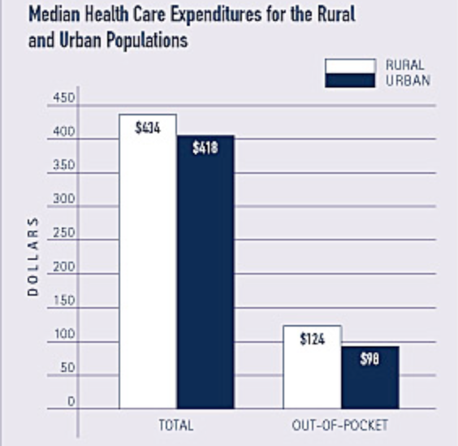
https://www.rwjf.org/en/library/research/2018/11/are-marketplace-premiums-higher-in-rural-than-in-urban-areas.html
Notes:
Median total health care for the rural population - $434 – are slightly higher than those for the urban population - $418. Rural residents pay a larger proportion – 29 percent – of their health care costs out-of-pocket than do urban residents – 23 percent. Rural residents pay 10 percent higher premiums than do urban residents.

Slide 12
The more rural your county, The More Likely You Are Uninsured
Percentage of county’s residents without insurance, 2017
Rates of Uninsured Fall in Rural Counties, Remain Higher Than Urban Counties, U.S. Census Bureau, April 9, 2019
https://www.census.gov/library/stories/2019/04/health-insurance-rural-america.html
Accessed October 22, 2020 https://pnhp.org/kitchen-table-campaign-rural-health-care/

Slide 13
It’s More Dangerous to be Pregnant in a Rural Community
Maternal mortality (deaths per 100,000 live births)
Scientific American analysis of U.S. Centers for Disease Control and Prevention, February 15, 2017
https://www.scientificamerican.com/article/maternal-health-care-is-disappearing-in-rural-america
Accessed October 21, 2020 https://pnhp.org/kitchen-table-campaign-rural-health-care/

Slide 14
Rural Communities – One in three rural seniors Have No Natural Teeth
Seniors without any natural teeth
Rural population number of dentists 29 per 100,000 residents
Urban number of dentists 61 per 100,000 residents
The 2014 Update of the Rural-Urban Chartbook,​ Rural Health Reform Policy, Research Center, October 2014
https://ruralhealth.und.edu/projects/health-reform-policy-research-center/pdf/2014-rural-urban-chartbook-update.pdf
Accessed Oct. 21, 2020 https://pnhp.org/kitchen-table-campaign-rural-health-care/
Notes:
Receipt of dental are differs between urban and rural populations. Among adults 18 to 64, some 66 percent of urban adults have been to the dentist in the past year, compared to 59 percent of rural adults.

Slide 15
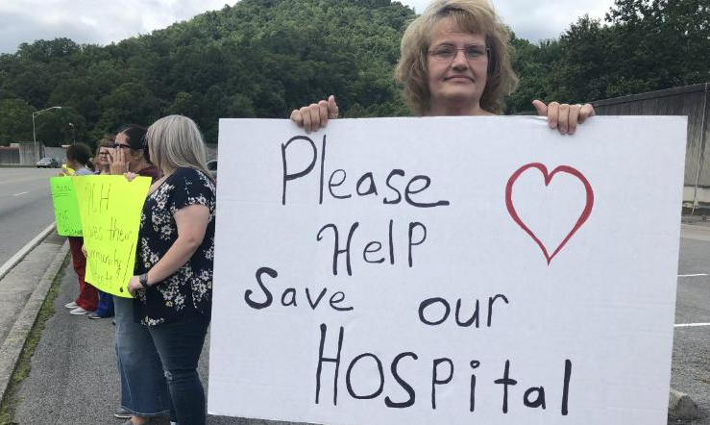
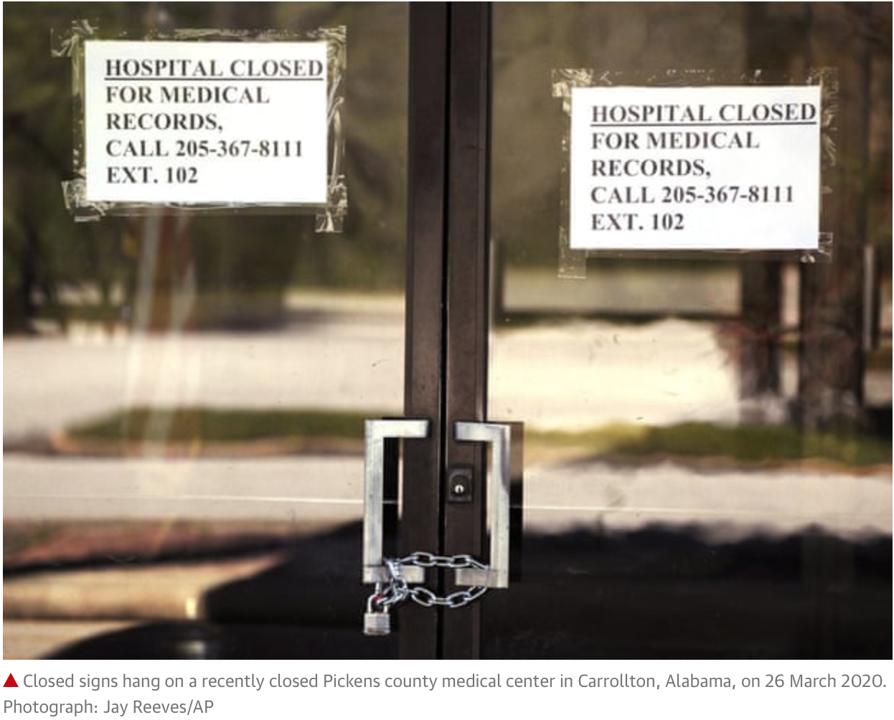
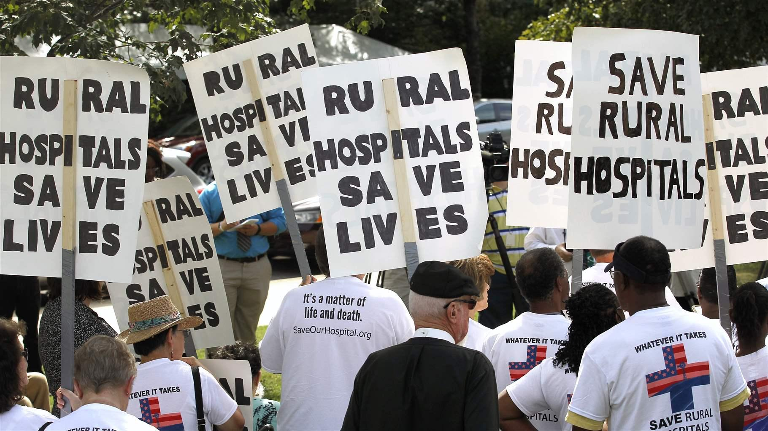
https://pnhp.org
https://www.theguardian.com/world/2020/apr/-face-shutdowns
https://www.pewtrusts.org/en/research-and-analysis/blogs/stateline/2019/01/22/rural-hospitals-in-greater-jeopardy-in-non-medicaid-expansion-states Chris Seward/The News and Observer via AP Accessed October 20, 2020

Slide 16
Between 2005 and 2020, 166 Rural Hospitals Have Closed
Cumulative rural hospital closures since 2005
https://www.shepscenter.unc.edu/programs-projects/rural-health/rural-hospital-closures/
Accessed October 21, 2020 https://pnhp.org/kitchen-table-campaign-rural-health-care/

Slide 17
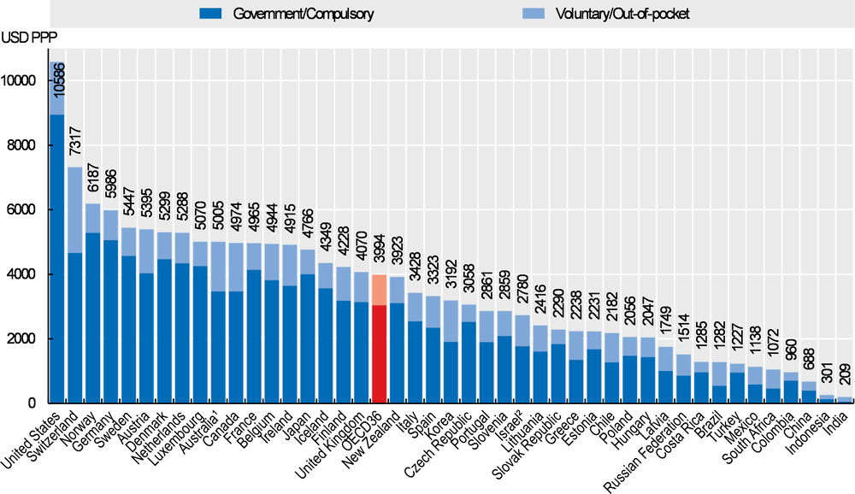
Health Expenditure per Capita, 2018
Note: Expenditure excludes investments, unless otherwise stated.
Note: Expenditure excludes investments, unless otherwise stated. (Accessed October 22, 2020)
1. Australia expenditure estimates exclude all expenditure for residential aged care facilities in welfare (social) services. 2. Includes investments.
Source: OECD Health Statistics 2019, WHO Global Health Expenditure Database. StatLink https://doi.org/10.1787/888934016778

Slide 18
What is Single Payer?
Single-payer, also known as “Expanded and Improved Medicare for all,” is a system in which a single public or quasi-public agency organizes health care financing, but the delivery of care remains largely in private hands.
http://www.pnhp.org/facts/what-is-single-payer
Notes:
What is Single Payer? How would this begin changing barriers to health care faced by rural communities?
This slide reiterates the definition given in the slide about definition of single payer in International Health Systems.

Slide 19
Single Payer Legislation
 | Single Payer Bill H. R. 1384
Universal Coverage | Yes. Everyone is covered automatically at birth.
Full Range of Services | Yes. Coverage for all medically necessary services. Primary, preventive, specialists, hospitalizations, mental health, reproductive health care, dental, vision, hearing, prescription drugs, medical supply costs, laboratory tests, rehabilitative services.
Savings | Yes. Would reduce costs by 24%, saving $829 billion in the first year by cutting administrative waste and allowing negotiation of prescription drugs (Friedman, 2013).
Cost Control and Sustainability | Yes. Large-scale cost controls (negotiated fee schedule with physicians, bulk purchasing of drugs, hospital budgeting, capital planning, etc.) ensure that benefits are sustainable over the long term.
Choice of Doctor & Hospital | Yes. Patients are allowed free choice of their doctor and hospital.
Progressive Financing Healthcare – NOW! https://www.healthcare-now.org/what-is-single-payer/ | Yes. Premiums and out-of-pocket costs are replaced with progressive income and wealth taxes. 95 percent of American households will pay less for care than they do now. Physicians for a National Health Program https://pnhp.org/system/assets/uploads/2018/06/HR676vsACAvsAHCA.pdf Accessed October 20, 2020
Notes:
Consumers and small businesses in every state (including the District of Columbia) have had access to obtain health and/or dental insurance coverage through Individual or Small Business Health Options Program (SHOP) Health Insurance Exchanges, operated by States through State-based Exchanges (SBEs), or operated by the Federal government through the Federally-facilitated Exchange (FFE).

Slide 20
Definition of Global Budgeting
How we budget many public services such as schools, fire departments, libraries, police…
Each hospital would receive an annual lump-sum payment to cover all operating expenses - a "global" budget.
1) reduce unit costs of services such as blood tests or imaging;
2) reduce the number of ancillary services per day; labs, radiology,
pharmacy and physical therapy services.
3) reduce length of stay;
4) reduce pre- and post- hospitalization services; and
5) reduce admission and readmission rates.
In simple terms, a hospital global budget caps the amount of revenue a facility can receive during the course of a given year, regardless of the number of patients treated or the number of services provided to those patients. As with any other fixed budget, cost increases incurred by the hospital beyond the cap will result in operating losses. However, if the hospital is able to reduce operating costs, it can retain the surplus.
Notes:
Achieving staying in global budget. They would have a number of ways to achieve this. Reducing readmissions, for one, would limit the care provided. Eliminating excessive or unnecessary treatments could help. Best practices would become an important priority. Procurement of supplies and medical devices and drugs would have to be mindful of cost efficiencies, instead of the pay-to-play clown show we currently have, which artificially increases prices. And, perish the thought, salaries for hospital administrators might have to go down.
). In most cases, a global payment encompasses physician and hospital services, diagnostic tests, prescription drugs and often, other services, such as hospice and home health care.
Care would be based on need, not ability to pay (Health care Now)

Slide 21
Definition of Global Budgeting cont’d
Negotiated with the state national health program board. Based on past expenditures, previous financial and clinical performance, projected changes in levels of services, wages and other costs, and proposed new and innovative programs.
Physicians employed in hospitals, health centers, group practices, clinics serving migrant workers, and medical home care agencies could elect to receive a global budget for the delivery of outpatient, home care, and physicians' services, as well as for preventive health care and patient-education programs.
Fee for Service: would use a single national fee schedule to pay MDs (renegotiated annually) with a single electronic billing system
Private practice, either inpatient or outpatient: get paid for the services you provide, based on a single, unchanging fee schedule.
https://www.shvs.org/wp-content/uploads/2018/05/SHVS_-Global-Hospital-Budgets_FINAL.pdf
http://www.pnhp.org/publications/NEJM1_12_89.htm
https://www.milbank.org/quarterly/articles/global-budgets-for-rural-hospitals/ Accessed October 21, 2020

Slide 22
Definition of Capital Expenditures
There would be a separate fund for capital expenses like new equipment, and an emergency fund if hospitals need to treat an epidemic.
https://www.shvs.org/wp-content/uploads/2018/05/SHVS_-Global-Hospital-Budgets_FINAL.pdf
http://www.pnhp.org/publications/NEJM1_12_89.htm
https://www.milbank.org/quarterly/articles/global-budgets-for-rural-hospitals/
Accessed October 21, 2020

Slide 23
Global Budgeting in the Organization for Economic Development Countries (OECD)
Many of the Organization for Economic Cooperation and Development countries (since 1982) use global budgeting to control all or certain portions of their health care expenditures. Exception is US and Japan. The structure, process, and effectiveness of these expenditure caps vary enormously, in part because the underlying social welfare (specifically health care) systems of each country are unique.
https://www.ncbi.nlm.nih.gov/pmc/articles/PMC4193373/ Accessed October 23, 2020

Slide 24
Maryland Model – All-Payer Rate Setting
Hospital rate setting is a system in which an authority, usually a state agency, establishes uniform rates for hospital services for multiple payers. When every payer in the state participates—as is the case in Maryland—it is referred to as all-payer hospital rate setting.
Maryland Model (1971-2013): Formulation and Evolution of the All-Payer Rate Setting System Maryland established its hospital rate setting system in the 1970s. With a 1977 Medicare waiver, Maryland added Medicare rates to their system, creating a true “all-payer” approach, with all public and private payers paying on the same basis. Further, the system helped create a more equitable spread of the costs of uncompensated care and helped eliminate cost shifting among payers. Yet, there was still an increase in hospital admissions.
Total Patient Revenue System (TPR) Pilot Program (2008-2010; 2010-2013): To address the increase in hospital admissions, in 2008, Maryland piloted a global budget system for hospitals as an incentive to reduce unnecessary admissions and readmissions. Three years after implementation, researchers found no significant changes in inpatient admissions, either overall or discretionary.

Slide 25
Maryland Model – All-Payer Rate Setting
Ten rural community hospitals participated in the three-year pilot called the Total Patient Revenue System (TPR) program. Overall, the TPR hospitals successfully reduced the number of admissions and re-admissions; as well as emergency department visits.
Global Budget Model (2014-2018): Making Progress Towards the Triple Aim (Improving the individual experience of care, improving population health and reducing per capita costs). Early results were mixed. Researchers found little impact on inpatient admissions, although it similarly concluded that outpatient and non-emergency department (ED) visits decreased. A 2019 evaluation shows that Maryland had already met or exceeded most waiver requirements by year three.
Maryland Model (2019-2027): Implementing the Total Cost of Care Model Encouraged by the success of the global budgeting model, Maryland submitted a progression plan to CMS (created by the ACA to test innovative payment and service delivery models for Medicare, Medicaid, CHIP https://innovation.cms.gov/
termed the Total Cost of Care (TCOC) Model. Under the expansion, the all-payer
model applies to some doctors' visits and other outpatient services, such as long-
term care. Community healthcare providers are able to choose whether they want
to participate in the model. Tools provided to encourage coordination of care.
Notes:
Early results were mixed. One study that compared changes in utilization among Medicare beneficiaries in Maryland with out-of-state control groups in the first two years had inconsistent results. Researchers found no clear evidence that hospitals met their budgets by reducing hospital utilization or enhancing primary care beyond changes that would have been expected without a global budget system.
However, by the fourth year of the waiver, the program was performing well against the program benchmarks.

Slide 26
Maryland Model – All-Payer Rate Setting
Conclusion
It is critical that states contemplating a rate setting system similar to Maryland's include input from stakeholders, including a strong voice from consumers, providers and other organizations involved in payment and costs for care. In 2017, The PA Rural Health Model (PARHM) began.
Additionally, the rate setting body must have access to a robust data collection and analysis system to support implementation and the monitoring of progress. These strategies help to ensure the rate setting program is reducing costs and improving the patient's hospital care experience.
Research Needed on Administrative Cost Savings. Although theory strongly predicts administrative cost savings under this system, research is lacking to measure the impact of the all-payer hospital rate setting model on administrative costs.
Capital Expenditures was not discussed.
“Is Maryland’s all-payer/global budget program an incremental step toward single payer?” Quote of the Day PNHP Or is it another way to bolster the current system?
https://pnhp.org/news/is-marylands-all-payer-global-budget-program-an-incremental-step-toward-single-payer/ Accessed Oct. 26, 2020
https://www.healthcarevaluehub.org/advocate-resources/publications/hospital-rate-setting-promising-challenging-replicate

Slide 27
What is the relationship between single payer and global budgeting?
A national single-payer system that would assure funding of every hospital through global budgeting. Hospitals’ income would be stable and predictable. Bureaucracy geared to billing, profits and bill collection would be eliminated. Responsiveness to the needs of the community and quality of care would replace financial performance as the criteria for judging the value of a hospital. Every hospital that serves a community would have the funds to care for its patients.
http://kyhealthcare.org/posts/global-budgeting-of-a-single-payer-plan-would-resolve-the-dilemma-of-closing-rural-hospitals Accessed October 25, 2020
Notes:
Early results were mixed. One study that compared changes in utilization among Medicare beneficiaries in Maryland with out-of-state control groups in the first two years had inconsistent results. Researchers found no clear evidence that hospitals met their budgets by reducing hospital utilization or enhancing primary care beyond changes that would have been expected without a global budget system.

Slide 28
How does implementing Single Payer and Global Budgeting change how rural communities’ health needs are met?
A global budget does not guarantee a hospital solvency, but it does provide a path to sustainability that is independent of inpatient volume. It ends the perpetual search for more patients and allows the hospital to do well by doing right by its community.
Since everyone is covered, rural hospitals would no longer absorb the costs of treating uninsured patients.
Johanna Fabian-Marks, Pennsylvania’s Department of Health Chief of Staff, stated in the announcement regarding implementation of The Rural Health Model in Pennsylvania - “This global budget model will incorporate whole-person care, social determinants of health, and long-term outcomes and keep our rural populations healthy and help rural hospitals thrive.” Identification of strategies to address their community’s top health problems, including diabetes, frequent emergency department utilization, and heart and lung diseases, mental health and dental care.
https://www.milbank.org/quarterly/articles/global-budgets-for-rural-hospitals/
https://ruralhealth.und.edu/assets/1376-5844/081616-all-payer-rate-setting-rural-impacts.pdf
https://revcycleintelligence.com/news/5-rural-hospitals-take-on-all-payer-global-budgets-to-boost-care Accessed October 21, 2020

Slide 29
Next Steps
This is the part of a Single Payer movement that highlights the need for a single payer health care plan, such as an expanded “Medicare for All”, which covers all necessary care, publicly financed and privately delivered. It ensures that all Americans, guaranteed by law, will have access to the highest quality and cost effective health care services, regardless of ones’ employment, income, or health care status. The goal is to raise political will around this issue. We know that it is a top priority of the voters. We need to make it a top priority for politicians.
Contact someone on your county or city council who is supportive of
this concept. Find out the procedure for presenting a resolution –
often it will go to a Health Committee or some other committee first,
before moving on to the whole legislature, ask to be on their agenda.
2. Put together a packet of materials to help educate legislators about this
topic, such as a summary, and economic analysis of the bill.
Notes:
Next Steps
This part of a movement to highlight the need for a Single Payer Health Care Plan such as an expanded “Medicare for All” health plan which covers all necessary care and is publicly financed and privately delivered. It ensures that all Americans, guaranteed by law, will have access to the highest quality and cost effective health care services regardless of ones’ employment, income, or health care status. The goal is to raise political will around this issue, we know that it is a top priority of the voters we need to make it a top priority among politicians.
2. Contact someone on your county or city council who is supportive of this
concept. Find out the procedure for presenting a resolution – often it will
go to a Health Committee or some other committee first before moving on to the
whole legislature, ask to be on their agenda.
3. SPNY has sample resolutions that can be used.
Put together a packet of materials to help educate legislators about this
topic such as a summary of the bill, economic analysis of the bill, testimony by
Albany Treasurer and testimony showing how municipalities would save money.

Slide 30
Next Steps Cont’d
Try to have ongoing communication with a number of legislators
that you are sure have read the materials and have had time to
get questions asked and answered. Speak with key members.
Have people prepared to speak, from various points of view, at the
meeting during public speaking time, i.e. uninsured members, small
business owners, social agencies, faith communities, labor unions,
physicians and health care providers, seniors, etc. Give an overview of
the bill – economic analysis, status of the bill, impact on property
taxes, etc.
7. Get as much publicity as possible – opinion pieces before the meeting
on the issues, letters to the editor about the bill, press release before
the meeting, hopefully with a picture, have people on local radio and
TV talk shows. When the resolution passes have some follow-up
publicity.
8. Organize, Organize, Organize…
Rebecca Elgie, Single Payer New York, Finger Lakes for New York Health, Ithaca, NY
Notes:
Next Steps Cont’d
Try to have ongoing communication with a number of legislators so that you are sure they have read the materials and have had time to get questions asked and answered. Speak with key members.
Have people prepared to speak, from various points of view, at the meeting during public speaking time, i.e. uninsured members, small business owners, social agencies, faith communities, labor unions, physicians and health care providers seniors, etc. Give an overview of the bill and economic analysis,
status of the bill, impact on property taxes, etc.
7. Get as much publicity as possible – opinion pieces before the meeting
on the issues, letters to the editor about the bill, press release before
the meeting, hopefully with a picture, have people on local radio and
TV talk show. When the resolution passes have some follow-up publicity.
Rebecca Elgie, Single Payer New York, Finger Lakes for New York Health, Ithaca, NY

Slide 31
National Single Payer Resources
Physicians for National Program (PNHP)
29 E Madison Suite 602, Chicago, IL 60602
Phone: (312) 782-6006 Fax: (312) 782-6007
Email: info@pnhp.org
Website: http://www.pnhp.org/
Healthcare-NOW
9A Hamilton Place, Boston, MA 02108
For all questions and press inquiries, call or email
Phone: (215) 732-2131
Email: info@healthcare-now.org
Website: https://www.healthcare-now.org
Notes:
Have a hand out on Federal and New York State single payer resources.

Slide 32
Oregon State Single Payer Resources
Joint Task Force on Universal Health Care
900 Court Street NE, Room 453, Salem, OR 97301.
Testimony is posted online to the Oregon Legislative Information System
(OLIS) as part of the legislative record and made publicly available
https://olis.oregonlegislature.gov/liz/2019I1/Committees/JTFUHC/Overview Written Testimony E-mail: JTFUHC.exhibits@oregonlegislature.gov
Oregon PNHP Chapters
President: Peter Mahr, MD 1417 SE Clinton St., Portland, OR 97202 Phone: 503-358-1715 Email: peter@pnhporegon.org
Website: http://pnhporegon.org
Health Care for All Oregon (HCAO)
1443 SE 122nd Ave., Portland, OR 97233
Phone: 503-206-6709
Email: info@hcao.org
Website: https://www.hcao.org
Notes:
Handout New York State Single Payer Resources

Slide 33
Rural Resources
Oregon Office of Rural Health
3030 South Moody Avenue Suite 200
Portland, OR 97201
Phone: 503-494-4450 Toll Free: 1-866-673-4376
Fax: 503-494-4798
E-mail: ruralweb@ohsu.edu
Website: https://www.ohsu.edu/oregon-office-of-rural-health
Rural Health Information Hub
School of Medicine and Health Sciences, Suite E231
Grand Forks, ND 58202-9037
Phone: 1-800-270-1898
E-mail: info@ruralhealthinfo.org
Website: https://www.ruralhealthinfo.org

Slide 34
Rural Resources
National Rural Health Association
7015 College Blvd Suite 150
Overland Park, KS 66211
Phone: 816-756-3140 Fax: 816-756-3144
E-mail: mail@nrharural.org
Website: https://www.ruralhealthweb.org
Washington D.C. Office
50 F. St., N.W. Suite 520
Washington, DC 20001
Phone: 202-639-0550
E-mail: dc@NRHArural.org
Website: https://www.ruralhealthweb.org
State Rural Health Associations
https://www.ruralhealthweb.org/programs/state-rural-health-associations

Slide 35
Supplemental Slides
Single Payer Legislation vs. Affordable Care Act
Global Budgeting in the OECD Countries (table)
France
Finland
Maryland Model – All-Payer Rate Setting

Slide 36
Single Payer Legislation vs. Affordable Care Act
 | Single Payer Bill H. R. 1384 | Affordable Care Act
Universal Coverage | Yes. Everyone is covered automatically at birth. | No. About 30 million people will still be uninsured in 2022 and tens of millions will remain underinsured.
Full Range of Services | Yes. Coverage for all medically necessary services. Primary, preventive, specialists, hospitalizations, mental health, reproductive health care, dental, vision, hearing, prescription drugs, medical supply costs, laboratory tests, rehabilitative services. | No. Insurers continue to strip down policies and increase patients’ co-payments and deductibles.
Savings | Yes. Would reduce costs by 24%, saving $829 billion in the first year by cutting administrative waste and allowing negotiation of prescription drugs (Friedman, 2013). | No. Increases health spending by about $1.1 trillion over 10 years. Adds further layers of administrative bloat to our health system through the introduction of state-based exchanges.
Cost Control & Sustainability | Yes. Large-scale cost controls (negotiated fee schedule with physicians, bulk purchasing of drugs, hospital budgeting, capital planning, etc.) ensure that benefits are sustainable over the long term. | No. Preserves a fragmented system incapable of controlling costs. Gains in coverage are erased by rising out-of-pocket expenses, bureaucratic waste and profiteering by private insurers and Big Pharma.
Choice of Doctor & Hospital | Yes. Patients are allowed free choice of their doctor and hospital. | No. Insurance companies continue to deny and limit care and to maintain restrictive networks.
Progressive Financing Healthcare – NOW! https://www.healthcare-now.org/what-is-single-payer/ October 21, 2020 | Yes. Premiums and out-of-pocket costs are replaced with progressive income and wealth taxes. 95 percent of American households will pay less for care than they do now. Physicians for a National Health Program https://pnhp.org/system/assets/uploads/2018/06/HR676vsACAvsAHCA.pdf | No. Continues the unfair financing of health care whereby costs are disproportionately paid by paid by middle- and lower-income Americans and those families facing acute or chronic illness.
Notes:
Consumers and small businesses in every state (including the District of Columbia) have had access to obtain health and/or dental insurance coverage through Individual or Small Business Health Options Program (SHOP) Health Insurance Exchanges, operated by States through State-based Exchanges (SBEs), or operated by the Federal government through the Federally-facilitated Exchange (FFE).

Slide 37
Global Budgeting in the OECD Countries
Country | Provider Type | Expenditure Type | Service Type | Budget Process | Action if Budget Exceeded | Financing Source | Geographic Specifics
Australia | Public hospitals | Operating costs | — | State-controlled | Rise in private patient revenues decreases State-funded revenues | State tax revenues and Federal grants | State-specific
Belgium | Teaching hospitals | Operating and capital costs | Magnetic resonance imaging | Sickness-fund-defined global budgeting for magnetic resonance imaging amortization, operating costs, and radiologist fee | No additional funds | Social Security contributions, State subsidies. | NA
 | Pharmaceutical companies | — | Prescriptions | Sickness fund sets cap on drug consumption | If consumption exceeds estimated level, unit prices are reduced | NA | NA
Canada | Physicians | — | Ambulatory care | Negotiation | Fees reduced following year | National and provincial tax revenues | Province-specific
 | Hospitals | Operating costs | _ | Negotiation | Government maintains small emergency budget for operating overruns | Same | Province-specific
Finland | Hospitals/clinics | Operating costs | — | Multiple review process | NA | National tax revenues | Province-specific
France | Public hospitals | Operating and debt service costs for construction and high-cost equipment | — | Nationwide hospital target guides negotiation between hospital, fund, and government | Small regional “maneuvering margin” | Payroll tax; hospitals paid in monthly installments | Regional
Germany¹ | Physicians | — | Ambulatory care | Negotiation between sickness fund associations and physician associations | NA | Payroll taxes, paid to physician associations, which distribute to physicians | Regional
Netherlands | Hospitals | Operating and some capital costs | Inventory and equipment only | Negotiation between hospital and sickness funds | None | Payroll tax, premiums, catastrophic fund | NA
 | Physicians | — | Ambulatory care | Income cap that limits volume growth; defined through negotiation | Must repay additional income according to a formula | Payroll tax, premiums, catastrophic fund | NA
Sweden | Hospital | Operating costs | — | Negotiation | NA | County and national taxes | County-specific
Switzerland | Hospital | Operating costs | — | Negotiation | NA | Federal Government | Canton of Vaud only
United Kingdom | Hospital and physician | Operating and capital costs | All, including prescription drugs | Set by the Ministry of Health | No excess funds | General tax revenues | Implemented through 200 District Health Authorities
¹As of September 1991, the substitute funds removed expenditure caps on expenditures for physician services. NOTE: NA is not applicable. SOURCE: Wolfe and Moran, Lewin-VHI, Fairfax, VA, 1992. Accessed October 23, 2020

Slide 38
Global Budgeting – France
National Health Insurance (NHI) system is administered through a network of local sickness funds that cover virtually 100 percent of the country's population
National government, supervises the funds and provides them with financing by means of a payroll tax.
Global budgeting, implemented for public hospitals in 1984.
Private hospitals pay per diem rates.
Each public hospital negotiates its proposed global budget with the predominant sickness fund in its region and with representatives of the national government.
Budget covers operating costs, as well as debt service expenses for hospital construction and high-cost medical equipment.
Hospitals paid in monthly installments, divided among the sickness funds according to their shares of total patient days.
Some additional funds exist to supplement the global budget under exceptional situations.
https://www.ncbi.nlm.nih.gov/pmc/articles/PMC4193373/ Accessed October 23, 2020

Slide 39
Global Budgeting – Finland
Finland's health system is recognized as one of the most efficient in the world.
Finnish national health insurance system is paid for through a combination of employer contributions, general tax revenues, and a very low out-of-pocket payment for both clinic visits and inpatient days.
The national administration does not organize services itself, but defines general health policy guidelines and directs the health care system at the state level. The majority of Finnish health care services are organized and provided by the municipal health care system.
In addition to the public municipal system, Finns can receive partial re- imbursement for private health care services through the obligatory National Health Insurance (NHI) system.
Corporations are legally obligated not only to pay particularly high income taxes but also to arrange comprehensive occupational health plans for their employees.
Capital expenditures for large or technologically advanced equipment purchases are also provided through central government subsidies.https://www.ncbi.nlm.nih.gov/pmc/articles/PMC4193373/ https://www.hbs.edu/faculty
publication%20filesfinnish_health_care_system_sitra2009_78584c8b-10c4-4206-9f9a-441bf8be1a2c.pdf
Accessed October 23, 2020

Slide 40
Maryland Model – All-Payer Rate Setting
Hospital rate setting is a system in which an authority, usually a state agency, establishes uniform rates for hospital services for multiple payers. When every payer in the state participates—as is the case in Maryland—it is referred to as all-payer hospital rate setting.
Maryland Model (1971-2013): Formulation and Evolution of the All-Payer Rate Setting System Maryland established its hospital rate setting system in the 1970s. With a 1977 Medicare waiver, Maryland added Medicare rates to their system, creating a true “all-payer” approach, with all public and private payers paying on the same basis. Further, the system helped create a more equitable spread of the costs of uncompensated care and helped eliminate cost shifting among payers.
While the system effectively reduced per-admission costs, Maryland faced challenges with the original model. Hospital admissions in Maryland increased at a rate of 2.7 percent from 2001 to 2007 compared to the national average of 1%.

Slide 41
Maryland Model – All-Payer Rate Setting
Total Patient Revenue System (TPR) Pilot Program (2008-2010; 2010-2013) To address the increase in hospital admissions, in 2008, Maryland piloted a global budget system for hospitals as an incentive to reduce unnecessary admissions and readmissions. Three years after implementation, researchers found no significant changes in inpatient admissions, either overall or discretionary.
Ten rural community hospitals participated in the three-year pilot called the Total Patient Revenue System (TPR) program. Overall, the TPR hospitals successfully reduced the number of admissions and re-admissions; as well as emergency department visits.
Global Budget Model (2014-2018): Making Progress Towards the Triple Aim (Improving the individual experience of care, improving population health and reducing per capita costs) found little impact on inpatient admissions, although it similarly concluded that outpatient and non-emergency department (ED) visits decreased. A 2019 evaluation shows that Maryland had already met or exceeded most waiver requirements by year three.

Slide 42
Maryland Model – All-Payer Rate Setting
Maryland Model (2019-2027): Implementing the Total Cost of Care Model Encouraged by the success of the global budgeting model, Maryland submitted a progression plan to CMS, termed the Total Cost of Care (TCOC) Model. Under the expansion, the all-payer model applies to some doctors' visits and other outpatient services, such as long-term care.
Community healthcare providers are able to choose whether they want to
participate in the model.
Tools and incentives for clinicians, hospitals, nonhospital facilities, and specialists to coordinate with each other and provide patient-centered, preventative, and timely care, while ensuring their financial stability.
The success of Maryland's all-payer model provides a roadmap for how to eliminate the negative incentives of fee-for-service systems by substituting a population-based system of payment and care delivery, which is consistent with the goals of the Triple Aim and many of CMS's new payment initiatives. Hospital rate setting systems can improve patient outcomes and provide predictable revenue for hospitals, while still producing overall system savings.

Slide 43
Maryland Model – All-Payer Rate Setting
It is critical that states contemplating a rate setting system similar to Maryland's include input from stakeholders, including a strong voice from consumers, providers and other organizations involved in payment and costs for care.
Additionally, the rate setting body must have access to a robust data collection and analysis system to support implementation and the monitoring of progress. These strategies help to ensure the rate setting program is reducing costs and improving the patient's hospital care experience.
Research Needed on Administrative Cost Savings Although theory strongly predicts administrative cost savings under this system, research is lacking to measure the impact of the all-payer hospital rate setting model on administrative costs.
There was no discussion of Capital Expenditures in Global Budgeting.
“Is Maryland’s all-payer/global budget program an incremental step toward single payer?” Quote of the Day PNHP Or is it another way to bolster the current system? Accessed October 26, 2020 https://pnhp.org/news/is-marylands-all-payer-global-budget-program-an-incremental-step-toward-single-payer/
https://www.healthcarevaluehub.org/advocate-resources/publications/hospital-rate-setting-promising-challenging-replicate

