Slide 1
Physicians for a
National Health Program
We are a non-profit research and education organization of 18,000 physicians, medical students and health professionals who support
single-payer national health insurance.

Slide 2
Costs are
Rising

Slide 3
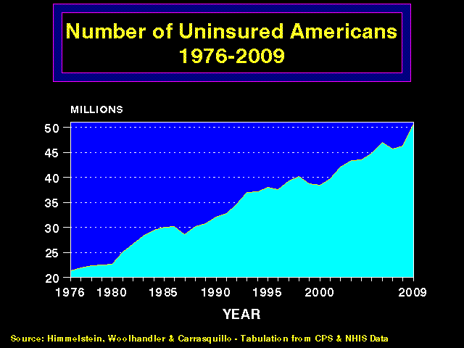
Health Care Costs Far Outpace Incomes
Average Per Capita Health Spending as % of Median Income
35%
30%
25%
20%
15%
10%
5%
1974 | 1980 | 1985 | 1990 | 1995 | 2000 | 2005 | 2011
Source: Himmelstein & Woolhandler calculation
based on data from NCHS and Bureau of the Census

Slide 4
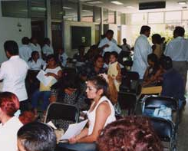
The Uninsured

Slide 5
More and More
Uninsured Americans
50
45
40
35
30
25
20
Millions of Uninsured American
1976 | 1980 | 1985 | 1990 | 1995 | 2000 | 2005 | 2012
Source: Himmelstein, Woolhandler & Carrasquilo.
Tabulation from CPS & NHIS data

Slide 6
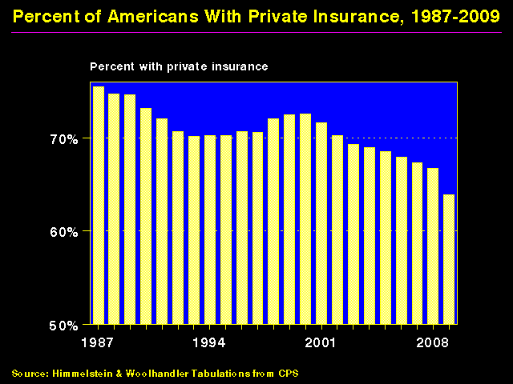
Shrinking Private Insurance
Percent with private coverage
80%
70%
60%
50%
1960
1970
1980
1990
2000
2012
Source: Himmelstein and Woolhandler – Tabluations from CPS and HIAA data
Note: Data are not adjusted for minor changes in survey methodology

Slide 7
44,798 Adult Deaths Annually
Due to Uninsurance
State | Percent Uninsured | Excess Deaths
California | 23.9% | 5,302
Texas | 29.7% | 4,675
Florida | 26.0% | 3,925
New York | 17.5% | 2,254
Georgia | 23.6% | 1,841
USA | 15.3% | 44,798
Source: Wilper et al. Am J Public Health 2009.
State tabulations by author

Slide 8
Medicaid:
Poor Access, but
Better Than Nothing

Slide 9
Many Specialists Won’t See
Kids With Medicaid
% of Clinics Scheduling
Appointments for Children
Bisgaier J, Rhodes KV.
N Engl J Med 2011;364:2324-2333
Notes:
9
Figure 2 Clinics Scheduling Specialty Care Appointments for Children, According to Type of Insurance. Public insurance was reported by callers as the Illinois Medicaid–Children's Health Insurance Program (CHIP) umbrella program; private insurance was reported by callers as Blue Cross Blue Shield. Each of the 273 clinics was called twice (for a total of 546 calls) by the same caller, with only insurance coverage varying between the two calls: once reporting Medicaid–CHIP coverage and once reporting private coverage. Calls were made 1 month apart, and the order of the reported insurance status was randomly assigned. Asthma clinics included 38 allergy–immunology clinics and 6 pulmonary disease clinics.

Slide 10
Medicaid Helps
A randomized controlled trial in Oregon
Source: NEJM May 2 2013
Note: Catastrophic medical costs = out-of-pocket spending >30% of income
Depression = screened positive for depression on PHQ8
Notes:
10
Figure 2 Clinics Scheduling Specialty Care Appointments for Children, According to Type of Insurance. Public insurance was reported by callers as the Illinois Medicaid–Children's Health Insurance Program (CHIP) umbrella program; private insurance was reported by callers as Blue Cross Blue Shield. Each of the 273 clinics was called twice (for a total of 546 calls) by the same caller, with only insurance coverage varying between the two calls: once reporting Medicaid–CHIP coverage and once reporting private coverage. Calls were made 1 month apart, and the order of the reported insurance status was randomly assigned. Asthma clinics included 38 allergy–immunology clinics and 6 pulmonary disease clinics.

Slide 11
High Deductible Insurance
Impedes Access
Worsens Health
Threatens Financial Ruin

Slide 12
Deductibles Are Rapidly Increasing
Percent of workers with deductibles
>$1,000
Kaiser/HRET Survey of Employer-Sponsored Benefits, 2013

Slide 13

Planning for Retirement?
Don’t Forget Health Care Costs
“Medicare covers only 51% of health care services….
For a 65 year old couple retiring this year, the cost of health care in retirement will be $240,000.”
New York Times. Wealth Matters

Slide 14
Uninsured and Under-Insured
Delay Seeking Care for Heart Attacks
Odds ratio for delayed care*
Source: JAMA April 15, 2010. 303:1392
*Adjusted for age, sex, race, clin. charact., hlth status,
social/psych fx, urban/rural. Under-insured=had coverage
but patient concerned about cost

Slide 15
Most of the Medically Bankrupt Had Coverage
Insurance at Illness Onset
Source: Himmelstein et al. Am J Med: August, 2009

Slide 16
Rising
Economic Inequality

Slide 17
Change in Real Family Income
1979 - 2012
Source: Bureau of the Census

Slide 18
Widening Gap in Life Expectancy Between High and Low Earners
Remaining Life Expectancy for Men Turning 60
Waldron. ORES, Social Security Admin, #108, 2007

Slide 19
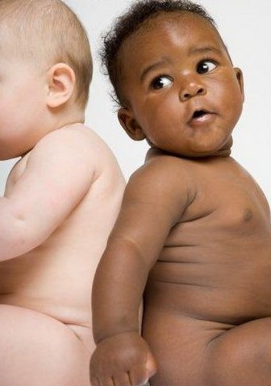
Persistent Racial Inequalities

Slide 20
Excess Deaths Among African Americans
83,369 fewer would have died in 2000 if racial gap were eliminated
Excess African American deaths
Source: Satcher et al. Health Affairs 2005;24:459

Slide 21
Causes of Black/White Disparity
In Life Expectancy
Source: MMWR 2001;50:780

Slide 22
Black Enrollment in US Medical Schools
20%
15%
10%
5%
AAMC Goal
%Blacks in 1st Year Class
1976 | 1982 | 1988 | 1994 | 2000 | 2006 | 2012
Source: RWJ Fdn. 1987, AAMC, and
JAMA Annual Medical Education Special Issue

Slide 23
Immigrants Get Little Care
Health Care
$ per capita
*Adjusted for ethnicity, poverty, age, insurance status, patient/parent-reported health status
Source: Mohanty et al. Am J Public Health 2005;95:1431

Slide 24
Immigrants Keep Medicare Afloat
$10.1 Billion
Net contribution to Medicare Trust Fund, 2009
$3.7 Billion
-$30.9 Billion
*Adjusted for ethnicity, poverty, age, insurance status, patient/parent-reported health status
Source: Mohanty et al. Am J Public Health 2005;95:1431

Slide 25
Administrative Overhead Rising

Slide 26
Growth of Physicians and Administrators
3000%
2500%
2000%
1500%
1000%
500%
0
Growth Since 1970
1970 | 1980 | 1990 | 2000 | 2010
Physicians
Administrators
Data updated through 2013
Source: Bureau of Labor Statistics; NCHS; Himmelstein/Woolhandler analysis of CPS

Slide 27
Investor-Owned Care:
Inflated Costs,
Inferior Quality

Slide 28
Extent of For-Profit Ownership
For-Profit Firms’ Share of Total Revenue
*Data are for share of establishments
Source: Commerce Department, Service Annual Survey, 2013 or more recent available data
Health Af 2012;31:1286

Slide 29
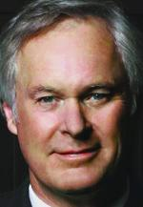
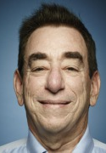
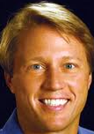
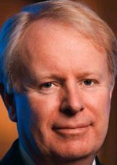
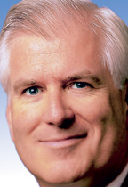
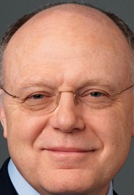
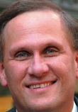
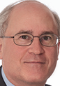
Health Care CEOs’ Pay, 2012
Richard Bracken
HCA
Leonard Schleifer
Regeneron
Kent Thiry
DaVita
David Pyott
Allergan
Total Pay: $34.6M
Holdings: $84.5M
Total Pay: $30.0M
Holdings: $666M
Total Pay: $26.8M
Holdings: $66.3M
Total Pay: $19.4M
Holdings: $108M
Miles White
Abbott
Ian Reed
Pfizer
Robert Parkinson
Baxter
Leonard Bell
Alexion
Total Pay: $19.0M
Holdings: $143M
Total Pay: $18.5M
Holdings: $48.1M
Total Pay: $16.0M
Holdings: $89.2M
Total Pay: $13.6M
Holdings: $311M
Source: NY Times. 6/30/2013

Slide 30
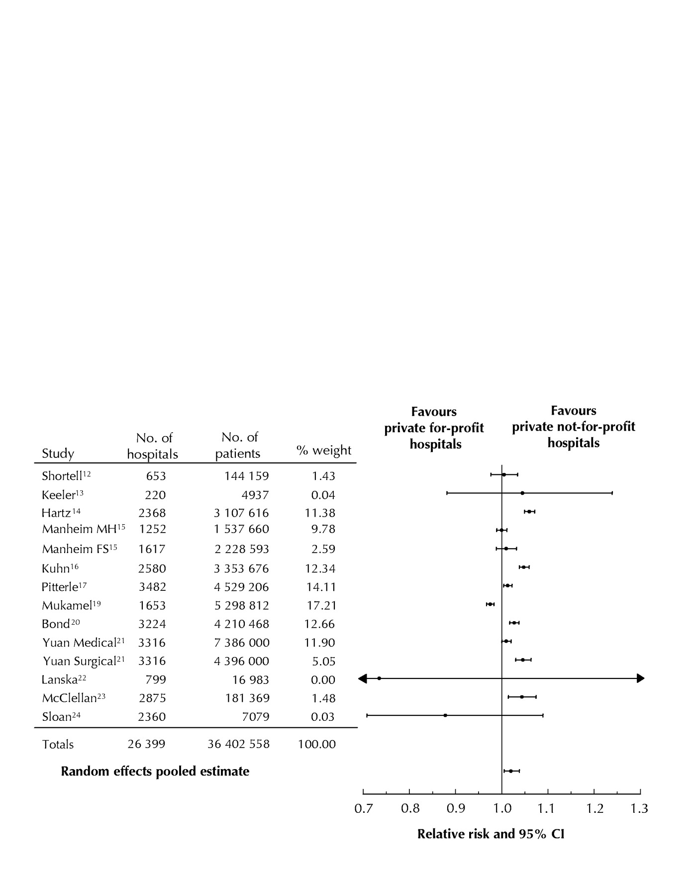
For-Profit Hospitals’
Death Rates Are 2% Higher
Favors
for-profit hospitals
Favors
not-for-profit hospitals
Relative risk and 95% CI
Relative risk of hospital mortality for adult patients in private for-profit hospitals relative to private not-for-profit hospitals
Source: CMAJ Devereaux et al. 166 (11): 1399.

Slide 31
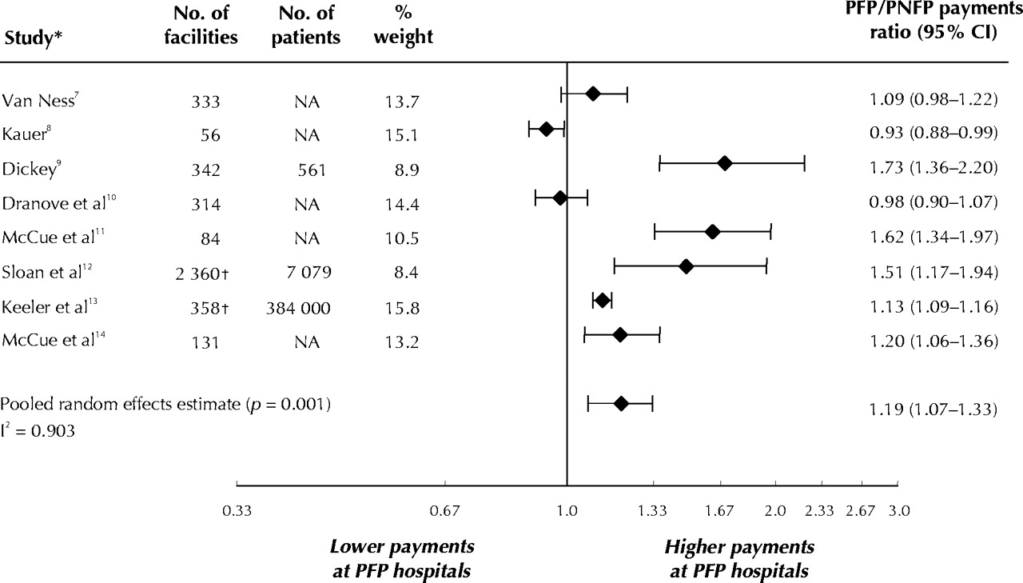
For-Profit Hospitals Cost 19% More
Lower payments at PFP Hospitals
Higher payments at PFP Hospitals
PFP/PNFP Payments Ratio (95% CI)
Relative payments for care at private for-profit (PFP)
and private not-for-profit (PNFP) hospitals
Source: CMAJ Devereaux et al. 170 (12): 1817.

Slide 32
Quality Measures for MI, CHF, Pneumonia:
For Profit Hospitals Are Worst; VA is Best
Odds ratio
of meeting composite quality measures (Higher = Better)
Source: Arch Int Med 2006;166:2511

Slide 33
Low Quality Hospitals
More Likely to be For-Profit
For-Profit
Non-Profit / Government
Source: Health Affairs 2011;30:1904.
Quality rating based on Medicare’s Hospital Compare data

Slide 34
For-Profit Hospitals’ Quality Lowest
More Nurses = Higher Quality Rating
Percent of patients giving hospital highest quality rating
Source: NEJM 10/31/2008

Slide 35
Tenet (AKA “NME”)
1985-1993: Recurrent criminal activity. Bribing state officials, kickbacks for referrals, and kidnapping psychiatric patients
1994-1995: Pays $379M Federal fine for insurance fraud/kickbacks. Pays more than $200M in private settlements.
CEO Richard Esmer retires with annual pension of $822,670 plus lump sum payment of $2.6M
1995: New CEO J. Barbakow appointed
2002-2003: FBI raids Tenet hospital re: unnecessary heart surgery + Medicare fraud
2003: Barbakow forced out (total compensation = $400M)
2003-2004: Pays $449M for unneeded heart surgery settlement
2006: Pays $215M + $900M for Medicare outlier fraud + $80M for improperly deducting previous fines from taxes
Mod Hlthcr 3/29/85,4/26/85, 9/6/93, 7/4/94, 11/4/02, 1/16/06, 11/27/06; NYT 10/22/91, 7/31/94, 11/1/02, 6/30/06; USA Today 8/26/02

Slide 36
Two For-Profit Giants Dominate Dialysis
Medicare pays, shareholders profit
Share of Dialysis Patients
Source: Modern Healthcare 9/16/2013

Slide 37
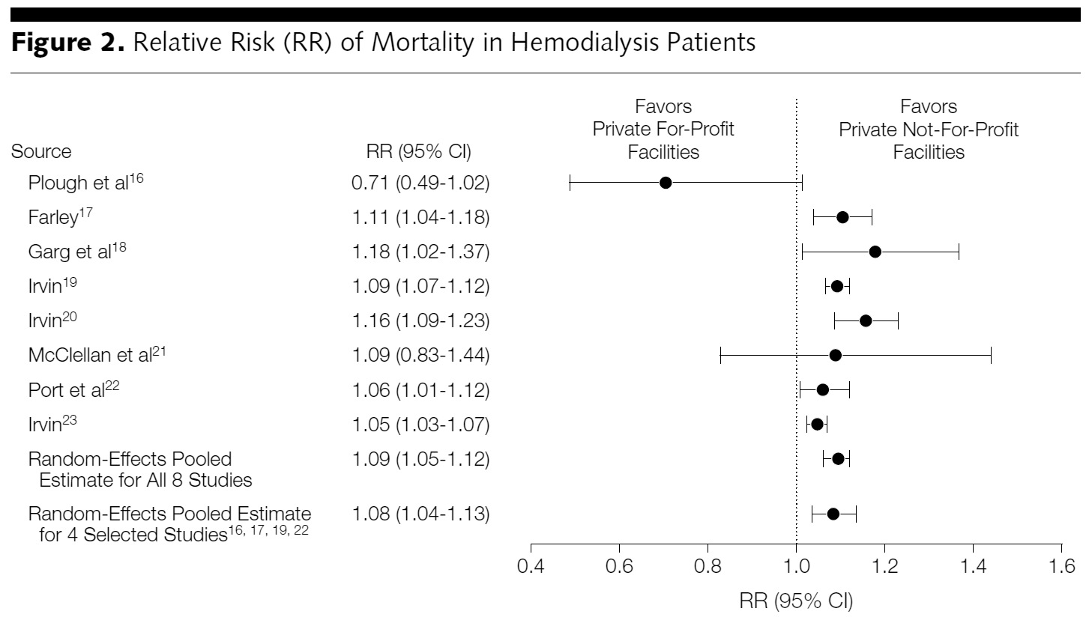
For-Profit Dialysis Clinics’
Death Rates Are 9% Higher
Relative Risk (RR) of mortality in hemodialysis patients
Source: Devereaux P. JAMA. 2002;288(19):2449-2457.

Slide 38
Hospice Care Goes For-Profit
2011: 60%
Percent of hospices under for-profit ownership
1993: 6%
Source: National Home Care and Hospice Surve & MEDPAC

Slide 39
For-Profit Hospices Avoid Unprofitable Patients
Likelihood of accepting all patients, regardless of care needs
(and profitability)
Source: Health Affairs 2012;31:2690
Note: Based upon accepting patients on chemo, TPN, transfusions, tube feeds, intrathecal cath, palliative radiation, or living alone

Slide 40
Drug Companies’ Cost Structure
Marketing and Admin
35%
Manufacturing
27%
Profits
(After Taxes)
18%
R&D
13%
Source: Health Affairs 2001;20(5):136

Slide 41
2012 Fraud/Civil Fines
Against Drug Firms
Glaxo – $3 Billion
Illegal promotion (Paxil & Wellbutrin)
Hiding safety problems (Avandia)
Johnson & Johnson - ~$2 Billion
Illegal marketing. Risperidal (multiple cases)
Abbott -- $1.5 Billion
Illegal marketing, Depakote
Amgen – $762 Million
Illegal marketing, Aranesp
Merck – $322 Million
Illegal marketing, Vioxx
Sanofi – $109 Million
Physician kickbacks for Hyalgan
Sources: NYT 7/3/2012; Fiscal Times 8/31/2012;
Modern Healthcare 2/25/13

Slide 42
HMO Overhead, 2013
SEC Filings/Reports to Shareholders. Data for Q1 or Q2
Calculated as 100% – Medical Loss Ratio
Note Medicare/Medicaid enrollees included in some figures

Slide 43
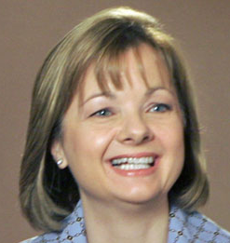
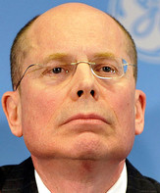
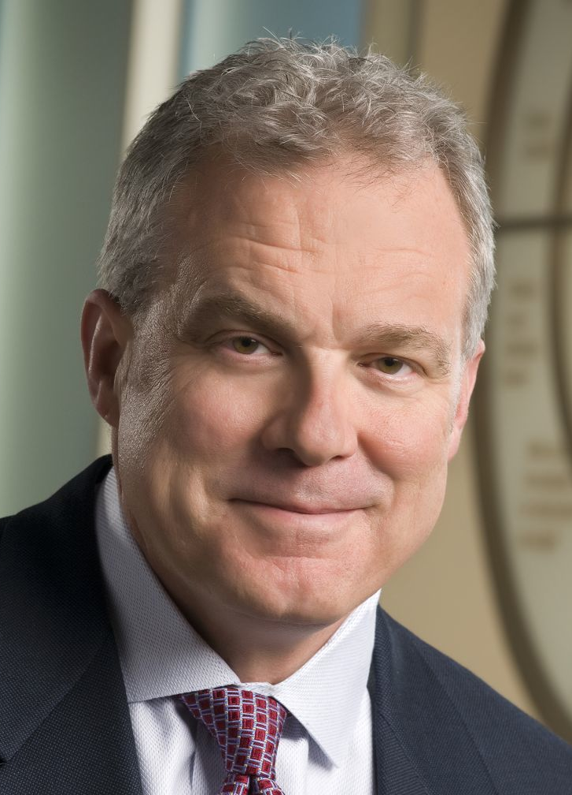
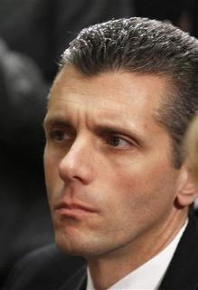
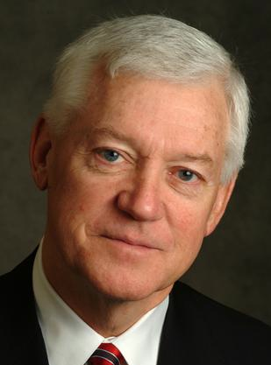
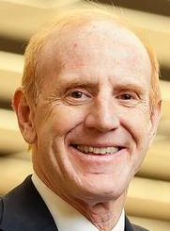
HMO CEOs’ 2012 Pay
Angela Braly
Steve Hemsley
Mark Bertolini
Wellpoint
$20.6 Million
United HC
$13.9 Million
Aetna
$113.3 Million
David Cordani
Allen Wise
Jay Gellert
Cigna
$12.9 Million
Coventry
$12.0
Million
HealthNet
$10.2 Million
Sources: Modern Healthcare 5/13/2013
and AFL-CIO CEO Database

Slide 44
Medicare
Remains Solvent and Relatively Efficient

Slide 45
Number of Years Before Medicare Trust Fund Projected to be Exhausted
Year of estimate
Estimated number of years until Trust Fund exhausted
Medicare Trust Funds Annual Reports

Slide 46
Risk Adjustment Increased
Medicare HMO Overpayment
25%
20%
15%
10%
5%
Annual Increase
4181%
2441%
1970
2011
Medicare
Private Insurance
National Health Accounts – Historical Series, Table 16

Slide 47
Medicare Threatened by
Private Medicare Advantage Plans

Slide 48
Private Medicare Advantage Plans’
High Overhead
Overhead
per enrollee
2008
Source: US House Committee on Energy and Commerce. December, 2009

Slide 49
Despite Medicare’s lower overhead, enrollment of Medicare patients in private plans has grown because of cherry picking.

Slide 50
Medicare HMO Enrollment
14
12
10
8
6
4
2
0
Medicare HMO enrollment (Millions)
1985 | 1990 | 1995 | 2000 | 2005 | 2013
Source: CMS

Slide 51
A Few Sick People
Account for Most Health Dollars
Percent of total health spending accounted for by decile
Top 2 deciles account for 78.3%
Decile of Privately Insured
Source: MEPS Data, from Thorpe and Reinhart

Slide 52
Medicare HMOs:
The Healthy Go In, The Sick Go Out
Inpatient costs as percentage of FFS Medicare
High medical needs when they leave
Healthier patients join
Source: NEJM 1997;337:169

Slide 53
Medicare Overpays HMOs
Overpayments Total $283 Billion Since 1985
$40
$30
$20
$10
Medicare HMO overpayments as compared to FFS costs for similar patients ($Billion)
1985 | 1990 | 1995 | 2000 | 2005 | 2012
VA
Cherry Picking
Legislated
PNHP Report 10/2012 based on data from MedPAC, Commonwealth Fund, Trivedi et al.
VA = Cost of VA uncompensated care provided to Medicare HMO enrollees
Legislated = Congressionally-mandated excess payments to Medicare HMOs

Slide 54
95% of Plans Cheat on
HEDIS Quality Measures
Medicare Advantage plans failing to cheat fall in rankings
Percent of elderly patients prescribed drugs that should be avoided
Annals of Internal Medicine 2013;159:456
Researchers compared reported HEDIS scores for high risk prescribing to actual Medicare Part D payment records for all enrollees and for enrollees sampled for HEDIS scoring

Slide 55
Bundled payment under ACOs:
A Rerun of the
HMO Experience?

Slide 56
Explosive Growth of ACOs
Number
of ACOs
Source: Health Affairs Blog 10/31/13

Slide 57
HMO and ACO Similarities
Diagnosis: FFS and “fragmentation”
Rx: Invert FFS incentives
  Shift insurance risk to providers
  “Protect” patients with “Pay for Performance (P4P)”
  Consolidate providers into entities large enough to be “held accountable” for cost (via capitation)

Slide 58
HMO and ACO Differences
More ACOs are provider-based (so far)
Patients mostly not aware they’re in an ACO

Slide 59
High Risk HMO Patients
Fared Poorly in the RAND Experiment
HMO
Free Fee-For-Service
Source: RAND Health Insurance Experiment, Lancet 1988;1:1017
Note: High Risk = 20% of population with lowest income
+ highest medical risk

Slide 60
Depressed Patients:
Fee-For-Service vs. Managed Care
Primary Care Patients
Patients Seeing Psychiatrist
# of Functional Limitations
Fee-For-Service
Managed Care
Source: Medical Outcomes Study. JAMA 1989; 262:3298
Arch Gen Psych 1993; 50:517

Slide 61
ACOs = Medical Practices owned by
Corporate Oligopolies

Slide 62

Modern Healthcare. Vol 42/No 52. Dec. 24/31, 2012

Slide 63
More Doctors Are
Hospital Employees
Percent of newly hired physicians employed by hospitals
Source: Medscape July 9, 2012

Slide 64
Hospital Mergers Rising
105
93
Hospital mergers and acquisitions
76
60
60
50
54
50
46*
*2013 data through date of publication
Each deal may involve multiple hospitals
NY Times Aug 12 2013

Slide 65
Poll: Patients Reject ACOs
“Here are two different ways Medicare could pay doctors.
Which of these do you think would be better for you?”
NEJM 2013;369:1066. Kaiser/RWJ/Harvard Survey, 201

Slide 66
Mandate Model Reform:
Keeping Private Insurers In Charge

Slide 67
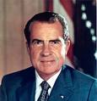

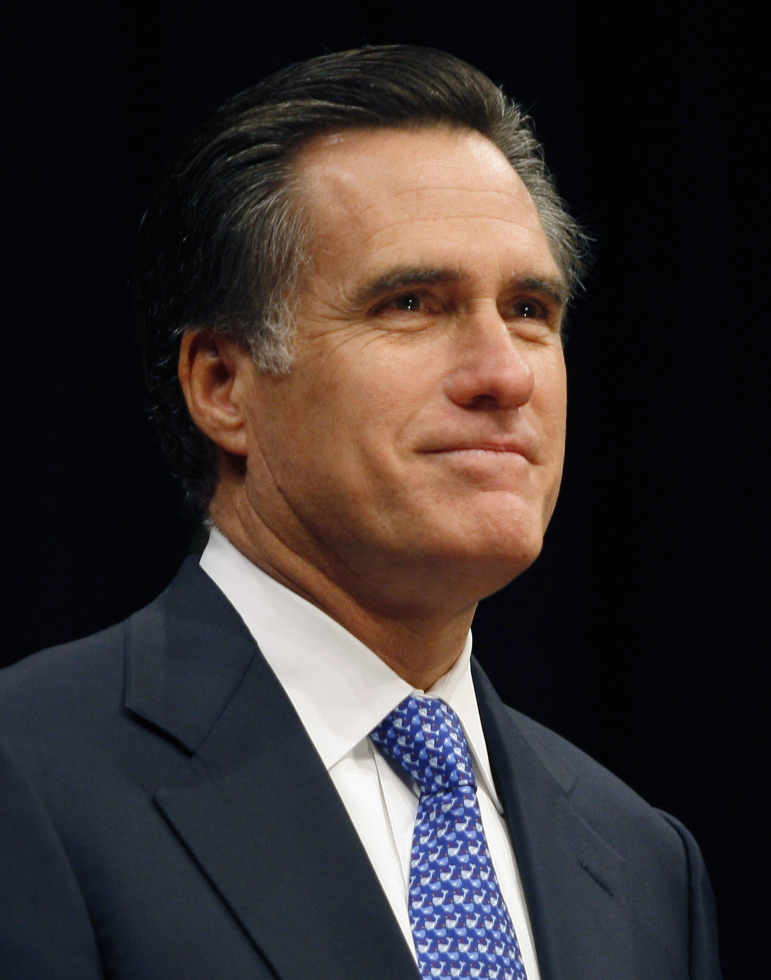

Mandate Model of Reform
Expanded Medicaid-like program
  Free for poor
  Subsidies for low income
  Buy-in without subsidy for others
Employer mandate +/- individuals
Managed Care / Care Management
Employer mandate
Individual mandate
Individual mandate
Affordable Care Act
Notes:
67

Slide 68
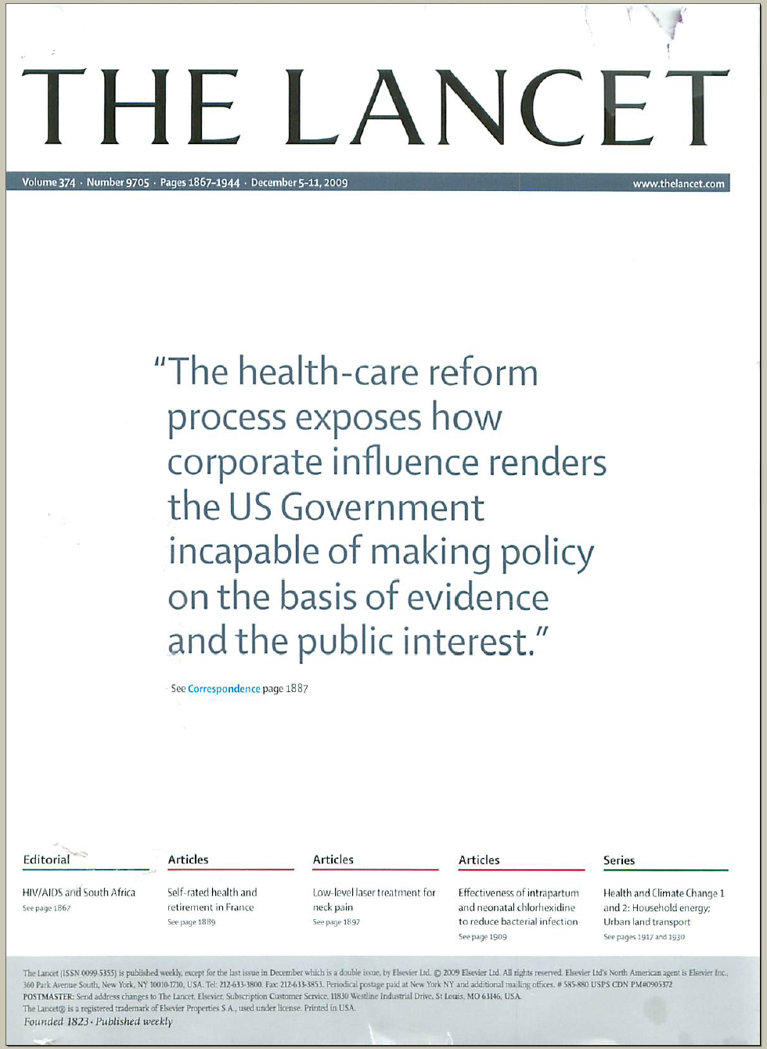
The Lancet Put It On Their Cover
“The health-care reform process exposes how corporate influence renders the US Government incapable of making policy on the basis of evidence and the public interest.”
Source: Lancet Dec 5, 2009. Cover of vol. 374.

Slide 69
Uninsured in Massachusetts
40%
30%
20%
10%
Percent Uninsured
Medicaid Expansion
Dukakis Bill
Reform
1987
1990 | 1995 | 2000 | 2005
2012
Source: Census Bureau
Figures prior to 1999 adjusted for changes in CPS survey methods

Slide 70
Adults Who Needed Care but
Cost Was an Obstacle
Percent of MA residents aged 18-64
Insured and uninsured adult residents who needed care
but for whom cost was an obstacle.
Massachusetts Division of Healthcare Finance and Policy, 2011

Slide 71
Health Costs Have Risen Faster in Massachusetts Since 2006 Reform
$20,000
$15,000
$10,000
$5,000
Average Premium for Employer-Based Family Coverage
Massachusetts
Reform
United States
1996 | 1998 | 2000 | 2002 | 2004 | 2006 | 2008 | 2010
Mechanic R E et al. Health Aff 2012;31:2334-2342
Notes:
Average Annual Employer-Based Family Health Insurance Premiums, Massachusetts And The United States, 1996–2011

Slide 72
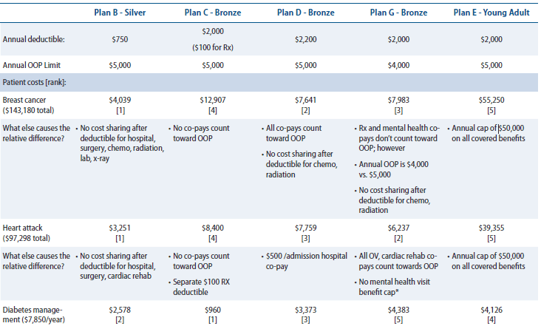
Massachusetts Plans Leave Many With High Out-of-Pocket Costs
Source: Center for American Progress

Slide 73
Massachusetts Plans Leave Many With High Out-of-Pocket Costs
Source: Center for American Progress
 | Plan C – Bronze | Plan G - Bronze
Breast Cancer | $12,907 | $7,983
Diabetes Management | $960 | $4,383

Slide 74
Number of Uninsured Americans
50
40
30
20
10
0
Millions of Uninsured American
1976
1985
1995
2005
2014
2021
With state opt-outs
As enacted
Himmelstein, Woolhandler, & Carrasquillo
Tabulations from CPS & NHIS data + CBO projections

Slide 75
Most Aren’t Directly Affected by ACA
Medicare
16%
Medicare
16%
Uninsured
10%
Medicaid
10%
Uninsured
18%
Medicaid
14%
Exchanges 7%
Current private
56%
Current private
53%
CBO Estimate, May 2013

Slide 76
Health Insurance Reform
Under the ACA
10 essential benefits, but no standard benefit package
Eliminates co-pays and deductibles, but only on preventive services
Limits insurers’ overhead to 15-20%, but lobbying has weakened enforcement
No regulation of premiums, deductibles and co-pays
Out-of-pocket caps, but uncovered services (and in some cases) drug costs don’t count

Slide 77
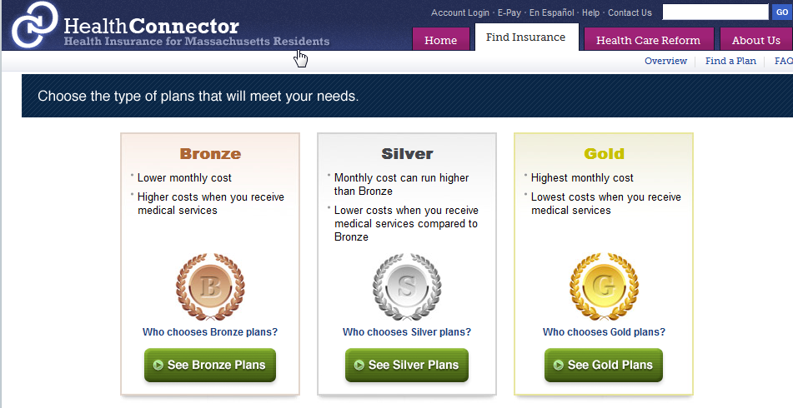
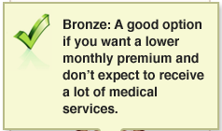
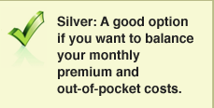
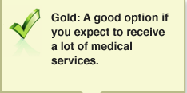
Underinsurance Becomes the Norm
(Average Employer Plan: 87% coverage)
60%
Actuarial value
70%
Actuarial value
80%
Actuarial value

Slide 78
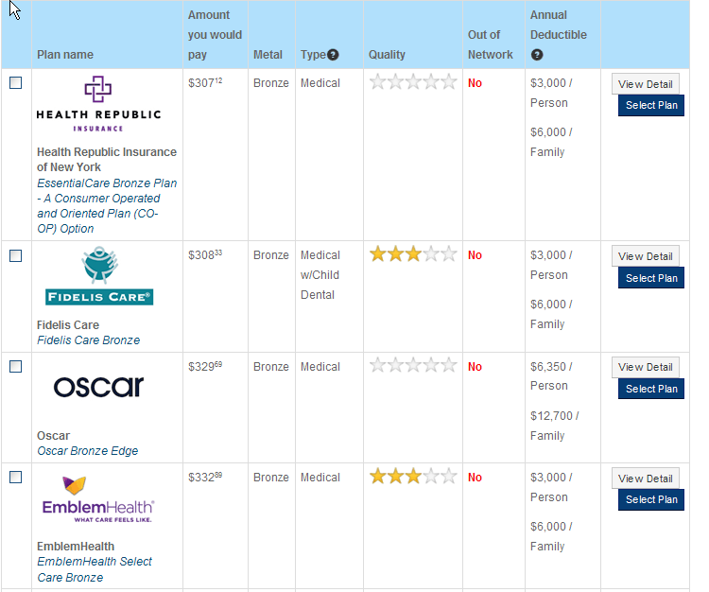
Cheapest Coverage Options
50 year old; New York City

Slide 79
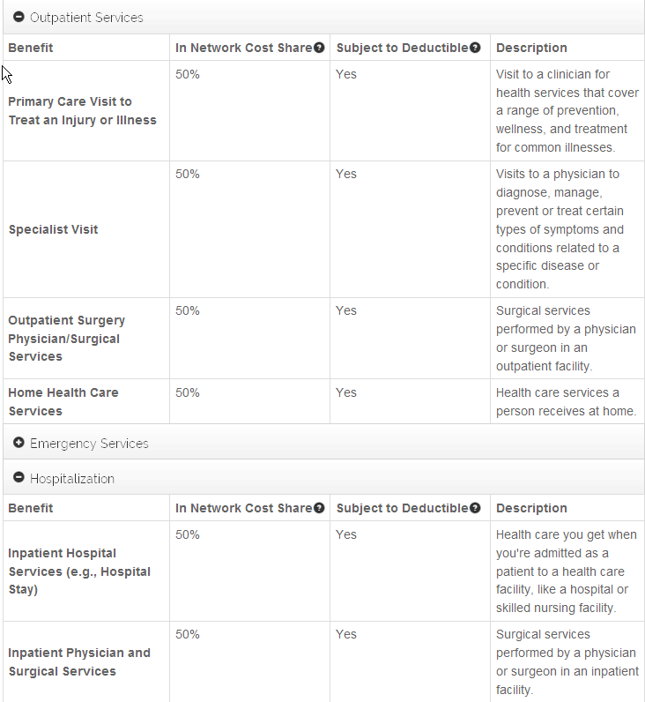

What’s Covered

Slide 80
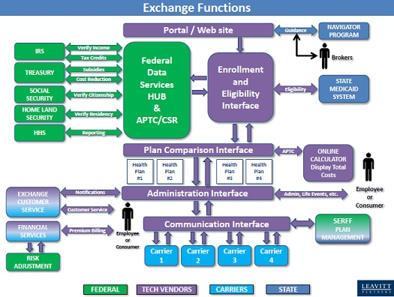

Slide 81
Vermont’s Exchange Costs
100,000 Exchange users expected
28,000 of pre-ACA’s 42,000 uninsured
72,000 pre-ACA insured
$170 million initial cost of Exchange
$1,700 per user
$6,071 per newly insured person
$92 million
Exchange cost 2015 – 2018
$218 million
Additional costs (over 5 years) for integrated eligibility system, staffing, operations, etc.
Source: Independent Review of Health Benefits Exchange (HBE)
And Integrated Eligibility (IE) Solutions, July 2013

Slide 82
Public Money,
Private Control

Slide 83
US Public Spending per Capita for Health
Exceeds Total Spending in Other Nations
$8,950
2011 healthcare spending per capita
Data are for 2011
Sources: OECD 2013; Health Affairs 2002 21(4)88

Slide 84
The U.S. Trails Other Nations

Slide 85
Life Expectancy
Years
Note: Data are for 2011 or most recent year available
Source: OECD, 2013

Slide 86
Infant Mortality
Deaths in First Year of Life Per 1,000 Live Births
Note: Data are for 2011 or most recent year available
Source: OECD, 2013

Slide 87
Maternal Mortality
Deaths per 100,000 Live Births
Note: Data are for 2011 or most recent year available
Source: OECD, 2013

Slide 88
Hospital Inpatient Days per Capita
Note: Data are for 2011 or most recent year available
Source: OECD, 2013

Slide 89
Physician Visits per Capita
Note: Data are for 2011 or most recent year available
Source: OECD, 2013

Slide 90
Out-of-Pocket Payments
Dollars per Capita
Note: Data are for 2011 or most recent year available
Figures adjusted for Purchasing Power Parity
Source: OECD, 2013

Slide 91
Insurance Overhead
Dollars per Capita
Note: Data are for 2011 or most recent available
Figures adjusted for Purchasing Power Parity
Source: OECD, 2013

Slide 92

Canada’s National Health Insurance Program

Slide 93
Minimum Standards for
Canada’s Provincial Programs
Universal coverage that does not impeded, either directly or indirectly, whether by charges or otherwise, reasonable access.
Portability of benefits from province to province
Coverage for all medically necessary services
Publicly administered, non-profit program

Slide 94
% of People with an Unmet Health Need
Canadians and US Insured Are Similar
Source: Joint Canada/US Survey of Health, 2002-03.
CDC and Statistics Canada

Slide 95
Quality of Care Slightly Better
In Canada Than USA
Meta-analysis of patients treated for same illnesses.
(US studies included mostly insured patients.)
Source: Guyatt et al, Open Medicine, April 19, 2007

Slide 96
Infant Mortality
30
20
10
Deaths per 1,000 Live Births
First province implements NHP
USA
Canada
1955 | 1965 | 1975 | 1985 | 1995 | 2009
Sources: Statistics Canada, Canadian Institute for Health Information, National Center for Health Statistics

Slide 97
Health Costs as % of GDP
19%
17%
15%
13%
11%
9%
7%
5%
Canada’s NHP Enacted
USA
Health costs % of GDP
“Uniquely American”
NHP Fully Implemented
Canada
1960 | 1970 | 1980 | 1990 | 2000
2014
Source: Statistics Canada, Canadian Institute for Health Info, and NCHS/Commerce Dept.

Slide 98
US Medicare Coverage
Much Worse than Canada’s
Percent of seniors’ total medical expenses covered
Note: Not comparable to figures for employer coverage because of high LTC needs in elderly
Source: EBRI and Himmelstein/Woolhandler analysis of Health Canada data

Slide 99
How Has Canada Controlled Costs?
Lower administrative costs via single payer - 16.7% of total health spending vs. 31.0% in the U.S.
Lump-sum, global budgets for hospitals
Stringent controls on capital spending for new buildings and expensive new equipment
Single buyer purchasing reins in drug/device prices
Low litigation and malpractice costs
Emphasis on primary care
Exclusion of private insurers - private plans overcharged U.S. Medicare by $34 billion in 2012
Source: Himmelstein & Woolhandler
Arch Intern Med, December, 2012

Slide 100
Overall Administrative Costs
Dollars per capita, 2014
Source: Woolhandler/Himmelstein/Campbell
NEJM 2003;349:769 (updated 2013)

Slide 101
Canadian Physicians’ Incomes
2010 – 2011
Specialty | Income
Family Medicine | $265,881
Internal Med | $361,551
Pediatrics | $270,073
Psychiatry | $214,702
Dermatology | $398,410
Specialty | Income
OB-GYN | $449,121
General Surgery | $411,995
Thoracic Surgery | $529,728
Ophthalmology | $573,258
All Canadian physicians: $307,482
Source: Canadian Institute for Health Information

Slide 102
Few Canadian Physicians Emigrate
Net loss (number moving abroad – number returning)
A negative number indicates that more physicians returned from abroad then moved abroad
Source: Canadian Institute for Health Information

Slide 103
What’s OK in Canada?
Compared to the USA…
Life expectancy 2 years longer
Infant deaths 25% lower
Universal comprehensive coverage
More physician visits, hospital care; less bureaucracy
Quality of care equivalent to insured Americans’
Free choice of doctor and hospital
Health spending half of USA level

Slide 104
What’s the Matter in Canada?
The wealthy lobby for private funding and tax cuts; they resent subsidizing care for others.
Result: government funding cuts (e.g., 30% of hospital beds closed during the 1990s) causing dissatisfaction and waits for care.
USA and Canadian firms seek profit opportunities in health care privatization
Conservative foes of public services own many Canadian newspapers
Misleading waiting list surveys by right wing Fraser Institute

Slide 105
Americans Want NHI
“Would you prefer the current health insurance system… or a universal coverage program like Medicare that is government run and financed by taxpayers?”
Source: ABC News Poll; USA Today; Kaiser Survey 9/06

Slide 106
Massachusetts Doctors
Support Single Payer
Source: Massachusetts Medical Society Survey. Oct. 2012

Slide 107
Many Who Oppose ObamaCare
Prefer Single Payer
Source: NY Times based on CNN/ORC Poll May 17-18 2013
Figures don’t add to 100% because some had “no opinion”

Slide 108

A National Health Program for the
USA

Slide 109
National Health Insurance
Universal – covers everyone
Comprehensive – all needed care, no co-pays
Single, public payer – simplified reimbursement
No investor-owned HMOs, hospitals, etc.
Improved health planning
Public accountability for quality and cost, but minimal bureaucracy
Proposal of the Physicians Working Group for Single Payer NHI
JAMA 2003;290:798

Slide 110
Funding for the NHP
Revenue Sources
NHP
Fund
Recipients of Money
Medicare and Medicaid
Hospital Operating Costs
Hospital Capital Costs
State /Local Governments
HMOs
Employers
Fee-for-Service Physicians
Private Insurance Revenues
Home Care Agencies
New Taxes
Long-Term Care
Source: NEJM 1989;320:102

Slide 111
Hospital Payment Under an NHP
Hospitals remain privately owned.
Capital purchases/expansion budgeted separately based on health planning goals.
Negotiated global budget for operating costs. Operating funds cannot be diverted to capital.
Himmelstein and Woolhandler. NEJM 1989;320:102

Slide 112
Three Options for Physician and Ambulatory Care Payment Under the NHP
Fee for
Service
Mandatory assignment
Simplified negotiated fee schedule
Capitation for Institutions
With Salaried Docs
Free disenrollment
Capitation for operating costs, not capital purchases, profits or doc incentives
No selective enrollment period
Inpatient care under hospital’s global budgets
Globally Budgeted Institutions
Hospitals
Clinics
Home care agencies
Institutions with salaried physicians
Source: Himmelstein and Woolhandler.
NEJM 1989;320:102

Slide 113
America Can Do This.
Excellent hospitals, empty beds
Enough well-trained professionals
Superb
research
Current spending
is sufficient
We already have what it takes

