Slide 1
International Health Systems: Models for the U.S.
Canadian Health Care System
in 8 minutes flat!

Slide 2
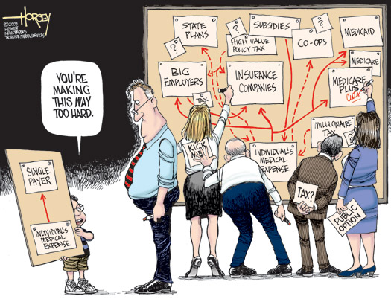

Slide 3
How to describe Canada’s health care system in one sentence?
Interlocking set of 10 provincial and 3 territorial health insurance plans
Publicly administered
Publicly funded
Privately delivered
Universal
Accessible
Comprehensive coverage
Portable wherever you go

Slide 4
What services are covered?
All medically necessary hospital and physician services

Slide 5
Who decides what’s medically necessary?
Medical experts, including physicians, not insurance companies.

Slide 6
Can you choose your own doctor?
Yes.
You choose FP and they refer to appropriate specialists (that you can choose).

Slide 7
Where do doctors work?
Most in “private” practice just like in the US
Some in other practice settings, such as clinics, community health centres, and group practices

Slide 8
How are doctors paid?
Private practice = FFS
Group practice = alternative payment schemes (salary, blended payment)
Fee schedules negotiated between each provincial/territorial government and medical associations
Notes:
Doctors in private practice are generally paid through fee-for-service schedules negotiated between each provincial and territorial government and the medical associations in their respective jurisdictions. Doctors in group practices are more likely paid through alternative payment schemes, such as salaries or a blended payment (e.g., fee-for-services plus incentives).

Slide 9
How are hospitals paid?
Mostly through global budgets, though some are experimenting with Activity-based Funding (ABF), the Canadian version of PPS/DRGs

Slide 10
Are there “death panels”?
No
Family doctors typically serve as gatekeepers to specialty care. Together with specialists and patients, treatment decisions are made based on best interest of patient

Slide 11
Aren’t there waits in Canada?
Sometimes
Some waits, in some provinces, for some physicians, for some elective procedures
Canada, waiting based on medical need
US, waiting based on ability to pay

Slide 12
Single Payer Benefits #1
Universal, Comprehensive Coverage
No out-of-pocket payments for medically necessary hospital and physician services
Co-payments & deductibles are barriers to access, administratively unwieldy, & ineffective for cost containment. Canada has no co-pays.
Single insurance plan in each country or region, administered by public or quasi-public agency

Slide 13
Single Payer Benefits #2
Global operating budgets for hospitals, nursing homes, & other facilities=administratively simple
Billing per-patient → unnecessary administrative complexity & expense
Separate allocation of capital funds

Slide 14
Single Payer Benefits #3
Free Choice of Providers
Patients free to seek care from any licensed health care provider
Ideally, ban on for-profit health care providers, though Canada has no such ban
Profit-seeking inevitably distorts care & diverts resources from patients to investors

Slide 15
Single Payer Benefits #4
Public Accountability, not corporate dictates
Best chance for democratically settting overall health policies & priorities
patients & providers make medical decisions rather than dictated by corporate executives

