Slide 1
The Healthcare System of Republic of Korea
Physicians for National Program
2014 Annual Meeting
Mira Lee, M.D.
November 2014
Notes:
Hi. My name is Mira Lee. M.D. from Korea and had some clinical experience in the U.S. as well. Honored to have a chance to talk about our healthcare system and hope to be a good story for your movement here too.

Slide 2
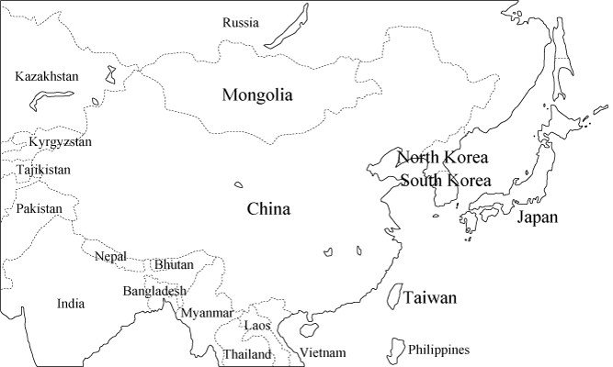
Republic of Korea
Notes:
As you see here, South Korea is located between China and Japan and has confronted North Korea since 1947. 50million people. Can easier to figure out by comparing that of California which is around 40 million. For the size, similar with Minnesota.

Slide 3
Healthcare system in Korea
National Health Insurance
Universal coverage
Free choice for physicians and institutions
GDP for healthcare: 7.5% (2012, WHO)
Private healthcare providers >90%
Notes:
Korean healthcare system is National Health Insurance, a single payer system. 98.6% according to ?? year data, covered by this and the rest is covered by 의료보호, consisting universal coverage. Free choice for physicians and institutions as well. It is illegal for healthcare providers to refuse any patients.
GDP for health expenditure is 7.5%. The red arrow is Korea, small input, compared to other OECD countries. Red line is OECD average and the green arrow is the U.S.
Public financing but the healthcare is mostly delivered by private providers.

Slide 4
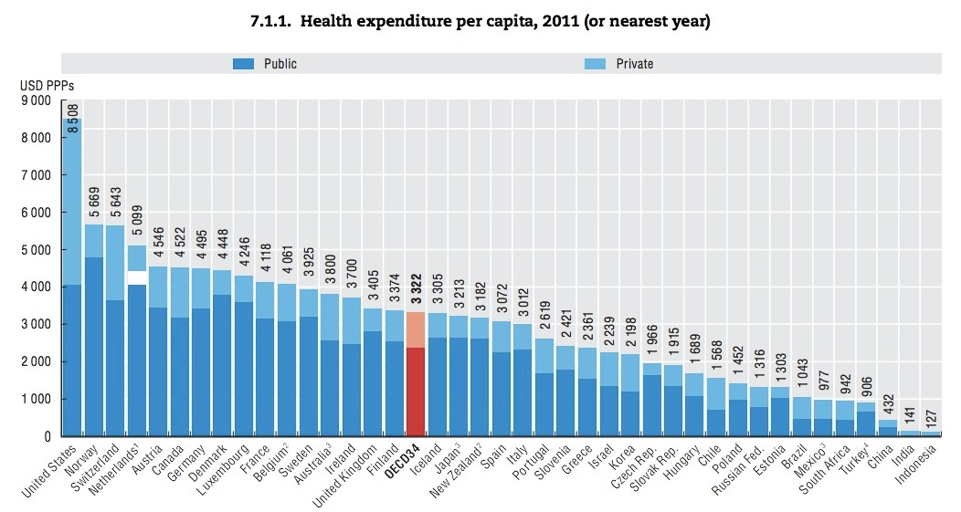
Notes:
Korean healthcare system is National Health Insurance, a single payer system. 98.6% according to ?? year data, covered by this and the rest is covered by 의료보호, consisting universal coverage. Free choice for physicians and institutions as well. It is illegal for healthcare providers to refuse any patients.
GDP for health expenditure is 7.5%. The red arrow is Korea, small input, compared to other OECD countries. Red line is OECD average and the green arrow is the U.S.
Public financing but the healthcare is mostly delivered by private providers.

Slide 5
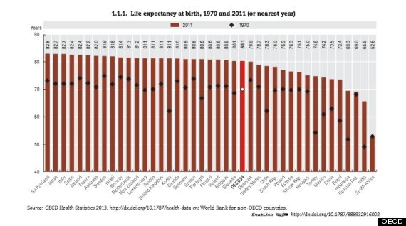
Notes:
For the relatively small input, our public health outcomes look decent.
Life expectancy at birth, accruing to 2011 data is the yellow arrow here. The distance between black dots and the top end of the line is the improvement since 1970. Which is obviously bigger than other countries.

Slide 6
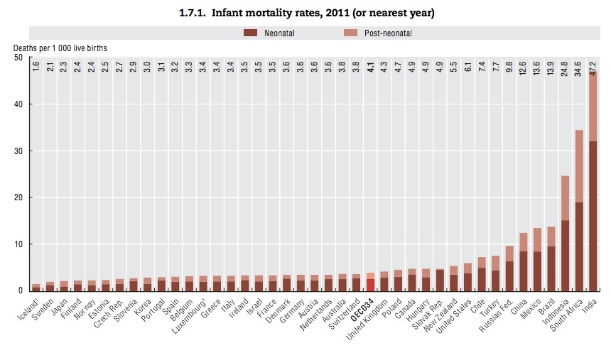
Notes:
Another indicator here is infant mortality rates.

Slide 7
Implemented as SHI 1977
with coverage 8.7%
1980 Problems arose related to
multipayer system
Universal coverage 1989
1989 Farmers’ resistance,
allied with progressive academics
Integration 1989
to single payer
vetoed by President Rho
Coalition
of
farmers,
progressive academics,
President Kim
elected 1998
Integration law 1999
passed
civic groups,
labor unions
Completed 2003
financial integration
Notes:
In 1977, our healthcare system started as a social health insurance. First it was applied to the companies with 500 or more workers. Coverage was only 8.7%. Immediately, problems related to this multi-payers system arose, such as high administration cost and, more importantly, inequality. Over the expansion of coverage, big workplace medical insurance funds with healthy members had a solid financial situation that did not have pay big premium while smaller funds forced members to pay higher premium. There was limitations of institutions and physicians that patients could see, depending on medical funds. In 1984, the debate about medical insurance integration started, first, in the administration itself, and shared with academics, though the debate did not continue due to the authoritarian government’ reluctance. In 1989, the health insurance coverage expanded to self-employed. Now it became universal coverage. Ironically, this became the big starting point of healthcare movement보건의료운동. Since the government did not want to subsidize for the premium of the self-employed, farmers were outrageous at their exorbitant premium. They boycotted paying premiums and continued the resistance, allied with progressive public health academics who had started organizing by themselves even before . With support of, the healthcare insurance integration bill passed the congress의회. But it was vetoed by the authoritarian president back then.
The coalition of farmers and academics reorganized National Committee for Medical Insurance Integration(의보대책회의?)…. 활동을 ‘장황하게’ ㅋㅋㅋ
In 1998, there came the political change. The relatively more progressive politician got elected as president. President Kim Dae-Joong. He was supportive of the medical insurance integration. And the bill was finally passed.
But the resistance to reverse it was harsh

Slide 8
After integration
National Health Insurance
367 medical insurance funds :
139 employees’ funds
227 regional funds
1 government workers and teachers’ fund
Administration cost 8% 3.4% (2009)
Out-of-pocket expenditure decreased.
Notes:
After the integration, 367 health funds became one national health insurance. Administration cost decreased from 3.4% from 8%. And out-of-pocket expenditure decreased.

Slide 9
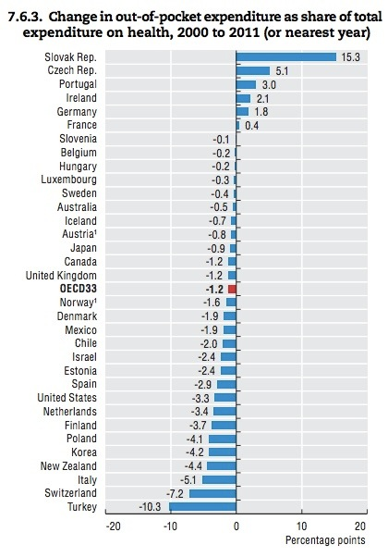
Notes:
Shown here, it has decreased by 4.2% between 2000 and 2011.

Slide 10
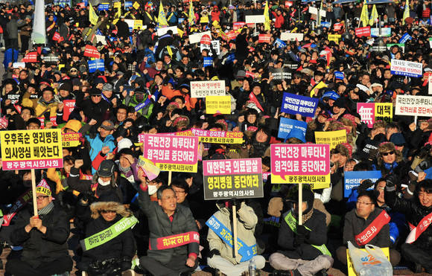
Notes:
Still, our system is far from perfection. We need to address fast increasing health expenditure. We also need to improve way too low benefits which is a big burden to people and has become a glitch for private insurance industry to expand.
The challenge related to privatization looks a big obstacle here, with the recent few corporate-friendly administrations. Our government constantly have tried to pass pertinent laws and for some laws, actually succeeded in passing for healthcare providers to be privatized.
A photo here is the one of the big scale protests against privatization. This protest was specifically organized by physicians who are realizing that physicians are not the exception to become corporations’ victim.
Korean constitution clearly explicits that the health of All citizens shall be protected by the STATE. But we also know through our history that we, all citizens should fight for that as well. This is not an ended war. Thanks.

Slide 11
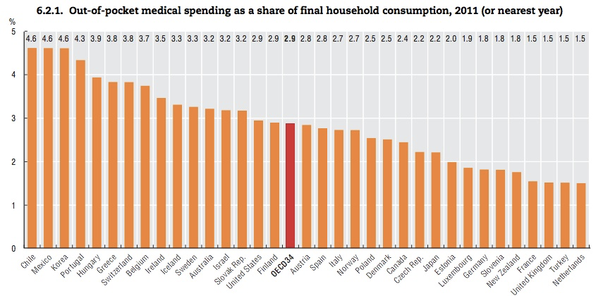
Low benefits
Notes:
Privatization
친기업적인 정부: 건보 보장성 악화 (보장성 추세)
민간보험시장 확대
최근의 현상들
의료비 상승
의료전달체계 부재

Slide 12
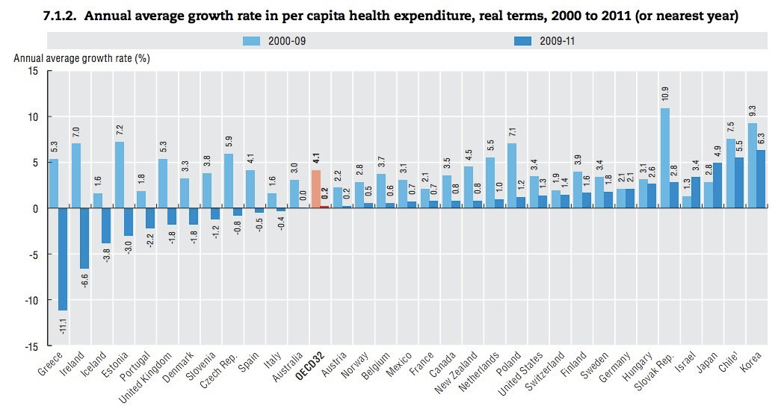
Skyrocketing health expenditure
Notes:
Privatization
친기업적인 정부: 건보 보장성 악화 (보장성 추세)
민간보험시장 확대
최근의 현상들
의료비 상승
의료전달체계 부재

Slide 13
Universalization of Medical Insurance
Corporation
with workers > 500
1977
Corporation
with workers > 300
1979
1979
Government workers
& teachers
Corporation
with workers > 100
1981
Corporation
with workers > 16
1983
Corporation
with workers > 5
1988
1988
Regional: Rural
unions
1989
Regional: City

