Slide 1
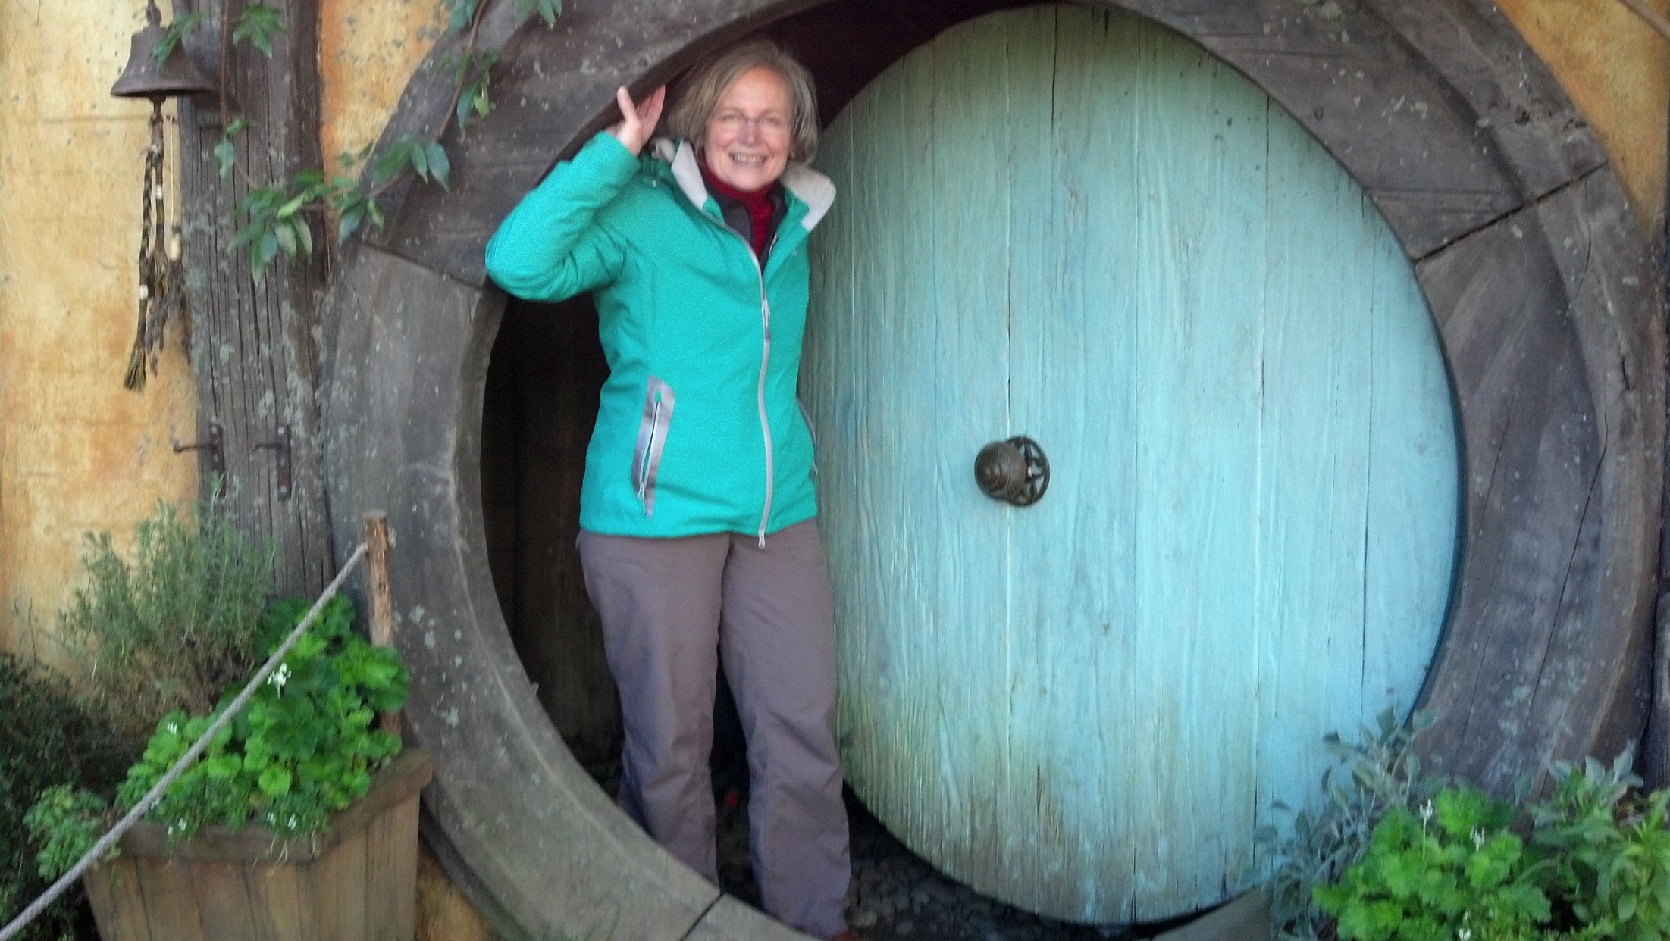
Lessons from Middle Earth Health care in New Zealand

Slide 2
The Good
Fair: all Kiwis get “a fair go” in life
Comprehensive: Most Kiwis don’t opt to add private insurance
Affordable: specialty care fully covered; varying co-pays for GP care, $5NZ for many prescription meds; accidental injury and “medical misadventures” fully covered
Accessible: 20 DHB’s funded by MoH
Collaborative: specialists encouraged (and paid) to coordinate care with GP’s
Effective: life expectancy #24 vs. US #51

Slide 3
The “Not So Good”
Comprehensive…but excludes adult dental care, optometry, much ambulance transport and treatment. Long term care asset tested. Co-pays for physiotherapy, chiropractic, complementary medicine.
GP co-pays
Wait lists for elective surgeries
Missed appointment frequency high

Slide 4
“The American system
is gloriously free
(and we cherish our liberty
and freedom more than ever)
but it is not very fair.”
David Hackett Fischer, 2012

Slide 5
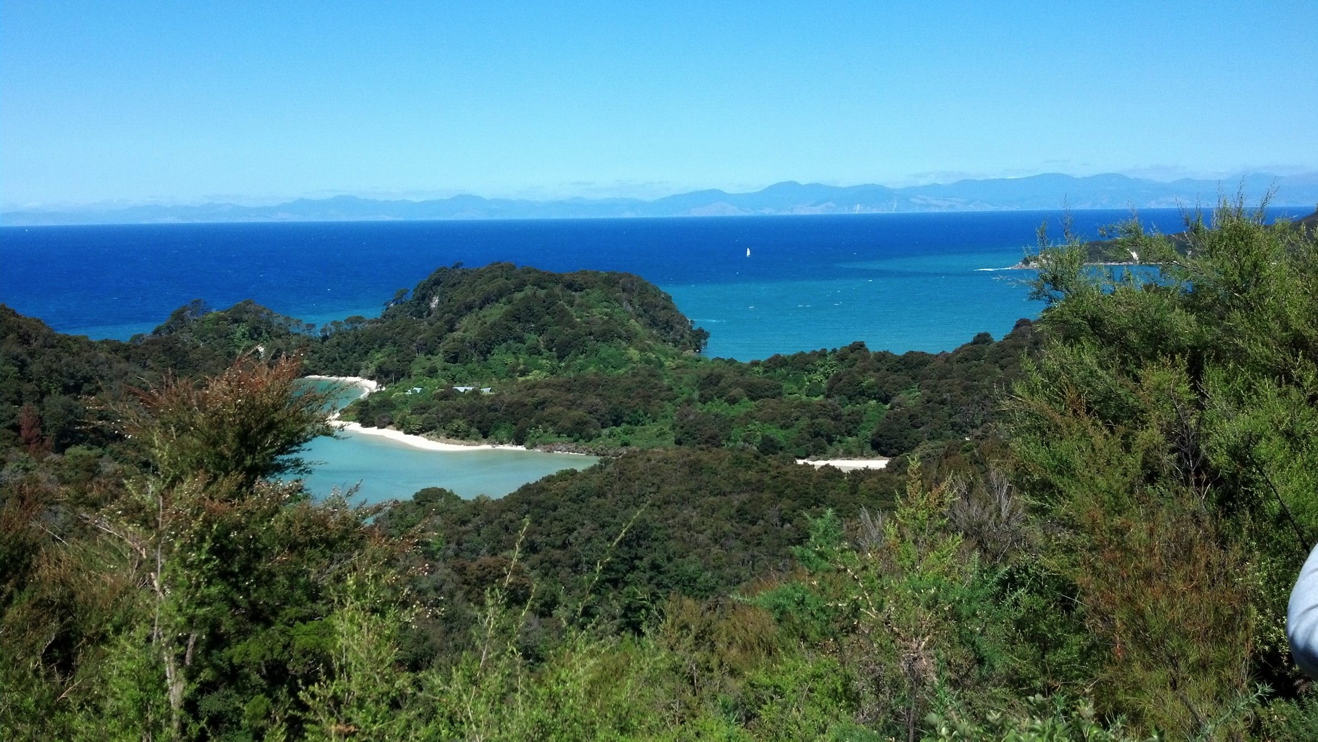
Kia Ora

