Slide 1
Effective Lobby Visits
Swathi and Shruthi Bhuma
California Health Professional Student Alliance

Slide 2
Basic Principles
“No matter what, no matter when, no matter who, any man student has a chance to sweep any woman legislator off her/his feet. Just need the right broom.”
Alex Hitchens

Slide 3
Agenda
Civics 101
Appointment Set-Up
Meeting Structure
Tasks (Pre-Meeting, Day of Meeting, Post-Meeting)
Troubleshooting
Recap & Resources

Slide 4
Civics 101
“If you can’t describe what you are doing as a process, you don’t know what you’re doing.”
W. Edwards Deming

Slide 5
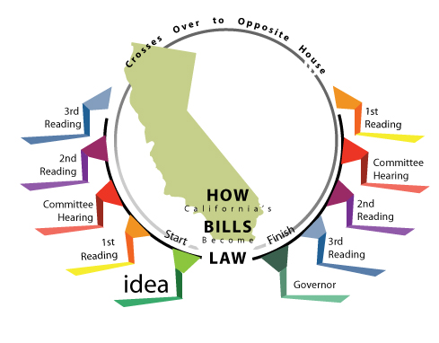
The Legislative Process (State)

Slide 6
The Legislative Process (National)

Slide 7
Appointment Set-Up
“You will never get a second chance to make a first impression.”
Will Rodgers

Slide 8
Who is YOUR Legislator(s)
Warning: This website requires your 9-Digit Zipcode.
To find out your 9-Digit Zipcode go to http://1.usa.gov/1ltSLIp

Slide 9
Logistics
Timeline | Task
T-4 Weeks | Step 1: Determine Office Scheduling Preference
T-3 Weeks | Step 2: Draft and Send Meeting Request
T-2 Weeks | Step 3: Follow up and Confirm Appointment Details
T-1 Weeks | *Step 4: For Lobby Days-Reschedule Overlapping Appointment Times & Beware of Overlapping Districts

Slide 10
Meeting Structure
“Past events have shown me that I’m not good at improvisation. However, I excel at preparation.”
Jemma Simmons

Slide 11
IIIR Method
Lobby Visit Duration: ~15 Min
IIIR Method: ~7-10 Min
Legislator’s Response/Questions: ~ 5-8 Min
Introduce
Individuals and Represented Organizations
Topic of Interest
Inquire
General Stance on Topic of Interest (In Support/Against/Undecided)
Level of Support from Legislator (Supporter/Co-Author)
Inform
Themed Spiel(s)/Argument(s) Illustrating Need and Urgency
Story + Facts + Data
Request
Action Step for Legislator
Anticipate
Interruptions
Concerns
Clarifications
Organizational History Questions
Alliances & Coalition Questions
Related Health Issues & Bills

Slide 12
Pre-Meeting Tasks
“If I am to speak for 10 minutes, I need a week for preparation; if 15 minutes, three days; if half an hour, two days; if an hour, I am ready now.”
Woodrow Wilson

Slide 13
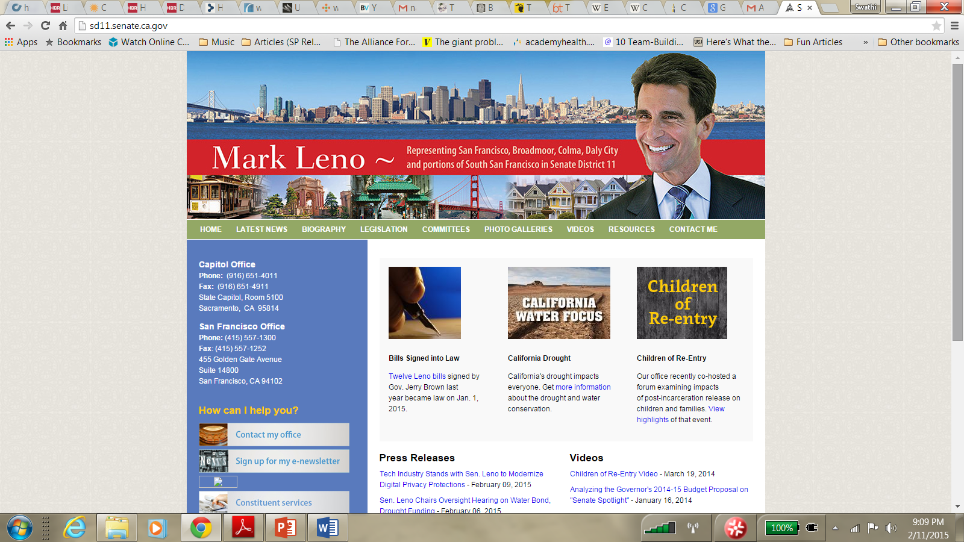
Research Legislator + Political Climate
Party Affiliation
Biographical Information
Committee Appointments
Key Issues of Concern (Platform)
Voting Record
Publically Stated Views and Options
District Demographics
Previous Lobby Day Notes
State/National Priorities and Politics

Slide 14
Sample Legislator Report Card

Slide 15
Formulate “Ask”
National or State Bill
Author/Co-Author—Will you encourage colleagues and actively promote this bill?
Supporter—Will you Co-Author?
Undecided—What information do you need to become supportive?
Opponent—What information might change your position?
State or District Financial Study
State Innovation Waiver Request

Slide 16
Assign Roles
Ideal Group Size
3-5
Team Leader (1Person)
Note-Taker (1Person)
*Story Tellers (1-2 People)
Moral/Social Justice
*Content Experts (2-3 People)
ACA vs. Single Payer
State/National Economics
Insurance Company Bureaucracy/Paperwork
Hard Hitters (Everyone)
Follow-Up/Social Media Person (1Person)
*The roles of Story Tellers and Content Experts overlap, but here we’ve split them into two categories to show what the emphasis of the message should be

Slide 17
Roles in Context of IIIR
Introduce
Team Leader
Everyone Else
Inquire
Team Leader
Inform
Story Tellers
Content Experts
Request
Follow-Up/Social Media Person
**General Roles: (1) Hard Hitters (2) Note-Taker

Slide 18
Put Together Legislator “Goodie-Bag”
Legislative Folder
Single Payer Basic Fact Sheet
Bill Fact-Sheet
Financial Study
Comparison of ACA vs Single Payer
SNaHP/PNHP Brochure
Thank You Card
Business Card/Contact Information
“The Healthcare Movie” DVD

Slide 19
Day of Meeting Tasks
“You're never ready for what you have to do. You just do it. That makes you ready.”
Flora Rheta Schreiber

Slide 20
The Big Day
Confirm Appointment Time and Group Size
Dress to Impress (Business Casual + White Coat)
Moisturize your Hands and Freshen your Breath
Final Team Pow-Wow
Go to Office at least 10 minutes early
Selfie and Social Media Time (End of Visit)

Slide 21
Post Meeting Tasks
“It was character that got us out of bed, commitment that moved us into action, and discipline that enabled us to follow through.”
Zip Ziglar

Slide 22
Follow Up
Debrief with Group
Review Note-taker’s notes
Fill out Legislative Visit Report Form (send to lead lobby day coordinator)
Discuss any requests for additional information made by the Legislative office
Send Thank You Note
Names of Everyone you met with including Legislator
Restate Issue
Thank them for commitment to ___________ action
Maintain Communication with Legislative Office

Slide 23
Troubleshooting
“If you know the enemy and know yourself, you need not fear the result of a hundred battles. If you know yourself but not the enemy, for every victory gained you will also suffer a defeat. If you know neither the enemy nor the yourself, you will succumb in every battle.”
Sun Tzu

Slide 24
Common Obstacles
Staying on Topic
Facilitation is Key
Answering “Hard” Questions
Don’t Know? Don’t BS!
Grey-Area Questions
Avoiding Analysis Paralysis

Slide 25
Recap
Appointment Set-Up
Meeting Structure
Tasks (Pre-Meeting, Day of Meeting, Post-Meeting)
Troubleshooting

Slide 26
Resources
Appointment Set Up
Phone Scripts
Email Templates
Generic Meeting Request Form
Content Preparation
IIIR Handout
Generic Legislator Report Card
Legislative Leader Checklist
Follow Up
Generic Legislative Visit Summary Form

Slide 27
Stay Involved
“No one is born a good citizen; no nation is born a democracy. Rather, both are processes that continue to evolve over a lifetime.”
Kofi Annan

Slide 28
Contact Information
SwathiBhuma@gmail.com
ShruthiBhuma@gmail.com

