Slide 1
The Uninsured

Slide 2
Uninsured All Year
Medicare/Medicaid
Millions
Data after 2013 are projected
Social Security Bul, HIAA, CPS, and CBO estimate

Slide 3
The ACA Cut Uninsurance Among Hispanics, Blacks, and Whites by ~1/3
Percent of adults 18-64 uninsured
Health Affairs 2015;34:1774

Slide 4
Medicaid: Poor Access, But Better Than Nothing

Slide 5
Medicaid Enrollment
Millions
Bureau of the Census
Data for 2015 based on CBO estimate

Slide 6
Medicaid Improved Access and Hypertension Control for the Poor
Odds ratio for Medicaid vs uninsured
Christopher, Wilper, Himmelstein, Woolhandler, McCormick – AJPH 2015
Odds ratios are adjusted for sex, age, race/ethnicity, presence of chronic conditions, disability

Slide 7
Many Specialists Won’t See Kids With Medicaid
% of Clinics Scheduling
Appointments for Children
Bisgaier J, Rhodes KV.
N Engl J Med 2011;364:2324-2333
Notes:
7
Figure 2 Clinics Scheduling Specialty Care Appointments for Children, According to Type of Insurance. Public insurance was reported by callers as the Illinois Medicaid–Children's Health Insurance Program (CHIP) umbrella program; private insurance was reported by callers as Blue Cross Blue Shield. Each of the 273 clinics was called twice (for a total of 546 calls) by the same caller, with only insurance coverage varying between the two calls: once reporting Medicaid–CHIP coverage and once reporting private coverage. Calls were made 1 month apart, and the order of the reported insurance status was randomly assigned. Asthma clinics included 38 allergy–immunology clinics and 6 pulmonary disease clinics.

Slide 8
Medicaid Managed Care Enrollment Soaring
Millions of enrollees
Sanofi Managed Care Digest, 2015
Note: Medicaid payments for managed care firms = $123.637 billion in 2013; profits = $2.4 billion
No evidence of cost savings; some evidence of worse quality

Slide 9
Underinsurance Impedes Access, Worsens Health, Bankrupts Families

Slide 10
Average Deductibles Rising
Average deductible for covered workers, single coverage
Kaiser/HRET Survey of Employer-Sponsored Benefits, 2015

Slide 11
Many Families Can’t Afford Out-of-Pocket Costs
Percent of non-poor families with liquid assets less than category
Kaiser Foundation, Consumer Assets and Cost Sharing, Based on Fed Survey, Feb 2015
31% of non-poor say they could not borrow $3,000 from relatives or friends in an emergency

Slide 12
High Deductibles Cut All Kinds of Care 150,000 Employees Lost “Cadillac” Coverage No Evidence that Patients Shifted to “Higher Value” Care
Percent utilization reduction
Brot-Goldberg et al, 6/2015
http://eml.berkeley.edu/~bhandel/wp/BCHK.pdf
Findings closely resemble those of Rand Health Insurance Experiment
Study found no evidence that patients shopped for lower prices

Slide 13
Privately Insured Skip Care Because of Cost Especially among those with high deductible plans
Percent with problems due to health costs
*Went to Urgent Care Center rather than usual PCP
Source: AP/NORC Survey, Oct. 2014

Slide 14
Uninsured and Under-Insured Delay Seeking Care for Heart Attacks
Odds ratio for delayed care*
Source: JAMA April 15, 2010. 303:1392
*Adjusted for age, sex, race, clin. charact., hlth status,
social/psych fx, urban/rural. Under-insured=had coverage
but patient concerned about cost

Slide 15
Higher Medication Co-Pays = Worse Pediatric Asthma Outcomes
Children age 5-18
Source: JAMA 2012;307:1284

Slide 16
Higher Copayments = Kids Without Care
Percentage with no physician visits in year
Source: Rand Experiment. Pediatrics 1985;75:942

Slide 17
Most of the Medically Bankrupt Had Coverage Insurance at Illness Onset
Source: Himmelstein et al. Am J Med: August, 2009

Slide 19
2005-2014 Medical Bill and Debt Problems: Back to Where We Were Pre-Recession
Percent of adults 19-64 reporting medical bill/debt problems
Commonwealth Fund Biennial Health Insurance Surveys
2005, 2010, 2012, 2014

Slide 20
Planning for Retirement? Don’t Forget Health Care Costs
“Medicare covers only 51% of health care services….
For a 65 year old couple retiring this year, the cost of health care in retirement will be $240,000.”
New York Times. Wealth Matters

Slide 21
Rising Economic Inequality

Slide 22
Change in Real Family Income 1979 - 2014
Woolhandler/Himmelstein
Analysis of data from the Bureau of the Census

Slide 23
Growing Gap in Life Expectancy by Income Dramatic gains for the wealthy; losses for lower income
Remaining life expectancy at age 50
Growing Gap in Life Expectancy by Income
National Academy of Sciences, 2015

Slide 24
Child Poverty Rates
OECD 2015

Slide 25
Incarceration Rates
Prisoners per 100,000 population
Walmsley – World Prison Population List, 10th Ed.

Slide 26
Persistent Racial Inequalities

Slide 27
Black Americans Die Younger
Life expectancy at birth
CDC, 2015 – Final Mortality Data for 2013
*Hispanics can be of any race, and Blacks and Whites include some Hispanics

Slide 28
Median Family Income
Median income
(2014 $s)
Whites
Blacks
2014
Inflation adjusted, 2014 $s
Bureau of the Census

Slide 29
Minority College Graduates’ Incomes Have Fallen
Change in median family income of college graduates, 1992-2013 (inflation adjusted)
Emmons WR. Federal Reserve.
St. Louis – August 2015

Slide 30
Driving While Black More Likely to be Searched; Less Likely to be Found with Contraband
Black Rate / White Rate
(1.0 = Equally Likely)
NY Times 10/25/2015
* Contraband found among those searched

Slide 31
Causes of Black/White Disparity In Life Expectancy
Source: MMWR 2001;50:780

Slide 32
Black Enrollment in U.S. Medical Schools
Percent Blacks in 1st Year Medical School Class
AAMC Goal
RWJ Fdn. 1987; AAMC;
JAMA Annual Medical Education Special Issue

Slide 33
Blacks in VA: No Health Disadvantage
Odds ratio for Black vs White Vets (<1 indicates lower rate for Blacks)
Kovesdy et al. Circulation 9/18/2015
Longitudinal study of 3,072,966 Vets cared for at VAs

Slide 34
Immigrants Keep Medicare Afloat
$10.1 Billion
Net contribution to Medicare Trust Fund, 2009
$3.7 Billion
-$30.9 Billion
*Adjusted for ethnicity, poverty, age, insurance status, patient/parent-reported health status
Source: Mohanty et al. Am J Public Health 2005;95:1431

Slide 35
Rationing Amidst a Surplus of Care

Slide 36
22.5% of 111,707 Defibrillator Implants Were Not Evidence-Based
Sometimes Lethal
In hospital death rate for non-evidence based ICD implant 0.6%
Cost of ICD implant ~$25,000
Note: In-hospital death rate for non-evidence-based ICD implantation was 0.6%. Cost of ICD implant ~$25,000
Source: JAMA 2011;305:43

Slide 37
Many Elective PCIs Are Inappropriate
JAMA IM 2014;174:1630
Based on 1,225,562 patients in PCI Cath Registry

Slide 38
Administrative Overhead Rising

Slide 39
Growth of Physicians and Administrators
Growth since 1970
Bureau of Labor Statistics; NCHS; Himmelstein/Woolhandler analysis of CPS
Managers shown as moving average of current year and two previous years

Slide 40
Investor-Owned Care: Inflated Costs, Inferior Quality

Slide 41
Health Industry Profits, 2014
Pharmaceuticals | $67.3 billion
Insurers | $14.0 billion
Equipment/Supplies | $7.4 billion
Pharmacy | $6.8 billion
Lab/Benefits Mgrs | $3.6 billion
Providers | $3.3 billion
Distributors/Wholesalers | $3.2 billion
Fortune 500, 2015

Slide 43
For Profit Hospitals = Lower Quality
For-Profit
Non-Profit / Government
Source: Health Affairs 2011;30:1904.
Quality rating based on Medicare’s Hospital Compare data

Slide 44
For-Profit Hospitals Cost 19% More
Lower payments
at PFP Hospitals
Higher payments
at PFP Hospitals
PFP/PNFP Payments Ratio (95% CI)
Relative payments for care at private for-profit (PFP)
and private not-for-profit (PNFP) hospitals
Source: CMAJ Devereaux et al. 170 (12): 1817.

Slide 45
For-Profit Hospitals’ Administrative Costs Are Higher
Percentage spent on administration
Himmelstein and Woolhandler
Analysis of 2011 Medicare hospital cost reports

Slide 46
For Profit Home Care: Lower Quality
Cabin, Siman, Himmelstein & Woolhandler.
Health Affairs 8/2014

Slide 47
For Profit Home Care: Higher Cost
Annual Cost per Patient
Cabin, Siman, Himmelstein & Woolhandler.
Health Affairs 8/2014

Slide 48
Hospice Care Goes For-Profit
Percent of hospices under for-profit ownership
Source: MEDPAC annual report, 2014
Profit rate: for-profits = 12.4%; non-profits = 3.2%

Slide 49
US Prescription Drug Spending
Prescription drug spending,
Billions of dollars
Source: CMS, Office of the Actuary
Note: 2014-2016 estimated

Slide 50
Drug Company Profits
Return on Revenue (%)
Fortune 500 rankings for 1995-2015
Total drug company profits, 2010 = $44.6 billion

Slide 51
Drug Companies’ Cost Structure
Marketing and Admin
35%
Manufacturing
27%
Profits
(After Taxes)
18%
R&D
13%
Source: Health Affairs 2001;20(5):136

Slide 52
For-Profit Medicare Advantage Plans: Lower Quality Ratings
Percent of plans
Modern Healthcare 10/8/2015
Analysis of CMS data

Slide 53
Investor-Owned Medicaid HMOs: Higher Administrative Costs, Lower Quality
Note: Publicly Traded = Publicly traded Medicaid-only plans
Source: McCue. Commonwealth Fund, June, 2011

Slide 54
HMO Overhead, 2015
SEC Filings/Reports to Shareholders. Data for Q1 or Q2
Calculated as 100-100(benefits/premiums)
Note Medicare/Medicaid enrollees included in some figures

Slide 55
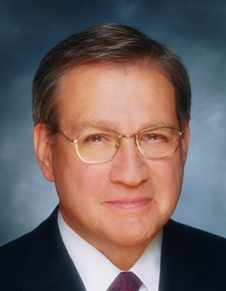
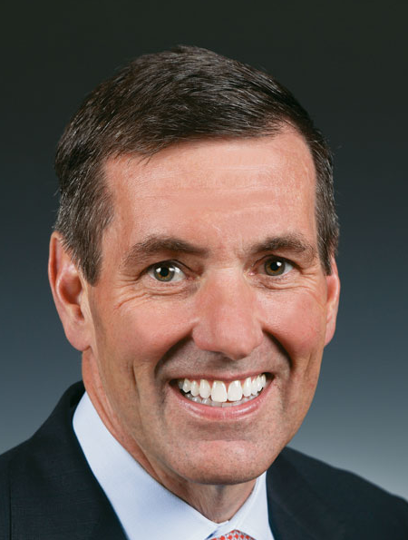
HMO CEOs’ 2014 Pay
Mark Bertolini | Joseph Swedish | Michael Neidorff
David Cordani | Steve Hemsley | Bruce Broussard
Aetna
Annual Comp:
$15.0 M
Pay/Weekday:
$57,745
Wellpoint
Annual Comp:
$8.1 M
Pay/Weekday:
$31,016
Centene
Annual Comp:
$ 28.1 M
Pay/Weekday:
$107,962
Cigna
Annual Comp:
$27.2 M
Pay/Weekday:
$104,479
United
Annual Comp:
$66.1 M
Pay/Weekday:
$254,328
Humana
Annual Comp:
$13.1 M
Pay/Weekday:
$50,319
Source: SEC filings

Slide 56
Medicare Remains Solvent But Is Threatened by Private Medicare Advantage Plans

Slide 57
Number of Years Before Medicare Trust Fund Projected to be Exhausted
Year of Estimate
Estimated Number of Years Until Funds Exhausted
Medicare Trustees Annual Reports

Slide 58
Medicare Advantage Plans’ High Overhead
Traditional
Medicare
Medicare Advantage Plans
Overhead
2.2%
Overhead
9.1%
Medical
Services
97.8%
Medical
Services
86.3%
Profit
4.5%
GAO 12/2013 and Medicare Trustees Report 2012 – Figures are for 2011
Note: MA overhead = $905/enrollee; profit = $447/enrollee
Total MA profit = $3.3 Billion

Slide 59
Despite Medicare’s lower overhead, enrollment of Medicare patients in private plans has grown because of cherry picking

Slide 60
Medicare HMO Enrollment
Medicare HMO Enrollees (millions)
CMS

Slide 61
A Few Sick People Account for Most Health Dollars
Percent of total health spending accounted for by decile
Top 2 deciles account for 78.3%
Decile of Privately Insured Americans
2001 data
Source: MEPS Data, from Thorpe and Reinhart

Slide 62
Sickest Patients Switch Out of Medicare Advantage
Percent switching out during 2011
Plan switched out of:
Health Affairs 2015;34:1675
Similar results for patients with hospital or home care use,
more marked among dual eligibles

Slide 63
Profit-Driven Upcoding Makes Accurate Risk Adjustment Impossible High cost providers inflate both reimbursement and quality scores by making patients look sicker on paper.

Slide 64
Medicare Advantage Plans Upcode When seniors joined MA Plans, their number of diagnoses jumped, boosting capitation payments
Mean number of chronic conditions coded
Geruso, Layton – NBER 2015 – W21222
Estimated MD overpayments due to upcoding
Vertical integration of insurers and doctors boosted upcoding

Slide 65
Audits Found Massive Overpayments to MA Plans
Audits of
Five Plans
Plans overstated risk score for >80% of patients
Over-Coding Is Expensive
Aetna
Humana
UnitedHealthcare
Lovelace
Over-Coding Is Common
Overcoding caused overpayment of $3,300/enrollee
Resulted in overpayments for 58% of enrollees
Only 7.5% were “under-coded”
Independence Blue Cross
Source: Schulte.
Center for Public Integrity, 7/10/15

Slide 66
95% of Plans Cheat on HEDIS Quality Measures
Medicare Advantage plans failing to cheat fall in rankings
Percent of elderly patients prescribed drugs that should be avoided
Annals of Internal Medicine 2013;159:456
Researchers compared reported HEDIS scores for high risk prescribing to actual Medicare Part D payment records for all enrollees and for enrollees sampled for HEDIS scoring

Slide 67
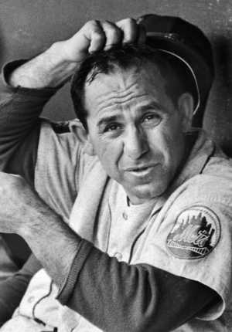
ACOs: Warmed Over Managed Care

Slide 68
ACOs’ Explosive Growth
Number of ACOs
Health Affairs Blog 10/31/13 and 3/31/15
Leavitt Partners

Slide 69
Poll: Patients Reject ACOs
“Here are two different ways Medicare could pay doctors.
Which of these do you think would be better for you?”
NEJM 2013;369:1066 – Kaiser/RWJ/Harvard Survey, 201

Slide 70
High Risk HMO Patients Fared Poorly in the RAND Experiment
HMO
Free Fee-For-Service
Source: RAND Health Insurance Experiment, Lancet 1988;1:1017
Note: High Risk = 20% of population with lowest income
+ highest medical risk

Slide 71
Depressed Patients: Fee-For-Service vs. Managed Care
Primary Care Patients
Patients Seeing Psychiatrist
# of Functional Limitations
Fee-For-Service
Managed Care
Source: Medical Outcomes Study. JAMA 1989; 262:3298
Arch Gen Psych 1993; 50:517

Slide 72
Medicare ACOs: No Savings
The 2014 ACO Experiment
196 ACOs cut Medicare’s costs
Net loss of $3 million to the Trust Fund after paying bonuses
Medicare paid $60 billion
Overall
Results
Economic Impact
353 ACOs
6 million patients
157 raised costs
Source: Kaiser Health News 9/14/15
Based on CMS 2014 ACO Performance data

Slide 73
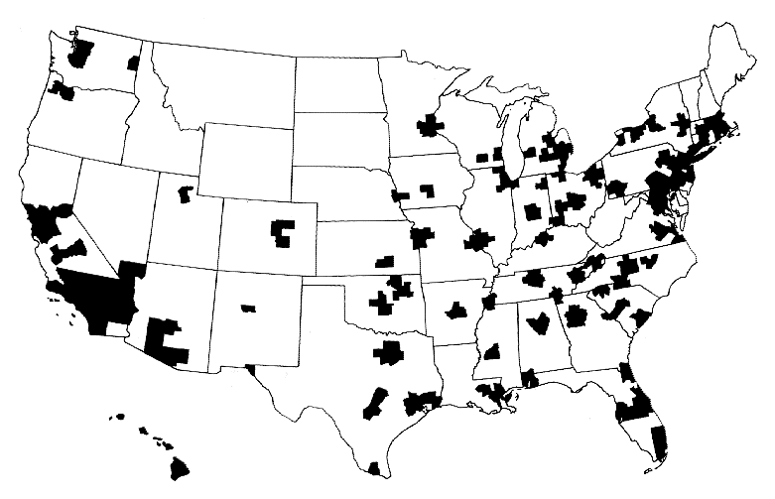
Half of Americans Live Where the Population is Too Low for Competition
A town’s only hospital will not compete with itself
NEJM 1993;328:148

Slide 74
Hospital Mergers Rising
105
93
Hospital mergers and acquisitions
76
60
60
50
54
50
Each deal may involve multiple hospitals
NY Times Aug 12 2013

Slide 75
More Doctors Are Hospital Employees
Percent of newly hired physicians employed by hospitals
Source: Medscape July 9, 2012

Slide 76
Hospital-Physician Integration Increases Costs by Raising Prices
Outpatient costs associated with greater physician/hospital integration
($s/capita)
JAMA IM 10/19/2015
Graph shows difference between MSAs at the 75th
(vs 50th) percentile in change in integration 2008-2012

Slide 77
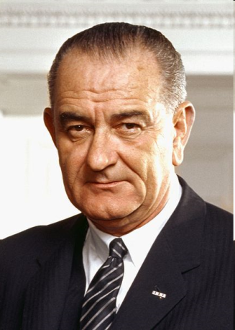
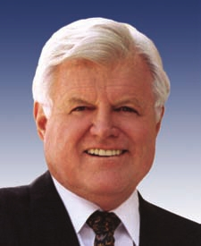
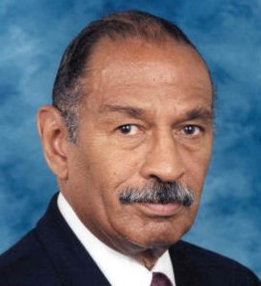
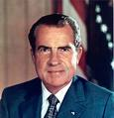
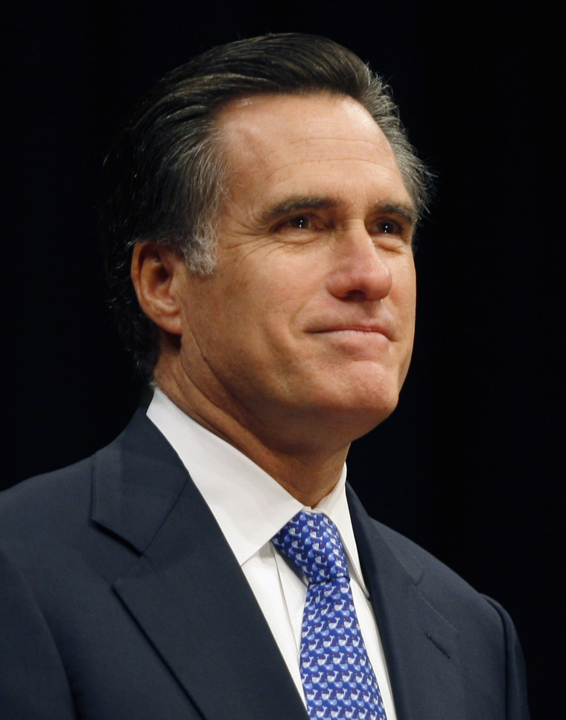
Progress(?) of US Health Reform
National Health Insurance
Medicare
Single Payer
HR 676
Employer mandate
Individual mandate
Individual mandate
Affordable Care Act
Notes:
77

Slide 78
Mandate Model Reform: Keeping Private Insurers In Charge

Slide 79
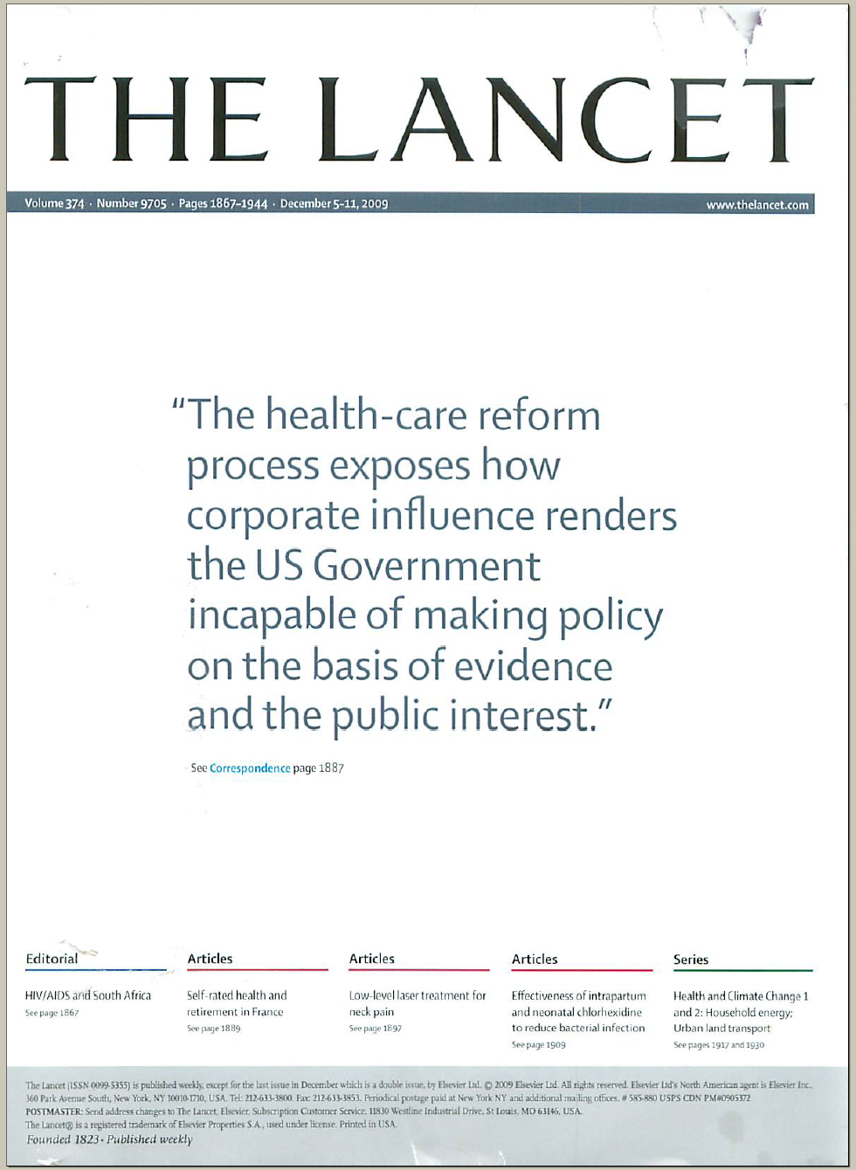
The Lancet Put It On Their Cover
“The health-care reform process exposes how corporate influence renders the US Government incapable of making policy on the basis of evidence and the public interest.”
Source: Lancet Dec 5, 2009. Cover of vol. 374.

Slide 80
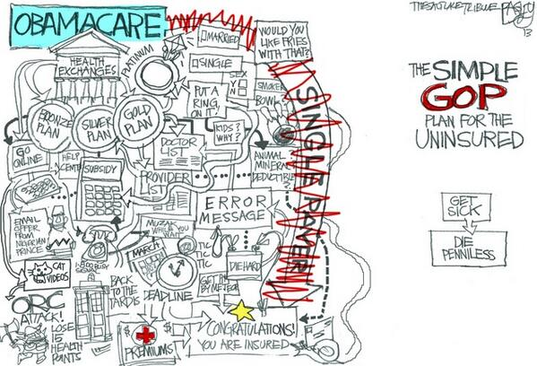

Slide 81
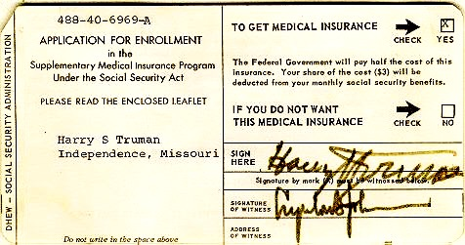
Medicare’s “Software” 18.9 million seniors enrolled within 11 months

Slide 82
Mandate Model of Reform
1. Expanded Medicaid
2. Private coverage through exchanges
Subsidies for low income
Buy-in without subsidy for others
3. Individual and Employer Mandates
4. ACOs / Managed Care
Notes:
82

Slide 83
The Toll of 24 States Opting Out of Medicaid Expansion
Estimated number who would benefit in “opt out” state
Dickman S et al. Int J Hlth Serv 2014
Ruinous medical costs=Out-of-Pocket spending >30% of income;
Depressed=screen (+) on PHQ8

Slide 84
Modest Gains in Access to Care Under the ACA
Percent of adults 19-64 who needed but did not get…
Commonwealth Fund Biennial Health Insurance Surveys
2005, 2010, 2014

Slide 85
Health Insurance Reform Under the ACA
10 essential benefits, but no standard benefit package
Eliminates co-pays and deductibles, but only on preventive services
Limits insurers’ overhead to 15-20%, but lobbying has weakened enforcement
No regulation of premiums, deductibles and co-pays
Out-of-pocket caps, but uncovered services (and in some cases) drug costs don’t count

Slide 86
ACA Makes Underinsurance the Norm (Average employer plan paid 87%)
Graphic from: http://www.whatmattersbywellmark.com/premiums.php

Slide 87
NY State Cheapest Bronze Plan (Family)
Premium: $10,539
$6,000 deductible
50% coinsurance after deductible for:
Ambulance, ED, Urgent Care
Imaging & diagnostic tests
Outpatient visits
Chemotherapy
Inpatient
Out-of-pocket maximum: $12,700 for a family with income-based adjustments …

Slide 88
ACA Exchange Plans’ High Deductibles Making Under-Insurance the New Normal
Second lowest silver plan premium for 40 year old
In NYC = $4,460
Nationally, average cost
of a silver plan for a 64 y/o non-smoker = $7,775
Average Deductible for Single Coverage
Kaiser Foundation 2015 Employer Health Benefits Survey

Slide 89
Silver Plans Restrict Patients’ Choice of Physician Particularly Cancer Specialists
All Specialties
Oncologists
Janet Weiner, LDI/RWJ Data Brief, 6/23/15
Ultra-Narrow = <25% of doctors in region; Narrow = 25-60%; Broad = >60%

Slide 90
Exchanges Add New Administrative Costs
Jurisdiction | Surcharge
Fed. Marketplace | 3.5% of premium
California | $13.95 pmpm
Colorado | 1.4% + 1.25 pmpm
Hawaii | 2% of premium (rise to 3.5% pending)
Minnesota | 3.5% of premium
Nevada | $13 pmpm
New York | Varies by region
Oregon | 3.38% of premium
Applies to Marketplace plans only, except in CO and NY where this applies to both marketplace and non-marketplace plans
Commonwealth Fund, 5/14/15 and Stateforum.org

Slide 91
ACA Will Increase Insurance Overhead by $266 Billion Over 10 Years
Insurance
Overhead
($Billions)
Himmelstein & Woolhandler analysis of
data from CMS Office of the Actuary

Slide 92
Jeb Bush’s Health Proposals
Repeal ACA
Tax credits for purchase of catastrophic coverage – same for all incomes
Modify, but maintain a "Cadillac” tax
Allow businesses that don’t provide coverage to deduct cash payments to workers who buy their own insurance
Eliminate mandated benefits
Increase amount people can contribute to tax free HSAs
Work requirement for Medicaid recipients
Block grants for Medicaid

Slide 93
Hillary Clinton’s Health Proposals
Defend the ACA, but repeal “Cadillac” tax
Tax credit of $2,500/$5,000 for individuals / families with O-O-P costs > 5% of income
Cap O-O-P costs for covered prescription drugs at $250/month
Prohibit “surprise” out-of-network bills.
Federal review of insurance rate hikes for states not doing that themselves.
Transform health care system to “reward value and quality”.

Slide 94
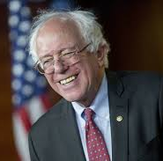
Bernie Sanders’ Health Proposals
Single payer, Medicare for all plan
Require Medicare to negotiate drug prices
Allow Canadian drug imports
Repeal “Cadillac” tax
Reduce income inequality

Slide 95
American Taxpayers Already Pay More Than People in Nations With National Health Insurance

Slide 96
Taxes Fund 2/3 of Health Spending
Himmelstein and Woolhandler
Analysis of NCHS data

Slide 97
US Public Spending per Capita for Health Exceeds Total Spending in Other Nations
$9,160
2013 healthcare spending per capita
Public includes benefit costs for govt. employees & tax subsidies for private insurance
Data are for 2014 or most recent year
Sources: OECD 2015; NCHS; Health Affairs 2002 21(4)88

Slide 98
The U.S.A. Trails Other Nations

Slide 99
Life Expectancy
Years
Note: Data are for 2013 or most recent year available
Source: OECD, 2015

Slide 100
Infant Mortality Deaths in First Year of Life Per 1,000 Live Births
Note: Data are for 2013 or most recent year available
Source: OECD, 2015

Slide 101
Maternal Mortality Deaths per 100,000 Live Births
Note: Data are for 2013 or most recent year available
Source: OECD, 2015

Slide 102
High U.S. costs don’t result from Bad Health Habits, Aging, or Overuse of Care

Slide 103
Smoking Prevalence Percent of population over age 15 who smoke daily
Note: Data are for 2013 or most recent year available
Source: OECD, 2015

Slide 104
Percent Elderly Percent of population over age 64
Note: Data are for 2014 or most recent year available
Source: OECD, 2015

Slide 105
Hospital Inpatient Days per Capita
Note: Data are for 2012 or most recent year available
Source: OECD, 2015

Slide 106
Physician Visits per Capita
Note: Data are for 2013 or most recent year available
Source: OECD, 2015

Slide 107
Nurses per 1,000 Population
Note: Data are for “professionally active nurses”
for 2013 or most recent year available.
Source: OECD, 2015

Slide 108
Medical Journal Articles 1992-2002 per Thousand Population
Source: Lancet 2004;363:250

Slide 109
Insurance Overhead
Dollars per Capita
Note: Data are for 2015 or most recent available
Figures adjusted for Purchasing Power Parity
Source: OECD, 2015; NCHS; CIHI

Slide 110
Canada’s National Health Insurance Program

Slide 111
Minimum Standards for Canada’s Provincial Programs
Universal coverage that does not impeded, either directly or indirectly, whether by charges or otherwise, reasonable access.
Portability of benefits from province to province
Coverage for all medically necessary services
Publicly administered, non-profit program

Slide 112
Canadian National Health Program Improved Access to Care
80%
70%
60%
50%
Percent of people with serious symptoms seeing a physician, before and after passage of NHP in Quebec
Before NHP
1 year after NHP
NEJM 1973;289:1174

Slide 113
Infant Mortality
Deaths per 1,000 Live Births
First Province Implements NHP
USA
Canada
Statistics Canada, Canadian Institute for Health Information, Natl Ctr for Health Statistics

Slide 114
Canadians’ Life Expectancy Growing Faster than Americans’
Life expectancy at birth
Sources: StatCan & NCHS

Slide 115
Mortality Gap by Income Is Shrinking in Canada
Remaining life expectancy at age 25
“For the most part, the differences in health status
between the highest and lowest income groups
have been shrinking over time.”
Public Health Agency of Canada
Toronto Globe and Mail, 11/8/2013

Slide 116
Health Costs as Percent of GDP
USA
Canada’s NHP Enacted
Canada
NHP Fully Implemented
2015
Statistics Canada, Canadian Inst. for Health Inf., and NCHS/Commerce Dept.

Slide 117
How Canada Controls Costs
Lower administrative costs via single payer - 16.7% of total health spending vs. 31.0% in the U.S.
Lump-sum, global budgets for hospitals
Stringent controls on capital spending for new buildings and expensive new equipment
Single buyer purchasing reins in drug/device prices
Low litigation and malpractice costs
Emphasis on primary care
Exclusion of private insurers - private plans overcharged U.S. Medicare by $34 billion in 2012
Source: Himmelstein & Woolhandler
Arch Intern Med, December, 2012

Slide 118
Hospital Billing and Administration
Dollars per capita, 2015
PPP adjusted
Source: Woolhandler/Himmelstein/Campbell
NEJM 2003;349:769 (updated)
Health Affairs 09/2014

Slide 119
Physicians’ Billing and Office Expenses
Dollars per capita, 2015
Source: Woolhandler/Himmelstein/Campbell
NEJM 2003;349:769 (updated 2015)
Excludes dentists and other non-physician office-based practices

Slide 120
Overall Administrative Costs
Dollars per capita, 2015
Source: Woolhandler/Himmelstein/Campbell
NEJM 2003;349:769 (updated 2015)
Himmelstein et al. Health Aff 09/2014

Slide 121
2015 Difference in Health Spending Per Capita
Woolhandler/Himmelstein/Campbell NEJM 2003;349:769 (updated 2015).
Himmelstein et al, Health Affairs 9/29; NCHS; CIHI; PPP adj.

Slide 122
Few Canadian Physicians Emigrate
Net loss (number moving abroad – number returning)
A negative number indicates that more physicians returned from abroad then moved abroad
Source: Canadian Institute for Health Information

Slide 123
Canadian Physicians’ Incomes 2013 – 2014
Specialty | Income
Family Medicine | $275,296
Internal Med | $381,776
Pediatrics | $299,399
Psychiatry | $255,794
Dermatology | $434,163
Specialty | Income
OB-GYN | $485,407
General Surgery | $443,188
Thoracic Surgery | $563,263
Ophthalmology | $584,150
All Canadian physicians: $328,640
Canadian Institute for Health Information
Figures are in Canadian $

Slide 124
Canadian Malpractice Insurance Costs 2016 Data. Canadian Dollars
Specialty | Ontario* | Quebec | Other Provinces
Family Med | $5,784 | $1,923 | $3,624
Psychiatry | $6,648 | $2,273 | $4,152
Cardiology | $6,648 | $2,773 | $4,152
Anesthesia | $16,908 | $6,108 | $10,812
Neurosurgery | $71,484 | $20,889 | $41,232
Obstetrics | $97,776 | $34,204 | $55,140
*Ontario reimburses physicians for premiums above 1986 level
Source: Canadian Medical Protective Association
www.cmpa-acpm.ca

Slide 125
What’s OK in Canada?
Compared to the USA…
Life expectancy 2 years longer
Infant deaths 25% lower
Universal comprehensive coverage
More physician visits, hospital care; less bureaucracy
Quality of care equivalent to insured Americans’
Free choice of doctor and hospital
Health spending half of USA level

Slide 126
What’s the Matter in Canada?
The wealthy lobby for private funding and tax cuts; they resent subsidizing care for others.
Result: government funding cuts (e.g., 30% of hospital beds closed during the 1990s) causing dissatisfaction and waits for care.
USA and Canadian firms seek profit opportunities in health care privatization
Conservative foes of public services own many Canadian newspapers
Misleading waiting list surveys by right wing Fraser Institute

Slide 127
The Rising Popularity Of National Health Insurance
“Who should provide coverage?”
1979
2009
Government
40%
Private
Enterprise
48%
Government
59%
Private
Enterprise
32%
Don’t
Know
12%
Don’t
Know
9%
Source: CBS News / New York Times Poll, Feb. 1, 2009

Slide 128
Many Who Oppose ObamaCare Prefer Single Payer
Source: NY Times based on CNN/ORC Poll May 17-18 2013
Figures don’t add to 100% because some had “no opinion”

Slide 129
Massachusetts Doctors Support Single Payer
Source: Massachusetts Medical Society Survey. Oct. 2012

Slide 130
Maine Doctors Favor Single Payer
“Would you prefer to make improvements to the current public/private system or a single payer system?”
Source: Maine Medical Association, 2014

Slide 131
A National Health Program for the USA

Slide 132
National Health Insurance
Universal – covers everyone
Comprehensive – all needed care, no co-pays
Single, public payer – simplified reimbursement
No investor-owned HMOs, hospitals, etc.
Improved health planning
Public accountability for quality and cost, but minimal bureaucracy
Proposal of the Physicians Working Group for Single Payer NHI
JAMA 2003;290:798

Slide 133
Funding for the NHP
Revenue Sources
NHP
Fund
Recipients of Money
Medicare and Medicaid
Hospital Operating Costs
Hospital Capital Costs
State /Local Governments
HMOs
Employers
Fee-for-Service Physicians
Private Insurance Revenues
Home Care Agencies
New Taxes
Long-Term Care
Source: NEJM 1989;320:102

Slide 134
Hospital Payment Under an NHP
Hospitals remain privately owned.
Capital purchases/expansion budgeted separately based on health planning goals.
Negotiated global budget for operating costs. Operating funds cannot be diverted to capital.
Himmelstein and Woolhandler. NEJM 1989;320:102

Slide 135
Three Options for Physician and Ambulatory Care Payment Under the NHP
Fee for
Service
Mandatory assignment
Simplified negotiated fee schedule
Capitation for Institutions
With Salaried Docs
Free disenrollment
Capitation for operating costs, not capital purchases, profits or doc incentives
No selective enrollment period
Inpatient care under hospital’s global budgets
Globally Budgeted Institutions
Hospitals
Clinics
Home care agencies
Institutions with salaried physicians
Source: Himmelstein and Woolhandler.
NEJM 1989;320:102

Slide 136
America Can Do This.
Excellent hospitals, empty beds
Enough well-trained professionals
Superb
research
Current spending
is sufficient
We already have what it takes

