Slide 1
Can’t Afford to Ignore Corruption
Ostrich Mentality (a.k.a. the Anechoic Effect)
Attitude toward (reports of) corruption, COI, more subtle threats to professionalism
May differ from attitudes about obvious threats
Unwary clinicians could be duped by subtlety of threats of corruption, COI
May represent to their patients that corruption doesn’t exist, or doesn’t affect their health.

Slide 2
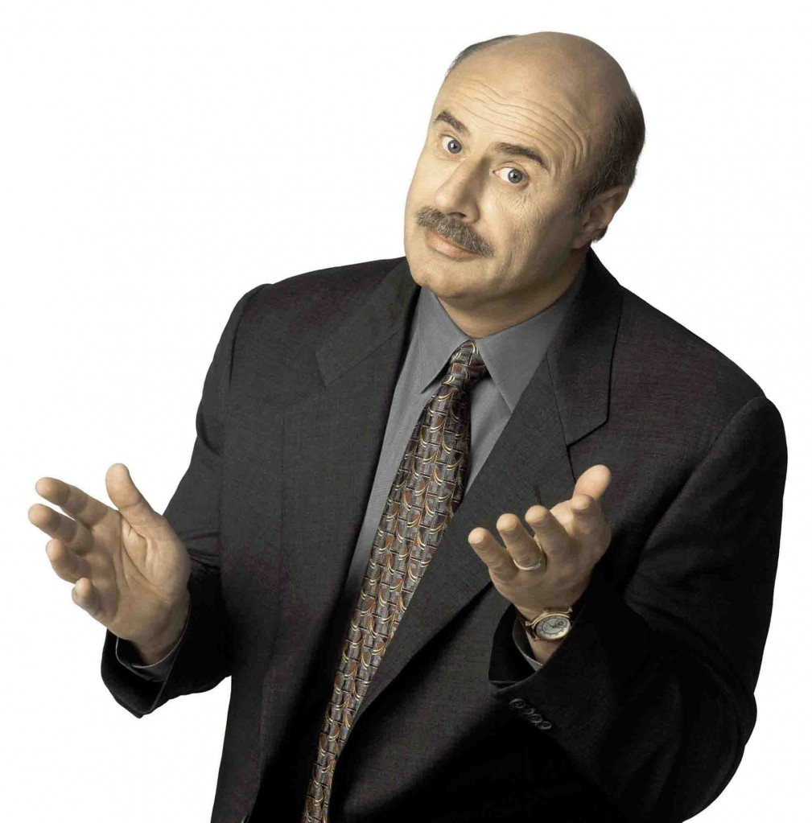
Dr. Phil:“How’s that (ignoring COI, Corruption) workin’ for‘ya?”
What’s YOUR answer to the question “Is my colleague, boss, and/or institution possibly corrupt”?

Slide 3
The Robber Barons
John D. Rockefeller Andrew Carnagie Cornelius Vanderbilt JP Morgan

Slide 4
Why no Public Outcry to Rampant (Health Care) Corruption in America? “The Age of Acquiescence”
Book proposes two “Gilded Ages”, i.e., rampant wealth inequality, often from ill-gotten gains
First: between end of Civil War and market crash 1929
Second: NOW
US Gini index, 2010=41.1
Gini index of 0 represents perfect equality, while an index of 100 implies perfect inequality.
http://data.worldbank.org/indicator/SI.POV.GINI
In 2014, 85 people controlled half the world’s wealth
By Jan 2015, it was down to 80
Book posits reasons for the difference in public response to the two Gilded Ages
THE AGE OF ACQUIESCENCE: The Life and Death of American Resistance to Organized Wealth and Power. Steve Fraser. 470 pp. Little, Brown & Company. $28.

Slide 5
Why no Public Outcry to Rampant Corruption in America? “The Age of Acquiescence”
“It is this imaginative capacity that is missing from our second Gilded Age, …The latest inequality chasm has opened up at a time when there is no popular memory — in the United States, at least — of another kind of economic system.
…we find ourselves fully within capitalism’s matrix.
So while we can demand slight improvements to our current conditions, we have a great deal of trouble believing in something else entirely.”

Slide 6
Ostrich Mentality = Anechoic Effect = Age of Acquiescence

Slide 7
End of the Gilded Age?
“A new era of rebellion and transformation” might yet be possible ….
Student-debt resisters
Fast-food and Walmart workers fighting for a living wage
Regional campaigns to raise the minimum wage to $15 an hour
Various creative attempts to organize vulnerable immigrant workers.
Occupy Wall Street
DOCTORS CRYING OUT AGAINST CORRUPTION, TO OBTAIN JUSTICE FOR THEIR PATIENTS?
NY Times Sunday Book review of “The Age of Acquiescence” by Steve Fraser. Mar 16, 2015
http://www.nytimes.com/2015/03/22/books/review/the-age-of-acquiescence-by-steve-fraser.html?_r=1
PNHP?

Slide 8
Time for Action
At minimum, every physician and organization should add combatting corruption and COI to its agenda, and step up efforts and funding toward this effort.
Maybe a new organization is needed.
At maximum, we need a wholesale change in health care delivery systems to avoid over-concentration of power and wealth → corruption if we want to see corruption diminish.

Slide 9
Caution: The Risks of the Health Care Revolving Door
In politics, the "revolving door" is a movement of personnel between roles as legislators and regulators and the industries affected by the legislation and ...
Wikipedia

Slide 10
A New Kind of “Revolver”?
Single payer system will not automatically protect against current health care corruption and COI.
Even a single payer system could result in a revolving door of officials going back and forth from government→non-profits/academia→government
Each “revolver” with intellectual and possible financial conflicts of interest.
Therefore each potentially corruptible.

Slide 11
How will PNHP protect against corruption in a single-payer system?

Slide 12
Possible Protections from the Revolver
Time
2-5 year ban on serving in government agency that regulates your industry sector (health care)
2-5 year (voluntary?) ban on serving in industry sector (health care) you just regulated

Slide 13
Possible Protections from the Revolver (cont’d)
Balance of personnel in government agencies, leadership, oversight
Similar to IOM’s recommendation about composition of guideline panels
Composition of government oversight agencies can have no more than (20%?) of people with even former industry (or non-profits, or academia) ties
Consider agency or panel head with no prior content expertise but expertise and leadership in another sector
Recognizes that each stakeholder sector-- industry, non-profits, academia, has content experts
Acknowledges that no one is conflict-free

Slide 14
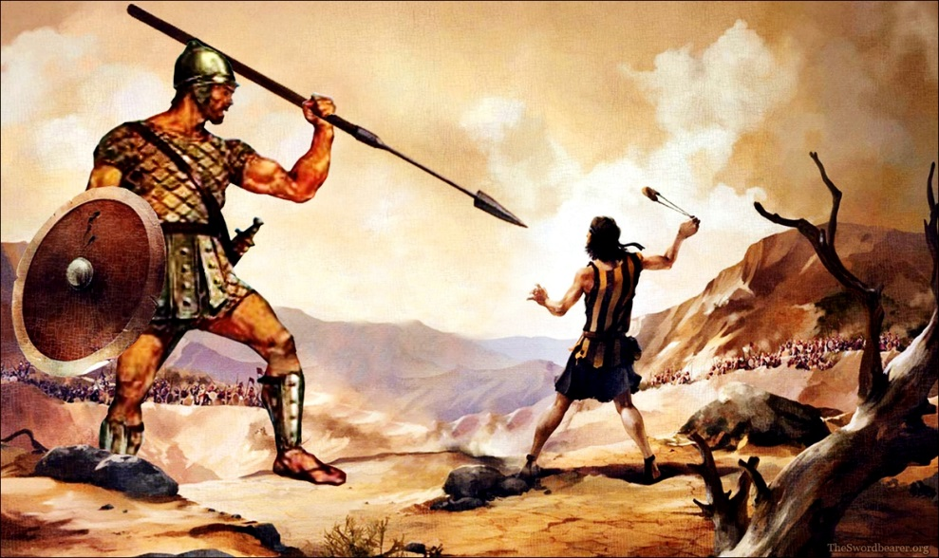
Killing Goliath
Poses, via email, 3/6/15:
“They [the new Robber Barons] are likely to work very hard to maintain the status quo. They already have a lot of power and money with which to do so. And if anyone really tries to oppose them, it won't be fun. "
Smith reply:
“But David DID kill Goliath, or at least Malcolm Gladwell and I think so.”
David and Goliath: Underdogs, Misfits, and the Art of Battling Giants. Malcolm Gladwell . Little, Brown and Company on October 1, 2013

Slide 15
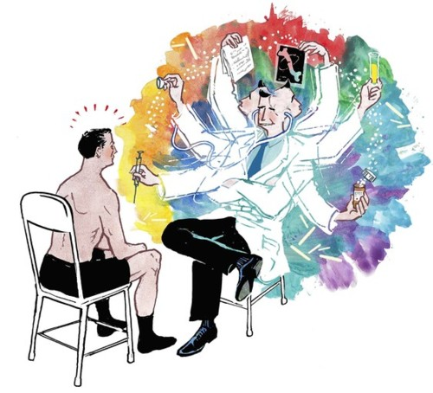
HELP US BRAINSTORM

Slide 16
Two Types of Solutions to Combat Health Care Corruption
Solutions involving mainly individuals
Solutions involving organizations

Slide 17
Solutions Involving Mainly Individuals
Acting within themselves (inward-focused)
Acting on their environment (outward-focused)

Slide 18
One Example List of Solutions Involving Individuals
Minimize personal conflicts of interest
Recognize the imperfect market
Implement and protect physician professionalism and autonomy
Be aware of and ready to battle corruption, pseudoevidence and stealth marketing
Expose corruption
E.g, become a whistleblower!
Expose vested interests

Slide 19
Minimize personal COI
How ‘bout them ‘70s?:
“in the practice of medicine a physician should limit the source of his professional income to medical services actually rendered by him, or under his supervision, to his patients”
“the practice of medicine should not be commercialized, nor treated as a commodity in trade”

Slide 20
Recognize the Imperfect Market
You are your patient’s agent
Consumers usually often don’t understand their choices in medicine
Consumers don’t usually see pernicious, corrupt influences on physicians, organizations, their own health
Example: Patient disease interest groups unwittingly led by pharma to promote dodgy drugs

Slide 21
The Medical Professionalism Charter
Maintain appropriate relations with inherently vulnerable, dependent patients who could be exploited for personal financial gain or other advantages
Maintain the integrity and appropriate use of scientific knowledge and technology
specifically condemns the creation and use of pseudoevidence.
Acknowledge the presence of conflicts of interest
Do not allow personal or corporate interests to compromise your duty to protect the patient

Slide 22
Be aware of and ready to battle corruption, pseudoevidence and stealth marketing
Internal integrity in applying evidence, prescribing, testing
Protect patients from fraud, abuse
Familiarize yourself with these cases
Battle the tendency to ignore them

Slide 23
Expose Corruption, Expose Vested Interests
Become a whistleblower!
Give courses like this one!

Slide 24
Solutions Involving Mainly Organizations
Acting within themselves (inward-focused)
Acting on their environment (outward-focused)

Slide 25
Solutions Involving Organizations
New Organization(s) to combat health care corruption
Existing Health Care Organizations
Combat existing internal corruption within organization
Develop arms to combat health care corruption
Reform or remove corrupt organizational leaders
Press, Watchdog organizations
Conduct Investigative journalism, investigations, reports
Consumer Organizations
Advocate against corruption, investigate corruption, apply pressure for reform
Government
Pass Legislation limiting corruption
Reform existing government regulations re: corruption
Companies, employers, unions, etc
Use buying power and bully pulpit to combat corruption

Slide 26
Example List of Inward-focused Organizational Solutions
Build Trustworthy Guidelines
Organizational COI Policies
Protect physician professionalism and autonomy within your organization
E.g., whistleblowers
Combat power and market asymmetry by arming patients with impartial information

Slide 27
Build Trustworthy Guidelines
Guideline makers should be free from COI as much as possible
Stakeholders should be kept from influencing guideline makers
See IOM Guideline Panel Recommendations

Slide 28
Organizational Ethics Policies
Code of conduct/ethics based on the organization’s core values
Professional practice standards interpreting the code’s principles
Procedures for managing conflicts of interest situations
Procedures for offering and accepting gifts and courtesies
Criteria for the proper use of organizational assets and authority
Prohibition of harassment and discrimination in the workplace
Criteria for protected reporting of unethical or illegal behavior
Rights of clients or patients to obtain service, including complaint procedures
Obligations for accountability and transparency
Standards for dealing with confidential and privileged information
Constraints on ancillary and post-separation employment
Standards for providing reasons for administrative decisions.

Slide 29
Organizational Ethics Policies: Activities
Specific training:
the organization’s integrity system
specific anticorruption measures,
harassment-free workplaces, non-discrimination principles,
financial management and audit, integrity in procurement practices, donor relations,
personal and institutional conflict of interest
accountability, responsibility, procedural fairness, and strategic problem-solving
Regular reporting to boards and executives
Independent, external scrutiny of policies
Protected reporting of improper conduct
Genuine whistleblowing must be effectively endorsed and protected
Procedures for the sanctioning of improper conduct and failure to meet relevant standards by staff

Slide 30
Summary of IOM COI Recommendations
Enforceable conflict of interest policies for clinical care, academic organizations, reinforced by accrediting organizations, journals, health insurers, government
Full disclosure of conflicts of interest to leaders of the institution, public reporting by commercial sources of money
Conflicts of interest banned for those who do research on humans, and who write practice guidelines
Gifts from, educational or scientific presentations of publications controlled or ghost-written by, excessive consulting fees from, unlimited access to representatives from industry banned
New system of funding continuing medical education free from industry influence
Academic institutions should develop educational programs about conflicts of interest
Government should support research about conflicts of interest

Slide 31
Evaluation of Implementation of IOM Recommendations
Enforceable conflict of interest policies for clinical care, academic organizations, reinforced by accrediting organizations, journals, health insurers, government –A FEW ORGANIZATIONS HAVE INCOMPLETE, PERHAPS WEAK POLICIES
Full disclosure of conflicts of interest to leaders of institution, public reporting by commercial sources of money – NOT CLOSE, BUT SUNSHINE LAW PASSED AS PART OF HEALTH REFORM
Conflicts of interest banned for those who do research on humans, and who write practice guidelines – NOT DONE
Gifts from, educational or scientific presentations of publications controlled or ghost-written by, excessive consulting fees from, unlimited access to representatives from industry banned – BITS AND PIECES IN A FEW INSTITUTIONS
New system of funding continuing medical education free from industry influence – NOT DONE
Academic institutions should develop educational programs about conflicts of interest – RARE AS HENS’ TEETH
Government should support research about conflicts of interest –NOT DONE

Slide 32
What the IOM Did Not Say
All conflicts should be disclosed publicly in detail
Any conflicts that affect education, public health, health policy should be banned
Leaders’ conflicts should be treated as more severe than lower-level professionals, staff, and students

Slide 33
Protect Physician Professionalism and Autonomy Within Your Organization
What is your organization’s funding profile?
Should the leaders adjust it? (Organizational Integrity Check)
Mostly pharma? Other large organizations
Mostly individuals?
Do individuals or other large organizations unduly influence the organizational agenda?

Slide 34
Protect Physician Professionalism and Autonomy
British House of Commons
recommended realignment of relationships between the pharmaceutical industry and government, regulators, doctors, the health service, and patients.
Smith R (2005) Curbing the Influence of the Drug Industry: A British View. PLoS Med 2(9): e241 DOI: 10.1371/journal.pmed.0020241
“a fundamental review of drug development, marketing, and prescribing practices.”
House of Commons health Committee (2005) The influence of the pharmaceutical industry. Available: http://www.parliament.the-stationery-office.co.uk/pa/cm200405/cmselect/cmhealth/42/42/pdf. Accessed 15 June 2005.

Slide 35
Arm Patients with Impartial Information
About criminal elements in health care organizations
Example: Health Care Renewal
About therapies
Example: clinicaltrials.gov, USPSTF, consumer reports (sometimes)

Slide 36
Organizations Related to Fighting Corruption
(Membership) Organizations devoted exclusively to combatting health care corruption
NONE
FIRM is a foundation but not an organization
Organizations with missions inclusive of or related to combatting health care corruption
Transparency International
Pharmed Out
Right Care Alliance
PNHP?

Slide 37
Foundation for Integrity and Responsibility in Medicine (FIRM): NOT a membership Organization
Foundation for Integrity and Responsibility in Medicine (FIRM), [www.firmfound.org],
blog sponsored by FIRM [http://hcrenewal.blogspot.com]
voluntary watchdog function
One-off conference in Phila 5 yrs ago

Slide 38
Transparency International https://www.transparency.org
Started in 1993
Now present in more than 100 countries
Vision: a world in which government, politics, business, civil society and the daily lives of people are free of corruption
Achievements to date:
the creation of international anti-corruption conventions
the prosecution of corrupt leaders and seizures of their illicitly gained riches
national elections won and lost on tackling corruption
companies held accountable for their behavior both at home and abroad.

Slide 39
Transparency International https://www.transparency.org
GLOBAL REACH, LOCAL KNOWLEDGE
>100 national chapters worldwide
International secretariat in Berlin
Work with partners in government, business and civil society to put effective measures in place to tackle corruption
INDEPENDENT AND ACCOUNTABLE
Politically non-partisan
Place great importance on independence
No donor has any input into Transparency International’s policies
Sources of funding are made transparent as is spending
CORRUPTION REPORTS
By topic
By country

Slide 40
Transparency International World Health Day
“Corruption poses a massive threat to health.
Whether it’s denying treatment to those who can’t afford a bribe or undermining the global fight to stop Ebola, the actions of the corrupt are endangering the health and wellbeing of millions of people.
Transparency International chapters are working worldwide to expose this abuse and call those responsible to account.
To mark World Health Day, here are some stories of health corruption-busting from around the world… ”
Posted 7 April 2015 under “BUSTING HEALTH CORRUPTION AROUND THE WORLD”

Slide 41
Transparency International’s Global Corruption Report
Any cure should start with maximum transparency.
Codes of conduct need to be adopted by health workers and private sector companies.
Any transgressions have to be rigorously prosecuted.
Whistleblowers from all sectors should be protected.
Corruption in health care costs lives.Anonymous. Lancet 2006; 367: 447.

Slide 42
PharmedOut http://www.pharmedout.org
Georgetown University Medical Center project
Dr. Adriane Fugh-Berman
Advances evidence-based prescribing
Educates healthcare professionals about pharmaceutical marketing practices.
Promotes evidence-based medicine by providing slideshows, videos, events, and links to pharma-free CME courses.

Slide 43
PharmedOut http://www.pharmedout.org
Goals
Document and disseminate information about how pharmaceutical companies influence prescribing
Foster access to unbiased information about drugs
Encourage physicians to choose pharma-free CME
Activities
Lectures at Grand Rounds, meetings, medical student events, and conferences
Next: The Real Risks of Rx Drugs
June 11-12, 2015, Georgetown University, Washington, DC.
Annual Reports since 2010
Newsletter

Slide 44
RIGHT CARE Alliance/ Lown Institute
Network of clinicians, patients, and community leaders
Aims to reduce overuse, underuse, and misuse of medical tests and treatments in the health care delivery system
Aims to restore the clinician-patient relationship
918 signators to declaration
as of 4/8/15
when I signed.
http://lowninstitute.org
A declaration, a web site, an annual meeting

Slide 45
"Power tends to corrupt, and absolute power corrupts absolutely..”
John Emerich Edward Dalberg-Acton, 1st Baron Acton, KCVO, DL (10 January 1834 – 19 June 1902)—known as Sir John Dalberg-Acton, 8th Bt from 1837 to 1869 and usually referred to simply as Lord Acton—was an English Catholic historian, politician, and writer.
http://en.wikipedia.org/wiki/John_Dalberg-Acton,_1st_Baron_Acton

Slide 46
The Consequences of Acquiescence
First they came for the Socialists, and I did not speak out—Because I was not a Socialist.
Then they came for the Trade Unionists, and I did not speak out—Because I was not a Trade Unionist.
Then they came for the Jews, and I did not speak out—Because I was not a Jew.
Then they came for me—and there was no one left to speak for me.
Pastor Martin Niemöller (1892–1984) about the cowardice of German intellectuals following the Nazis’ rise to power
http://en.wikipedia.org/wiki/First_they_came_...
Niemöller at The Hague's Grote of Sint-Jacobskerk in May 1952.

