Slide 1
A Sickly Democracy Money Politics, Healthcare and the Presidential Campaign
Robert Weissman, Public Citizen PNHP, October 31, 2015 Washington, DC

Slide 3
Notes:
http://thehill.com/policy/healthcare/229959-majority-still-support-single-payer-option-poll-finds

Slide 4
Why not?

Slide 5
“I will tell you that our system is broken. I gave to many people, before this, before two months ago, I was a businessman. I give to everybody. When they call, I give. And do you know what? When I need something from them two years later, three years later, I call them, they are there for me.”

Slide 6
Overview
The Post-Citizens United World
Dark Money, Plutocracy and the new campaign culture
Financing the 2016 Election
Presidential Candidate Healthcare Policy
Opportunities

Slide 7
The Post-Citizens United World

Slide 10
The Money Explosion
2014 officially reported cost: $4 billion.
Outside spending in 2012: close to $1 billion.
Dark Money: Almost all corporate money was secret.

Slide 11
Outside Money Explosion

Slide 12
Dark Money Skyrockets

Slide 15
$889 Million.

Slide 16
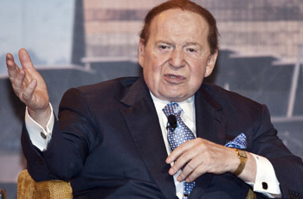
Plutocracy
Top 100 = 75% of Super PAC donations
Sheldon Adelson: ready to “double” his donations. “I’ll spend that much and more. Let’s cut any ambiguity.”

Slide 17
153 families

Slide 18
Campaign Contribution Inequality
Adam Bonica and Jenny Shen
Notes:
http://www.washingtonpost.com/blogs/monkey-cage/wp/2014/04/23/the-rich-are-dominating-campaigns-heres-why-thats-about-to-get-worse/

Slide 19
The New Campaign Culture

Slide 20
The New Campaign Culture
No time for campaigning
Obama: 221 fundraisers, 101 campaign rallies
“For long stretches of the summer and fall, Mr. Romney was so busy with fundraisers that he often did no more than one public event a day.”
Massive Negative Ads
85 % of expenditures by top 15 SuperPACs

Slide 21
Crossroads Negative Ad Flurry

Slide 22
You get what you pay for

Slide 23
Congressional Priorities
Bipartisan support for 21st Century Cures Act
Riders to bar OSHA from issuing a new silica rule, undermine FDA regulation of tobacco products, block FDA from stronger regulation of generic drug safety, and much much more.

Slide 24
But you can’t always get what you want

Slide 25
What Americans Do Want
Raise the minimum wage (69 percent)
They want policies to advance income and wealth equality (2-1)
Americans oppose more NAFTA-style trade agreements (more than 201)
Break up the giant banks (2-1)
Americans want investment in our schools, on sustainable transportation and infrastructure. (72 percent “rather than worry about long-term debt”)
They want policies to prevent catastrophic climate change (74 percent “substantial action”)
They want to protect—and improve—Social Security and Medicare. (87 percent)

Slide 26
The Rich Really Are Different
View | Top 1 percent | General public
I favor cuts in Medicare, education and hiways to reduce budget deficits | 58 | 27
Govt has essential role in regulating the market | 55 | 71
I’m willing to pay more taxes to fund healthcare for all | 41 | 59
Govt should spend what is necessary to ensure all children have good public schools | 35 | 87
Govt should provide a decent standard of living for the unemployed | 23 | 50
Govt should provide jobs to everyone who can’t find one in the private sector | 8 | 53
Notes:
Benjamin Page, Larry Bartels, Jason Seawright, Democracy and the Policy Preference of Wealthy Americans, Perspectives on Politics, vol 11 (march 2013)

Slide 27
Deep corruption
Who the candidates consort with
Who they are obligated to
Outside spending framing of campaigns
The threats that outside spenders can make on policy
The convergence of campaign spending and lobbying
The new power of the oligarchs

Slide 28
Is there hope? What can we do?

Slide 29
Reform Agenda
Disclosure
Executive Order: Govt contractors must disclose campaign spending
SEC Rule: Public companies must disclose campaign spending
Public Financing
Constitutional amendment campaign

Slide 31
Financing the 2016 election

Slide 32
2016 Race: Campaigns & Super PACs

Slide 33
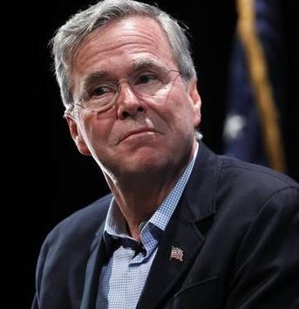
Right to Rise (Bush) By Industry

Slide 34
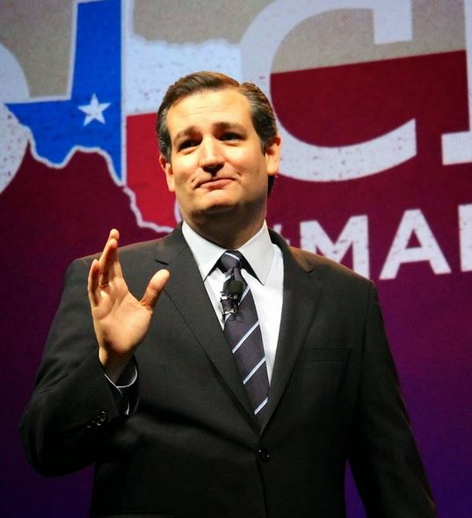
Cruz Super PACs
Keep the Promise I
Keep the Promise II

Slide 35
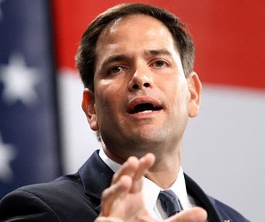
Cruz/Rubio Super PACs
Keep the Promise III
Conservative Solutions

Slide 36
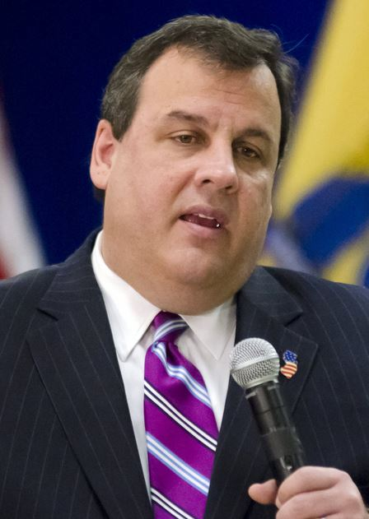
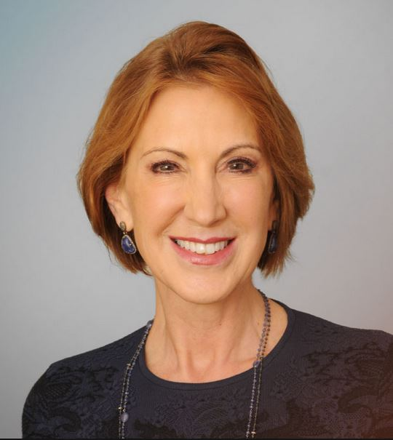
Christie/Fiorina Super PACs
America Leads
Carly for America

Slide 37
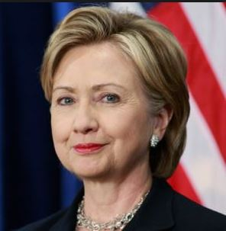
Priorities USA (Clinton) by industry

Slide 38
Presidential candidate healthcare policy

Slide 39
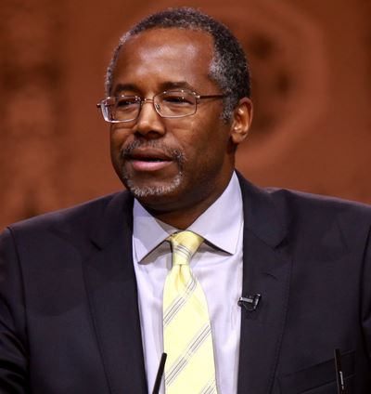
Carson
Carson would eliminate the program that provides health care to 49 million senior citizens, as well as Medicaid, and replace it with a system of cradle-to-grave savings accounts which would be funded with $2,000 a year in government contributions.
Notes:
http://www.politico.com/story/2015/10/ben-carson-medicare-medicaid-215055#ixzz3q3YAh3bb

Slide 40
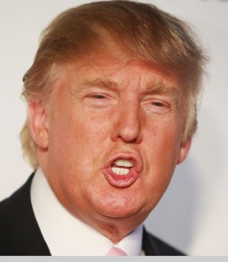
Trump I
Donald Trump says he agrees with fellow Republican presidential candidate Dr. Ben Carson, who has suggested that Health Care Savings Accounts (HSA) could render Medicare unnecessary.
“I’m OK with the savings accounts. I think it’s a good idea; it's a very down-the-middle idea. It works. It's something that's proven,” Trump said.
Notes:
http://abcnews.go.com/Politics/donald-trump-views-medicare-program-worked/story?id=34759891

Slide 41
Trump II
“Abolishing Medicare, I don't think you'll get away with that one. It's actually a program that's worked. It’s a program that some people love, actually.”
Notes:
http://abcnews.go.com/Politics/donald-trump-views-medicare-program-worked/story?id=34759891

Slide 42
Rubio
“I propose we transition to a premium support system, which would give seniors a generous but fixed amount of money with which to purchase health insurance from either Medicare or a private provider.”
Notes:
http://www.rubio.senate.gov/public/index.cfm/files/serve/?File_id=6f8ff279-671b-42fa-b60a-10402e35747b

Slide 43
Cruz
“This law isn’t working. Instead, Congress should repeal Obamacare and make meaningful reforms to expand Health Savings Accounts, allow individuals to purchase insurance across state lines, and make health care more personal, portable, and affordable.”
Notes:
http://www.cruz.senate.gov/?p=issue&id=34

Slide 44
Bush
Lower costs and enable portable, secure coverage for all Americans
Provide a tax credit for the purchase of affordable, portable health plans that protect Americans from high-cost medical events
Increase contribution limits and uses for Health Savings Accounts (HSAs) to help with out-of-pocket costs
Medicare premium support (where Medicare provides seniors with a fixed amount toward a set of guaranteed coverage options)
Notes:
https://jeb2016.com/protect-and-reform-medicare-and-social-security/
http://www.cruz.senate.gov/?p=issue&id=34

Slide 45
The Face of Republican Policy

Slide 46
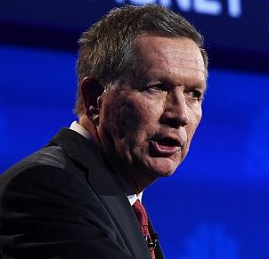
“Fantasy”

Slide 48
Clinton
Defend the Affordable Care Act. Hillary will continue to defend the Affordable Care Act (ACA) against Republican efforts to repeal it. She'll build on it to expand affordable coverage, slow the growth of overall health care costs (including prescription drugs), and make it possible for providers to deliver the very best care to patients.
Lower out-of-pocket costs like copays and deductibles.
Reduce the cost of prescription drugs.
Transform our health care system to reward value and quality.
Defend against the efforts to privatize Medicare
Notes:
https://www.hillaryclinton.com/issues/health-care/
https://www.hillaryclinton.com/issues/social-security-and-medicare/

Slide 49
Clinton II
Require plans to cover 3 sick visits/year with no deductible.
Refundable tax credit of $5K for excessive out-of-pocket costs.
No surprise bills (balance billing).
Stronger state regulatory authority over price, and tougher antitrust enforcement.

Slide 50
Clinton – Drug Pricing
Stop direct-to-consumer drug company advertising subsidies
Require drug companies that benefit from taxpayers’ support to invest in research, not marketing or profits.
Lowering the biologic exclusivity period from 12 to 7 years will spur greater competition.
Prohibit “pay for delay” arrangements.
Importation from Canada.
Allow Medicare to negotiate drug and biologic prices.

Slide 51
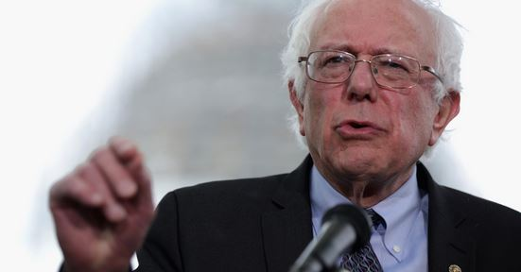
Sanders
“We are the only major country on earth that doesn't guarantee health care to all people as a right and yet we end up spending much more than they do. So I do believe that we have to move toward a Medicare for all, single-payer system.”

Slide 52
Sanders – Drug Pricing
Medicare price negotiation.
Importation from Canada.
Close the Medicare Part D donut hole faster.
Require drug co.’s to pay Medicaid rebate if prices rise faster than inflation.
End pay-for-delay.
End exclusivity for companies found to have committed fraud.
Require cost transparency.

Slide 53
opportunities

Slide 54
Election Year Opportunities
Single payer back on the table
Drug Pricing / Medicare negotiation
Co-pays and Deductibles
Protect and improve Medicare

Slide 56
Robert Weissman Public Citizen rweissman@citizen.org www.citizen.org

