Slide 1
So, Why Single Payer?
Susan Rogers, MD, FACP
October 30, 2015

Slide 2
No Disclosures

Slide 3
Identify the problems that exist with our current health care system
Describe how a single payer/universal health care/medicare for all health care system would address current problems
Understand why the current proposed health care reform (ACA) will not solve the problems

Slide 4
Purpose of Health Insurance
Protect financial assets in the face of illness
Improve access to care
Protect health

Slide 5
Four major types of ‘health care delivery systems’ currently in the US
Working people under 65 y/o similar to Germany, France or Japan where the worker and employer share the premium to a private insurance comp
Older than 65 y/o similar to Canada or Sweden, Medicare
Native Americans, veterans, military similar to Cuba with govt bldgs and govt employees
Uninsured we are like Cambodia, or rural India or any other third world country
Notes:
Model for socialized medicine: British NHS, American VA Health System
Model for Single-Payer: Canada, Taiwan, Denmark, Sweden, American Medicare

Slide 8
Life Expectancy
Years
Note: Data are for 2012 or most recent year available
Source: OECD, 2014

Slide 9
Infant Mortality Deaths in First Year of Life Per 1,000 Live Births
Note: Data are for 2012 or most recent year available
Source: OECD, 2014

Slide 10
Maternal Mortality Deaths per 100,000 Live Births
Note: Data are for 2012 or most recent year
Source OECD, 2014
available
Source: OECD, 2014

Slide 11
Smoking Prevalence Percent of population over age 15 who smoke daily
Note: Data are for 2012 or most recent year
Source OECD, 2014
available
Source: OECD, 2014

Slide 12
Percent Elderly Percent of population over age 64
Note: Data are for 2013 or most recent
Source OECD, 2014
year available
Source: OECD, 2014

Slide 13
Physician Visits per Capita
Note: Data are for 2012 or most recent year available
Source OECD 2013
Source: OECD, 2014

Slide 14
Nurses per 1,000 Population
Note: Data are for “professionally active nurses”
for 2012 or most recent year available.
Source: OECD, 2014

Slide 15
Stem Cell Marrow Transplants
Transplants per million population
Note: Data are for 2012 or most recent year available
Source: OECD, 2014

Slide 16
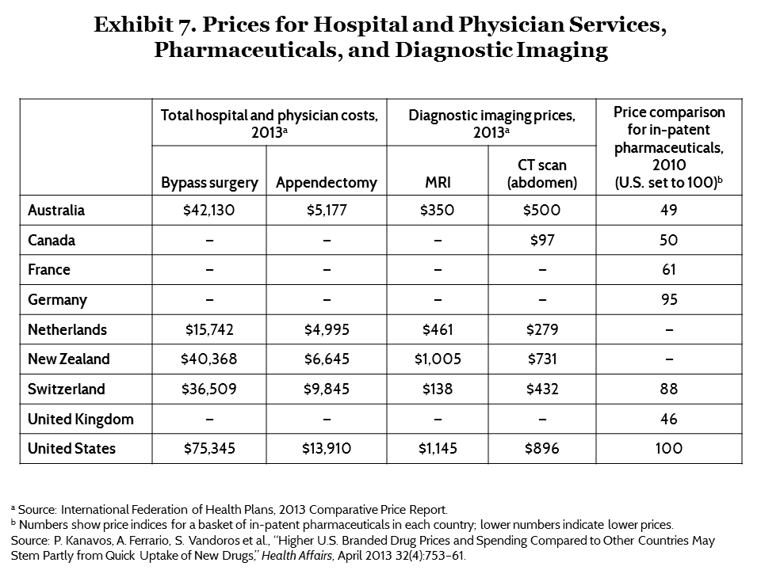

Slide 17
CHALLENGES
ACCESS
CHOICE
BENEFITS
QUALITY
COSTS

Slide 18
ACCESS

Slide 21
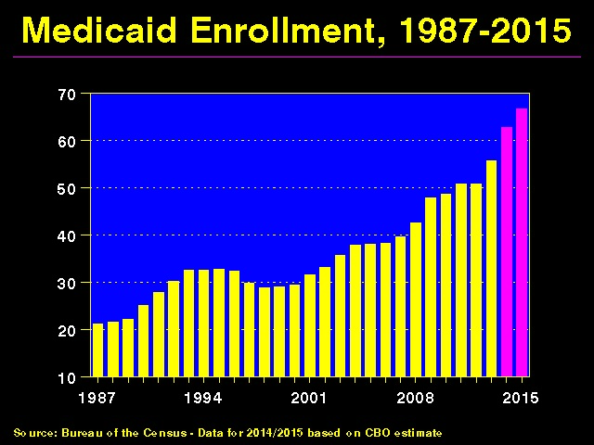

Slide 23
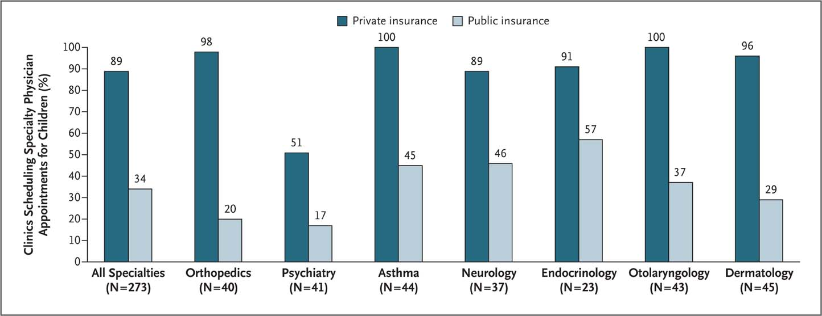
Many Specialists Won’t See Kids With Medicaid
Bisgaier J, Rhodes KV. N Engl J Med 2011;364:2324-2333
Notes:
23

Slide 24
HEALTH INSURANCE REFORM (ACA)
Mandates purchase of private HI (2014) – THIS
HAS BEEN DELAYED
Subsidizes premiums up to 400% FPL
• Expands Medicaid eligibility to 138% FPL
Insurance market reforms: Coverage up to
age 26; no pre-existing condition exclusions;
no annual/lifetime limits

Slide 25
Millions Will Remain Uninsured…
Millions
Note: The uninsured include about 5 million undocumented immigrants.
Source: Congressional Budget Office
Notes:
25

Slide 26
SINGLE PAYER MEDICARE FOR ALL
Automatic enrollment
Federal guarantee
All residents of the United States
“Everybody in, nobody out”

Slide 27
CHOICE

Slide 28
THERE IS RESTRICTED CHOICE WITH PRIVATE HEALTH INSURANCE
Private health insurance limits choice to
the network of doctors and hospitals with
whom they have negotiated contracts
You pay more to go out of network
Impossible to determine what your plan is offering or what services are covered
Less than half of those employed have choice of insurance plans

Slide 29
http://nypost.com/2014/03/19/nations-elite-cancer-hospitals-off-limits-under obamacare/

Slide 30
HEALTH INSURANCE REFORM (ACA)
Creation of HI Exchanges Expands Choice
For only a Few
Enrollment is limited to those in the individual and small group market
Market-place of private HI plans
State-based, but no standard national plan

Slide 31
Single Payer Medicare for All
Expands Choice for Everyone
Not limited to a restricted network of providers, hospitals or formularies

Slide 32
BENEFITS
Notes:
How can you predict what benefits you will need?

Slide 33
HEALTH INSURANCE REFORM (ACA)
10 essential benefits, but no standard benefit package
Eliminates co-pays and deductibles, but only on preventive services
Stipulation that health insurers have medical loss ratios (MLR) of 80-85%
No regulation of the magnitude of premiums, deductibles and co-pays – just the stipulation that benefits have an actuarial value of 60% or higher

Slide 34
Actuarial Value
The percentage of total average costs for covered (essential) benefits that a plan will cover
For example, if a plan has an actuarial value of 70%, on average, you would be responsible for 30% of the costs of all covered benefits. However, you could be responsible for a higher or lower percentage of individual services, depending on what your plan actually covers

Slide 35
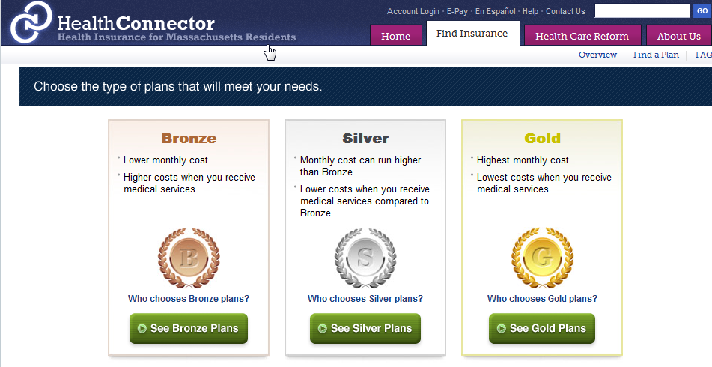
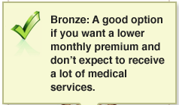
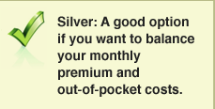
Underinsurance becomes the Norm
60%
70%
80%

Slide 36
Bankruptcy 2009
62% caused by illness and medical bills
Most were middle class,
homeowners, college grads
78% were insured when they became ill
Himmelstein et al, American Journal
of Medicine, August 2009

Slide 37
Medical Debts: The Largest Share of Collection Agency Business
Khazan. Atlantic 10/8/2014.
Based on 2013 data from Ernst & Young

Slide 38
Single Payer Medicare for All
Comprehensive coverage
- Preventive services
- Hospital care
- Physician services
- Dental services
- Mental health services
- Medication expenses
Reproductive health services
Physical/Occupational Therapy
- Home Care/Nursing home care/Long term care
“All medically necessary services”
No co-pays or deductibles

Slide 39
QUALITY

Slide 40
HEALTH INSURANCE REFORM (ACA)
Comparative Effectiveness Research (which disallows cost effectiveness research)
Innovation Center in CMS to test new payment and service delivery models (2011)
Value based purchasing – hospital payments based on quality reporting measures (2013)
P4P
Readmission penalties (2013)
Reduce hospital payments for hospital-acquired conditions (2015)

Slide 41
Improved Quality with Single Payer
Single tiered system would foster quality by making it acceptable to everyone
System would provide continuity of care
Preventive care would be a priority
It would make possible the creation of a unified, useful and confidential EHR like the VA already has
Facilitates real health planning by putting resources where they are needed

Slide 42
COSTS

Slide 45
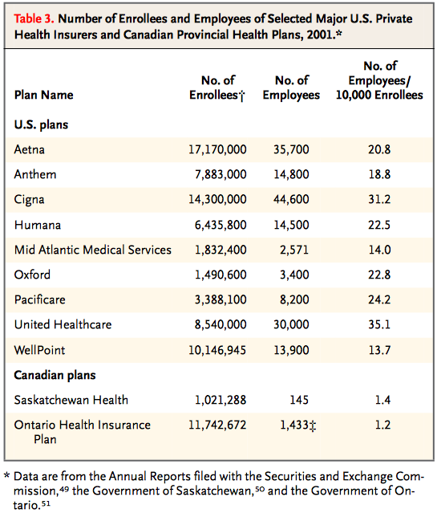
Number of administrators per enrollee
Source: Woolhandler, et al N Engl J Med 2003;349:768-75.

Slide 46
Private insurers’ High Overhead

Slide 47
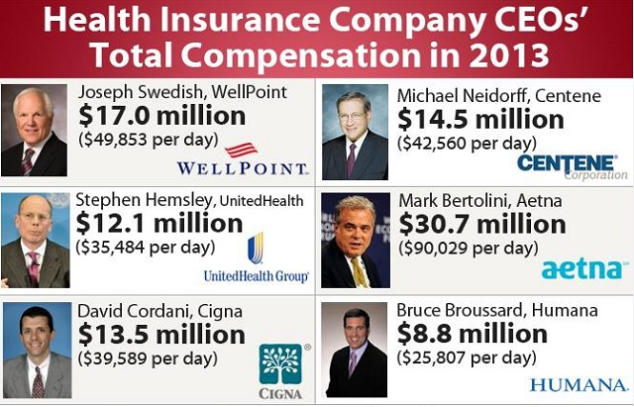

Slide 49
HEALTH INSURANCE REFORM (ACA)
Increased taxes
- Excise tax on “Cadillac” health insurance plans (2018)
- Medicare payroll tax increase with incomes over 200K
- 3.8% tax on investment income
2. Savings from Medicare
- Advantage: ($132 bill over 10 yrs)
- Cut DSH payments ($36 billion)
- Cut Medicare payments to hospitals
($136 bill over 10 yrs)
- Cut payments for home care/nursing homes ($60 bill)
3. Revenue from cracking down on fraud and abuse

Slide 50
HEALTH INSURANCE REFORM (ACA)
Leaves many of the undesirable features of private insurance coverage unchanged
Employers can change coverage and plans
Employees must accept the employer plan
Insurers can change networks
Plans for ‘market forces’ to lower cost has been proven to not work

Slide 51
What have market forces done for health care in the last 20 years?
• Increase in the number of uninsured/underinsured
• Decrease in choice of provider
• Diversion of health care resources to areas of profit rather than need
• Underfunding of less profitable endeavors
• Unaffordable prescription drugs, increased costs of technology
• Dissatisfied patients & frustrated physicians
AND…HIGHER COSTS !!!

Slide 52
The ACA’s Biggest Flaw
Preserves the
insurance industry
Limited lists of doctors and hospitals
Large gaps in covered benefits
Financial barriers to care
Needless complexity
Millions remains uninsured

Slide 53
SINGLE PAYER OFFERS REAL TOOLS TO CONTAIN COSTS
Global budgeting of hospitals, similar to budgeting for police, fire depts
Capital investment planning separate from operating costs
Emphasis on primary care; coordination of care
Bulk purchasing of pharmaceuticals
Decrease in malpractice costs

Slide 54
Single Payer Medicare for All
Public funding
Graduated payroll tax instead of premiums
Corporate taxes
Income taxes
Tax on unearned income (stocks, bonds, etc)
No premiums
No overall increase in spending because of administrative savings
A publicly funded-privately delivered partnership

Slide 55
New Savings Exceed New Costs
Cover everyone
with better benefits and save
$243 Billion
$ Billions
Admin costs
to providers
Increased utilization
(especially home health and dental)
Increased market power (pharma and devices)
Covering the uninsured
Health insurance admin
Medicaid Rate Adjustment
Gov. admin ($23B)
New Costs
New Savings
Friedman, G. Dollars & Sense. March/April 2012

Slide 56
How Canada Controls Costs
Low administrative costs – 1.3% of health spending vs. 31.0% in U.S.
Lump-sum, global budgets for hospitals
Stringent controls on capital spending for new buildings and equipment
Single buyer purchasing reins in drug/device prices
Low litigation and malpractice costs
Emphasis on primary care
Exclusion of private insurers - private plans overcharged U.S. Medicare by $34 billion in 2012
Source: Himmelstein & Woolhandler, Arch Intern Med, December, 2012

Slide 57
Lower Health Costs with NHP
17%
15%
13%
11%
9%
7%
5%
United States
Health Costs as Percent of GDP
NHP Fully Implemented
Canada
Canada’s NHP Enacted
1960 | 1970 | 1980 | 1990 | 2000 | 2010
Sources: Statistics Canada;
Canadian Inst. for Health Information;
NCHS/Commerce Department

Slide 58
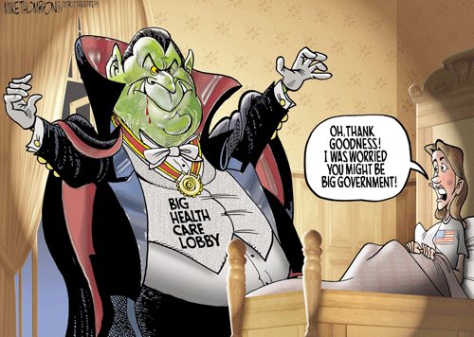

Slide 59
Single Payer MEDICARE FOR ALL THE PHYSICIANS’ PROPOSAL (JAMA, August 13, 2003 P. 798-805)
Universal coverage/automatic enrollment
Low administrative costs=single payer
Comprehensive coverage without co-pays
and deductibles
4. Maximum choice of Doctor, NP, Hospital
5. Improved quality through nationwide HIT
6. Expanded primary care
7. Publicly-funded/privately delivered

Slide 60
HR 676: U.S. National Health Care Act (“Improved & Expanded Medicare for All”)
Sponsor: Rep. John Conyers (53 co-sponsors)
Comprehensive benefit package
Full choice of physician and hospital
No copays or deductibles
Automatic enrollment
Progressive tax financing
Costs contained through budgeting, capital planning, emphasis on primary care

Slide 61
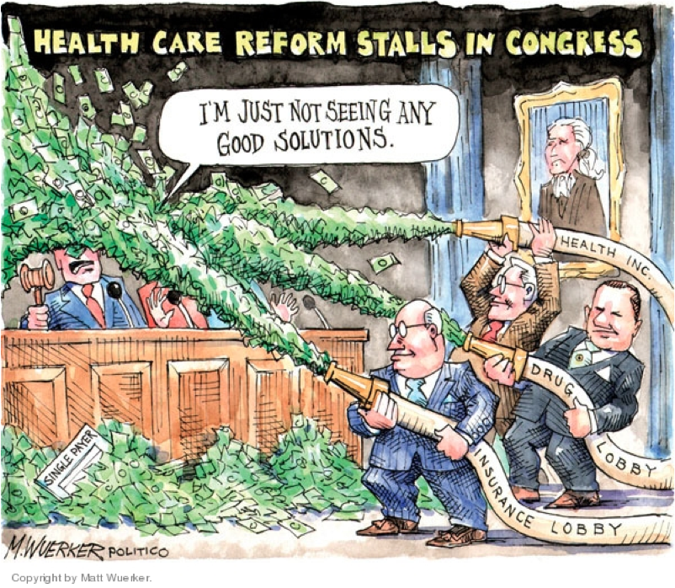

Slide 62
The Bottom Line
The ACA – which is based on private insurance – will not solve our problems
Single payer health insurance is the only plan that addresses all 3 goals of reform:
Access to care
Control of costs and avoidance of personal financial disaster
Patient choice

Slide 63
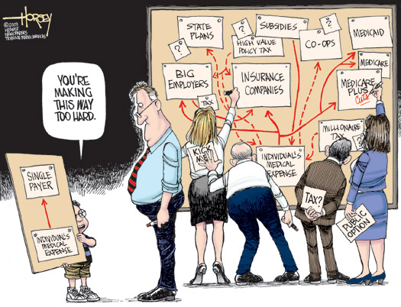

Slide 64
What Can You Do Now?
Stay informed
Join Physicians for a National Health Program
Ask your Congressman to support HR 676 “Improved & Expanded Medicare for All”
Physicians for a National Health Program
29 E Madison Suite 602, Chicago, IL 60602
Phone (312) 782-6006 | Fax: (312) 782-6007
email: info@pnhp.org
www.pnhp.org

