Slide 1
Over the River and Through the Woods:
Health Disparities and the
Need for Single Payer Healthcare
in Rural America
Liberty Foye, M3
Annie Kolarik, M3

Slide 2

Objectives
Define what the terms “rural” and “Appalachia” mean and examine the health disparities between rural and non-rural America.
Discuss the unique healthcare needs of those living in rural areas.
Educate SNaHP members of the importance of single-payer health care specifically as it applies to rural areas, and show how they can be advocates for their rural patients.

Slide 3
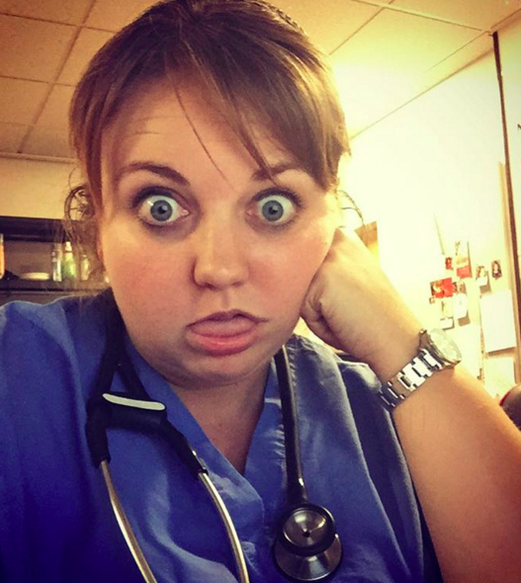
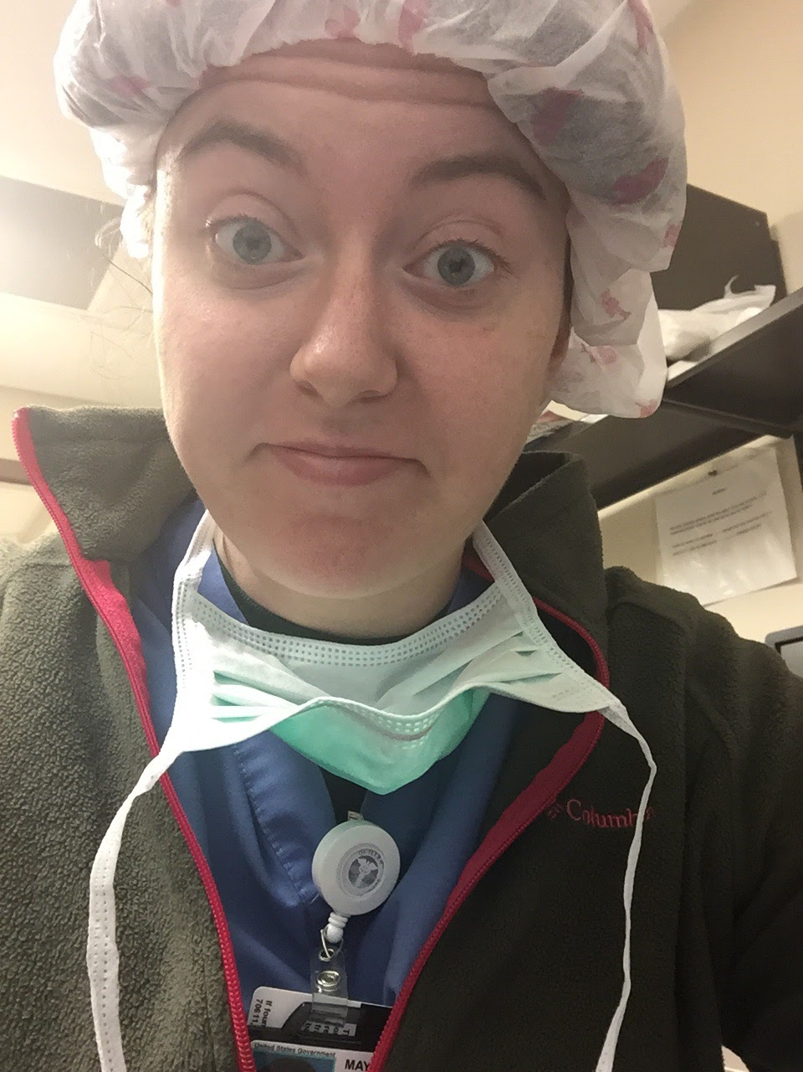
Who are we?
Future Family Doc
Future Pediatrician
We are third year medical students at ETSU Quillen College of Medicine located in Johnson City, TN. We both study in the Rural Primary Care Track, specifically in Mountain City, TN. We were both raised in Appalachia, and are proud to call this region our home!!

Slide 4
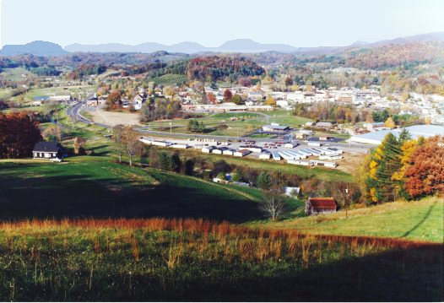
Johnson County, TN

Slide 5
Demographics
 | Johnson County | US
Population | 17,859
Median Household Income | $31,711 | $53,482
Percent persons in poverty | 26.4% | 14.8%
Persons under 65 years with a disability | 18.6% | 8.5%
Persons under 65 years without health insurance | 18.0% | 12.0%

Slide 6
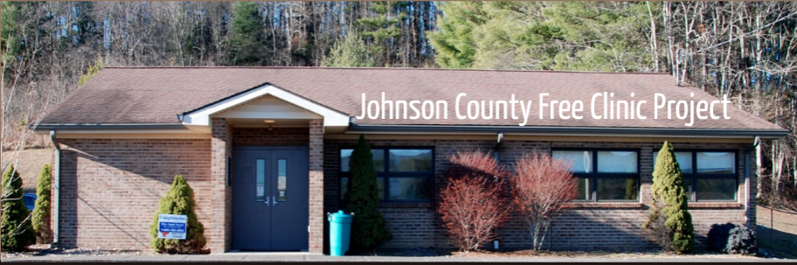

Slide 7

What is “rural?”
(Discuss!)

Slide 8
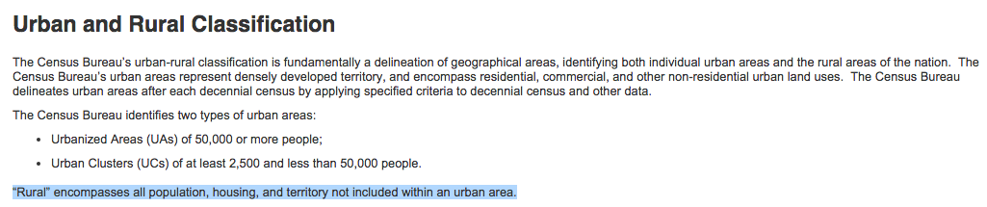
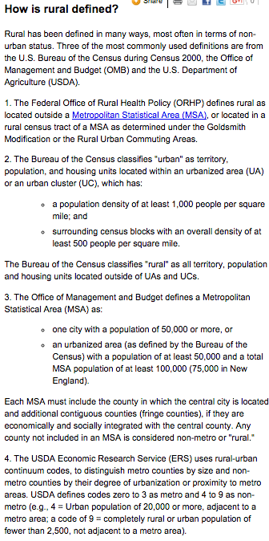
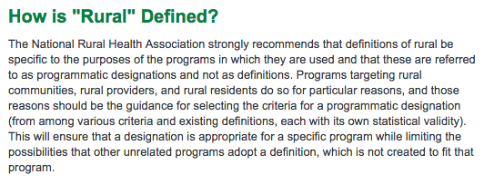
No set definition!
Health Resources and
Services Administration
US Census Bureau
National Rural Health Association

Slide 9
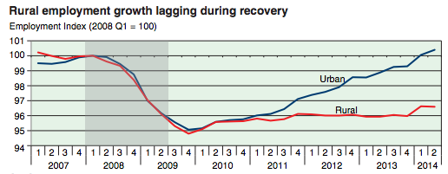
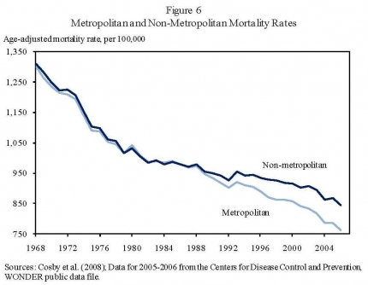
Demographics of Rural America
Depending on how you define rural, anywhere from 16-25% of the population lives in a rural area, spread over 72% of the nation’s land area.
The economic recovery since the recession has been markedly slower in rural areas.
Mortality rates between urban and rural areas have diverged since 1990 and rural areas are experiencing higher mortality than non-rural.

Slide 10
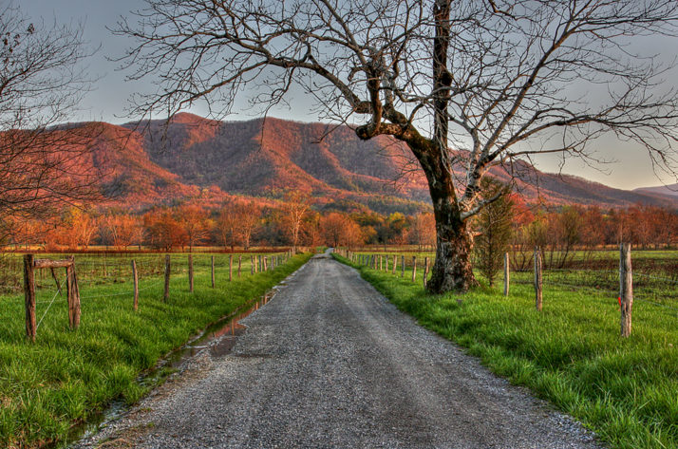
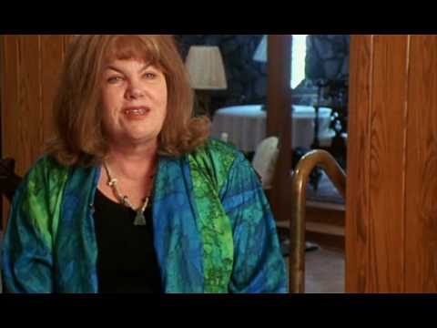
What is Appalachia?
(Discuss!)

Slide 11

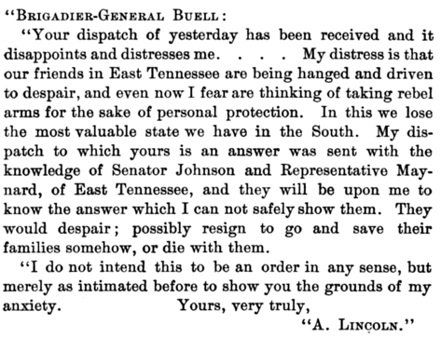
Appalachia:
The Spirit of the Region
Despite being a part of the confederacy, Union sentiment was prominent in East Tennessee and North Carolina. Abraham Lincoln recognized this and vowed to provide aid to the region after the war. After his assassination, this aid never arrived.
A distinctive culture was developed in the region due to its geographic isolation from the rest of the country. As a whole, Appalachian people are kind, fiercely independent, close to nature, religious, intensely moral, distrustful of outsiders and often resistant to change.
There is a sense of equality between those who live in Appalachia. Residents often agree with the idea that health care distribution should be more equitable, though they have a higher-than-average distrust of the government than others. They also have a negative response to what they consider “handouts.”

Slide 12
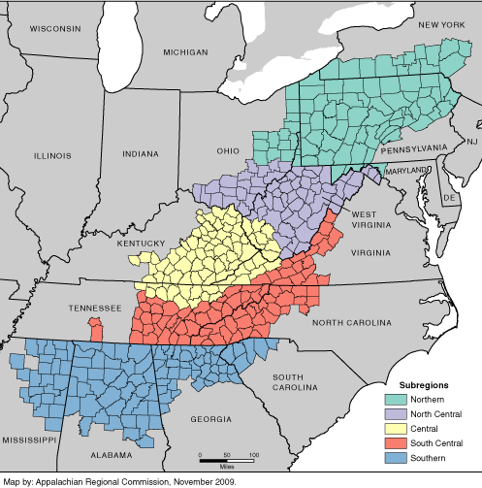
Demographics of Appalachia
8.3 mil
Total Population: 25,243,456 (as much as have the total US rural population!)
2.4 mil
Several cities with over 100,000 residents including Huntsville, Knoxville, Birmingham, Chattanooga, Asheville, and Pittsburgh
Primarily white (83.6%) but this varies widely by region
1.9 mil
4.7 mil
7.8 mil

Slide 13

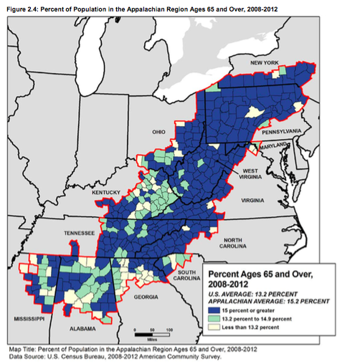
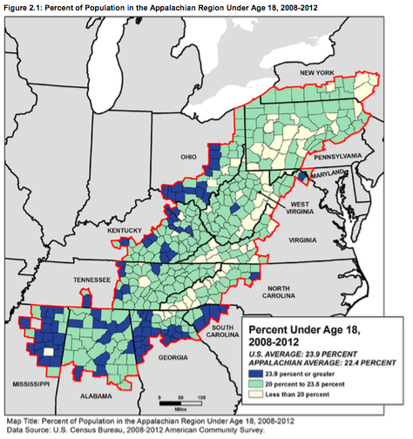
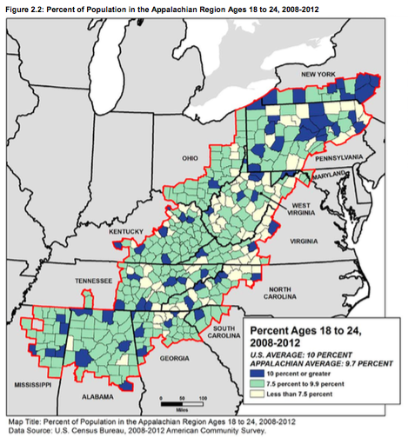
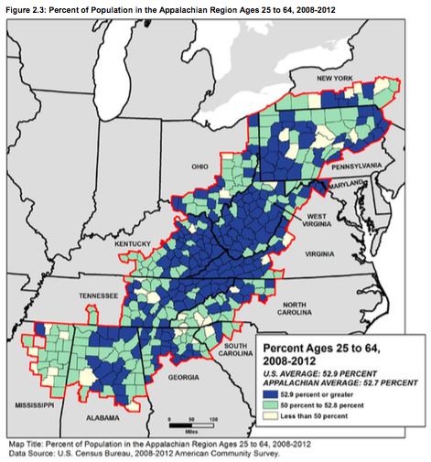
Appalachia is an Aging Population

Slide 14

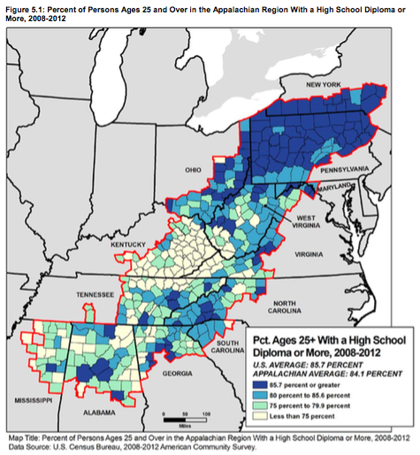
Residents of Appalachia are less likely to have a high school diploma.

Slide 15

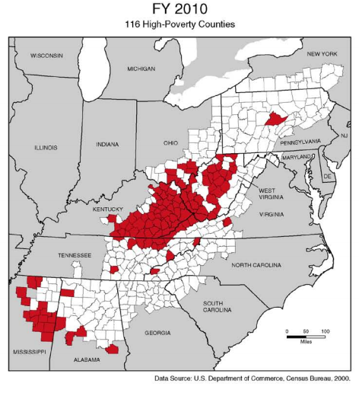
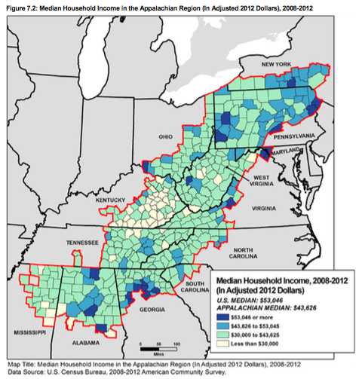
Much of Appalachia is Poor

Slide 16

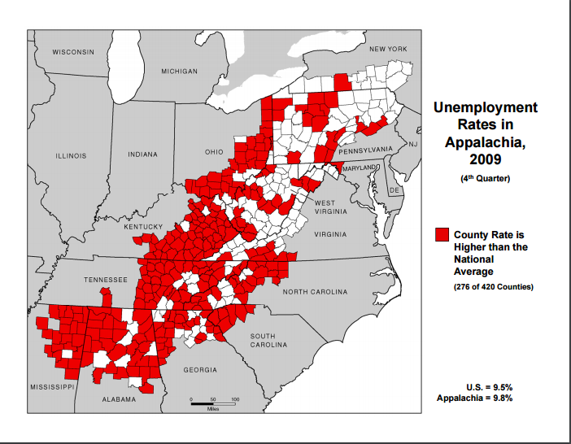
In Appalachia, you’re more
likely to be unemployed.

Slide 17
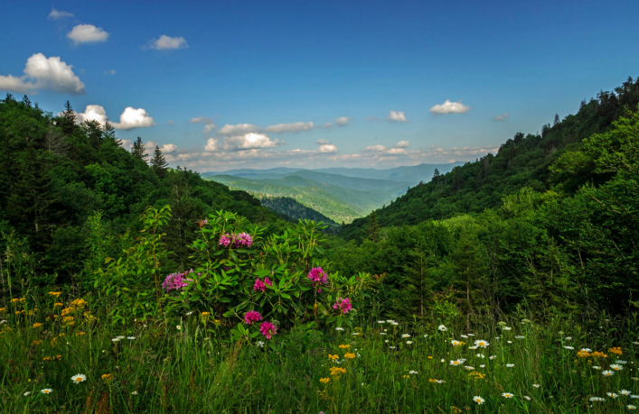
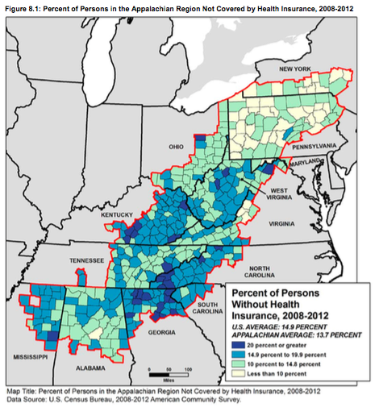
In much of Appalachia, you are less likely to have health insurance.

Slide 18
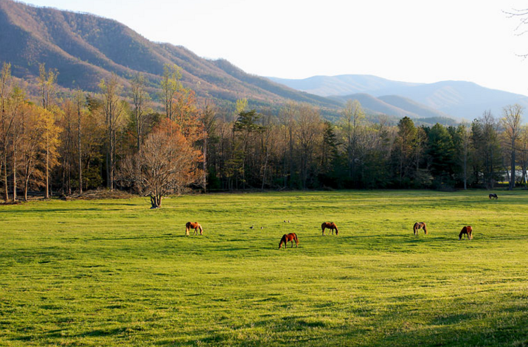
Why is single-payer healthcare so important in rural America?

Slide 19
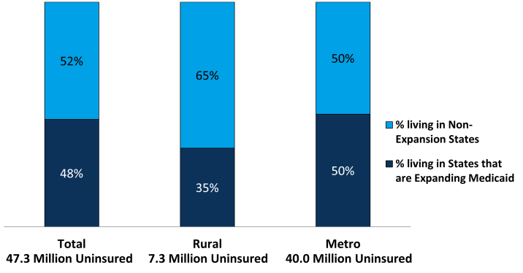
Holes in Our Current, Employer-Based System
The nonelderly population in rural areas is more likely than metropolitan counterparts to live in family without either a full-or part-time worker (17% versus 14%).
Bad!
The coverage holes in our current, employment-based system are more likely to result in lack of coverage in urban areas where people are less likely to have typical jobs with provided insurance (71% vs 63%). In fact, half of all rural workers work in “low ESI industries,” or industries in which less than 80% of workers are covered by employer-sponsored insurance.
Worse!!
To further complicate matters, rural populations are disproportionately likely to live in a state that did NOT elect to expand Medicaid through the ACA.
WORST!!!

Slide 20
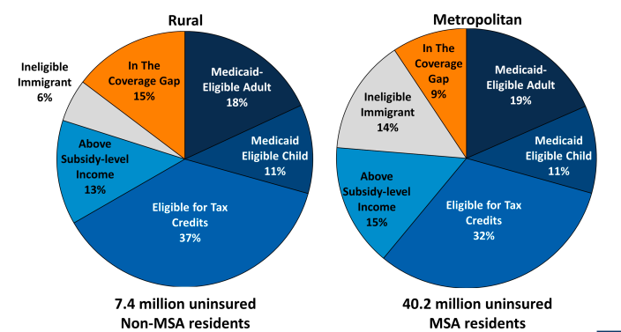
Worstest?

Slide 21
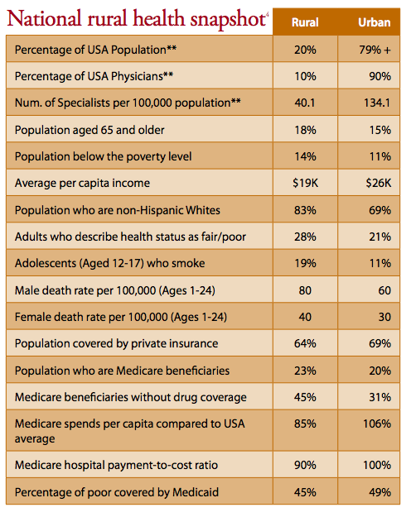
All this on top of
pre-existing barriers.

Slide 22
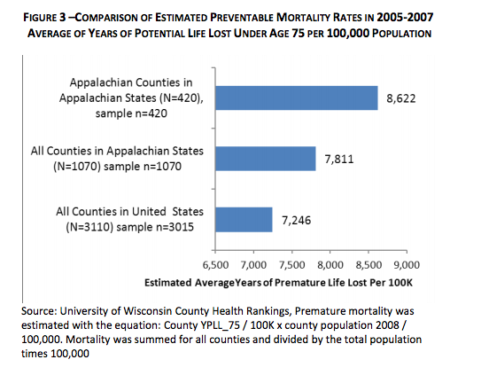
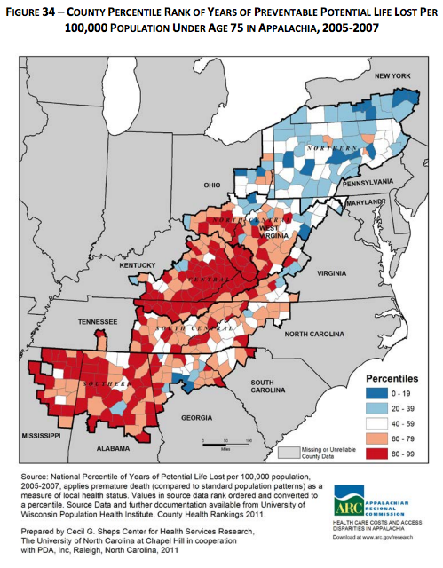
So what?
These health disparities lead to an unequal loss of life compared to non-rural US Counties.

Slide 23
Mr. Jones
Mr. Jones is a 34-old-male who presents to his primary care provider with finger pain. He has a history of rheumatoid arthritis controlled with prednisone and methotrexate and is under the care of a rheumatologist.

Slide 24
Patient Interview
HPI: Mr. Jones complains of increasing pain, swelling, and stiffness in his right 3rd MCP joint for the past 3-4 weeks along with pain in both thumbs. Stiffness is worse in the morning and improves throughout the day. The patient is currently taking 800mg ibuprofen per day which somewhat controls the pain. The patient denies any acute injury.
ROS: Negative for rashes, fevers; remainder as per HPI.

Slide 25
Physical Exam
Vitals: wnl, afebrile
CV: RRR, no m/r/g appreciated
PULM: CTAB
EXT: swelling of the R 3rd MCP with limited ROM in the R hand and fingers, no deformities of the joints, FROM in L hand and knees, ankles, elbows, and shoulders
SKIN: several rheumatoid nodules present, no rashes

Slide 26
Why is he seeing his PCP for an RA flare?
Approximately 2 months ago, Mr. Jones was laid off and lost his health insurance. He was late in paying a $100 bill from the rheumatologist’s office and was fired from the practice. The patient is currently working and has health insurance again but still won’t be seen by his rheumatologist. He was forced to discontinue his prednisone and methotrexate 1.5 months ago
At this visit, we prescribed prednisone and high-dose ibuprofen to control his inflammation and made a referral to a different rheumatologist

Slide 27
Considerations
In a health care system that ties health insurance to employment, lapses in employment can result in lapses in the care of chronic conditions.
In Appalachia, job growth is slower as compared to the rest of the nation and the jobs in place are often not secure.
Specialists are scarce in Appalachia and switching care can result in increased driving time and transportation costs.

Slide 28
Mr. Smith
82 y/o male
CC: Numbness of the
lower extremities.

Slide 29
Objective:
Vitals:
Height: 5’11” Weight: 162 lbs
BP: 184/88 Afebrile
PMHx: Broke his hip 4-5 years ago and it was repaired but not replaced. Otherwise he reports no medical problems.
Family Hx: He reports a mother with diabetes and sister with heart disease, otherwise noncontributory.
Social Hx: Denies alcohol use. Former smoker but quit 20 years ago. He lives in Shady Valley with his wife. They are both retired. Before they retired, he grew tobacco on a farm he inherited from his father-in-law and his wife taught piano lessons. He and his wife now live on $331/month from social security.
Medications: 81 mg aspirin daily after seeing a TV commercial about heart disease

Slide 30
Objective (cont’d):
Physical Exam:
Neck: no carotid bruit appreciated, thyroid appropriate size, no appreciable lymph nodes
CV: RRR, no m/r/g
Pulm: CTAB, no w/r/r
Abd: protuberant, soft, NT, ND, +bs in all 4 quadrants
Extremities: no cyanosis or edema, monofilament exam showed lack of sensation in stocking glove distribution up to the knees, skin of the shins was shiny, brown, dry, and hairless, dorsalis pedis and posterior tibial pulses WNL bilaterally
Review of Systems:
Negative, except the patient admits to occasional chest pain when he is working outside that radiates into his neck and jaw.
What tests do we order - keeping in mind that though tests are free to the patient, the free clinic has to absorb associated costs.

Slide 31
Test Results:
Urinalysis showed 4+ glucose.
Finger stick glucose was 427 fasting.
EKG showed normal sinus rhythm.
Assessment/Plan:
Elevated Glucose: High levels of glucose in urine and blood suggests diabetes. Refer to the Rural Health Consortium (which provides services on a sliding scale) for follow up. Prescribe 500mg Metformin to bridge until appointment.
Exertional Chest Pain: Radiation of the pain as well as its association with exertion suggests stable angina. Suggest patient follow-up with a stress test once a the patient has been established with a primary care physician.
Elevated BP: Prescribe Lisinopril 10mg qday and adjust dose once the patient has been established with a primary care physician.

Slide 32
Considerations
Does this patient really have no PMHx?
There’s one sliding-scale physician in town and she is likely going to have a very long wait list.
Despite attempt to choose reasonably priced medications, with such a limited budget, even these additions can be a hardship.
Does Medicare ensure reasonable prices for medical tests? NO - this man will likely pay a substantial amount for his tests despite Medicare coverage.
Unique considerations due to this man’s location in Rural Appalachia:
  His drive to the clinic is long, curvy, and often impassable during winter.
  Because he never paid much into social security due to being a private farmer, his monthly income is very low.
  If he requires special testing, he will have to drive a long distance to these tests, costing him time, gas, and other resources.

Slide 33
Take home points!
Treating rural patients is different than treating other patients. Keep in mind the special needs and attitudes of these patients, and how they may experience unique barriers to their health care.
Americans living in rural America have long been experiencing the brunt of the failings of our current healthcare system. These patients have the most to gain from a National Health Program, and often the most to lose from continued lack of coverage.
Don’t forget about us! Look for opportunities to engage in the healthcare of rural America, and don’t hesitate to start a dialogue on the special needs of this population. For those who go to schools in more urban areas, talk to your school about how you can work outreach into rural areas into your curriculum.

Slide 34

Thank you for
your participation!
Questions?

