Slide 1
Turning Threats to Medicare and Medicaid Into Organizing Opportunities
Ed Weisbart, MD. Chair, PNHP-MO
John Marty. MN State Senator

Slide 2
Lesson #1: Be Careful Mixing Medicaid and NHI Discussions
NHI
is not
Medicaid for All
Medicaid expansion
is not a
path to NHI

Slide 3
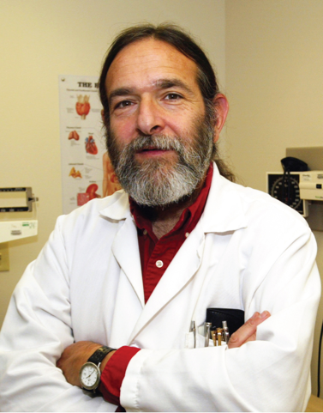
Medicaid: The Only Safety Net
“Medicaid is far from perfect.
In many parts of the country, Medicaid pays so little that patients have trouble finding a doctor who will accept it.
A single-payer program like Canada’s that covers all Americans is a far better solution for both the poor and the middle class.
But until we get to single payer, Medicaid is the only safety net for many low-income Americans.”
David Himmelstein MD
Health Affairs Blog Jan 30 2014

Slide 4
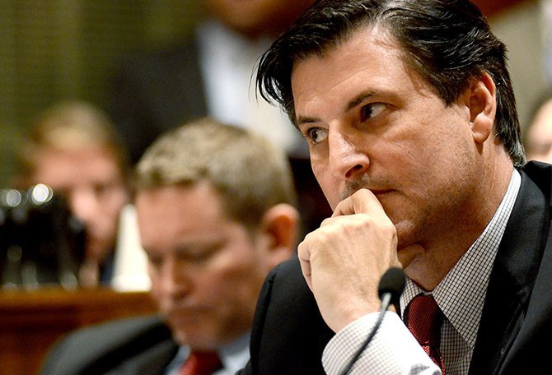
Does This Pass the Sniff Test?
“Giving Medicaid to
an uninsured person
does not improve
their health.”
John Lamping
MO State Senator

Slide 5
Medicaid Expansion Is About Life and Death
Better women’s health
195,492 more mammograms
Better treatment of chronic diseases
422,553 more diabetics receiving medications
712,037 fewer adults with depression
Between 7,115 and 17,104 fewer deaths
Many fewer preventable deaths
443,667 more Pap smears
Isn’t this the point of a health care system?
Anticipated health impact of Medicaid expansion into current non-expansion states.
Dickman S, Himmelstein D, McCormick D, and Woolhandler S.
Opting out of Medicaid Expansion: The Health and Financial Impacts. Health Affairs Blog.
January 30, 2014, accessed Dec. 14 2015

Slide 6
“Medicaid Is Nearly As Bad As No Insurance”
Relative Risk of Death from the Presenting Cancer
Analysis was adjusted for many factors,
including the receipt of
appropriate cancer care.
Walker, G et al. Journal of Clinical Oncology. Aug 4, 2014. JCO.2014.55.6258
(Slide title paraphrased from article)

Slide 7
“Oregon Proved That Medicaid Does Not Improve Health”
Randomized Prospective Controlled Trial
Commonly Shown Results
Expanded Medicaid via a lottery in 2008
6,387 newly, 5,842 controls
Most recent data is two years after the lottery
No significant difference in average blood pressure, cholesterol, or glucose
Utilization increased, outcomes did not
Baicker, K. The Oregon Experiment. NEJM 2013;368:1713-22

Slide 8
Oregon: Expand Medicaid, Increase Utilization
“So this was a 2013 study about an expansion in 2008. Five years later.
Expansion increased utilization and cost,
but no impact on life expectancy.”
54%
more
32%
more
103%
more
All results valid at P<0.02 or better.
Baicker, K. The Oregon Experiment. NEJM 2013;368:1713-22

Slide 9
The Rest of the Story in the Oregon Study
HgbA1c in both total populations averaged 5.6%
Intermediate markers showed dramatic improvements
94.6% non-diabetics dilute the population-wide metrics
Surrogate endpoints were all encouraging
Study not powered to show broad population impact
Average patient in the study for 17 months
Baicker, K. The Oregon Experiment. NEJM 2013;368:1713-22

Slide 10
Oregon: Expand Medicaid, Improve Health
Uncontrolled Diabetes
Elevated Total Cholesterol
Screen Positive for Depression
Hypertension
No Medicaid
Medicaid
Depression p<0.05; the others area clinically meaningful but not powered to show statistical significance
Baicker, K. The Oregon Experiment. NEJM 2013;368:1713-22

Slide 11
“Oregon: Expand Medicaid, Increase ED Usage by 40%”
A 40% relative increase means
one extra visit per person
every four years
Annual emergency room visits per person
Absolute increase: 0.27 visits per year
Taubman, S. Science Magazine. Jan 2, 2014.

Slide 12
“Oregon: Expand Medicaid, Increase ED Usage by 40%”
“40% relative increase”
“One extra visit every four years”
Taubman, S. Science Magazine. Jan 2, 2014.

Slide 13
The Latest News on Medicaid Expansion and ED Use
“Expanded coverage is unlikely to drive substantial substitution of office visits for ED use.”
– Oct. 20, 2016
Finkelstein, A. NEJM 375;16 Oct. 20, 2016
http://www.nejm.org/doi/pdf/10.1056/NEJMp1609533
Accessed Oct. 27, 2016

Slide 14
2011 – 2015 Data: Oregon Medicaid Continues to Improve
“Welcome to Insurance” phone calls;
schedule PCP appointments; re-book no-shows
Overall Medicaid
ED Utilization
Avoidable Medicaid
ED Utilization
All-Cause Hospital Readmissions
Per 1,000 members
Rates are per 1,000 member months
http://www.oregon.gov/oha/Metrics/Documents/2015_performance_report.pdf Accessed )ct 27, 2016

Slide 15
Lesson #2: At Times, We Are The Only Source of Actual Facts
Headline:
ED usage remains high in Oregon Medicaid
Fine print:
2016 release of 2010 data
Facts:
Trends show steady improvement
Primary source data from 2011-2015

Slide 16
Medicare is popular
Should we call single payer Medicare for All?
A potentially useful theme, but use caution:
As Medicare gets dismantled, piece by piece, that slogan might come across as “let’s expand a broken system”.

Slide 17
The Slow Dismantling of Medicare
Medicare Privatization through Medicare Advantage
(Good argument for why a “public option” is not a solution)
Medicare is less & less affordable as costs rise – it is not comprehensive coverage:
need supplemental insurance for long term care,
and for prescription drugs (with or w/out a “doughnut hole”)
and Medigap policies to cover deductibles, etc.
Now, Speaker Paul Ryan proposals would:
Increase Age for Eligibility
Means Test Medicare

Slide 18
If We Use the Label “Medicare for All”
At a minimum, call it Medicare Plus
After all, it:
Covers all Medicare benefits, plus dental care, plus long-term care, plus all the benefits that currently require supplemental coverage, plus elimination of co-payments and deductibles.
Plus, it would give those same benefits to people under age 65 as well.

Slide 19
The Politics of
Single Payer
after the
Trump Election

Slide 20
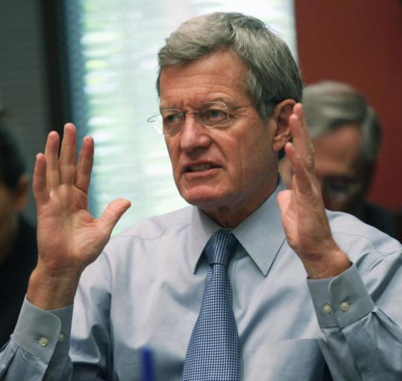
How We Got to This Point
Many politicians who claim
to support Health Care for All…
…refuse to push for Single Payer.
“It’s not on the table... because it cannot pass.”
Sen. Max Baucus
Author of ACA in 2009, on Single Payer

Slide 21
Two Reasons Single Payer “Cannot Pass”
Politicians from both parties receive huge campaign contributions from Insurance Industry and Pharmaceutical Lobby to protect their interests.
Politicians who support universal health care are afraid that single payer will be controversial and could cost them the next election.

Slide 22
As a result,
Instead of fighting for a solution that works,
they fight for proposals that don’t work…
…proposals they hope will be popular.
…proposals like the Affordable Care Act.

Slide 23
The Results? Not What They Intended.
2010
Affordable Care Act was enacted – because Single Payer “cannot pass”
2010 Election
Democrats get slaughtered at the polls – Obama loses his congressional majority
2012 Election
Democrats regain some ground

Slide 24
The Results? Not What They Intended.
2014
ACA is Implemented (Insurance Exchanges Open)
2014 Election
Democrats Lose Ground Again
2016
Clinton Defends ACA & promises to fix problems
2016 Election
Trump wins Huge Upset in part by attacking ObamaCare

Slide 25
What would have happened if
the Democratic Presidential Candidate proposed replacing the ACA
with a health system that worked?
Note: a change of only 107,000 votes
spread across three states
would have led to Trump’s defeat

Slide 26
It’s not that we haven’t tried other reforms...

Slide 27
Just in Minnesota – More Than a Dozen Health Reform Studies
Governor's Task Force on Insurance and Health
Legislative Commission on Health Care Access
Health Care Commission (HealthRight)
Governor’s Citizens Forum on Health Care Costs
Health Care Reform Task Force
Health Insurance Exchange Advisory Task Force
Health Care Transformation Task Force
Health Care Access Commission
Governor's Task Force on Health Care
Health Care Financing Task Force

Slide 28
ACA & state reforms
largely “tinker” with
a broken system.

Slide 29
Why All the Tinkering?
Because we need to:
Increase access
Reduce costs
But Have We Made Progress?
After all those “reforms”
we spend twice as much as other countries
and have worse health outcomes

Slide 30
The Big Picture
“If you tried to design
a health care system that didn’t work...
you couldn’t have done a better job”
– a Minnesota Business Executive (2007)
And it is even worse now, ten years later!

Slide 31
We Need a New Model, a New Direction But before starting a trip…
…you need a road map!
Where are you headed?
What are your goals?

Slide 32
Before Designing a Health System, We Need To…
…Map out our direction
Spell out the principles we want
our health care system to meet.

Slide 33
Principles of a Good Health System
The health care system must:
Ensure all people are covered;
Cover all types of care, including
Dental, vision and hearing, mental health, chemical dependency treatment, prescription drugs, & long-term care;

Slide 34
Principles of a Good Health System
The health care system must:
Allow patients to choose their providers;
Reduce costs by cutting administrative bureaucracy, not by restricting or denying care;
Set premiums based on ability to pay;
Focus on preventive care and early intervention to improve health;

Slide 35
Principles of a Good Health System
The health care system must:
Ensure sufficient care providers to guarantee timely access;
Continue American leadership in medical education, research, and technology;
Provide adequate and timely payments to providers; and
Use a simple funding and payment system.

Slide 36
Minnesota Health Plan
Designed to follow road map
Governed by those principles
Focus on well-being and public health, NOT profits or politics
Responsible for ensuring sufficient providers to meet needs throughout state
Medical decisions left to doctor & patient

Slide 37
Minnesota Health Plan
Saves time and money
for doctors, patients, & businesses
while improving health

Slide 38
Minnesota Health Plan
A comprehensive proposal for a commonsense health care system
Had hoped to push in 2017 and 2018.
Politics intervened. Electoral losses in 2016 (unpopularity of the ACA was a major cause)
Minnesota will need to build for change.
Can other states benefit from our ideas?

Slide 39
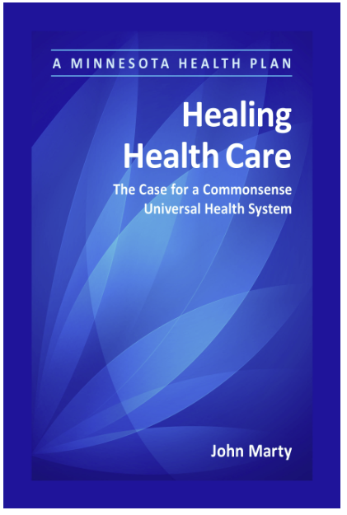
Learn more, and download a free copy at: MNhealthplan.org

Slide 40
Questions? Comments?

Slide 41
What about cost?

Slide 42
2007 Colorado Health Care Reform Proposals
Proposal | # Remaining Uninsured | Increase in Total Health Spending
Better Health Care for Colorado Increase access to public programs Subsidies for private insurance
Solutions for a Healthy Colorado Private insurance with low-income subsidies Expand Medicaid
A Plan for Covering Coloradans Limit benefit set, add low-income subsidies Expand public programs
The Colorado Health Services Program Universal health care Patient choice of providers
467,000
$595 million
138,000
$271 million
109,000
$1.3 billion
0
– $1.4 billion
Data from The Lewin Group, “Technical Assessment of Health Care Reform Proposals,” August 20, 2007, http://tinyurl.com/Colorado-2007Lewin. Note Lewin Group’s parent company is United Health Care, largest insurance company in the country – they are NOT biased in favor of single payer….

Slide 43
In Colorado:
Only the single payer plan covered everyone.
Only the single payer plan saved money.
Only the single payer plan worked.
But experts decided that single payer isn’t feasible…
…so instead of fighting for something that works, let’s pick something that doesn’t work… and fight for that instead!

Slide 44
Design Matters.
Marketing Matters.

Slide 45
Vermont (It wasn’t single payer)
Left multi-payer system in place
Didn’t incorporate Medicare, large businesses
No administrative savings, no drug price negotiations
Taxes to replace premiums as insurance industry’s primary revenue source
Consequently, it wouldn’t save money.

Slide 46
Marketing Matters.
Vermont’s Single Payer Washout
The left’s health-care ideal implodes over
punishing tax rates.
– Wall St Journal headline, 2014
Cannot market in a manner that gives critics chance to distort cost implications.
Since single payer is cheaper, we need to talk about shifting premium payments from private insurance plans to a single health plan.

