Slide 1
Notes:
I’d like to start out by saying, if you’re handed a pile of poop, let it dry a bit and then heat your house with it. If you’re handed a pile of garbage, let it compost and make food with it,

Slide 2
What’s going on in Oregon?
Notes:
I am Mike Huntington, a retired radiation oncologist from Corvallis, Oregon ready to give you a ten minute update on Oregon’s progress toward universal health care. On a clear day law makers can see Mt. Jefferson, here, 40 miles to the east of Salem.
I got involved in health care reform after meeting too many patients with advanced cancers who had delayed medical attention because they feared the cost of it.
I have found that advocating for universal health care is not only necessary, but even more worthwhile than what I did at the cancer center.
Like you do in your states we have lots of problems to solve.

Slide 3
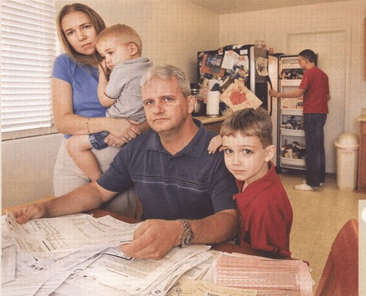
What are the problems?
Notes:
What are the problems?
The Problems
1/14 remain uninsured even after Medicaid expansion and the ACA (1 in 4 young adults [25-35 y/o], 1 in 4 of people who are already broke [$23,000/yr])
Access to care not improved (84% report timely access 2013-2015)
1 in 2 uninsured are ineligible (80% are citizens, not "undocumented)
1 in 2 with the standard Silver ACA plans can’t afford their premiums now. Next year those premiums will go up 20-30%
$1.3 Billion shortfall in state budget is projected for 2017-18 biennium.
Bloomberg, 10/19/16, goo.gl/hKjbOC
Oregon Center for Public Policy Mar. 15, 2016. goo.gl/wlwV1B

Slide 4
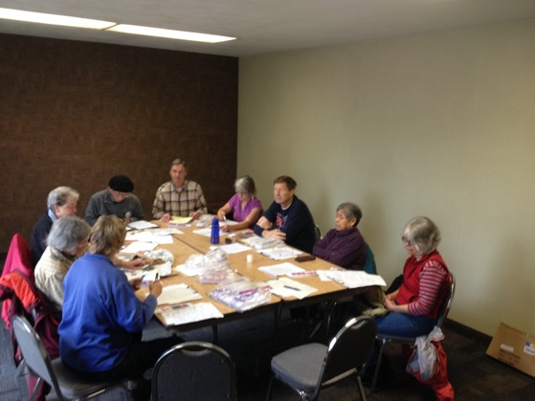
What are we doing about it?
Notes:
What are we doing about it?
Well, Oregon has done quite a bit over the past 22 years as I will show you. But…
We still have a train-wreck of a health care system.
We know we have to explore new options.
And so we meet, educate ourselves, create messaging that will be understood in our communities. We have 10 chapters of Health Care for All Oregon around the state, each with 10-30 activists, and a coalition of 120 unions and other social benefit organizations which endorse and support us.
We have two PNHP Oregon chapters, one in Portland and another Corvallis. These chapters serve as think tanks, they supply speakers and trainers of other speakers, and cooperate with HCAO. Of over 400 Oregonians who pay dues to the national PNHP only about 12 of us are active in the movement. Room for improvement there.

Slide 5
2013: Study bill
2015: Funded
2016: RAND Corp.
Notes:
Currently our focus is on a RAND study that was approved by the legislature.
2013: passed a study bill but did not fund it
2015: funded it at $400,000
2016: hired RAND Corporation

Slide 6
Four options to achieve universal health care in Oregon.
Notes:
What is being studied?
Four options of how best to achieve and finance universal health care in Oregon.
1. Status quo: Affordable Care Act
2. Basic Health Plan and a public option
3. Single payer, public funds, private delivery of care
4. Public funding of private insurance, basic benefits for all Oregonians

Slide 7
There is no easy ascent
Notes:
Now I'd like to report on Oregon's progress in health care reform over the past 22 years that has led us to where we are today. I think our willingness to innovate is clear and it gives me hope that Oregon will eventually be willing to accept a unified payer system.

Slide 8
“All diseases have two causes:
one is pathological
the other — political.”
Notes:
The importance of political activism and legislation was expressed by this pathologist 168 years ago.
Rudolf Virchow
1848 Pathologist University of Berlin
“All diseases have two causes:
one is pathological
the other — political.”

Slide 9
1994 John Kitzhaber, MD
The Oregon Health Plan made better use of Medicaid money and provided care for many more people. Medicaid.
Notes:
Dr. John Kitzhaber 110 years later took Dr. Virchow’s comments to heart and as a state senator designed the Oregon Health Plan that made better use of Medicaid money and provided care for many more people than would be eligible under standard Medicaid. The new plan focused on what is covered rather than who is covered. A prioritization list of over 700 paired diagnoses and procedures was established to decide what would be covered depending on available revenue.
Unfortunately with budget crises people were cut from the plan, not just services, compromising the core tenets of the Oregon Health Plan.

Slide 10
2002: Ballot Measure 23
Notes:
And so In the late 1990s a single payer movement in Oregon was born. A single payer bill was brought to a vote in the legislature in 1998 and as a ballot measure in 2002. Both times defeated.

Slide 11
2012 Governor John Kitzhaber
Coordinated Care Organizations
Notes:
In 2012, Coordinated Care Organizations were created for the Medicaid population as an improvement on the Accountable Care Organization model. There are 16 CCOs around the state, each with a capitated budget and patient-centered primary medical homes as the mode of care delivery. CCOs appear to be slowing the annual cost escalation and actually coordinating care better. But most of the CCOs are managed by for-profit companies and are opaque to public oversight. The CCO in Lane County distributed $22 M in dividends to it’s stock holders in 2015.
This situation re-energized our interest in a publicly managed unified payer system.
The Obama administration agreed to not only grant the waivers needed to implement new care model, but also to invest $1.9 billion investment in our CCOs—as long as we reduced the the Medicaid cost trend from 5.4% to 3.4%.
Section 1115

Slide 12
State Senator Michael Dembrow
Single payer bills in 2011, 2013, and 2015
Notes:
State Sen. Michael Dembrow from Portland, worked with Health Care for All Oregon and PNHP to create single payer legislation because he knew that tweaking Medicaid was not the answer. He introduced single payer bills in 2011, 2013, and 2015 and was the main author of the study bill I mentioned earlier.
While living in France as a grad student his family benefitted much under France’s universal health care system. After returning to the US his family suffered financial hardship under our health care system.

Slide 13
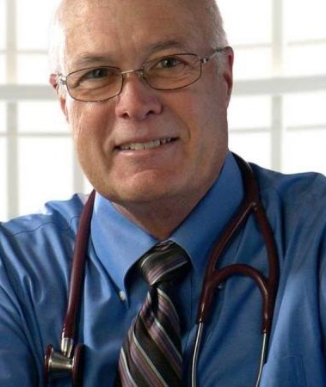
… believed that unified or single payer health care was a good idea but politically unachievable.
State Senator Alan Bates
Notes:
State Senator Alan Bates, a practicing physician from southern Oregon believed that unified or single payer health care was a good idea but politically unachievable. He did agree reluctantly to support the study bill, but we think the health care industry already had a pretty good arm twist on him.

Slide 14
Notes:
A study bill drama played out here in the Oregon State capitol building in Salem on July 4, 2016.

Slide 15
Notes:
To the surprise of many Sen. Bates voted against the bill, presumably because of pressure from the health care industry.
HCAO activists went to work on the weekend before the session ended twisting his other arm. On Monday July 4 he voted yea and the bill passed 16-14.
Colleagues at their desks and supporters in galleries were stunned. After his nay vote a few Senators who supported the bill made a tactical move and also voted nay thus giving them the option of calling the bill back for a revote on Monday.
I hope you all go back to your legislators and respectfully break a leg or two!

Slide 16
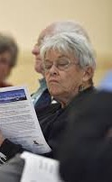
Relationships take work, but they save the day.
Notes:
It took lots of visits from activists in the Rogue Valley in Southern Oregon to get Sen. Bates, a Democrat, to support our bills.
It took lots of visits to Rep. Andy Olson also. Rep. is a conservative Republican from Albany who voted party line against health care reform in 2009.
Then Edie Orner, a retired teacher and union negotiator, started meeting with him several times a year.
By 2015 he crossed party line to cosponsor a bill for a health care financing study.
Nothing like a retired teacher to straighten a guy out. Recruit them to help you.

Slide 17
Building relationships
Educating
each other
Notes:
The HCAO chapters such as this one in Corvallis build relationships within the chapter and out to the community. Education, persuasion, and arm twisting are planned and practiced here.

Slide 18
Building relationships, educating each other.
Notes:
Small Oregon PNHP chapters in Portland and Corvallis work closely with HCAO, researching and sharing current information on health care reform, developing messaging, training speakers, and recruiting recognized experts in health care reform to come speak in Oregon.

Slide 19
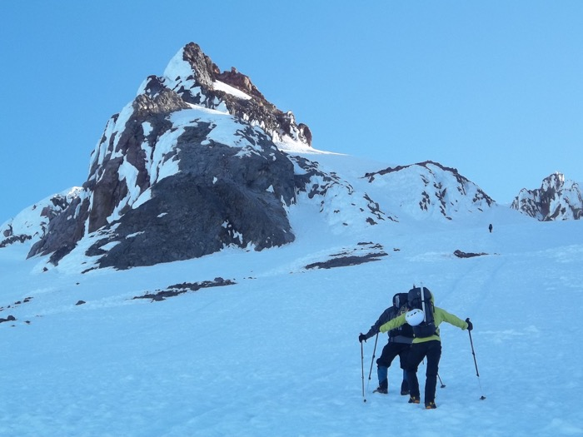
Building relationships, educating each other.
Notes:
We seek out and influence legislators. It works best if you can reach them when they are candidates.
A young local attorney, ran for state senate four years ago. We met for coffee and talked about health care. I learned that he liked to climb mountains. We’ve since climbed together and had lots of time to talk. He now cosponsors our single payer and study bills. Our donations to his campaigns helped.

Slide 20
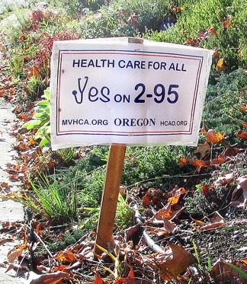
Local advisory ballot measures.
Notes:
What’s next?
Activists organized campaigns for advisory ballot measures in Corvallis, Ashland, and Portland this year. The measures urge the legislature to pay full attention to the RAND study and then involve the public in developing a universal health care system for Oregon. All three measures passed with 3:1 margins last week.

Slide 21
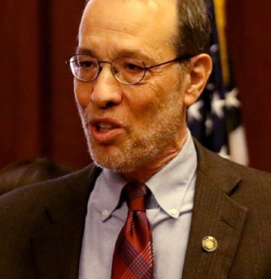
Task force bill directing legislature to take action in 2017
State Sen. Dembrow
Notes:
State Sen. Dembrow will introduce a task force bill in the 2017 session directing the legislature to take action on the results of the study.

Slide 22
Reintroduce single payer bill in 2017.
State Rep. Smith-Warner
Notes:
Sen. Dembrow and Rep. Smith Warner will reintroduce single payer bill in 2017, to further refine the bill through legislative counsel, committee hearings and public discussion.

Slide 23
Continue building knowledge base, passion, relationships, and plans.
Notes:
Continue building knowledge base, passion, relationships, and plans.

Slide 24
Put plans into action with energy, humor, and camaraderie.
Notes:
Put plans into action with energy, humor, and camaraderie.

Slide 25
Statewide ballot measure 2020
Notes:
By 2020 we plan to have convinced one million voters to approve a unified payer universal health care plan for Oregon. The odds are daunting. The work is vital.

Slide 26
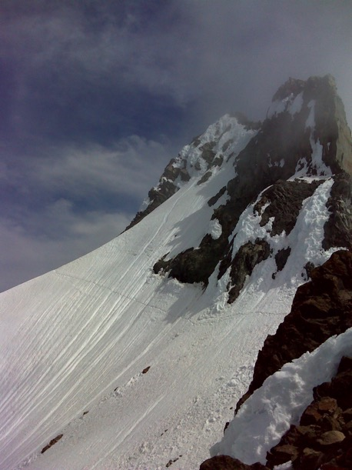
Need passion, knowledge, judgment and timing, good relationships and trust, anchors and life-lines.
Notes:
This the last 600 feet of elevation on the mountain. We’ve already climbed a tedious 6,000 feet, 90% of the way. The summit is still cloudy, the Terrible Traverse here awaits us. To reach the summit will require good climbing conditions, knowledge, judgement and timing, good relationships and trust among us, and use of life-lines as needed to protect each other.
I hope this information will help you reach your own mountain summits and that you find advocating for universal health care as enjoyable and worthwhile as I do. What routes are you considering? What do you think of the routes we have chosen?

