Slide 1
Progressive Persuasions
Speaking Beyond the Choir
Ed Weisbart, MD, CPE, FAAFP
Chair, PNHP-MO

Slide 2
My Career Has Been About Medicine, Business, and Politics
Family Medicine
Physician
Express Scripts
Chief Medical Officer
Physicians for a
National Health Program
1982 – 2003
Practice in Chicago at Rush Medical University
2003 – current
Washington University internal medicine volunteer faculty
2003 – 2010
Fortune 100 company in St Louis MO with $15B revenue and 12,000 employees
Responsible for clinical integrity of all products and services
PNHP nationally:
Established 1987, 20,000+ members
MO chapter chair:
Founded in 2012, now reaches more than 2,200 people
Also advocates for Medicaid expansion

Slide 3
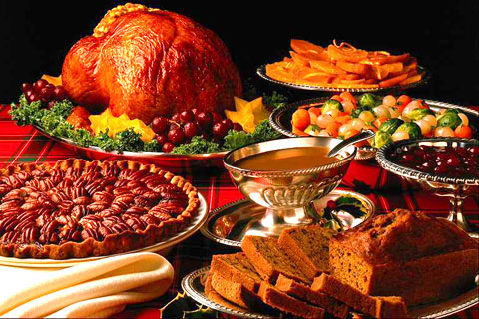
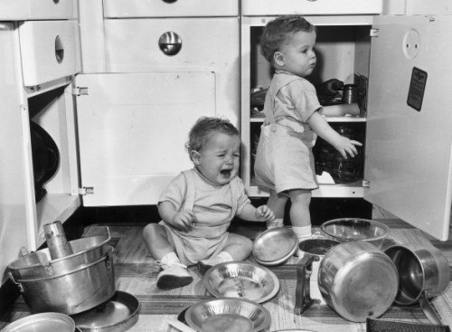
Me? I Want Dinner, Not a Tour of Your Kitchen
Smells good
Looks good
Tastes good
Has a flow to it
Leaves me satisfied
Makes me want to come back

Slide 4
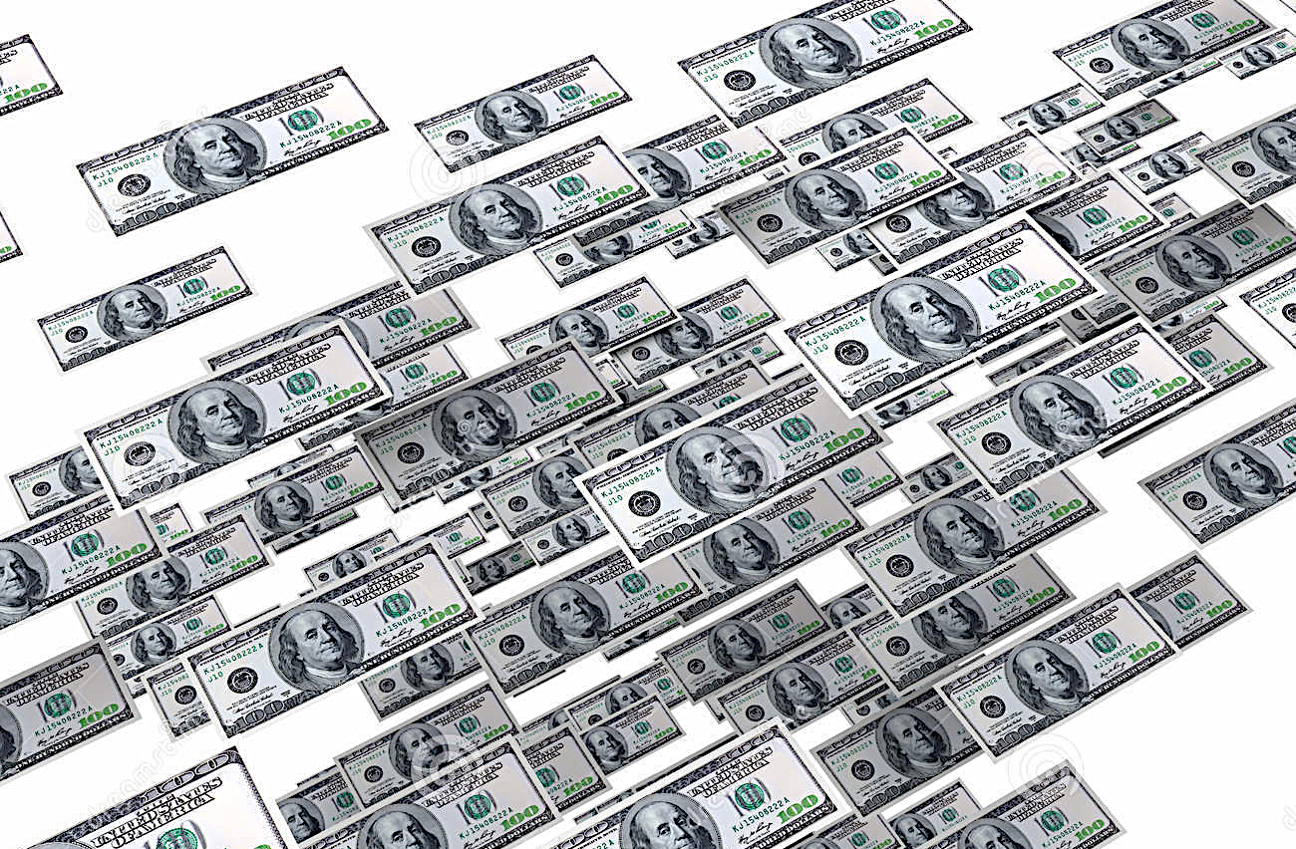
What Is Single Payer?
Also known as
“National Health
Insurance”
also known as
“Medicare for All”
“Single Payer”

Slide 5
Watch Your Words
Also known as
“National Health
Insurance”
also known as
“Medicare for All”
“Single Payer”
“Government take-over!”
“What is a ‘payer’?”
“Medicare is flawed!”

Slide 6
Subtle Differences in Words Matter
“How important is it to you…”
“…to vote?”
“…to be a voter?”
Turnout rate among registered voters
in the 2008 presidential
election
Small differences in words really matter
Boyd, Christopher. Proceedings of the National Academy of Sciences USA, sited in Scientific American Mind Jan/Feb 2012 p.9.

Slide 7
Let’s Play a Game
Losses generally
count double
of gains.
Heads: You lose $10.
How much do you need to gain on tails for you to play?

Slide 8
Apply Loss Aversion
Gain Centric Messages
Loss Centric Messages
Save money for the other things you want.
See any doctor you want.
Live longer and healthier.
Stop wasting your money.
Why should insurers pick your doctor?
Don’t die younger than you need to.

Slide 9
Loss Aversion Which surgeon would you pick?
“95% chance of success”
“5% chance of failure”
This is
loss aversion.
“Outcomes? I don’t really track them.”

Slide 10
Know Your Audience’s Comfort Zones
Efficiency, financials, performance, measurements
Methods, regulation, quality, control, timing, policies
Facts
Forms
Manny Elkind
“Whole Brain Model”
Don’t just dwell in
your own comfort zone
Futures
Feelings
Concepts, vision, purpose, strategy, global
Relationships, communication, culture, values
Manny Elkind, Mindtech Inc.

Slide 11
Find the Common Ground
Liberals
Hear
Common Ground
Conservatives Hear
Equal opportunity
Fairness
Nurturing
Health care is a right not a privilege
Everybody is already in so let’s be prudent
Bureaucracy is wasteful
Free market should apply to healthcare. It fails in insurance.
Govt. over-reach
Longer lines, higher cost
Moral hazard to support bad choices
Undermine individual responsibility
The best health care
in the world,
efficiently delivered
You heartless conservatives just don’t care.
Your bleeding heart
will destroy America!

Slide 12
George Lakoff “Moral Politics”

Slide 13
Intelligent and Compassionate People Can Disagree
Strict Father
Hierarchical
Morality = prosperity
We learn from consequences
Social Darwinism
Nurturing Mother
Core values of fairness, equity
Civilization is inter-dependent
Authority needs to be earned
Bi-Conceptual
Not “moderate” but assigns different frames for different issues
Try to activate nurturing frame early
Conservatives
Independents
Liberals
Gun rights
Death penalty
Anti-abortion
Pro-military
Prudence
Less taxes
Some are uninformed and truly no opinion
Many have alignments on both sides depending on the issue
Schools
Environment
Public health
Pro-choice
Diplomacy first
Based upon Lakoff, G. Moral Politics

Slide 14
Learning Requires a Frame
Intelligent and Compassionate People Can Disagree
Strict Father
Hierarchical
Morality = prosperity
We learn from consequences
Social Darwinism
Nurturing Mother
Core values of fairness, equity
Civilization is inter-dependent
Authority needs to be earned
Bi-Conceptual
Not “moderate” but assigns different frames for different issues
Try to activate nurturing frame early
20%
60%
20%
Based upon Lakoff, G. Moral Politics

Slide 15
Learning Requires a Frame
Strict Father
Hierarchical
Morality = prosperity
We learn from consequences
Social Darwinism
Nurturing Mother
Core values of fairness, equity
Civilization is inter-dependent
Authority needs to be earned
Bi-Conceptual
Not “moderate” but assigns different frames for different issues
Try to activate nurturing frame early
20%
60%
20%
No frame, no learning.
Each group believes it has the moral high ground.
Speak to common values, not morality.
Based upon Lakoff, G. Moral Politics

Slide 16
Moral Foundations Questionnaire Jonathan Haidt
Online survey of 132,000 Americans
Identified five moral values
Compared individual scores with where people stood on the political spectrum
Haidt, Jonathan. The Righteous Mind. 2013.

Slide 17
Our Moral Foundations Vary With Our Politics
Strongly
Endorse
Fairness
Reciprocal altruism, justice, rights, autonomy
Which group really has the moral high ground?
Care
Empathy, kindness, gentleness, nurturance
Loyalty
Patriotism, self-sacrifice, “one for all, all for one”
Authority
Deference to leadership, respect for traditions
Bodies are temples desecrated by immorality
Sanctity
Strongly
Reject
Very Liberal | Slightly Liberal
Moderate
Slightly Conservative | Very Conservative
Haidt, Jonathan. The Righteous Mind. 2013.

Slide 18
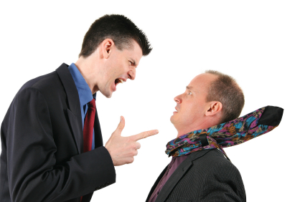
Handling Objections

Slide 19
Handling Objections This Is Not “Good v Evil”
Yes, and…
No, but…
Help me understand…
You’re right; and what that means to me is…
What do you think about this part…?
I hear you, but…
Let me tell you the facts…
Here’s why you’re wrong…
Same Ideas

Slide 20
Humility: A Strategy, Not Just a Virtue
“The sincere and genuine demonstration
of your interest and understanding of
the other person's point of view
is far more important than
your ability to provide a quick solution."
Gary Noesner
Former FBI Hostage Negotiator
crisisnegotiator.blogspot.com/2014/12/in-this-corner-janus-theory-whats-old.html
Accessed Oct. 24 2015

Slide 21
Respect: A Strategy, Not Just a Virtue
“The toes you step on today
might be connected to the
butt you want to kiss tomorrow.”
Jimmy Hoffa
International Brotherhood of Teamsters

Slide 22
Imagine You Have Fifteen Seconds In This Elevator
Hi there.
What’s on
your mind?

Slide 23
Talking Points Example: Single Payer
See any doctor
Best health care
in the world,
efficiently delivered.
Stabilize the nation’s costs
No copays or deductibles
Cover everybody

Slide 24
Talking Point #1 Cover Everybody
Liberal
Messages
Conservative Messages
Everybody in, nobody out (Fairness)
Healthcare is a human right (Fairness)
We’ll live longer (Care)
Children need their families healthy (Care)
We should not die younger than we have to (Sanctity)
All communities need healthcare (Loyalty)
Faith-based leaders advocate for universal care (Authority)

Slide 25
Talking Point #2 No Copays or Deductibles
Liberal Messages
Conservative Messages
No one should have to choose between rent, food, and medicine. (Care)
Your wealth shouldn’t determine your health (Fair)
No one should get sick because they can’t afford to pay for care (Sanctity)
Every American should be able to get health care (Loyalty)

Slide 26
Talking Point #3 Stabilize the Nation’s Costs
Liberal
Messages
Conservative
Messages
Wasting money for healthcare makes it harder to fund other important social programs. (Care)
Health insurance CEOs are grossly overpaid. (Fairness)
Draining business resources through excessive insurance administration weakens America (Loyalty)
Be good stewards of our resources. (Sanctity)

Slide 27
Talking Point #4 See Any Doctor
Liberal Messages
Conservative Messages
Insurers profit by limiting my choices (Fairness)
Nobody should be able to tell me whom I can and can’t see (Authority - rejection).
I need control over my choice of physician. (Sanctity)
Insurance companies should not contradict my doctor (Authority)

Slide 28
Single Payer Talking Points
See any doctor
Best health care
in the world,
efficiently delivered.
Stabilize the nation’s costs
No copays or deductibles
Cover everybody

Slide 29
Our Churchill Moment Is Here
“You can always
count on Americans
to do the right thing –
after they've tried
everything else.”
Winston Churchill

