Slide 1
The Uninsured

Slide 2
Uninsured All Year, 1940-2025
Medicare / Medicaid
Millions
Estimated
Source: Social Security Bul, HIAA, CPS, and CBO estimate

Slide 3
28,949 Deaths During 2015
Due to Uninsurance
State | % Uninsured | Excess Deaths
Texas | 17.1 | 4,612
California | 8.6 | 3,315
Florida | 13.3 | 2,660
Georgia | 13.9 | 1,387
New York | 7.1 | 1,380
USA | 9.4% | 28,949
Source: Wilper et al. Am. J. Public Health, 2009 – updated using 2016 CPS

Slide 4
Medicaid: Poor Access,
But Better than Nothing

Slide 5
Medicaid Enrollment, 1987-2016
Millions of Americans
Bureau of the Census and Kaiser Foundation

Slide 6
Many Specialists Won’t See
Kids With Medicaid
% of Clinics Scheduling
Appointments for Children
Bisgaier J, Rhodes KV.
N Engl J Med 2011;364:2324-2333
Notes:
6
Figure 2 Clinics Scheduling Specialty Care Appointments for Children, According to Type of Insurance. Public insurance was reported by callers as the Illinois Medicaid–Children's Health Insurance Program (CHIP) umbrella program; private insurance was reported by callers as Blue Cross Blue Shield. Each of the 273 clinics was called twice (for a total of 546 calls) by the same caller, with only insurance coverage varying between the two calls: once reporting Medicaid–CHIP coverage and once reporting private coverage. Calls were made 1 month apart, and the order of the reported insurance status was randomly assigned. Asthma clinics included 38 allergy–immunology clinics and 6 pulmonary disease clinics.

Slide 7
Underinsurance
Impedes Access, Worsens Health, Bankrupts Families

Slide 8
Deductibles Are Increasing Rapidly
Percent of Workers
With Deductibles >$999 (Single Coverage)
Source: Kaiser/HRET Survey of Employer-Sponsored Benefits, 2015

Slide 9
High Deductibles Cut All Kinds of Care
150,000 Employees Lost “Cadillac” Coverage
No Evidence that Patients Shifted to “Higher Value” Care
Percent utilization reduction
Brot-Goldberg et al, 6/2015
http://eml.berkeley.edu/~bhandel/wp/BCHK.pdf
Findings closely resemble those of Rand Health Insurance Experiment
Study found no evidence that patients shopped for lower prices

Slide 10
Uninsured and Under-Insured
Delay Seeking Care for Heart Attacks
Odds ratio for delayed care*
Source: JAMA April 15, 2010. 303:1392
*Adjusted for age, sex, race, clin. charact., hlth status, social/psych fx, urban/rural.
Under-insured=had coverage but patient concerned about cost

Slide 11
Medication Copays Increased Post-MI Vascular Events in Minorities (An RCT)
60%
50%
40%
30%
20%
10%
0
Copay Group
Cumulative Incidence
Free Med
Group
0 | 6 | 12 | 18 | 24 | 30 | 36
Months
Source: Choudhry N. Health Aff 2014:33:863

Slide 12
Higher Medication Co-Pays =
Worse Pediatric Asthma Outcomes
Children age 5-18
Source: JAMA 2012;307:1284

Slide 13
Higher Copayments = Kids Without Care
Percentage with no physician visits in year
Source: Rand Experiment. Pediatrics 1985;75:942

Slide 14
Most of the Medically Bankrupt Had Insurance at the Onset of Their Illness
Source: Himmelstein et al. Am J Med: August, 2009

Slide 15
Medical Debts:
Most Common Ding on Credit Reports
Source: Consumer Credit Reports – Consumer Financial Protection Bureau, December, 2014
Figures indicate percent of credit reports with an item appearing as “sent to collection”

Slide 16
Rising Economic and Health Inequality

Slide 17
Mean Family Income for Each Fifth:
1966 – 2015 (Inflation Adjusted)
Source: Bureau of the Census

Slide 18
Growing Gap in Life Expectancy by Income
Dramatic gains for the wealthy; losses for lower income
Remaining life expectancy at age 50
Growing Gap in Life Expectancy by Income
National Academy of Sciences, 2015

Slide 19
Rising Mortality For US Non-Hispanic Whites, 45-54
450
400
350
300
250
200
USW
Deaths per 100,000
FRA
GER
USH
UK
CAN
AUS
SWE
1990
2000
2010
Year
Source: Case & Deaton, PNAS 2016

Slide 20
Child Poverty Rates
U.S. and Other Industrialized Nations
Source: OECD 2016

Slide 21
Income Inequality Worst in USA
Top 1% Income Share, 2014/2015
Source: World Top Incomes Database

Slide 22
Persistent
Racial Inequalities

Slide 23
Black Americans Die Younger
Life Expectancy at birth
CDC, 2015 – Final Mortality Data for 2013
*Hispanics can be of any race, and Blacks and Whites include some Hispanics

Slide 24
Median Family Income
Median income
Whites
Blacks
Inflation adjusted, 2014 $s
Bureau of the Census, 2016 data

Slide 25
Job Discrimination Persists
Experimental Study of the Impact of “Whitening” Resumes
Black Applicant
Asian Applicant
Callback rate after resume submitted
Source: Kang SK, et al. Admin SciQ, 2016 – Job ads with pro-diversity language yielded same result
*e.g., change “Lamar J. Smith” to “L. James Smith” or “Lei Zhange” to “Luke Zhang”
** e.g., change “Aspiring Asian Business Leaders” to “Aspiring Business Leaders”

Slide 26
Causes of Black/White
Disparity in Life Expectancy
Source: MMWR 2001;50:780

Slide 27
Physicians/Population by Race/Ethnicity
Physicians per 1000 population
Data are for 2008
Source: AMA and Census Bureau

Slide 28
Black and Female Physicians Earn Less
Annual Income
Source: Ly et al. BMJ 2016;353:2923
Note: Figures are adjusted for hours worked, specialty, age, years in practice, practice type, percent of revenue from Medicare/Medicaid

Slide 29
Minority Children and Youth
Get Few Psychiatrist Visits
Psychiatrist visits per year per 1,000 population
Source: Marrast, Himmelstein, Woolhandler. Int J Hlth Serv 2016

Slide 30
Worse OB Care and Outcomes for Black Women
Odds Ratio or Risk Ratio (1=no racial difference)
Source: AJPH 2016;106:1771
*Likelihood of knowing that genetic testing is optional

Slide 31
Immigrants Get Little Care
Health Care
$ per capita
*Adjusted for ethnicity, poverty, age, insurance status, patient/parent-reported health status
Source: Mohanty et al. Am J Public Health 2005;95:1431

Slide 32
Immigrants Keep Medicare Afloat
$3.7 Billion
$10.1 Billion
Net contribution to Medicare Trust Fund, 2009
-$30.9 Billion
Source: Zallman et al, Health Affairs 2013;32:1153

Slide 33
Administrative Overhead Rising

Slide 34
Growth of Physicians and Administrators
Growth since 1970
Bureau of Labor Statistics; NCHS; Himmelstein/Woolhandler analysis of CPS
Managers shown as moving average of current year and two previous years

Slide 35
Doctors Spend Twice as Much Time on
EHR/Desk Work as With Patients
Source: Sinsky et al. Ann Int Med 9/6/2016 – based on time/motion observation + home diary
Note: Figures are percent of office hours – exclude the 1-2 hrs/night of home EHR/desk work

Slide 36
Investor-Owned Care:
Inflated Costs, Inferior Quality

Slide 37
Extent of For-Profit Ownership
100%
95%
90%
76%
65%
11%
27%
37%
63%
For-profit firms’ share of total revenues
Source: Commerce Dept. Service Annual Surveys & MedPac. Data are Q1, 2016 or most recent available.
*Data are for share of establishments.

Slide 38
Health Industry Profits, 2015
Billions of Dollars
Source: Fortune 500, 2016

Slide 39
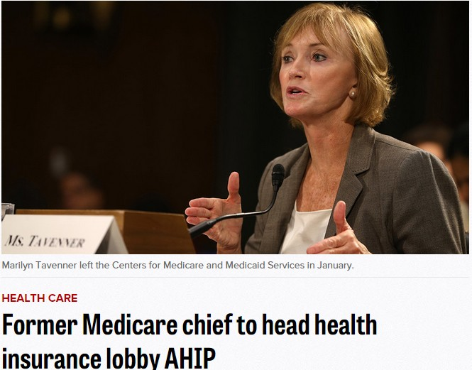
Source: Palmer, A and Demko, P. Politico 7/15/2015.

Slide 40
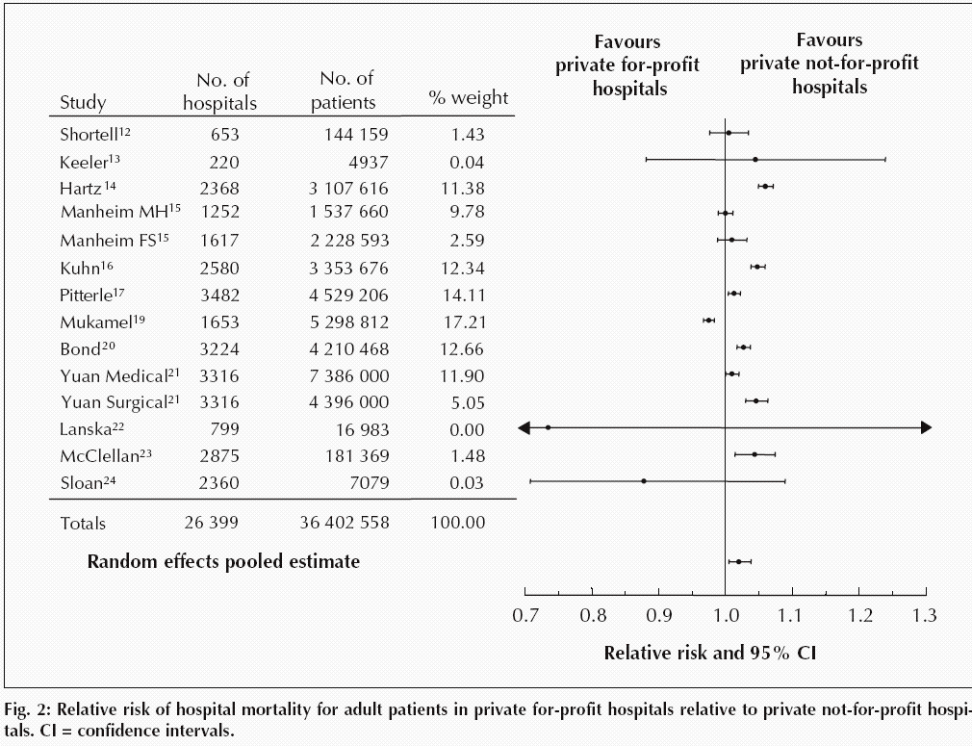
For-Profit Hospitals’ Death Rates
Are 2% Higher
Relative risk of hospital mortality for adult patients in private for-profit hospitals relative to private not-for-profit hospitals
Source: CMAJ Devereaux et al. 166 (11): 1399.

Slide 41
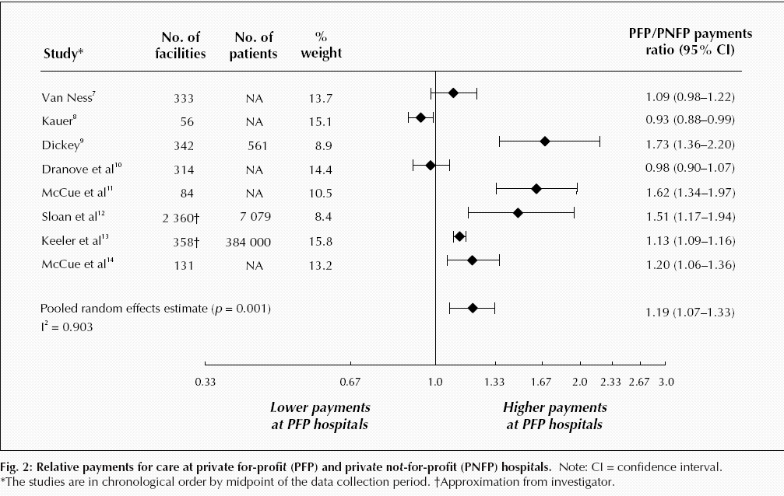
For-Profit Hospitals Cost
19% More
Relative payments for care at private for-profit (PFP) and private not-for-profit (PNFP) hospitals
Source: CMAJ Devereaux et al. 170 (12): 1817.

Slide 42
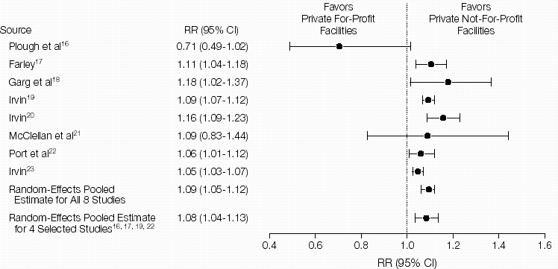
For-Profit Dialysis Clinics’ Death Rates
Are 9% Higher
Relative Risk (RR) of Morality in Hemodialysis Patients
Source: JAMA 2002;288:2449
Notes:
42

Slide 43
Hospice Care Goes For-Profit
Percent of hospices under for-profit ownership
Source: MEDPAC annual report, 2016 and previous reports
Profit rate: for-profits = 15.6%; non-profits = 2.4%.
Mean LOS: for-profits = 107 days; non-profits = 67 days

Slide 44
For-Profit Hospices Avoid
Unprofitable Patients
Likelihood of accepting all patients, regardless of care needs
(and profitability)
Source: Health Affairs 2012;31:2690
Note: Based upon accepting patients on chemo, TPN, transfusions, tube feeds, intrathecal cath, palliative radiation, or living alone

Slide 45
US Prescription Drug Spending
Prescription drug spending,
Billions of dollars
Estimated
Source: CMS, Office of the Actuary
Note: 2015-2017 estimated

Slide 46
Insulin Cost Tripled 2006-2013
Average cost per patient in 2013:
$763
Mean expenditure per patient for insulin
Source: JAMA 2016;315:1400

Slide 47
USA Spends the Most on Drugs
Double the OECD Average
Per capita spending
on retail prescription drugs
Source: OECD, Health at a Glance, 2015
Note: Data are for 2013 or most recent year available. OCED average includes 29 developed nations.

Slide 48
Drug Company Profits
Return on Revenue (%)
Fortune 500 rankings for 1995-2016
Total drug company profits, 2015= $67.1 billion

Slide 49
Investor-Owned Medicaid HMOs:
Higher Administrative Costs, Lower Quality
Note: Publicly Traded = Publicly traded Medicaid-only plans
Source: McCue. Commonwealth Fund, June, 2011

Slide 50
HMO Overhead, 2015
SEC Filings/Reports to Shareholders. Data for Q1 or Q2
Calculated as 100-100(benefits/premiums)
Note Medicare/Medicaid enrollees included in some figures

Slide 51
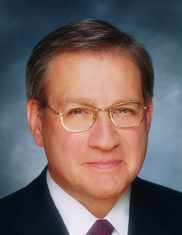




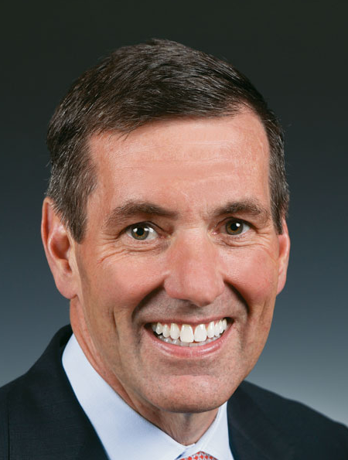
HMO CEOs’ 2015 Pay
Michael Neidorff | David Cordani | Mark Bertolini
Steve Helmsley | Joseph Swedish | Bruce Broussard
Centene
Annual Comp:
$20.8 M
Pay/Weekday:
$80,000
Cigna
Annual Comp:
$17.3 M
Pay/Weekday:
$66,538
Aetna
Annual Comp:
$ 17.3 M
Pay/Weekday:
$66,538
United
Annual Comp:
$14.5 M
Pay/Weekday:
$55,769
Wellpoint
Annual Comp:
$13.6 M
Pay/Weekday:
$52,308
Humana
Annual Comp:
$10.3 M
Pay/Weekday:
$39,615
Source: SEC filings

Slide 52
Medicare
Remains Solvent and Relatively Efficient

Slide 53
Growth in Spending 1969-2014:
Medicare Vs. Private Insurers
Per Enrollee, Common Benefits
Percent Increase
Medicare
Private Insurance
Source: CMS Office of the Actuary

Slide 54
Medicare Advantage Plans’
High Overhead
Sources: GAO 12/2013 and Medicare Trustees Report 2012 – Figures are for 2011
Note: MA overhead = $905/enrollee; profit = $447/enrollee
Total MA profit = $3.3 Billion

Slide 55
Medicare Advantage Plans’ Narrow Networks
More than a third of all Medicare Advantage plans lack an NCI cancer center.
49% of narrow networks exclude academic med centers.
Sources: Kaiser Family Foundation June, 2016
Note: “Narrow” = <30% of hospitals; “Medium Small” = 20-49%; “Medium” = 50-69%; “Broad” = >69%

Slide 56
Despite Medicare’s Lower Overhead, Medicare Advantage Plans Outcompete Traditional Medicare by
Cherry Picking, Upcoding, and Lobbying for Overpayment

Slide 57
Medicare HMO Enrollment
Medicare HMO Enrollees (millions)
2016
Source: CMS

Slide 58
A Few Sick People
Account for Most Health Dollars
Percent of total health spending accounted for by decile
Top 2 deciles account for 78.3%
Decile of Privately Insured Americans
2001 data
Source: MEPS Data, from Thorpe and Reinhart

Slide 59
Sickest Patients
Switch Out of Medicare Advantage
Percent switching out during 2011
Plan switched out of:
  Traditional Medicare
  Medicare Advantage
Health Affairs 2015;34:1675
Similar results for patients with hospital or home care use, more marked among dual eligibles

Slide 60
Audits Found Massive Overpayments to MA Plans
Audits of 5 plans – Aetna, Humana, UnitedHealthcare, Independence Blue X, Lovelace
Plans overstated risk score for >80% of patients, resulting in overpayments for 58% of enrollees.
Only 7.5% were “under-coded”.
Overcoding caused overpayment of $3,300/enrollee
Source: Schulte. Center for Public Integrity, 7/10/15

Slide 61

HMO “House Calls”:
A New Upcoding Scam
HMOs send their “house call doctor” – or one from Mobile Medical Examination Services Inc.
Doctor seeks out unimportant diagnoses, e.g. mild arthritis
No treatment offered
Extra diagnoses allow HMOs to upcode, adding >$3 billion/year to Medicare Advantage payments
Efforts to outlaw upcoding “house calls” were scrapped after industry lobbying blitz
Schulte, Center for Public Integrity, 2014

Slide 62
Medicare Overpays Private Plans
Overpayments ($ Billions)
Total overpayments 2008-2016:
$173.7 Billion
Source: MedPAC and Geruso and Layton, 2015

Slide 63
Medicare advantage experience warns that Ryan’s premium support plan to voucherize Medicare would increase costs, inequality, and profiteering

Slide 64
Competition
In Health Care
Is Fading as
Oligopolies Gain Control

Slide 65
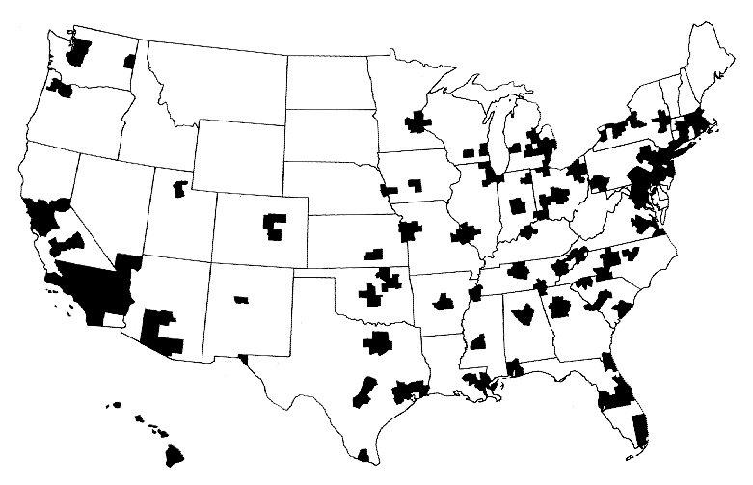
Half of Americans Live Where Population Is Too Low for Competition
A town’s only hospital will not compete with itself
Source: NEJM 1993;328:148

Slide 66
Hospitals Merging
System-Owned
Proportion of Hospitals That Are System-Owned vs. Independent
Independent
Source: Sanofi Hospital/Systems Digest, 2016

Slide 67
More Doctors Are Hospital Employees
Percent of newly hired physicians employed by hospitals
Source: Medscape July 9, 2012

Slide 68
Physician/Hospital Integration
Raises Costs
Annual Outpatient Cost Increase with 1.9% Increase in Physician/Hospital Integration
Source: JAMA IM 2015;175:1932
Note: Physician/Hospital integration measured by % of MDs billing with a hospital place of service code

Slide 69
The Toxicity of
Pay for Performance (P4P)

Slide 70
Quality Scores Tell More About Patients than Physicians
Harvard physicians with poorer/minority patients score low
Patient characteristics in panels of high-
and low-scoring physicians
Source: Hong C et al. JAMA 9/8/2010. 304:10;1107.

Slide 71
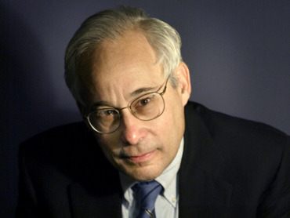
Pay for Performance?
“I do not think it’s true that the way to get better doctoring and better nursing is to put money on the table in front of doctors and nurses. I think that's a fundamental misunderstanding of human motivation.
“I think people respond to joy and work and love and achievement and learning and appreciation and gratitude – and a sense of a job well done. I think that it feels good to be a doctor, and better to be a better doctor.
“When we begin to attach dollar amounts to throughputs and to individual pay, we are playing with fire. The first and most important effect of that may be to begin to dissociate people from their work.”
– Don Berwick M.D.
Health Affairs. 1/12/2005

Slide 72
95% of Plans Cheat on HEDIS Quality Measures
Medicare Advantage plans failing to cheat fall in rankings
Percent of elderly patients prescribed drugs that should be avoided
Annals of Internal Medicine 2013;159:456
Researchers compared reported HEDIS scores for high risk prescribing to actual Medicare Part D payment records for all enrollees and for enrollees sampled for HEDIS scoring

Slide 73
Medicare’s Premier Demonstration:
A P4P Failure at 252 Hospitals
Worse
5-year outcomes show no effect on mortality
Change from baseline in 30-day mortality
Better
Note: P4P failed even among poor performers at baseline
Source: NEJM March 28, 2012

Slide 74
P4P Did Not Lower
Hospital Mortality in England
P4P Hospitals
20%
15%
10%
5%
P4P Hospitals
30-Day Mortality
Control Regions
No
P4P
Bonuses Only
Bonuses plus Incentives
Difference
2007 | 2008 | 2009 | 2010 | 2011 | 2012
Source: N Engl J Med 2014;371:540-548

Slide 75
P4P Did Not Improve Mortality in England
World’s largest P4P program tied 25% of GP income to quality targets
Change in Deaths/100,000 From Pre to Post P4P Implementation
Source: Lancet 2016;388:268
Note: Data shows trends compared to developed nations without P4P

Slide 76
Mandate Model Reform:
Keeping Private Insurers In Charge

Slide 77

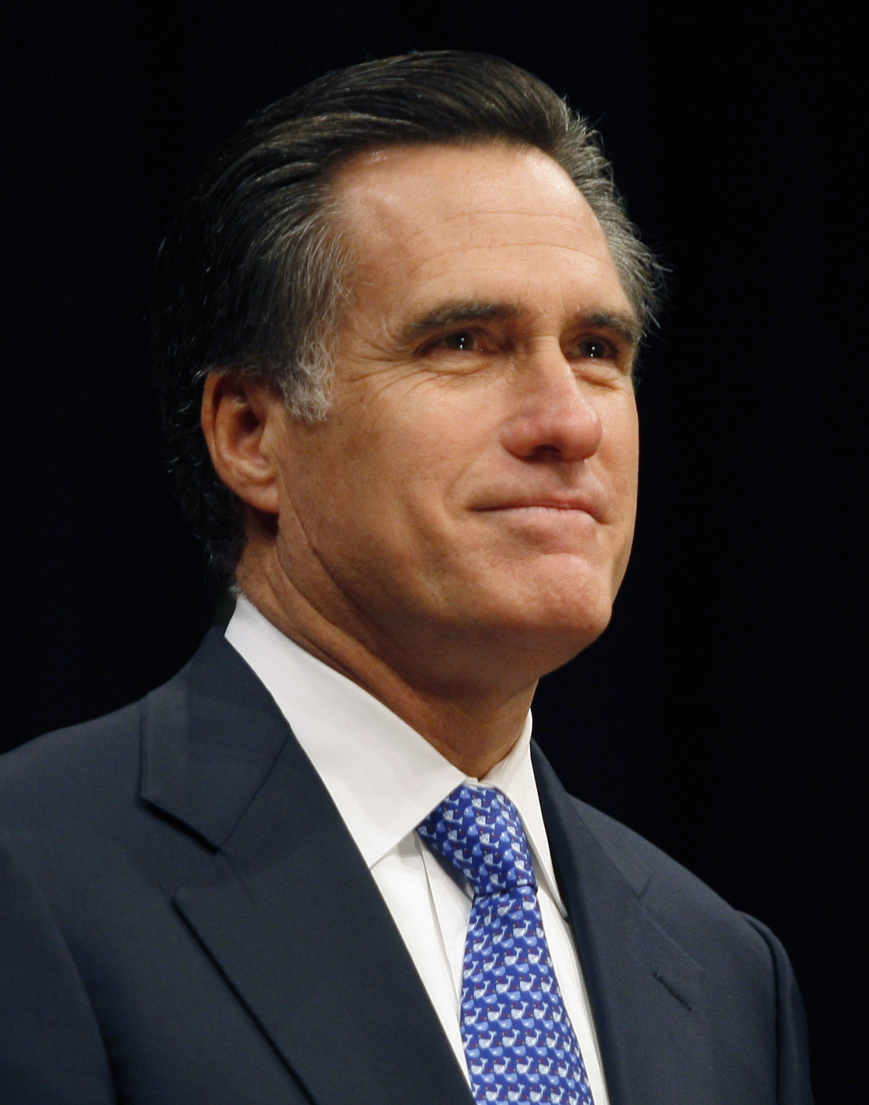

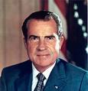
“Mandate Model” of Reform
Expanded Medicaid-like program
  Free for the poor
  Subsidies for low income
  Buy-in without subsidies for others
Employer Mandate +/- Individual
Insurance Exchanges
Notes:
77

Slide 78

The Heritage Foundation Proposal: 1989
Universal coverage
Individual mandate
Refundable tax credits pegged to income and health status.
Minimum benefit package

Slide 79
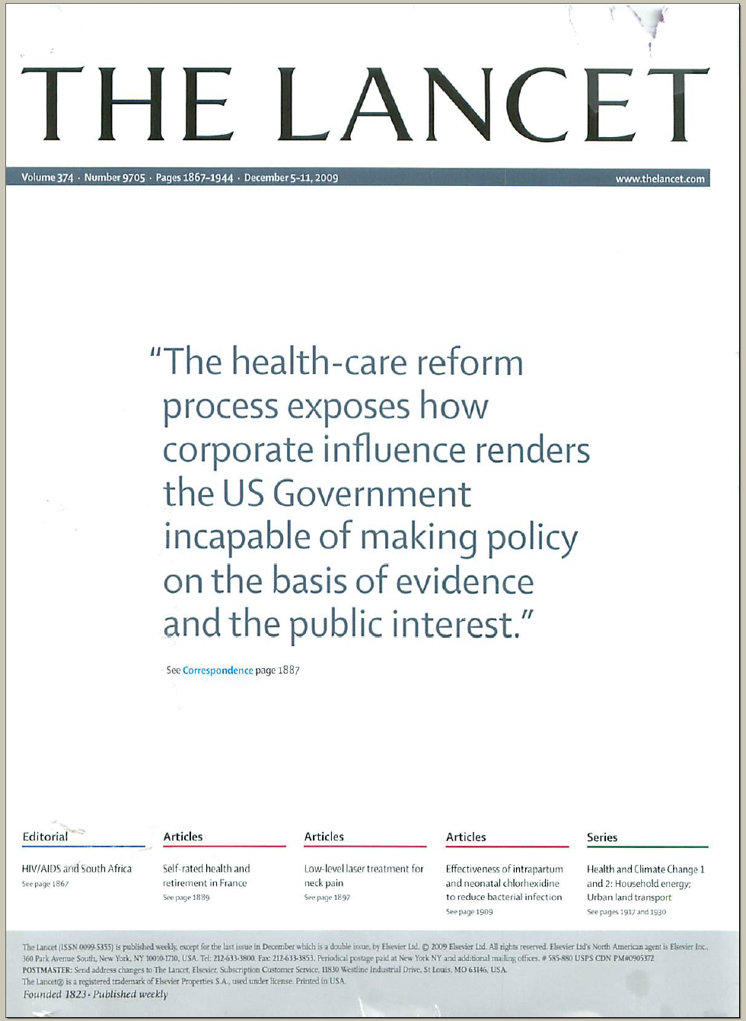
The Lancet Put It on Their Cover
“The health-care reform process exposes how corporate influence renders the US Government incapable of making policy on the basis of evidence and the public interest.”
Source: Lancet Dec 5, 2009. Cover of vol. 374.

Slide 80
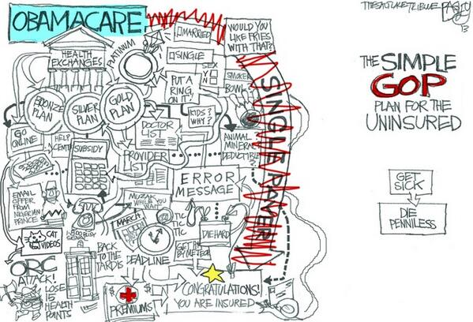

Slide 81
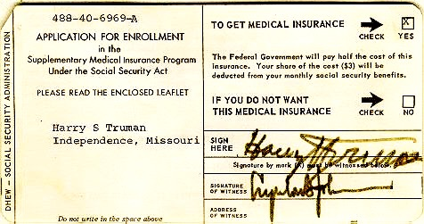
Medicare’s “Software”
18.9 million seniors enrolled within 11 months

Slide 82
ACA Reduced Percent of Americans Unable to Afford Care
Back to Level in 2000
Percent of Americans who failed to obtain needed care due to costs, past 12 months
Source: NHIS 1997-2015 – NCHS Release 5/16

Slide 83
Gains in Access to Care Under the ACA
Percent of adults 19-64 who needed but did not get:
Source: Commonwealth Fund Biennial Health Insurance Surveys 2005, 2010, 2012, 2014

Slide 84
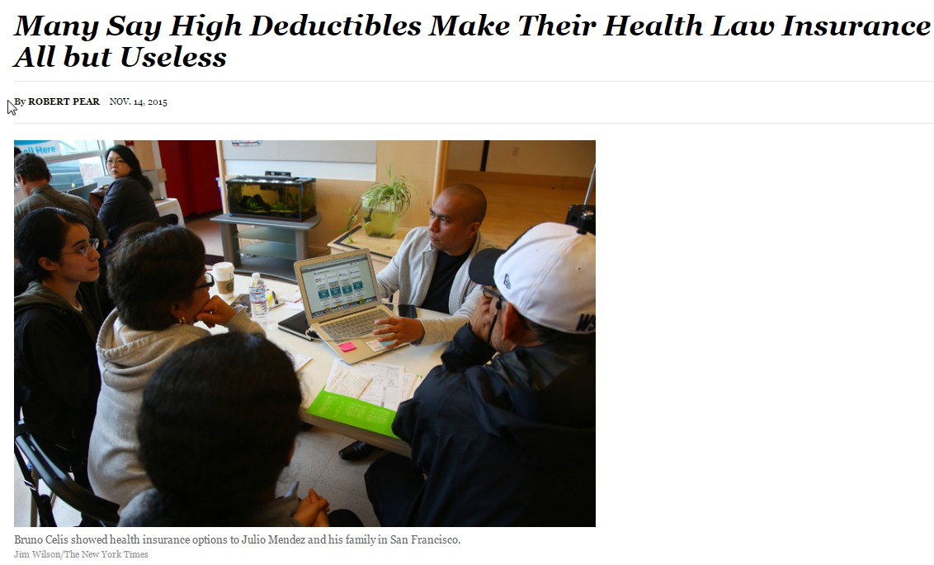
Source: Pear, R. NYTimes Nov 14, 2015

Slide 85
NY State Cheapest Bronze Plan (Family, 2017)
Premium: $12,563
Deductible: $8,000
Coinsurance: 50% after deductible for:
    Ambulance, ED, Urgent Care
    Imaging & diagnostic tests
    Outpatient visits
    Chemotherapy
    Inpatient
Out-of-pocket maximum:
  $14,300 for a family with income-based adjustments …

Slide 86
Silver Plans Restrict Patients’ Choice of Physician
Particularly Cancer Specialists
Janet Weiner, LDI/RWJ Data Brief, 6/23/15
Ultra-Narrow = <25% of doctors in region; Narrow = 25-60%; Broad = >60%

Slide 87
What Trump Has Said
Repeal ACA and replace with:
  Return insurance regulation to states, but allow insurance sales across state borders
  “Modernize” Medicare
  State “flexibility” on Medicaid
  HSAs
  High risk pools
Relax FDA drug approval process
Restrict (or end) access to abortion
Source: greatagain.gov – 11/13/16

Slide 88
What We Expect from Trump:
A Meaner and Rebranded ACA
Substitute tax credits for ACA subsidies, making them
  less progressive and shrinking coverage
More copays/deductibles and excluded services
Deregulate insurers
Block-grant Medicaid and drop federal regs, encouraging state cutbacks
Further privatize Medicare
Allow states/employers to restrict reproductive health care

Slide 89
American Taxpayers Already
Pay More Than People in Nations
With National Health Insurance

Slide 90
Taxes Fund ²/₃ of Health Spending
Tax Funded
65%
Source: Himmelstein & Woolhandler – Analysis of NCHS data

Slide 91
US Public Spending per Capita for Health
Exceeds Total Spending in Other Nations
Per Capita Health Expenditures
USA Total
$9,960
Note: Public includes benefit costs for govt. employees & tax subsidy for private insurers
Source: OECD 2016;106:449 – Data are for 2015 or most recent available

Slide 92
The USA
Trails Other Nations

Slide 93
Life Expectancy
Years
Source: OECD, 2016
Note: Data are for 2014 or most recent year available

Slide 94
Infant Mortality:
Deaths within the first year of life / 1,000 live births
Source: OECD, 2016
Note: Data are for 2014 or most recent year available

Slide 95
Maternal Mortality
Deaths per 100,000 Live Births
Source: OECD, 2016
Note: Data are for 2014 or most recent year available

Slide 96
Maternal Mortality:
Unprecedented Increase
Deaths per 100,000 Live Births
Source: Obstetrics & Gynecology 2016;128:447
Note: California excluded from national figures because of discontinuity in ascertainment

Slide 97
High U.S. Costs Do Not Result From
Bad Health Habits
Aging
Overuse of Care

Slide 98
Smoking Prevalence
Percent of population >age 15 who smoke daily
Source: OECD, 2016
Note: Data are for 2015 or most recent year available

Slide 99
Percentage of Elderly
Percent of population >age 64
Source: OECD, 2016
Note: Data are for 2015 or most recent year available

Slide 100
Hospital Inpatient Days per Capita
Days/person/year
Source: OECD, 2015 & AHRQ
Note: Data are for 2014 or most recent year available

Slide 101
Physician Visits per Capita
Source: OECD, 2016
Note: Data are for 2015 or most recent year available

Slide 102
Number of Nurses per 1,000 Population
Source: OECD, 2016
Note: Data are for “professionally active nurses” for 2015 or most recent year available

Slide 103
Pet Scan Units per Million Population
Source: OECD 2016
Note: Data are for 2015 or most recent year available

Slide 104
Private Insurance = High Overhead
Everywhere!
Percent Overhead
Source: “Voluntary Health Insurance in Europe” (WHO, 2016); NCHS and CIHI

Slide 105

Canada’s
National Health Insurance Program

Slide 106
Minimum Standards for
Canada’s Provincial Programs
Universal
  Universal coverage that is not impeded, either directly or indirectly, whether by charges or otherwise, reasonable access.
Portable
  Portability of benefits from province to province
Comprehensive
  Coverage for all medically necessary services
Public
  Publicly administered, non-profit program

Slide 107
Free Care in Quebec Increased Physician Care for Serious Symptoms
Biggest impact on poor and middle class
Percent of serious symptoms for which physician was seen
Source: NEJM 1973;289:1174

Slide 108
Quality of Care
Slightly Better in Canada Than in USA
Source: Guyatt et al, Open Medicine, April 19, 2007

Slide 109
Canadians’ Life Expectancy
Growing Faster than Americans’
Life expectancy at birth
Sources: StatCan & NCHS

Slide 110
Mortality Gap by Income
Is Shrinking in Canada
Remaining Life Expectancy at Age 25
Source: Toronto Globe & Mail, 11/8/2013
“For the most part, the differences in health status between the highest and lowest income groups have been shrinking over time.” – Public Health Agency of Canada

Slide 111
Health Costs as Percent of GDP
USA
NHP Fully Implemented
Canada’s NHP Enacted
Canada
Sources: Statistics Canada, Canadian Inst. for Health Inf., and NCHS/Commerce Dept.

Slide 112
US Medicare Coverage
Much Worse than Canada’s
Percent of Seniors’ Total Medical Expenses Covered
Note: Not comparable to figures for employer coverage because of high LTC needs in elderly
Source: EBRI and Himmelstein/Woolhandler analysis of Health Canada data

Slide 113
How Canada Controls Costs
Low administrative costs (16.7% of health spending vs. 31.0% in USA)
Lump-sum, global budgets for hospitals
Stringent controls on capital spending for new buildings and equipment
Single buyer purchasing reins in drug/device prices
Low litigation and malpractice costs
Emphasis on primary care
Exclusion of private insurers (private plans overcharged U.S. Medicare by $34 billion in 2012)
Source: Himmelstein & Woolhandler, Arch Intern Med, December, 2012

Slide 114
Hospital Billing and Administration
USA and Canada, 2016
$ per Capita
(PPP Adjusted)
Source: Woolhandler et al. NEJM 2003;349:768 (updated); Himmelstein et al, Health Aff 9/2014

Slide 115
Physicians’ Billing and Office Expenses
United States and Canada, 2016
$ per Capita
(PPP Adjusted)
Source: Woolhandler/Campbell/Himmelstein NEJM 2003;349:768 (updated)
Note: Excludes dentists and other non-physician, office-based practitioners

Slide 116
Overall Administrative Costs per Capita
United States and Canada, 2016
Source: Woolhandler et al. NEJM 2003;349:768 (updated); Himmelstein et al. Health Aff 9/2014

Slide 117
Difference in Health Spending per Capita
USA and Canada, 2016
Source: Woolhandler/Himmelstein/Campbell NEJM 2003;349:768 (updated)
Himmelstein et al, Health Affairs 9/29; NCHS; CIHI; PPP adj.

Slide 118
Few Canadian Physicians Emigrate Today
Net loss
(number moving abroad –
number returning)
A negative number indicates that more physicians returned from abroad then moved abroad
Source: Canadian Institute for Health Information

Slide 119
Canadian Physicians’ Incomes
Average FFS billings per FTE physician, 2014-2015
Specialty | Income
Family Medicine | $271,417
Internal Med | $378,468
Pediatrics | $292,242
Psychiatry | $258,697
Dermatology | $368,003
Specialty | Income
OB-GYN | $405,504
General Surgery | $417,773
Thoracic Surgery | $529,829
Ophthalmology | $668,887
Avg All Canada | $337,767
Source: Canadian Institute for Health Information
Figures are in Canadian $

Slide 120
Canadian Malpractice Insurance Costs, 2017
Specialty | Ontario* | Quebec | BC & Alberta
Family Med | $5,700 | $1,661 | $4,020
Psychiatry | $7,092 | $2,341 | $4,812
Cardiology | $7,092 | $2,341 | $4,812
Anesthesia | $16,644 | $5,075 | $11,148
Neurosurgery | $72,516 | $17,789 | $47,988
Obstetrics | $99,072 | $29,208 | $63,984
*Ontario reimburses physicians for premiums above 1986 level. All figures in Canadian $s.
Source: Canadian Medical Protective Association
www.cmpa-acpm.ca

Slide 121
What’s OK in Canada?
Compared to the USA…
Life expectancy 2 years longer
Infant deaths 25% lower
Universal comprehensive coverage
More physician visits, hospital care; less bureaucracy
Quality of care equivalent to insured Americans’
Free choice of doctor and hospital
Health spending half of USA level

Slide 122
What’s the Matter in Canada?
The wealthy lobby for private funding and tax cuts; they resent subsidizing care for others.
Result: government funding cuts (e.g., 30% of hospital beds closed during the 1990s) causing dissatisfaction and waits for care.
USA and Canadian firms seek profit opportunities in health care privatization
Conservative foes of public services own many Canadian newspapers
Misleading waiting list surveys by right wing Fraser Institute

Slide 123
Most Want Medicare-for-All
Do you favor “expanded, universal Medicare-for-All”?
All Adults
Democrats
Source: Kaiser Health Tracking Poll, 12/17/2015

Slide 124
“Expanded, Universal Medicare for All”
Favored by Most Independents and Even Many Republicans
Independents
Republicans
Source: Kaiser Health Tracking Poll, 12/17/2015

Slide 125
Most Support “Replacing the ACA With a Federally Funded System for All”
All Adults
Democrats
Source: Gallup 5/16/2016

Slide 126
Unlikely Single Payer Supporters
“Do you support a “federally funded healthcare program for all Americans?”
Republicans
Favor Repeal of ACA
Source: Gallup 5/16/2016

Slide 127
A National Health Program for the USA

Slide 128
National Health Insurance
Universal – covers everyone
Comprehensive – all needed care, no co-pays
Single, public payer – simplified reimbursement
No investor-owned HMOs, hospitals, etc.
Improved health planning
Public accountability for quality and cost, but minimal bureaucracy
Proposal of the Physicians Working Group for Single Payer NHI
Gaffney et al AJPH JUne 2016 106:6 + Suppl.
JAMA 2003;290:798
http://ajph.aphapublications.org/doi/full/10.2105/AJPH.2015.303157

Slide 129
Funding for the NHP
Revenue Sources
Recipients of Money
NHP
Fund
Medicare and Medicaid
Hospital Operating Costs
Hospital Capital Costs
State /Local Governments
HMOs
Employers
Fee-for-Service Physicians
Private Insurance Revenues
Home Care Agencies
New Taxes
Long-Term Care
Proposal of the Physicians Working Group for Single Payer NHI
Gaffney et al AJPH JUne 2016 106:6 + Suppl.
JAMA 2003;290:798
http://ajph.aphapublications.org/doi/full/10.2105/AJPH.2015.303157

Slide 130
Hospital Payment Under an NHP
Hospitals remain privately owned.
Capital purchases/expansion budgeted separately based on health planning goals.
Negotiated global budget for operating costs. Operating funds cannot be diverted to capital.
Proposal of the Physicians Working Group for Single Payer NHI
Gaffney et al AJPH JUne 2016 106:6 + Suppl.
JAMA 2003;290:798
http://ajph.aphapublications.org/doi/full/10.2105/AJPH.2015.303157

Slide 131
Three Options for Physician and Ambulatory Care Payment Under the NHP
Fee for
Service
Capitation for Institutions
With Salaried Physicians
Globally Budgeted Institutions
  Mandatory assignment
  Simplified negotiated fee schedule
  Free disenrollment
  No selective enrollment period
  Capitation for operating costs, not capital purchases, profits or physician incentives
  Inpatient care under hospital’s global budgets
  Institutions with salaried physicians
    Hospitals
    Clinics
    Home care agencies
Proposal of the Physicians Working Group for Single Payer NHI
Gaffney et al AJPH JUne 2016 106:6 + Suppl.
JAMA 2003;290:798
http://ajph.aphapublications.org/doi/full/10.2105/AJPH.2015.303157

Slide 132
We Have What It Takes
Excellent hospitals, empty beds
Enough well-trained professionals
Superb research
Current spending is sufficient

