Slide 1
Healthcare Reform in 2017: What should ICU physicians support?
Philip A. Verhoef, MD, PhD, FAAP, FACP
Assistant Professor
Dept of Medicine: Section of Pulm/Critical Care
Dept of Pediatrics: Section of Critical Care
May 11, 2017

Slide 2


No financial disclosures or conflicts of interest
I am actively involved in several non-profit health care advocacy groups:
  President, Board of Directors for the Ilinois Single Payer Coalition
  Immediate Past-President, Illinois chapter of Physicians for a National Health Program (PNHP)
  Board advisor, PNHP national organization

Slide 3
Objectives
Review why healthcare reform is still necessary
Review the current system (including the ACA)
Review the current plan in Congress to “repeal and replace” (the AHCA)
Review single payer as an alternative for docs to consider supporting

Slide 4
WHY are we still talking about healthcare reform?
The current administration wants to repeal and replace the ACA
In 2016, 29 million Americans lack health insurance (even under the ACA)
Lack of health insurance will be responsible for 15,000-30,000 deaths in the year 2016.
We are the only developed nation in the world who does not guarantee health insurance coverage to its citizens

Slide 5
Cut to the chase.
What should ICU docs support?
(obviously, this reflects your values and personal opinions. But here are your options.)
Change NOTHING. Leave in place the ACA (and continue to support it, and not let it collapse…)
Repeal the ACA and go back to the way it was before 2010 (never gonna happen)
Repeal the ACA and replace with…

Slide 6
Trumpcare?
(whatever that means…)
“Everybody’s going to be taken care of”
“Get rid of the artificial lines around the states”
“Nobody will be worse off financially”
“No cuts to… Medicare and Medicaid”
“No one will lose coverage”
“We’re going to have insurance for everybody.”
“Will have much lower premiums and deductibles while at the same time taking care of pre-existing conditions.”

Slide 7
Single Payer, ala HR 676?
Insurance is public, delivery remains private
Everyone covered, all medically necessary care
Minimal or no deductibles & co-pays
Access to care based on need, not means
Insurance risk is managed by risk pooling alone, pooled across entire population – not shifted onto doctors, hospitals, and patients.
Vastly simplified administration
Minimizes centralized management of care & bureaucracy

Slide 8
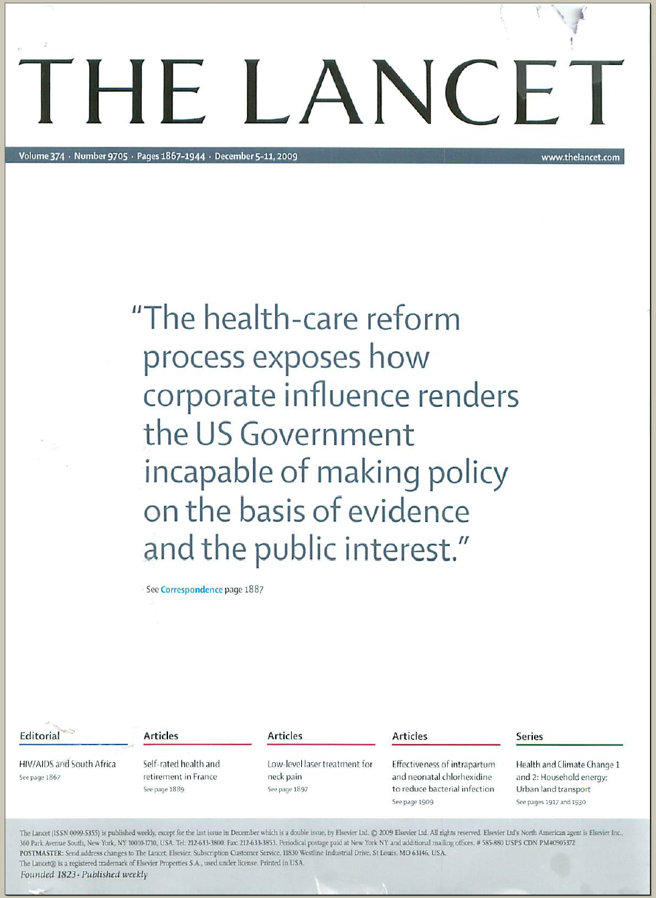

Slide 9
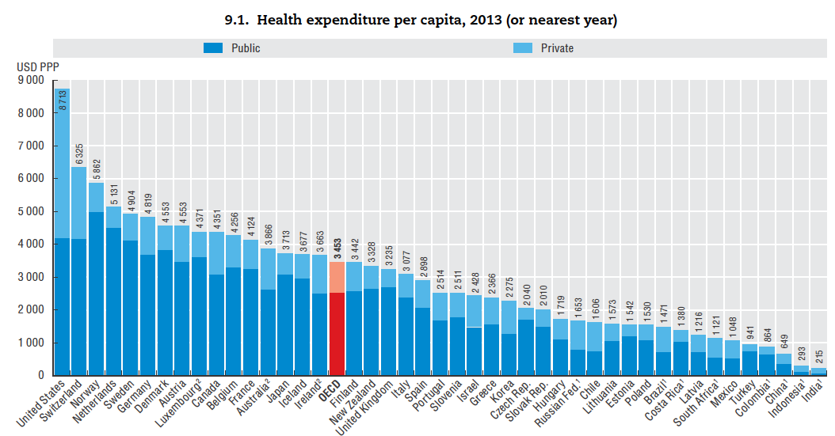
Public
(VA, Medicare,
Medicaid, IHS)
Private
(Insurance, self-pay,
copays, premiums)
%age of costs (around 50%) that are PRIVATE is more than any other country, until we get down to Russia and Chile.
We spend as much on public sector spending as the next 6 countries (all of whom assure universal health coverage) and more than France, Japan, and the UK spend at all.
USA

Slide 10
So we pay more per capita and per GDP… what do we get for that money spent?

Slide 11
So maybe quality (at a system level) isn’t so good
What is driving the high cost with poor quality?

Slide 12
Perhaps the disconnect between knowing the costs of healthcare and actually paying for it means we overuse care (moral hazard)… so do we need more “skin in the game”?

Slide 13
Out-of-Pocket Payments=Skin in the Game
$/Capita
Adjusted for Purchasing Power Parity
Note: Data are for 2013 or most recent year available
Source: OECD, 2015

Slide 14
Is there evidence that we overuse care?

Slide 15
Physician Visits per Capita
Note: Data are for 2013 or most recent year available
Source: OECD, 2015

Slide 16
We don’t overuse care
AND we bear more of the costs as individuals (both in out-of-pocket care and in total expenditures) than any other country in the developed world (and get less for it)…
So what contributes to this excess spending?

Slide 17
Growth of Physicians and Administrators
Growth since 1970
Bureau of Labor Statistics; NCHS; Himmelstein/Woolhandler analysis of CPS
Managers shown as moving average of current year and two previous years

Slide 18
Doctors Spend Twice as Much Time on
EHR/Desk Work as With Patients
Source: Sinsky et al. Ann Int Med 9/6/2016 – based on time/motion observation + home diary
Note: Figures are percent of office hours – exclude the 1-2 hrs/night of home EHR/desk work

Slide 19
What IS it about private insurance?
Administrative costs are typically 5-6x that of public plans (not to mention our lost time spent in billing/paying people to interface with insurance companies)

Slide 20
Insurance Overhead
Dollars per Capita
Note: Data are for 2015 or most recent available
Figures adjusted for Purchasing Power Parity
Source: OECD, 2015; NCHS; CIHI

Slide 21
What IS it about private insurance?
Administrative costs are typically 5-6x that of public plans (not to mention our lost time spent in billing/paying people to interface with insurance companies)
The medical-loss ratio: this is the amount of money paid out to claims, as a function of the total revenue collected by an insurer. Used to be 95%... Now at 80% and dropping.

Slide 22
What IS it about private insurance?
“Race to the bottom” among plans: don’t be the best; be the worst!
  If you’re the best, everyone who is sick is going to want to join your plan… and bankrupt you
Insurers make money by denying claims, or by cherry picking healthy people: THIS IS A FINANCIAL DISINCENTIVE TO A JUST, EQUITABLE SYSTEM.

Slide 23
What else beyond private insurance drives costs in the United States?

Slide 24
US Prescription Drug Spending
Billions of dollars
Source: CMS, Office of the Actuary
Note: 2015-2017 estimated

Slide 25
Insulin Cost Tripled 2006-2013
Average cost per patient in 2013:
$763
Source: JAMA 2016;315:1400

Slide 26
USA Spends the Most on Drugs
Per capita spending on retail prescription drugs
Per capita spending
on retail prescription drugs
Source: OECD, Health at a Glance, 2015
Note: Data are for 2013 or most recent year available. OECD average includes 29 developed nations.

Slide 27
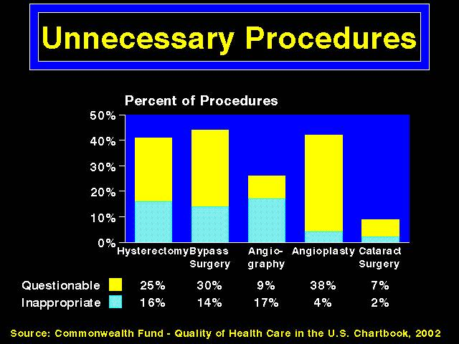
What else (other than drugs and private insurance) drives cost?
Malpractice and the practice of defensive medicine?
  Probably not. According to a 2008 study, this may account for, at most, 2% of healthcare spending
Inappropriate care?
  Possibly.
  But you have to ask… why would people have unnecessary procedures done?

Slide 28
Objectives
Review why healthcare reform is still necessary
Review the current system (including the ACA)
Review the current plan in Congress to “repeal and replace” (the AHCA)
Review single payer as an alternative for docs to consider supporting

Slide 29
ACA: Main features
Expand Medicaid coverage to people at 138% of the Federal poverty level (instead of 50-100%), assuming your state expanded it…
Anyone between 139% FPL and 400% will qualify for subsidies to buy insurance…
…on state-based health insurance exchanges to offer greater variety of options
Mandate citizens purchase health insurance
Medical/loss ratio must not be <85% for large insurers or <80% for small insurers/plans

Slide 30

ACA: Main features
Children up to age 26 can stay on parents private plans
Bans pre-existing condition exclusions
Bans cost sharing for preventive care
10 essential benefits must be covered in all insurance plans: outpatient, inpatient, ER, maternity/newborn, drugs, physical rehab, labs, mental health, preventive care, pediatric dental/vision, chronic disease management
Delivery and Payment Reform: Value-based care, bundled payments, CMMI, ACOs

Slide 31
Anything specific to ICU care?
The palliative care stuff was pulled: “death panels.”
Bars insurers from imposing lifetime dollar limits on benefits or rescinding coverage

Slide 32
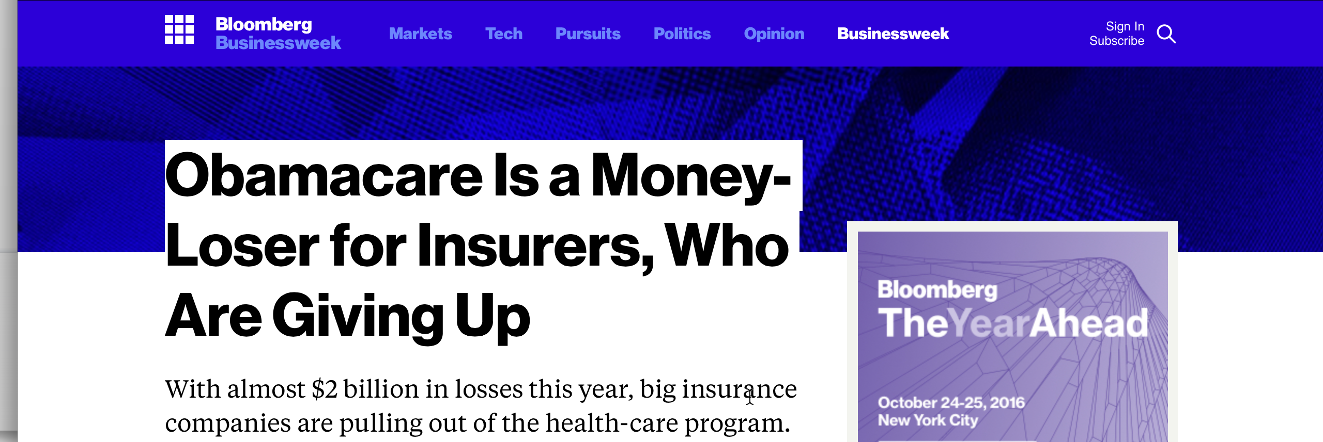
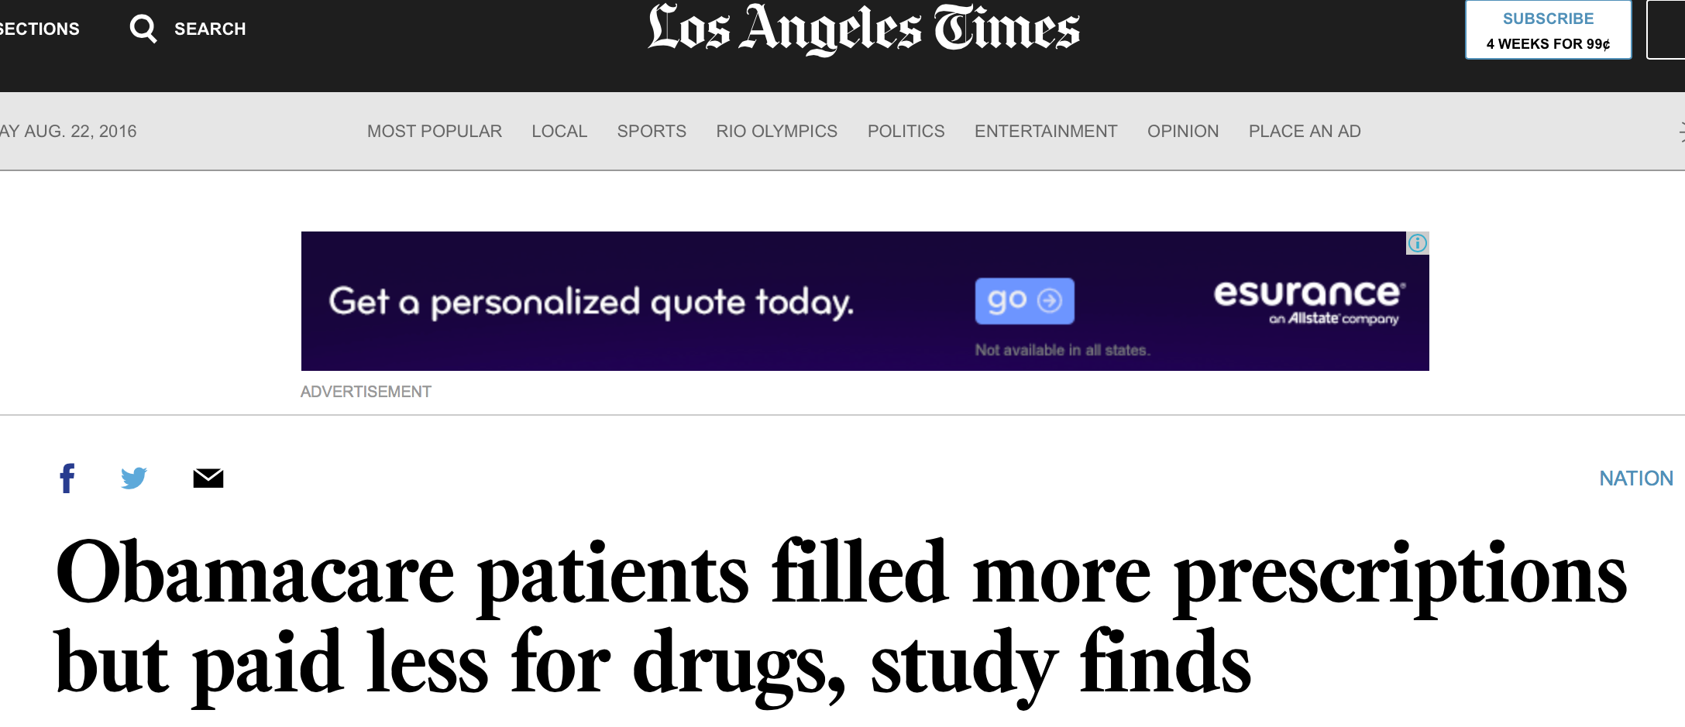
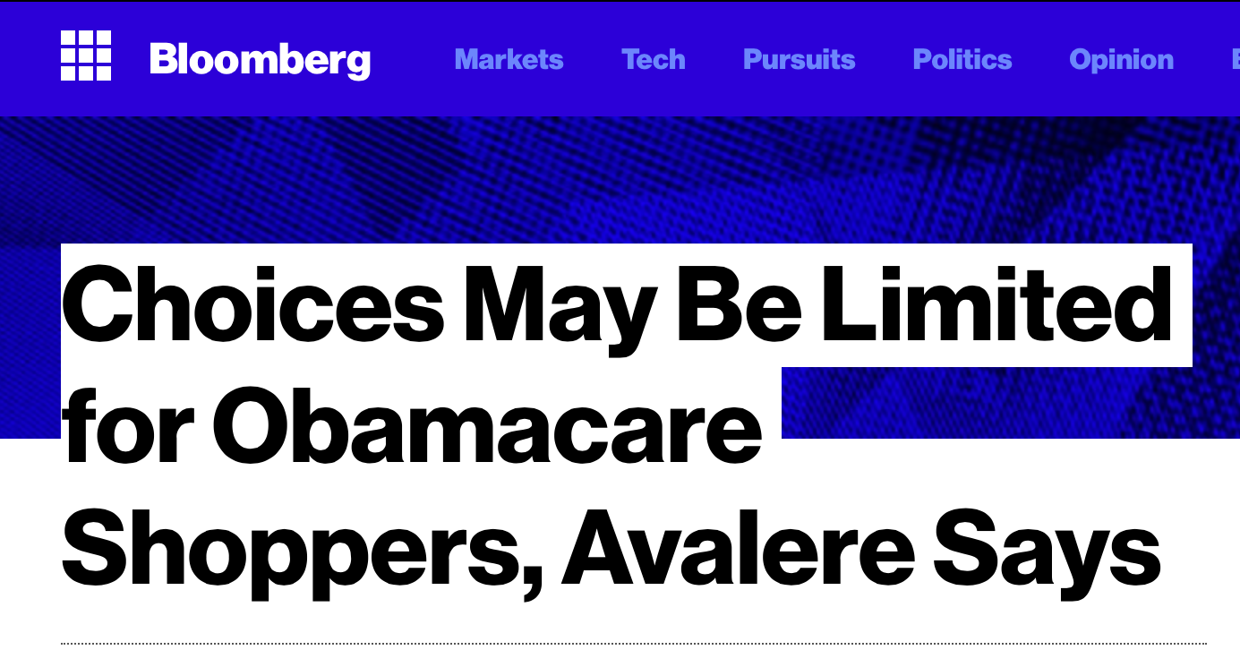
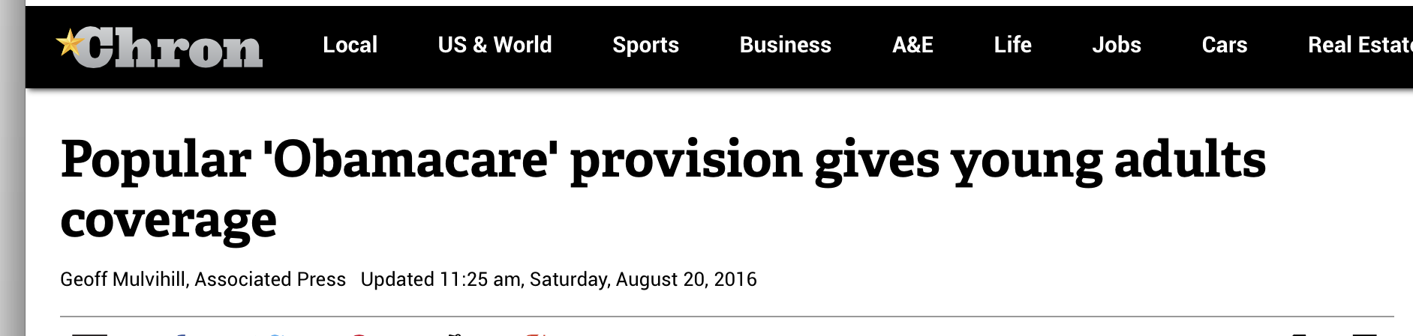
So, it’s been a few years… how’s it going? Depends who you ask.
One thing that’s clear… the ACA entrenches a multi-tiered, complex system by shifting some to private insurance via exchanges and others to Medicaid.

Slide 33
Many Specialists Won’t See
Kids With Medicaid (BAD!)
% of Clinics Scheduling
Appointments for Children
Bisgaier J, Rhodes KV.
N Engl J Med 2011;364:2324-2333

Slide 34
Oregon: Expand Medicaid,
Improve Health (GOOD!)
No Medicaid
Medicaid
Depression p<0.05; the others area clinically meaningful but not powered to show statistical significance
Baicker, K. The Oregon Experiment. NEJM 2013;368:1713-22

Slide 35
So Medicaid has its pros and cons… how is private insurance under the ACA?

Slide 36
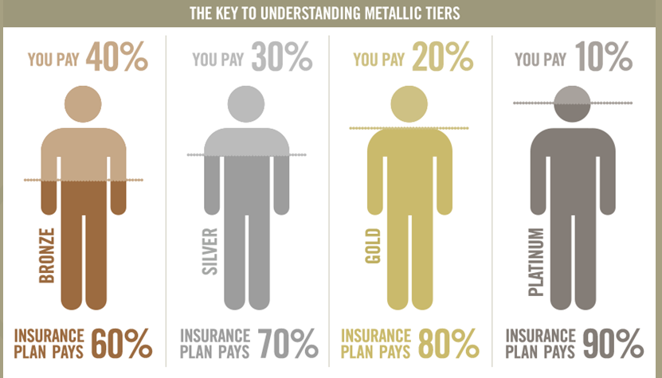
ACA Makes Underinsurance the Norm
(Average Employer Plan Paid 87%)
Graphic from: http://www.whatmattersbywellmark.com/premiums.php

Slide 37
NY State Cheapest Bronze Plan (Family, 2017)
Say income is 401% FPL ($98,600K)
Premium: $12,563
$8,000 deductible
50% coinsurance after deductible for:
  Ambulance, ED, Urgent Care
  Imaging & diagnostic tests
  Outpatient visits
  Chemotherapy
  Inpatient
Out-of-pocket maximum: $14,300
14,300+12,563=$26,863 or ¼ of income.
So why is this bad?

Slide 38
High Deductibles Cut All Kinds of Care
150,000 Employees Lost “Cadillac” Coverage
Percent utilization reduction
Brot-Goldberg et al, 6/2015
http://eml.berkeley.edu/~bhandel/wp/BCHK.pdf
Findings closely resemble those of Rand Health Insurance Experiment
Study found no evidence that patients shopped for lower prices

Slide 39
Uninsured and Under-Insured
Delay Seeking Care for Heart Attacks
Odds ratio for delayed care*
Source: JAMA April 15, 2010. 303:1392
*Adjusted for age, sex, race, clin. charact., hlth status, social/psych fx, urban/rural.
Under-insured=had coverage but patient concerned about cost

Slide 40
Medication Copays Increased Post-MI Vascular Events in Minorities (An RCT)
60%
50%
40%
30%
20%
10%
0
Copay Group
Cumulative Incidence
Free Med
Group
0 | 6 | 12 | 18 | 24 | 30 | 36
Months
Source: Choudhry N. Health Aff 2014:33:863

Slide 41
So is the Affordable Care Act affordable?

Slide 42


Slide 43
Summary of the ACA
Yes, it helped 20 million people acquire insurance…
…but insurance ≠ access, both in Medicaid and private insurance
Oh, and around 30 million are still uninsured (never mind underinsured)
It created mechanisms to change the way care is paid for (ACOs, value-based, P4P)
It facilitates greater cost-shifting to patients
It makes sure 10 essential benefits are covered
It requires the govt continue to prop it up

Slide 44
Objectives
Review why healthcare reform is still necessary
Review the current system (including the ACA)
Review the current plan in Congress to “repeal and replace” (the AHCA)
Review single payer as an alternative for docs to consider supporting

Slide 45
Enter: the AHCA
What does it repeal?
Repeal the ACA mandates (individual and the employer-based) and tax penalties
Repeal cost-sharing subsidies for people with incomes between 100-250% of FPL
Repeal the subsidies given for purchasing insurance on the exchanges…
  But it would be replaced with tax credits based on age, with the younger getting a lower tax credit, which would be phased out at incomes from 75,000-115,000, and which CAN be used for catastrophic plans

Slide 46
Enter: the AHCA
Repeal funding for Prevention and Public Health Fund (1 billion/year to the CDC, about 12% of their budget)
Repeals lots of taxes that funded Medicare and the ACA: Medicare payroll tax on people making >250,000/yr, tax on tanning beds, tax on drug companies, cadillac tax on high cost plans, lowered tax on withdrawals from HSAs
Prohibits federal funding for Planned Parenthood clinics
Phases out actuarial value/metal plan requirements

Slide 47
Enter: the AHCA
What does it keep?
Certain private market rules: dependents may stay on plans to age 26
Health insurance marketplaces/exchanges
Medicare benefit enhancements
No cost sharing for preventive care

Slide 48
Enter: the AHCA
What does it keep, but allow states to opt out of (meaning that insurers could sell plans that do this)?
Pre-existing condition exclusion
Lifetime limits on care (ie up to 1 million dollar caps on benefits)
The 10 essential benefits

Slide 49
Enter: the AHCA
What does it add?
Encourages use of Health Savings Accounts by increasing tax free contribution limits
Adds state option to require employment as a condition of Medicaid eligibility
Converts federal Medicaid funding to a per capita allotment in 2020, using 2016 as a base year, with the option of a block grant to cover “nonexpansion” adults/kids

Slide 50
Enter: the AHCA
Penalty for late enrollment (pay 30% of the premium to the insurer) if you haven’t maintained continuous creditable coverage… (sound familiar?)
Establish State Patient and State Stability Fund: 130 billion over 9 years plus 8 billion (Upton amendment). Fund for states to use to provide financial help to high-risk people (ie fund high-risk pools), promote access to preventive services, provide cost-sharing subsidies, with certain amounts ear-marked for maternity/newborn, mental health/substance abuse

Slide 51
Whew. So why has it been so hard to get passed?
Is it really just “ACA-lite?”
CBO says that the version it evaluated back in March will save 330 billion dollars over 10 years… and that 24 million people will lose health insurance.
The CBO hasn’t had a chance to evaluate the current bill, but presumably it will save more money and leave more without coverage.

Slide 52
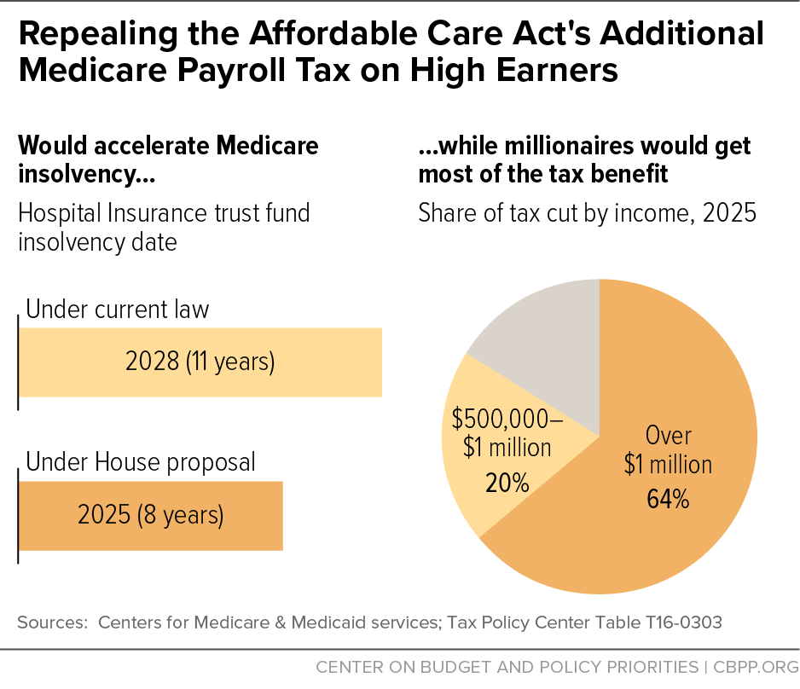
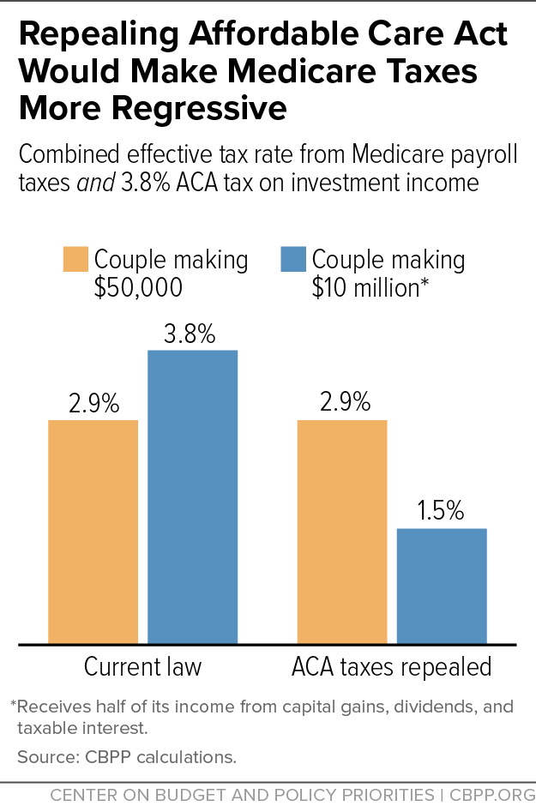
Other AHCA criticisms
It’s a HUGE tax break for the wealthy, and that tax break will comes by gutting revenue for Medicare.
It limits protections for people: the quality of the insurance products will only go down, especially once states opt out of pre-existing conditions, lifetime limits, essential benefits
HSAs really only help people with disposable income (like rich people)
It’s tough on the old: currently, max premiums for the elderly can only be 3x greater than for the young. Under AHCA, this would increase to 5x greater.

Slide 53
Other AHCA criticisms
What about the Medicaid changes?
  What do you do if there’s a recession, with a near doubling of the unemployment rate, as we saw a few years ago?
Age-based (rather than income-based) tax credits don’t really make sense.
If it saves 330 billion dollars over 10 years, who is paying for those savings? We are, with reduced coverage (esp through Medicaid), reduced subsidies, tax breaks on the wealthy…

Slide 54
So what about single payer?
Can we advocate for repealing the ACA and replacing it with a Canadian-style single payer system (HR676)?

Slide 55
Objectives
Review why healthcare reform is still necessary
Review the current system (including the ACA)
Review the current plan in Congress to “repeal and replace” (the AHCA)
Review single payer as an alternative for docs to consider supporting

Slide 56
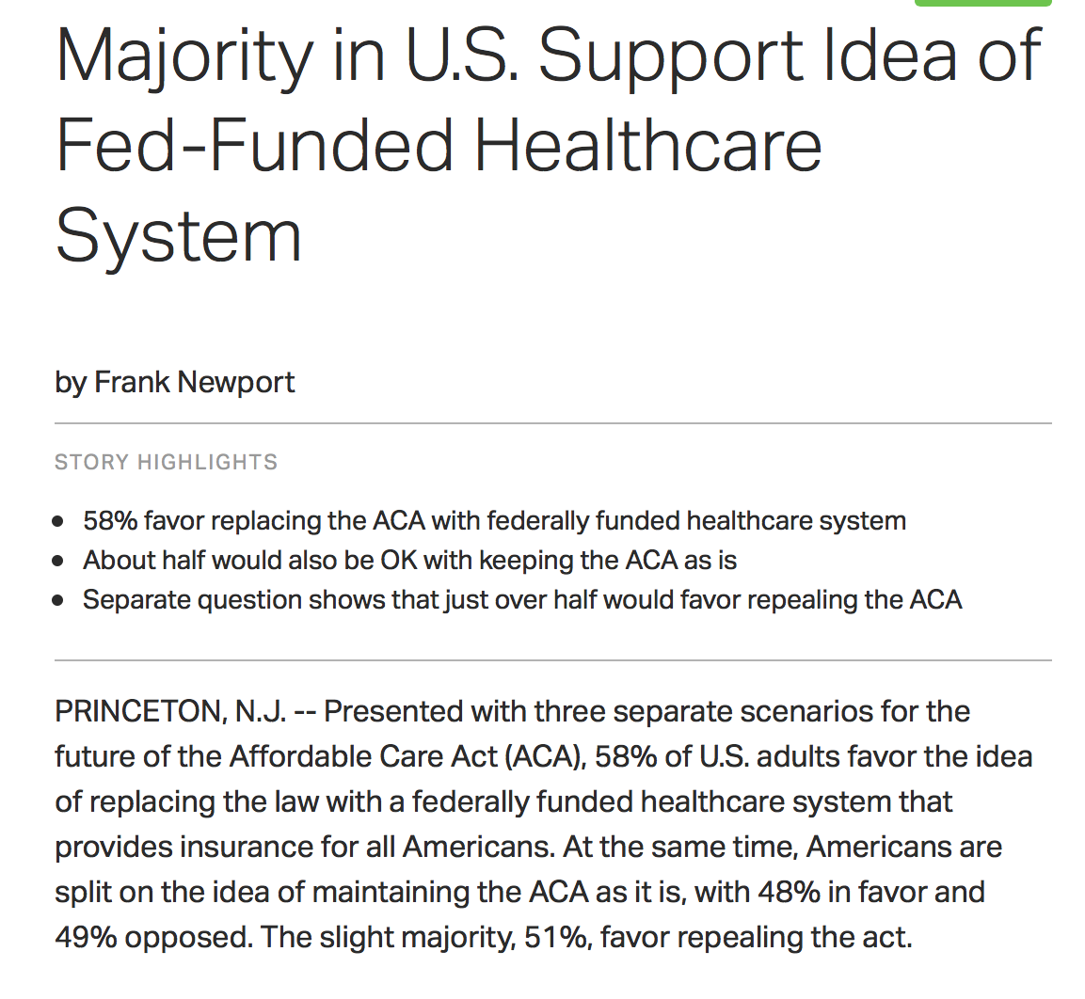
May 2016

Slide 57
Single payer…
Is equitable. Everyone is covered for whatever they need
Is cost-effective

Slide 58
Health Costs as Percent of GDP
USA
Canada’s NHP Enacted
Canada
NHP Fully Implemented
2015
Statistics Canada, Canadian Inst. for Health Inf., and NCHS/Commerce Dept.

Slide 59
Overall Administrative Costs per Capita
United States and Canada, 2016
Source: Woolhandler et al. NEJM 2003;349:768 (updated); Himmelstein et al. Health Aff 9/2014

Slide 60
Single payer…
Is equitable. Everyone is covered for whatever they need
Is cost-effective
Will improve health

Slide 61
Infant Mortality
Deaths per 1,000 Live Births
First Province Implements NHP
USA
Canada
Statistics Canada, Canadian Institute for Health Information, Natl Ctr for Health Statistics

Slide 62
Canadians’ Life Expectancy
Growing Faster than Americans’
Life expectancy at birth
Sources: StatCan & NCHS

Slide 63
Single payer…
Is equitable. Everyone is covered for whatever they need
Is cost-effective
Will improve health
Lifts the burden of covering healthcare from employers
Improves our lives both as docs and citizens
  No more fighting with insurers
  Markedly reduce medical bankruptcies
  Reduce and simplify paperwork
  Reduce burnout?

Slide 64
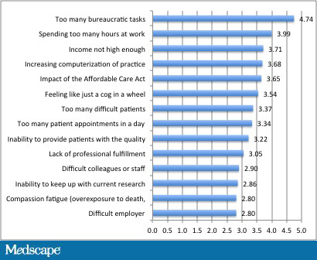
Causes of physician burnout

Slide 65
So why NOT single payer?
Government will never be as efficient as the free market
Rationing/death panels/waiting lists
Lack of choice of insurer
It represents a huge increase in taxes
What about all the people in the private insurance industry who will lose their jobs?
People will overuse care (moral hazard)
Stifle innovation
Facilitate massive cronyism

Slide 66
From an editorial in Annals of Int Medicine, May 2, 2017
By Dawn DeWitt, entitled “A tale of two countries: How I saw more patients with more joy in internal medicine practice”
“In Australia, documentation was focused on patient care rather than minutiae related to billing requirements…”
“persons in the US worry about limited choice in single-payer systems but the Australian formulary (determined by physicians) proved to be worry-free”
“Australian system enables physicians to do more of what we love and what we are trained to do”

Slide 67
Of course, we know what Trump thinks of Australian healthcare…
“It’s going to be fantastic health care. I shouldn’t say this to our great gentleman and my friend from Australia because you have better health care than we do.”
May 4, 2017

Slide 68
Healthcare Reform in 2017: what should physicians support?
HR676, introduced by Conyers (every session since 2003)
Currently has over 108 cosponsors (more than half of Democratic congresspeople)
Only 30 pages long!
Is a simple, practical, evidence-based solution to the problems of cost, access, equity, and disparity that we have now.

Slide 69
More info about how single payer would work tonight at 6pm!!
Please contact me at pverhoef@uchicago.edu if you’d like more info about references or how else to get involved
If you’re interested in single payer, check out www.pnhp.org or www.ilsinglepayercoalition.org
If you’re interested in free market solutions, check out www.aapsonline.org

Slide 70
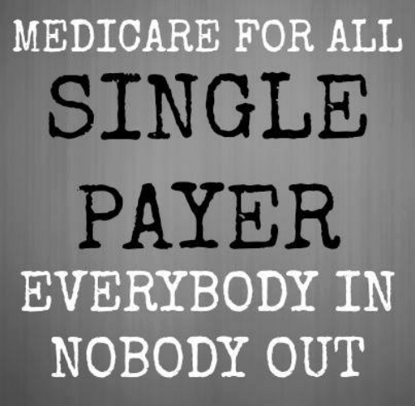

Slide 71
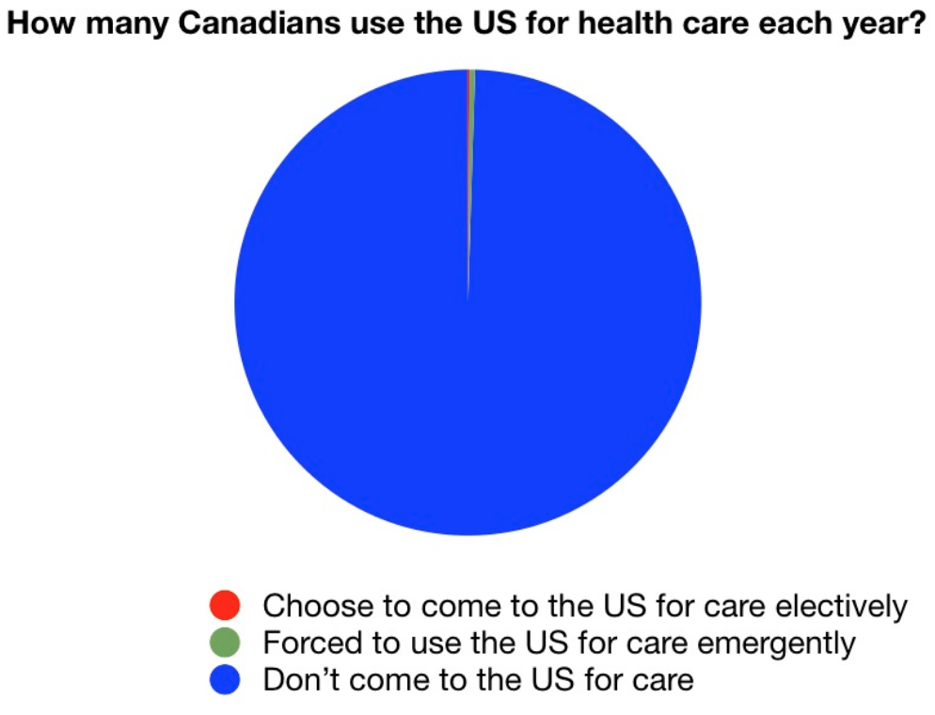
(from Sunday night)
“She wants to go to a single-payer plan, (not true) which would be a disaster, somewhat similar to Canada. And if you haven't noticed the Canadians, when they need a big operation, when something happens, they come into the United States in many cases because their system is so slow. (also not true) It's catastrophic in certain ways.”
“But she wants to go to single payer, which means the government basically rules everything.” (misrepresentation)

Slide 72
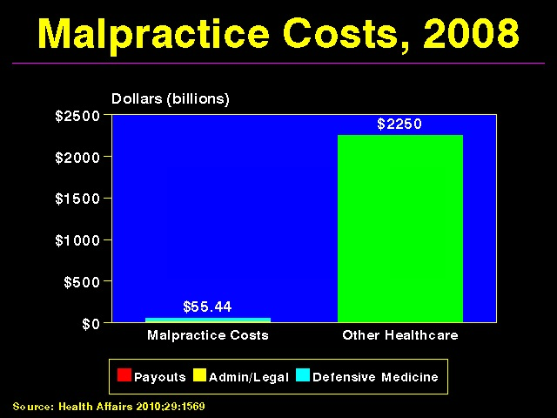

Slide 73
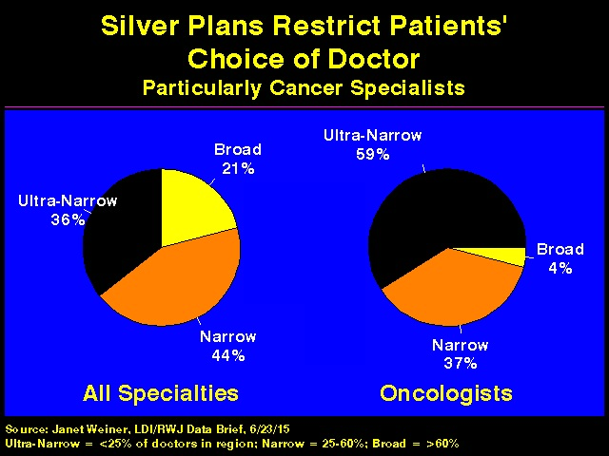

Slide 74
Restricting Access Increases Costs
Restricting care requires bureaucracy that costs more than it saves
We already rely heavily on incentives to deliver less care and pushing more costs onto patients.
If these worked to control costs, we would not be spending twice as much as other advanced countries!

Slide 75
HR 676 “Medicare for All”
Covers Everyone and Spends Less
$ Billions
$142
Increased utilization (especially home health and dental)
$200
0
-$200
-$400
-$600
$110
Covering the uninsured
Medicaid Rate Adjustment
$74
Government administration ($23B)
$153
Health insurance administration
$178
Increased market power (pharma and devices)
$215
Admin costs to providers
New Costs
Savings
Friedman, G. Dollars & Sense. March/April 2012

