Slide 1
Single Payer Health Care: A solution for healthcare disparities in critical care?
Philip A. Verhoef, MD, PhD, FAAP, FACP
Assistant Professor
Dept of Medicine: Section of Pulm/Critical Care
Dept of Pediatrics: Section of Critical Care
May 11, 2017

Slide 2


No financial disclosures or conflicts of interest
I am actively involved in several non-profit health care advocacy groups:
  President, Board of Directors for the Ilinois Single Payer Coalition
  Immediate Past-President, Illinois chapter of Physicians for a National Health Program (PNHP)
  Board advisor, PNHP national organization

Slide 3
What’s the problem?
In 2016, 29 million Americans lack health insurance
We are the only developed nation in the world who does not guarantee UNIVERSAL HEALTH CARE to its citizens

Slide 4
28,949 Deaths During 2015
Due to Uninsurance
State | % Uninsured | Excess Deaths
Texas | 17.1 | 4,612
California | 8.6 | 3,315
Florida | 13.3 | 2,660
Georgia | 13.9 | 1,387
New York | 7.1 | 1,380
USA | 9.4% | 28,949
Source: Wilper et al. Am. J. Public Health, 2009 – updated using 2016 CPS

Slide 5
I assume that we all agree that universal healthcare should be the objective, regardless of our own opinions about how this should be achieved (or our political leanings).

Slide 6
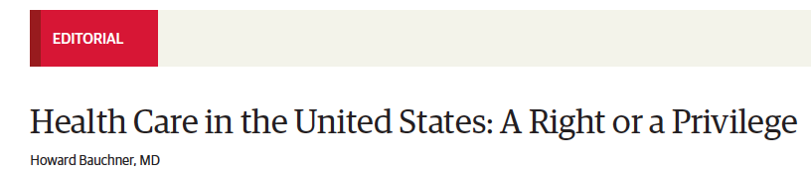
The Editor in Chief of JAMA agrees.
“Until that question is debated and answered, it may not be possible to reach consensus on the ultimate goal of further health care reform. Without agreeing to the goal, measuring success will be nearly impossible.”
“I hope that all physicians, including those who are members of Congress, other health care professionals, and professional societies would speak with a single voice and say that health care is a basic right for every person, and not a privilege to be available and affordable only for a majority.”

Slide 7
What IS universal healthcare?
According to the WHO:
Equity in access: those who need services should get them, without regard for ability to pay
Quality: the care should be of high enough quality to improve health outcomes
Affordable: ensure that the cost does not put people at risk for financial hardship

Slide 8
How does the US system do at equity, quality, affordability especially with regards to critical care?
Stated differently, what are the disparities in the US health system?

Slide 9
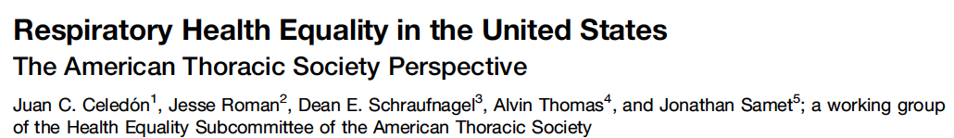
Because we know that disparities are emblematic of the problem.
The ATS agrees, too.
“Attainment of respiratory health equality requires the elimination of respiratory health disparities, which can be achieved only through multidisciplinary efforts to eliminate detrimental exposures while promoting a healthy lifestyle, implementing all aspects of high-quality health care (prevention, screening, diagnosis, and treatment), and conducting research that will lead to better prevention and management of respiratory diseases for all members of society.”

Slide 10
Because we know that disparities are emblematic of the problem.
What they could have said:
“Attainment of respiratory health equality requires the elimination of respiratory health disparities, which can be achieved only through guarantee of access to universal health care in the United States.”
Or rather, we cannot hope to attain respiratory health equality without a universal health care system in the United States.

Slide 11
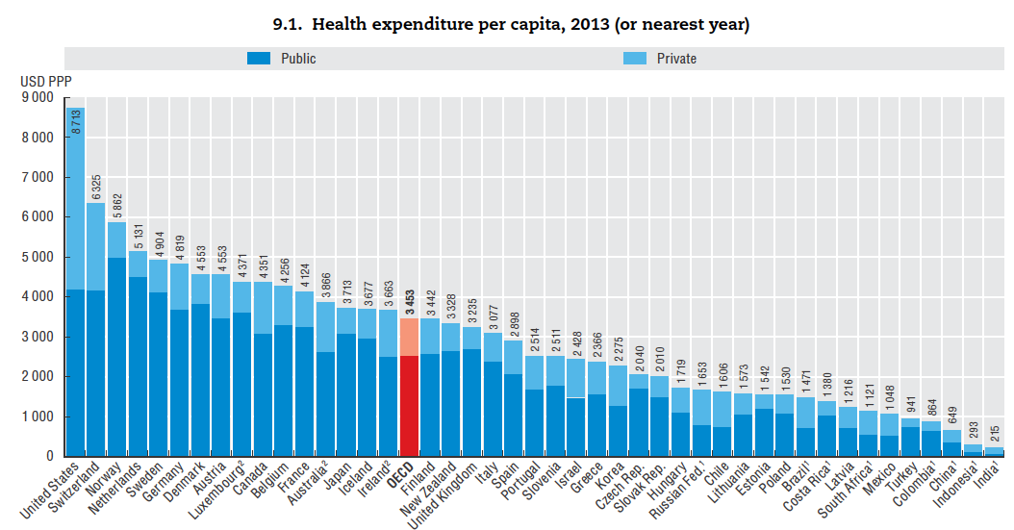
Public
(VA, Medicare,
Medicaid, IHS)
Private
(Insurance, self-pay,
copays, premiums)
%age of spending (around 50%) that are PRIVATE is more than any other country, until we get down to Russia and Chile.
We spend as much on public sector spending as the next 6 countries (all of whom assure universal health coverage) and more than France, Japan, and the UK spend at all.
USA

Slide 12
So we pay more per capita. But what do we get for that money spent?

Slide 13
But the high cost, low quality is only part of the problem… individuals are bearing more of the cost!

Slide 14
Deductibles Are Increasing Rapidly
Percent of Workers
With Deductibles >$999 (Single Coverage)
Source: Kaiser/HRET Survey of Employer-Sponsored Benefits, 2015

Slide 15
Out-of-Pocket Payments
$/Capita
Adjusted for Purchasing Power Parity
Note: Data are for 2013 or most recent year available
Source: OECD, 2015

Slide 16
Having private insurance doesn’t protect you from medical bankruptcy!
Insurance coverage type among people who filed for medical bankruptcy
Source: Himmelstein et al. Am J Med: August, 2009

Slide 17
And the more costs are shifted to citizens, the worse the outcomes.

Slide 18
Higher Medication Co-Pays =
Worse Pediatric Asthma Outcomes
Children age 5-18
Source: JAMA 2012;307:1284

Slide 19
Medication Copays Increased Post-MI Vascular Events in Minorities (An RCT)
60%
50%
40%
30%
20%
10%
0
Copay Group
Cumulative Incidence
Free Med
Group
0 | 6 | 12 | 18 | 24 | 30 | 36
Months
Source: Choudhry N. Health Aff 2014:33:863

Slide 20
Uninsured and Under-Insured
Delay Seeking Care for Heart Attacks
Odds ratio for delayed care*
Source: JAMA April 15, 2010. 303:1392
*Adjusted for age, sex, race, clin. charact., hlth status, social/psych fx, urban/rural.
Under-insured=had coverage but patient concerned about cost

Slide 21
What is “underinsurance”?
-annual OOP expenses>10% income or
-if income is <200% FPL, OOP expenses >5% income or
-deductibles >5% income

Slide 22
NY State Cheapest ACA Bronze Plan (Family, 2017)
Say income is 401% FPL ($98,600K)
Premium: $12,563
$8,000 deductible
50% coinsurance after deductible for:
  Ambulance, ED, Urgent Care
  Imaging & diagnostic tests
  Outpatient visits
  Chemotherapy
  Inpatient
Out-of-pocket maximum: $14,300
14,300+12,563=$26,863 or ¼ of income.

Slide 23
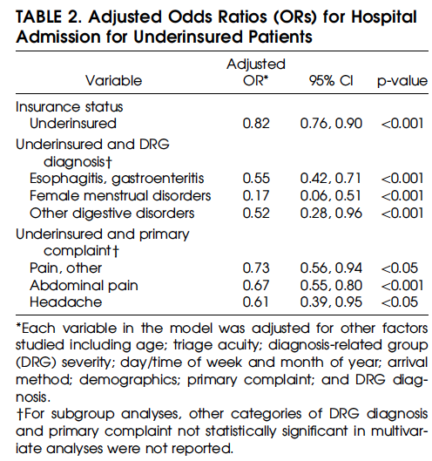
The underinsured are less likely to be admitted to the hospital!
Ruger et al 2003 Acad Emerg Med

Slide 24
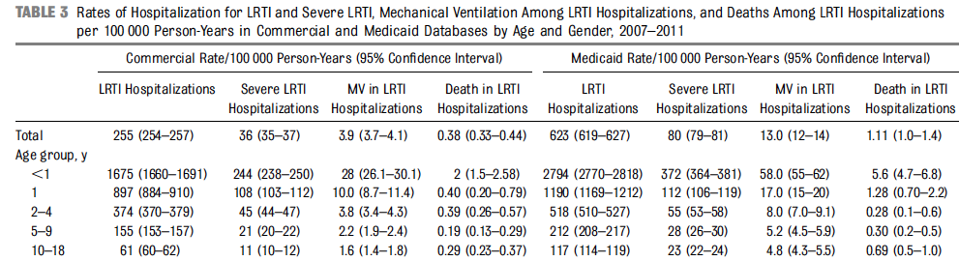
Kids hospitalized with Medicaid for LRTI? 3x more likely to die.
0.38 deaths/100,000 PY
1.11 deaths/100,000 PY
Greenbaum et al Pediatrics 2014

Slide 25
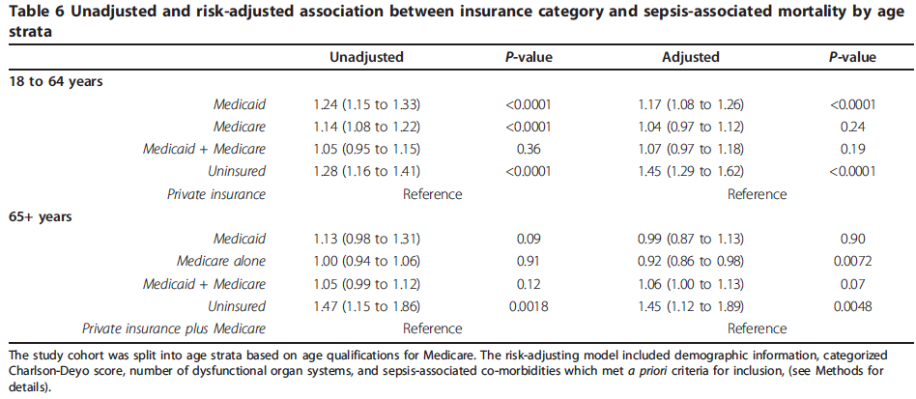
Medicaid, or no insurance? More likely to die of sepsis.
O’Brien et al, Critical Care 2011

Slide 26
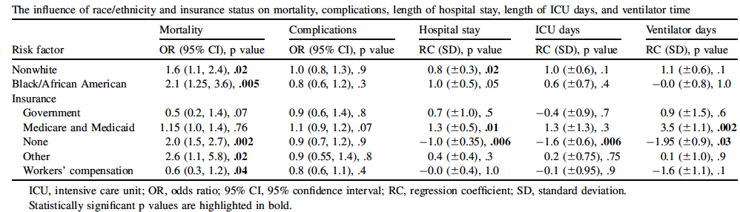
Spinal trauma, but no insurance?
More likely to die (but fewer number of hospital days, ICU days, ventilator days… Charles Dickens, anyone?)
Schoenfeld et al, 2013 The Spine Journal

Slide 27
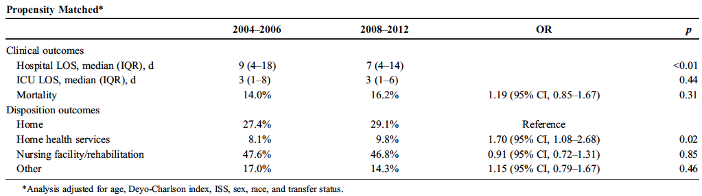
Health insurance REDUCES length of stay for critical trauma
Before
Masscare
After
Masscare
Lee et al 2014 J Trauma Acute Care Surg

Slide 28
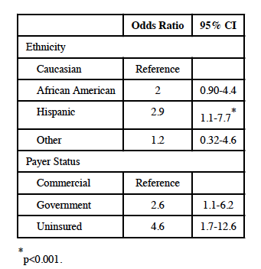
Uninsured pediatric trauma patients 4.6x odds of death
Univariate logistic regression for mortality based on race, payer status for critically ill pediatric trauma patients
Cassidy et al 2013 J Am Coll Surg

Slide 29
How does the US system do at equity, quality, affordability, especially with regards to critical care?
Poorly.
So what drives healthcare costs?

Slide 30
Growth of Physicians and Administrators
Growth since 1970
Bureau of Labor Statistics; NCHS; Himmelstein/Woolhandler analysis of CPS
Managers shown as moving average of current year and two previous years

Slide 31
What IS it about private insurance?
Administrative costs are typically 5-6x that of public plans (not to mention our lost time spent in billing/paying people to interface with insurance companies)

Slide 32
Insurance Overhead
Dollars per Capita
Note: Data are for 2015 or most recent available
Figures adjusted for Purchasing Power Parity
Source: OECD, 2015; NCHS; CIHI

Slide 33
What IS it about private insurance?
Administrative costs are typically 5-6x that of public plans (not to mention our lost time spent in billing/paying people to interface with insurance companies)
  Insurance companies reward employees for denying claims (check out the work of Wendell Potter)
“Race to the bottom” among plans: don’t be the best; be the worst!
Insurers make money by denying claims, or by cherry picking healthy people: THIS IS A FINANCIAL DISINCENTIVE TO A JUST, EQUITABLE SYSTEM.

Slide 34
What else beyond private insurance drives costs in the United States?

Slide 35
US Prescription Drug Spending
Billions of dollars
Source: CMS, Office of the Actuary
Note: 2015-2017 estimated

Slide 36
USA Spends the Most on Drugs
Per capita spending on retail prescription drugs
Source: OECD, Health at a Glance, 2015
Note: Data are for 2013 or most recent year available. OECD average includes 29 developed nations.

Slide 37
Drug Company Profits
Return on Revenue (%)
Fortune 500 rankings for 1995-2016
Total drug company profits, 2015= $67.1 billion

Slide 38
What to do?
Keep the ACA (and support it)?
Repeal and replace with the AHCA?
Public option?
Lower Medicare eligibility age?
Or just move right to single payer?

Slide 39
What about single payer?
A system in which a single public or quasi-public agency organizes health care financing, but the delivery remains largely in private hands.
The focus is on the insurer, not on the delivery mechanism… so docs and hospitals remain private
  Traditional Medicare is a single payer for patients over 65 (albeit with LOTS of flaws)
  VA, IHS, UK health systems are public delivery. This is NOT what I’m talking about!
Canada has Medicare-for-all, and is a model for us to consider.

Slide 40
The Single-Payer Alternative – HR 676
Everyone covered, all medically necessary care
Minimal or no deductibles & co-pays
Access to care based on need, not means
Insurance risk is managed by risk pooling alone, pooled across entire population – not shifted onto doctors, hospitals, and patients.
Vastly simplified administration
Minimizes centralized management of care & bureaucracy

Slide 41
Single-Payer Cost Control
Assure access to cost-effective care for all
Simplify, streamline administration
Use admin savings to reduce prices
  Hospitals - global budgeting
  Doctors – negotiated fees, simplified billing, support quality improvement
  Drugs and medical equipment - negotiated prices, bulk purchasing

Slide 42
Single-Payer Savings
Hospitals (~7%): global operating budgets – no itemized billing
Doctors (~5%): Reduced admin and malpractice cost, incentive-neutral pay
Patients (~5%):
  better access to cost-effective outpatient care
  reduced complications
  reduced ER and hospital use
  (Savings as % of total health spending)
  Sources include Price Waterhouse Coopers, Blanchfield et al, “Saving Billions of Dollars—and Physicians’ Time— by Streamlining Billing Practices,” Health Affairs, Apr. 29, 2010, Lewin Group and Friedman economic analyses for California, Maryland, Colorado
Notes:
The percentages are percent of total health spending. I have taken the percentage of the health care dollar that goes to each and multiplied it by the percent savings each would realize with a single-payer system, based on economic studies of single-payer proposals compared to existing US health care.
Reduced administrative costs for doctors include large savings on medical malpractice premiums if injury related health care costs were covered by a universal system and removed from liability insurance, including medical malpractice.
For patients, with a universal system there would be increased cost due to expansion of coverage, but economic analyses project even larger savings from improved access to cost-effective care in out-patient settings, with reduced complications leading to reduced ER and hospital care.

Slide 43
Single-Payer Savings
Drugs and Medical Equipment (~6%):
  bulk purchasing, negotiated prices, less fraud
Business (~1%):
  no health insurance administration
  much lower worker’s comp, liability, and vehicle insurance
  No COBRA or retiree health benefits
Notes:
Every other country with a universal system allows government to negotiate prices with the pharmaceutical industry, and they pay about 40% less than we do for drugs.
For businesses, with a universal system health care costs can be removed from all types of liability insurance, and based on the experience of other countries this would bring insurance costs down by about 2/3.

Slide 44
Single-Payer Savings
Administration (~16%): focused on assuring care and payment, not avoiding “risk”
For entire health care system: ~ 30-40% savings
Insurance Administration | Managed Care Administration
No: Exorbitant exec salaries, marketing, lobbying, profit Underwriting, insurance reserves, broker fees, exchange fees Eligibility determination, narrow networks | Care managed by doctors & hospitals, not health plans No complex financial incentives and risk adjustment Simplified data for QI No distortion of data due to “pay-for-documentation” Much less fraud and abuse
Notes:
The insurance administrative costs on the left would almost completely disappear with a single-payer system. There might be some public service advertising to inform the public about their benefits and how to access them, and there is some debate about whether a large-scale national system would still need insurance reserves. In any case, the larger the risk pool the more predictable costs become, so reserve requirements would be proportionally far smaller.
Managed care costs are possible under a single-payer system, but without competing health plans trying to come up with justifications for their presence in health care, the incentive would be to minimize administrative costs so as to bring prices down. Centralized managed care has been shown repeatedly to cost more than it saves. Much of the administrative savings for a single-payer system would come from markedly limiting centralized managed care to outlier providers and those few drugs and services shown to be prone to over-use and misuse.
With a universal system, especially one that pays physicians and hospitals in incentive-neutral ways, there would be far less opportunity for fraud and abuse, and they would also be far easier to detect.

Slide 45
HR 676 “Medicare for All”
Covers Everyone and Spends Less
$ Billions
$142
Increased utilization (especially home health and dental)
$200
0
-$200
-$400
-$600
$110
Covering the uninsured
Medicaid Rate Adjustment
$74
Government administration ($23B)
$153
Health insurance administration
$178
Increased market power (pharma and devices)
$215
Admin costs to providers
Cover everyone
with better benefits and save
$243 Billion
New Costs
Savings
Friedman, G. Dollars & Sense. March/April 2012

Slide 46
How’s it going in Canada?

Slide 47
Health Costs as Percent of GDP
USA
Canada’s NHP Enacted
Canada
NHP Fully Implemented
2015
Statistics Canada, Canadian Inst. for Health Inf., and NCHS/Commerce Dept.

Slide 48
Overall Administrative Costs per Capita
United States and Canada, 2016
Source: Woolhandler et al. NEJM 2003;349:768 (updated); Himmelstein et al. Health Aff 9/2014

Slide 49
Canadian Physicians’ Incomes
2013 – 2014
Specialty | Income
Family Medicine | $275,296
Internal Med | $381,776
Pediatrics | $299,399
Psychiatry | $255,794
Dermatology | $434,163
Specialty | Income
OB-GYN | $485,407
General Surgery | $443,188
Thoracic Surgery | $563,263
Ophthalmology | $584,150
All Canadian physicians: $328,640
Canadian Institute for Health Information
Figures are in Canadian $

Slide 50
Few Canadian Physicians Emigrate Today
Net loss
(number moving abroad –
number returning)
A negative number indicates that more physicians returned to Canada from abroad then moved abroad
Source: Canadian Institute for Health Information

Slide 51
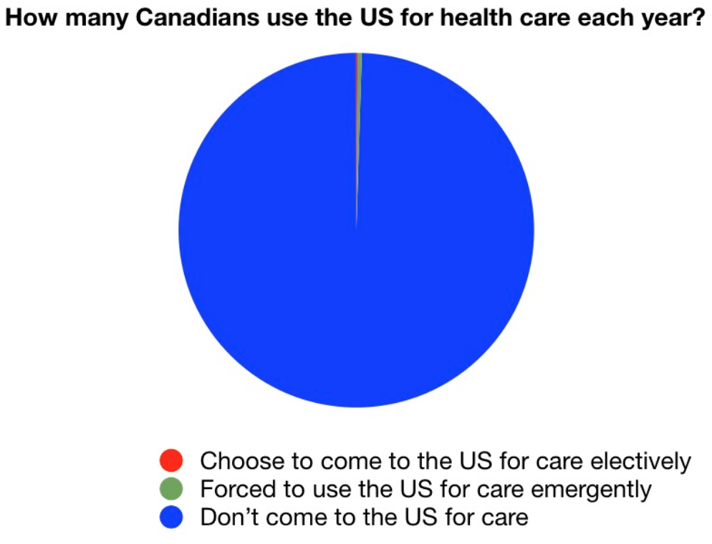

Slide 52
So why NOT incremental steps?
Public option?
Lowering the age of Medicare eligibility?
Is single payer “politically feasible”?
  Well, right now there are 108 cosponsors of the house bill, well over half the Dems in the house…
  This will either happen because physicians demand it, or because campaign finance rules change.

Slide 53
Support single payer?
Join Physicians for a National Health Plan, pnhp.org
Get your congressperson to cosponsor HR676
Take the opportunity to make your voice heard!
Email me at pverhoef@uchicago.edu

Slide 54
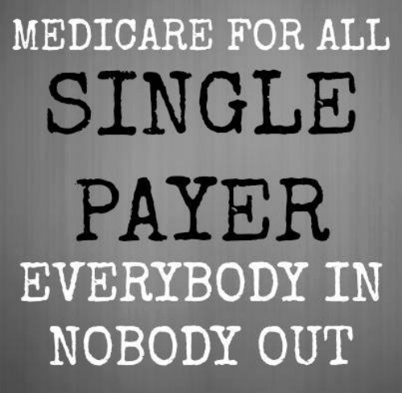

Slide 55
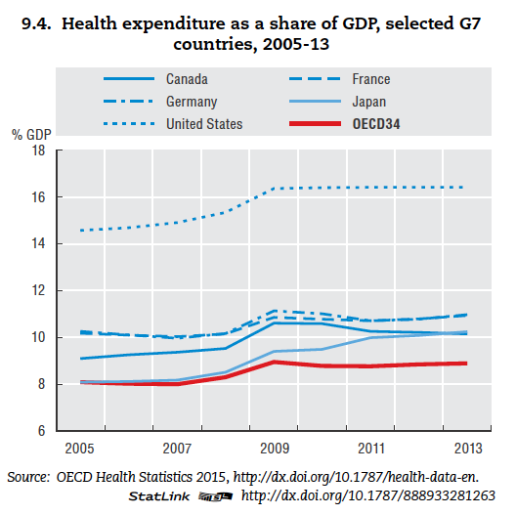

Slide 56
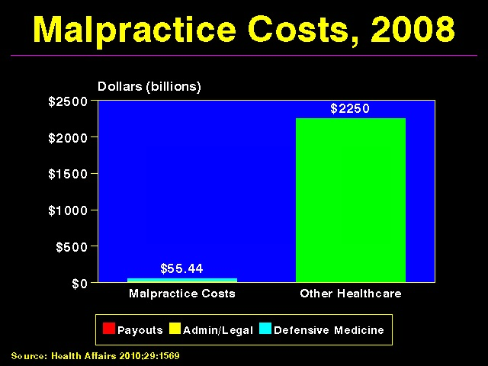

Slide 57
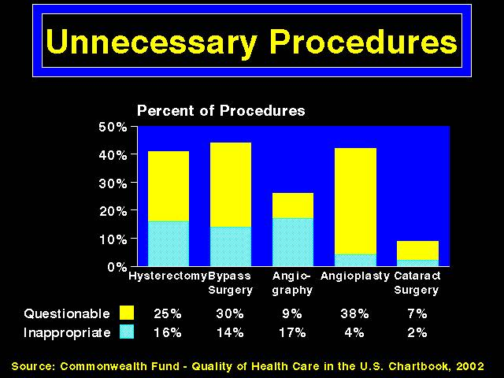

Slide 58
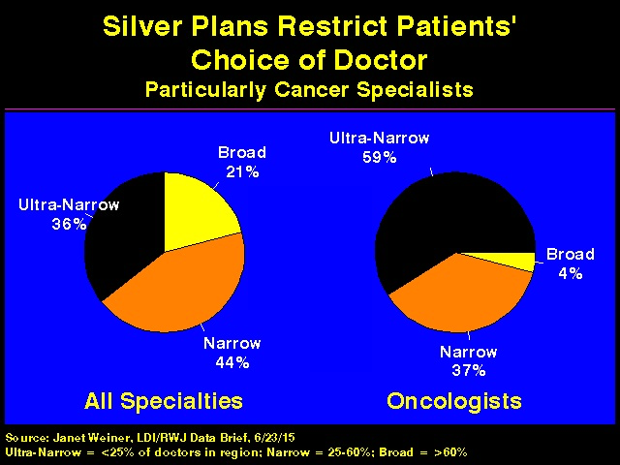

Slide 59
Many Specialists Won’t See
Kids With Medicaid (BAD!)
% of Clinics Scheduling
Appointments for Children
Bisgaier J, Rhodes KV.
N Engl J Med 2011;364:2324-2333

Slide 60
Oregon: Expand Medicaid,
Improve Health (GOOD!)
No Medicaid
Medicaid
Depression p<0.05; the others area clinically meaningful but not powered to show statistical significance
Baicker, K. The Oregon Experiment. NEJM 2013;368:1713-22

Slide 61
Perhaps the disconnect between knowing the costs of healthcare and actually paying for it means we overuse care (moral hazard)… so do we need more “skin in the game”?

Slide 62
Out-of-Pocket Payments=Skin in the Game
$/Capita
Adjusted for Purchasing Power Parity
Note: Data are for 2013 or most recent year available
Source: OECD, 2015

Slide 63
Is there evidence that we overuse care?

Slide 64
Physician Visits per Capita
Note: Data are for 2013 or most recent year available
Source: OECD, 2015

Slide 65
How is PNHP considering drug policy under a single payer plan?
Preclinical
Clinical
Approvals
Post-marketing surveillance
Promotion/advertising
Drug costs should be cut substantially (through negotiated pricing)

