Slide 1
The Uninsured

Slide 2
Uninsured All Year, 1940-2026
Medicare / Medicaid
Millions
Estimated
Source: Social Security Bul, HIAA, CPS, and CBO estimate

Slide 3
Uninsured by Race/Ethnicity, 2016
US Census Bureau
Note: Figures for Native Amerians are for 2014

Slide 4
36,530 Deaths During 2016
Due to Uninsurance
State | % Uninsured | Excess Deaths
Texas | 16.6 | 5,909
California | 3.7 | 3,697
Florida | 12.5 | 3,307
Georgia | 12.9 | 1,703
New York | 6.1 | 1,538
USA | 8.8% | 36,530
Woolhandler & Himmelsetin. Ann Int Med 2017;167:424
Based on best estimate from multiple studies of 1 death per 769 uninsured/year

Slide 5
Mentally Ill Pushed Out of Private Coverage
Percent of persons with severe mental illness with private coverage
Health Affairs 2013;32:1723
Note: Severe mental illness = severe psychological distress causing functional limitations

Slide 6
Medicaid:
Poor Access, But Better Than Nothing

Slide 7
Medicaid Enrollment, 1987-2016
Millions of Americans
2019 Est 66.3
Bureau of the Census and Kaiser Foundation

Slide 8
Medicaid Helps
A randomized controlled trial in Oregon
Source: NEJM May 2 2013
Note: Catastrophic medical costs = out-of-pocket spending >30% of income
Depression = screened positive for depression on PHQ8
Notes:
8
Figure 2 Clinics Scheduling Specialty Care Appointments for Children, According to Type of Insurance. Public insurance was reported by callers as the Illinois Medicaid–Children's Health Insurance Program (CHIP) umbrella program; private insurance was reported by callers as Blue Cross Blue Shield. Each of the 273 clinics was called twice (for a total of 546 calls) by the same caller, with only insurance coverage varying between the two calls: once reporting Medicaid–CHIP coverage and once reporting private coverage. Calls were made 1 month apart, and the order of the reported insurance status was randomly assigned. Asthma clinics included 38 allergy–immunology clinics and 6 pulmonary disease clinics.

Slide 9
Medicaid Improved Access and Hypertension Control for the Poor
Odds ratio for Medicaid vs Uninsured
Christopher, Wilper, Himmelstein, Woolhandler, McCormick – AJPH 2015
Odds ratios are adjusted for sex, age, race/ethnicity, presence of chronic conditions, disability

Slide 10
Many Specialists Won’t See
Kids With Medicaid
% of Clinics Scheduling
Appointments for Children
Bisgaier J, Rhodes KV.
N Engl J Med 2011;364:2324-2333
Notes:
10
Figure 2 Clinics Scheduling Specialty Care Appointments for Children, According to Type of Insurance. Public insurance was reported by callers as the Illinois Medicaid–Children's Health Insurance Program (CHIP) umbrella program; private insurance was reported by callers as Blue Cross Blue Shield. Each of the 273 clinics was called twice (for a total of 546 calls) by the same caller, with only insurance coverage varying between the two calls: once reporting Medicaid–CHIP coverage and once reporting private coverage. Calls were made 1 month apart, and the order of the reported insurance status was randomly assigned. Asthma clinics included 38 allergy–immunology clinics and 6 pulmonary disease clinics.

Slide 11
Medicaid Managed Care Enrollment Soaring
Millions of enrollees
Sanofi Public Payer Digest, 2016
Note: Medicaid payments for managed care firms, 2014 = $161.981 billion; MLR = 85.4% (overhead = $9 bil.
No evidence of cost savings; some evidence of worse quality

Slide 12
Medicaid Managed Care Patients
Can’t Get Appointments
Won’t take new plan patient
8%
Offered appt >2 wks
24%
HHS OIG survey of
1800 physicians listed on managed care rosters finds
majority are unavailable
Offered appt <2 wks
25%
Not participating
43%
Source: HHS Inspector General’s Report. 12/2014. OEI-02-00670

Slide 13
Underinsurance
Impedes Access, Worsens Health, Bankrupts Families

Slide 14
Under-Insurance Growing
Percent of Adults 19-64 under-insured*
Commonwealth Fund Health insurance Survey 2016
*Under-insurance = OOP >10% of income, or >5% of income if low income, or deductible >5% of income

Slide 15
Average Deuctible Rising
Average Deductible for Covered Workers, Single Coverage
Kaiser/HRET Survey of Employer-Sponsored Benefits

Slide 16
High Deductibles Cut All Kinds of Care
150,000 Employees Lost “Cadillac” Coverage
No Evidence that Patients Shifted to “Higher Value” Care
Percent utilization reduction
Brot-Goldberg et al, 5/2015 – http://eml.berkeley.edu/~bhandel/wp/BCHK.pdf accessed Nov. 15, 2017
Note: Findings closely resemble those of Rand Health Insurance Experiment
Note: Study found no evidence that patients shopped for lower prices

Slide 17
High Deductible Coverage (HDHP) Compromises Finances and Access
Percent of Adults 18-64
Cohen & Zammitti, NCHS, June, 2017 – Based on 2016 NHIS data
Note: Of people with job-based coverage, 26.9% had HDHP in 2011, rising to 39.6% in 2016
Note: HDHP = >$1200/$2400 single/family deductible in 2011. $1300/$2600 in 2016

Slide 18
Uninsured and Under-Insured
Delay Seeking Care for Heart Attacks
Odds ratio for delayed care*
Source: JAMA April 15, 2010. 303:1392
*Adjusted for age, sex, race, clin. charact., hlth status, social/psych fx, urban/rural.
Under-insured=had coverage but patient concerned about cost

Slide 19
Drug Deductible Reduced Needed Medication Use
Comparison at Firms That Added vs Didn’t Add Drug Deductible
Percent change in days of medication use after drug deductible implemented
Source: Huckfeldt et al. NBER W20927 – 2/2015

Slide 20
Medication Copays Increased Post-MI Vascular Events in Minorities (An RCT)
60%
50%
40%
30%
20%
10%
0
Copay Group
Cumulative Incidence
Free Med
Group
0 | 6 | 12 | 18 | 24 | 30 | 36
Months
Source: Choudhry N. Health Aff 2014:33:863

Slide 21
Higher Medication Co-Pays =
Worse Pediatric Asthma Outcomes
Children age 5-18
Source: JAMA 2012;307:1284

Slide 22
Higher Copayments = Kids Without Care
Percentage with no physician visits in year
Source: Rand Experiment. Pediatrics 1985;75:942

Slide 23
Who Pays for Long Term Care?
NCHS – National Health Expenditure Accounts – Data are for 2017
Note: Includes spending for NHs + Home care + “other residential and personal care”

Slide 24
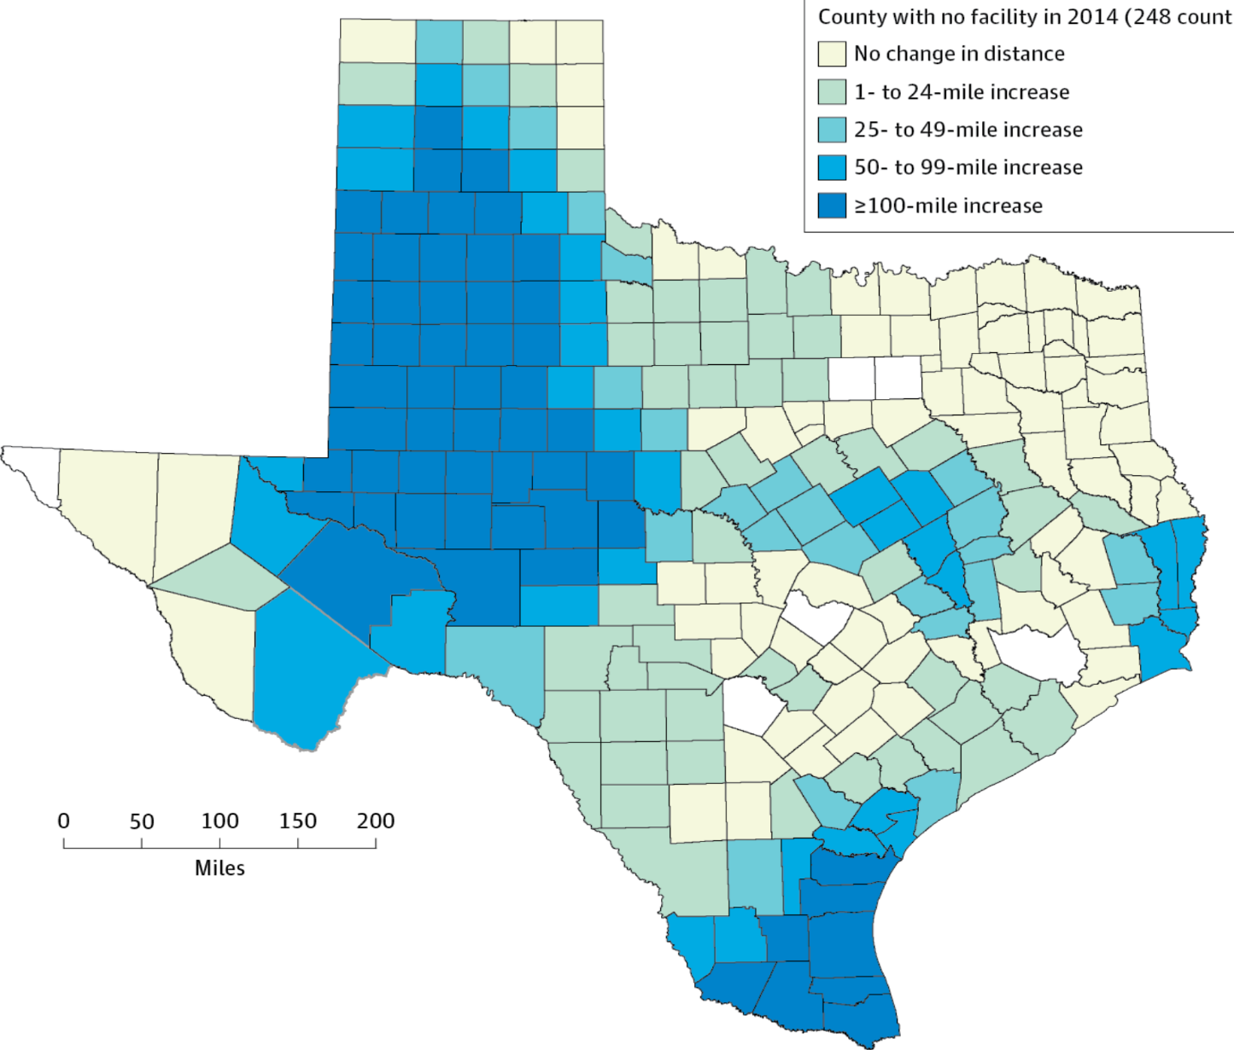
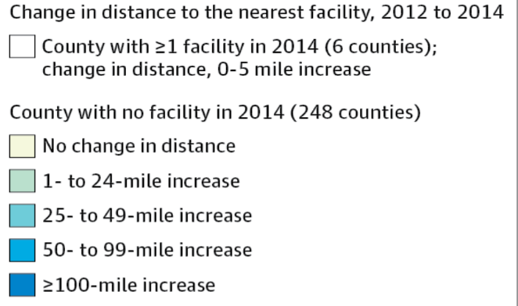
Texas Is Putting Abortion Facilities Out of Reach: Forcing Women to Travel 100 Miles Further
Copyright © 2012 American Medical Association.
All rights reserved

Slide 25
Most of the Medically Bankrupt Had Insurance at the Onset of Their Illness
Source: Himmelstein et al. Am J Med: August, 2009

Slide 26
Medical Bills Are Most Common Reason for Collection Calls
Percent of Consumers Receiving Collection Calls with Specific Type of Debt
Medical collection calls were the only category which did not differ by income
Consumer Financial Protection Bureau, January 2017

Slide 27

Planning for Retirement?
Don’t Forget Health Care Costs
“Medicare covers only 51% of health care services….
For a 65 year old couple retiring this year, the cost of health care in retirement will be $240,000.”
New York Times. Wealth Matters

Slide 28
Medicare Needs Improvement
Percent of seniors spending at least 20% of income on premius and out-of-pocket costs
For many seniors,
medical costs consume
more than 1/5th of income
Income Group (% of Federal Poverty Level)
Commonwealth Fund, May 12, 2017

Slide 29
Rising Economic and Health Inequality

Slide 30
Mean Family Income for Each Fifth:
1966 – 2016 (Inflation Adjusted)
Income
Source: Bureau of the Census
Constant USD, 2015

Slide 31
Widening Gap in Life Expectancy Between High and Low Earners
Remaining Life Expectancy for Men Turning 60
Source: Waldron. ORES, Social Security Admin, #108, 2007

Slide 32
Growing Gap in Life Expectancy by Income
Dramatic gains for the wealthy; losses for lower income
Remaining life expectancy at age 50
Growing Gap in Life Expectancy by Income
National Academy of Sciences, 2015

Slide 33
Death Rates Rose 2014-2015 Overall and for Black Males, White Males and Females, and Infants
Age adjusted mortality / 100,000
Source: NCHS
Note: Death rates for Hispanics and Black Females did not change

Slide 34
Widening Disparities in Death Rates for Non-Hispanic Whites
Increased Overall Morality for Those Age 45-54
Change In Deaths/100,000
for Non-Hispanic Whites age 45-54
1999-2013
Case and Deaton, PNAS 2016;1518393112

Slide 35
Poverty Rates
Percent of Population Below Poverty
OECD 2017; Figures are for 2014 or most recent available

Slide 36
Income Inequality Worst in USA
Top 1% Income Share, 2015/2016
Source: World Top Incomes Database
Data are for 2015-2016 or most recent year available

Slide 37
Incarceration Rates
Prisoners per 100,000 population
Walmsley – World Prison Population List, 11th Ed.

Slide 38
Persistent
Racial Inequalities

Slide 39
Black Americans Die Younger
Life Expectancy at birth
CDC, 2015 – Final Mortality Data for 2013
*Hispanics can be of any race, and Blacks and Whites include some Hispanics

Slide 40
Median Family Income
Median income
(Inflation Adjusted)
Whites
Blacks
Inflation adjusted, 2015 $s
Bureau of the Census, 2016 data

Slide 41
White High School Dropouts Have More Assets than College-Educated Blacks
Medican Wealth of Working Households Young than Age 55
Demos – The Asset Value of Whiteness – Based on 2013 sFederal Reserve survey data

Slide 42
Job Discrimination Persists
Experimental Study of the Impact of “Whitening” Resumes
Black Applicant
Asian Applicant
Callback rate after resume submitted
Source: Kang SK, et al. Admin SciQ, 2016 – Job ads with pro-diversity language yielded same result
*e.g., change “Lamar J. Smith” to “L. James Smith” or “Lei Zhange” to “Luke Zhang”
** e.g., change “Aspiring Asian Business Leaders” to “Aspiring Business Leaders”

Slide 43
Driving While Black
More Likely to Be Searched, Less Likely to Be Found with Contraband
Black Rate / White Rate
(1.0 = Equally Likely)
Car Searched
Contraband Found Among Those Searched
NY Times 10/25/15

Slide 44
Causes of Black/White Disparity
In Adult Mortality
MMWR May 2, 2017
Note: “Other” includes conditions (e.g., diabetes) for which Black death rates are higher and some (e.g., COPD, cirrhosis) for which Black death rates are lower.

Slide 45
Black Enrollment in
U.S. Medical Schools
AAMC Goal:
11.7%
Percent Blacks in 1st Year Medical School Class
RWJ Fdn. 1987; AAMC;
JAMA Annual Medical Education Special Issue

Slide 46
Blacks in Health Occupations
Blacks as percent of occupational group
USA Workforce Avg: 11.6%
HRSA based on data from American Commuity Survey 2011-2015

Slide 47
Hispanics in Health Occupations
Hispanics as % of occupational group
USA Workforce Avg: 16.1%
HRSA based on data from American Commuity Survey 2011-2015

Slide 48
Physicians/Population by Race/Ethnicity
Physicians per 1000 population
Data are for 2008
Source: AMA and Census Bureau

Slide 49
Black and Female Physicians Earn Less
Annual Income
Source: Ly et al. BMJ 2016;353:2923
Note: Figures are adjusted for hours worked, specialty, age, years in practice, practice type, percent of revenue from Medicare/Medicaid

Slide 50
Minority Children and Youth
Get Few Psychiatrist Visits
Psychiatrist visits per year per 1,000 population
Source: Marrast, Himmelstein, Woolhandler. Int J Hlth Serv 2016

Slide 51
Blacks in VA: No Health Disadvantage
Odds ratio for Black vs White Vets
(<1 indicates lower rate for Blacks)
Kovesdy et al. Circulation 9/18/2015
Longitudinal study of 3,072,966 Vets cared for at VAs

Slide 52
Immigrants Get Little Care
Health Care
$ per capita
*Adjusted for ethnicity, poverty, age, insurance status, patient/parent-reported health status
Source: Mohanty et al. Am J Public Health 2005;95:1431

Slide 53
Low Birth Weight Rose Among
Arabic-Named Women in California After 9/11
Relative Risk of Low Birth Weight Post- vs Pre-9/11
Demography 2006;43:185
* Mother’s name Arabic, infant’s name not ethnically distinctive
** Mother’s name Arabic, infant’s name ethnically distinctive

Slide 54
Low Birth Weight Increased in Iowa
After a Massive Immigration Raid
Relative Risk of Low Birth Weight
Int J Epidemiol 2017;839
Note: 2008 Postville, Iowa raid was the largest single-site immigration raid in history. 900 agents handcuffed and chained all Latinos at meatpacking plant.

Slide 55
Immigrants Keep Medicare Afloat
$3.7 Billion
$10.1 Billion
Net contribution to Medicare Trust Fund, 2009
-$30.9 Billion
Source: Zallman et al, Health Affairs 2013;32:1153

Slide 56
Rationing Amidst A Surplus of Care

Slide 57
22.5% of 111,707 Defibrillator Implants Were
Not Evidence-Based
Sometimes Lethal
  In hospital death rate for non-evidence based ICD implant 0.6%
  Cost of ICD implant ~$25,000
Note: In-hospital death rate for non-evidence-based ICD implantation was 0.6%.
Cost of ICD implant ~$25,000
Source: JAMA 2011;305:43

Slide 58
Many Elective PCIs Are Inappropriate
Uncertain
41.3%
Appropriate
33.9%
Inappropriate
22.0%
JAMA IM 2014;174:1630
Based on 1,225,562 patients in PCI Cath Registry

Slide 59
Free Standing ERs in Texas
Avoid Areas of Greatest Need
Mean
Family Income
in Service Area
Percent
Privately Insured in Service Area
Percent
on Medicaid
in Service Area
Percent Uninsured
in Service Area
Urgicenter No Urgicenter
Health Affairs 2017;36:1712

Slide 60
The Medical Arms Race:
Which Hospitals Opened New
Invasive Cardiology Programs, 1996 – 2014?
Strong Predictors
Modest Predictor
Weak Predictor
  A competing hospital opening a program was a strong predictor of opening a new program.
  For-profit ownership was a strong predictor.
  Being a non-profit in a market dominated by for-profits was also a predictor.
  Lack of service availability in the community was a weak predictor of opening a new program.
Source: NBER Working Paper W23530 - June, 2017

Slide 61
Administrative Overhead Rising

Slide 62
Growth of Physicians and Administrators
Growth since 1970
Bureau of Labor Statistics; NCHS; Himmelstein/Woolhandler analysis of CPS
Managers shown as moving average of current year and two previous years

Slide 63
Doctors Spend Twice as Much Time on
EHR/Desk Work as With Patients
Source: Sinsky et al. Ann Int Med 9/6/2016 – based on time/motion observation + home diary
Note: Figures are percent of office hours – exclude the 1-2 hrs/night of home EHR/desk work

Slide 64
Investor-Owned Care:
Inflated Costs,
Inferior Quality

Slide 65
Extent of For-Profit Ownership
Commerce Dept. Service Annual Surveys & MedPac. Data are Q1, 2016 or most recent available.
* Data are for share of establishments

Slide 66
Health Industry Profits, 2016
Pharmaceuticals | $67.7 B
Insurers | $15.1 B
Equipment / Supplies | $10.4 B
Pharmacy / Lab / Benefit Mgr. | $10.2 B
Distributors / Wholesalers | $5.9 B
Providers | $2.0 B
Fortune 500, 2017

Slide 67
Academic Leaders on For-Profit Health Corporations’ Boards
Academic Position | Number of Directorships | Pay per Directorship (median) | Shares Owned (mean)
CEO Hosp/System | 21 | $221,000 | 42,445
Dean | 17 | $268,000 | 32,113
Department Chair | 18 | $103,000 | 65,574
Professor | 131 | $160,000 | 171,856
Trustee | 83 | $227,000 | 342,198
Any | 309 | $193,000 | 193,629
Source: BMJ 2015;351:H4826

Slide 68
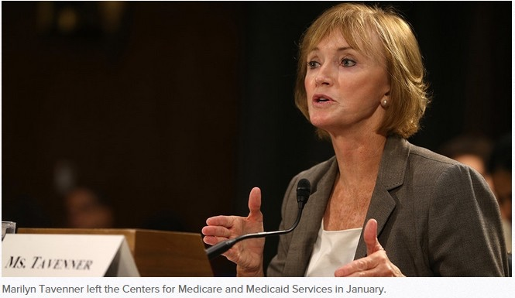
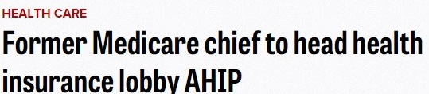
Source: Palmer, A and Demko, P. Politico 7/15/2015.

Slide 69
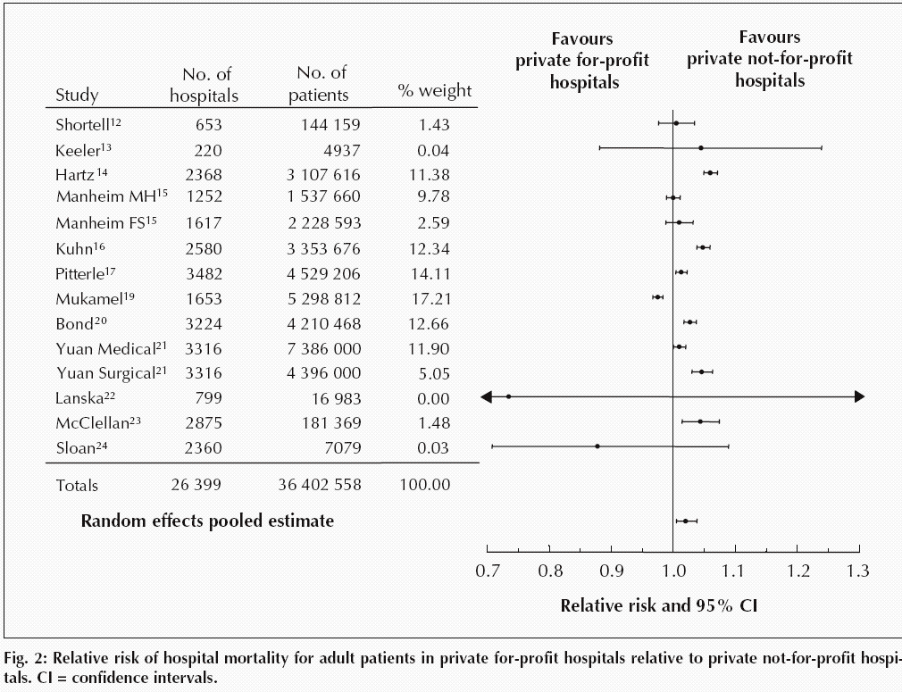
For-Profit Hospitals’ Death Rates
Are 2% Higher
Relative risk of hospital mortality for adult patients in private for-profit hospitals relative to private not-for-profit hospitals
Source: CMAJ Devereaux et al. 166 (11): 1399.

Slide 70
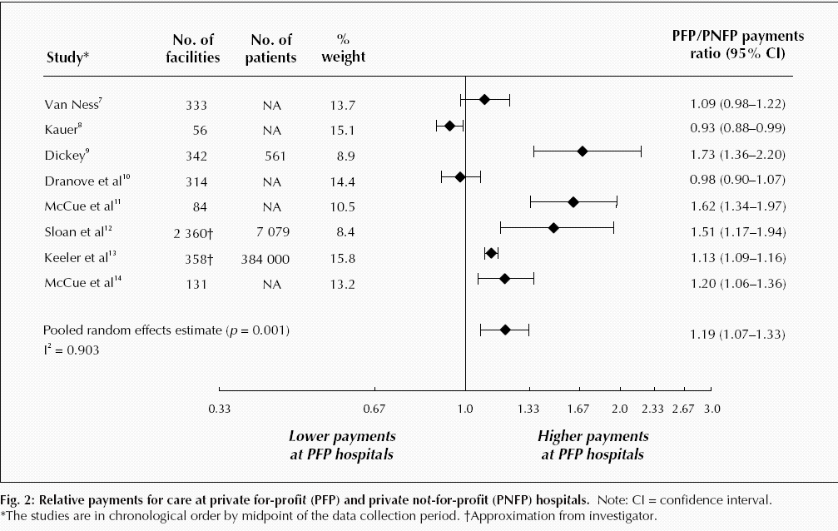
For-Profit Hospitals Cost
19% More
Relative payments for care at private for-profit (PFP) and private not-for-profit (PNFP) hospitals
Source: CMAJ Devereaux et al. 170 (12): 1817.

Slide 71
For-Profit Hospitals’
Administrative Costs Are Higher
Percentage spent on administration
Himmelstein and Woolhandler
Analysis of 2011 Medicare hospital cost reports

Slide 72
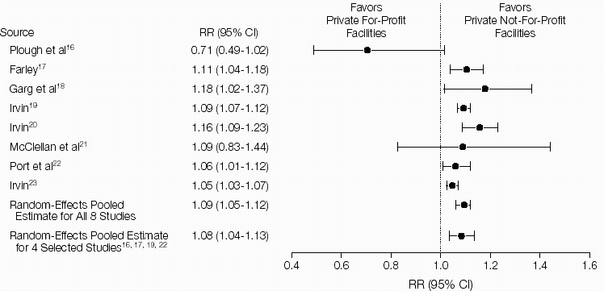
For-Profit Dialysis Clinics’ Death Rates
Are 9% Higher
Relative Risk (RR) of Morality in Hemodialysis Patients
Source: JAMA 2002;288:2449
Notes:
72

Slide 73
During era when more EPO = more profit
For-Profit Dialysis Facilities
Overdosed Patients with EPO
Weekly EPO units for patients with HCT <33%
Note: Higher EPO dose associated with higher CV death rate
Similar pattern was observed among patients with HCT.33%
Source: JAMA 2007;297:1667

Slide 74
For Profit Home Care: Lower Quality
Source: Cabin, Siman, Himmelstein & Woolhandler.
Health Affairs 8/2014

Slide 75
For Profit Home Care: Higher Cost
Annual Cost per Patient
Source: Cabin, Siman, Himmelstein & Woolhandler.
Health Affairs 8/2014

Slide 76
Hospice Care Goes For-Profit
Percent of hospices under for-profit ownership
Source: MEDPAC annual report, 2017 and previous reports
Profit rate: for-profits = 15.3%; non-profits = -.7%.
Mean LOS: for-profits = 105 days; non-profits = 65 days

Slide 77
For-Profit Hospices Avoid
Unprofitable Patients
Likelihood of accepting all patients, regardless of care needs
(and profitability)
Source: Health Affairs 2012;31:2690
Note: Based upon accepting patients on chemo, TPN, transfusions, tube feeds, intrathecal cath, palliative radiation, or living alone

Slide 78
US Prescription Drug Spending
Prescription drug spending,
Billions of dollars
Estimated
Source: CMS, Office of the Actuary
Note: 2016-2018 estimated

Slide 79
USA Spends the Most on Drugs
Double the OECD Average
Per capita spending on prescription drugs
Sources: OECD, 2017; NCHC; American Hospital Association
Note: Data are for 2015 or most recent year available.

Slide 80
Insulin Cost Tripled 2006-2013
Average cost per patient in 2013:
$736
Mean expenditure per patient for insulin
Source: JAMA 2016;315:1400

Slide 81
Drug Company Profits
Return on Revenue (%)
Fortune 500 rankings for 1995-2017
Total drug company profits, 2016= $67.7 billion

Slide 82
Profits Dwarf Cancer Drug R&D Costs
Analysis of All Drugs Approved 2006 – 2015
From Firms With Only One Approved Drug
Mean Cost or Revenue per Drug
(Millions)
Prasad et al. JAMA IM, online 9/11/2017
* Costs of all company R&D, including their non-approved agents
** Total revenue from sales since approve – mean of 3.8 years

Slide 83
Drug Companies’ Cost Structure
Marketing
and Admin
35%
Manufacturing
27%
Profits
(After Taxes)
18%
R&D
13%
Taxes
7%
Source: Health Affairs 2001;20(5):136

Slide 84
For-Profit Medicare Advantage Plans:
Lower Quality Ratings
Percent of plans
Star (Quality) Rating
Modern Healthcare 10/8/2015
Analysis of CMS data

Slide 85
Investor-Owned Medicaid HMOs:
Higher Administrative Costs, Lower Quality
Note: Publicly Traded = Publicly traded Medicaid-only plans
Source: McCue. Commonwealth Fund, June, 2011

Slide 86
Insurers Risk Select Via Formulary Design
Put generics needed by sicker patients into high co-pay tier
Drugs of Choice | Illness | Plan 1 | Plan 2 | Plan 3
Anti-Retrovirals | HIV | No | No | No
Triptans | Migraines | No | No | No
Anti-Psychotics | Schizophrenia | No | No | No
Macrolides | Pneumonia | Yes | No | No
L-Dopa | Parkinson’s | Yes | No | No
Anti-Convulsants | Seizures | Yes | No | No
ACE Inhibitors | Hypertension | Yes | Yes | No
Metformin | Diabetes | Yes | Yes | No
Oster & Fendrick, Am J Managed Care 2014;9:693-4
Plan 3 = Harvard Pilgrim
“No” = No drug of choice available on Tier 1 (lowest co-pay)

Slide 87
HMO Overhead, 2017
SEC Filings/Reports to Shareholders. Data for Q1 or Q2 2017
Calculated as 100-100(benefits/premiums)
Note Medicare/Medicaid enrollees included in some figures

Slide 88
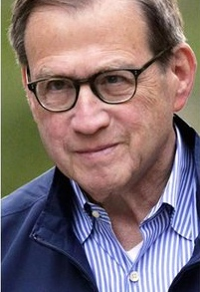

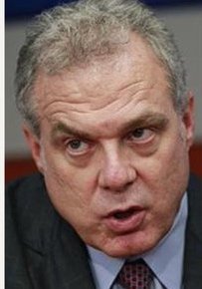
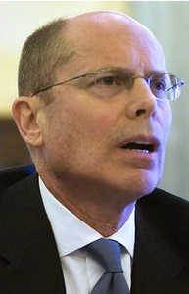
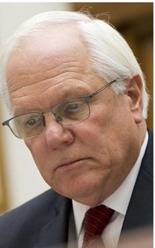
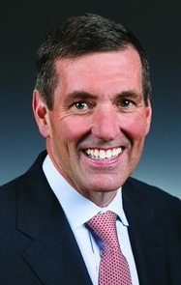
Health Insurance Company CEOs’ Totay Direct Compensation, 2016
Michael Neidorff | David Cordani | Mark Bertolini
Steve Helmsley | Joseph Swedish | Bruce Broussard
Centene
Annual Comp:
$32.2 M
Pay/Day:
$123,225
Cigna
Annual Comp:
$21.9 M
Pay/Day:
$84,017
Aetna
Annual Comp:
$ 41.7M
Pay/Day:
$159,647
Median earnings of full-time
wage and salary workers in 2016:
$43,264
United
Annual Comp:
$31.3 M
Pay/Day:
$119,918
Wellpoint
Annual Comp:
$17.1 M
Pay/Day:
$65,356
Humana
Annual Comp:
$17.0M
Pay/Day:
$65,208
Sources: DEF 14A Schedules, SEC; Bureau of Labor Statistics; Current Population Survey.
Annual CEO compensation includes salary, non-equity incentive pay, other compensation, and value of stock options exercised and stock awards that vested. In addition, these CEOs were given stock and option awards totaling $78.6 million (in aggregate) this year, which will provide value in future years.

Slide 89
Medicare
Remains Solvent and Relatively Efficient

Slide 90
Number of Years Before Medicare Trust Fund Projected to be Exhausted
Estimated Number of Years Until Fund Exhausted
Year of Estimate
Source: Medicare Trustees Annual Reports

Slide 91
Growth in Spending 1969-2014:
Medicare Vs. Private Insurers
Per Enrollee, Common Benefits
Percent Increase
Medicare
Private Insurance
Source: CMS Office of the Actuary

Slide 92
Medicare Advantage Plans’
High Overhead
Sources: GAO 12/2013 and Medicare Trustees Report 2012 – Figures are for 2011
Note: MA overhead = $905/enrollee; profit = $447/enrollee
Total MA profit = $3.3 Billion

Slide 93
Medicare Advantage Plans’ Narrow Networks
More than a third of all Medicare Advantage plans lack an NCI cancer center.
49% of narrow networks exclude academic med centers.
Sources: Kaiser Family Foundation June, 2016
Note: “Narrow” = <30% of hospitals; “Medium Small” = 20-49%; “Medium” = 50-69%; “Broad” = >69%

Slide 94
Despite Medicare’s Lower Overhead, Medicare Advantage Plans Outcompete Traditional Medicare by
Cherry Picking, Upcoding, and Lobbying for Overpayment

Slide 95
Medicare HMO Enrollment
Medicare HMO Enrollees (millions)
2016
Source: CMS

Slide 96
A Few Sick People
Account for Most Health Dollars
Percent of total health spending accounted for by decile
Top 2 deciles account for 81.5%
Decile of Privately Insured Americans
JAMA 2016;316:1348

Slide 97
Sickest Patients
Switch Out of Medicare Advantage
Percent switching out during 2011
Plan switched out of:
  Traditional Medicare
  Medicare Advantage
Health Affairs 2015;34:1675
Similar results for patients with hospital or home care use, more marked among dual eligibles

Slide 98
Profit-Driven Upcoding Makes
Accurate Risk Adjustment Impossible:
High cost providers inflate both reimbursement and quality scores
by making patients look sicker on paper.

Slide 99
CMS Payment to MA Plans:
Same Patient, Different Coding
Original Coding
Base rate | $3,950
DM 2, uncomplicated | $1,040
Chronic Kidney Disease | $0
Obesity | $0
Depression | $0
Coronary Art. Dis., Chronic | $0
Total | $4,990
Enhanced Coding
Base rate | $3,950
DM 2 with Diabetic CKD | $3,180
CKD Stage 4 | $2,370
Morbid Obesity | $2,730
Major Depression | $3,950
CAD with Angina | $1,400
Total | $17,580
Enhanced Coding
Base rate | $3,950
DM 2 with Diabetic CKD | $3,180
CKD Stage 4 | $2,370
Morbid Obesity | $2,730
Major Depression | $3,950
CAD with Angina | $1,400
Enhanced Coding
Base rate | $3,950
DM 2 with Diabetic CKD | $3,180
CKD Stage 4 | $2,370
Morbid Obesity | $2,730
Major Depression | $3,950
Enhanced Coding
Base rate | $3,950
DM 2 with Diabetic CKD | $3,180
CKD Stage 4 | $2,370
Morbid Obesity | $2,730
Enhanced Coding
Base rate | $3,950
DM 2 with Diabetic CKD | $3,180
CKD Stage 4 | $2,370
Enhanced Coding
Base rate | $3,950
DM 2 with Diabetic CKD | $3,180
Enhanced Coding
Base rate | $3,950
SGIM Forum, 2017

Slide 100
Audits Found Massive
Overpayments to MA Plans
Audits of 5 plans – Aetna, Humana, UnitedHealthcare, Independence Blue X, Lovelace
Plans overstated risk score for >80% of patients, resulting in overpayments for 58% of enrollees. Only 7.5% were “under-coded”.
Overcoding caused overpayment of $3,300/enrollee
Schulte. Center for Public Integrity, 7/10/15

Slide 101
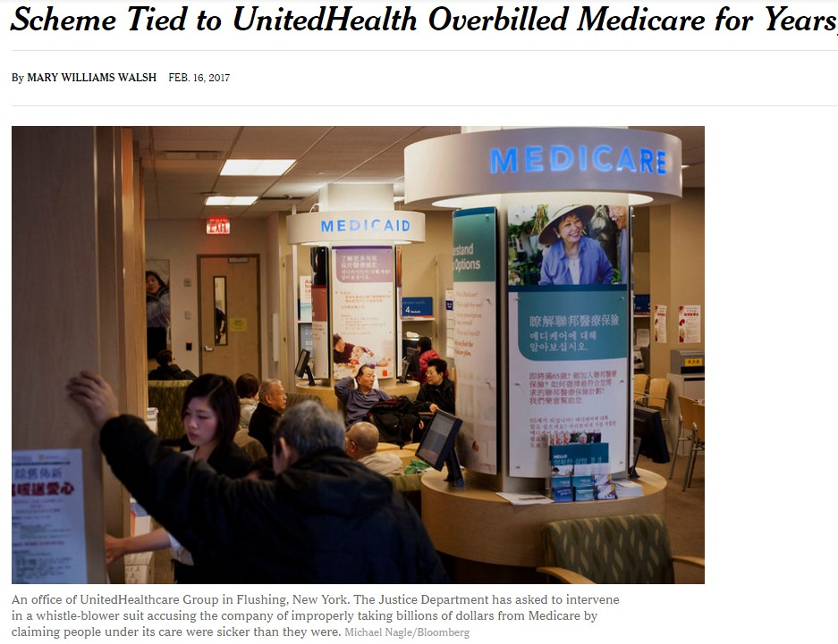
“UnitedHealth Overbilled Medicare
By Billions, U.S. Says in Suit”
An office of UnitedHealthcare Group in Flushing NY. The Justice Department has asked to intervene in a whistle-blower suit accusing the company of improperly taking billions of dollars from Medcare by claiming people under its care were sicker than they were.
Michael Nagle/Bloomberg; Mary Williams Walsh, New York Times, Feb. 16, 2017

Slide 102
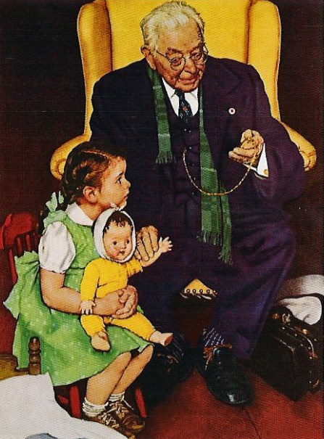
HMO “House Calls”:
A New Upcoding Scam
HMOs send their “house call doctor” – or one from Mobile Medical Examination Services Inc.
Doctor seeks out unimportant diagnoses, e.g. mild arthritis
No treatment offered
Extra diagnoses allow HMOs to upcode, adding >$3 billion/year to Medicare Advantage payments
Efforts to outlaw upcoding “house calls” were scrapped after industry lobbying blitz
Schulte, Center for Public Integrity, 2014

Slide 103
Medicare Overpays Private Plans
Overpayments ($ Billions)
Total overpayments 2008-2016:
$173.7 Billion
Source: MedPAC and Geruso and Layton, 2015

Slide 104
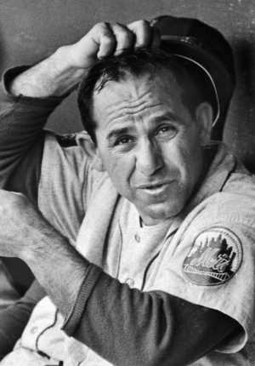

ACOs: Warmed Over Managed Care

Slide 105
HMO and ACO Similarities
Diagnosis:
FFS and “Fragmentation”
Rx:
Invert FFS incentives
  Shift insurance risk to providers
  Protect” patients with P4P
  Consolidate providers into entities large enough to be “held accountable” for cost (via capitation)

Slide 106
ACOs’ Explosive Growth Since 2010
Number of ACOs
2010 | 2011 | 2012 | 2013 | 2014 | 2015 | 2016 | 2017
Sources: Health Affairs Blog 10/31/13 and 3/31/15. Leavitt Partners 6/28/17

Slide 107
HMO and ACO Differences
More ACOs are provider-based (so far)
Patients not restricted to ACO (so far)
Patients are mostly unaware they’re in an ACO

Slide 108
Poll: Patients Reject ACOs
“Here are two different ways Medicare could pay doctors.
Which of these do you think
would be better for you?”
NEJM 2013;369:1066 – Kaiser/RWJ/Harvard Survey, 201

Slide 109
High Risk HMO Patients
Fared Poorly in the RAND Experiment
Relative Risk of Dying
Diastolic Blood Pressure
Source: RAND Health Insurance Experiment, Lancet 1988;1:1017
Note: High Risk = 20% of population with lowest income + highest medical risk

Slide 110
Depressed Patients:
Fee-For-Service vs. Managed Care
Primary Care Patients
Patients Seeing a Psychiatrist
Fee-For-Service
Number of Functional Limitations
Managed Care
Source: Medical Outcomes Study. JAMA 1989; 262:3298
Arch Gen Psych 1993; 50:517

Slide 111
Failure of Medicare HMO Risk Adjustment
Despite decades-long effort, CMS has failed to stop cherry-picking
Implications
  No net savings, probable increased costs
  Resources transferred from sick to healthy
  Biggest cheaters are biggest winners
  ACOs that embrace problem patients driven from the market
Intensive coding makes patients appear sicker on paper, ups risk-adjusted capitation fee and factitiously raises quality scores
ACOs that fail to cherry pick/upcode get low payments, and factitiously poor quality scores

Slide 112
Claims for ACO Savings Ignore Bonuses
ACOs Slightly Increased Medicare’s Costs, 2013-2015
Medicare Payments
to ACOs,
2013-2015
$ Millions
2013
2014
Total:
-$954 M
2015
DHHS Inspector General, August, 2017

Slide 113
Hospitals Merging
System-Owned
Proportion of Hospitals That Are System-Owned vs. Independent
Independent
Source: Sanofi Hospital/Systems Digest, 2016

Slide 114
Hospitals and Health Systems Are Buying Up Primary Care Practices
50%
40%
30%
20%
10%
0
Hospital or Health Care System
Practice Ownership
Solo Practice
Medical Group
2010 | 2011 | 2012 | 2013 | 2014 | 2015 | 2016
Trands in Practice Ownership
Brent D. Fulton Health Aff 2017;36:1530-1538
Notes:
Percentages of primary care physicians working in organizations, by ownership type, 2010–16

Slide 115
Corporate Ownership of Oncology Practices Has Doubled Since 2010
60%
50%
40%
30%
20%
10%
Percentage of
all oncology practices
owned by a hospital
or health system
2003 | 2005 | 2007 | 2009 | 2011 | 2013 | 2015
Health Affairs 2017;36:580

Slide 116
Physician/Hospital Integration
Raises Costs
Annual Outpatient Cost Increase with 1.9% Increase in Physician/Hospital Integration
Source: JAMA IM 2015;175:1932
Note: Physician/Hospital integration measured by % of MDs billing with a hospital place of service code

Slide 117
The Toxicity of
Pay for Performance (P4P)

Slide 118
Assumptions Implicit in P4P
Performance can be accurately ascertained
Individual variation is caused by variation in motivation
Financial incentives will add to intrinsic motivation
Current payment system is too simple
Hospitals/MDs delivering poor quality care should get fewer resources

Slide 119
Quality Scores Tell More About Patients than Physicians
Harvard physicians with poorer/minority patients score low
Patient characteristics in panels of high-
and low-scoring physicians
Source: Hong C et al. JAMA 9/8/2010. 304:10;1107.

Slide 120
MACRA Penalizes Doctors With
Sicker (or Poorer) Patients
Percent of practices receiving bonuses / penalties
JAMA 2017;318:453 – Figures are simulated based on 2015 Medicare data

Slide 121
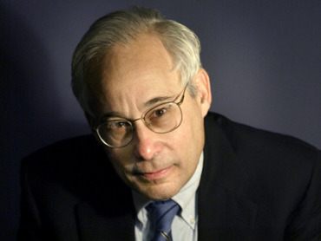
Pay for Performance?
“I do not think it’s true that the way to get better doctoring and better nursing is to put money on the table in front of doctors and nurses. I think that's a fundamental misunderstanding of human motivation.
“I think people respond to joy and work and love and achievement and learning and appreciation and gratitude – and a sense of a job well done. I think that it feels good to be a doctor, and better to be a better doctor.
“When we begin to attach dollar amounts to throughputs and to individual pay, we are playing with fire. The first and most important effect of that may be to begin to dissociate people from their work.”
– Don Berwick M.D.
Health Affairs. 1/12/2005

Slide 122
95% of Plans Cheat on HEDIS Quality Measures
Medicare Advantage plans failing to cheat fall in rankings
Percent of elderly patients prescribed drugs that should be avoided
Annals of Internal Medicine 2013;159:456
Researchers compared reported HEDIS scores for high risk prescribing to actual Medicare Part D payment records for all enrollees and for enrollees sampled for HEDIS scoring

Slide 123
Medicare’s Premier Demonstration:
A P4P Failure at 252 Hospitals
Worse
5-year outcomes show no effect on mortality
Change from baseline in 30-day mortality
Better
Note: P4P failed even among poor performers at baseline
Source: NEJM March 28, 2012

Slide 124
Medicare’s P4P Incentives:
No faster improvement than non-P4P conditions
Improvement in Survival Rate per Quarter
P4P
No P4P
Source: Annals of Internal Medicine 2016;165:153

Slide 125
Medicare’s Readmission Penalties:
Fewer CHF Readmissions, More Deaths
Gupta et al. JAMA Cardiology, posted online 11/12/2017
Note: Analysis based on 115,245 CHF discharges, 2008-2014

Slide 126
Medicare’s Value-Based Payment Program
Penalizes Doctors Caring for High-Needs Patients
Percent of Practices Penalized*
JAMA 2017;318:453
*Estimate based on simulation of penalties under mandatory Physician Value-Based Paryment Modifier Program

Slide 127
P4P Did Not Lower
Hospital Mortality in England
P4P Hospitals
20%
15%
10%
5%
P4P Hospitals
30-Day Mortality
Control Regions
No
P4P
Bonuses Only
Bonuses plus Incentives
Difference
2007 | 2008 | 2009 | 2010 | 2011 | 2012
Source: N Engl J Med 2014;371:540-548

Slide 128
P4P Did Not Improve Mortality in England
World’s largest P4P program tied 25% of GP income to quality targets
Change in Deaths/100,000 From Pre to Post P4P Implementation
Source: Lancet 2016;388:268
Note: Data shows trends compared to developed nations without P4P

Slide 129
VA Hospitals Have Lower Mortality and Readmissions than Other Hospitals
Mortality
Readmissions
30 Day Mortality or readmissions per 100 patients
JAMA IM 2017;177:882
PNA = Pneumonia; All rates are risk-adjusted

Slide 130
ACOs and P4P:
Implementation Without Evidence
P4P – Official Medicare policy, widely adopted by private payers
Implementing everywhere interventions which
have been proven nowhere
risks failure on a colossal scale
  No RCTs showing improved outcomes.
  No improvement in 3 largest programs.
  Negative side effects likely, e.g. increased CHF deaths.
  VA (no P4P) has better quality than hospitals paid P4P
ACOs – Newest health policy panacea
  No RCTs.
  No savings once bonuses factored in.
  Disturbing HMO experience.

Slide 131
Mandate Model Reform:
Keeping Private Insurers In Charge

Slide 132

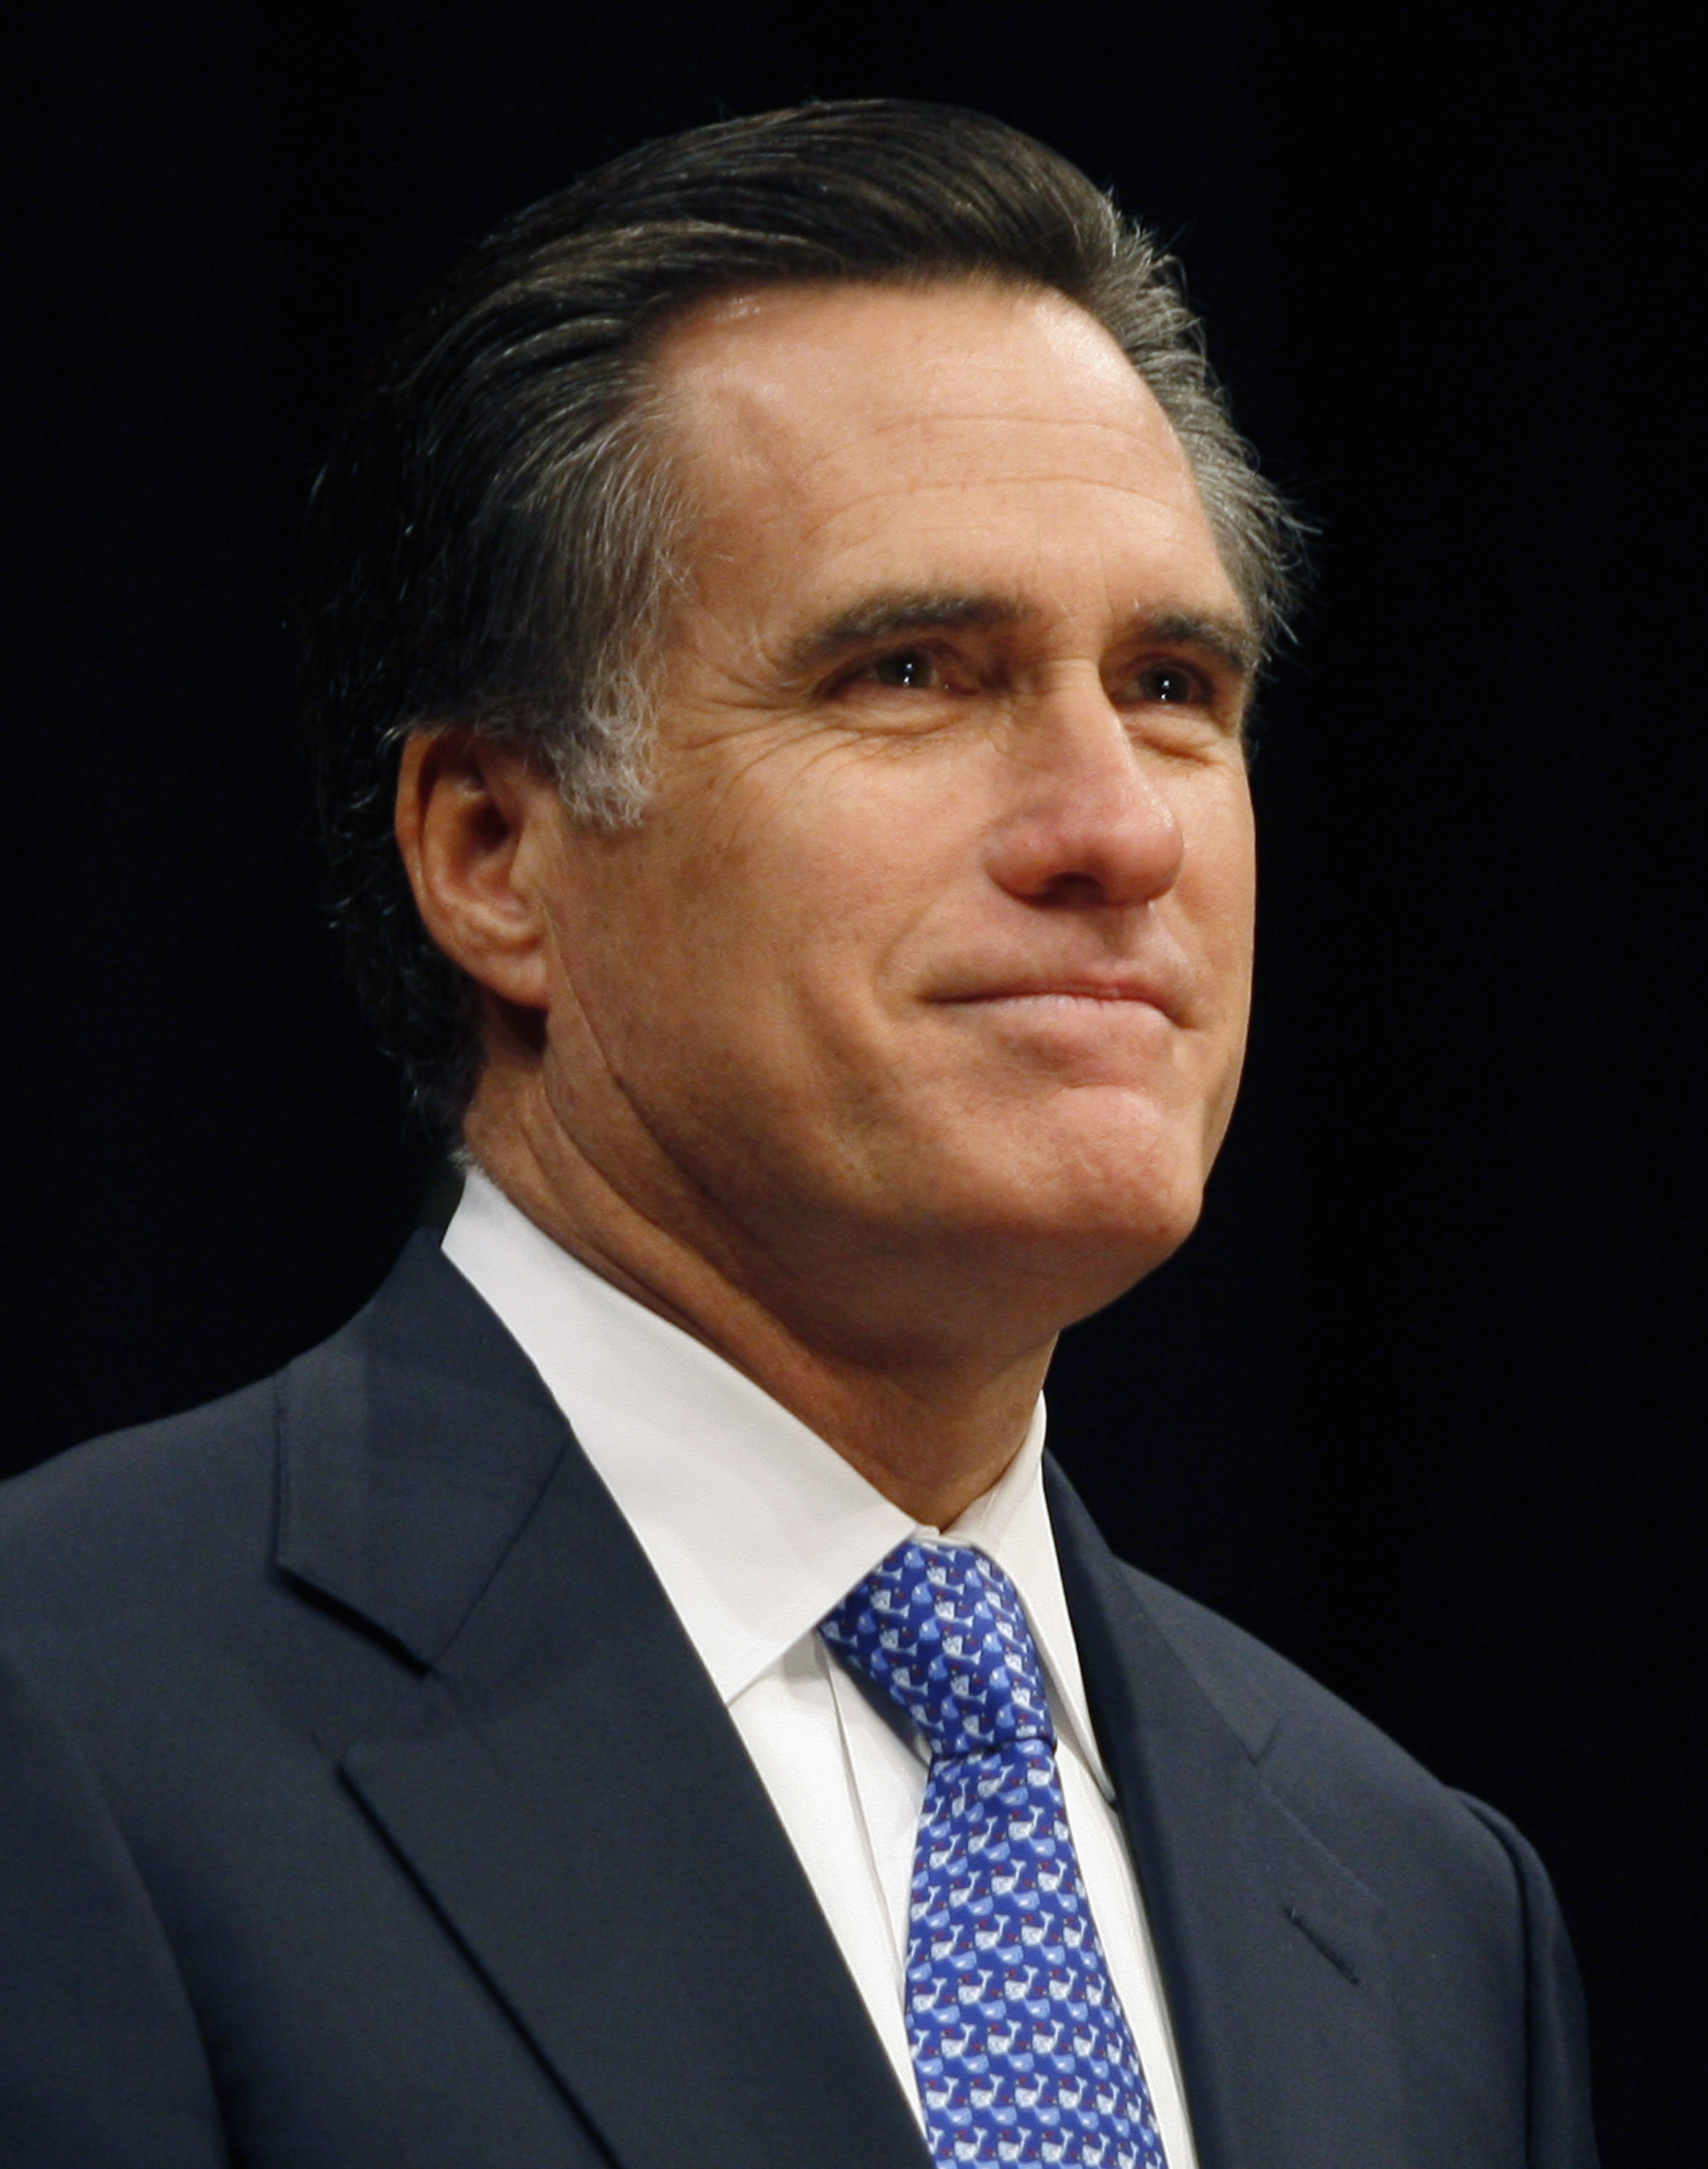

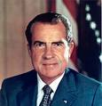
“Mandate Model” of Reform
Expanded Medicaid-like program
  Free for the poor
  Subsidies for low income
  Buy-in without subsidies for others
Employer Mandate +/- Individual
Insurance Exchanges
Notes:
132

Slide 133

The Heritage Foundation Proposal: 1989
Universal coverage
Individual mandate
Refundable tax credits pegged to income and health status.
Minimum benefit package

Slide 134
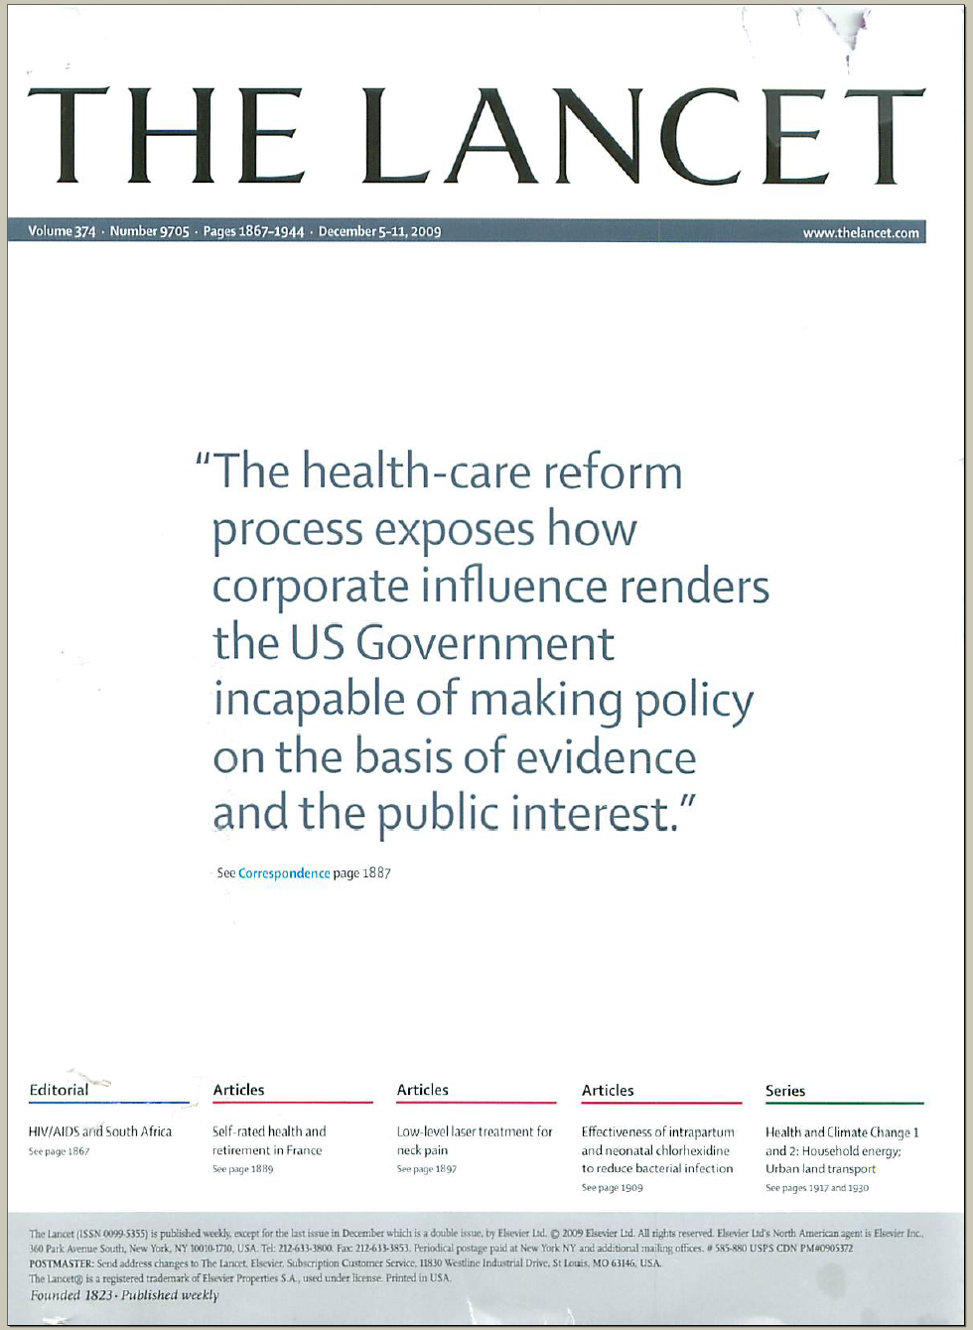
The Lancet Put It on Their Cover
“The health-care reform process exposes how corporate influence renders the US Government incapable of making policy on the basis of evidence and the public interest.”
Source: Lancet Dec 5, 2009. Cover of vol. 374.

Slide 135
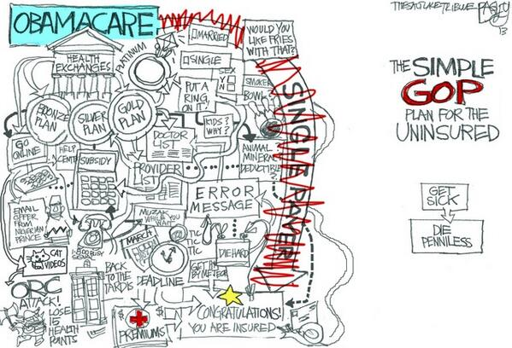

Slide 136
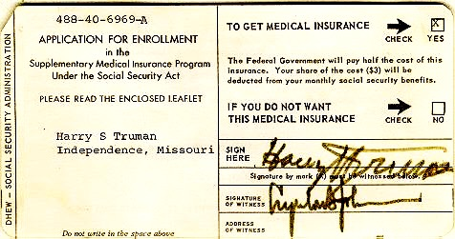
Medicare’s “Software”
18.9 million seniors enrolled within 11 months

Slide 137
ACA Decreased Incidence of Unmet Medical Needs Due to Cost
Better, but still not good.
Percent of Adults
Ages 18-64
Reporting an Unmet Health Need (Past 12 Months)
Income as Percent of Federal Poverty Level
Health Affairs 2017;36:1656

Slide 138
Average ACA Plan Excludes ³/₄ of PCPs,
Almost 90% of Psychiatrists
Percent Included in Plans’ Physician Network
Health Affairs 2017;36:1624

Slide 139
Administrative Costs Risking Quickly Since ACA’s Passage
Average rate of increase annually, 2009-2017
Himmelstein & Woolhandler, unplublished analysis based on NHEA and Medicare cost reports
Note: Hospital figure is for 2009-2016

Slide 140
Trump’s Health Financing Actions So Far
Stop ACA cost reduction payments – 2 million more uninsured, federal costs increase $6 bil/yr.
Expand “association” and “short term” junk insurance – Increase under-insurance, undermine ACA risk pool raising cost for sicker people.
Let employers deny coverage for birth control.
Obstruct ACA enrollment.
Allow states to implement punitive Medicaid changes.

Slide 141
American Taxpayers
Already Pay More Than
People in Nations With
National Health Insurance

Slide 142
²/₃ of Our Healthcare Spending
Comes From Our Taxes
Tax Funded
65%
Source: Himmelstein & Woolhandler – Analysis of NCHS data

Slide 143
US Public Spending per Capita for Health Exceeds Total Spending in Other Nations
USA Total:
$10,370
Note: “Public” includes benefit costs for gvt employees and tax subsidies for private insurance
OECD 2017; NCHS; AJPH 2016;106:449 – Data are for 2017 or most recent available

Slide 144
The USA
Trails Other Nations

Slide 145
USA Patients Skip Care More Often
Patients skipping a consultation, test, treatment, Rx, or follow-up due to cost in the past 12 months
Commonwealth Fund Survey, 2016

Slide 146
Even Americans with Above-Average Incomes Have Worst Access to Care
Percent Reporting Access Problem
Source: NEJM 10/23/2014

Slide 147
Life Expectancy
Years
OECD, 2017
Note: Data are for 2015 or most recent year available

Slide 148
Infant Mortality
Deaths in First Year of Life / 1000 Live Births
OECD, 2017
Note: Data are for 2015 or most recent year available

Slide 149
Maternal Mortality
Deaths per 1000 Live Births
OECD, 2017 and Global Burden of Disease, 2015
Note: Data are for 2015 or most recent year available

Slide 150
Maternal Mortality:
Unprecedented Increase
Maternal Deaths per 100,000 Live Births
Source: Obstetrics & Gynecology 2016;128:447
Note: California excluded from national figures because of discontinuity in ascertainment

Slide 151
High U.S. Costs Do Not Result From
Bad Health Habits
Aging
Overuse of Care

Slide 152
Smoking Prevalence
Percent of population >age 15 who smoke daily
Source: OECD, 2016
Note: Data are for 2015 or most recent year available

Slide 153
Percentage of Elderly
Percent of population >age 64
Source: OECD, 2016
Note: Data are for 2015 or most recent year available

Slide 154
Hospital Inpatient Days per Capita
Days/person/year
Source: OECD, 2015 & AHRQ
Note: Data are for 2014 or most recent year available

Slide 155
Physician Visits per Capita
Source: OECD, 2017
Note: Data are for 2016 or most recent year available

Slide 156
Number of Nurses per 1,000 Population
Source: OECD, 2017
Note: Data are for “professionally active nurses” for 2016 or most recent year available

Slide 157
Hip Replacement
Procedures per 100,000 Population
Source: OECD, 2017
Note: Data are for 2016 or most recent year available

Slide 158
USA Renal Failure Patients
Are Less Likely to Get Transplants
Percent of ESRD Patients with Functioning Transplants
Source: OECD 2015
Note: Data are for 2013 or most recent year available

Slide 159
Other Countries Provide
More Long Term Care
Percent of total population receiving LTC
OECD, 2017
Note: Data are for 2015 or most recent year available

Slide 160
Out-of-Pocket Payments
$ per Capita
Source: OECD 2017, NCHS
Notes: Data are for 2015 or most recent year available. Figures adjusted for Purchasing Power Parity

Slide 161
Medical Journal Articles per Capita
Number of clinical medicine articles 1992-2002 per thousand population
Source: Lancet 2004;363:250

Slide 162
Insurance Overhead
$ per Capita
Source: OECD 2017; NCHS; CIHI
Notes: Data are for 2016 or most recent year available. Figures adjusted for Purchasing Power Parity

Slide 163
Private Insurance = High Overhead
Everywhere!
Percent Overhead
Source: “Voluntary Health Insurance in Europe” (WHO, 2016); NCHS and CIHI

Slide 164
USA Doctors Face Biggest Rx Hassles
Percent of Primary Care Doctors Saying MD or Staff Time
Getting Needed Rx Approvals Is a Major Problem
Source: Commonwealth Fund Survey of Primary Care Physicians, November, 2012
Note: Rx indicates prescribed drug or treatment

Slide 165
Quality of Care
Slightly Better in Canada Than in USA
Source: Guyatt et al, Open Medicine, April 19, 2007

Slide 166
USA Doctors’ Satisfaction Is Low
Percent of primary care doctors saying they are satisfied or very satisfied
Source: Commonwealth Fund Survey of Primary Care Physicians, November 2012

Slide 167

Canada’s
National Health Insurance Program

Slide 168
Minimum Standards for
Canada’s Provincial Programs
Universal
  Universal coverage that is not impeded, either directly or indirectly, whether by charges or otherwise, reasonable access.
Portable
  Portability of benefits from province to province
Comprehensive
  Coverage for all medically necessary services
Public
  Publicly administered, non-profit program

Slide 169
Free Care in Quebec Increased Physician Care for Serious Symptoms
Biggest impact on poor and middle class
Percent of serious symptoms for which physician was seen
Source: NEJM 1973;289:1174

Slide 170
Cystic Fibrosis Patients
Live Longer in Canada
Uninsured in USA die youngest
Hazard Ratio
for death.
Canadian vs USA
CF patients
(USA = 1.0)
Ann Int Med 2017;166:537
Note: Hazard Ratios are adjusted for multiple genetic and clinical characteristics

Slide 171
Infant Mortality, USA and Canada
Deaths/1,000 Live Births
Statistics Canada, Canadian Institute for Healtb Information, Natl Ctr for Health Statistics

Slide 172
Infant Deaths by Income, Canada 2011
Infant Mortality per Thousand
Even poor Canadians
do as well as
the USA average
CDC and StatCam

Slide 173
Mortality Gap by Income
Is Shrinking in Canada
Remaining Life Expectancy at Age 25
Source: Toronto Globe & Mail, 11/8/2013
“For the most part, the differences in health status between the highest and lowest income groups have been shrinking over time.” – Public Health Agency of Canada

Slide 174
Healthcare Costs as a % of GDP
Canada’s NHP Enacted
USA
Health costs
% of GDP
NHP Fully Implemented
Canada
Sources: Statistics Canada, Canadian Inst. for Health Inf., and NCHS/Commerce Dept.

Slide 175
US Medicare Coverage
Much Worse than Canada’s
Percent of Seniors’ Total Medical Expenses Covered
Note: Not comparable to figures for employer coverage because of high LTC needs in elderly
Source: EBRI and Himmelstein/Woolhandler analysis of Health Canada data

Slide 176
How Canada Controls Costs
Low administrative costs (16.7% of health spending vs. 31.0% in USA)
Lump-sum, global budgets for hospitals
Stringent controls on capital spending for new buildings and equipment
Single buyer purchasing reins in drug/device prices
Low litigation and malpractice costs
Emphasis on primary care
Exclusion of private insurers (private plans overcharged U.S. Medicare by $34 billion in 2012)
Source: Himmelstein & Woolhandler, Arch Intern Med, December, 2012

Slide 177
Hospital Billing and Administration
USA and Canada, 2016
$ per Capita
(PPP Adjusted)
Source: Woolhandler et al. NEJM 2003;349:768 (updated); Himmelstein et al, Health Aff 9/2014

Slide 178
USA Hospital Administration Costs
$ Billions
Himmelstein et al. Health Affairs 9/2014 - updated

Slide 179
Physicians’ Billing and Office Expenses
United States and Canada, 2017
$ per Capita
(PPP Adjusted)
Source: Woolhandler/Campbell/Himmelstein NEJM 2003;349:768 (updated)
Note: Excludes dentists and other non-physician, office-based practitioners

Slide 180
Overall Administrative Costs per Capita
United States and Canada, 2017
Source: Woolhandler et al. NEJM 2003;349:768 (updated); Himmelstein et al. Health Aff 9/2014

Slide 181
Difference in Health Spending per Capita
USA and Canada, 2017
Source: Woolhandler/Himmelstein/Campbell NEJM 2003;349:768 (updated)
Himmelstein et al, Health Affairs 9/29; NCHS; CIHI; PPP adj.

Slide 182
Few Canadian Physicians Emigrate Today
Net loss
(number moving abroad –
number returning)
A negative number indicates that more physicians returned from abroad then moved abroad
Source: Canadian Institute for Health Information

Slide 183
Canadian Physicians’ Incomes
Average Clinical Payments per Physician, 2015-2016
Specialty | Income
Family Medicine | $275,000
Internal Med | $389,000
Pediatrics | $294,000
Psychiatry | $266,000
Dermatology | $378,000
Specialty | Income
OB-GYN | $398,000
General Surgery | $435,000
Thoracic Surgery | $569,000
Ophthalmology | $714,000
Avg All Canada | $339,000
Source: Canadian Institute for Health Information
Figures are in Canadian $

Slide 184
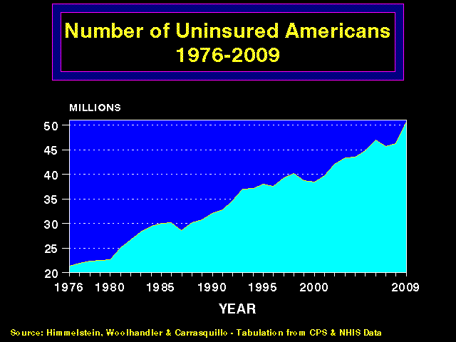
Trends in Canadian Physician Incomes
Mean physician income as multiple of all Canadian
full time employees
Source: Grant and Hurley, U Calgary School of Public Pol. Research Papers. July 2013, Vol 6, Iss 22.

Slide 185
Canadian Malpractice Insurance Costs, 2018
Specialty | Ontario* | Quebec | BC & Alberta
Family Med | $5,208 | $1,517 | $3,936
Psychiatry | $5,208 | $1,517 | $3,936
Obstetrics | $8,400 | $3,008 | $3,936
Cardiology | $8,400 | $3,008 | $3,936
Anesthesia | $13,872 | $3,754 | $9,780
Neurosurgery | $40,548 | $9,679 | $30,000
*Government reimburses physicians for premiums above 1986 level. All figures in Canadian $s.
Source: Canadian Medical Protective Association www.cmpa-acpm.ca

Slide 186
Applicants per Medical School Position
AAMC and Association of Faculties of Medicine of Canada

Slide 187
What’s OK in Canada?
Compared to the USA…
Life expectancy 2 years longer
Infant deaths 25% lower
Universal comprehensive coverage
More physician visits, hospital care; less bureaucracy
Quality of care equivalent to insured Americans’
Free choice of doctor and hospital
Health spending half of USA level

Slide 188
What’s the Matter in Canada?
The wealthy lobby for private funding and tax cuts; they resent subsidizing care for others.
Result: government funding cuts (e.g., 30% of hospital beds closed during the 1990s) causing dissatisfaction and waits for care.
USA and Canadian firms seek profit opportunities in health care privatization
Conservative foes of public services own many Canadian newspapers
Misleading waiting list surveys by right wing Fraser Institute

Slide 189
Most Democrats and a Plurality of Republicans Favor Medicare for All
Democrats
Republicans
“Do you favor or oppose
expanding Medicare
to provide health insurance
to every American?”
Source: Economist/YouGov poll April 2017

Slide 190
Most Americans Now Agree
Percent of US adults agreeing
“It is the responsibility of the
federal government to ensure that
all Americans have health coverage.”
NEJM 8/16/17. Based on surveys by Gallup 11/13 and 11/15; Per 3/14, 3/17, and 6/17.

Slide 191
Most Doctors Now Favor Single Payer
Support Has Sharply Increased
2008
2017
Source: Merritt Hawkins surveys of physicians

Slide 192
A National Health Program for the USA

Slide 193
National Health Insurance
Universal – covers everyone
Comprehensive – all needed care, no co-pays
Single, public payer – simplified reimbursement
No investor-owned HMOs, hospitals, etc.
Improved health planning
Public accountability for quality and cost, but minimal bureaucracy
Proposal of the Physicians Working Group for Single Payer NHI
Gaffney et al AJPH JUne 2016 106:6 + Suppl.
JAMA 2003;290:798

Slide 194
Funding for the NHP
Revenue Sources
Recipients of Money
NHP
Fund
Medicare and Medicaid
Hospital Operating Costs
Hospital Capital Costs
State / Local Governments
HMOs
Employers
Fee-for-Service Physicians
Private Insurance Revenues
Home Care Agencies
New Taxes
Long-Term Care
NEJM 1989;320:102

Slide 195
Hospital Payment Under an NHP
Hospitals remain privately owned.
Capital purchases/expansion budgeted separately based on health planning goals.
Negotiated global budget for operating costs. Operating funds cannot be diverted to capital.
NEJM 1989;320:102

Slide 196
Three Options for Physician and Ambulatory Care Payment Under the NHP
Fee for
Service
Capitation for Institutions
With Salaried Physicians
Globally Budgeted Institutions
  Mandatory assignment
  Simplified negotiated fee schedule
  Free disenrollment
  No selective enrollment period
  Capitation for operating costs, not capital purchases, profits or physician incentives
  Inpatient care under hospital’s global budgets
  Institutions with salaried physicians
    Hospitals
    Clinics
    Home care agencies
Himmelstein and Woolhandler. NEJM;320:102

Slide 197
HR 676 (the Conyers Bill)
Universal coverage, single, public plan
Comprehensive benefits, includes LTC
No copayments for covered services
Ban on duplicative private coverage
Hospital global budgeting
But…
no exemption from the
Hyde Amendment

Slide 198
S.1804 (the Sanders Bill)
Strengths
Universal coverage, single, public plan
Comprehensive acute care benefits
No copayments for covered services
Ban on duplicative private coverage
Exemption from Hyde Amendment
Drug formulary and price negotiations

Slide 199
S.1804 (the Sanders Bill)
Weaknesses
Long Term Care remains in means-tested Medicaid
Adopts Medicare payment strategies
  No global budgets for hospitals
  Lumps operating/capital payments
  Medicare Advantage, ACOs
Small drug copays (with poorly designed exemptions)
Allows docs, hospitals be partly in/partly out

Slide 200
Why Global Budget Hospitals?
(and why the Sanders bill needs an amendment)
Maximizes administrative savings by eliminating per-patient billing, incentives for upcoding, and much internal cost accounting
Reduces disparities in profitability of particular patients or services (e.g. psych vs. ortho)

Slide 201
Sanders Bill’s Failure to Mandate Separate Hospital Operating and Capital Payments Means…
Survival of the Fattest
Profitable institutions expand, unprofitable ones shrivel – regardless of need
Survival of the Meanest
Institutions able to cherry pick profitable patients and services, and avoid unprofitable ones thrive, those that can’t or won’t shrivel
Data Distorted
Profit-seeking drives upcoding, and meaningless quality numbers
Costs Rise,
Care-Need Mismatch

Slide 202
Single Payer Transition:
For Displaced Clerical and Administrative Workers
All 400,000 health insurance workers and about ½ of the 2.6 million clerical/administrative employees in healthcare providers likely to be displaced – total 1.7 million.
Many likely to be redeployed in expanded clinical workforce.
Funding for income support and job retraining modeled on WWII GI Bill.
Job displacement is common in the US – 60 million/year, including 20 million who are fired: 1.7 million = number who are fired every 31 days. (source: People’s Policy Report)

Slide 203
Single Payer Transition:
For Patients
Every U.S. resident receives an insurance card.
Full coverage for all medically necessary care, no copayments, deductibles or coinsurance.
Prescription drug formulary, with alternatives covered when medically indicated
Free choice of any participating provider or hospital.

Slide 204
We Have What It Takes
Excellent hospitals, empty beds
Enough well-trained professionals
Superb research
Current spending is sufficient

