Slide 1
Mass Incarceration in the era of unjust healthcare
Lello Tesema
Dir. of Population Health/LA County Correctional Health
PNHP Annual Conference
November 2017
Notes:
Thank you for the introduction and thank you for inviting me to speak to you all today. I trained at Cambridge Health Alliance. There’s no other place like CHA.

Slide 2
Jay
39 yo M
IDDM Type 2, HTN
SMI, 2 prior SA while in custody
Notes:
I wanna start with a patient that I saw on Friday morning, a few hours before I flew out here. We’ll call him Jay. So Jay came to see me to be to establish care. He’s 39, and even though he’s pretty young, he’s been a type 2 diabetic on insluin for almost 10 years. He also has HTN. Jay mood disorder for which he’s on antipsychitocs. While he’s beein custody, he’s tried twice to committ suicide.
Jay’s story while heartbreaking is sadly not uncommon in the environment I work in.

Slide 3
US leads the world in incarceration rates
Notes:
Its no surpise to people in this room that as a country we incarcerate more people per capita than any other country in the world.. At 5% of the population, we hold 25% of the worlds prisoners.

Slide 4
Notes:
This is is one of the buildings in the vast and large LA County jail system.

Slide 5
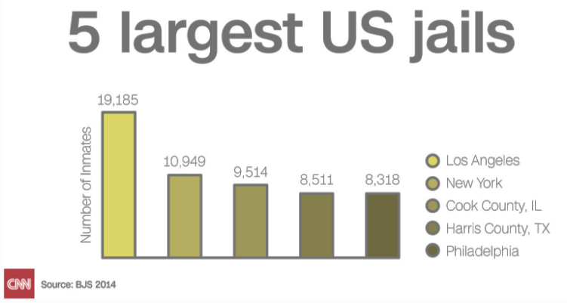
LAC - Largest jail system in the country
Notes:
In fact, the LA county jail system is the largest jail system in the country. Will a population of 19,000 it’s the size of a small town.

Slide 6
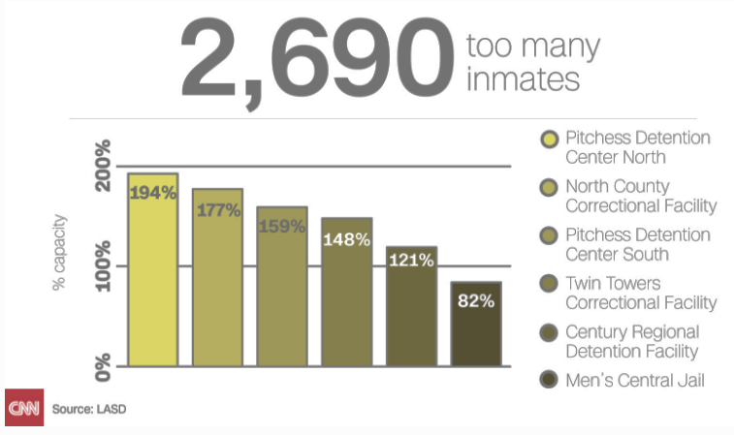
Overcapacity and overcrowded
Notes:
It large and also any given point overcrowded. Some of ourfacilities are at almost double the capacity that they were designed to house. So you can imagine ways in which overcrowding can exercabete the health of our patients health conditions – asthma, communicable disease, mental illness.

Slide 7
High burden of mental illness and SUD
1 in 3 have SMI
2 out of 3 have SUD
Notes:
Speaking of MI, our jails have become de facto mental health facilities. About a third of our population have SMI, 2/3 SUD. This makes LAC jail the largest mental health facility. This is in part driven the closure of of MH clinics and psychiatry hospitals due to state budgetary cuts in mental health – which we know is in part driven by financial pressures from poor Medicaid reimbursement. Where we have patients who have deemed by a doctor or judge to be too sick to be in jail, but we have no where to place them. And so they languish in our system.

Slide 8
High burden of chronic medical disease
> 80% have ≥ 1 chronic health condition
HIV is 4-5x higher
HCV 17x higher
Notes:
In addition to mental illness, our patients have a high rates of other chronic diseases. My patients diabetes and HTN often get worse due to the poor stress, diet, and confinement of the jails.

Slide 9
Historically poor access to healthcare
55% are uninsured
12% are homeless on intake
Notes:
And lastly, over half of our or our patients are uninsured, many are homeless.

Slide 10
Jay
Raised in child welfare system
“Bad kid” in school
First contact with CJ at 11
Notes:
So how does J, at 39, end up with multiple and serious chronic disease, incarcerated. Well in many ways, in as much as the social safety net failed him, so did our broken healthcare system. Jay came of age in the child welfare system. He got in trouble in school, which looking back,, was for sure due to untreated mental illness. By the time he was 11, instead of being in a child therapists office, he did his first stint in a juvenile jail.

Slide 11
Delinquency vs disease
Juvenile Justice
SUD
ADHD
ACE
Mental Illness
Notes:
Behaviors that are linked to so called childhood delinquency are without a doubt medical in nature. These diseases are both preventable and treatable for those with access to healthcare. Diseases like depression, trauma, ADHD which we know from research is underdaignosed among minority kids and addiction. In our current systems, these problems too often get relegated to our juvenile and later adult CJ system.

Slide 12
Notes:
And there’s growing research to support this. This is one study done by LM that looked at disparities MH utilizatoin patterns by race. Black children and young adults are about half as likely as their white counterparts to get mental health care despite having similar patterns of disease, This is not suprising when we see that the treatment facilities are simply much more scare in poor communities of color. This study in JAMA psychiatrcy found first of all, that even in post-ACA, almost 40% of countes in the US have ZERO MH tx facilities that accept Medicaid. that counties that are predominatly black and latino have less access to outpatient facilities that accept Medicaid.

Slide 13
Notes:
Post-ACA we have seen modest reductions in the percentage of uninsuredin the ballpark of 9-13 % largely driven by dependent coverage mandate, medicaid expansion.

Slide 14
Ongoing barriers to access
Low use of preventive services¹⁻⁵
42% of recently prisoners experienced discrimination based on CJ history⁶
1. Van Houtven CH, Voils CI, Oddone EZ, Weinfurt KP, Friedman JY, Schulman KA, et al. Perceived discrimination and reported delay of pharmacy prescriptions and medical tests. J Gen Intern Med 2005;20(7):578-83.
2. Casagrande SS, Gary TL, LaVeist TA, Gaskin DJ, Cooper LA. Perceived discrimination and adherence to medical care in a racially integrated community. J Gen Intern Med 2007;22(3):389-
3. Hausmann LR, Jeong K, Bost JE, Ibrahim SA. Perceived discrimination in health care and use of preventive health services. J Gen Intern Med 2008;23(10):1679-84.
4. Benjamins MR. Race/Ethnic Discrimination and Preventive Service Utilization in a Sample of Whites, Blacks, Mexicans, and Puerto Ricans. Med Care 2012.
5. Blanchard J, Lurie N. R-E-S-P-E-C-T: patient reports of disrespect in the health care setting and its impact on care. J Fam Pract 2004;53(9):721-30.
6. Frank, J, Discrimination based on criminal record and healthcare utilization among men recently released from prison: a descriptive study. Health Justice. 2014 Mar 25;2:6
Notes:
They return to communites where wait times to see a PCP who accepts medicaid can be 6 months to a year like in LAC.

Slide 15
where do we go from here
Criminal justice system in part stems from a broken health safety net
Notes:
So where do we go from here. Our oversized CJ system is a result of a fractured safety net. Not having access to mental and BH drives who ends up in our jails and prisons, who ends up in our community clinics and hospital. And this is where I think the healthcare reform and the CJ reform movements intersect.
And there’s never been a more important time to make noise

Slide 16
Thank you
Ltesema@dhs.lacounty.gov

