Slide 1
The Impact of Market Based Healthcare on the Opioid Epidemic
Elizabeth Salisbury-Afshar, MD, MPH
Bruce Trigg, MD
Karen Hochman, MD, MPH
Nov 4, 2017

Slide 2
No financial disclosures

Slide 3
Goals
The Opioid Crisis in the US: where we are and how we got here
Access to effective pain and opioid use disorder treatment
Naloxone Access as part of the solution

Slide 4
The Opioid Crisis in the US: where we are and how we got here

Slide 5
Overdose Deaths in US- all types
Source: National Center for Health Statistics
Notes:
In 2014, there were 1.5 times as many deaths from drug overdose than MVC
Leading cause of injury death in US

Slide 6
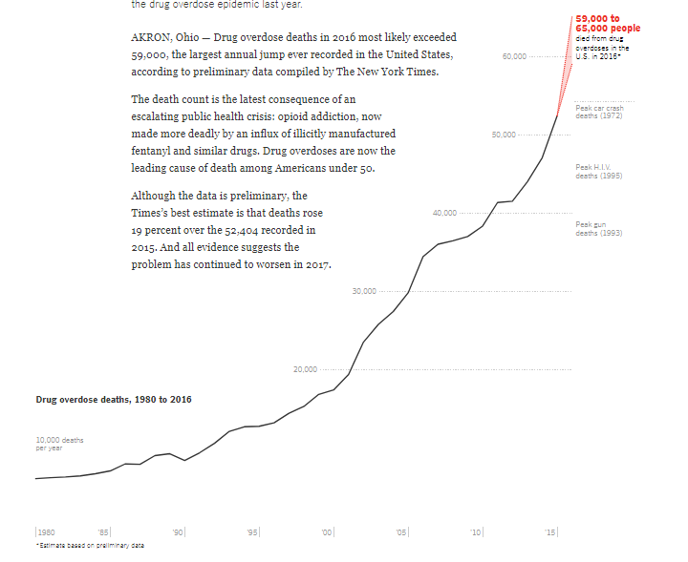
“Drug Deaths in America Are Rising Faster than Ever”
60
60,000
Peak Car Crash Deaths (1972)
Drug Overdose Deaths, 1980-2016
50,000
Peak HIV Deaths (1995)
40,000
Peak Gun Violence Deaths (1993)
30,000
20,000
10,000 deaths per year
1980
1985
1990
1995
2000
2005
2010
2015
*2016 estimate based on preliminary data
Source: New York Times, June 5, 2017

Slide 7
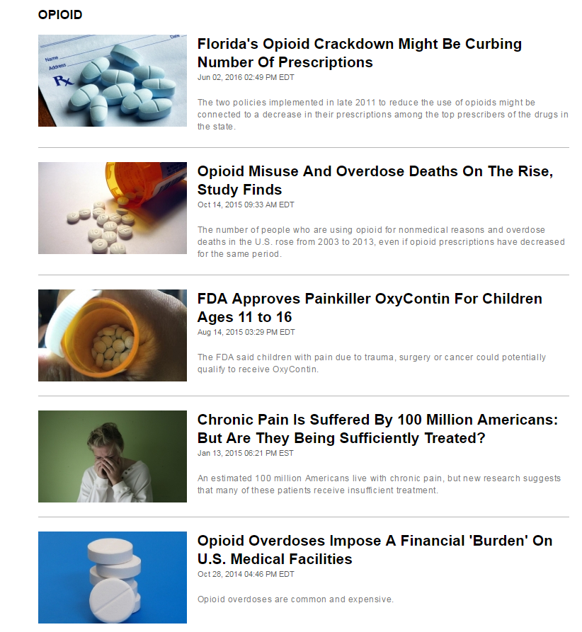
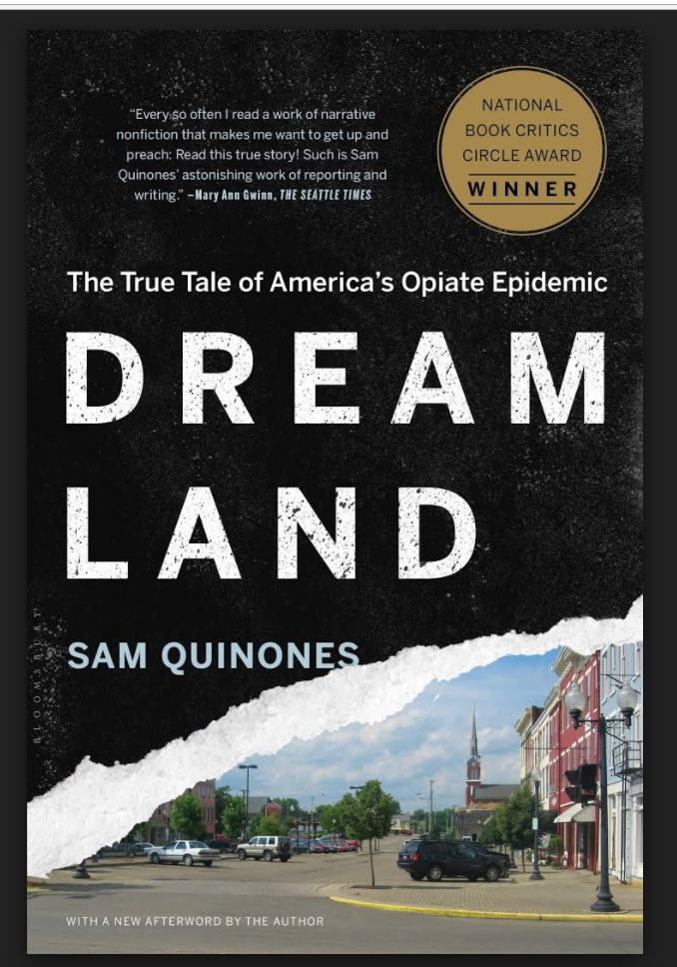
National Story
Notes:
5 changes:
Awareness that pain was undertreated- many patients, even hospitalized ones reported suffering
Significant increases in marketing of pharmaceutical opioids for pain
Economic decline in many parts of the country- particularly more rural/smaller cities
Changing heroin markets (“pizza delivery style heroin delivery)- people coming up from Mexico, also b/c of limited economic opportunity
IN SOME PLACES- some very bad actors (doctors) overprescribing and spurring both addiction and an underground economy

Slide 8
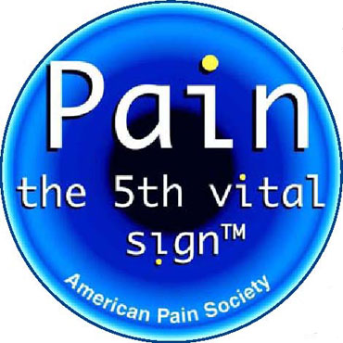
Pain: The 5th Vital Sign
History
  Introduced by president of American Pain Society 1995
  Embraced by VA system late 1990s
  Became Joint Commission standard 2001
Because
  Recognition pain undertreated
  Untreated pain leads to chronic pain
  Chronic pain interferes with quality of life, is costly, and common

Slide 9
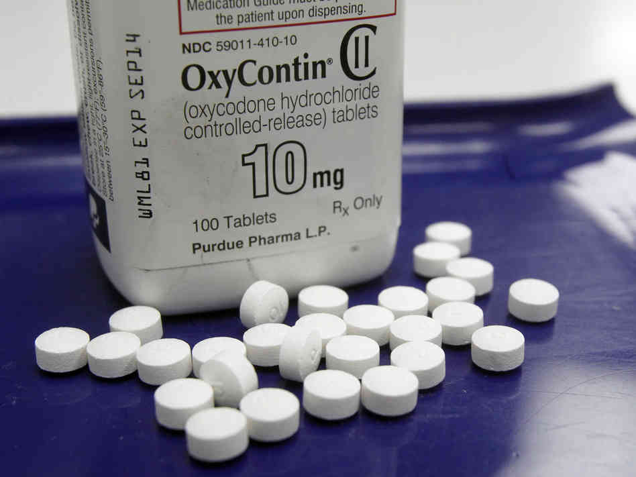
Education: Oxycodone (OxyContin)
Approved 1995
Sales:
  1996 $45 million
  2000 $1.1 billion
  2010 $3.1 billion (30% of painkiller market)
1996-2002 funded >20,000 pain-related educational programs
Provided financial support to: American Pain Society, the American Academy of Pain Medicine, the Federation of State Medical Boards, the Joint Commission
Notes:
2012 11 billion revenue from opioids in US – aggressive sales marketing -

Slide 10
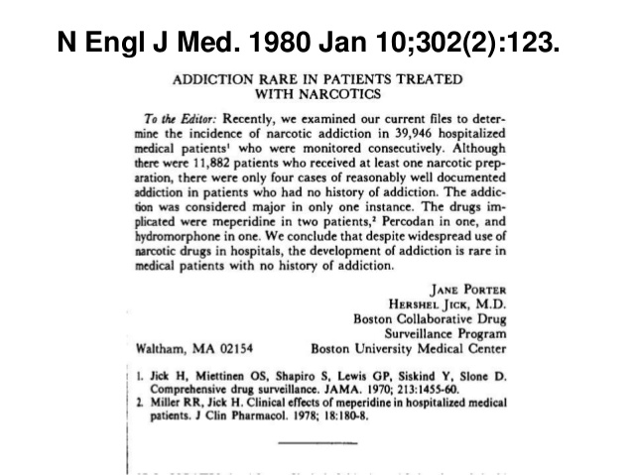
Notes:
Cited by 896

Slide 11
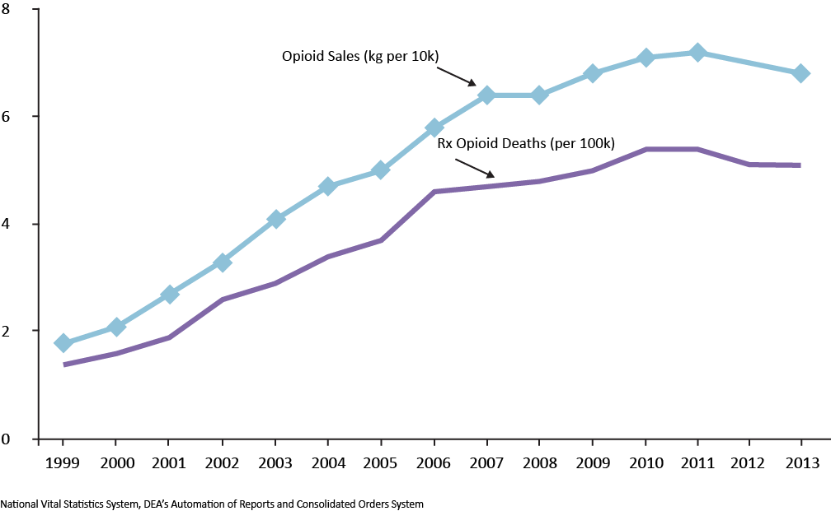
Increase in Opioid Prescribing Associated with Increase in Death
Slide from and used with permission of CDC Division of Unintentional Injury Prevention
Notes:
In this graph, you can see how one main driver of the increase in opioid overdose deaths is the sharp increases in the prescribing of these drugs.
Since 1999, sales of prescription opioids have quadrupled, and this graph shows the relationship between the sales of opioids (the blue line) and the number of deaths from them (the purple line.) As the amount of opioids sold increased—so did the number of deaths.
Note: [data are not available for 2012—the ARCOS file is incomplete, but other sources indicate that the drop in deaths followed declines in prescribing]

Slide 12
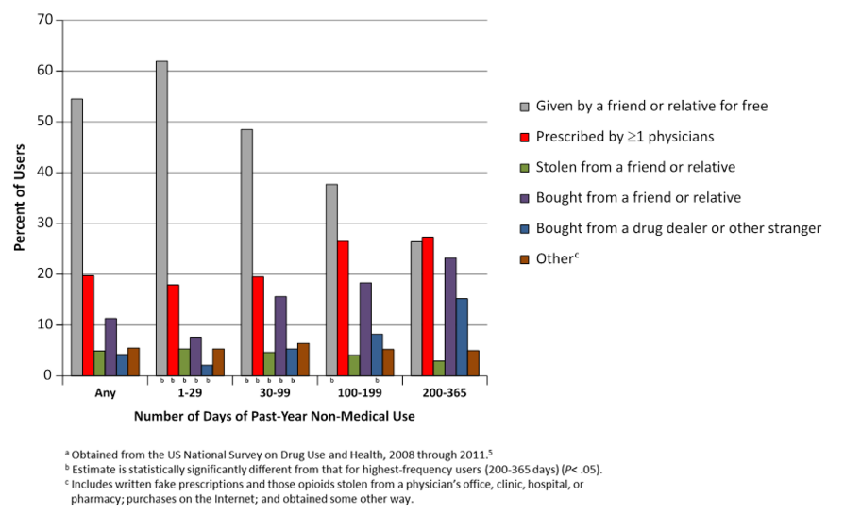
Sources of Rx Opioids Among Past-year Non-Medical Users
Jones, Paulozzi, et al. JAMA Int Med 2014

Slide 13
Rx Opioids and Transition to Heroin
Nonmedical use of Rx opioids is the strongest risk factor for heroin use¹
Majority of current heroin users initiated opioid use with Rx opioids for non-medical purposes (approx 75^{%)2}
Only a small percentage of nonmedical Rx opioid users transition to heroin (approx 3-5%)¹
1- Compton W, et al. NEJM. 2016; 374; 154-63. 2- Cicero et al. JAMA Psychiatry; 2014; 71(7):821-826
Notes:
Estimates suggest approximately 75% of heroin users initiated opioid use with non-medical use of Rx opioids

Slide 14
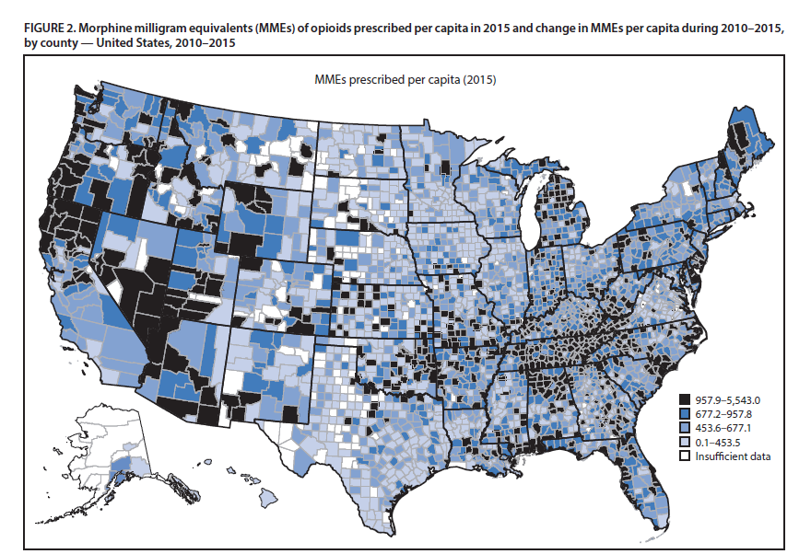
US Opioid Prescription By MME Per Capita
2015 By County
Source: MMWR July 7, 2017; Vol 66, No 26

Slide 15
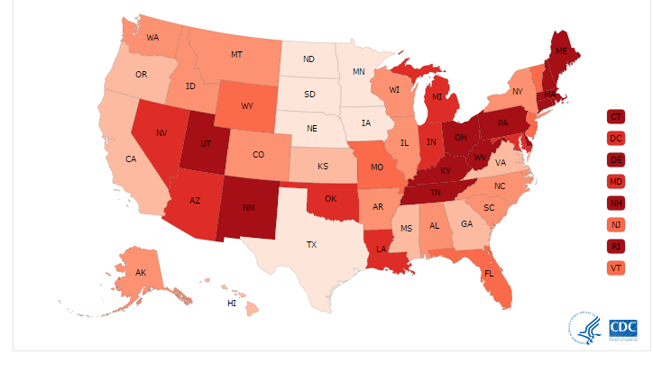
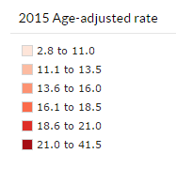
Rates of Drug Overdose Deaths, 2015
Source: https://www.cdc.gov/drugoverdose/data/statedeaths.html

Slide 16
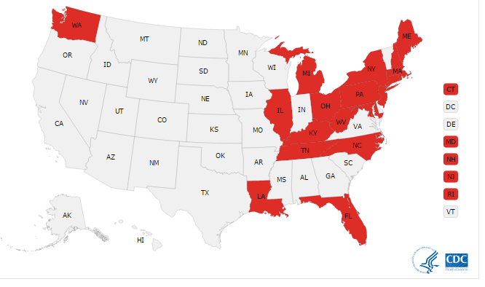
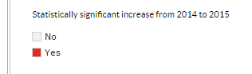
Significant Increase in OD Death Rate from 2014-2015
Source: https://www.cdc.gov/drugoverdose/data/statedeaths.html

Slide 17
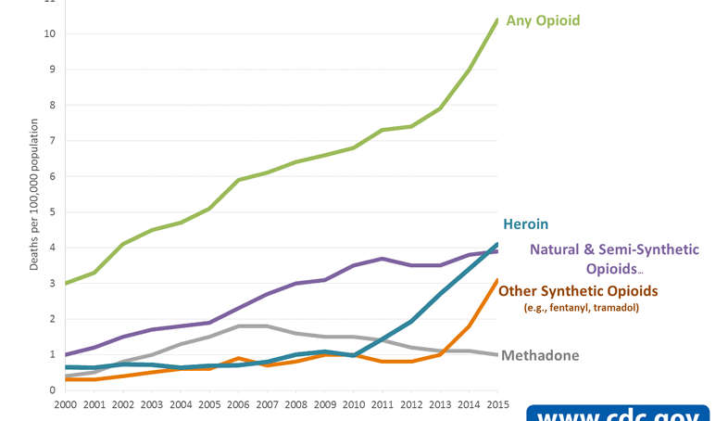
Overdose Deaths Involving Opioids by type, US 2000-2015
https://www.cdc.gov/drugoverdose/data/analysis.html

Slide 18
Public Health Approaches to Opioid Crisis
Primary prevention school education programs
Safe opioid prescribing & disposal
  Prescription Drug Monitoring Programs*
  Drug take-back initiatives
  Provider education (and education mandates)
  Regulation and legal action around “pill mills”
  Opioid prescribing limits (insurance and legislation)
Screening, Brief Intervention and Referral to Treatment
Abuse-deterrent opioid formulations
Opioid Use Disorder (OUD) treatment with agonist therapy*
Overdose response education and naloxone distribution*
  Good Samaritan Laws
  Laws to allow access without a prescription
Safe Injection/Consumption Facilities*
Notes:
All states but MO have PDMP. Missouri passed legislation in April 2017 to adopt state PDMP.
Several states have enacted legislation that will limit the number/day supply of opioids that can be prescribed (NJ, NY, MA, etc. NJ limits to 5 day supply)
* Means there is an evidence base that the intervention has been linked to reduction in MORTALITY

Slide 19
Opioid Use Disorder Treatment
Counseling and Community Support (without medication)
Medication assisted treatment (MAT):
  Methadone*
    Only available in Opioid Treatment Programs (“methadone clinics”)
  Buprenorphine*
    Prescriber must have “waiver” to be able to prescribe and there are limits on size of patient population
  Injectable extended release naltrexone
Detox is not treatment!

Slide 20
Benefits Of Agonist (Methadone and Buprenorphine) Treatment
Increases retention in treatment
Reduces illicit opioid use
Reduces risk of overdose
Reduces risk of HIV infection
Reduces risk of HBV and HCV infections
Increases rates of employment
Decreases crime
Increases length of life
Notes:
Reduces risk of HIV infection by 6 fold
Returns people to productive functioning

Slide 21
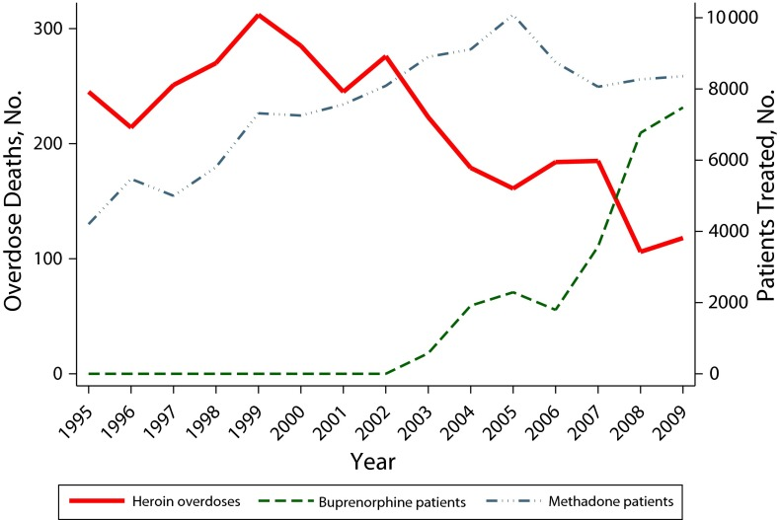
Opioid Agonist Treatments and Heroin Overdose Deaths in Baltimore 1995-2009
Schwartz et al. Am Journal of Public Health. 2013; 103(5):917-922

Slide 22
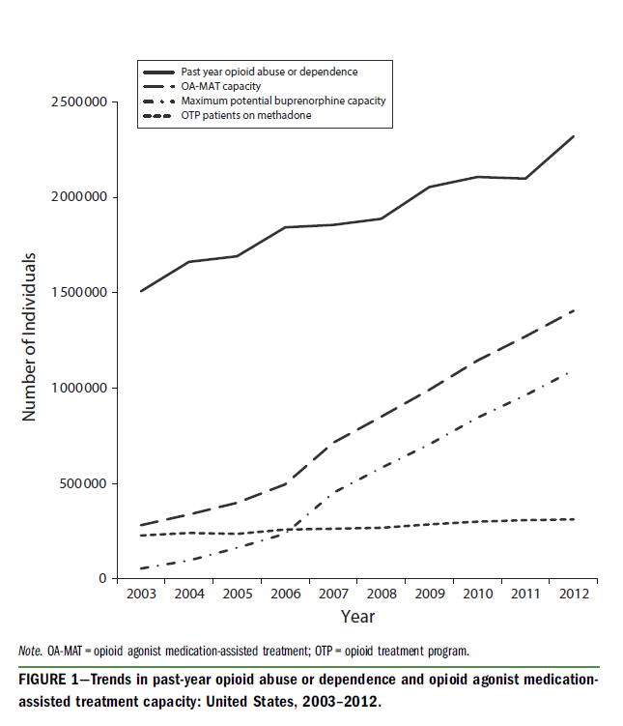
Access to opioid use disorder medication assisted treatment in US
Jones CM, Campopiano M, et al. Am Journal of Public Health. 2015; 105(8):e55-e63

Slide 23
Overdose Response & Naloxone Distribution
No increase in drug use; increase in drug treatment
  Seal et al. J Urban Health 2005:82:303-11
  Galea et al. Addict Behav 2006:31:907-912
  Wagner et al. Int J Drug Policy 2010: 21: 186-93
  Doe-Simkins et al. BMC Public Health 2014; 14:297
Cost effective
  Coffin & Sullivan Ann Internal Med 2013; 158: 1-9
Reduction in overdose deaths
  Walley et al. BMJ 2013 346:f174
Should center around people who use drugs
  Rowe et al. Addiction 2015; 1301-1310

Slide 24
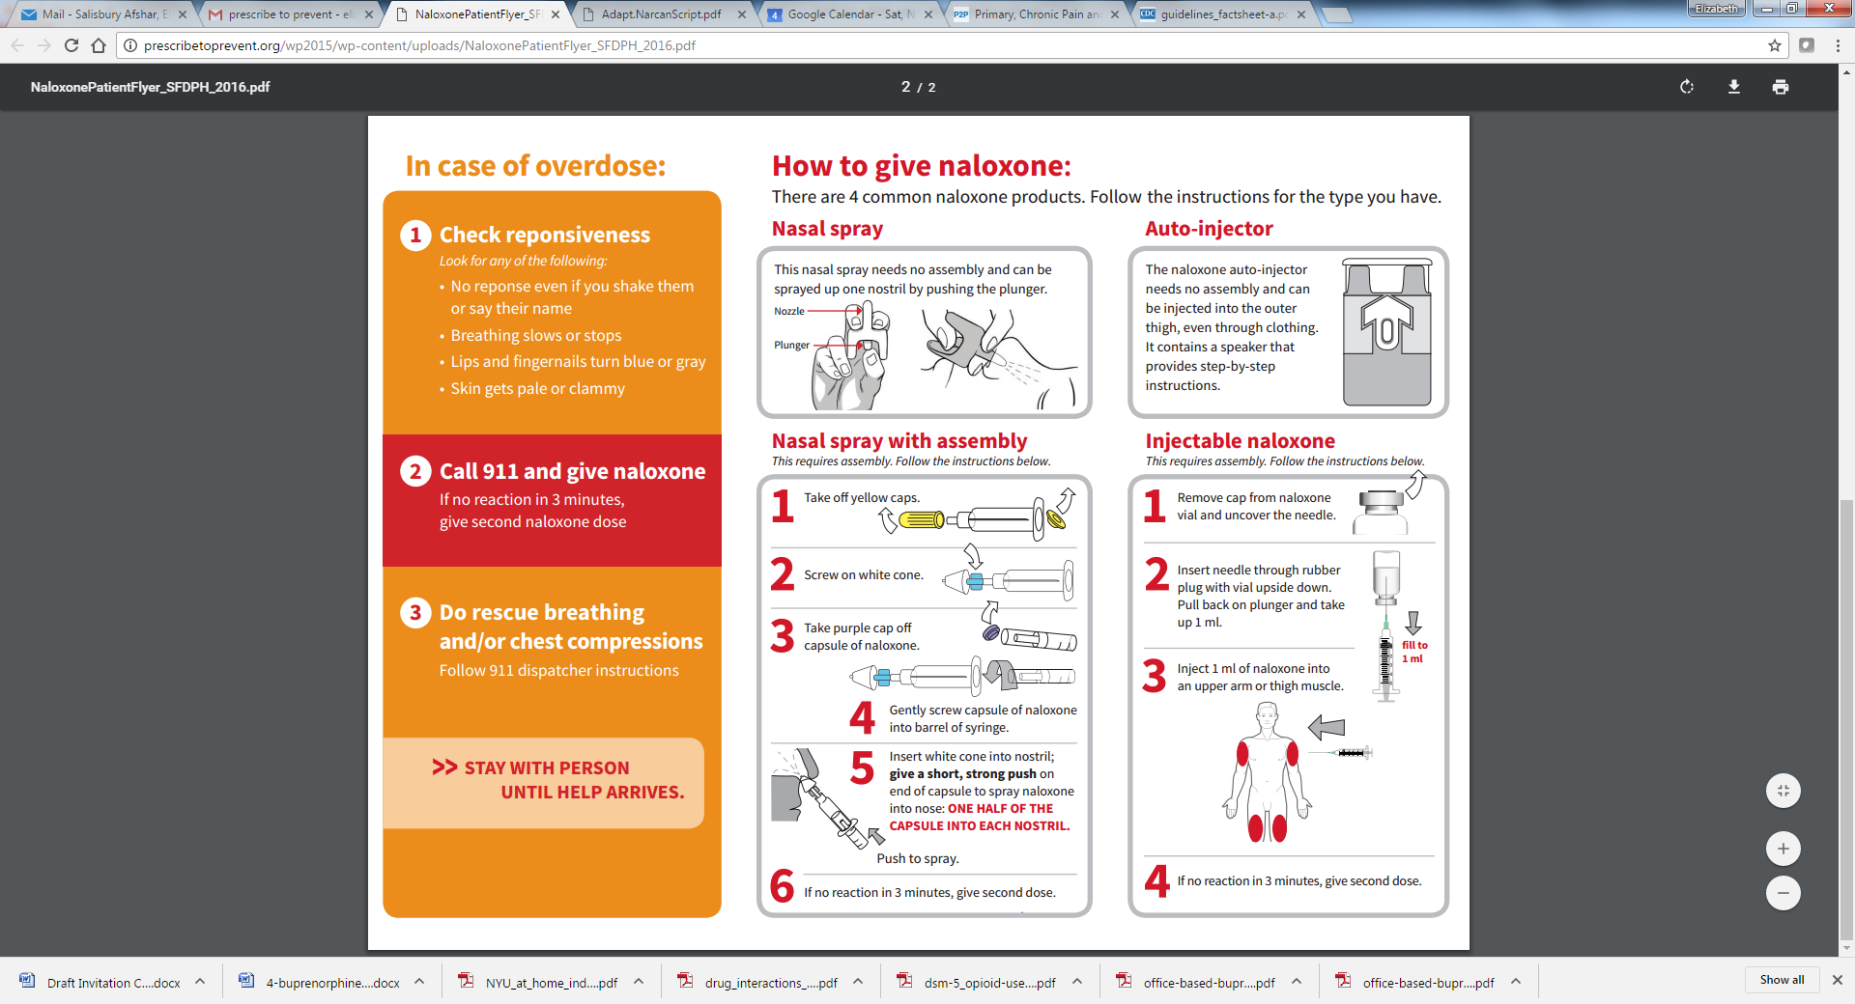
Overdose Response & Naloxone Distribution
Many states have good Samaritan laws to protect responders
Many states allow third party prescribing
Increasingly states are allowing dispensing under standing order
Auto-injector
Intra-nasal
Intra-muscular

Slide 25
Supervised Injection Facilities
Facilities where people may go to consume drugs obtained elsewhere in a hygienic environment with appropriate equipment without fear of arrest under trained supervision
Primary goals:
  Provide an environment for safer drug use
  Improve health status of target group
  Reduce public disorder
  Hedrich, D., T. Kerr & F. Dubois-Arber (2010) 'Chapter 11; Drug consumption facilities in Europe and beyond. European Monitoring Centre for Drugs and Drug Addiction
Slide credit: Sharon Stancliff, MD

Slide 26
Insite, Vancouver
British Columbia
Internationally:
97 facilities
66 cities
11 countries
1 in the US¹
Photo Credit: Sharon Stancliff, MD
1- http://www.abell.org/sites/default/files/files/Safe%20Drug%20Consumption%20Spaces%20final.pdf

Slide 27
Findings from Insite Vancouver BC
Overdose death reduction
  Milloy et al, PLOS One, 2008
  Marshall et al, Lancet 2011
  Kerr et al., International Journal of Drug Policy, 2006
Reductions in syringe sharing
  Kerr et al., The Lancet, 2005
  Wood et al. American Journal of Infectious Diseases, 2005
Increases in safer injection behaviors
  Stoltz et al, Journal of Public Health, 2007
  Small et al., Drug and Alcohol Dependence, 2008
Increased use of addiction treatment
  Wood et al., New England Journal of Medicine, 2006
  Wood et al., Addiction, 2007
  DeBeck et al., Drug and Alcohol Dependence, 2010
Reductions in violence against women
  Fairbairn et al, Social Science and Medicine, 2008
Slide credit: Sharon Stancliff, MD

Slide 28
Findings from Insite Vancouver BC
Reductions in public disorder
  Wood et al., Canadian Medical Association Journal, 2004
  Petrar et al., Addictive Behaviors,
  Stoltz et al., Journal of Public Health, 2007
No negative changes in community drug use patterns
  Kerr et al., British Medical Journal, 2006
No increases in initiation into injection drug use
  Kerr et al., American Journal of Public Health, 2007
No increases in drug-related crime
  Wood et al., Substance Abuse Treatment. Prevention, and Policy, 2006
Promotes effective police-public health partnerships
  DeBeck et al, Substance Abuse Treatment. Prevention, and Policy, 2008
Cost-effective
  Bayoumi & Zaric, CMAJ, 2009
  Andersen & Boyd, IJDP, 2010
  Pinkerton, et al, Addiction, 2010
Slide credit: Sharon Stancliff, MD

Slide 29
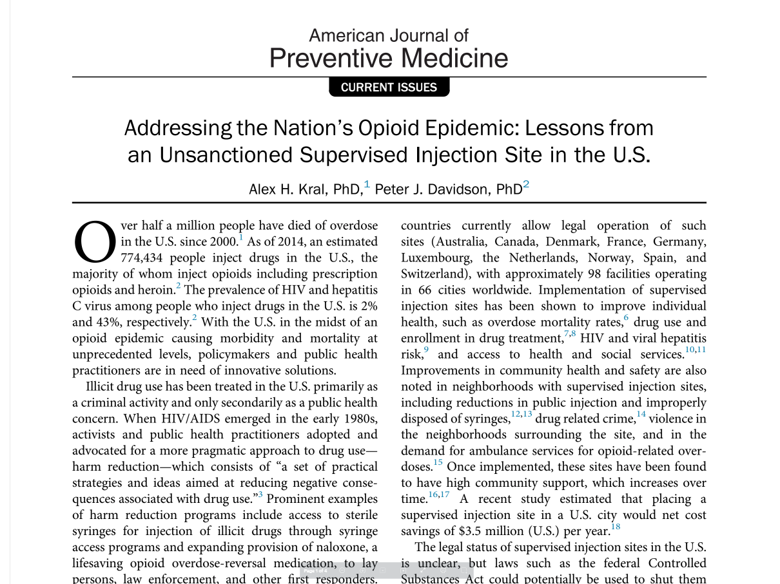
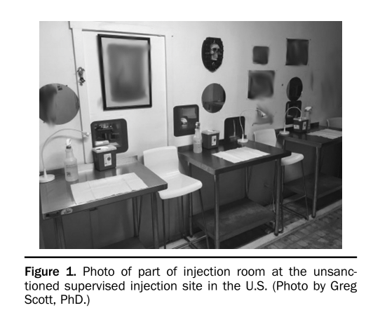
American Journal of Preventive Medicine. August 8, 2017

Slide 30
Questions
Elizabeth.Salisbury@gmail.com
trigabov@gmail.com
Kmhochman@gmail.com

